Slide 1



Hazard Communication 2012:
One Year of Implementation
July 25, 2013
1:00-2:30 PM

Slide 2
HazCom 2012 – One Year
Public awareness has been the key OSHA activity
  Webinars and speeches
  Training for regional Hazard Communication Coordinators
  Hazard Communication Roundtable
  Responding to public inquiries
  Drafting revisions to the HazCom directive
  Working on guidance/compliance assistance products

Slide 3
One year, cont.
Litigation Issues
Continuing work on international issues
Number 1 Lesson for OSHA?
  Many stakeholders do not know the requirements of the 1994 HCS…and the questions being asked are often about longstanding requirements rather than the new provisions

Slide 4
What We Will Cover
Training requirements for December 1, 2013
  Training principles
  Considerations for design of training
  What subjects to address
Update on Other Implementation Issues
Guidance and Other Resources for Compliance
International activities

Slide 5
REQUIRED TRAINING

Slide 6
2013 Required Training
Employers are already required to provide effective information and training on the hazardous chemicals in their work areas
  Must be done at the time of initial assignment to work with a chemical, and when a new chemical hazard is introduced into the work area
  May be done by chemical, or by hazard (e.g., flammable liquids)

Slide 7
Required Training, cont.
In addition, the training required includes the following:
  (h)(3)(iv) The details of the hazard communication program developed by the employer, including an explanation of the labels received on shipped containers and the workplace labeling system used by their employer; the safety data sheet, including the order of information and how employees can obtain and use the appropriate hazard information.

Slide 8
Required Training, cont.
Since HazCom 2012 is requiring a new label and SDS, OSHA has specified that employers must provide training on the new approach
This training will help ensure that workers can access and use the information on the new labels and SDSs effectively
New labels and SDSs are already being produced and are coming into American workplaces

Slide 9
Required Training, cont.
Specifically, OSHA has stated:
  Employers shall train employees regarding the new label elements and safety data sheet format by December 1, 2013
The 2013 training thus does NOT include a requirement to re-train on all hazards
The training is to ensure that employees understand the new label and SDS approach

Slide 10
TRAINING PRINCIPLES, & SUBJECTS TO COVER

Slide 11
Considerations
How and when will this training be conducted?
What will be covered?
Who will be doing the training?
Have you developed a curriculum?
Is there other training you need to do that could also be addressed (for example, re-training on the hazards)?

Slide 12
Other Factors
While new labels and SDSs are required to be provided by manufacturers and importers by June 1, 2015, employers have until June 1, 2016 to make adjustments to their workplace programs for any new hazards identified as a result of the transition to the GHS system
If workplace labeling changes (i.e., alternative systems are used), workers will have to be trained on this as well—timing will depend on when the workplace labeling is updated

Slide 13
Topics to Address in Training
Why is the training being done now?
  Labels and SDSs are changing
  Information is being standardized and specified
  All suppliers of a chemical should communicate hazards in the same way

Slide 14
Topics to Address in Training, cont.
Role of labels
  Immediate source of information
  New labels have more information
What is a label element?
  Each label element should be explained
  Hazard class should also be addressed to help understand the label elements
  Example label should be provided

Slide 15
Topics to Address in Training, cont.
Safety Data Sheet (SDS)
  Format (sections)
  Information found on SDSs
Requirements (accessibility and use)

Slide 16
Role of Labels
Labels are the immediate source of information on a chemical
New labels will have more information than current labels
There may also be additional information (known as supplemental information) on the label that is not required—the required information should be presented together on the label

Slide 17
Training on Label Elements
Labels on shipped containers of hazardous chemicals will be changing by June 1, 2015
The primary change is that information on labels has been standardized
  There are certain types of information required to appear on labels
  All suppliers have the same requirements, so labels should be more consistent in approach than current labels

Slide 18
What is a label element?
“Label element” means the specified pictogram(s), hazard statement(s), signal word and precautionary statement(s) for each hazard class and category

Slide 19
Example of a Hazard Class w/Categories (Appendix A: A.1): Acute Toxicity
Exposure route | Category 1 | Category 2 | Category 3 | Category 4
Oral (mg/kg bodyweight) see: Note (a) Note (b) | ≤ 5 | >5 and ≤ 50 | >50 and ≤ 300 | >300 and ≤ 2000
Dermal (mg/kg bodyweight) see: Note (a) Note (b) | ≤ 50 | >50 and ≤ 200 | >200 and ≤ 1000 | >1000 and ≤ 2000
Inhalation - Gases (ppmV) see: Note (a) Note (b) Note (c) | ≤ 100 | >100 and ≤ 500 | >500 and ≤ 2500 | >2500 and ≤ 20000
Inhalation - Vapors (mg/l) see: Note (a) Note (b) Note (c) Note (d) | ≤ 0.5 | >0.5 and ≤ 2.0 | >2.0 and ≤ 10.0 | >10.0 and ≤ 20.0
Inhalation – Dusts and Mists (mg/l) see: Note (a) Note (b) Note (c) | ≤ 0.05 | >0.05 and ≤ 0.5 | >0.5 and ≤ 1.0 | >1.0 and ≤ 5.0

Slide 20
Label Requirements
Labels on shipped containers must include:
  Product Identifier
  Signal Word
  Pictogram
  Hazard Statement(s)
  Precautionary Statement(s)
  Supplier Identification (Name, Address, Phone Number)

Slide 21
Signal Word
“Signal word” means a word used to indicate the relative level of severity of hazard and alert the reader to a potential hazard on the label
The signal words used in this section are “danger” and “warning.” “Danger” is used for the more severe hazards, while “warning” is used for the less severe

Slide 22
Pictogram
“Pictogram” means a composition that may include a symbol plus other graphic elements, such as a border, background pattern, or color, that is intended to convey specific information about the hazards of a chemical
Eight pictograms are designated under this standard for application to a hazard category

Slide 23
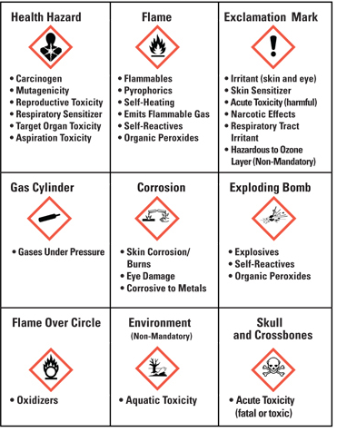
HCS Pictograms and Hazards

Slide 24
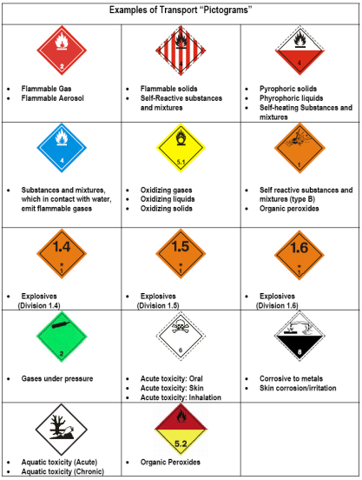
Examples of Transport “Labels”

Slide 25
Hazard Statement
“Hazard statement” means a statement assigned to a hazard class and category that describes the nature of the hazard(s) of a chemical, including, where appropriate, the degree of hazard
  Example: Fatal if swallowed (Acute Oral Toxicity)

Slide 26
Precautionary Statement
“Precautionary statement” means a phrase that describes recommended measures that should be taken to minimize or prevent adverse effects resulting from exposure to a hazardous chemical, or improper storage or handling
  Example: Do not eat, drink, or smoke when using this product
  Example: Keep container tightly closed

Slide 27
Precautionary Statements, cont.
The statements assigned to a chemical address the following four areas
  Prevention
  Response
  Storage
  Disposal

Slide 28
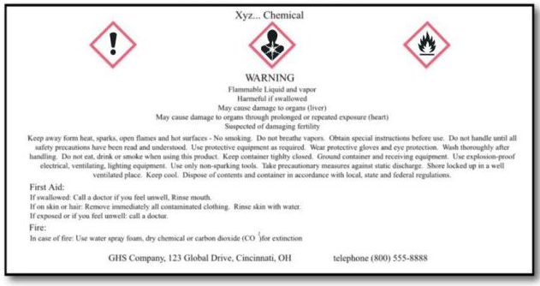
Label Example

Slide 29
Role of the Safety Data Sheet
The Safety Data Sheet is the detailed source of information about the chemical
  The SDS has many audiences
  The SDS is thus a reference to help ensure a chemical is handled safely

Slide 30
Safety Data Sheet Format
New safety data sheets will be organized using a specified order of information
The required information will appear in the same sections of an SDS regardless of the supplier
The most important information will be listed in the first sections of the SDS

Slide 31
SDS Sections
1. Identification
2. Hazard(s) identification
3. Composition/information on ingredients
4. First-aid measures
5. Fire-fighting measures
6. Accidental release measures
7. Handling and storage
8. Exposure control/personal protection

Slide 32
SDS Sections, cont.
9. Physical and chemical properties
10. Stability and reactivity
11. Toxicological information
12. Ecological information
13. Disposal considerations
14. Transport information
15. Regulatory information
16. Other information

Slide 33
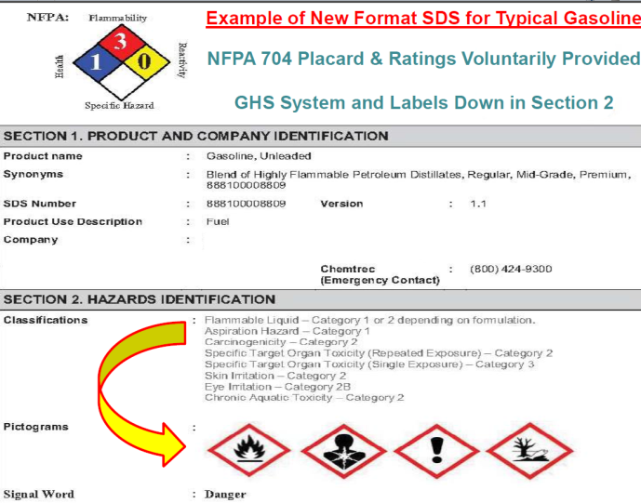
Product XYZ

Slide 34
SDS Requirements
SDSs must be readily accessible to workers when they are in their work areas, during each work shift
Hazard communication works when employers also use SDS information to make sure that proper protective measures are being implemented

Slide 35
Elements of Effective Training
Determine training needs
Identify training needs
Identify goals and objectives
Identify learning activities
Conduct the training
Evaluate program effectiveness
Improve the training

Slide 36
IMPLEMENTATION ISSUES

Slide 37
Implementation Issues
OSHA has received many questions regarding interpretations of HazCom 2012
Responses to common questions are provided on OSHA’s Hazard Communication web page:
http://www.osha.gov/dsg/hazcom/index.html

Slide 38
Classification
HazCom 2012 covers workplace hazards
For effects such as sensitization or CMRs (carcinogens, mutagens, reproductive hazards) that have a hazard category that is divided into sub-categories A and B:
  If the data is available, then you must classify into the most hazardous sub-category
  If the data does not allow classification into the sub-category, then you may use the category
You may include GHS hazard categories that are not covered by the HCS

Slide 39
Combustible Dust
HazCom 2012 does not define combustible dust, but OSHA provides guidance through
  OSHA’s Combustible Dust National Emphasis Program Directive CPL 03-00-008
  NFPA standards
Materials that present a combustible dust hazard in their shipped form must be labeled
The SDS must include the following information:
  List the classification in Section 2
  Signal word (Warning)
  Hazard statement

Slide 40
Combustible Dust, cont.
Special labeling provision (f)(4): label may be shipped with the safety data sheet for solid materials that present a hazard only when processed or used downstream
On March 25th, 2013, OSHA published a letter of interpretation on combustible dust and the labeling requirements

Slide 41
Pesticides
OSHA has maintained the same exemptions for labeling under (b)(5) – FIFRA labels are exempt
SDSs are required for workplaces under OSHA’s jurisdiction
Stakeholders were concerned about conflicts between EPA label and the OSHA SDS
  Signal words
  Chronic effects
EPA has published a Pesticide Registration Notice (PRN 2012-1)

Slide 42
Labels
Small Packages
  No exemptions for small packages
  OSHA provides practical accommodations on a case-by-case basis
Pictograms
  Blank pictograms are not permitted on a label
No size requirements for labels

Slide 43
Labels, cont.
Information on hazards not otherwise classified may be included along with the supplemental information on the label, but is not required
Precautionary statements and hazard statements may be combined or consolidated to save label space and improve readability

Slide 44
Labels, cont.
A DOT label (placard) is required for transport. An OSHA/HCS label is required for the workplace
The DOT and HCS labels may appear for the same hazard, depending upon the container’s use
Consumer products subject to CPSC labeling requirements are exempted from the labeling requirements of the HCS

Slide 45
Labels, cont.
Workplace Labeling
  No change to general workplace labeling requirements
  HMIS labels and NFPA ratings, by themselves, are not sufficient for workplace labels
  NFPA rating systems used for emergency response
Before the June 1, 2015 deadline, employers may use labels compliant with HCS 1994

Slide 46
Safety Data Sheets
Distribution
  An updated SDS must be provided with products shipped by June 1, 2015
  Companies are not required to send new SDSs to previous customers who may still have the product in inventory
  New SDSs do not have to be provided for chemicals no longer produced

Slide 47
Safety Data Sheets, cont.
Section headings for SDS sections 12-15 must still be listed on the SDS; OSHA will not be enforcing the content of these sections
The requirements to maintain MSDSs or SDSs under 29 CFR 1910.1020 have not changed
The conditions under which employers may maintain SDSs electronically in the workplace have not changed
SDSs must be in English; they may also be kept in other languages
A red border is not required for pictograms on SDSs
Hazards Not Otherwise Classified should be described in Section 2 of the SDS

Slide 48
Safety Data Sheets, cont.
Component disclosure on SDSs
  Options for using ranges instead of exact percentages include trade secret, batch-to-batch variation, similar mixtures
  With very small variances or tolerances during production, the anticipated percentage in the formula may be used
  In all cases the concentration ranges must have no effect on the hazard of the mixture

Slide 49
Trade Secrets
For mixtures, the trade secret provisions apply to the individual chemicals and their associated CAS numbers
When a company is claiming a percentage as a trade secret, a statement saying that information is withheld as a trade secret is required in SDS Section 3

Slide 50
Other Standards
With the exception of several definition changes and an edit to Appendix A for SDSs, the laboratory standard was not changed
Changes to other standards were made to minimize changes to scope. For example, the change to the definition of flammable liquid is expected to have minimal to no impact on PSM, flammable storage requirements, and shipping requirements

Slide 51
Guidance, Outreach, and International Activities

Slide 52
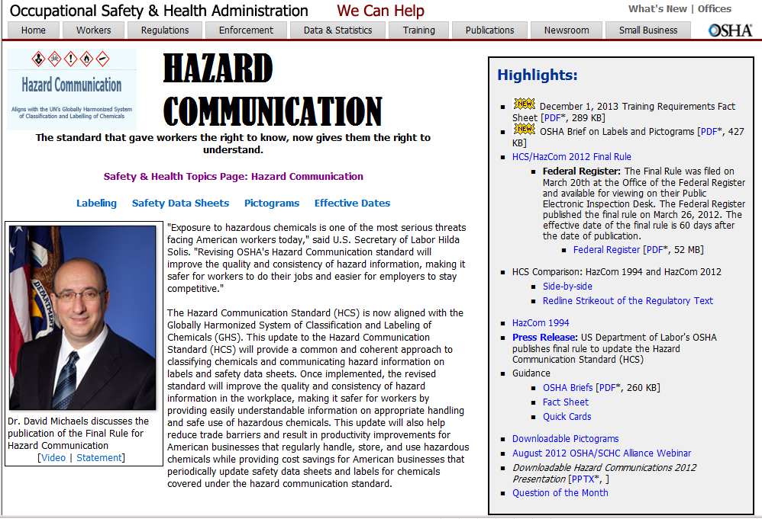
Updated HazCom Web Page

Slide 53
Guidance and Outreach

Slide 54
Guidance and Outreach, cont.
OSHA is developing an array of guidance materials
Initial Materials
  Quick cards; OSHA briefs; booklets; small entity compliance guides; wallet-sized card
Technical Materials
  Model training materials; Safety Data Preparation guidance; Hazard Classification Guidance
Web Applications
  SDS Electronic Form; Label Elements Application; Acute Toxicity Calculator

Slide 55
Updated Webpages
HazCom 2012 Webpage
http://www.osha.gov/dsg/hazcom/index.html
  Safety & Health Topics Webpage
  http://www.osha.gov/dsg/hazcom/index2.html
UN GHS Sub-Committee Home Page
http://www.unece.org/trans/danger/publi/ghs/ghs_welcome_e.html

Slide 56
International Harmonization
UN Sub-committee: Globally Harmonized System of Classification and Labelling of Chemicals (GHS)
  GHS allows choices
  Meets twice a year to discuss issues
    Implementation issues
    Practical classification Issues
    Other harmonization issues
  Works on two year cycles (Biennium)
  Public meeting held June 12, 2013

Slide 57
International Harmonization, cont.
OSHA
  Supported adoption of the international mandate to develop the GHS
  Helped to negotiate the provisions of the GHS
  Leads the current US delegation to the United Nations’ Committee and Sub-committee on the GHS, as well as Chairs the Sub-committee
Interagency Group
  OSHA, EPA, State, DOT, CPSC, US Coast Guard

Slide 58
International Harmonization, cont.
Regulatory Cooperation Council
  To foster harmonization as Canada and US work to implement GHS, including guidance and future updates
  Memorandum of Understanding signed June 19, 2013

Slide 59
International Activities
UN Sub-Committee – December 2012: End of the Biennium
  Notable changes
    Update of the Skin and Eye Chapters
    Changes in precautionary statements
    Guidance on combustible dust information for the Safety Data Sheet
  Other Work Streams
    Combustible Dust work continues; work on exploring a global list of classifications; streamlining the physical properties section of the SDS

Slide 60
Conclusions
By December 1, 2013, employee training is required on label information and SDS format
  With proper planning and consideration, employers should be able to comply on time and conduct effective training programs
Implementation of HazCom 2012 is proceeding on course
OSHA continues to provide additional guidance and other resources to assist employer implementation
OSHA continues to work with other federal agencies and Canada on international issues

Slide 61

TM
Thank you for attending today’s Webinar on the Hazard Communication Standard 2012: One Year of Implementation
  OSHA’s Hazard Communication Website
  http://www.osha.gov/dsg/hazcom/index.html
  SCHC Website
  www.schc.org
Disclaimer: Comments and opinions expressed by the speakers do not necessarily reflect the opinions or beliefs of OSHA and SCHC.

