Slide 1
So You Want to be a Special Government Employee (SGE)?
So You Want to be a Special Government Employee (SGE)?

Slide 2

OSHA

Slide 3
Overview
Special Government Employee (SGE) role in the Federal Government
Qualifications
Application process
Special training provided
Benefits
Questions & Answers

Slide 4
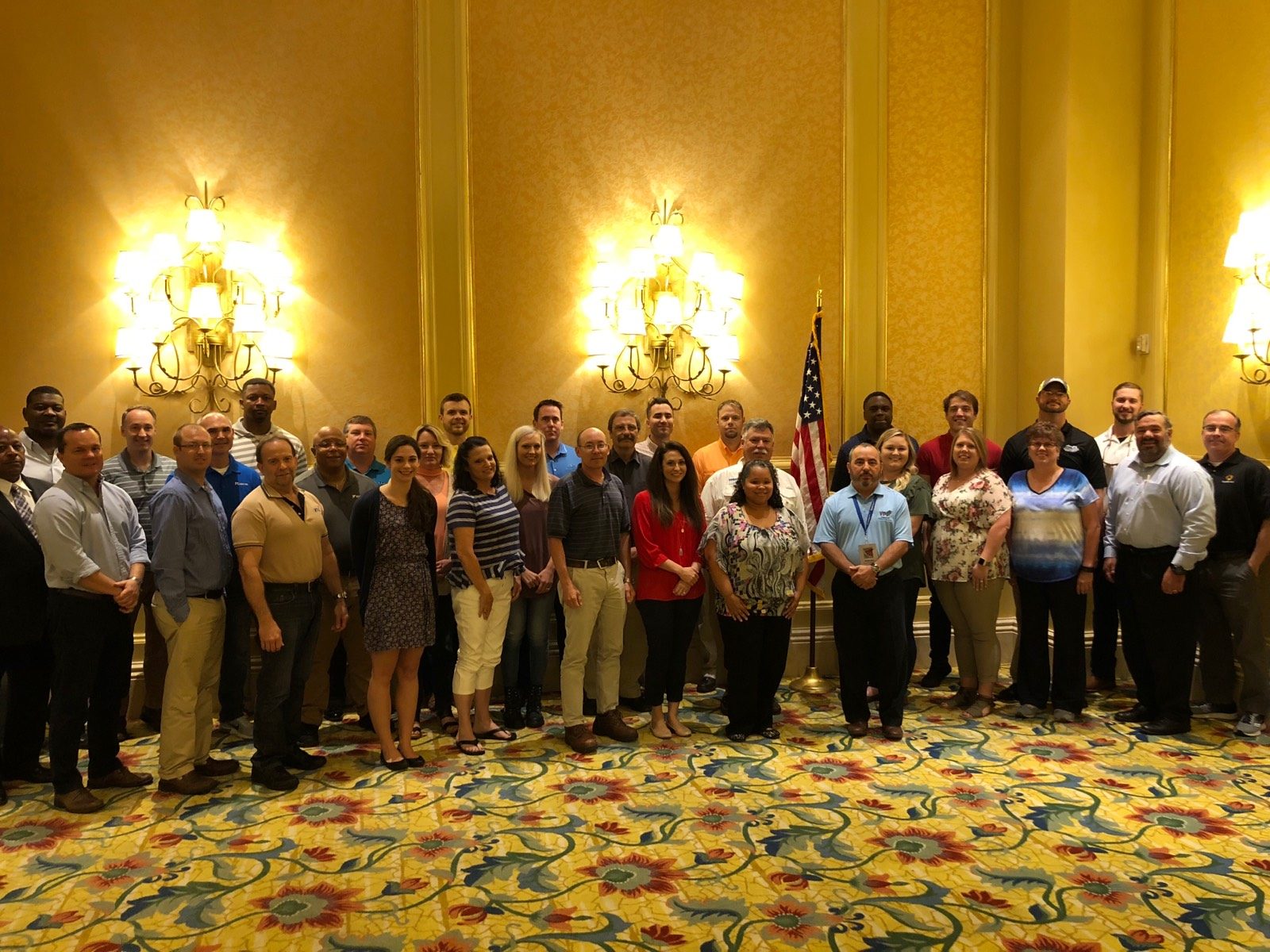
SGE Course
SGE course in Biloxi, MS (June, 2018)

Slide 5
SGEs in Government
Created by statue in 1962
  An officer or employee retained, appointed, or employed by the government
  Perform temporary duties, with or without compensation
  No more than 130 days during any period of 365 consecutive days
Bring outside expertise to the government
Alleviates concern about conflicts of interest
Any government agency may use SGEs

Slide 6
OSHA SGE History
Early 1990s: OSHA saw an opportunity to use SGEs for VPP
1990 – 1994: VPPPA assisted in developing SGEs
1994: SGEs officially used for VPP
As of 2018, there are 1,500 active OSHA SGEs
93% of VPP On-site Evaluation Teams in Fiscal Year 2017 had at least one OSHA SGE

Slide 7
OSHA VPP SGE Qualifications for CIHs/CSPs
2 + years experience with occupational safety and health
Safety and health activities equate to at least 50 percent of daily work duties
Connection to an active OSHA VPP site as an employee:
  At an active VPP site
  At a corporate office with direct oversight of at least one VPP site
  Of a non-VPP site previously employed at a VPP site within the same corporation

Slide 8
OSHA VPP SGE Qualifications w/o certification
You do not need a CIH or CSP to be an OSHA SGE if you:
  Are a current employee at a VPP site and have worked there for at least two years
  and
  Have experience in at least three of the following nine activities:
  Chair S&H Committee
  Accident/Incident Coordinator
  Lead Inspection Team
  Perform Hazard Analyses
  Conduct S&H Training
  Active Member of Prep Team for VPP
  Active Employee Participation in VPP
  Coordinate Hazard Abatement
  Knowledge of S&H Management

Slide 9
How to Apply
Applications accepted four times per year
  January 15
  April 15
  July 15
  October 15
Applications are available on the OSHA SGE webpage: http://www.osha.gov/dcsp/vpp/sge.html

Slide 10
The Application Documents
Eligibility Information Sheet
  Safety and Health experience
  Manager signature
One of the two:
  Application for Federal Employment (OF-612), or
  Current Resume
Confidential Financial Disclosure Report (OGE Form 450)

Slide 11
OSHA SGE Training
Required before officially becoming an OSHA SGE
At VPP sites offered several times a year
Free of charge and all training materials are provided except:
  Lodging
  Transportation
  Meals
Conducted by OSHA and experienced SGEs
Three full days (Tuesday – Thursday)

Slide 12
OSHA SGE Training: Day One
VPP policies and procedures
VPP Application requirements
General requirements for VPP participation
  Different types of “on-sites”
  On-site procedures
  Evaluation techniques

Slide 13
OSHA SGE Training: Day Two
In depth training on the four VPP elements
How SGE participation in on-sites is coordinated
Writing reports

Slide 14
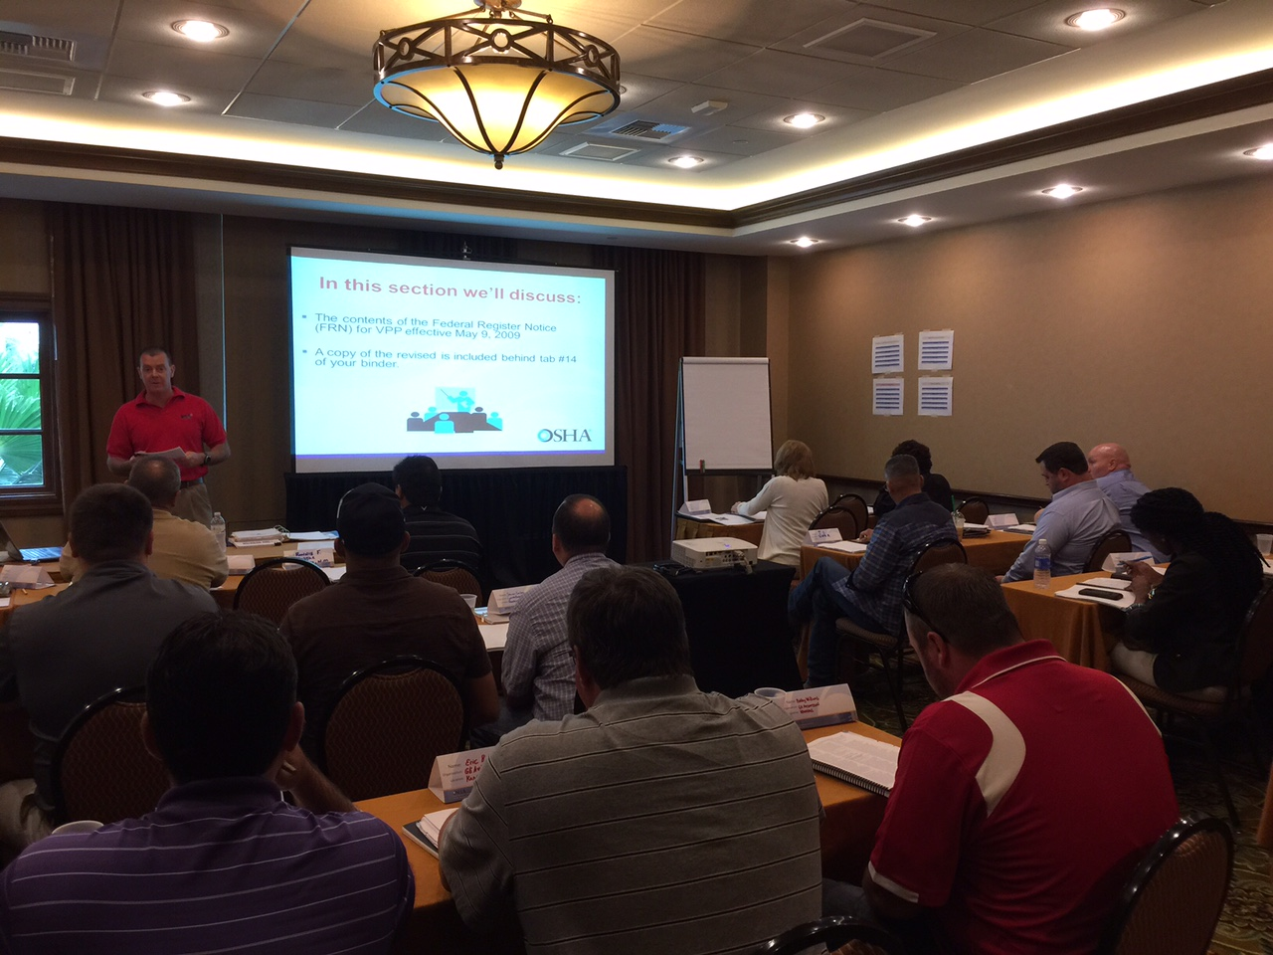
SGE Course

Slide 15
OSHA SGE Training: Day Three
Report writing continued
Reaching team consensus with the team leader
Making recommendations
Closing comments/evaluations

Slide 16
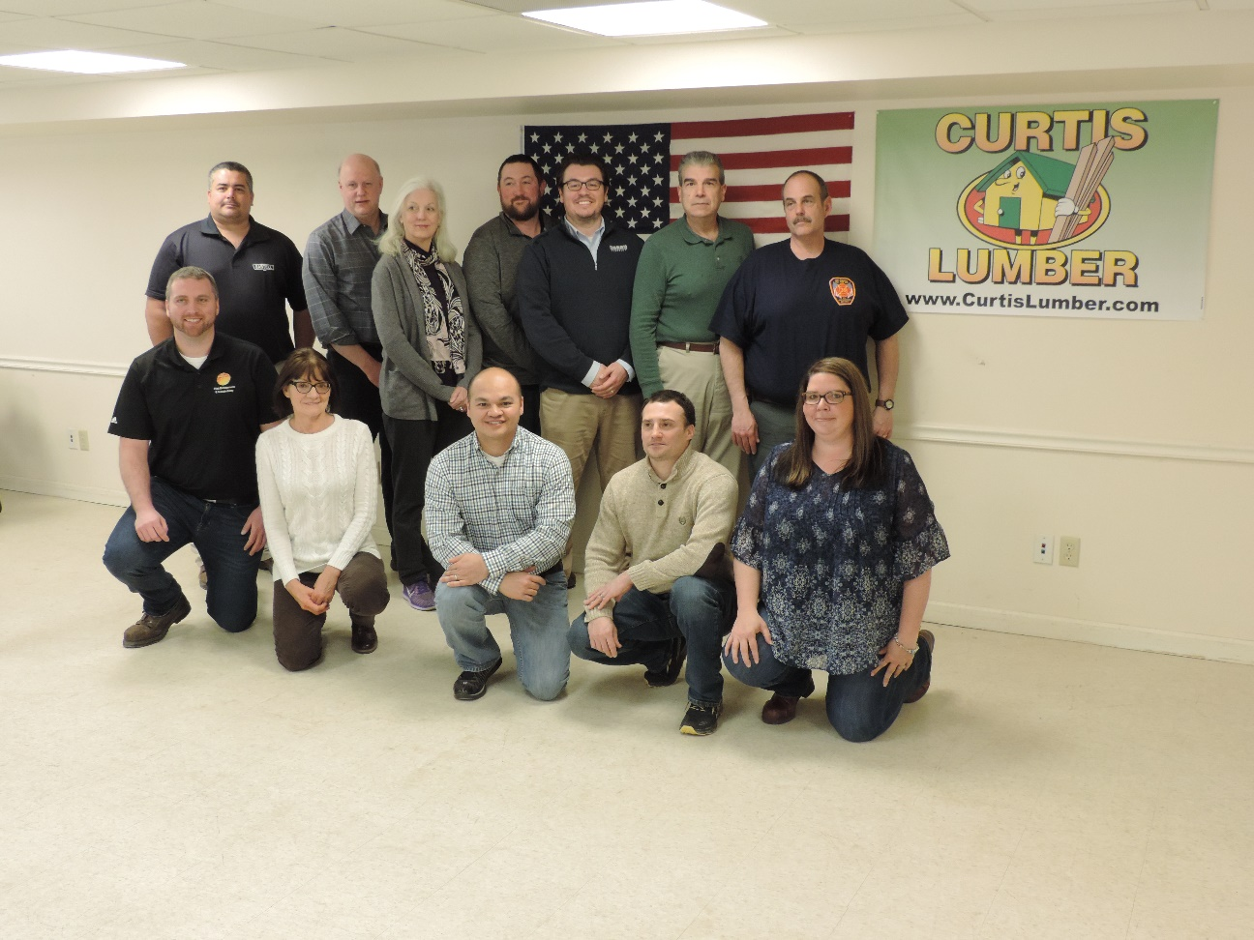
Congratulations
You’re now an SGE!
Curtis Lumber SGE Training
Ballston Spa, NY
April 2018

Slide 17
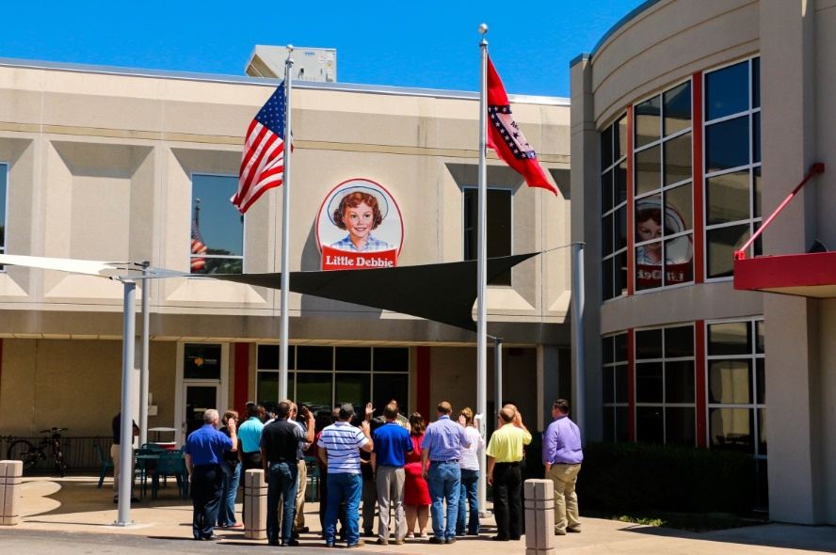
Becoming an Official OSHA SGE
Sworn into government service with the same oath as Federal Employees
Three-year term of service
McKee Foods SGE Training
Gentry, AR
July 2015

Slide 18
What’s Next: How do I volunteer for a VPP On-site Team?
Name is added to the SGE email address list
All OSHA Regions have access to this list
OSHA Regional VPP Manager or the team leader for an on-site will ask for volunteers via email
Reply only if you are available to participate in the on-site
Or: Check out the available opportunities on the SGE webpage

Slide 19
OSHA SGE Renewal
Actively involved in VPP during the three-year term of service
Performed a minimum of three qualifying activities
Participated in at least one VPP on-site evaluation

Slide 20
OSHA SGE: A Unique Experience
Professional development while working with OSHA federal employees
Meet & network with other safety & health professionals
Inspiration from seeing other VPP safety programs
Earn CSP and CIH certification points
Free training courses at OTI after first on-site

Slide 21
OSHA Values SGEs
Brings diversified expertise to OSHA
Adds an industry perspective to the VPP On-site Team
Serves a critical role for VPP growth and expansion
Represents VPP to potential future participants

Slide 22
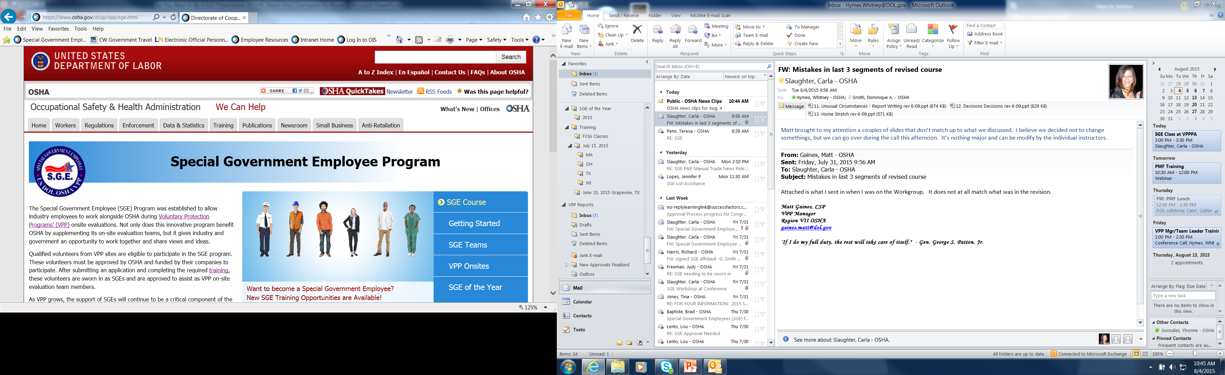
SGE Webpage
How to Get Involved
SGE Information and Data
SGE Training Schedule
List of VPP Evaluations by Region

Slide 23
OSHA SGE Program Contact Information
U.S. Department of Labor – OSHA
200 Constitution Ave, NW Rm # N-3700
Washington DC 20210
202-693-2213
SGECoordinator@dol.gov

Slide 24

Questions

Slide 25
OSHA

