Slide 1
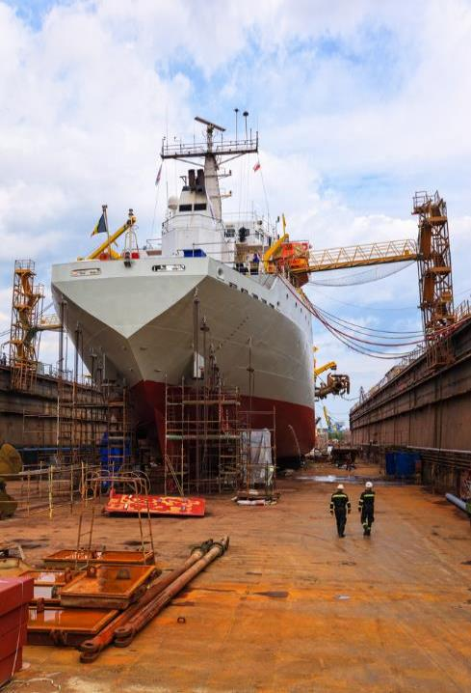

Most Frequently Cited Serious Violations
Maritime Industry FY2024
OSHA Federal Standards
October 1, 2023 – September 30, 2024

Slide 2
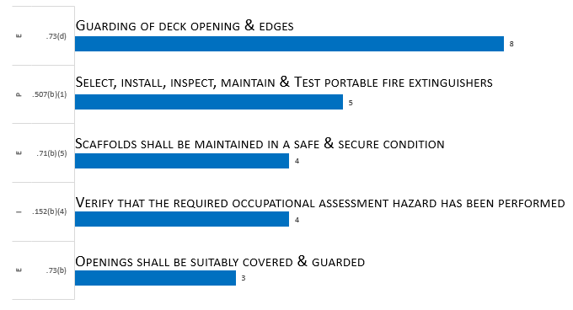
Most Frequently Cited Serious Violations in
Shipyard Employment FY 2024
29 CFR 1915

Slide 3
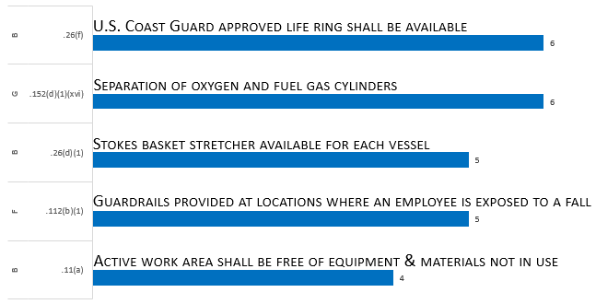
Most Frequently Cited Serious Violations in
Marine Terminals FY 2024
29 CFR 1917

Slide 4
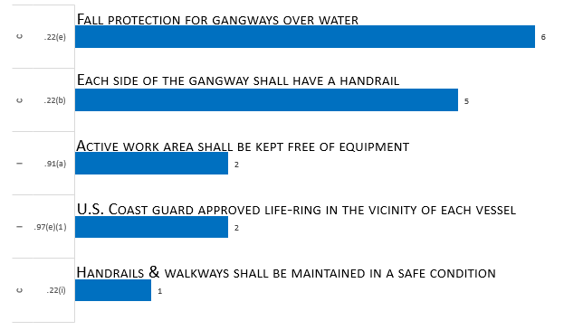
Most Frequently Cited Serious Violations in
Longshoring FY 2024
29 CFR 1918

