Slide 1
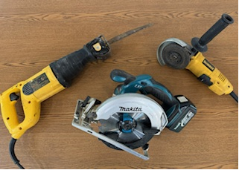
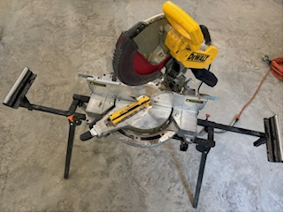
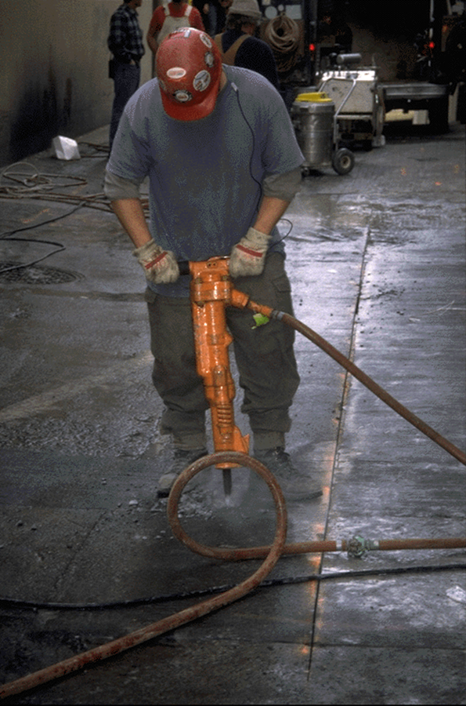
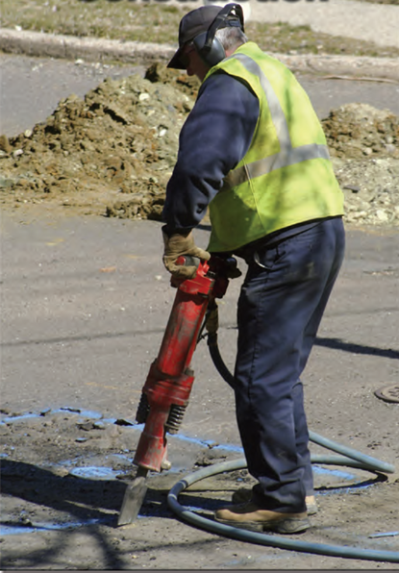
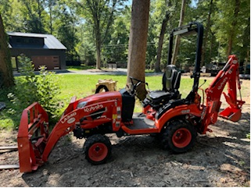
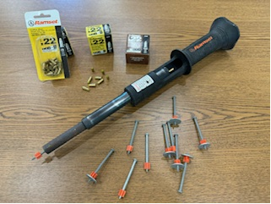
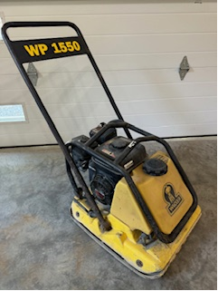
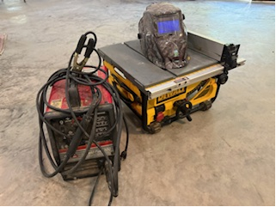
#ListenUp
Hearing Protection in Construction

Slide 2
Make It Your Own!
Personalize the Presentation: Choose your own background.
Showcase Your Brand: Add your logo for a unique touch.
Tailor to Your Needs: Make it truly yours!
  Can you identify the hearing conservation items needed on your current project?

Slide 3
Is Hearing Loss Preventable?
The Center for Disease Control and Prevention (CDC) estimates that 22 million workers are exposed to potentially damaging noise at work each year. Whether you work at a sports venue, on a tarmac, or operate a jackhammer—hearing loss is preventable.
Notes:
22 million workers are exposed to potentially damaging noise annually (CDC estimate).
Industries at risk: Sports venues, tarmacs, construction sites, and more.
Hearing loss is a serious risk from prolonged noise exposure.
Prevention is key: Hearing loss is preventable with the right measures.
Protective steps: Use earplugs or earmuffs and adhere to noise safety guidelines.
Employers’ role: Implement hearing conservation programs and provide necessary PPE.
Workers’ role: Consistently use hearing protection and stay aware of noise levels.

Slide 4
Top 5 “Must Know” About Noise Hazards
Negative impacts of noise
Recognition of loud environments
Noise reduction techniques
Hearing protection selection and fitting
Ensure your hearing protection works
Notes:
Negative Impacts of Noise:
- Can cause permanent hearing loss and tinnitus.
- Increases risk of stress and other health issues.
Recognition of Loud Environments:
- Identify areas with high noise levels, such as machinery zones or crowded events.
- Use noise measurement tools if necessary.
Noise Reduction Techniques:
- Implement engineering controls (e.g., sound barriers, quieter equipment).
- Apply administrative controls (e.g., rotating shifts, limiting exposure time).
Hearing Protection Selection and Fitting:
- Choose appropriate earplugs or earmuffs based on noise level and comfort.
- Ensure correct fitting to maximize effectiveness.
Ensure Your Hearing Protection Works:
- Regularly check and maintain hearing protection equipment.
- Verify proper usage and fit to ensure optimal protection.

Slide 5
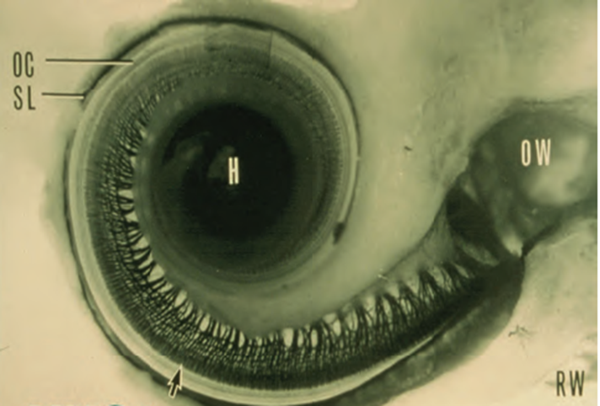
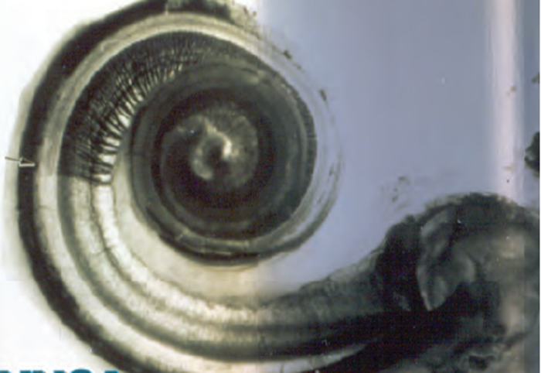
Negative Impacts of Noise on Hearing
Noise can be distracting
You may not hear warnings in the workplace
Hearing loss increases your risk of falling
Years of noisy job sites can lead to various degrees of hearing loss
Noise can cause “tinnitus”, ringing in the ears, which can interfere with your sleep and peace of mind
Noise can cause high blood pressure and stress
Healthy
Damaged
Cilia (hairs) in the cochlea after prolonged exposure to loud noise
Notes:
- Distraction: Noise can reduce focus and productivity.
- Missed Warnings: May prevent you from hearing important workplace alerts.
- Increased Fall Risk: Hearing loss heightens the risk of falls and accidents.
- Permanent Damage: Prolonged exposure can lead to irreversible deafness.
- Tinnitus: Noise can cause persistent ringing in the ears, disrupting sleep and peace of mind.
- Health Issues: Noise exposure can contribute to high blood pressure and stress.

Slide 6
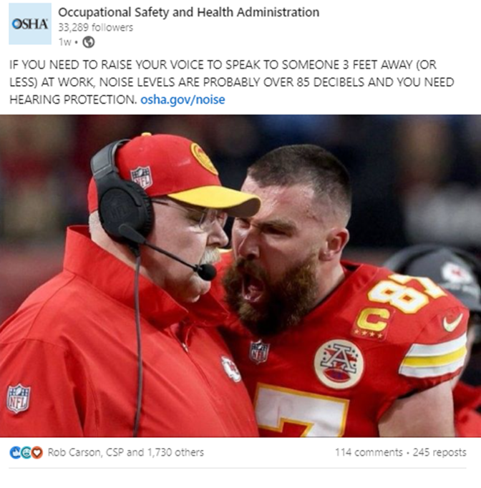
Recognition of Loud Environments
If you must raise your voice to be heard by someone an arm’s length away, the environment is too loud, and your hearing could be at risk
Ringing of the ears or trouble hearing, could be a sign the noise might be too loud
The area has machinery, heavy equipment, or loud processes
The noise sounds muffled or distorted
Notes:
Noise is all around us. Both at work and at home. We must be aware of the potential hazards and take steps to minimize those hazards.
- Voice Level: If you need to raise your voice to be heard at arm's length, the noise level is too high.
- Hearing Signs: Ringing in the ears or difficulty hearing may indicate excessive noise.
- Presence of Equipment: Environments with machinery, heavy equipment, or loud processes are likely noisy.
- Sound Quality: Noise that sounds muffled or distorted can be a sign of hazardous levels.

Slide 7
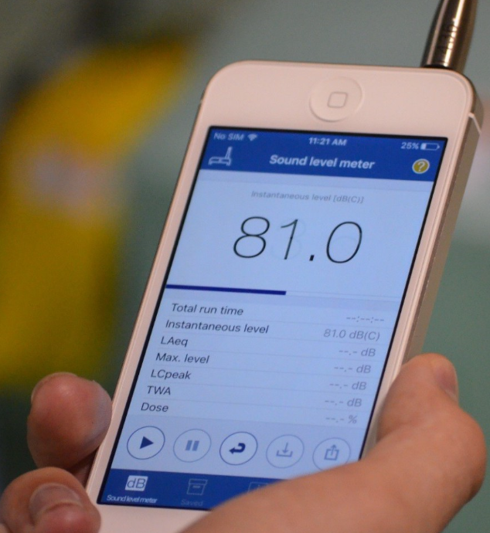

Recognition of Loud Environments
New NIOSH Sound Level Meter App
Screening tool for potentially loud environments, which can assist in determining if noise sampling is needed
Provides a readout of the sound level using the built-in microphone and reports the instantaneous sound level
The app also contains basic information on noise and hearing loss prevention
Notes:
- NIOSH Sound Level Meter App: A new tool for assessing noise levels.
- Screening Tool: Helps identify potentially loud environments and determine if further noise sampling is needed.
- Instant Readout: Provides real-time sound level readings using the device’s built-in microphone.
- Educational Resource: Includes basic information on noise and hearing loss prevention.

Slide 8
Noise Reduction Techniques
Choose quieter machinery where possible
Arrange workstations and processes to minimize noise exposure
Regularly maintain and lubricate machinery
Install barriers or baffles to deflect noise from sensitive areas
Modify machinery with mufflers or sound enclosures
Use acoustic panels, foam, or insulation to soundproof walls, ceilings, and floors
Notes:
- Quieter Machinery: Opt for quieter equipment when possible.
- Workstation Arrangement: Design layouts to minimize noise exposure.
- Maintenance: Regularly maintain and lubricate machinery to reduce noise.
- Noise Barriers: Install barriers or baffles to redirect noise from sensitive areas.
- Sound Modifications: Equip machinery with mufflers or sound enclosures.
- Soundproofing: Use acoustic panels, foam, or insulation for walls, ceilings, and floors.

Slide 9
Hearing Protection Selection and Fitting
Assess noise levels and discomfort
Choose hearing protection: earplugs or over-ear, based on noise, comfort, and environment
Ensure a proper fit for comfort
Inspect and replace as needed
Check compatibility with other safety gear
Notes:
- Assess Noise Levels: Determine the noise level and any discomfort to choose appropriate protection.
- Choose Protection: Select earplugs or over-ear protection based on noise level, comfort, and work environment.
- Ensure Proper Fit: Verify that the hearing protection fits comfortably and effectively.
- Inspect and Replace: Regularly check for wear and replace, as necessary.
- Check Compatibility: Ensure hearing protection works well with other safety gear.

Slide 10
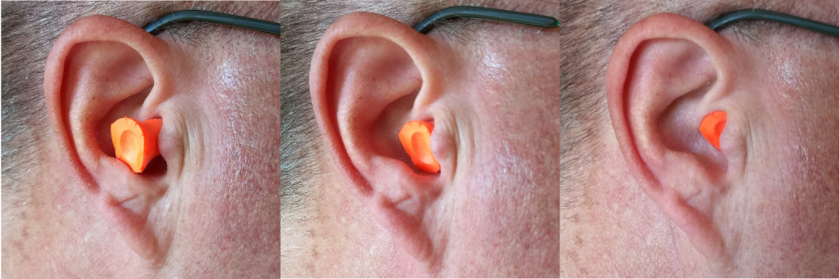
Ensure Your Hearing Protection Works
Poorly-inserted earplug
Semi-inserted earplug
Properly-inserted earplug
Ensure proper fit by inserting earplugs correctly and making sure earmuffs create a tight seal around your ears. Wear hearing protection consistently in noisy environments and inspect it regularly for damage or wear, replacing it as needed. Avoid overusing protection in quieter areas to maintain situational awareness and ensure you only use it when necessary.
Notes:
Proper Fit: Insert earplugs correctly and ensure earmuffs form a tight seal around your ears.
Consistent Use: Wear hearing protection consistently in noisy environments.
Regular Inspection: Check for damage or wear and replace protection as needed.

Slide 11
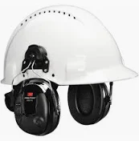
Ensure Your Hearing Protection Works
Ensure proper fit by inserting earplugs correctly and making sure earmuffs create a tight seal around your ears. Wear hearing protection consistently in noisy environments and inspect it regularly for damage or wear, replacing it as needed. Avoid overusing protection in quieter areas to maintain situational awareness and ensure you only use it when necessary.
Notes:
Proper Fit: Insert earplugs correctly; ensure earmuffs create a tight seal.
Consistent Use: Wear protection consistently in noisy environments.
Regular Inspection: Check for damage or wear and replace as needed.

Slide 12
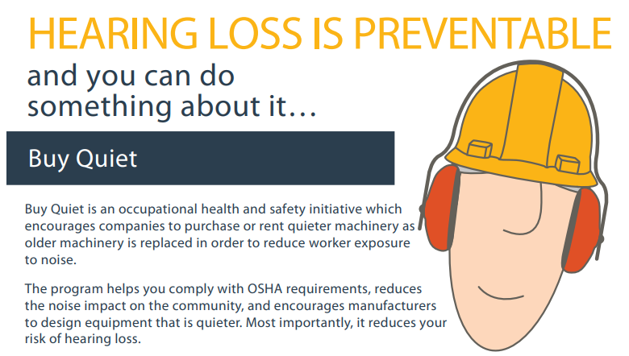
What You Can Do…Prevention Through Design
Some noise is always present at construction sites, so we recommend taking these steps to protect your hearing:
1. Arrange noisy equipment and processes away from employee occupied work areas
2. Take breaks or rotate off loud tasks
Notes:
- Arrange Equipment: Position noisy equipment and processes away from work areas occupied by employees.
- Breaks and Rotation: Implement breaks or rotate tasks to minimize prolonged exposure to loud noise.

Slide 13
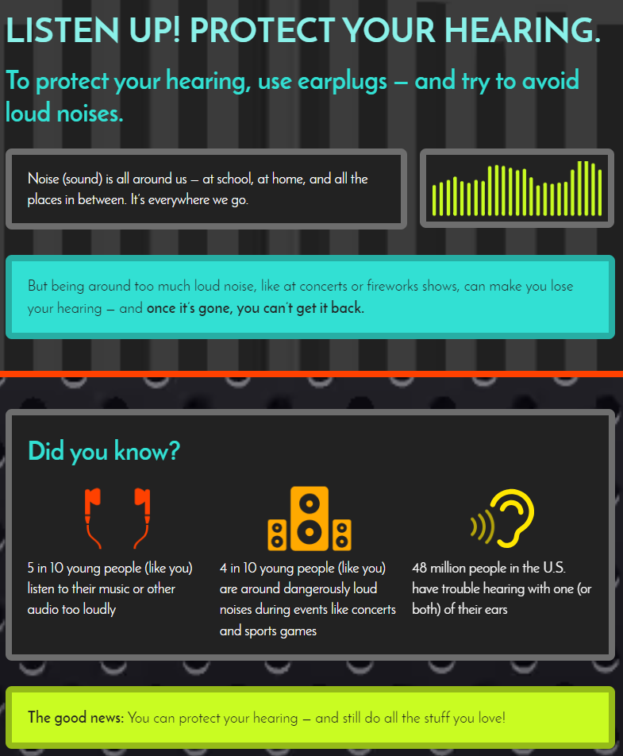
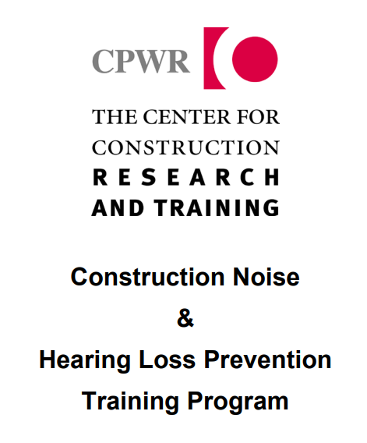
Additional Resources
https://www.cdc.gov/nceh/hearing_loss/infographic/
https://www.cpwr.com/research/research-to-practice-r2p/r2p-library/other-resources-for-stakeholders/preventing-hearing-loss/
Notes:
The purpose of the CDC’s Hearing Loss Infographic is to provide a clear, visual summary of key information about hearing loss. Here are the main objectives of the infographic:
Raise Awareness: Highlight the prevalence and impact of hearing loss in the U.S.
Educate on Causes: Illustrate common causes of hearing loss, including exposure to loud noise.
Promote Prevention: Offer tips and strategies to prevent hearing loss, such as using hearing protection and managing noise exposure.
Encourage Action: Urge individuals to take proactive steps to protect their hearing and to seek regular hearing check-ups.
Visual Appeal: Use engaging graphics to make the information easily understandable and memorable.
The infographic serves as a tool to educate the public and promote hearing health awareness effectively.
The Purpose of the CPWR Construction Noise & Hearing Loss Prevention Training Program is to educate workers on noise hazards in construction and promote safe practices.
Noise Hazards: Understanding sources and effects of construction noise.
Health Risks: Long-term hearing damage and other health impacts.
Regulations: Compliance with OSHA noise standards and guidelines.
Noise Measurement: Use of sound level meters and dosimeters.
Control Measures: Engineering controls, administrative controls, and personal protective equipment (PPE).
Hearing Conservation: Implementing hearing conservation programs and proper use of hearing protection.
Best Practices: Reducing noise through equipment maintenance, job site planning, and use of quieter tools.
Emergency Procedures: Responding to noise-related health issues and accidents.

Slide 14

Speak-up!
Let your Supervisor know if you are experiencing pain, ringing in the ears, loss of hearing, and signs related to hearing damage.
Notes:
Let your Supervisor know if you are experiencing pain, ringing in the ears, loss of hearing, and signs related to hearing damage.

Slide 15
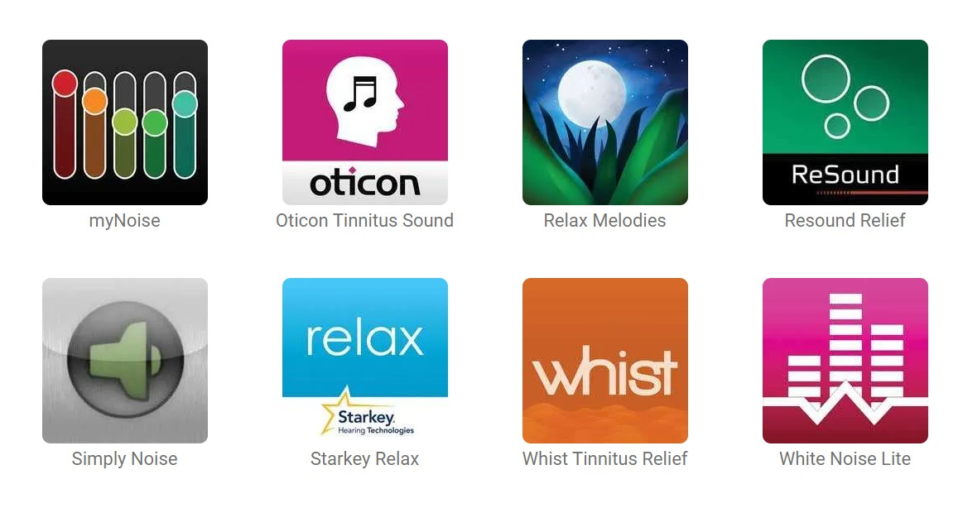
Tinnitus Management Apps

Slide 16

Hearing Loss Can Impact Mental Health
Mental Health Awareness & Suicide Prevention Resources
https://www.nimh.nih.gov/health/statistics/suicide
https://www.cdc.gov/suicide/facts/index.html
https://www.samhsa.gov/suicide
Notes:
Mental Health Awareness & Suicide Prevention Resources are here to help us understand and address mental health issues more effectively. They offer crucial information on spotting the signs of mental health crises and suicidal behavior.
These resources provide practical strategies for prevention and support, making it easier for people to seek help when they need it. By raising awareness and reducing stigma, we can create a more supportive environment and prevent tragedies.

