Slide 1
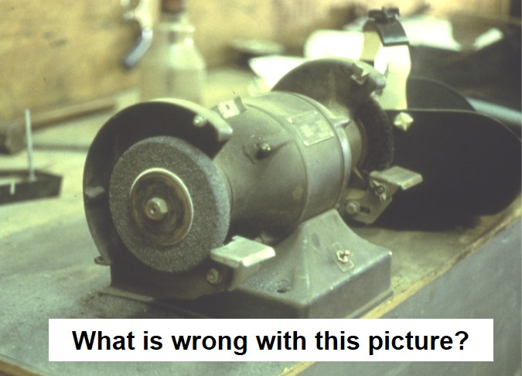
Machinery Safety
Source: NJAFL-CIO
Machinery and Machine Guarding Hazards for General Industry
This material was produced under grant [SH-31178-SH7] from the Occupational Safety and Health Administration, U.S. Department of Labor. It does not necessarily reflect the views or policies of the U.S. Department of Labor, nor does mention of trade names, commercial
products, or organizations imply endorsement by the U.S. Government
Notes:
Bench grinder picture - unguarded wheel, no tongue guard

Slide 2
Machinery Safety Training
Group Worksheet or Discussion

Slide 3
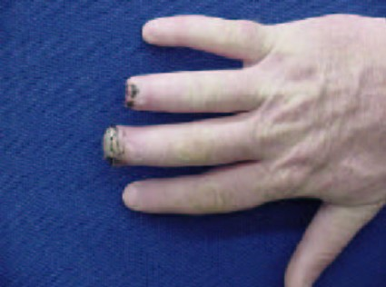
The Problem
Speaker Notes: Machines are fixed and portable powered devices that do work tasks. They have moving parts that can cause worker injury.
Data source - https://www.osha.gov/SLTC/etools/machineguarding/index.html
Source of picture: OSHA 7100 Curriculum Student Manual
Machines have the potential to cause
  Crushed fingers or hands
  Amputations
  Burns
  Blindness
  Fatalities
Each year machinery workers suffer approximately
  18,000 amputations, lacerations, crushing injuries, and abrasions
  800 deaths
Source: OSHA
Notes:
Machines are fixed and portable powered devices that do work tasks. They have moving parts that can cause worker injury.
Data source - https://www.osha.gov/SLTC/etools/machineguarding/index.html
Source of picture: OSHA 7100 Curriculum Student Manual

Slide 4
High-Risk Machinery
Speaker Notes: Data Source – OSHA Quick Card – Amputations (https://www.osha.gov/Publications/amputations-qc.html)
Mechanical power presses
Power press brakes
Powered and non-powered conveyors
Printing presses
Roll-forming and roll-bending machines
Shearing machines
Food slicers
Meat grinders
Meat-cutting band saws
Drill presses
Milling machines
Shears, grinders, and slitters
Table and portable saws
Notes:
Data Source – OSHA Quick Card – Amputations (https://www.osha.gov/Publications/amputations-qc.html)

Slide 5
Causes of Machine Incidents
Reaching in to “clear” powered equipment
Performing maintenance on powered equipment
Unauthorized person doing maintenance or using the machine
Missing or loose machine guards
Lack of worker training

Slide 6
Prevention
Speaker Notes: 1910.212(a) Machine guarding.
1910.212(a)(1) Types of guarding. One or more methods of machine guarding shall be provided to protect the operator and other employees in the machine area from hazards such as those created by point of operation, ingoing nip points, rotating parts, flying chips and sparks. Examples of guarding methods are-barrier guards, two-hand tripping devices, electronic safety devices, etc.
1910.212(a)(2) General requirements for machine guards. Guards shall be affixed to the machine where possible and secured elsewhere if for any reason attachment to the machine is not possible. The guard shall be such that it does not offer an accident hazard in itself.
1910.212(a)(3) Point of operation guarding.
1910.212(a)(3)(i) Point of operation is the area on a machine where work is actually performed upon the material being processed.
1910.212(a)(3)(ii) The point of operation of machines whose operation exposes an employee to injury, shall be guarded. The guarding device shall be in conformity with any appropriate standards therefor, or, in the absence of applicable specific standards, shall be so designed and constructed as to prevent the operator from having any part of his body in the danger zone during the operating cycle.
Safeguarding any machine part, function, or process which may cause injury
Controlling or eliminating all hazards where the operation of a machine can injure the operator or other workers
Training workers on the hazards of machines and how to safely operate and repair machinery
Notes:
1910.212(a) Machine guarding.
1910.212(a)(1) Types of guarding. One or more methods of machine guarding shall be provided to protect the operator and other employees in the machine area from hazards such as those created by point of operation, ingoing nip points, rotating parts, flying chips and sparks. Examples of guarding methods are-barrier guards, two-hand tripping devices, electronic safety devices, etc.
1910.212(a)(2) General requirements for machine guards. Guards shall be affixed to the machine where possible and secured elsewhere if for any reason attachment to the machine is not possible. The guard shall be such that it does not offer an accident hazard in itself.
1910.212(a)(3) Point of operation guarding.
1910.212(a)(3)(i) Point of operation is the area on a machine where work is actually performed upon the material being processed.
1910.212(a)(3)(ii) The point of operation of machines whose operation exposes an employee to injury, shall be guarded. The guarding device shall be in conformity with any appropriate standards therefor, or, in the absence of applicable specific standards, shall be so designed and constructed as to prevent the operator from having any part of his body in the danger zone during the operating cycle.

Slide 7
Applicable OSHA Standards
Speaker Notes: There are numerous OSHA standards that cover machinery safety. This is list of the General Industry standards:
1910 Subpart J: General environmental controls
1910.147 - The control of hazardous energy (lockout/tagout)
1910 Subpart O, Machinery and machine guarding. Includes definitions, general requirements, and different kinds of machinery requirements
1910.211, Definitions
1910.212, General requirements for all machines
1910.213, Woodworking machinery requirements
1910.214, Cooperage machinery [Reserved]
1910.215, Abrasive wheel machinery
1910.216, Mills and calendars in the rubber and plastics industries
1910.217, Mechanical power presses. Includes general requirements in addition to specific requirements for construction, safeguarding, dies, inspection, maintenance, modification, operation, injury reporting, and presence sensing device initiation (PSDI).
1910.218, Forging machines
1910.219, Mechanical power-transmission apparatus
1910 Subpart P - Hand and Portable Powered Tools and Other Hand-Held Equipment
1910.241 - Definitions.
1910.243 - Guarding of portable powered tools.
1910 Subpart R, Special industries
1910.262, Textiles. Paragraph (c)(3) [reserved] contains a short statement on machine guarding requirements and a reference to 29 CFR 1910.219. [related topic page]
1910.263, Bakery equipment. Paragraph (c) addresses general requirements for machine guarding.
1910.268, Telecommunications. Paragraph (b)(1)(v) addresses some general requirements for machine guarding.
29 CFR Part 1910
  Subpart J (1910.147): The control of hazardous energy (Lockout/Tagout)
  Subpart O: Machinery and machine guarding
  Subpart P (1910.243): Guarding of portable powered tools
  Subpart R: Special industries (e.g., Bakery equipment)
Notes:
There are numerous OSHA standards that cover machinery safety. This is list of the General Industry standards:
1910 Subpart J: General environmental controls
1910.147 - The control of hazardous energy (lockout/tagout)
1910 Subpart O, Machinery and machine guarding. Includes definitions, general requirements, and different kinds of machinery requirements
1910.211, Definitions
1910.212, General requirements for all machines
1910.213, Woodworking machinery requirements
1910.214, Cooperage machinery [Reserved]
1910.215, Abrasive wheel machinery
1910.216, Mills and calendars in the rubber and plastics industries
1910.217, Mechanical power presses. Includes general requirements in addition to specific requirements for construction, safeguarding, dies, inspection, maintenance, modification, operation, injury reporting, and presence sensing device initiation (PSDI).
1910.218, Forging machines
1910.219, Mechanical power-transmission apparatus
1910 Subpart P - Hand and Portable Powered Tools and Other Hand-Held Equipment
1910.241 - Definitions.
1910.243 - Guarding of portable powered tools.
1910 Subpart R, Special industries
1910.262, Textiles. Paragraph (c)(3) [reserved] contains a short statement on machine guarding requirements and a reference to 29 CFR 1910.219. [related topic page]
1910.263, Bakery equipment. Paragraph (c) addresses general requirements for machine guarding.
1910.268, Telecommunications. Paragraph (b)(1)(v) addresses some general requirements for machine guarding.

Slide 8
OSHA Citations
Fiscal Year 2016
Speaker Notes: https://https://www.osha.gov/oshstats/commonstats.html
Lockout/Tagout (1910.147)
  5th most frequently cited standard
Machines, general requirements (1910.212)
  8th most frequently cited standard
Notes:
https://https://www.osha.gov/oshstats/commonstats.html

Slide 9
OSHA Requirements for Recordkeeping and Reporting
Speaker Notes: Recordkeeping regulations are contained in 29 CFR Part 1904.
Some low-hazard employers (for example, retail trade, finance, insurance, real estate) are not required to keep records.
While the 1904 regulation exempts many employers from keeping records at all times, these employers are not exempted from all of the 1904 requirements.
Employers that are partially exempt from the recordkeeping requirements because of their size (10 or less employees) or industry must continue to comply with:
1904.39, Reporting fatalities, in-patient hospitalizations, amputations or eye loss
1904.41, Annual OSHA injury and illness survey (if specifically requested to do so by OSHA)
1904.42, Bureau of Labor Statistics (BLS) Annual Survey (if specifically requested to do so by BLS)
Employers of 11 or more employees must maintain records of occupational injuries and illnesses
All employers must display the OSHA poster
All employers must report to OSHA within 8 hours any accident that results in a fatality, any in-patient hospitalization, any amputation, and any loss of an eye
Notes:
Recordkeeping regulations are contained in 29 CFR Part 1904.
Some low-hazard employers (for example, retail trade, finance, insurance, real estate) are not required to keep records.
While the 1904 regulation exempts many employers from keeping records at all times, these employers are not exempted from all of the 1904 requirements.
Employers that are partially exempt from the recordkeeping requirements because of their size (10 or less employees) or industry must continue to comply with:
1904.39, Reporting fatalities, in-patient hospitalizations, amputations or eye loss
1904.41, Annual OSHA injury and illness survey (if specifically requested to do so by OSHA)
1904.42, Bureau of Labor Statistics (BLS) Annual Survey (if specifically requested to do so by BLS)

Slide 10
Employers’ responsibilities Under OSHA
Provide a safe and healthful workplace free of recognized hazards
Follow OSHA standards
Provide worker training in an understandable language
Maintain injury/illness records
Provide required safety gear

Slide 11
Employees’ rights under OSHA
Filing an OSHA complaint
Participating in OSHA inspections and talking to an inspector
Accessing employer exposure and injury records
Reporting an injury
Complaining to the employer about a safety and health concern

Slide 12
Whistleblower Laws
Section 11(c) of the OSHA Act prohibits employers from discriminating against employees who exercise their rights
OSHA also enforces anti-discrimination laws for 20 other statutes

Slide 13
Employer
Prohibited Retaliatory Actions
Firing or laying off
Blacklisting
Demoting
Denying overtime or promotion
Disciplining
Denial of benefits
Failure to hire or rehire
Intimidation and harassment
Making threats
Reassignment
Reducing pay or hours

Slide 14
Complaint Procedures
Safety and health complaints should be filed when problem is noticed
Whistleblower complaints must be filed within 30 days of alleged reprisal
Complaints may be filed online, fax, mail or telephone
Complaints are confidential

Slide 15

Machine Guarding
Source: NJAFL-CIO
Notes:
Safety Sign source – NJ AFL-CIO

Slide 16
Basic Areas To Be Safeguarded
Point of Operation
Power Transmission Apparatus
Other Moving Parts
Speaker Notes: Point of Operation - The point where work is performed on the material, such as cutting, shaping, boring or forming of stock.
Power Transmission Apparatus - All components of the mechanical system which transmit energy to the part of the machine performing the work. Including flywheels, pulleys, belts, connecting rods, couplings, cams, spindles, chains, cranks and gears.
Other moving parts - all parts which move while machine is working. Includes reciprocating, rotating and transverse moving parts, feed mechanisms etc.
Notes:
Point of Operation - The point where work is performed on the material, such as cutting, shaping, boring or forming of stock.
Power Transmission Apparatus - All components of the mechanical system which transmit energy to the part of the machine performing the work. Including flywheels, pulleys, belts, connecting rods, couplings, cams, spindles, chains, cranks and gears.
Other moving parts - all parts which move while machine is working. Includes reciprocating, rotating and transverse moving parts, feed mechanisms etc.

Slide 17
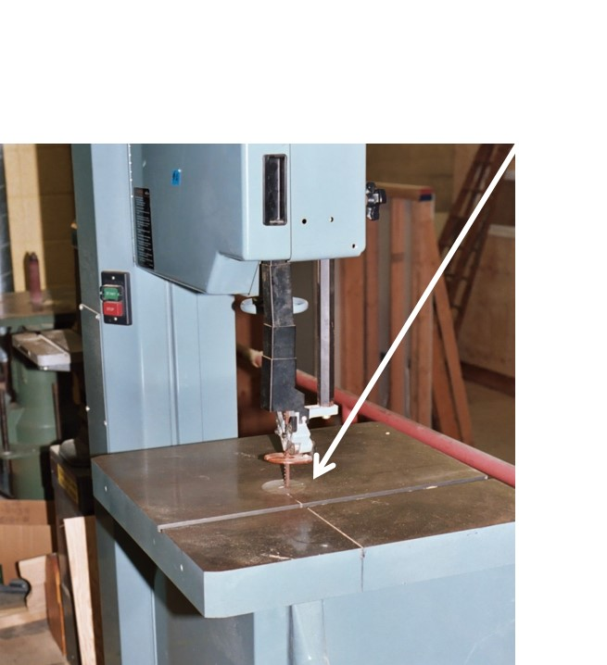
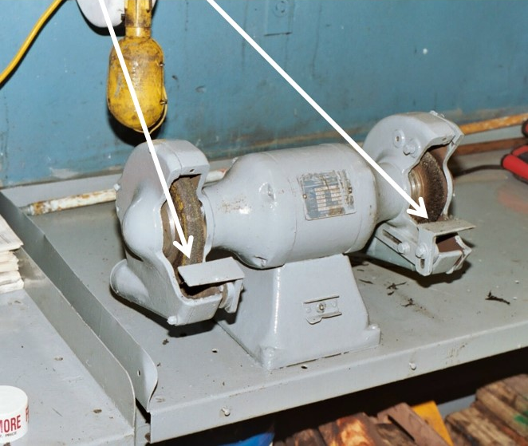
Point of Operation
Source: NJAFL-CIO
Source: NJAFL-CIO

Slide 18
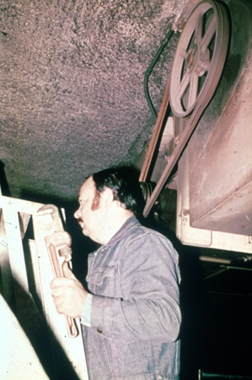
Power-Transmission Apparatus
Unguarded belt and pulley
Power-transmission apparatus (shafting, flywheels, pulleys, belts, chain drives, etc.) less than 7 feet from the floor or working platform must be guarded.
Speaker notes:
Picture from OSHA 10 slide
1910.219
Source: OSHA
Notes:
Picture from OSHA 10 slide
1910.219

Slide 19
Hazardous Motions & Actions
Motions
  Rotating (including in-running nip points)
  Transverse
  Reciprocating
Actions
  Cutting
  Punching
  Shearing
  Bending
Speaker notes:
These will be discussed in more detail on the following slides.
Notes:
These will be discussed in more detail on the following slides.

Slide 20
Rotating Motion
Hazard – Machinery grips and moves clothing, hair and body parts into danger area
Danger increases when projections are present
  Screws, bolts, nicks, abrasions, etc.

Slide 21
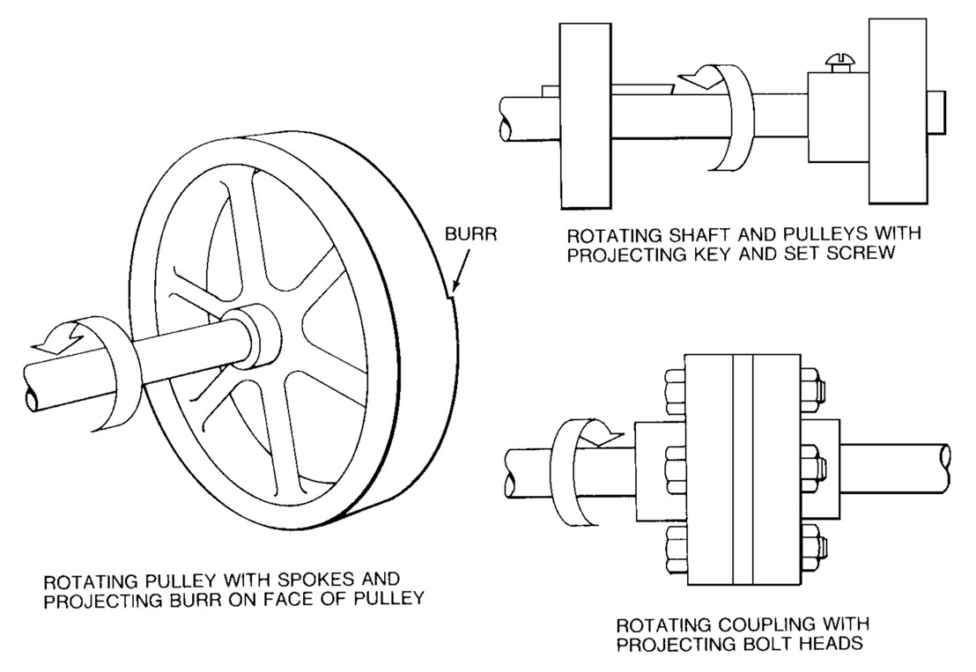
Rotating Parts with Projections
Speaker notes:
Pictures from OSHA 3067
Rotating pulley with spokes and projecting burr on face of pully
  Burr
Rotating shaft and pulleys with projecting key and set screw
Rotating coupling with projecting bolt heads
BURR
Rotating shaft and pulleys with projecting key and set screw
Rotating pulley with spokes and projecting burr on face of pulley
Rotating coupling with projecting bolt heads
Source: OSHA
Notes:
Pictures from OSHA 3067

Slide 22
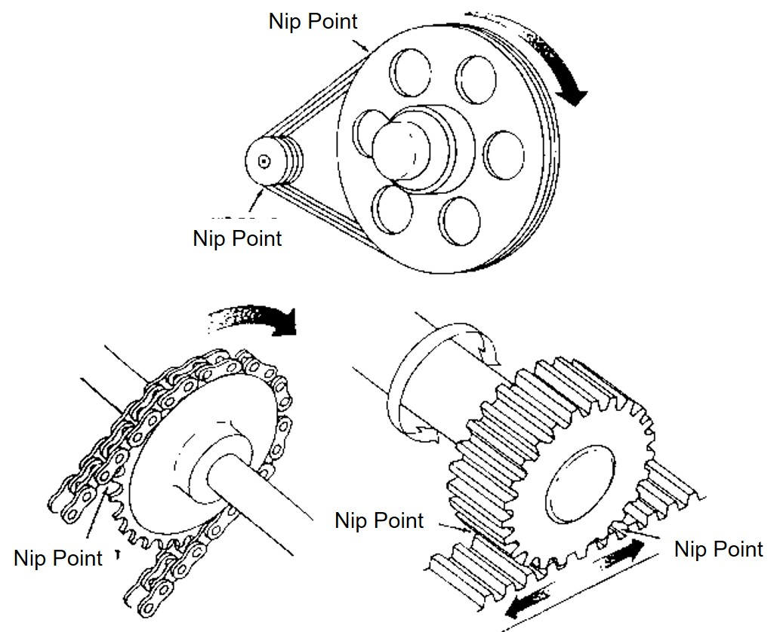
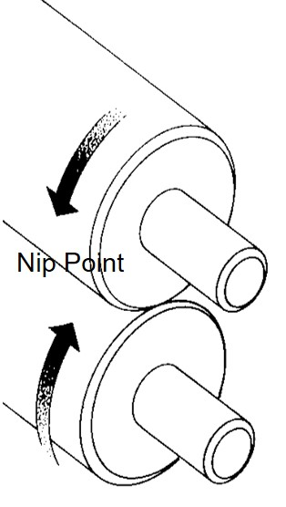
In-Running Nip Point
Speaker Notes: Pictures from OSHA 3067
Pressure rollers, belt and pulley; chain and sprocket; and rack and pinion
In-running nip point hazards are caused by the rotating parts on machinery. There are three main types of in-running nips.
Parts can rotate in opposite directions while their axes are parallel to each other. These parts may be in contact (producing a nip point) or in close proximity to each other (where the stock fed between the rolls produces the nip points). This danger is common on machinery with intermeshing gears and rotating cylinders.
Another type of nip point is created between rotating and tangentially moving parts; for example, a chain and a sprocket, a rack and pinion, or the point of contact between a power transmission belt and its pulley.
Source: OSHA
Notes:
Pictures from OSHA 3067
Pressure rollers, belt and pulley; chain and sprocket; and rack and pinion
In-running nip point hazards are caused by the rotating parts on machinery. There are three main types of in-running nips.
Parts can rotate in opposite directions while their axes are parallel to each other. These parts may be in contact (producing a nip point) or in close proximity to each other (where the stock fed between the rolls produces the nip points). This danger is common on machinery with intermeshing gears and rotating cylinders.
Another type of nip point is created between rotating and tangentially moving parts; for example, a chain and a sprocket, a rack and pinion, or the point of contact between a power transmission belt and its pulley.

Slide 23
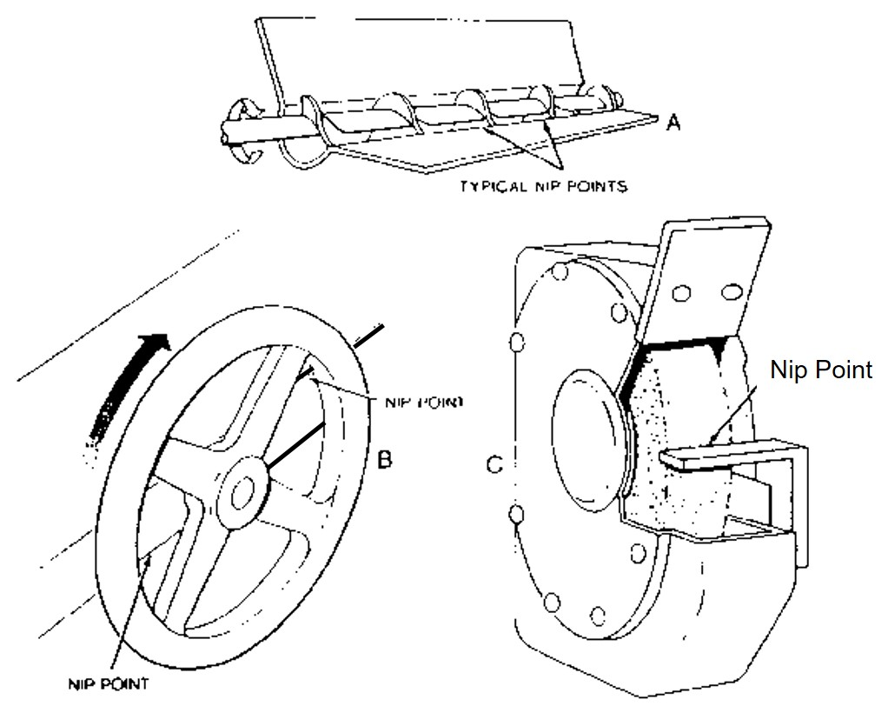
In-Running Nip Points
Speaker Notes: Picture from OSHA 3067
Nip points can also occur between rotating and fixed parts which create a shearing, crushing, or abrading action; for example, spoked handwheels or flywheels, screw conveyors, or the periphery of an abrasive wheel and an incorrectly adjusted work rest.
Source: OSHA
Notes:
Picture from OSHA 3067
Nip points can also occur between rotating and fixed parts which create a shearing, crushing, or abrading action; for example, spoked handwheels or flywheels, screw conveyors, or the periphery of an abrasive wheel and an incorrectly adjusted work rest.

Slide 24
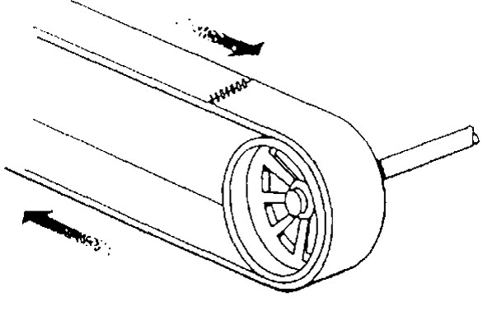
Transverse Motion
Speaker Notes: Picture from OSHA 3067
Motion may strike or catch an employee in a pinch or shear point created by the moving part and a fixed object.
Movement in a straight, continuous line around rotating component
Hazard may strike or catch employee a pinch or shear point
Source: OSHA
Notes:
Picture from OSHA 3067
Motion may strike or catch an employee in a pinch or shear point created by the moving part and a fixed object.

Slide 25
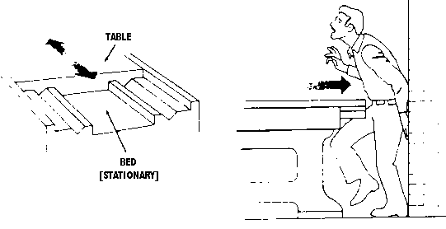
Reciprocating Motion
Speaker notes:
Picture from OSHA 3067
Back and forth / up and down
Hazard - Caught between moving part and stationary object
Source: OSHA
Notes:
Picture from OSHA 3067

Slide 26
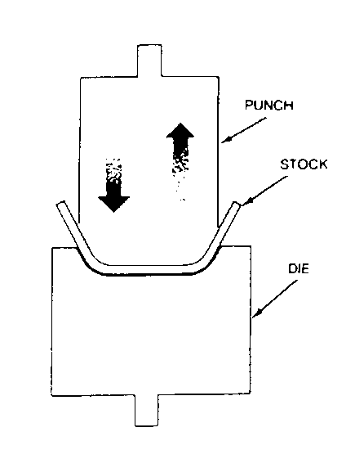
Bending Actions
Speaker Notes: Picture from OSHA 3067
The hazard occurs at the point of operation where the employee typically inserts, holds, or withdraws the stock by hand.
Power applied to slide to draw or stamp metal or other materials in a bending motion
Example: Press Brake, Tube Benders
Source: OSHA
Notes:
Picture from OSHA 3067
The hazard occurs at the point of operation where the employee typically inserts, holds, or withdraws the stock by hand.

Slide 27
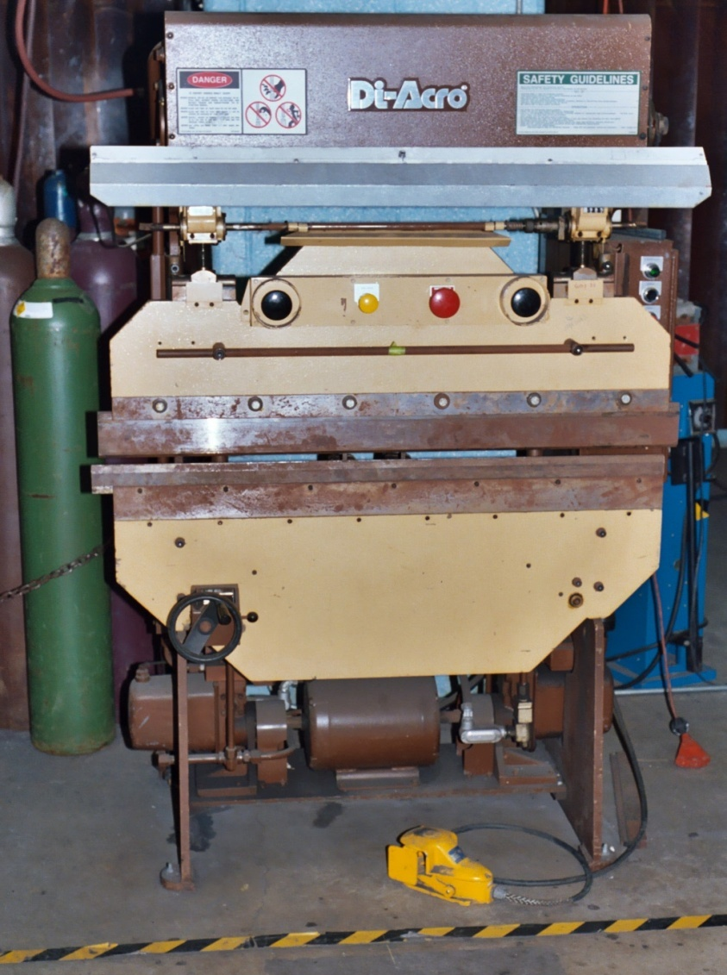
Bending Actions
Press Brake
Speaker Notes: Press Brake picture. Source: NJ AFL-CIO. The hazard occurs at the point of operation where the employee typically inserts, holds, or withdraws the stock by hand.
Source: NJAFL-CIO
Notes:
Press Brake picture. Source: NJ AFL-CIO. The hazard occurs at the point of operation where the employee typically inserts, holds, or withdraws the stock by hand.

Slide 28
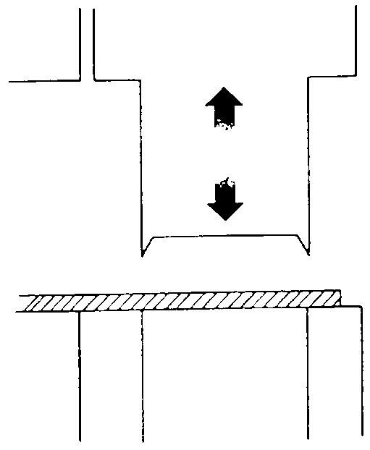
Punching Actions
Speaker Notes: Picture from OSHA 3067
The hazard occurs at the point of operation where the employee typically inserts, holds, or withdraws the stock by hand.
Power applied to slide ram for purpose of blanking, drawing or stamping
Example: Power press
Source: OSHA
Notes:
Picture from OSHA 3067
The hazard occurs at the point of operation where the employee typically inserts, holds, or withdraws the stock by hand.

Slide 29
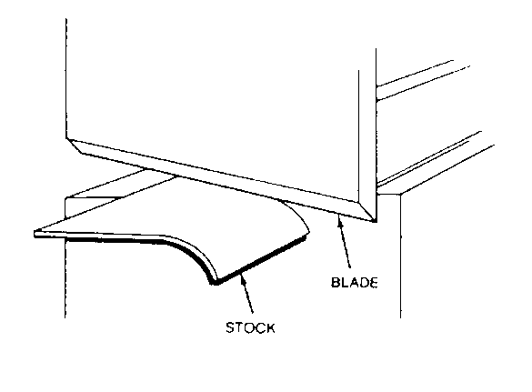
Shearing Actions
Speaker Notes: Picture from OSHA 3067
The hazard occurs at the point of operation where the employee typically inserts, holds, or withdraws the stock by hand.
Apply power to slide or knife to trim or cut
Source: OSHA
Notes:
Picture from OSHA 3067
The hazard occurs at the point of operation where the employee typically inserts, holds, or withdraws the stock by hand.

Slide 30
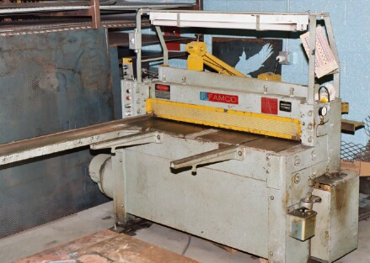
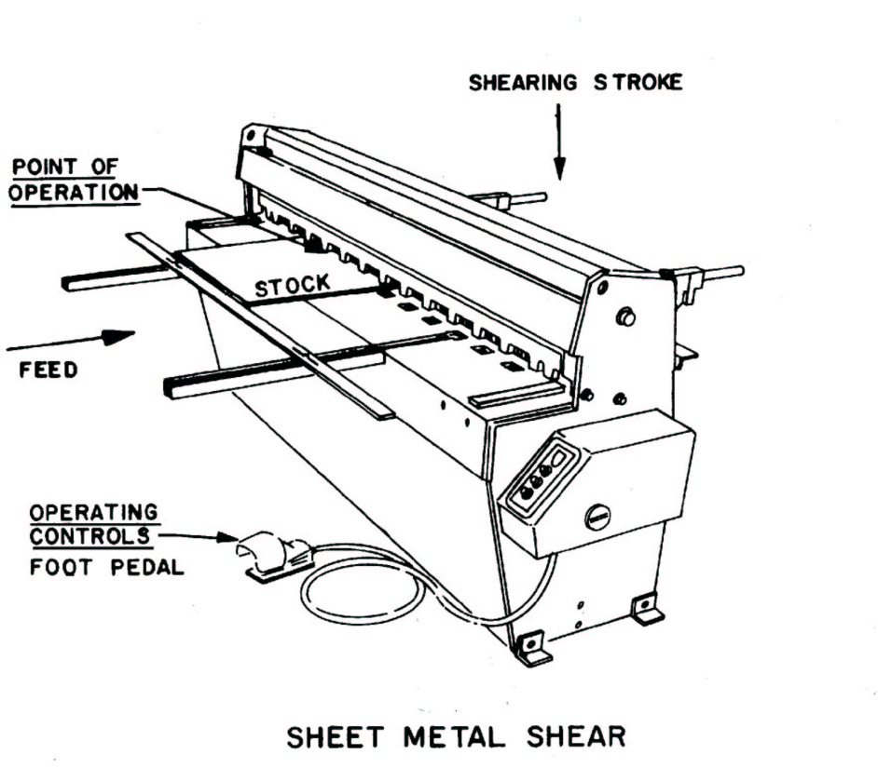
Shearing Actions
Sheet Metal Shear
Source: NJAFL-CIO
Source: OSHA
Speaker notes:
NJ AFL-CIO picture and picture from OSHA 7100 Course Manual
Notes:
NJ AFL-CIO picture and picture from OSHA 7100 Course Manual

Slide 31
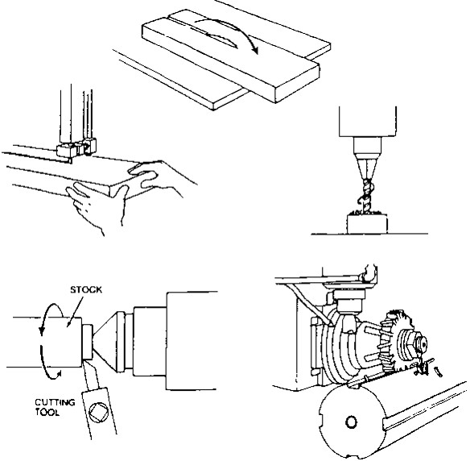
Cutting Actions
Rotating, reciprocating or transverse motion
Examples: Band saw, circular saws, lathes, drills
Speaker notes:
Picture from OSHA 3067
Source: OSHA
Notes:
Picture from OSHA 3067

Slide 32
Types of Safeguards
Guards
Devices
Location/distance
Automatic/semiautomatic feed or ejection
Miscellaneous
Speaker Notes: Guards: physical barriers that enclose dangerous machine parts and prevent employee contact
Devices: Controls or attachments that, when properly designed, applied and used, usually prevent inadvertent access by employees to hazardous machine areas.
Location/distance: may involve an operator holding and supporting a work-piece with both hands at a predetermined minimum safe distance or, if both hands cannot be used to hold the work-piece at a distance so that the operator cannot reach the hazard with the free hand.
Notes:
Guards: physical barriers that enclose dangerous machine parts and prevent employee contact
Devices: Controls or attachments that, when properly designed, applied and used, usually prevent inadvertent access by employees to hazardous machine areas.
Location/distance: may involve an operator holding and supporting a work-piece with both hands at a predetermined minimum safe distance or, if both hands cannot be used to hold the work-piece at a distance so that the operator cannot reach the hazard with the free hand.

Slide 33
Types of Guards
Fixed
  Provide secure barrier
Interlocked
  Cuts off power when guard opened or removed
Adjustable
  Barrier manually moved to accommodate stock or operation
Self-adjusting
  Barrier automatically moves to accommodate operation

Slide 34
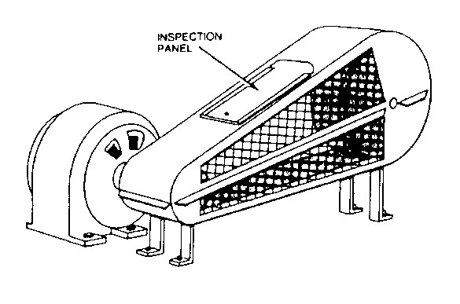
Fixed Guards
Advantages
  Maximum
  protection
  Variety of applications
  In-house
  fabrication
  Low cost & maintenance
Disadvantages
  Poor visibility
  Must remove for repairs requiring LOTO
Source: OSHA
Speaker Notes: Picture from OSHA 3067
Advantages: Can be constructed to suit many applications; permanently encloses the point of operation or hazard area; provides protection against machine repeat; and allows simple, in-plant construction, with minimal maintenance.
Disadvantages: Sometimes not practical for changing production runs involving different size stock or feeding methods; machine adjustment and repair often require guard removal; and other means of protecting maintenance personnel often required (lockout/tagout).
Notes:
Picture from OSHA 3067
Advantages: Can be constructed to suit many applications; permanently encloses the point of operation or hazard area; provides protection against machine repeat; and allows simple, in-plant construction, with minimal maintenance.
Disadvantages: Sometimes not practical for changing production runs involving different size stock or feeding methods; machine adjustment and repair often require guard removal; and other means of protecting maintenance personnel often required (lockout/tagout).

Slide 35
Interlocked Guards
Switch that when opened stops power
Advantage
  Maximum protection
  Portion of guard easily removed for access
Disadvantage
  Can be overridden by employee
  High cost
  Maintenance required
Speaker Notes: Advantages: Allows access for some minor service work, in accordance with the lockout/tagaout exception, without time-consuming removal of fixed guards.
Disadvantages: May require periodic maintenance or adjustment; movable section cannot be used for manual feeding; some designs may be easy to defeat; and interlock control circuitry may not be used for all maintenance and servicing work.
Notes:
Advantages: Allows access for some minor service work, in accordance with the lockout/tagaout exception, without time-consuming removal of fixed guards.
Disadvantages: May require periodic maintenance or adjustment; movable section cannot be used for manual feeding; some designs may be easy to defeat; and interlock control circuitry may not be used for all maintenance and servicing work.

Slide 36
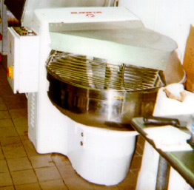
Interlocked Guards
Dough Mixing Machine
Dough mixing machine. When cover is lifted to expose mixing bowl and mixing fork, interlock switch shuts off rotating mixing fork.
Picture from http://www.cdc.gov/niosh/face/stateface/nj/01nj118.html
Source: NIOSH FACE Report
Notes:
Dough mixing machine. When cover is lifted to expose mixing bowl and mixing fork, interlock switch shuts off rotating mixing fork.
Picture from http://www.cdc.gov/niosh/face/stateface/nj/01nj118.html

Slide 37
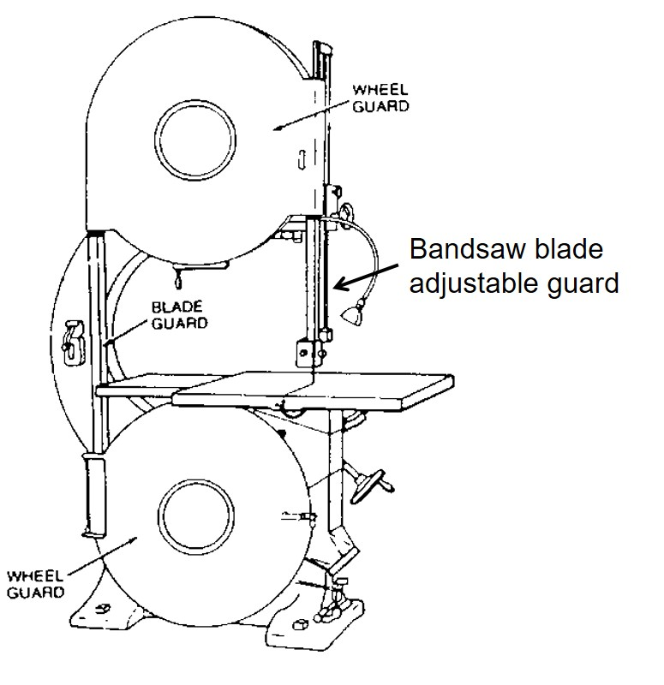
Adjustable Guards
Speaker Notes: Picture from OSHA 3067
Advantages: Can be constructed to suit many applications; and can be adjusted admit varying stock sizes.
Disadvantages: May require frequent maintenance or adjustment; and operator may make guard ineffective
Advantage
  Flexibility
  In-house fabrication
Disadvantage
  Not maximum protection
  Rely on worker to properly position
  May prohibit easy access
Notes:
Picture from OSHA 3067
Advantages: Can be constructed to suit many applications; and can be adjusted admit varying stock sizes.
Disadvantages: May require frequent maintenance or adjustment; and operator may make guard ineffective

Slide 38
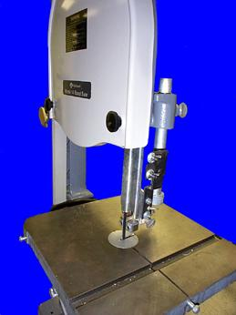
Adjustable Guards
Bandsaw
Speaker notes:
Picture from OSHA 10 Slide
Bandsaw blade adjustable guard
Source: OSHA
Notes:
Picture from OSHA 10 Slide

Slide 39
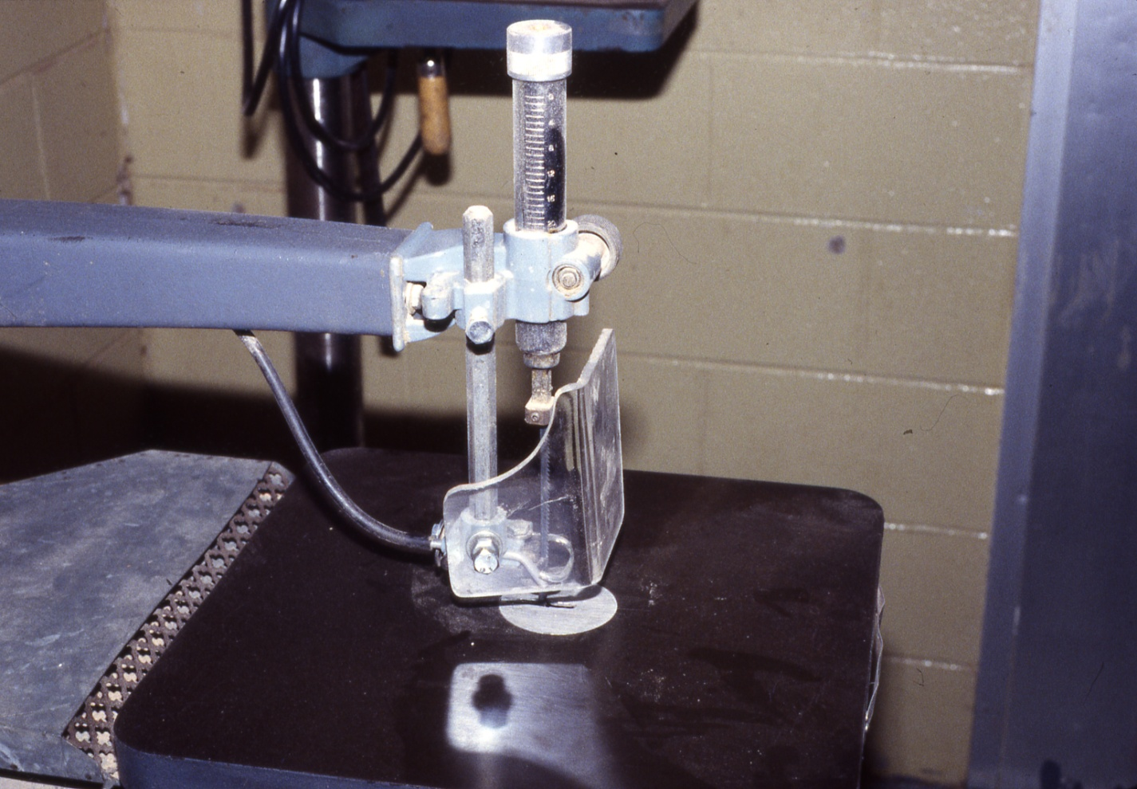
Adjustable Guards
Scroll Saw
Scroll saw blade adjustable guard
Source: NJAFL-CIO
Notes:
Scroll Saw picture. Source of picture = NJ AFL-CIO

Slide 40
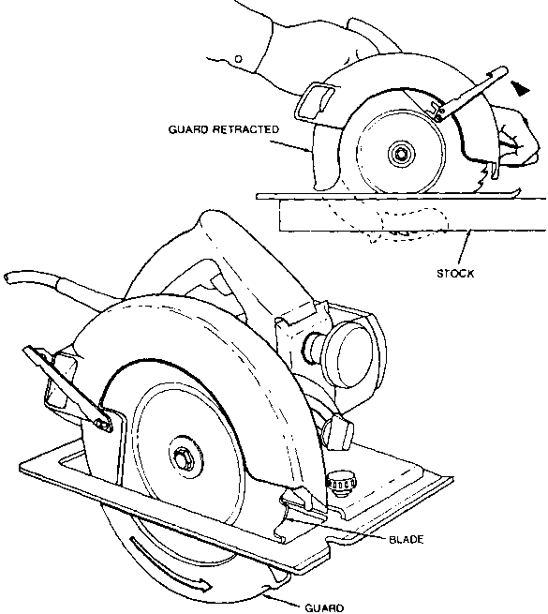
Self-adjusting Guards
Advantage
  Employee not involved in positioning
  Readily available
Disadvantage
  Not maximum protection
  May need frequent fine tuning
Source: OSHA
Notes:
Picture from OSHA 3067
Advantages: Off-the-shelf guards are often commercially available
Disadvantages: Does not provide maximum protection; and may require frequent maintenance and adjustment.

Slide 41
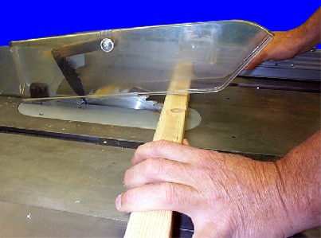
Self-adjusting Guard Table Circular Saw
Speaker notes:
Picture from OSHA 10 slide
Source: OSHA
Notes:
Picture from OSHA 10 slide

Slide 42
Devices
Presence sensing
  Photoelectrical
  Radiofrequency
  Electromechanical
Pullback
Restraint
Safety Controls
  Safety trip control
  Two-hand control/trip
Gates

Slide 43
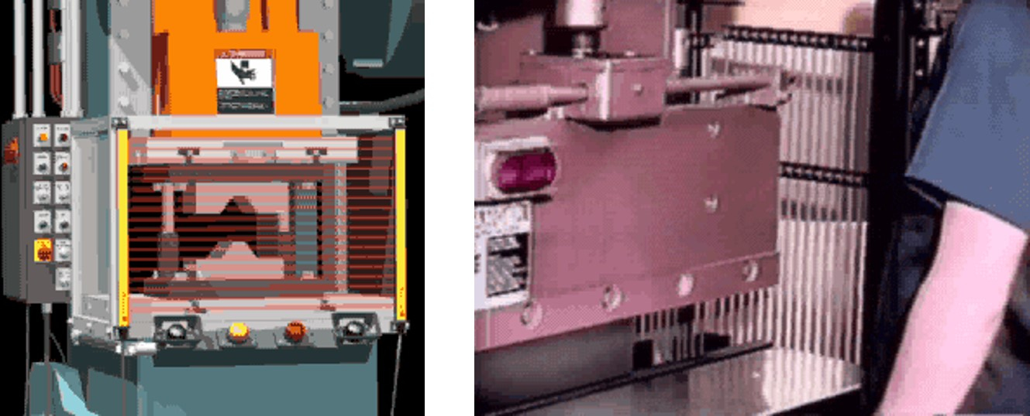
Presence-Sensing Device
Speaker Notes: Animations from http://www.osha.gov/SLTC/etools/machineguarding/presses/psd.html
Interlocks into the machine’s control system to stop operation when the sensing filed (photoelectric, radio frequency, or electromagnetic) is disturbed.
Advantages: adjust to fit different stock sizes; allows access to load and unload the machine; and allows access to the guarded area for maintenance and set-up activities.
Disadvantages: Restricted to machines that stop operating cycle before operator can reach into danger area (e.g., machines with partial revolution clutches or hydraulic machines); Must be carefully maintained and adjusted; does not protect operator in the event of a mechanical failure; and operator may make device ineffective.
There are also presence-sensing mats that interlock into machine’s control system to stop operation when a predetermined weight is applied to the mat. A manual reset switch must be located outside the protected zone.
Source: OSHA
Source: OSHA
Notes:
Animations from http://www.osha.gov/SLTC/etools/machineguarding/presses/psd.html
Interlocks into the machine’s control system to stop operation when the sensing filed (photoelectric, radio frequency, or electromagnetic) is disturbed.
Advantages: adjust to fit different stock sizes; allows access to load and unload the machine; and allows access to the guarded area for maintenance and set-up activities.
Disadvantages: Restricted to machines that stop operating cycle before operator can reach into danger area (e.g., machines with partial revolution clutches or hydraulic machines); Must be carefully maintained and adjusted; does not protect operator in the event of a mechanical failure; and operator may make device ineffective.
There are also presence-sensing mats that interlock into machine’s control system to stop operation when a predetermined weight is applied to the mat. A manual reset switch must be located outside the protected zone.

Slide 44
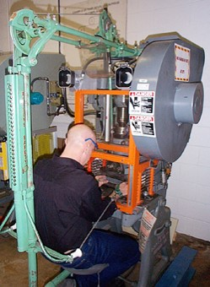
Pullback Device
Speaker Notes: Picture from OSHA 10 slide.
Cords connected to operator’s wrists and linked mechanically to the machine automatically withdraw the hands from the point of operation during the machine cycle.
Advantages: Allows the hands to enter the point of operation for feeding and removal; and provides protection even in the event of mechanical repeat.
Disadvantages: Close supervision ensures proper use and adjustment; must be inspected prior to each operator change or machine set-up; limits operator’s movement and may obstruct their work space; and operator may easily make device ineffective by not adjusting the device properly.
Utilizes a series of cables attached to the operator’s hands, wrists, and/or arms
Primarily used on machines with stroking action
Allows access to the point of operation when the slide/ram is up
Withdraws hands when the slide/ram begins to descend
Source: OSHA
Notes:
Picture from OSHA 10 slide.
Cords connected to operator’s wrists and linked mechanically to the machine automatically withdraw the hands from the point of operation during the machine cycle.
Advantages: Allows the hands to enter the point of operation for feeding and removal; and provides protection even in the event of mechanical repeat.
Disadvantages: Close supervision ensures proper use and adjustment; must be inspected prior to each operator change or machine set-up; limits operator’s movement and may obstruct their work space; and operator may easily make device ineffective by not adjusting the device properly.

Slide 45
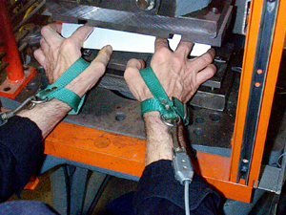
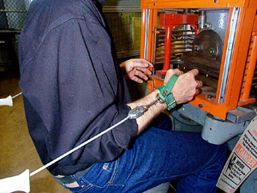
Pullback Device (cont’d)
Source: OSHA
Source: OSHA
Hands in die, feeding
Point of operation exposed
Pullback device attached and properly adjusted
Die closed
Hands withdrawn from point of operation by pullback device
Speaker notes:
Pictures form OSHA 10 slide
Notes:
Pictures form OSHA 10 slide

Slide 46
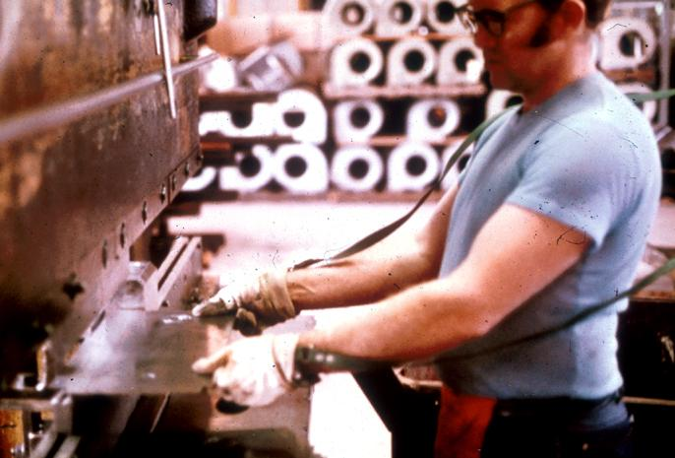
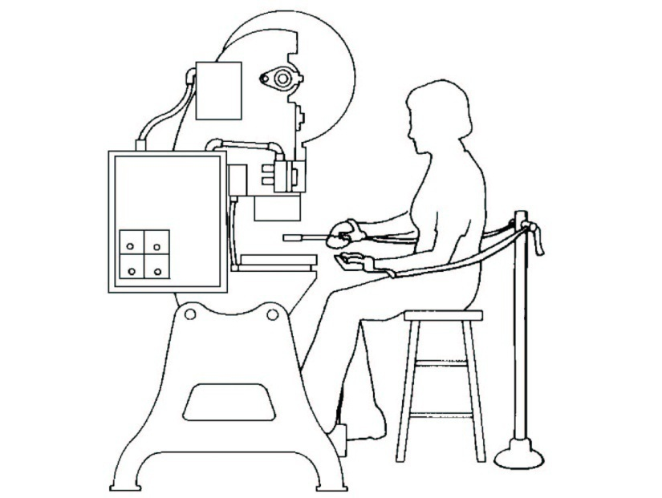
Restraint Device
Speaker Notes: Pictures form OSHA 10 slide and OSHA 3067
Wrists are connected by cords and secured to a fixed anchor point which limit operator’s hands from reaching the point of operation at any time.
Advantages: Simple, few moving parts; requires little maintenance; operator cannot reach into the danger area; little risk of mechanical failure; provides protection even in the event of mechanical repeat.
Disadvantages: Close supervision required to ensure proper use and adjustment; must be inspected prior to each operator change or machine set-up; operator must use hand tools to enter the point of operation; limits the movement of the operator; may obstruct work space around operator; operator may easily make device ineffective by disconnecting the device.
Uses cables or straps attached to the operator’s hands and a fixed point
Must be adjusted to let the operator’s hands travel within a predetermined safe area
Hand-feeding tools are often necessary if the operation involves placing material into the danger area
Source: OSHA
Notes:
Pictures form OSHA 10 slide and OSHA 3067
Wrists are connected by cords and secured to a fixed anchor point which limit operator’s hands from reaching the point of operation at any time.
Advantages: Simple, few moving parts; requires little maintenance; operator cannot reach into the danger area; little risk of mechanical failure; provides protection even in the event of mechanical repeat.
Disadvantages: Close supervision required to ensure proper use and adjustment; must be inspected prior to each operator change or machine set-up; operator must use hand tools to enter the point of operation; limits the movement of the operator; may obstruct work space around operator; operator may easily make device ineffective by disconnecting the device.

Slide 47
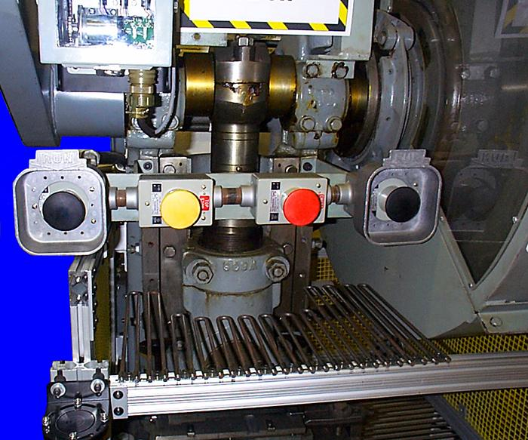
Two-Hand Control
Speaker Notes: Picture from OSHA 10 Slide
This kind of control requires a part-revolution clutch, brake, and brake monitor if used on a power press as shown.
A similar device, known as a two-hand trip, requires concurrent application of both of the operator’s control buttons to activate the machine cycle, after which the hands are free. This device is used with machines equipped with full-revolution clutches. The trips must be placed far enough from the point of operation to make it impossible for the operators to move their hands from the trip buttons or handles into the point of operation before the first half of the cycle is completed to prevent them from being accidentally placed in the danger area prior to the slide/ram or blade reaching the full “down” position.
Advantages: operator’s hands are at a predetermined safe distance; and operator’s hands are free to pick up new parts after completion of first part of cycle.
Disadvantages: Requires a partial cycle machine with a brake and anti-repeat feature; operator may make devices without anti-tiedown ineffective; and protects the operator only.
Requires constant, concurrent pressure to activate the machine
The operator’s hands are required to be at a safe location (on control buttons) and at a safe distance from the danger area while the machine completes its closing cycle
Source: OSHA
Notes:
Picture from OSHA 10 Slide
This kind of control requires a part-revolution clutch, brake, and brake monitor if used on a power press as shown.
A similar device, known as a two-hand trip, requires concurrent application of both of the operator’s control buttons to activate the machine cycle, after which the hands are free. This device is used with machines equipped with full-revolution clutches. The trips must be placed far enough from the point of operation to make it impossible for the operators to move their hands from the trip buttons or handles into the point of operation before the first half of the cycle is completed to prevent them from being accidentally placed in the danger area prior to the slide/ram or blade reaching the full “down” position.
Advantages: operator’s hands are at a predetermined safe distance; and operator’s hands are free to pick up new parts after completion of first part of cycle.
Disadvantages: Requires a partial cycle machine with a brake and anti-repeat feature; operator may make devices without anti-tiedown ineffective; and protects the operator only.

Slide 48
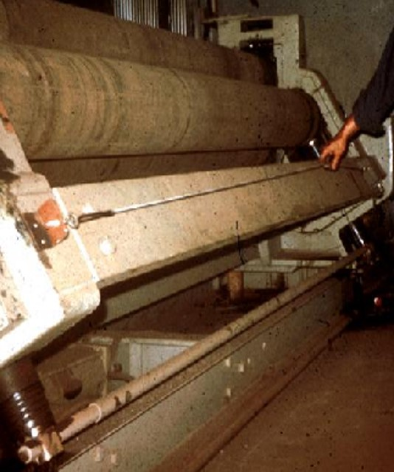
Safety Tripwire Cables
Speaker Notes: Picture from OSHA 10 Slide
Safety trip controls provide a quick means for deactivating the machine in an emergency situation. For example a pressure-sensitive body bar, when depressed, will deactivate the machine. If the operator or anyone trips, loses balance, or is drawn toward the machine, applying pressure to the bar will stop the operation. Trip-rods and trip-wires are also used in the same fashion. Tripwire cables must be manually reset to restart the machine.
Device located around the perimeter of or near the danger area
Operator must be able to reach the cable to stop the machine
Source: OSHA
Notes:
Picture from OSHA 10 Slide
Safety trip controls provide a quick means for deactivating the machine in an emergency situation. For example a pressure-sensitive body bar, when depressed, will deactivate the machine. If the operator or anyone trips, loses balance, or is drawn toward the machine, applying pressure to the bar will stop the operation. Trip-rods and trip-wires are also used in the same fashion. Tripwire cables must be manually reset to restart the machine.

Slide 49
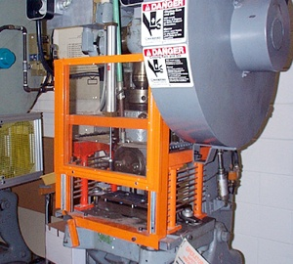
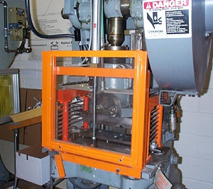
Gate
Speaker Notes: Picture from OSHA 10 slide
Power Press: Provides barrier between danger area and operator until completion of machine cycle. Another potential application of this type of device is where the gate is a component of a perimeter safeguarding system. Here the gate may provide protection not only to the operator but to pedestrian traffic as well.
Advantages: prevents operator from reaching into danger area during machine cycle; and provides protection from machine repeat.
Disadvantages: may require frequent inspection and regular maintenance; and may interfere with operator’s ability to see work.
On some machines, gate may only prevent access on the downstroke. This may increase production by allowing the operator to remove and feed the press on the upstroke.
Movable barrier device which protects the operator at the point of operation before the machine cycle can be started
If the gate does not fully close, machine will not function
Gate Open
Gate Closed
Source: OSHA
Source: OSHA
Notes:
Picture from OSHA 10 slide
Power Press: Provides barrier between danger area and operator until completion of machine cycle. Another potential application of this type of device is where the gate is a component of a perimeter safeguarding system. Here the gate may provide protection not only to the operator but to pedestrian traffic as well.
Advantages: prevents operator from reaching into danger area during machine cycle; and provides protection from machine repeat.
Disadvantages: may require frequent inspection and regular maintenance; and may interfere with operator’s ability to see work.
On some machines, gate may only prevent access on the downstroke. This may increase production by allowing the operator to remove and feed the press on the upstroke.

Slide 50
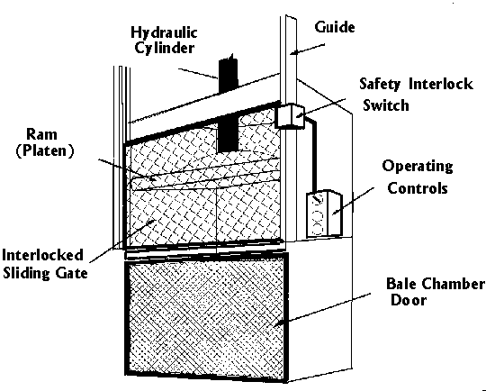
Gate
Vertical Downstroke Baler
Speaker Notes: When gate is lifted, interlock switch prevents baler from operating.
Picture from http://www.cdc.gov/niosh/hc14.html
Source: NIOSH
Notes:
When gate is lifted, interlock switch prevents baler from operating.
Picture from http://www.cdc.gov/niosh/hc14.html

Slide 51
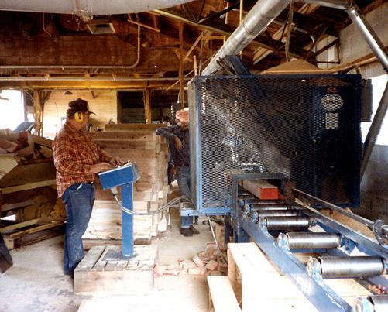
Safeguard by location/distance
Speaker Notes: Picture from OSHA 10 slide
One approach to safeguarding by location is shown in this photo. Operator controls may be located at a safe distance from the machine if there is no reason for the operator to tend it.
Another approach is to locate the machine so that a plant design feature, such as a wall, protects the worker and other personnel. Enclosure walls or fences can also restrict access to machines. Another possible solution is to have dangerous parts located high enough to be out of the normal reach of any worker.
Another example of a safe distance safeguarding method is the use of gravity feed methods that reduce or eliminate employee exposure to machine hazards as the part slides down a chute into the point of operation.
Position dangerous parts of machine in inaccessible areas during normal operation
  Moving parts more than 7 feet above floor
  Controlled access room
  Control station at safe distance from machine
Source: OSHA
Notes:
Picture from OSHA 10 slide
One approach to safeguarding by location is shown in this photo. Operator controls may be located at a safe distance from the machine if there is no reason for the operator to tend it.
Another approach is to locate the machine so that a plant design feature, such as a wall, protects the worker and other personnel. Enclosure walls or fences can also restrict access to machines. Another possible solution is to have dangerous parts located high enough to be out of the normal reach of any worker.
Another example of a safe distance safeguarding method is the use of gravity feed methods that reduce or eliminate employee exposure to machine hazards as the part slides down a chute into the point of operation.

Slide 52
Feeding and Ejection Methods
Speaker Notes: In these devices and employee places the part in a magazine which is then fed into the point of operation. Automatic and semiautomatic ejection methods include pneumatic (jet of air), magnetic, mechanical *such as an arm), or vacuum.
Automatic / semiautomatic feed
Automatic / semiautomatic ejection
Robots
Notes:
In these devices and employee places the part in a magazine which is then fed into the point of operation. Automatic and semiautomatic ejection methods include pneumatic (jet of air), magnetic, mechanical *such as an arm), or vacuum.

Slide 53
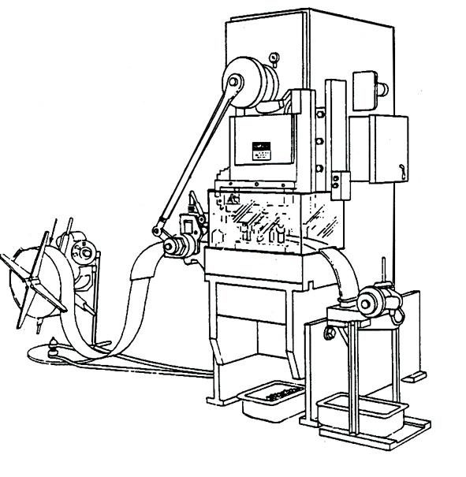
Automatic Feed
(shown on power press)
Speaker Notes: Picture from OSHA 3170
Many feeding and ejection methods do not require operators to place their hands in the danger area. In some cases, no operator involvement is necessary after the machine is set up. In other situations, operators can manually feed the stock with the assistance of a feeding mechanism. Properly designed ejection methods do not require operator involvement after the machine starts to function.
Using feeding and ejection methods does not eliminate the need for safeguarding. Guards and other devices must be used wherever they are necessary to provide protection from hazards.
Automatic feeds reduce the operator exposure during the work process, and sometimes do not require any effort by the operator after the machine is set up and running.
The power press shown in the photo above has an automatic feeding mechanism. Notice the transparent fixed enclosure guard at the danger area.
Transparent
Enclosure
Guard
Stock Feed
Roll
Danger
Area
Completed Work
Source: OSHA
Notes:
Picture from OSHA 3170
Many feeding and ejection methods do not require operators to place their hands in the danger area. In some cases, no operator involvement is necessary after the machine is set up. In other situations, operators can manually feed the stock with the assistance of a feeding mechanism. Properly designed ejection methods do not require operator involvement after the machine starts to function.
Using feeding and ejection methods does not eliminate the need for safeguarding. Guards and other devices must be used wherever they are necessary to provide protection from hazards.
Automatic feeds reduce the operator exposure during the work process, and sometimes do not require any effort by the operator after the machine is set up and running.
The power press shown in the photo above has an automatic feeding mechanism. Notice the transparent fixed enclosure guard at the danger area.

Slide 54
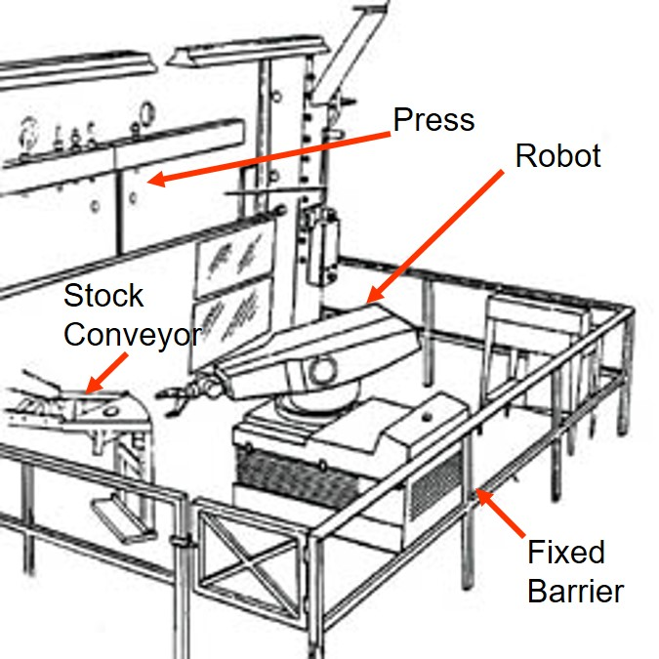
Robots
Speaker Notes: Pictures from OSHA 3170
Robots may create hazards themselves. If they do, appropriate guards must be used. The most common technique is to use perimeter guarding with interlocked gates.
The American National Standards Institute (ANSI) safety standard for industrial robots, ANSI/RIA R15.06-1999, presents certain basic requirements for protecting the worker. However, when a robot is used in a workplace, the employer should accomplish a comprehensive operational safety and health hazard analysis and then implement an effective safeguarding system which is fully responsive to the situation. [Various effective safeguarding techniques are described in ANSI B11.19-1990 (R1997).]
Studies in Sweden and Japan indicate that many robot accidents did not occur under normal operating conditions, but rather during programming, program touch-up, maintenance, repair, testing, setup, or adjustment. During these operations, workers may temporarily be within the robot’s working envelope where unintended operation could result in injuries.
Machines that load and unload stock, assemble parts, transfer objects, or perform other tasks
Best used in high-production processes requiring repeated routines where they prevent other hazards to employees
Source: OSHA
Notes:
Pictures from OSHA 3170
Robots may create hazards themselves. If they do, appropriate guards must be used. The most common technique is to use perimeter guarding with interlocked gates.
The American National Standards Institute (ANSI) safety standard for industrial robots, ANSI/RIA R15.06-1999, presents certain basic requirements for protecting the worker. However, when a robot is used in a workplace, the employer should accomplish a comprehensive operational safety and health hazard analysis and then implement an effective safeguarding system which is fully responsive to the situation. [Various effective safeguarding techniques are described in ANSI B11.19-1990 (R1997).]
Studies in Sweden and Japan indicate that many robot accidents did not occur under normal operating conditions, but rather during programming, program touch-up, maintenance, repair, testing, setup, or adjustment. During these operations, workers may temporarily be within the robot’s working envelope where unintended operation could result in injuries.

Slide 55
Miscellaneous
Awareness Barriers
Protective Shields
Hand tools

Slide 56

Awareness Devices
Alert employees to hazard
  Signs
  Awareness signals (audible or visual)
  Awareness barriers (allows access to machine danger areas, but is designed to contact employee, creating an awareness that employee is close to danger point)
  Awareness barriers (allows access to machine danger areas, but is designed to contact employee, creating an awareness that employee is close to danger point)

Slide 57
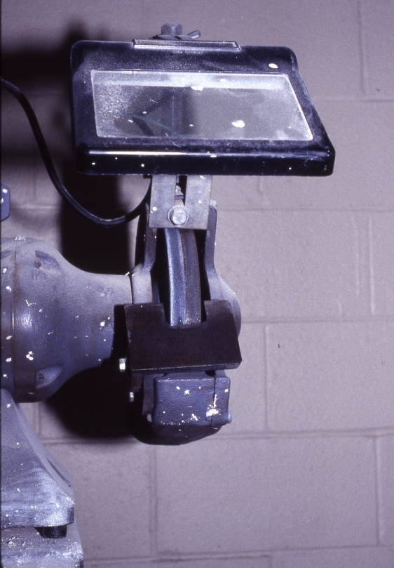
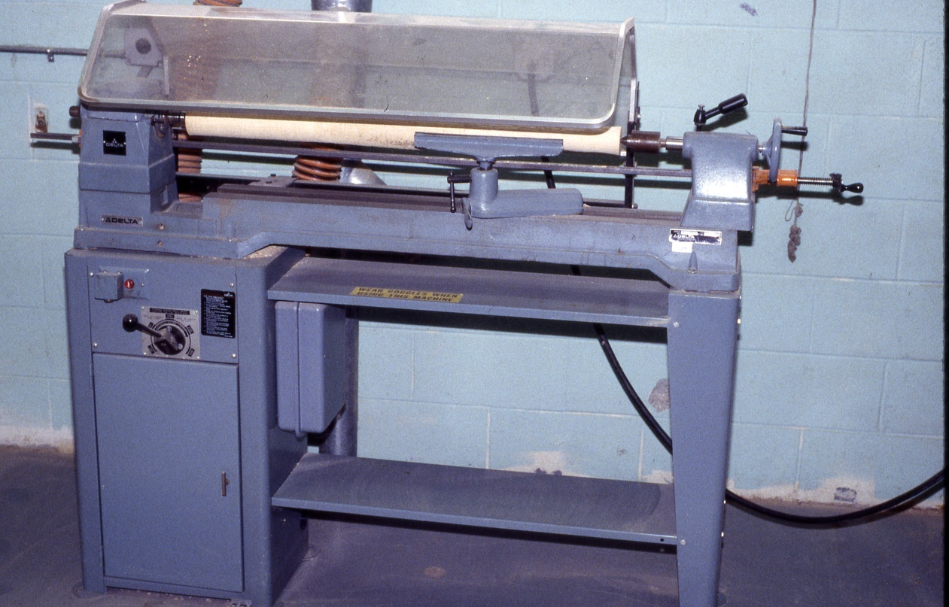
Protective Shields
These do not give complete protection from machine hazards, but do provide some protection from flying particles, splashing cutting oils, or coolants.
Source: NJAFL-CIO
Source: NJAFL-CIO
Notes:
Picture Source = NJ AFL-CIO
Miscellaneous aids, such as these, do not give complete protection from machine hazards, but may provide the operator with an extra margin of safety.

Slide 58
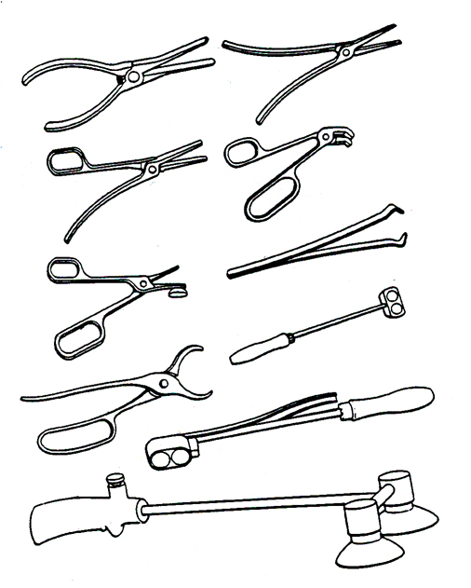
Holding Tools
Speaker Notes: Picture from OSHA 3067
1910.212(a)(3)(iii) Special handtools for placing and removing material shall be such as to permit easy handling of material without the operator placing a hand in the danger zone. Such tools shall not be in lieu of other guarding required by this section, but can only be used to supplement protection provided.
Used to place and remove stock in the danger area
Not to be used instead of other machine safeguards, but as a supplement
Source: OSHA
Notes:
Picture from OSHA 3067
1910.212(a)(3)(iii) Special handtools for placing and removing material shall be such as to permit easy handling of material without the operator placing a hand in the danger zone. Such tools shall not be in lieu of other guarding required by this section, but can only be used to supplement protection provided.

Slide 59
General Requirements for Safeguards
Fixed guards should be used whenever possible
Prevent contact
Secure, tamper-resistant, and durable
Protect from falling objects
Create no new hazards
Create no interference
Allow safe lubrication and maintenance
Speaker Notes:
Fixed Guards – Offer the best protection because they don’t require worker adjustment.
Prevent Contact – Prevent worker’s body or clothing from contacting hazardous moving parts. A good safeguarding system eliminates the possibility of the operator or other workers placing parts of their bodies near hazardous moving parts.
Secure – firmly secured to machine and not easily removed. A safeguard that can easily be made ineffective is no safeguard at all. Guards and safety devices should be made of durable material that will withstand the conditions of normal use and be firmly secured to the machine.
Protect from falling objects – Ensure that no objects can fall into moving parts. A small tool which is dropped into a cycling machine could easily become a projectile that could strike and injure someone.
Create no new hazards – Must not have shear points, jagged edges or unfinished surfaces. A safeguard defeats its own purpose if it creates a hazard of its own such as a shear point, a jagged edge, or an unfinished surface which can cause a laceration. The edges of guards, for instance, should be rolled or bolted in such a way that they eliminate sharp edges.
Create no interference – Must not prevent worker from performing the job quickly and comfortably. Any safeguard which impedes a worker from performing a job quickly and comfortably might soon be overridden or disregarded. Proper safeguarding can actually enhance efficiency since it can relieve the worker’s apprehensions about injury.
Allow safe lubrication – If possible, be able to lubricate the machine without removing the safeguards. Locating oil reservoirs outside the guard, with a line leading to the lubrication point, will reduce the need for the worker to enter the hazardous area.
Notes:
Fixed Guards – Offer the best protection because they don’t require worker adjustment.
Prevent Contact – Prevent worker’s body or clothing from contacting hazardous moving parts. A good safeguarding system eliminates the possibility of the operator or other workers placing parts of their bodies near hazardous moving parts.
Secure – firmly secured to machine and not easily removed. A safeguard that can easily be made ineffective is no safeguard at all. Guards and safety devices should be made of durable material that will withstand the conditions of normal use and be firmly secured to the machine.
Protect from falling objects – Ensure that no objects can fall into moving parts. A small tool which is dropped into a cycling machine could easily become a projectile that could strike and injure someone.
Create no new hazards – Must not have shear points, jagged edges or unfinished surfaces. A safeguard defeats its own purpose if it creates a hazard of its own such as a shear point, a jagged edge, or an unfinished surface which can cause a laceration. The edges of guards, for instance, should be rolled or bolted in such a way that they eliminate sharp edges.
Create no interference – Must not prevent worker from performing the job quickly and comfortably. Any safeguard which impedes a worker from performing a job quickly and comfortably might soon be overridden or disregarded. Proper safeguarding can actually enhance efficiency since it can relieve the worker’s apprehensions about injury.
Allow safe lubrication – If possible, be able to lubricate the machine without removing the safeguards. Locating oil reservoirs outside the guard, with a line leading to the lubrication point, will reduce the need for the worker to enter the hazardous area.

Slide 60
Machinery: General Safety Principles
Securely fasten equipment to eliminate movement or “walking”
No loose clothing, long hair, jewelry, or gloves around rotating machine parts
Respect machine guards
Keep electrical cords and plugs intact
Inspect machinery before each use
Speaker Notes: 1910.212(b) Anchoring fixed machinery. Machines designed for a fixed location shall be securely anchored to prevent walking or moving.
Notes:
1910.212(b) Anchoring fixed machinery. Machines designed for a fixed location shall be securely anchored to prevent walking or moving.

Slide 61
Machinery: General Safety Principles cont.
Do not leave machines running and unattended
Never attend to brush debris from the table surface while the machine is running
An active brake mechanism adds greatly to safety
Easily reached “off” switch increases safety

Slide 62
Machine Safety Responsibilities
Management
  ensure all machinery is properly guarded
Supervisors
  train employees on specific guard rules in their areas
  ensure machine guards remain in place and are functional
  immediately correct machine guard deficiencies

Slide 63
Machine Safety Responsibilities cont.
Employees
  do not remove guards unless machine is locked and tagged
  report machine guard problems to supervisors immediately
  do not operate equipment unless guards are in place

Slide 64
Employee Training
Hazards associated with particular machines
How the safeguards provide protection and the hazards for which they are intended
How and why to use the safeguards
How and when safeguards can be removed and by whom
What to do if a safeguard is damaged, missing, or unable to provide adequate protection

Slide 65
Machine Guarding Checklist
Checklist (Optional)

Slide 66
Machine Guarding
Case Studies
Case Studies
(Optional)
Case Studies (Optional)

Slide 67
Control of Hazardous Energy
Lockout/Tagout (LOTO)
29 CFR 1910.147

Slide 68
LOTO Purpose
To prevent serious injury or death from the unexpected release of stored energy during servicing and maintenance of machines
To establish procedures to physically isolate stored energy from the equipment being serviced or repaired
Speaker Notes: Examples: 1) a guard needs to be removed to do the work; 2) a steam valve is automatically turned on burning workers who are repairing a downstream connection in the piping; 3) a jammed conveyor system suddenly releases, crushing a worker who is trying to clear the jam; 4) internal wiring on a piece of factory equipment electrically shorts, shocking worker who is repairing the equipment. [https://www.osha.gov/SLTC/controlhazardousenergy/index.html]
Notes:
Examples: 1) a guard needs to be removed to do the work; 2) a steam valve is automatically turned on burning workers who are repairing a downstream connection in the piping; 3) a jammed conveyor system suddenly releases, crushing a worker who is trying to clear the jam; 4) internal wiring on a piece of factory equipment electrically shorts, shocking worker who is repairing the equipment. [https://www.osha.gov/SLTC/controlhazardousenergy/index.html]

Slide 69
Types of Stored Energy
Needing Isolation
Electrical
Mechanical
Hydraulic
Pneumatic
Chemicals
Thermal
Other energy sources
Speaker Notes: OSHA Lockout/Tagout Fact Sheet: https://www.osha.gov/OshDoc/data_General_Facts/factsheet-lockout-tagout.pdf
1910.147(b) Definitions applicable to this section.
Energy source. Any source of electrical, mechanical, hydraulic, pneumatic, chemical, thermal, or other energy.
Notes:
OSHA Lockout/Tagout Fact Sheet: https://www.osha.gov/OshDoc/data_General_Facts/factsheet-lockout-tagout.pdf
1910.147(b) Definitions applicable to this section.
Energy source. Any source of electrical, mechanical, hydraulic, pneumatic, chemical, thermal, or other energy.

Slide 70
LOTO Applies
Speaker Notes: https://www.cdc.gov/niosh/docs/wp-solutions/2011-156/pdfs/2011-156.pdf
1910.147(a)(2) Application.
1910.147(a)(2)(i) This standard applies to the control of energy during servicing and/or maintenance of machines and equipment.
When servicing and maintaining equipment, and unexpected startup of the machine or released of stored energy could occur
When, during normal production, workers must remove or bypass a guard or safety device
When, during normal production, workers place and part of their body into the danger zone or near the machine’s point of operation
During all set up activities
Notes:
https://www.cdc.gov/niosh/docs/wp-solutions/2011-156/pdfs/2011-156.pdf
1910.147(a)(2) Application.
1910.147(a)(2)(i) This standard applies to the control of energy during servicing and/or maintenance of machines and equipment.

Slide 71
LOTO Exemption
Normal Production Operations
Speaker Notes: 1910.147(a)(2)(ii) Normal production operations are not covered by this standard (See Subpart O of this Part). Servicing and/or maintenance which takes place during normal production operations is covered by this standard only if:
  1910.147(a)(2)(ii)(A) An employee is required to remove or bypass a guard or other safety device; or
  1910.147(a)(2)(ii)(B) An employee is required to place any part of his or her body into an area on a machine or piece of equipment where work is actually performed upon the material being processed (point of operation) or where an associated danger zone exists during a machine operating cycle.
  Note: Exception to paragraph (a)(2)(ii): Minor tool changes and adjustments, and other minor servicing activities, which take place during normal production operations, are not covered by this standard if they are routine, repetitive, and integral to the use of the equipment for production, provided that the work is performed using alternative measures which provide effective protection (See Subpart O of this Part).
Routine, repetitive, & integral to production
Guards/safety devices not bypassed
Body part not placed in the point of operation or other dangerous area during machine cycle
Need to use alternative measures for protection
Notes:
1910.147(a)(2)(ii) Normal production operations are not covered by this standard (See Subpart O of this Part). Servicing and/or maintenance which takes place during normal production operations is covered by this standard only if:
1910.147(a)(2)(ii)(A) An employee is required to remove or bypass a guard or other safety device; or
1910.147(a)(2)(ii)(B) An employee is required to place any part of his or her body into an area on a machine or piece of equipment where work is actually performed upon the material being processed (point of operation) or where an associated danger zone exists during a machine operating cycle.
Note: Exception to paragraph (a)(2)(ii): Minor tool changes and adjustments, and other minor servicing activities, which take place during normal production operations, are not covered by this standard if they are routine, repetitive, and integral to the use of the equipment for production, provided that the work is performed using alternative measures which provide effective protection (See Subpart O of this Part).

Slide 72
LOTO Exemption
Cord & Plug Connected Equipment
Plug is only source of energy
Plug is under continuous control of one person
Cord is unplugged from energy source
Speaker Notes: 1910.147(a)(2)(iii) This standard does not apply to the following:
1910.147(a)(2)(iii)(A) Work on cord and plug connected electric equipment for which exposure to the hazards of unexpected energization or start up of the equipment is controlled by the unplugging of the equipment from the energy source and by the plug being under the exclusive control of the employee performing the servicing or maintenance.
Notes:
1910.147(a)(2)(iii) This standard does not apply to the following:
1910.147(a)(2)(iii)(A) Work on cord and plug connected electric equipment for which exposure to the hazards of unexpected energization or start up of the equipment is controlled by the unplugging of the equipment from the energy source and by the plug being under the exclusive control of the employee performing the servicing or maintenance.

Slide 73
Important LOTO Elements
Speaker Notes: https://blogs.cdc.gov/niosh-science-blog/2014/07/07/loto/
Written procedures
Documentation of each source of energy
Locking and tagging devices
Verification of energy isolation
Proper locks at proper places (isolation points)
Training (including skills demonstration) in the primary language(s) of employees.
Auditing of work process
Notes:
https://blogs.cdc.gov/niosh-science-blog/2014/07/07/loto/

Slide 74
Worker Categories
Speaker Notes: 1910.147(b) Definitions applicable to this section.
Authorized employee. A person who locks out or tags out machines or equipment in order to perform servicing or maintenance on that machine or equipment. An affected employee becomes an authorized employee when that employee's duties include performing servicing or maintenance covered under this section.
Affected employee. An employee whose job requires him/her to operate or use a machine or equipment on which servicing or maintenance is being performed under lockout or tagout, or whose job requires him/her to work in an area in which such servicing or maintenance is being performed.
Authorized employee – Person who does LOTO to perform servicing
Affected employee – Person required to use machines/equipment on which servicing is performed under LOTO or who must work in such an area
Other employees – All employees who are or may be in an area were LOTO may be utilized
Notes:
1910.147(b) Definitions applicable to this section.
Authorized employee. A person who locks out or tags out machines or equipment in order to perform servicing or maintenance on that machine or equipment. An affected employee becomes an authorized employee when that employee's duties include performing servicing or maintenance covered under this section.
Affected employee. An employee whose job requires him/her to operate or use a machine or equipment on which servicing or maintenance is being performed under lockout or tagout, or whose job requires him/her to work in an area in which such servicing or maintenance is being performed.

Slide 75
LOTO Steps Shutdown
Speaker Notes: https://www.osha.gov/pls/oshaweb/owadisp.show_document?p_table=STANDARDS&p_id=9805
Sequence of Lockout
(1) Notify all affected employees that servicing or maintenance is required on a machine or equipment and that the machine or equipment must be shut down and locked out to perform the servicing or maintenance.
________________________
Name(s)/Job Title(s) of affected employees and how to notify.
(2) The authorized employee shall refer to the company procedure to identify the type and magnitude of the energy that the machine or equipment utilizes, shall understand the hazards of the energy, and shall know the methods to control the energy.
________________________
Type(s) and magnitude(s) of energy, its hazards and the methods to control the energy.
(3) If the machine or equipment is operating, shut it down by the normal stopping procedure (depress the stop button, open switch, close valve, etc.).
________________________
Type(s) and location(s) of machine or equipment operating controls.
(4) De-activate the energy isolating device(s) so that the machine or equipment is isolated from the energy source(s).
________________________
Type(s) and location(s) of energy isolating devices.
(5) Lock out the energy isolating device(s) with assigned individual lock(s).
(6) Stored or residual energy (such as that in capacitors, springs, elevated machine members, rotating flywheels, hydraulic systems, and air, gas, steam, or water pressure, etc.) must be dissipated or restrained by methods such as grounding, repositioning, blocking, bleeding down, etc.
________________________
Type(s) of stored energy - methods to dissipate or restrain.
(7) Ensure that the equipment is disconnected from the energy source(s) by first checking that no personnel are exposed, then verify the isolation of the equipment by operating the push button or other normal operating control(s) or by testing to make certain the equipment will not operate.
Caution: Return operating control(s) to neutral or "off" position after verifying the isolation of the equipment.
________________________
Method of verifying the isolation of the equipment.
(8) The machine or equipment is now locked out.
Notify affected employees
Prepare for LOTO: review LOTO procedures, identify energy sources, confirm LOTO methods to be used and obtain necessary LOTO equipment
Shutdown machine following normal procedures
De-activate energy isolating devices
Notes:
https://www.osha.gov/pls/oshaweb/owadisp.show_document?p_table=STANDARDS&p_id=9805
Sequence of Lockout
(1) Notify all affected employees that servicing or maintenance is required on a machine or equipment and that the machine or equipment must be shut down and locked out to perform the servicing or maintenance.
________________________
Name(s)/Job Title(s) of affected employees and how to notify.
(2) The authorized employee shall refer to the company procedure to identify the type and magnitude of the energy that the machine or equipment utilizes, shall understand the hazards of the energy, and shall know the methods to control the energy.
________________________
Type(s) and magnitude(s) of energy, its hazards and the methods to control the energy.
(3) If the machine or equipment is operating, shut it down by the normal stopping procedure (depress the stop button, open switch, close valve, etc.).
________________________
Type(s) and location(s) of machine or equipment operating controls.
(4) De-activate the energy isolating device(s) so that the machine or equipment is isolated from the energy source(s).
________________________
Type(s) and location(s) of energy isolating devices.
(5) Lock out the energy isolating device(s) with assigned individual lock(s).
(6) Stored or residual energy (such as that in capacitors, springs, elevated machine members, rotating flywheels, hydraulic systems, and air, gas, steam, or water pressure, etc.) must be dissipated or restrained by methods such as grounding, repositioning, blocking, bleeding down, etc.
________________________
Type(s) of stored energy - methods to dissipate or restrain.
(7) Ensure that the equipment is disconnected from the energy source(s) by first checking that no personnel are exposed, then verify the isolation of the equipment by operating the push button or other normal operating control(s) or by testing to make certain the equipment will not operate.
Caution: Return operating control(s) to neutral or "off" position after verifying the isolation of the equipment.
________________________
Method of verifying the isolation of the equipment.
(8) The machine or equipment is now locked out.

Slide 76
LOTO Steps Shutdown cont.
Lock out the energy isolating device(s)
Dissipate or restrain stored or residual energy
Verify machine is disconnected from the energy source(s)
Speaker Notes: https://www.osha.gov/pls/oshaweb/owadisp.show_document?p_table=STANDARDS&p_id=9805
Notes:
https://www.osha.gov/pls/oshaweb/owadisp.show_document?p_table=STANDARDS&p_id=9805

Slide 77
LOTO Steps Startup
Speaker Notes: https://www.osha.gov/pls/oshaweb/owadisp.show_document?p_table=STANDARDS&p_id=9805
Restoring Equipment to Service. When the servicing or maintenance is completed and the machine or equipment is ready to return to normal operating condition, the following steps shall be taken.
(1) Check the machine or equipment and the immediate area around the machine to ensure that nonessential items have been removed and that the machine or equipment components are operationally intact.
(2) Check the work area to ensure that all employees have been safely positioned or removed from the area.
(3) Verify that the controls are in neutral.
(4) Remove the lockout devices and reenergize the machine or equipment.
Note: The removal of some forms of blocking may require reenergization of of the machine before safe removal.
(5) Notify affected employees that the servicing or maintenance is completed and the machine or equipment is ready for use.
Inspect machine and surrounding area to ensure machine ready for normal operation
Ensure affected employees are away from hazards
Remove locks and tags from isolation devices and reenergize machine
Notify affected employees of restart and verify machine is working properly
Notes:
https://www.osha.gov/pls/oshaweb/owadisp.show_document?p_table=STANDARDS&p_id=9805
Restoring Equipment to Service. When the servicing or maintenance is completed and the machine or equipment is ready to return to normal operating condition, the following steps shall be taken.
(1) Check the machine or equipment and the immediate area around the machine to ensure that nonessential items have been removed and that the machine or equipment components are operationally intact.
(2) Check the work area to ensure that all employees have been safely positioned or removed from the area.
(3) Verify that the controls are in neutral.
(4) Remove the lockout devices and reenergize the machine or equipment.
Note: The removal of some forms of blocking may require reenergization of of the machine before safe removal.
(5) Notify affected employees that the servicing or maintenance is completed and the machine or equipment is ready for use.

Slide 78
Energy Isolating Devices
Speaker notes: 1910.147(b) Definitions applicable to this section.
Energy isolating device. A mechanical device that physically prevents the transmission or release of energy, including but not limited to the following: A manually operated electrical circuit breaker; a disconnect switch; a manually operated switch by which the conductors of a circuit can be disconnected from all ungrounded supply conductors, and, in addition, no pole can be operated independently; a line valve; a block; and any similar device used to block or isolate energy. Push buttons, selector switches and other control circuit type devices are not energy isolating devices.
Device that physically prevents the transmission or release of energy
Includes: electrical circuit breakers, disconnect switches, line valves and a blocks
Excludes: push buttons and selector switches
Notes:
1910.147(b) Definitions applicable to this section.
Energy isolating device. A mechanical device that physically prevents the transmission or release of energy, including but not limited to the following: A manually operated electrical circuit breaker; a disconnect switch; a manually operated switch by which the conductors of a circuit can be disconnected from all ungrounded supply conductors, and, in addition, no pole can be operated independently; a line valve; a block; and any similar device used to block or isolate energy. Push buttons, selector switches and other control circuit type devices are not energy isolating devices.

Slide 79
LOTO Devices
Speaker Notes: 1910.147(b) Definitions applicable to this section.
Lockout device. A device that utilizes a positive means such as a lock, either key or combination type, to hold an energy isolating device in the safe position and prevent the energizing of a machine or equipment. Included are blank flanges and bolted slip blinds.
Tagout device. A prominent warning device, such as a tag and a means of attachment, which can be securely fastened to an energy isolating device in accordance with an established procedure, to indicate that the energy isolating device and the equipment being controlled may not be operated until the tagout device is removed.
1910.147(c)(5) Protective materials and hardware.
1910.147(c)(5)(i) Locks, tags, chains, wedges, key blocks, adapter pins, self-locking fasteners, or other hardware shall be provided by the employer for isolating, securing or blocking of machines or equipment from energy sources.
1910.147(c)(5)(ii) Lockout devices and tagout devices shall be singularly identified; shall be the only devices(s) used for controlling energy; shall not be used for other purposes; and shall meet the following requirements:
1910.147(c)(5)(ii)(A) Durable.
1910.147(c)(5)(ii)(A)(1)Lockout and tagout devices shall be capable of withstanding the environment to which they are exposed for the maximum period of time that exposure is expected.
1910.147(c)(5)(ii)(A)(2)Tagout devices shall be constructed and printed so that exposure to weather conditions or wet and damp locations will not cause the tag to deteriorate or the message on the tag to become illegible.
1910.147(c)(5)(ii)(A)(3)Tags shall not deteriorate when used in corrosive environments such as areas where acid and alkali chemicals are handled and stored.
1910.147(c)(5)(ii)(B) Standardized. Lockout and tagout devices shall be standardized within the facility in at least one of the following criteria: Color; shape; or size; and additionally, in the case of tagout devices, print and format shall be standardized.
1910.147(c)(5)(ii)(C) Substantial -
1910.147(c)(5)(ii)(C)(1)Lockout devices. Lockout devices shall be substantial enough to prevent removal without the use of excessive force or unusual techniques, such as with the use of bolt cutters or other metal cutting tools.
1910.147(c)(5)(ii)(C)(2)Tagout devices. Tagout devices, including their means of attachment, shall be substantial enough to prevent inadvertent or accidental removal. Tagout device attachment means shall be of a non-reusable type, attachable by hand, self-locking, and non-releasable with a minimum unlocking strength of no less than 50 pounds and having the general design and basic characteristics of being at least equivalent to a one-piece, all environment-tolerant nylon cable tie.
1910.147(c)(5)(ii)(D)Identifiable. Lockout devices and tagout devices shall indicate the identity of the employee applying the device(s).
1910.147(c)(5)(iii)Tagout devices shall warn against hazardous conditions if the machine or equipment is energized and shall include a legend such as the following: Do Not Start. Do Not Open. Do Not Close. Do Not Energize. Do Not Operate.
Includes locks, tags, chains, wedges, key blocks, and self-locking fasteners
Uniquely identified and used only for controlling energy
Durable
Standardized
Substantial
Identify employee applying device
Tags must have special warnings
Notes:
1910.147(b) Definitions applicable to this section.
Lockout device. A device that utilizes a positive means such as a lock, either key or combination type, to hold an energy isolating device in the safe position and prevent the energizing of a machine or equipment. Included are blank flanges and bolted slip blinds.
Tagout device. A prominent warning device, such as a tag and a means of attachment, which can be securely fastened to an energy isolating device in accordance with an established procedure, to indicate that the energy isolating device and the equipment being controlled may not be operated until the tagout device is removed.
1910.147(c)(5) Protective materials and hardware.
1910.147(c)(5)(i) Locks, tags, chains, wedges, key blocks, adapter pins, self-locking fasteners, or other hardware shall be provided by the employer for isolating, securing or blocking of machines or equipment from energy sources.
1910.147(c)(5)(ii) Lockout devices and tagout devices shall be singularly identified; shall be the only devices(s) used for controlling energy; shall not be used for other purposes; and shall meet the following requirements:
1910.147(c)(5)(ii)(A) Durable.
1910.147(c)(5)(ii)(A)(1)Lockout and tagout devices shall be capable of withstanding the environment to which they are exposed for the maximum period of time that exposure is expected.
1910.147(c)(5)(ii)(A)(2)Tagout devices shall be constructed and printed so that exposure to weather conditions or wet and damp locations will not cause the tag to deteriorate or the message on the tag to become illegible.
1910.147(c)(5)(ii)(A)(3)Tags shall not deteriorate when used in corrosive environments such as areas where acid and alkali chemicals are handled and stored.
1910.147(c)(5)(ii)(B) Standardized. Lockout and tagout devices shall be standardized within the facility in at least one of the following criteria: Color; shape; or size; and additionally, in the case of tagout devices, print and format shall be standardized.
1910.147(c)(5)(ii)(C) Substantial -
1910.147(c)(5)(ii)(C)(1)Lockout devices. Lockout devices shall be substantial enough to prevent removal without the use of excessive force or unusual techniques, such as with the use of bolt cutters or other metal cutting tools.
1910.147(c)(5)(ii)(C)(2)Tagout devices. Tagout devices, including their means of attachment, shall be substantial enough to prevent inadvertent or accidental removal. Tagout device attachment means shall be of a non-reusable type, attachable by hand, self-locking, and non-releasable with a minimum unlocking strength of no less than 50 pounds and having the general design and basic characteristics of being at least equivalent to a one-piece, all environment-tolerant nylon cable tie.
1910.147(c)(5)(ii)(D)Identifiable. Lockout devices and tagout devices shall indicate the identity of the employee applying the device(s).
1910.147(c)(5)(iii)Tagout devices shall warn against hazardous conditions if the machine or equipment is energized and shall include a legend such as the following: Do Not Start. Do Not Open. Do Not Close. Do Not Energize. Do Not Operate.

Slide 80
Training
Speaker Notes: 1910.147(c)(7)Training and communication.
1910.147(c)(7)(i)The employer shall provide training to ensure that the purpose and function of the energy control program are understood by employees and that the knowledge and skills required for the safe application, usage, and removal of the energy controls are acquired by employees. The training shall include the following:
1910.147(c)(7)(i)(A)Each authorized employee shall receive training in the recognition of applicable hazardous energy sources, the type and magnitude of the energy available in the workplace, and the methods and means necessary for energy isolation and control.
1910.147(c)(7)(i)(B)Each affected employee shall be instructed in the purpose and use of the energy control procedure.
1910.147(c)(7)(i)(C)All other employees whose work operations are or may be in an area where energy control procedures may be utilized, shall be instructed about the procedure, and about the prohibition relating to attempts to restart or reenergize machines or equipment which are locked out or tagged out.
1910.147(c)(7)(ii)When tagout systems are used, employees shall also be trained in the following limitations of tags:
1910.147(c)(7)(ii)(A)Tags are essentially warning devices affixed to energy isolating devices, and do not provide the physical restraint on those devices that is provided by a lock.
1910.147(c)(7)(ii)(B)When a tag is attached to an energy isolating means, it is not to be removed without authorization of the authorized person responsible for it, and it is never to be bypassed, ignored, or otherwise defeated.
1910.147(c)(7)(ii)(C)Tags must be legible and understandable by all authorized employees, affected employees, and all other employees whose work operations are or may be in the area, in order to be effective.
1910.147(c)(7)(ii)(D)Tags and their means of attachment must be made of materials which will withstand the environmental conditions encountered in the workplace.
1910.147(c)(7)(ii)(E)Tags may evoke a false sense of security, and their meaning needs to be understood as part of the overall energy control program.
1910.147(c)(7)(ii)(F)Tags must be securely attached to energy isolating devices so that they cannot be inadvertently or accidentally detached during use.
1910.147(c)(7)(iv)The employer shall certify that employee training has been accomplished and is being kept up to date. The certification shall contain each employee's name and dates of training.
All employees must be trained based on worker categories
Must ensure employees understand LOTO program
Must address limitations of tags if they are used as part of LOTO
Notes:
1910.147(c)(7)Training and communication.
1910.147(c)(7)(i)The employer shall provide training to ensure that the purpose and function of the energy control program are understood by employees and that the knowledge and skills required for the safe application, usage, and removal of the energy controls are acquired by employees. The training shall include the following:
1910.147(c)(7)(i)(A)Each authorized employee shall receive training in the recognition of applicable hazardous energy sources, the type and magnitude of the energy available in the workplace, and the methods and means necessary for energy isolation and control.
1910.147(c)(7)(i)(B)Each affected employee shall be instructed in the purpose and use of the energy control procedure.
1910.147(c)(7)(i)(C)All other employees whose work operations are or may be in an area where energy control procedures may be utilized, shall be instructed about the procedure, and about the prohibition relating to attempts to restart or reenergize machines or equipment which are locked out or tagged out.
1910.147(c)(7)(ii)When tagout systems are used, employees shall also be trained in the following limitations of tags:
1910.147(c)(7)(ii)(A)Tags are essentially warning devices affixed to energy isolating devices, and do not provide the physical restraint on those devices that is provided by a lock.
1910.147(c)(7)(ii)(B)When a tag is attached to an energy isolating means, it is not to be removed without authorization of the authorized person responsible for it, and it is never to be bypassed, ignored, or otherwise defeated.
1910.147(c)(7)(ii)(C)Tags must be legible and understandable by all authorized employees, affected employees, and all other employees whose work operations are or may be in the area, in order to be effective.
1910.147(c)(7)(ii)(D)Tags and their means of attachment must be made of materials which will withstand the environmental conditions encountered in the workplace.
1910.147(c)(7)(ii)(E)Tags may evoke a false sense of security, and their meaning needs to be understood as part of the overall energy control program.
1910.147(c)(7)(ii)(F)Tags must be securely attached to energy isolating devices so that they cannot be inadvertently or accidentally detached during use.
1910.147(c)(7)(iv)The employer shall certify that employee training has been accomplished and is being kept up to date. The certification shall contain each employee's name and dates of training.

Slide 81
Retraining
Speaker Notes: 1910.147(c)(7)Training and communication.
1910.147(c)(7)(iii)Employee retraining.
1910.147(c)(7)(iii)(A)Retraining shall be provided for all authorized and affected employees whenever there is a change in their job assignments, a change in machines, equipment or processes that present a new hazard, or when there is a change in the energy control procedures.
1910.147(c)(7)(iii)(B)Additional retraining shall also be conducted whenever a periodic inspection under paragraph (c)(6) of this section reveals, or whenever the employer has reason to believe that there are deviations from or inadequacies in the employee's knowledge or use of the energy control procedures.
1910.147(c)(7)(iii)(C)The retraining shall reestablish employee proficiency and introduce new or revised control methods and procedures, as necessary.
Authorized/Affected Employees: when change in job, change in machines and change in LOTO program
When evidence indicates employees lack knowledge of LOTO program
Notes:
1910.147(c)(7)Training and communication.
1910.147(c)(7)(iii)Employee retraining.
1910.147(c)(7)(iii)(A)Retraining shall be provided for all authorized and affected employees whenever there is a change in their job assignments, a change in machines, equipment or processes that present a new hazard, or when there is a change in the energy control procedures.
1910.147(c)(7)(iii)(B)Additional retraining shall also be conducted whenever a periodic inspection under paragraph (c)(6) of this section reveals, or whenever the employer has reason to believe that there are deviations from or inadequacies in the employee's knowledge or use of the energy control procedures.
1910.147(c)(7)(iii)(C)The retraining shall reestablish employee proficiency and introduce new or revised control methods and procedures, as necessary.

Slide 82
Some Examples of Machine Guarding

Slide 83
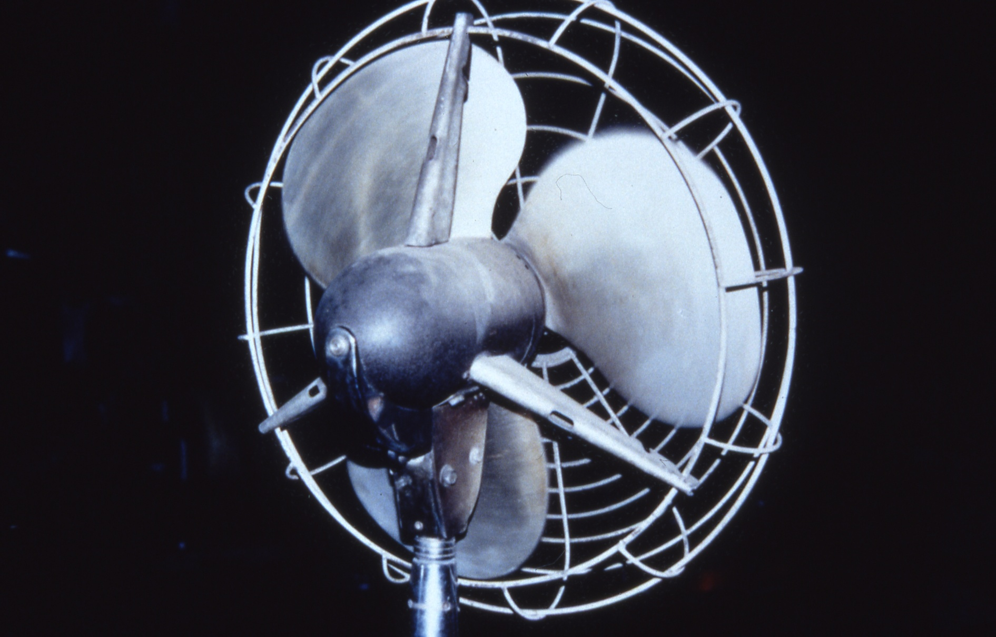
Unguarded Fan Blade
Source: NJAFL-CIO
Speaker notes:
Picture source = NJ AFL-CIO
1910.212(a)(5)
Notes:
Picture source = NJ AFL-CIO
1910.212(a)(5)

Slide 84
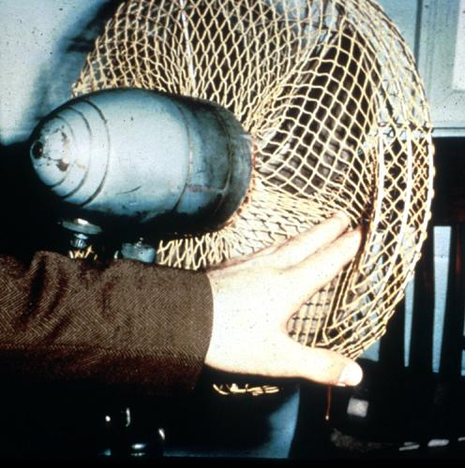
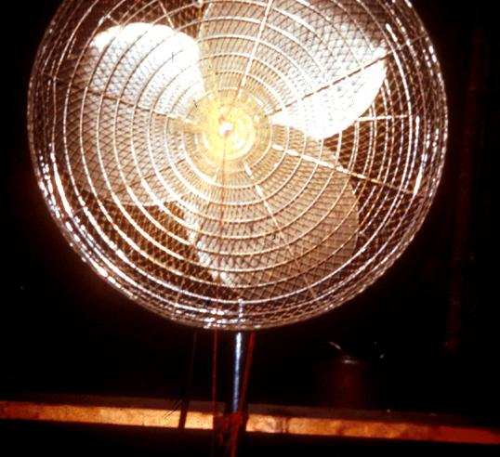
Guarding Fan Blades
When the periphery of the blades of a fan is less than 7 feet above the floor or working level, the blades must be guarded with a guard having openings no larger than 1/2 inch.
Source: OSHA
Source: OSHA
Notes:
Pictures form OSHA 10 slide
1910.212(a)(5) Exposure of blades. When the periphery of the blades of a fan is less than seven (7) feet above the floor or working level, the blades shall be guarded. The guard shall have openings no larger than one-half (1/2) inch.

Slide 85
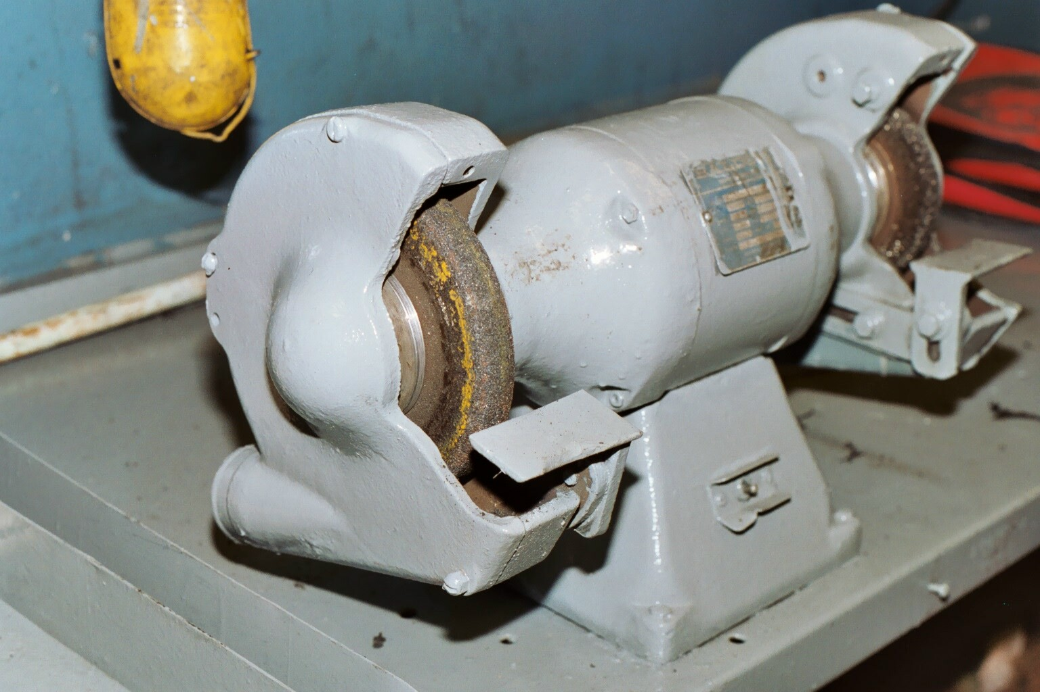
Abrasive Wheel Machinery
Improper Work Rest and Tongue
Source: NJAFL-CIO
Speaker Notes: Picture source = NJ AFL-CIO
1910.215(a)(4) Work rests. On offhand grinding machines, work rests shall be used to support the work. They shall be of rigid construction and designed to be adjustable to compensate for wheel wear. Work rests shall be kept adjusted closely to the wheel with a maximum opening of one-eighth inch to prevent the work from being jammed between the wheel and the rest, which may cause wheel breakage. The work rest shall be securely clamped after each adjustment. The adjustment shall not be made with the wheel in motion.
Notes:
Picture source = NJ AFL-CIO
1910.215(a)(4) Work rests. On offhand grinding machines, work rests shall be used to support the work. They shall be of rigid construction and designed to be adjustable to compensate for wheel wear. Work rests shall be kept adjusted closely to the wheel with a maximum opening of one-eighth inch to prevent the work from being jammed between the wheel and the rest, which may cause wheel breakage. The work rest shall be securely clamped after each adjustment. The adjustment shall not be made with the wheel in motion.

Slide 86
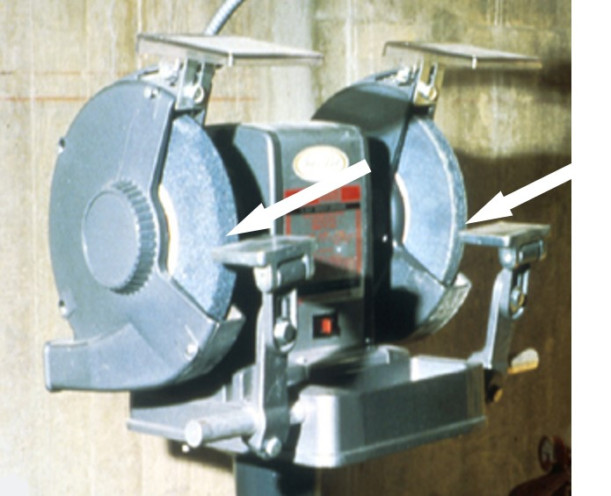
Abrasive Wheel Machinery
Work rests on offhand grinding machines must be kept adjusted closely to the wheel with a maximum opening of 1/8-inch to prevent the work from being jammed between the wheel and the rest, which may result in wheel breakage.
Speaker notes:
Picture from OSHA 10 slide.
1910.215(a)(4) Work rests. On offhand grinding machines, work rests shall be used to support the work. They shall be of rigid construction and designed to be adjustable to compensate for wheel wear. Work rests shall be kept adjusted closely to the wheel with a maximum opening of one-eighth inch to prevent the work from being jammed between the wheel and the rest, which may cause wheel breakage. The work rest shall be securely clamped after each adjustment. The adjustment shall not be made with the wheel in motion.
Source: OSHA
Notes:
Picture from OSHA 10 slide
1910.215(a)(4) Work rests. On offhand grinding machines, work rests shall be used to support the work. They shall be of rigid construction and designed to be adjustable to compensate for wheel wear. Work rests shall be kept adjusted closely to the wheel with a maximum opening of one-eighth inch to prevent the work from being jammed between the wheel and the rest, which may cause wheel breakage. The work rest shall be securely clamped after each adjustment. The adjustment shall not be made with the wheel in motion.

Slide 87
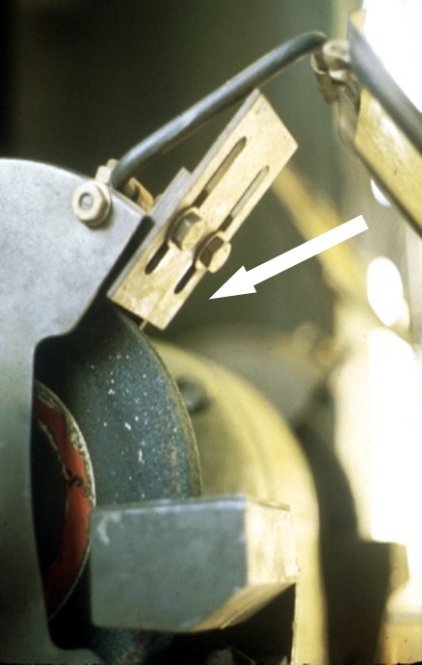
Abrasive Wheel Machinery cont.
Speaker Notes: Picture from OSHA 10 slide
1910.215(b)(9) Exposure adjustment. Safety guards of the types described in Subparagraphs (3) and (4) of this paragraph, where the operator stands in front of the opening, shall be constructed so that the peripheral protecting member can be adjusted to the constantly decreasing diameter of the wheel. The maximum angular exposure above the horizontal plane of the wheel spindle as specified in paragraphs (b)(3) and (4) of this section shall never be exceeded, and the distance between the wheel periphery and the adjustable tongue or the end of the peripheral member at the top shall never exceed one-fourth inch. (See Figures O-18, O-19, O-20, O-21, O-22, and O-23.)
The distance between the wheel periphery and the adjustable tongue must never exceed 1/4-inch.
Source: OSHA
Notes:
Picture from OSHA 10 slide
1910.215(b)(9) Exposure adjustment. Safety guards of the types described in Subparagraphs (3) and (4) of this paragraph, where the operator stands in front of the opening, shall be constructed so that the peripheral protecting member can be adjusted to the constantly decreasing diameter of the wheel. The maximum angular exposure above the horizontal plane of the wheel spindle as specified in paragraphs (b)(3) and (4) of this section shall never be exceeded, and the distance between the wheel periphery and the adjustable tongue or the end of the peripheral member at the top shall never exceed one-fourth inch. (See Figures O-18, O-19, O-20, O-21, O-22, and O-23.)

Slide 88

Abrasive Wheel Machinery Video
When installing new abrasive wheel
  Inspect for condition and compatibility
  Conduct ring test
Click on picture for video
Source: OSHA
Speaker Notes: Movie from OSHA 7100 Machine Guarding Course
1910.215(d)(1) Inspection. Immediately before mounting, all wheels shall be closely inspected and sounded by the user (ring test) to make sure they have not been damaged in transit, storage, or otherwise. The spindle speed of the machine shall be checked before mounting of the wheel to be certain that it does not exceed the maximum operating speed marked on the wheel. Wheels should be tapped gently with a light nonmetallic implement, such as the handle of a screwdriver for light wheels, or a wooden mallet for heavier wheels. If they sound cracked (dead), they shall not be used. This is known as the "Ring Test".
1910.215(d)(1)(i) Wheels must be dry and free from sawdust when applying the ring test, otherwise the sound will be deadened. It should also be noted that organic bonded wheels do not emit the same clear metallic ring as do vitrified and silicate wheels.
910.215(d)(1)(ii) "Tap" wheels about 45 deg. each side of the vertical centerline and about 1 or 2 inches from the periphery as indicated by the spots in Figure O-25 and Figure O-26. Then rotate the wheel 45 deg. and repeat the test. A sound and undamaged wheel will give a clear metallic tone. If cracked, there will be a dead sound and not a clear "ring."
Notes:
Movie from OSHA 7100 Machine Guarding Course
1910.215(d)(1) Inspection. Immediately before mounting, all wheels shall be closely inspected and sounded by the user (ring test) to make sure they have not been damaged in transit, storage, or otherwise. The spindle speed of the machine shall be checked before mounting of the wheel to be certain that it does not exceed the maximum operating speed marked on the wheel. Wheels should be tapped gently with a light nonmetallic implement, such as the handle of a screwdriver for light wheels, or a wooden mallet for heavier wheels. If they sound cracked (dead), they shall not be used. This is known as the "Ring Test".
1910.215(d)(1)(i) Wheels must be dry and free from sawdust when applying the ring test, otherwise the sound will be deadened. It should also be noted that organic bonded wheels do not emit the same clear metallic ring as do vitrified and silicate wheels.
910.215(d)(1)(ii) "Tap" wheels about 45 deg. each side of the vertical centerline and about 1 or 2 inches from the periphery as indicated by the spots in Figure O-25 and Figure O-26. Then rotate the wheel 45 deg. and repeat the test. A sound and undamaged wheel will give a clear metallic tone. If cracked, there will be a dead sound and not a clear "ring."

Slide 89
Abrasive Wheel Machinery
Checklist
Checklist

Slide 90
Portable Circular Saws
Speaker Notes: Picture from OSHA 3067
1910.243(a)(1)(i) All portable, power-driven circular saws having a blade diameter greater than 2 in. shall be equipped with guards above and below the base plate or shoe. The upper guard shall cover the saw to the depth of the teeth, except for the minimum arc required to permit the base to be tilted for bevel cuts. The lower guard shall cover the saw to the depth of the teeth, except for the minimum arc required to allow proper retraction and contact with the work. When the tool is withdrawn from the work, the lower guard shall automatically and instantly return to covering position.
1910.243(a)(2)(i) All hand-held powered circular saws having a blade diameter greater than 2 inches, electric, hydraulic or pneumatic chain saws, and percussion tools without positive accessory holding means shall be equipped with a constant pressure switch or control that will shut off the power when the pressure is released. All hand-held gasoline powered chain saws shall be equipped with a constant pressure throttle control that will shut off the power to the saw chain when the pressure is released.
Guard Retracted
Stock
Blade
Guard
Source: OSHA
Notes:
Picture from OSHA 3067
1910.243(a)(1)(i) All portable, power-driven circular saws having a blade diameter greater than 2 in. shall be equipped with guards above and below the base plate or shoe. The upper guard shall cover the saw to the depth of the teeth, except for the minimum arc required to permit the base to be tilted for bevel cuts. The lower guard shall cover the saw to the depth of the teeth, except for the minimum arc required to allow proper retraction and contact with the work. When the tool is withdrawn from the work, the lower guard shall automatically and instantly return to covering position.
1910.243(a)(2)(i) All hand-held powered circular saws having a blade diameter greater than 2 inches, electric, hydraulic or pneumatic chain saws, and percussion tools without positive accessory holding means shall be equipped with a constant pressure switch or control that will shut off the power when the pressure is released. All hand-held gasoline powered chain saws shall be equipped with a constant pressure throttle control that will shut off the power to the saw chain when the pressure is released.

Slide 91
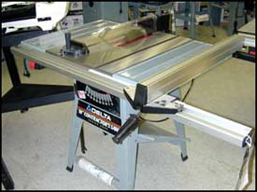
Table Saw
Speaker Notes: Picture from http://www.osha.gov/SLTC/etools/machineguarding/saws/tablesaws.html
On/off switch should be located at knee height -- so you can turn off machine while your hands are on the material
Blade must be guarded
Automatic brake a good safety feature
Guard
Source: OSHA
Notes:
Picture from http://www.osha.gov/SLTC/etools/machineguarding/saws/tablesaws.html

Slide 92
Table Saw -- Kickback
Back of the blade, as it rises out of table, is the critical “kickback zone”
Material tends to be lifted off of the table
If wood moves sideways at this point, it will be caught by the rotational motion and will be flung back toward the operator!

Slide 93
Preventing Kickbacks
Use a splitter or wedge inserted into the saw kerf to separate material
Make sure rip fence is perfectly parallel to the blade

Slide 94
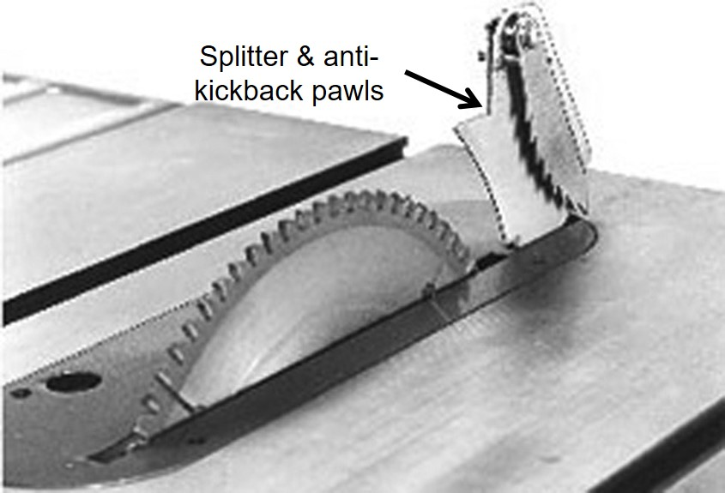
Table Saw - Splitters
Speaker Notes: Picture from http://www.orosha.org/pdf/pubs/2980.pdf
OSHA requires splitter and anti-kickback pawls for hand-fed ripsaw
OSHA does not required a splitter and anti-kickback pawls for hand-fed crosscut saw
Metal fins, secured behind and in line with the blade -- must move freely & not stick open
Anti-kickback pawls also attached
Source: Oregon OSHA
Notes:
Picture from http://www.orosha.org/pdf/pubs/2980.pdf
OSHA requires splitter and anti-kickback pawls for hand-fed ripsaw
OSHA does not required a splitter and anti-kickback pawls for hand-fed crosscut saw

Slide 95

Table Saw - Push Sticks
Speaker Notes: Picture from http://www.osha.gov/SLTC/etools/machineguarding/saws/tablesaws.html
Push stick
Source: OSHA
Notes:
Picture from http://www.osha.gov/SLTC/etools/machineguarding/saws/tablesaws.html

Slide 96

Radial Arm Saw
Speaker Notes: Picture Source = NJ AFL-CIO
1910.213(h)(1) The upper hood shall completely enclose the upper portion of the blade down to a point that will include the end of the saw arbor. The upper hood shall be constructed in such a manner and of such material that it will protect the operator from flying splinters, broken saw teeth, etc., and will deflect sawdust away from the operator. The sides of the lower exposed portion of the blade shall be guarded to the full diameter of the blade by a device that will automatically adjust itself to the thickness of the stock and remain in contact with stock being cut to give maximum protection possible for the operation being performed.
1910.213(h)(2) Each radial saw used for ripping shall be provided with nonkickback fingers or dogs located on both sides of the saw so as to oppose the thrust or tendency of the saw to pick up the material or to throw it back toward the operator. They shall be designed to provide adequate holding power for all the thicknesses of material being cut.
1910.213(h)(3) An adjustable stop shall be provided to prevent the forward travel of the blade beyond the position necessary to complete the cut in repetitive operations.
1910.213(h)(4) Installation shall be in such a manner that the front end of the unit will be slightly higher than the rear, so as to cause the cutting head to return gently to the starting position when released by the operator.
1910.213(h)(5) Ripping and ploughing shall be against the direction in which the saw turns. The direction of the saw rotation shall be conspicuously marked on the hood. In addition, a permanent label not less than 1 1/2 inches by 3/4 inch shall be affixed to the rear of the guard at approximately the level of the arbor, reading as follows: "Danger: Do Not Rip or Plough From This End".
Anti-Kickback Device
Lower Blade Guard
Source: NJAFL-CIO
Notes:
Picture Source = NJ AFL-CIO
1910.213(h)(1) The upper hood shall completely enclose the upper portion of the blade down to a point that will include the end of the saw arbor. The upper hood shall be constructed in such a manner and of such material that it will protect the operator from flying splinters, broken saw teeth, etc., and will deflect sawdust away from the operator. The sides of the lower exposed portion of the blade shall be guarded to the full diameter of the blade by a device that will automatically adjust itself to the thickness of the stock and remain in contact with stock being cut to give maximum protection possible for the operation being performed.
1910.213(h)(2) Each radial saw used for ripping shall be provided with nonkickback fingers or dogs located on both sides of the saw so as to oppose the thrust or tendency of the saw to pick up the material or to throw it back toward the operator. They shall be designed to provide adequate holding power for all the thicknesses of material being cut.
1910.213(h)(3) An adjustable stop shall be provided to prevent the forward travel of the blade beyond the position necessary to complete the cut in repetitive operations.
1910.213(h)(4) Installation shall be in such a manner that the front end of the unit will be slightly higher than the rear, so as to cause the cutting head to return gently to the starting position when released by the operator.
1910.213(h)(5) Ripping and ploughing shall be against the direction in which the saw turns. The direction of the saw rotation shall be conspicuously marked on the hood. In addition, a permanent label not less than 1 1/2 inches by 3/4 inch shall be affixed to the rear of the guard at approximately the level of the arbor, reading as follows: "Danger: Do Not Rip or Plough From This End".

Slide 97

Meat Cutting Band Saw
Follow LOTO procedures
Install brake
Use pushing guard or fence
Adjust blade guard
Use only sharp blades
Only remove meat from saw when blade stopped
Unplug when not in use
Adjustable guard
Sliding Table & Pushing Guard
Operator Control
Picture from OSHA 3170
Source: OSHA
Notes:
Picture from OSHA 3170

Slide 98

Jointer
Large, high-speed cutterheads are main hazard
Knives rotating at high speed become invisible
Source: OSHA
Speaker Notes: Picture from OSHA 3067
1910.213(j) Jointers.
1910.213(j)(1) Each hand-fed planer and jointer with horizontal head shall be equipped with a cylindrical cutting head, the knife projection of which shall not exceed one-eighth inch beyond the cylindrical body of the head.
1910.213(j)(2) The opening in the table shall be kept as small as possible. The clearance between the edge of the rear table and the cutter head shall be not more than one-eighth inch. The table throat opening shall be not more than 2 1/2 inches when tables are set or aligned with each other for zero cut.
1910.213(j)(3) Each hand-fed jointer with a horizontal cutting head shall have an automatic guard which will cover all the section of the head on the working side of the fence or gage. The guard shall effectively keep the operator's hand from coming in contact with the revolving knives. The guard shall automatically adjust itself to cover the unused portion of the head and shall remain in contact with the material at all times.
1910.213(j)(4) Each hand-fed jointer with horizontal cutting head shall have a guard which will cover the section of the head back of the gage or fence.
1910.213(j)(5) Each wood jointer with vertical head shall have either an exhaust hood or other guard so arranged as to enclose completely the revolving head, except for a slot of such width as may be necessary and convenient for the application of the material to be jointed.
Notes:
Picture from OSHA 3067
1910.213(j) Jointers.
1910.213(j)(1) Each hand-fed planer and jointer with horizontal head shall be equipped with a cylindrical cutting head, the knife projection of which shall not exceed one-eighth inch beyond the cylindrical body of the head.
1910.213(j)(2) The opening in the table shall be kept as small as possible. The clearance between the edge of the rear table and the cutter head shall be not more than one-eighth inch. The table throat opening shall be not more than 2 1/2 inches when tables are set or aligned with each other for zero cut.
1910.213(j)(3) Each hand-fed jointer with a horizontal cutting head shall have an automatic guard which will cover all the section of the head on the working side of the fence or gage. The guard shall effectively keep the operator's hand from coming in contact with the revolving knives. The guard shall automatically adjust itself to cover the unused portion of the head and shall remain in contact with the material at all times.
1910.213(j)(4) Each hand-fed jointer with horizontal cutting head shall have a guard which will cover the section of the head back of the gage or fence.
1910.213(j)(5) Each wood jointer with vertical head shall have either an exhaust hood or other guard so arranged as to enclose completely the revolving head, except for a slot of such width as may be necessary and convenient for the application of the material to be jointed.

Slide 99
Jointer cont.
Do not pass material over planing head by hand
  Only one layer of material between your hands and the cutters
Keep guards in place -- open cover only enough to allow material to pass through

Slide 100

Jointer
Push Stick
Source: OSHA
Speaker Notes:
Picture from OSHA 3067.
Notes:
Picture from OSHA 3067

Slide 101
Food Slicer
Case History: an employee was cleaning a meat slicer that was turned off but was still plugged in. He inadvertently turned the machine on by bumping the on/off switch, resulting in an amputation of his right ring fingers.
Speaker Notes:
Source OSHA 3170.
Notes:
Source OSHA 3170

Slide 102

Food Slicers
Never hand-feed slicer
Retract the slicer blade during cleaning
Unplug when servicing or use lockout/tagout
Source: NJAFL-CIO
Notes:
Source of picture = NJ AFL-CIO

Slide 103

Meat Grinder
Use properly sized plungers
Operate with feeding tray and throats installed
Follow LOTO procedures
Source: OSHA
Speaker notes:
OSHA 3170
Notes:
OSHA 3170

Slide 104
Quiz

Slide 105
Resources Machine Guarding
OSHA Machine Guarding Website
http://www.osha.gov/SLTC/machineguarding/index.html
OSHA Machine Guarding eTool
http://www.osha.gov/SLTC/etools/machineguarding/index.html
OSHA Amputation Fact Sheet
http://www.osha.gov/OshDoc/data_General_Facts/amputation-factsheet.pdf
Safeguarding Equipment and Protecting Employees from Amputations
http://www.osha.gov/Publications/osha3170.pdf

Slide 106
Resources LOTO
OSHA LOTO Website
https://www.osha.gov/SLTC/controlhazardousenergy/index.html
NIOSH Workplace Solutions: Using Lockout and Tagout Procedures to Prevent Injury and Death during Machine Maintenance
https://www.cdc.gov/niosh/docs/wp-solutions/2011-156/pdfs/2011-156.pdf
OSHA LOTO Fact Sheet
https://www.osha.gov/OshDoc/data_General_Facts/factsheet-lockout-tagout.pdf
OSHA 3120: LOTO https://www.osha.gov/Publications/osha3120.pdf

