Slide 1
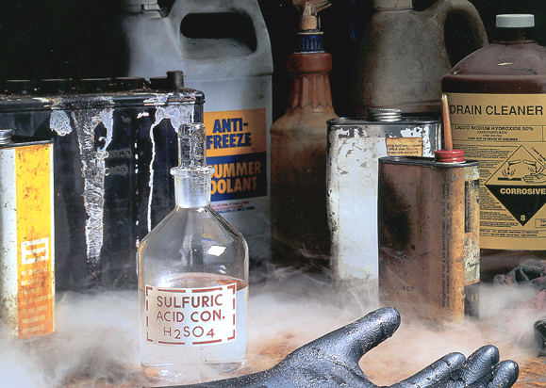
Chemical safety training
1
Chemical Safety Training
Notes:
The photo in this slide depicts unsafe chemical storage.
Visible issues include:
-Different types of chemicals stored together
-Containers that are unlabeled or have labels worn off
-Damaged or rusted containers
-Visible mist suggests presence of a leak
-----------------------------------------------------------------------------------------
This PowerPoint is designed to focus on chemical safety and hazards identification. It briefly covers the hierarchy of hazard controls and OSHA’s Right to Know law. The main goal of this training initiative is to create safer work practices and a safer work environment in order to prevent workplace illnesses and injuries.

Slide 2
Chemical Safety Training
This material was produced under a grant from the Occupational Safety and Health Administration (SH-31179-SH7), U.S. Department of Labor. It does not necessarily reflect the views or the policies of the U.S. Department of Labor, nor does the mention of trade names, commercial products, or organization imply endorsement by the US government.

Slide 3
Course Objectives
3
Provide participants with training to
Identify hazards that exist in their workplaces
Identify potential health effects of workplace hazards
Understand ways that chemicals can enter the body
Understand principles of hazard prevention and control
Apply principles of hazard control in the work place
Understand employer responsibilities regarding exposure to hazardous chemicals
Discuss and analyze strategies to create safer workplaces

Slide 4
Introduction
4
About 32 million workers are potentially exposed to one or more chemical hazards¹
There are approximately 650,000 existing chemical products, and hundreds of new ones being introduced annually¹
Chemical exposure may cause or contribute to many serious health effects such as heart ailments, central nervous system damage, kidney and lung damage, sterility, cancer, burns, and rashes
Some chemicals may also be safety hazards and have the potential to cause fires and explosions and other serious accidents
Notes:
¹ OSHA 3084; Chemical Hazard Communication. https://www.osha.gov/Publications/osha3084.html
Revised in 1998. We expect both the number of workers and the number of chemicals has increased since then.
This is one of the most frequently cited OSHA standards.
This program is intended for workplaces that do not manufacture, import, or distribute hazardous chemicals. Notes have been provided that highlight some of the requirements for these employers. For complete requirements, consult 29 CFR 1910.1200.

Slide 5
Hazard Identification
5
What are some hazards that can be found in your workplace?

Slide 6
Hazard Identification (cont.)
6
Routes of exposure
Inhalation
Absorption
Ingestion
Injection
Notes:
There are 4 main ways a chemical can enter the body:
Inhalation: For most chemicals in the form of vapors, gases, mists, or particulates, inhalation is the major route of entry. Once inhaled, chemicals are either exhaled or deposited in the respiratory tract. If deposited, damage can occur through direct contact with tissue or the chemical may diffuse into the blood through the lung-blood interface.
Upon contact with tissue in the upper respiratory tract or lungs, chemicals may cause health effects ranging from simple irritation to severe tissue destruction. Substances absorbed into the blood are circulated and distributed to organs that have an affinity for that particular chemical. Health effects can then occur in the organs, which are sensitive to the toxicant.
• Skin (or eye) absorption: Skin (dermal) contact can cause effects that are relatively mild such as redness or irritation (dermatitis); more severe effects include destruction of skin tissue or other debilitating conditions. Many chemicals can also cross the skin barrier and be absorbed into the blood system. Once absorbed, they may produce systemic damage to internal organs. The eyes are particularly sensitive to chemicals. Even a short exposure can cause severe effects to the eyes or the substance can be absorbed through the eyes and be transported to other parts of the body causing harmful effects.
• Ingestion: Chemicals that inadvertently get into the mouth and are swallowed do not generally harm the gastrointestinal tract itself unless they are irritating or corrosive. Chemicals that are insoluble in the fluids of the gastrointestinal tract (stomach, small, and large intestines) are generally excreted. Others that are soluble are absorbed through the lining of the gastrointestinal tract. They are then transported by the blood to internal organs where they can cause damage.
• Injection: Substances may enter the body if the skin is penetrated or punctured by contaminated objects. Effects can then occur as the substance is circulated in the blood and deposited in the target organs.

Slide 7
Hazard Identification (cont. )
7
Severity of health effects depend on
Duration of exposure
Frequency of exposure
Route of exposure
Personal health
Type of chemical

Slide 8
Types of Health Effects
8
May be acute or long-term
Neurologic
Affect the brain, spinal cord, or nerves
Respiratory
Affects lung function
Cardiovascular
Affects movement of nutrients & wastes; body temperature
Notes:
Neurologic symptoms can include:
muscle weakness,
partial or complete loss of sensation,
partial or complete paralysis,
seizures,
loss of cognitive abilities,
unexplained pain
decreased alertness
Respiratory symptoms can include:
sore throat
coughing/wheezing
shortness of breath
decreased lung capacity/decreased lung function
suffocation/asphyxiation
lung cancer
Respiratory symptoms can include:
heart failure
inability of blood to carry oxygen throughout the body

Slide 9
Types of Health Effects (cont.)
9
Immunologic
Affects body’s ability to fight infection
Mutagenic
Cause changes in the genetic code
Teratogenic
Affect developing fetus or embryo
Carcinogenic
Affect rate of cell division
Notes:
Immunologic symptoms can include:
allergy
immune system slow down or failure
autoimmune disorders (body attacks itself)
Mutagens can cause a permanent change to the DNA, which may harm cells and cause certain diseases (such as cancer).
Mutations can be passed down to offspring
Teratogens can affect the development of an embryo or fetus, which may cause birth defects
Carcinogens can affect the DNA directly (similar to mutagens), but can also cause cells to divide at a faster rate, which could increase the likelihood of cell division error, which could result in changes to the DNA code (mutation)

Slide 10
Types of Hazards
10
Biological
Chemical
Ergonomic
Physical
Psychosocial
Safety
Notes:
biological - bacteria, viruses, insects, plants, birds, animals, and humans, etc.,
chemical - depends on the physical, chemical and toxic properties of the chemical,
ergonomic - repetitive movements, improper set up of workstation, etc.,
physical - radiation, magnetic fields, pressure extremes (high pressure or vacuum), noise, etc.,
psychosocial - stress, violence, etc.,
safety - slipping/tripping hazards, inappropriate machine guarding, equipment malfunctions or breakdowns.

Slide 11
Types of Chemicals
11
Flammable
Uses: solvents, adhesives, fuel
Examples: Methanol, acetonitrile, diesel fuel, mineral spirits
Corrosive
Uses: cleaning agents, degreasers, chemical reactants
Examples: Acetic acid, sodium hydroxide, ammonia; phenol
Reactive
Oxidizers
Uses: disinfectants, cleaning agents; chlorine
Examples: nitric acid, hydrogen peroxide
Notes:
Flammable: Material that will burn or ignite, causing fire or combustion. An ignitable chemical has a flashpoint less than 100° F. A combustible material will burn, but require a flame or elevated temperature plus a spark to start them; and has a flashpoint greater than 100° F but less than 200° F.
Corrosive: Chemical that causes visible destruction of, or irreversible alterations in, living tissue by chemical action at the site of contact.pH < 2 and pH > 12.5
Reactive: Material that reacts violently or explodes under either ambient conditions or when in contact with air, water, or other chemicals.
Oxidizers: materials that react strongly with organic materials, sometimes strongly enough to start fires

Slide 12
Types of Chemicals (cont.)
12
Organic peroxides
Uses: Bleaching agents, disinfectants, chemical synthesis reactions
Examples: benzoyl peroxide, methyl ethyl ketone peroxide; hydrogen peroxide
Water reactive
Uses: Additives, neutralizers, chemical synthesis reactions
Examples: sodium metal, sodium borohydride, sodium hydroxide
Air reactive
Uses: Adhesives, coating agents, chemical synthesis reactions
Examples: silane, t-butyl lithium
Notes:
Organic Peroxides: form friction and shock-sensitive explosives
Water Reactive: react violently with water
Air Reactive (pyrophoric): react violently with air

Slide 13
Types of Chemicals ( cont.)
13
Toxic
Carcinogen
Uses: Solvent, cleaning fluid, degreaser, disinfectant
Examples: benzene, carbon tetrachloride, formaldehyde*
Mutagen:
Uses: Disinfectant, solvent
Examples: bromine, benzene; phenol
Poison:
Uses: Chemical preservative, pigment
Examples: sodium azide, powdered pigments/inks
Notes:
Toxic: Material that may cause harm to an individual if it enters the body.
Carcinogen: a substance or agent that may cause cancer
*IARC classifies formaldehyde as a human carcinogen; EPA classifies it as a probable human carcinogen
Mutagen: An agent that can induce or increase the frequency of mutation in an organism
Poison: any substance that can impair function, cause structural damage, or otherwise injure the body

Slide 14
Types of Chemicals (cont.)
14
Sensitizer:
Uses: Disinfectants, biocides
Examples: formaldeyde, phenol
Teratogen:
Uses: Electrical equipment, insulation; conductors
Examples: PCBs, mercury
Irritant
Powdered substances
Uses: Filler, casting
Examples: silica
Notes:
Sensitizer: a substance that causes hypersensitivity or reactivity to an antigen, such as pollen, especially by a second or repeated exposure.
Teratogen: An agent that causes malformation of an embryo or fetus.
Irritant: Material that can cause harm to an individual in the following ways:
Irritant: a substance that can irritate the skin or eyes
Skin Sensitizer: a substance which can cause an allergic response following skin contact
Acute Toxicity (harmful): a substance that may be fatal or cause organ damage from a single short-term exposure

Slide 15
Protective Measures
15
Substitute a safe(r) chemical, if possible
Use appropriate engineering controls, including ventilation
Wear appropriate personal protective equipment (PPE) when handling hazardous materials
Remove PPE when entering common areas and hallways
Label areas that require PPE
Do not eat, drink, smoke, store food, or apply make up in work areas

Slide 16
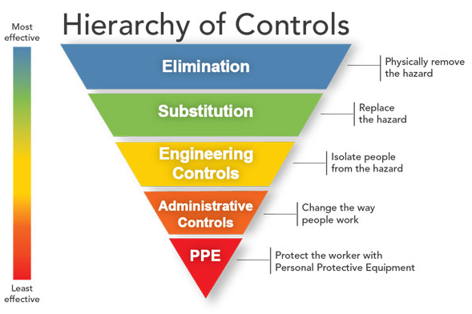
Hierarchy of Controls
16
https://www.cdc.gov/niosh/topics/hierarchy/
Notes:
Eliminating the hazard is the most effective method of controlling hazards. Next best is substituting the hazard for a non- or less hazardous chemical or process. However, for existing operations, elimination and substitution may be the most difficult to implement, as major changes may be needed to remove the hazardous substance or process.
Engineering controls are designed to remove the hazard at the source, before it comes in contact with the worker. This is preferable to administrative controls or personal protective equipment (PPE) because it is not dependent on human action or behavior. The initial cost of engineering controls can be higher than the cost of administrative controls or PPE, but may lower operating costs in the long term.
Administrative Controls are aimed at changing the human element of the work process or schedule. For example, limiting an employee’s time in an area of exposure, rotating shifts, etc.
PPE is safety equipment worn by the employees to protect them from the hazard(s) they come into contact with. Administrative controls and PPE rely heavily on the employees for implementation.
Administrative controls and PPE have been demonstrated to be less effective than other measures. They may be relatively inexpensive to establish (particularly when compared to the up-front cost of an engineering control) but, over the long term, can be very costly to sustain (eg, continuously purchasing PPE).

Slide 17
How can workplace hazards be minimized?
17
The first step in minimizing workplace hazards is to perform a thorough hazard assessment
Employers can rely on the evaluations performed by the manufacturers or importers to establish the hazards of the chemicals they use
This information is obtained from SDSs and labels
Notes:
Chemical manufacturers and importers must review scientific evidence on the hazards of chemicals they produce or import and report findings to their employees and to employers who distribute or use their products.

Slide 18
General Duty Clause
18
Provide a workplace free of recognized hazards
Employer has a legal obligation to provide workplace without conditions or activities that are recognized as hazardous and that cause, or are likely to cause, death or serious physical harm to employees

Slide 19
Employer Responsibilities
19
Provide a workplace free of recognized hazards
Identify and list hazardous chemicals in their workplaces
Implement a written HazCom program
Communicate hazard information to employees
Provide training
Notes:
It is the employer’s responsibility to obtain Safety Data Sheets (SDSs) and labels for each hazardous chemical if they are not provided by the manufacturer, importer, or distributor
Written HazCom program includes labels, SDSs, and employee training
Communicate hazard information to employees through labels, SDSs, and formal training programs. Employees should know where to find information on hazards, and it should be accessible to them.

Slide 20
Training
20
Training is required for employees who are exposed to hazardous chemicals in their work area:
At the time of initial assignment
Whenever a new hazard is introduced into their work area
Training must be provided in the language that the employee can understand
https://www.arlo.co/features/training-company-software
Notes:
1910.1200(h)
Training is not satisfied solely by giving the employee the data sheets to read. An employer's training program is to be a forum for explaining to employees not only the hazards of the chemicals in their work area, but also how to use the information generated in the hazard communication program. This can be accomplished in many ways (audiovisuals, classroom instruction, interactive video), and should include an opportunity for employees to ask questions to ensure that they understand the information presented to them. Training must be carried out in a language that is comprehensible to the employees.
Training need not be conducted on each specific chemical found in the workplace, but may be conducted by categories of hazard (e.g., carcinogens, sensitizers, acutely toxic agents, irritants, flammables) that are or may be encountered by an employee during the course of his duties.
Employees who have been previously trained by another employer, union, or other entity, do not have to be retrained if the previous training is sufficient to meet the standard’s training requirements for the current work being performed. However, employees must have information about where to find SDSs in the workplace, who in the company is responsible for the HazCom program, and where to get copies.

Slide 21
What training is needed to protect workers?
21
Explanation of the HazCom program, including information on labels, SDSs, and how to obtain and use available hazard information
How to detect the presence or release of a hazardous chemical (using monitoring devices, observation, or smell)
Hazards and potential health effects of chemicals
Protective measures such as engineering controls, work practices, and the use of PPE

Slide 22
What information must be provided to workers?
22
Employees must be informed of:
The HazCom standard and its requirements
Operations in their work areas where hazardous chemicals are present
Location and availability of the written hazard evaluation procedures, communications program, lists of hazardous chemicals, and the required SDSs

Slide 23
Recordkeeping
23
Employers are responsible for
Keeping records of work-related injuries and illnesses
Providing employees, former employees, and designated representatives with access to work-related injuries and illnesses log (OSHA 300 Log)
Providing employees, former employees, and their designated representatives with access to their medical records and exposure records

Slide 24
Employee Rights
24
Receive information and training about hazards and about methods to prevent harm.
The training must be in a language workers can understand
Get copies of test results done to find hazards in the workplace
Review records of work-related injuries and illnesses
Workers may file a complaint to have OSHA inspect their workplace if they believe that their employer is not following OSHA standards or that there are serious hazards.
Notes:
It is the employer’s responsibility to obtain Safety Data Sheets (SDSs) and labels for each hazardous chemical if they are not provided by the manufacturer, importer, or distributor
Written HazCom program includes labels, SDSs, and employee training
Communicate hazard information to employees through labels, SDSs, and formal training programs. Employees should know where to find information on hazards, and it should be accessible to them.

Slide 25
Anti-Retaliation Provisions
25
Employer must not discriminate against employees who exercise their rights under OSHA (Whistleblower Protection Program)
File a complaint
Participate in an inspection/talking to an inspector
Request access to exposure and injury records
Report an injury
Raise health & safety concerns

Slide 26
Purpose of OSHA’s Hazard Communication Standard
26
To ensure that employers and employees know about work hazards and how to protect themselves so that the incidence of illnesses and injuries due to hazardous chemicals is reduced.
Hazard Communication
Program
Container
Labeling
Safety
Data Sheet
Program
SDS
Label
Notes:
29 CFR 1910.1200
The Hazard Communication (HazCom) standard establishes uniform requirements to make sure that the hazards of all chemicals imported into, produced, or used in U.S. workplaces are evaluated, and that this hazard information is transmitted to affected employers and exposed employees.
The HazCom standard is different from other OSHA health rules because it covers all hazardous chemicals. The rule also incorporates a “downstream flow of information,” which means that producers of chemicals have the primary responsibility for generating and disseminating information, whereas users of chemicals must obtain the information and transmit it to their employees.

Slide 27
Who is covered?
27
OSHA’s Hazard Communication (HazCom) Standard applies to:
General industry
Shipyard
Marine terminals
Longshoring
Construction
Chemical manufacturers
Importers
Employers
Employees
Notes:
1910.1200(b)
Does the standard apply to an office environment?
Office workers who encounter hazardous chemicals only in isolated instances are not covered by the rule. OSHA considers most office products (such as pens, pencils, adhesive tape) to be exempt under the provisions of the rule. OSHA has stated that intermittent or occasional use of a copying machine does not result in coverage under the rule. However, if an employee handles the chemicals to service the machine, or operates it for long periods of time, then the standard would apply.
“Hazardous Chemical” is any chemical which is a physical or health hazard.

Slide 28
Why is a written program required?
28
Ensures that all employers receive the information they need to inform and train their employees
Provides necessary hazard information to employees
HazCom Program
(f) "Labels and other forms of warning."
(g) “Safety data sheets."
(h) "Employee information and training."
Notes:
1910.1200(e)

Slide 29
Written HazCom Program Requirements
29
List known hazardous chemicals
Provide Safety Data Sheets (SDS)
Inform employees of hazardous operations in their area
Inform employees about hazards of non-routine tasks
Written HazCom must be available upon request to employees or their designated representative
Notes:
Employer also required to describe how they will inform employees of the hazards of non-routine tasks (for example, cleaning reactor vessels), and the hazards associated with chemicals in unlabeled pipes.

Slide 30
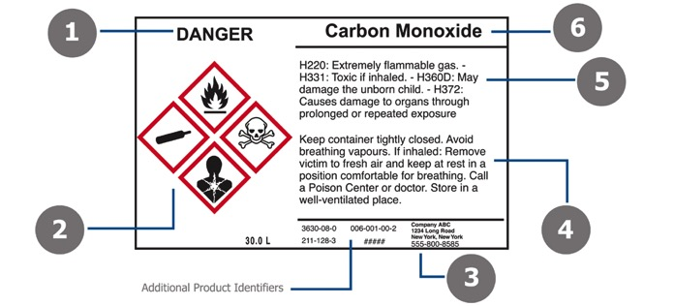
Container Labeling in the Workplace
30
Effective 2012, all chemicals must be labeled using the Globally Harmonized System (GHS)
There are 6 elements of a GHS label:
Product Name
Signal Word
Hazard Statement
Precautionary Statement
GHS Symbol
https://www.bradyid.com/en-us/applications/ghs-labeling-requirements
Manufacturer Information
Notes:
30
1910.1200(f)
Chemical manufacturers and importers must convey the hazard information to downstream employers by means of labels on containers and Safety Data Sheets (SDSs)
Chemical manufacturers, importers, and distributors must be sure that containers of hazardous chemicals leaving the workplace are labeled, tagged, or marked with the appropriate information. Consumer products having labels meeting requirements of the Consumer Product Safety Act do not have to have additional labeling under the HazCom Standard.
Various other chemical products (for example, pesticides, foods, drugs, cosmetics, beverage alcohols) that are subject to labeling laws administered by other Federal agencies are also exempt from the labeling requirements of the HazCom Standard.
1- Signal Word – The signal word indicates hazard level. "Danger" is used for the most severe instances, while "Warning" is less severe.
2- GHS Symbol (Pictogram)- These pictograms are used to identify hazardous products and are commonly grouped by chemical/physical risk, health risk and environmental risk
3- Manufacturer Information- This identifies the manufacturer's company name, address and telephone number.
4- Precautionary Statements/First Aid- These are phrases that are tied to each hazard statement. They describe general preventative, response, storage, or disposal precautions. These statements are found on the chemical's Safety Data Sheet. Similar to Hazard Statements, Precautionary Statements can be identified by a P-Code (like P100).
5- Hazard Statements- These are phrases that describe the nature of hazardous products and the degree of hazard. Hazard statements are on the chemical's Safety Data Sheet (SDS) and identified by an H-Code (like H100).
6- Product Name or Identifiers- This identifies the product or chemical name. Additional identifiers can be noted to the right of the Manufacturer's information (#1).

Slide 31
Primary vs Secondary Container Labeling
Primary containers must be labeled following GHS guidelines
Bags, barrels, bottles, boxes, cans, cylinders, drums
Received from manufacturer
Secondary containers hold chemicals transferred from primary containers
Spray bottles, jugs, jars
Must comply with GHS except when:
Container stays within the work area and in possession of the worker who filled it
Material is used within the work shift of the individual who filled it

Slide 32
Globally Harmonized System (GHS)
32
The purpose of the GHS is to standardize hazard communication worldwide
OSHA’s HazCom standard incorporates GHS classifications and labeling
New SDS must incorporate GHS system

Slide 33
Safety Data Sheets
33
Prepared by the chemical manufacturer or importer
Must describe:
Physical hazards, such as fire and explosion
Health hazards, such as signs of exposure
Routes of exposure
Precautions for safe handling and use
Emergency and first-aid procedures
Control measures
Notes:
1910.1200(g)
Chemical manufacturers and importers must develop an SDS for each hazardous chemical they produce or import, and must provide the SDS at the time of the initial shipment to a downstream distributor or user. Distributors also must ensure that downstream employers are similarly provided an SDS.
Employers who become newly aware of “any significant information” regarding the hazards of a chemical must revise the labels for the chemical within six months of becoming aware of the new information and labels on containers of hazardous chemicals after that time must contain the new information.
OSHA does not require that SDSs be provided to purchasers of household consumer products (such as "windex" and "white‑out“) when the products are used in the workplace in the same manner that a consumer would use them, i.e.; where the duration and frequency of use (and therefore exposure) is not greater than what the typical consumer would experience. Employees who are required to work with hazardous chemicals in a greater duration and frequency of exposure than a normal consumer have a right to know about the properties of those hazardous chemicals.

Slide 34
Safety Data Sheets (cont’d)
34
Must be in English and include information regarding the specific chemical identity and common names
Must provide information about the:
Physical and chemical characteristics
Health effects
Exposure limits
Carcinogenicity (cancer-causing)
Identification (name, address, and telephone number) of the organization responsible for preparing the sheet
Must be readily accessible to employees in their work area
Notes:
In the absence of other employee exposure records, SDSs that indicate a health hazard are considered employee exposure records under the Access to Employee Medical Records standard, 29 CFR 1910.1020 and must be preserved and maintained for at least thirty years, with some exceptions.
[See 29 CFR 1910.1020(d)]
Electronic access is acceptable provided:
- A back-up procedure is available if the electronic system fails
- It can be accessed in the employee’s work area
The telephone number provided must be that of a person who can provide additional information about the hazardous chemical and appropriate emergency procedures.

Slide 35
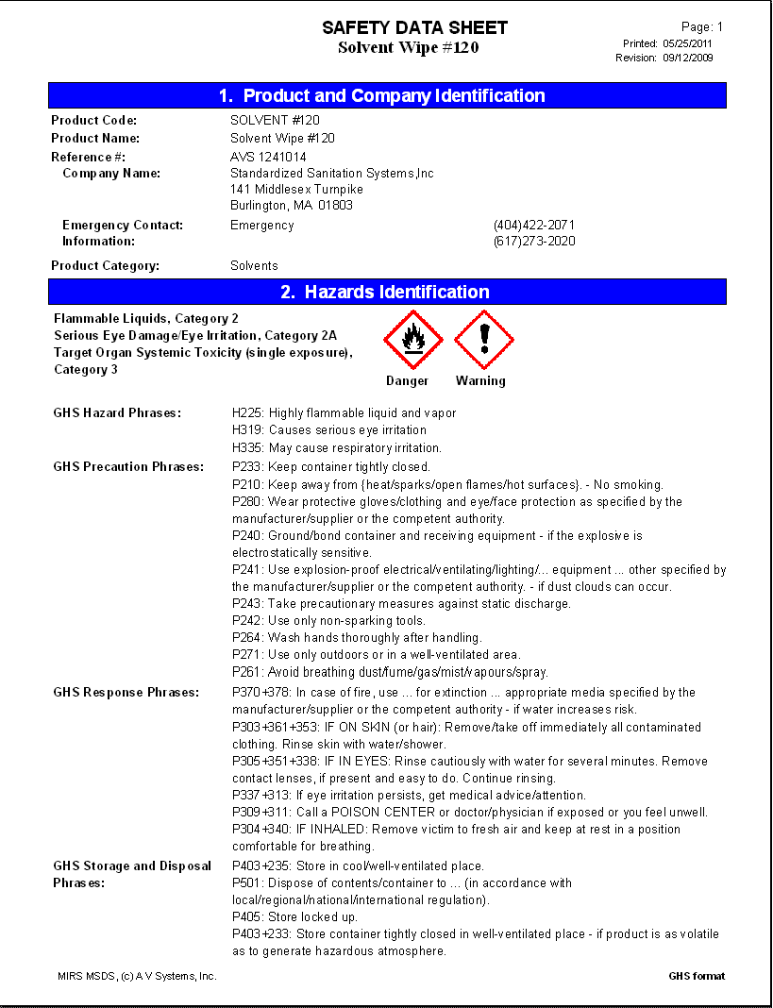
Safety Data Sheets (cont’d.)
35
If no SDS has been received for a hazardous chemical, employer must contact the supplier, manufacturer, or importer to obtain one and maintain a record of the contact
As of 2012, SDS have new format and requirements

Slide 36
Safety Data Sheets ( cont’d)
36
Identification (product, manufacturer, contact)
Hazard Identification
Ingredients
First Aid Measures
Fire Fighting Measures
Accidental Release Measures
Handling and Storage
Exposure Controls/Personal Protection
Physical and Chemical Properties
Stability and Reactivity
Toxicological Information
Ecological Information (non-mandatory)
Disposal Considerations (non-mandatory)
Transport Information (non-mandatory)
Regulatory Information (non-mandatory)
Other Information
Notes:
Section 1, Identification includes product identifier; manufacturer or distributor name, address, phone number; emergency phone number; recommended use; restrictions on use.
Section 2, Hazard(s) identification includes all hazards regarding the chemical; required label elements.
Section 3, Composition/information on ingredients includes information on chemical ingredients; trade secret claims.
Section 4, First-aid measures includes important symptoms/effects, acute, delayed; required treatment.
Section 5, Fire-fighting measures lists suitable extinguishing techniques, equipment; chemical hazards from fire.
Section 6, Accidental release measures lists emergency procedures; protective equipment; proper methods of containment and cleanup.
Section 7, Handling and storage lists precautions for safe handling and storage, including incompatibilities.
Section 8, Exposure controls/personal protection lists OSHA’s Permissible Exposure Limits (PELs); ACGIH Threshold Limit Values (TLVs); and any other exposure limit used or recommended by the chemical manufacturer, importer, or employer preparing the SDS where available as well as appropriate engineering controls; personal protective equipment (PPE).
Section 9, Physical and chemical properties lists the chemical's characteristics.
Section 10, Stability and reactivity lists chemical stability and possibility of hazardous reactions.
Section 11, Toxicological information includes routes of exposure; related symptoms, acute and chronic effects; numerical measures of toxicity.
Section 12, Ecological information* Section 13, Disposal considerations* Section 14, Transport information* Section 15, Regulatory information*
Section 16, Other information, includes the date of preparation or last revision.
*Note: Since other Agencies regulate this information, OSHA will not be enforcing Sections 12 through 15 (29 CFR 1910.1200(g)(2)).
Employers must ensure that SDSs are readily accessible to employees.

Slide 37
Summary
37
OSHA’s Hazard Communication Standard is based on a simple concept - that employees have both a need and a right to know the hazards and identities of the chemicals they are exposed to when working
Employees also need to know what protective measures are available to prevent adverse effects from occurring.
Reporting injury or incident is protected by law
Disciplinary action against employee for reporting an injury or incident is in violation of OSH Act
Notes:
See www.osha.gov for more information on hazard communication, including the following publications:
Hazard Communication Guidelines for Compliance – OSHA 3111
(This is the same information that is contained in Appendix E to 1910.1200 and is also available in Spanish.)
Chemical Hazard Communication – OSHA 3084
(This is also available in Spanish.)

Slide 38
Activity
38
Please refer to instructions for Hazard Mapping Exercise
Notes:
See www.osha.gov for more information on hazard communication, including the following publications:
Hazard Communication Guidelines for Compliance – OSHA 3111
(This is the same information that is contained in Appendix E to 1910.1200 and is also available in Spanish.)
Chemical Hazard Communication – OSHA 3084
(This is also available in Spanish.)

Slide 39
Acknowledgements
39
This material was produced under a grant from the Occupational Safety and Health Administration (#SH31179-SH7), U.S. Department of Labor. It does not necessarily reflect the views or the policies of the U.S. Department of Labor, nor does the mention of trade names, commercial products, or organization imply endorsement by the US government.

