Slide 1

HAZCOM and
G.H.S.
(Chemical Hazards)
Notes:
The Globally Harmonized System (GHS) is an international approach to hazard communication, providing agreed criteria for classification of chemical hazards, and a standardized approach to label elements and safety data sheets. The GHS was negotiated in a multi-year process by hazard communication experts from many different countries, international organizations, and stakeholder groups. It is based on major existing systems around the world, including OSHA's Hazard Communication Standard and the chemical classification and labeling systems of other US agencies.
The result of this negotiation process is the United Nations' document entitled "Globally Harmonized System of Classification and Labeling of Chemicals," commonly referred to as The Purple Book. This document provides harmonized classification criteria for health, physical, and environmental hazards of chemicals. It also includes standardized label elements that are assigned to these hazard classes and categories, and provide the appropriate signal words, pictograms, and hazard and precautionary statements to convey the hazards to users. A standardized order of information for safety data sheets is also provided. These recommendations can be used by regulatory authorities such as OSHA to establish mandatory requirements for hazard communication, but do not constitute a model regulation.

Slide 2
Disclaimer
HAZCOM and G.H.S.
This material was produced under
grant number SH-05073-SH8 from the Occupational Safety and Health Administration, U.S. Department of Labor.
It does not necessarily reflect the views or policies of the U.S. Department of Labor, nor does mention of trade names, commercial products, or organizations imply endorsement by the U.S. Government.
Notes:
This material was produced under
grant number SH-05073-SH8 from
the Occupational Safety and Health Administration, U.S. Department of Labor.
It does not necessarily reflect the views or policies of the U.S. Department of Labor, nor does mention of trade names, commercial products, or organizations imply endorsement by the U.S. Government.

Slide 3
Welcome
HAZCOM and G.H.S.
What is HAZCOM?
What changes came with G.H.S.
Pictograms, what are they?
Chemical hazards.
Notes:
Ask and prep for the following subjects;
What is HAZCOM?
What changes came with G.H.S.
Pictograms, what are they?
Chemical hazards.

Slide 4
Module- 1
HAZCOM and G.H.S.
What is HAZCOM?
What changes came with G.H.S.
Pictograms, what are they?
Chemical hazards.

Slide 5
HAZCOM and G.H.S.
What is HAZCOM?
Hazard Communication Standard,
Also known as the Right-to-Know Law and more commonly as HAZCOM, is a federal regulation designed to protect workers from hazardous chemicals in the workplace.
The goal of HAZCOM is to help employers and employees recognize dangerous materials in their work environment and the hazards these materials present.

Slide 6
OSHA HCS Activity
Phase-in period for the new standard
Date | Requirement(s)
December 1, 2013 | Train employees on the new label elements and SDS format.
June 1, 2015 | Comply with all modified provisions of this final rule
Transition Period | Comply with either 29 CFR 1910.1200 (this final standard), or the current standard, or both.

Slide 7
Top OSHA Violations of 2018
HAZCOM and G.H.S.
1. Fall Protection (1926.501)
2. Hazard Communication (1910.1200)
3. Scaffolding - General Requirements (1926.451)
4. Respiratory Protection (1910.134)
5. Control of Hazardous Energy - Lockout/Tagout (1910.147)
6. Ladders (1926.1053)
7. Powered Industrial Trucks (1910.178)
8. Fall Protection – Training Requirements (1926.503)
9. Machine Guarding– General Requirement (1910.212)
10. Personal Protective and Lifesaving Equipment – Eye and Face Protection (1926.102)

Slide 8
Module- 2
HAZCOM and G.H.S.
What is HAZCOM?
What changes came with G.H.S.
Pictograms, what are they?
Chemical hazards.

Slide 9

HAZCOM and G.H.S. – Part 2
What is G.H.S.?
"Globally Harmonized System
of Classification and Labeling of Chemicals," commonly referred to as The Purple Book.
The purpose of classification under the GHS is to provide harmonized information to users of chemicals with the goal of enhancing protection of human health and the environment.
Notes:
A standardized order of information for safety data sheets is also provided.
These recommendations can be used by regulatory authorities such as OSHA to establish mandatory requirements for hazard communication.

Slide 10
HAZCOM and G.H.S. – Part 3
Globally Harmonized System
  Harmonized classification criteria for health, physical, and environmental hazards of chemicals
  Standardized labelling
  Signal words, pictograms, precautionary statements
  A standardized order of information for safety data sheets, SDS
Notes:
The GHS Classification and Communication elements are the foundation of programs to ensure the safe use of chemicals.
The general goal of these systems is to minimize exposure, resulting in reduced risk. The systems vary in focus and include activities such as establishing exposure limits, recommending exposure monitoring methods and creating engineering controls. However, the target audiences of such systems are generally limited to workplace settings. With or without formal risk management systems, the GHS is designed to promote the safe use of chemicals.

Slide 11
HAZCOM and G.H.S. – Part 4
Globally Harmonized System
  GHS establishes:
    Harmonized definitions of hazards
      Physical , health, environmental
    Specific criteria for labels
      Pictograms, signal words, hazard and precautionary statements
    Harmonized format for safety data sheets
      16 sections (ANSI format)

Slide 12
HAZCOM and G.H.S. – Part 5
Harmonized definitions of hazards:
      Physical,
      health,
      environmental
Notes:
A Harmonized System can be defined as the adjustment of differences and inconsistencies among different systems to make them uniform or mutually compatible. The GHS system is composed of several elements in such a way that the end result is an aligned system based on a common approach

Slide 13
HAZCOM and G.H.S. – Part 6
Specific criteria for labels:
      Pictograms,
      Signal words,
      Hazard
      precautionary statements
Notes:
A Harmonized System can be defined as the adjustment of differences and inconsistencies among different systems to make them uniform or mutually compatible. The GHS system is composed of several elements in such a way that the end result is an aligned system based on a common approach

Slide 14

Unlabeled bottles
Unlabeled bottles

Slide 15
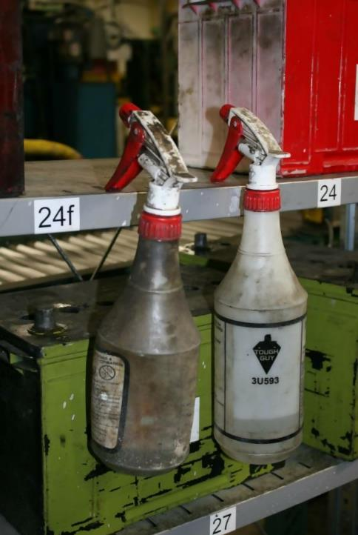
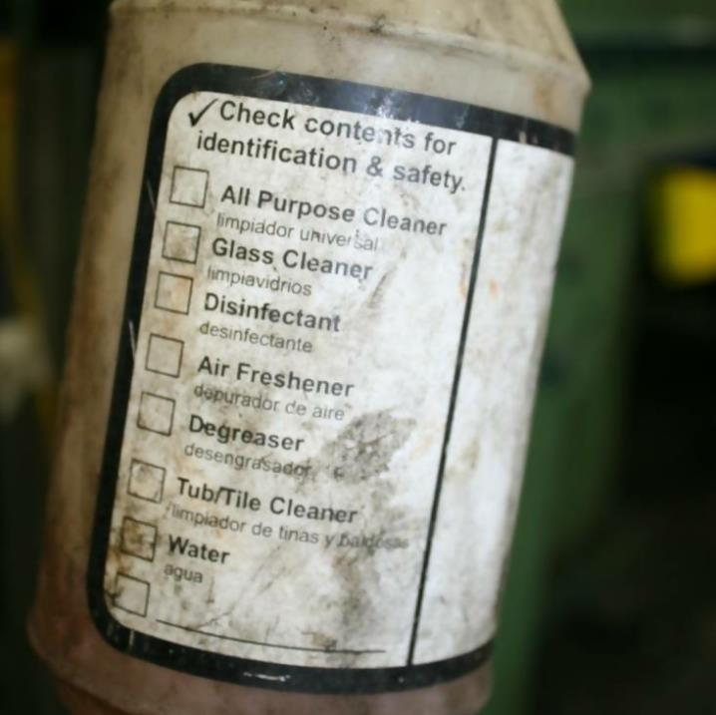
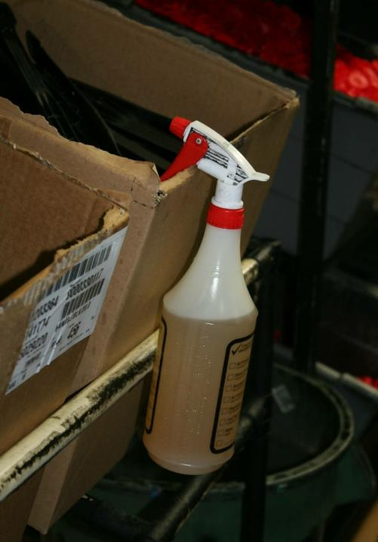
Unlabeled bottles – Part 2

Slide 16
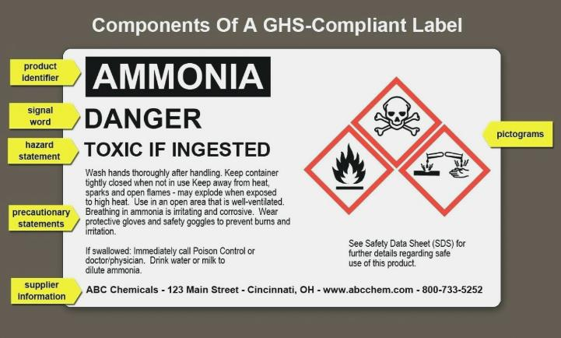
HAZCOM and G.H.S. – Part 7
Specific criteria for labels:
Notes:
Labels: Chemical manufacturers and importers will be required to provide a label that includes a harmonized signal word, pictogram, and hazard statement for each hazard class and category. Precautionary statements must also be provided.

Slide 17
HAZCOM and G.H.S. – Part 8
Harmonized format for safety data sheets:
      16 sections (ANSI format)
Notes:
A Harmonized System can be defined as the adjustment of differences and inconsistencies among different systems to make them uniform or mutually compatible. The GHS system is composed of several elements in such a way that the end result is an aligned system based on a common approach

Slide 18
HAZCOM and G.H.S. – Part 9
16 sections (ANSI Format)
Section 1, Identification includes the product identifier; manufacturer or distributor name, address, and phone number, along with an emergency phone number.
Section 2, Hazard(s) identification includes all hazards regarding the chemical and required label elements.
Section 3, Composition/information on ingredients includes information on chemical ingredients, along with trade secret claims.
Section 4, First-aid measures includes important symptoms—including effects, acute, and delayed—and required treatments.
Section 5, Fire-fighting measures lists suitable extinguishing techniques and equipment; it includes chemical hazards from fire.
Section 6, Accidental release measures lists emergency procedures; protective equipment; and proper methods of containment and cleanup.
Section 7, Handling and storage lists precautions for safe handling and storage, including incompatibilities.
Notes:
A Harmonized System can be defined as the adjustment of differences and inconsistencies among different systems to make them uniform or mutually compatible. The GHS system is composed of several elements in such a way that the end result is an aligned system based on a common approach

Slide 19
HAZCOM and G.H.S. – Part 10
16 sections (ANSI Format)
Section 8, Exposure controls/personal protection lists OSHA’s Permissible Exposure Limits (PELs); Threshold Limit Values (TLVs); appropriate engineering controls; and personal protective equipment (PPE).
Section 9, Physical and chemical properties lists the chemical’s characteristics.
Section 10, Stability and reactivity lists chemical stability and possibility of hazardous reactions.
Section 11, Toxicological information includes routes of exposure; related symptoms, acute and chronic effects; and numerical measures of toxicity.
Section 12, Ecological information*
Section 13, Disposal considerations*
Section 14, Transport information*
Section 15, Regulatory information*
Section 16, Other information includes the date of preparation or last revision.
Notes:
A Harmonized System can be defined as the adjustment of differences and inconsistencies among different systems to make them uniform or mutually compatible. The GHS system is composed of several elements in such a way that the end result is an aligned system based on a common approach

Slide 20
Module- 3
HAZCOM and G.H.S.
What is HAZCOM?
What changes came with G.H.S.
Pictograms, what are they?
Chemical hazards.

Slide 21

HAZCOM and G.H.S. – Part 11
Notes:
There are nine pictograms under the GHS to convey the health, physical and environmental hazards. The final Hazard Communication Standard (HCS) requires eight of these pictograms, the exception being the environmental pictogram, as environmental hazards are not within OSHA's jurisdiction. The hazard pictograms and their corresponding hazards are shown on this slide.
Pont out the red borders and explain the reasoning.
Under the revised Hazard Communication Standard (HCS), pictograms must have red borders. OSHA believes that the use of the red frame will increase recognition and comprehensibility. Therefore, the red frame is required regardless of whether the shipment is domestic or international.
Will OSHA allow blank red borders?
A. The revised Hazard Communication Standard (HCS) requires that all red borders printed on the label have a symbol printed inside it. If OSHA were to allow blank red borders, workers may be confused about what they mean and concerned that some information is missing. OSHA has determined that prohibiting the use of blank red borders on labels is necessary to provide the maximum recognition and impact of warning labels and to ensure that users do not get desensitized to the warnings placed on labels.

Slide 22

Health Hazard
Carcinogen
Mutagenicity
Reproductive Toxicity
Respiratory Sensitizer
Target Organ Toxicity
Aspiration Toxicity

Slide 23

Fire
Flammables
Pyrophorics
Self-Heating
Emits Flammable Gas
Self-Reactives
Organic Peroxides

Slide 24

Gas Cylinder
For gases Under Pressure
May exploded if heated punctured or dropped
Liquefied gases
Dissolved gases

Slide 25

Corrosion
Skin Corrosion/Burns
Eye Damage
Corrosive to Metals

Slide 26

Exploding Bomb
Explosives
Self-Reactives
Organic Peroxides

Slide 27

Skull and Crossbones
Acute Toxicity
(fatal or toxic)
Deadly
(oral, dermal, inhalation)

Slide 28

Harmful
Acute toxicity
Skin irritation
Eye irritation
Skin sensitization

Slide 29

Flame Over Circle
Oxidizers
Reacts w/ Oxygen

Slide 30

Environment
(Non-Mandatory)
Aquatic Toxicity

Slide 31
HAZCOM and G.H.S. – Part 12
Labels:
Chemical manufacturers and importers will be required to provide a label that includes a harmonized signal word, pictogram, and hazard statement for each hazard class and category.
Understanding the Danger ensure you correctly pair the correct P.P.E.
Safety Data Sheets:
Will now have a specified 16-section format.
Information and training: Employers were required to train workers by December 1, 2013 on the new label's elements and safety data sheets format to facilitate recognition and understanding.

Slide 32
Module- 4
HAZCOM and G.H.S.
What is HAZCOM?
What changes came with G.H.S.
Pictograms, what are they?
Chemical hazards.

Slide 33
HAZCOM and G.H.S. – Part 13
How has chemical hazard evaluation changed under the revised Hazard Communication Standard?
The revised HCS has specific criteria for each health and physical hazard.
It provides detailed instructions for hazard evaluation and determinations for classifying chemical substances and mixtures.
Hazard classes and hazard categories—for most of the effects, the classes are divided into categories that reflect the relative severity of the effect. Chemical manufacturers and importers are responsible for classifying the hazards of the chemicals they manufacture or import.

Slide 34
HAZCOM and G.H.S. – Part 14
During an inspection, you will be asked to produce:
Written HCS / HAZCOM Plan
List / Inventory of Chemicals Used in the Workplace
Evidence of Proper Labeling of Chemicals
SDS / MSDS Documents & Details about Employee Access
Information about Employee HazCom Training

Slide 35

HAZCOM and G.H.S. – Review

Slide 36
Knowledge Check
What is HAZCOM?
Hazard Communication Standard,
Also known as the Right-to-Know Law and more commonly as HAZCOM.
The goal is to Communicate the Hazards to the Workers.

Slide 37
Knowledge Check – Part 2
What is G.H.S.?
"Globally Harmonized System of Classification and Labeling of Chemicals"
The purpose is to provide harmonized information to users of chemicals with the goal of enhancing protection of human health and the environment..

Slide 38
Knowledge Check – Part 3
What is a PICTOGRAM?
    A pictogram consists of a symbol on a white background framed within a red border and represents a distinct hazard(s).
    GHS Pictograms graphically represent a chemical’s hazards. And is determined by the chemical hazard classification.

Slide 39
Knowledge Check – Part 4
What are the two signal Words that must appear on a label?
    WARNING
    or
    DANGER

Slide 40
Knowledge Check – Part 5
Besides the Pictograms, and the Signal Words… what else must appear on the labels?
    Hazard statements
    Precautionary statements
  See last page.

Slide 41
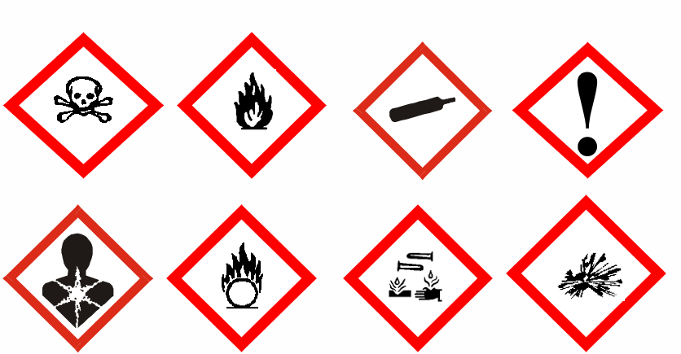
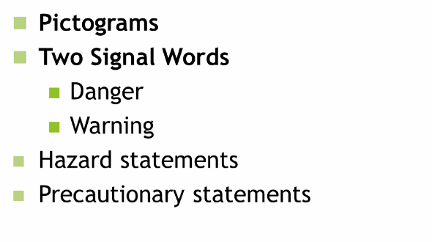
Knowledge Check – Part 6
OSHA maintains the approach in the current HCS that allows employers to use workplace-specific labeling systems as long as they provide the required information and make sure the information is consistent with the new classifications.

Slide 42
Additional Resources
OSHA website: http://www.osha.gov and OSHA offices: Call or Write (800-321-OSHA)
OSHA’s website on GHS
http://www.osha.gov/dsg/hazcom/global.html
National Institute for Occupational Safety and Health (NIOSH) – OSHA’s sister agency
OSHA Training Institute Education Centers
Public libraries

