Slide 1
Introduction to
Mill Safety
This material was produced under Susan Harwood grant number SH-31214-SH7 Occupational Safety and Health Administration, U.S. Department of Labor. The contents in this presentation do not necessarily reflect the views or policies of the U.S. Department of Labor, nor does the mention of trade names, commercial products, or organizations imply endorsement by the U.S. Government.

Slide 2
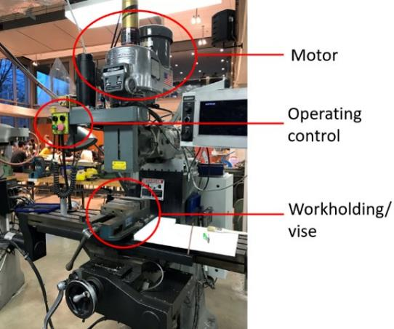
Introduction: What’s a mill?
Mills are highly adaptable, and can be used to cut material in a number of ways. The types of cuts they can perform include:
Flat surfaces
Grooves
Shoulders
Inclined Surfaces
Slots
The components of a Mill
Notes:
Commonly called "Bridgeport" style mills, these versatile mills are capable of performing many operations, including some that are similar to those performed on the drill press like drilling, reaming, countersinking, and counter boring. Other operations performed on the mill include but are not limited to side and face milling, fly cutting, and precision boring. Mills are classified on the basis of the position of their spindle. The spindle operates in either a vertical or horizontal position. The amount of horsepower the mill is able to supply to the cutter is also often important.
Source(s): http://www.bookrags.com/research/milling

Slide 3
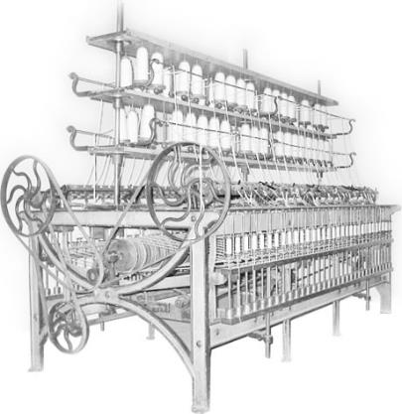
Introduction: Early mills
Mills are wheel-cutting machines
Early milling machines were used by clockmakers as far back as the 1700s
Eli Whitney is credited with designing the first modern, dependable milling machine
An early version of mill
Notes:
A milling machine is a wheel-cutting machine, dating from the 1700s and used by clockmakers, were the precursors of industrial milling machines. Eli Whitney is most often mentioned as the first to design and construct a milling machine that was dependable, and which served as a prototype for later, improved cutting machines.

Slide 4
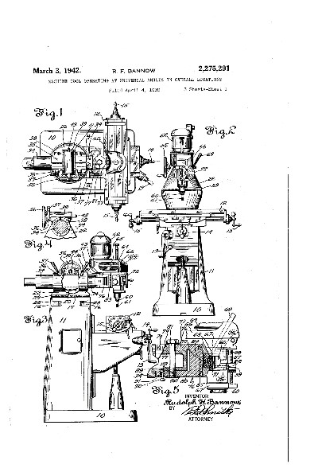
Introduction: Early mills continued
In 1936, Rudolph Bannow invented the Bridgeport milling machine
Bridgeport mills are still commonly used today
The success of the Bridgeport Mill has lead to numerous variations
The patent drawing of the Bridgeport milling machine
Notes:
In 1936, Rudolph Bannow conceived of the Bridgeport milling machine, which is still in production today. It was lighter, cheaper, and easier to use than many of the milling machines on the market at the time and became an instant success. Its success inspired others to copy the design, which lead to numerous clones.

Slide 5
Safety: Who is OSHA?
With the Occupational Safety and Health Act of 1970, Congress created the Occupational Safety and Health Administration (OSHA) to assure safe and healthful working conditions for working men and women by setting and enforcing standards and by providing training, outreach, education and assistance.
OSHA is part of the United States Department of Labor. The administrator for OSHA is the Assistant Secretary of Labor for Occupational Safety and Health. OSHA's administrator answers to the Secretary of Labor, who is a member of the cabinet of the President of the United States.
Notes:
OSHA was started to protect workers in the work place. Before OSHA there was no organization that tracked work place injuries. There were also no safety standards for employers.
OSHA has 2 branches, the Enforcement Branch and the Collaboration Branch.
The Enforcement Branch investigates complaints and serious accidents.
The Collaboration Branch works on education, such as the Susan Harwood Grant.

Slide 6
Safety: Know your rights
Under federal law, you are entitled to a safe workplace.
Your employer must provide a workplace free of known health and safety hazards.
If you have concerns, you have the right to speak up about them without fear of retaliation. You also have the right to:
Be trained in a language you understand
Work on machines that are safe
Be provided required safety gear, such as gloves or a harness and lifeline for falls
Be protected from toxic chemicals
Request an OSHA inspection, and speak to the inspector
Report an injury or illness, and get copies of your medical records
See copies of the workplace injury and illness log
Review records of work-related injuries and illnesses
Get copies of test results done to find hazards in the workplace
Notes:
Read the rights to the trainees and point them to the posters available around the workplace where they can refer to for more information.
Extra resources can be found at https://www.osha.gov/workers/index.html

Slide 7

Hazards: Machine-related injuries
Possible machine-related injuries include:
Crushed fingers or hands
Amputations
Blindness
Blindness is a possible machine-related injury
Notes:
Many accidents result from persons working on, or around, moving machinery. These accidents could have been prevented by the installation and proper maintenance of guarding. The goal of this training is to make the guarding of all equipment as easily understood as possible and re-inforce the safe working procedures that must always be in place around dangerous equipment.
This list of accidents is as long as it is horrifying.
Safeguards are essential for protecting workers from needless and preventable injuries. Where the operation of a machine can injure the operator or other workers, the hazard must be controlled or eliminated.
National Emphasis Program on Amputations*. CPL 03-00-019, (August 13, 2015). Describes policies and procedures for implementing a National Emphasis Program (NEP) to identify and to reduce workplace machinery and equipment hazards which are causing or likely to cause amputations.
Resource: https://www.osha.gov/dte/outreach/construction_generalindustry/gi_outreach_tp.html
https://safetyresourcesblog.com/2014/08/16/osha-quickcards-download-here-all-free-englishspanishother/

Slide 8
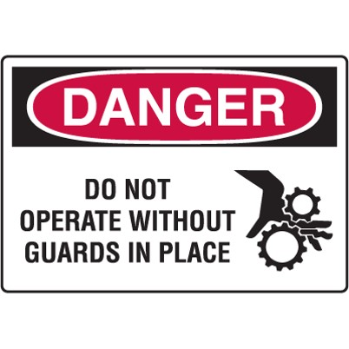
Hazards: Machinery accidents
Examples of how machine accidents can occur:
Hazardous conditions
  Missing or loose machine guards
Human actions
  Reaching-in to “clear” equipment
  Unauthorized persons doing maintenance or using the machines
An example of hazard signage to prevent accidents
Notes:
It is important for machine users to always check to make sure that the machine guards are in place or available prior to use.
Never reach in towards the point of operation of the machine while it is running.

Slide 9
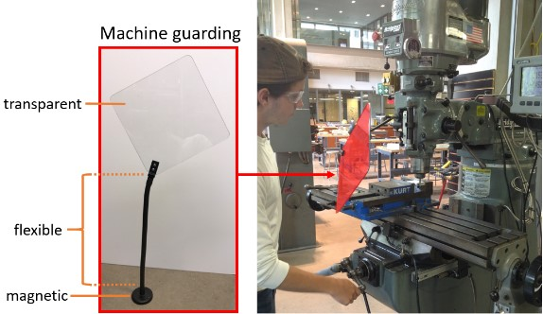
Hazards: What is machine guarding?
Machine Guarding is a means of shielding employees from moving or flying parts and preventing them from accidentally coming into contact with moving pieces of equipment.
The transparent guarding (highlighted in red) should be placed to shield the face. The flexible neck can be adjusted to different height/angle, and the magnetic base allows firm attachment to the mill.
Propper guarding for use of the mill
Notes:
Machine guarding is a means of shielding employees from moving or flying parts and preventing them from accidentally coming into contact with moving pieces of equipment.

Slide 10
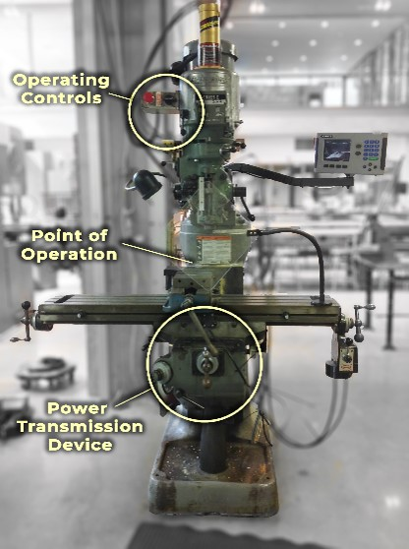
Hazards: Basic parts and hazards
Three fundamental machine areas:
Point of operation
Power transmission device
Other moving parts – Operating controls such as mechanical or electric power control
The three fundamental machine areas on a mill
Notes:
These hazards exist on the Milling Machine and they need to be guarded.
Explain that the Point of Operation is where the work is being done on the machine. In this case it is where the cutting tool contacts the work material.

Slide 11
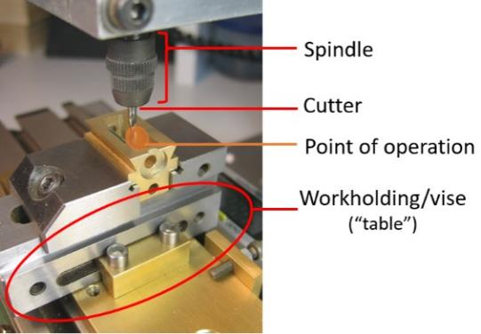
Hazards: Point of operation
The Point of Operation is the area on a machine where work is actually
performed on the material being processed (highlighted in orange).
The spindle is the rotating part, the cutter is the “drill,” and the workholding/vise is the “table.”
The point of operation for the mill
Notes:
The Point of Operation is the area on a machine where work is actually
performed on the material being processed (highlighted in orange).
The spindle is the rotating part, the cutter is the “drill,” and the workholding/vise is the “table.”

Slide 12
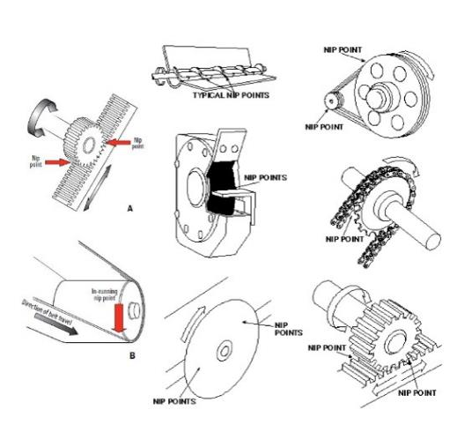
Hazards: Nip points and rotating parts
In-running nip points are commonly found among rotating or reciprocating parts. They
occur in two scenarios:
When machine parts move
toward each other
When machine parts run past a
stationary object
Examples of nip points in different mechanisms
Notes:
In-running nip points are commonly found among rotating or reciprocating parts. They
occur in two scenarios:
When machine parts move
toward each other
When machine parts run past a
stationary object

Slide 13
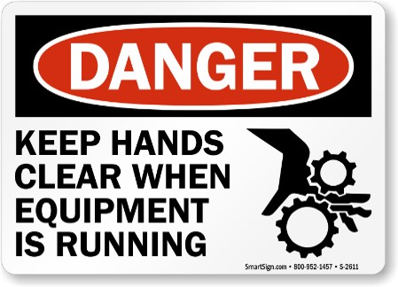
Hazards: Hazard Signage
To prevent injuries, be aware of hazard signages next to the machinery.
An example of hazard signage
Notes:
To prevent injuries, be aware of hazard signages next to the machinery.

Slide 14
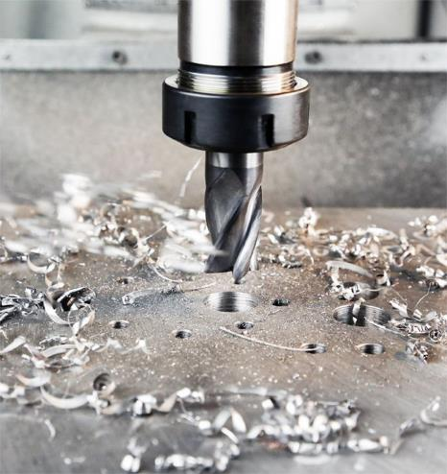
Hazards: Flying chips and sparks
Chips and other pieces of material may fly off of the mill at the point of operation during cutting.
Sparks may occur during cutting, especially at higher speeds or with harder materials such as steel
An example of chips created by the mill
Notes:
Chips and other pieces of material may fly off of the mill at the point of operation during cutting.
Sparks may occur during cutting, especially at higher speeds or with harder materials such as steel

Slide 15
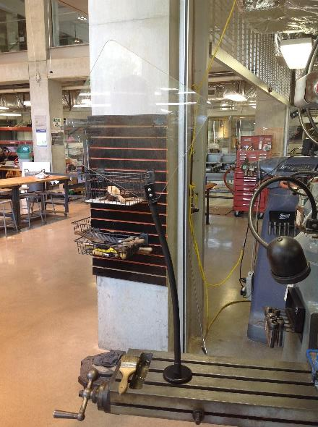
Hazards: Preventing injuries and amputations
Do not remove any guards or other devices
Do not operate the milling machine unless you are trained and authorized to operate the machine
Operators must place the jig or vise locking arrangement so that the force is exerted away from the cutter
A guard attached to the mill table
Notes:
Any user must have had the milling machine introduction before using it.
If the Emergency Stop switch is engaged, pull it out to reset it.
If a measurement needs to be made or a tool needs to be changed turn the directional switch off.
Do not reach in while the cutting tool is rotating.
If the milling machine is malfunctioning or something isn’t working right let one of the shop staff know.

Slide 16
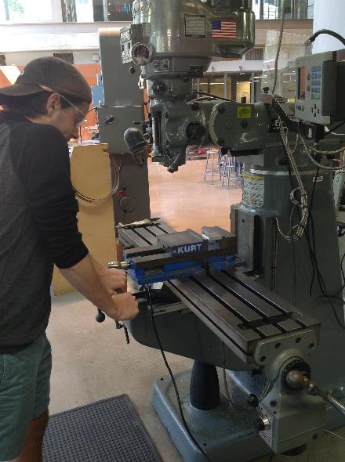
Hazards: Preventing injuries and amputations (continued)
Turn the spindle off before reaching in towards the Point of Operation, then move the work holding device back to a safe distance when loading or unloading parts and measuring work
Do not reach around the cutter or hob to remove chips while the machine is in motion or not locked/tagged out
If a machine needs maintenance/service, follow lock out tag out procedures
A young worker using the mill

Slide 17
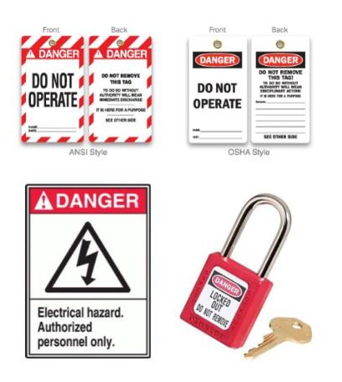
Hazards: Lockout/Tagout
Lockout/tagout procedures are safeguarding methods to prevent injury due to hazardous energy sources. If you see the machines with the signs featured in the image or that are under lock and key, please stay away and do not touch or attempt to start it.
Examples of Lockout/tagout equipment
Notes:
Lockout/tagout procedures are safeguarding methods to prevent injury due to hazardous energy sources. If you see the machines with the signs featured in the image or that are under lock and key, please stay away and do not touch or attempt to start it.

Slide 18
Hazards: Best practices
Set the guard to clear stock/workpiece
Wear Personal Protective Equipment (PPE) at all times
Clean up and clear work area
An example of hazard signage
Notes:
Personal Protective Equipment may be a bit uncomfortable or bulky, but needs to be worn to protect the user from injury.

