Slide 1
General Electrical Safety and Hazard Recognition

Slide 2
Susan Harwood Grant
This material was produced under Grant SH-31231-SH7 from the Occupational Safety and Health Administration, U.S. Department of Labor. It does not necessarily reflect the views or policies of the U.S. Department of Labor, nor does mention of trade names, commercial products, or organizations imply endorsement by the U.S. Government.

Slide 3
Employer Responsibilities
Employers have the responsibility to provide a safe workplace
Employers have the responsibility to…
Provide their employees with a workplace that does not have serious hazards and follow all relevant OSHA safety and health standards;
Inform employees about chemical hazards through training, labels, alarms, color-coded systems, chemical information sheets and other methods;
Keep accurate records of work-related injuries and illnesses;
Perform tests in the workplace, such as air sampling, required by some OSHA standards;
Provide hearing exams or other medical tests required by OSHA standards;
Post OSHA citations, injury and illness data, and the OSHA poster in the workplace where workers will see them;
Notify OSHA within 8 hours of a work-place incident in which there is a death; 24 hours when one or more workers are admitted to a hospital, amputations, and losses of an eye; and
Not discriminate or retaliate against workers for using their rights under the law.

Slide 4
Employee Rights & Responsibilities
You have the right to:
  A safe and healthful workplace
  Know about hazardous chemicals
  Information about injuries and illnesses in your workplace
  Complain or request hazard correction from employer
Notes:
The information above was taken from the new 2 hour Intro to OSHA PPT, slide #10.
The instructor will discuss employee rights and responsibilities with the participants.

Slide 5
Employee Rights & Responsibilities
You have the right to:
File a confidential complaint with OSHA to have their workplace inspected.
Receive information and training about hazards, methods to prevent harm, and the OSHA standards that apply to their workplace. The training must be done in a language and vocabulary workers can understand.
Get copies of their workplace medical records and exposure records.
Participate in an OSHA inspection and speak in private with the inspector.
Notes:
Workers Rights
http://www.osha.gov/Publications/osha3021.pdf

Slide 6
Employee Rights & Responsibilities
Continued:
File a complaint with OSHA if they have been retaliated or discriminated against by their employer as the result of requesting an inspection or using any of their other rights under the OSH Act.
File a complaint if punished or discriminated against for acting as a “whistleblower” under the additional 21 federal statutes for which OSHA has jurisdiction.
Notes:
Workers Rights
http://www.osha.gov/Publications/osha3021.pdf
Incorporate into all 4 modules. 3-4 slides need to be added.
Provide handouts to minimize amount of info on slides.

Slide 7


Whistleblower Protection Program
Whistle Blower Protection Program

Slide 8
Employee Rights and Responsibilities 1.1
You have the right to:
  A safe and healthful workplace
  Know about hazardous chemicals
  Information about injuries and illnesses in your workplace
  Complain or request hazard correction from employer
Notes:
Review Employee Rights www.osha.gov

Slide 9
Employee Rights and Responsibilities 1.2
You have the right to:
  Training
  Access to hazard exposure and medical records
  File a complaint with OSHA
  Participate in an OSHA inspection
  Be free from retaliation for exercising safety and health rights
Notes:
Review Employee Rights www.osha.gov

Slide 10
Introduction
General Electrical Safety and Hazard Recognition
Lesson objectives:
  Understand and describe the dangers of electricity
  Describe and identify different types of electrical hazards
Notes:
Enabling Objectives:
Identify major electrical hazards.
Describe types of electrical hazards.

Slide 11
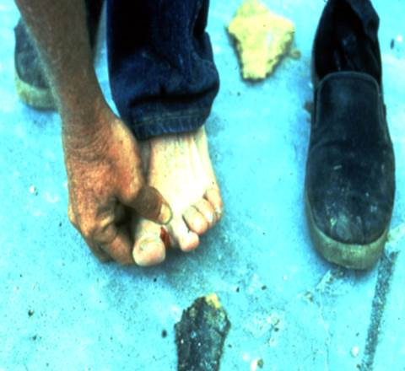
Electricity - The Dangers
Takes very little electricity to cause harm.
Significant risk of causing fires.
According to the U.S. Bureau of Labor Statistics, there were 156 electrocutions for 2014.
Courtesy OSHA
Notes:
Electricity has long been recognized as a serious workplace hazard, exposing employees to electric shock, electrocution, burns, fires, and explosions.
According to the U.S. Bureau of Labor Statistics, between 1992 and 2006, an average of
283 employees died per year from contact with electric current. This downward trend is due, in major part, to 30 years of highly protective OSHA regulation in the area of
electrical installation, based on the NEC and NFPA 70E standards. The final standard carries
forward most of the existing requirements for electrical installations, with the new and revised
requirements intended as fine tuning, introducing new technology along with other
improvements in safety. By complying with the final standard, employers will prevent unsafe
electrical conditions from occurring.

Slide 12
Dangers Of Electricity
SHOCK
ARC
BURNS
BLAST
FALLS
Notes:
Electricity is widely recognized as a serious workplace hazard, exposing employees to electric shock, burns, fires, and explosions.
It is well known that the human body will conduct electricity. If direct body contact is made with an electrically energized part while a similar contact is made simultaneously with another conductive surface that is maintained at a different electrical potential, a current will flow, entering the body at one contact point, traversing the body, and then exiting at the other contact point, usually the ground. Each year many employees suffer pain, injuries, and death from such electric shocks.
Current through the body, even at levels as low as 3 milliamperes, can also cause injuries of an indirect or secondary injuries in which involuntary muscular reaction from the electric shock can cause bruises, bone fractures and even death resulting from collisions or falls.

Slide 13
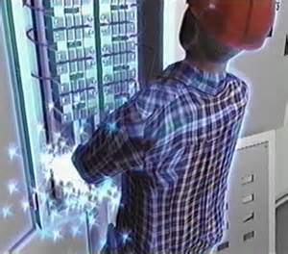
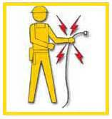
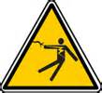
SHOCK 1.1
Serious injuries and death can be caused by electrical hazards such as arc flash, shocks, burns, falls, and fires. Source of graphics: OSHA
Notes:
Source: https://www.osha.gov/Publications/osha3075.pdf
“Most electrical accidents result from one of the following three factors:
• unsafe equipment or installation,
• unsafe environment, or
• unsafe work practices.”

Slide 14
SHOCK 1.2
Electrical shock is the physical stimulation that occurs when electrical current passes through the body.
The effect that electric shock has on the body depends on:
  The voltage magnitude
  The magnitude of the current flow
  The body parts through which the current flows
  Duration of contact
  General physical condition of the person being
shocked
Notes:
Other factors that may affect the severity of the shock are:
- The voltage of the current.
- The presence of moisture
- The general health of the person prior to the shock.
Low voltages can be extremely dangerous because, all other factors being equal, the degree of injury increases the longer the body is in contact with the circuit.
The resistance of the body varies based on:
The amount of moisture on the skin (less moisture = more resistance)
The size of the area of contact (smaller area = more resistance)
The pressure applied to the contact point (less pressure = more resistance)
Muscular structure (less muscle = less resistance)

Slide 15
Shock and Burns
Current, not voltage, causes Electric Shock
mA Affect on Person
0.5 - 3 Tingling sensation
3+ May be painful
10+ Muscle contractions and pain
30+ Respiratory paralysis
75+ Ventricular fibrillation
4+ Amps Heart Paralysis
5+ Amps Tissue and Organs start to burn
Source: OSHA
Notes:
Shock-related injuries include burns, internal injuries, and injuries due to involuntary muscle contractions. The most common shock-related injury is a burn. Burns suffered in electrical incidents may be one or more of the following three types. Electrical burns cause tissue damage, and are the result of heat generated by the flow of electrical current through the body. These are one of the most serious injuries you can receive and require immediate attention. Arc or Flash burns are caused by high temperatures near the body produced by an electrical arc or explosion. Attend to them immediately. Thermal contact burns occur when skin comes in contact with overheated electric equipment, or when clothing is ignited by an electrical incident.
Burns suffered in electrical accidents can be very serious. These burns may be of three basic types: electrical burns, arc burns, and thermal contact burns. Electrical burns are the result of the electric current flowing in the tissues, and may be either skin deep or may affect deeper layers (such as muscles and bones) or both. Tissue damage is caused by the heat generated from the current flow; if the energy delivered by the electric shock is high, the body cannot dissipate the heat, and the tissue is burned. Typically, such electrical burns are slow to heal. Arc burns are the result of high temperatures produced by electric arcs or by explosions close to the body. Finally, thermal contact burns are those normally experienced from the skin contacting hot surfaces of overheated electric conductors, conduits, or other energized equipment. In some circumstances, all three types of burns may be produced simultaneously.

Slide 16
Arcing
Electric arcing occurs when a substantial amount of electric current flows through what previously had been air.
  When the conductor vaporizes, the metal vapor can conduct current
  Fault will continue until source is de-energized or conductor is consumed

Slide 17
Arc Flash
Factors which affect injuries due to electric arc:
Distance from arc
Absorption coefficient of clothing
Temperature of arc
Time of exposure
Length of arc

Slide 18
Temperature data
On-Set of 2nd degree burn (1/10 sec) 176º F
3rd degree (cell death) (1/10 sec) 205º F
Temperature at arc terminals 35,000º F
Temperature of sun’s surface 9941º F
Temperature of burning clothing 1400º F
Notes:
The ignition temperature of clothing made from natural fibers varies from 700°F to about 1400°F

Slide 19
Burns 1.1
Most common shock-related injury
Occurs when you touch electrical wiring or equipment that is improperly used or maintained
Typically occurs on hands
Notes:
Shock-related injuries include burns, internal injuries, and injuries due to
involuntary muscle contractions.

Slide 20
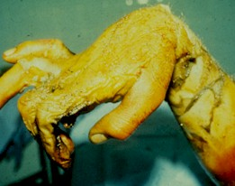
Involuntary Muscle Contraction Caused by Shock
Courtesy OSHA
Notes:
https://www.osha.gov/SLTC/etools/construction/images/ecbp35.jpg
This worker fell and grabbed a powerline to catch himself. The resulting electric shock mummified his first two fingers, which had to be removed. The acute angle of the wrist was caused by burning of the tendons, which contracted, drawing the hand with them.

Slide 21
Burns 1.2
Burns suffered in electrical incidents may be one or more of the following three types.
Electrical burns cause tissue damage, and are the result of heat generated by the flow of electrical current through the body. These are one of the most serious injuries you can receive and require immediate attention.
Arc or Flash burns are caused by high temperatures near the body produced by an electrical arc or explosion. Attend to them immediately.
Thermal contact burns occur when skin comes in contact with overheated electric equipment, or when clothing is ignited by an electrical incident.

Slide 22
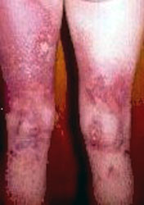
Thermal Contact Burns
Courtesy OSHA
Notes:
https://www.osha.gov/SLTC/etools/construction/images/ecbp35.jpg
Current exited this man at his knees, catching his clothing on fire and burning his upper leg.

Slide 23
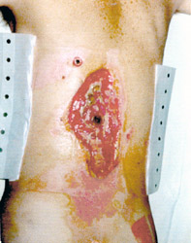
Electrical Burns
Courtesy OSHA
Notes:
https://www.osha.gov/SLTC/etools/construction/images/ecbp35.jpg
Entrance Wound: High resistance of skin transforms electrical energy into heat, which produces burns around the entrance point (dark spot in center of wound). This man was lucky, the current narrowly missed his spinal cord.

Slide 24
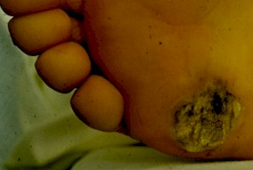
Contact With Ground
Courtesy OSHA
Notes:
https://www.osha.gov/SLTC/etools/construction/images/ecbp35.jpg
Exit Wound: Current flows through the body from the entrance point, until finally exiting where the body is closest to the ground. This foot suffered massive internal injuries, which weren't readily visible, and had to be amputated a few days later.

Slide 25
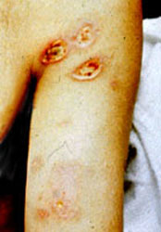
Arc or Flash Burns
Courtesy OSHA
Notes:
https://www.osha.gov/SLTC/etools/construction/images/ecbp35.jpg
This man was near a power box when an electrical explosion occurred. Though he did not touch the box, electricity arced through the air and entered his body. The current was drawn to his armpits because perspiration is very conductive.

Slide 26
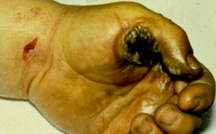
Electrical Burns Get Worse Before They Get Better
Courtesy OSHA
Notes:
https://www.osha.gov/SLTC/etools/construction/images/ecbp35.jpg
Internal Injuries
This worker was shocked by a tool he was holding. The entrance wound and thermal burns from the overheated tool are apparent.

Slide 27
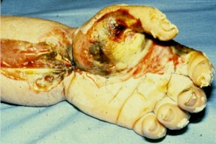
A Few Days Later
Courtesy OSHA
Notes:
https://www.osha.gov/SLTC/etools/construction/images/ecbp35.jpg
Same hand a few days later, when massive subcutaneous tissue damage had caused severe swelling (swelling usually peaks 24-72 hours after electrical shock). To relieve pressure which would have damaged nerves and blood vessels, the skin on the arm was cut open.

Slide 28
Survival Rates from a Burn Injury
100
25% Body Burn
80
50% Body Burn
60
75% Body Burn
Chance
of Survival, %
40
20
0
20-29 30-39 40-49 50-59
Age Range, Years
Source: American Burn Association (1991-1993 Study)

Slide 29
Arc Blast
Blast comes from the pressure developed by the near-instantaneous heating of the air surrounding the arc and from the expansion of the metal as it is vaporized:
  Throw people from ladders
  Causes deafness
  Knocks down walls
  Burns
  Damage to internal organs

Slide 30
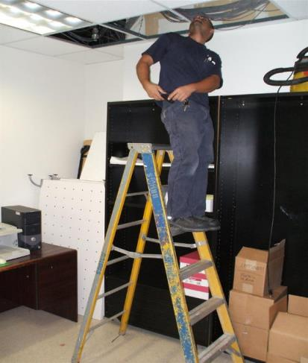
Falls
Workers in elevated locations who experience a shock may fall, resulting in serious injury or death
Courtesy OSHA
Notes:
During electrical incidents affect personnel will do whatever it takes to get away from the exposure. Falls cause a great deal of secondary injuries during electrical incidents

Slide 31
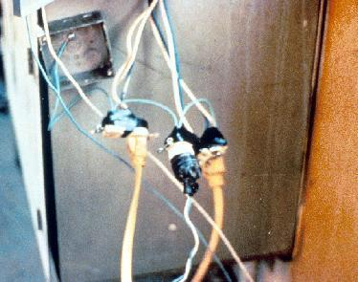
Electrical Hazards 1.1
Electrical accidents are caused by a combination of three factors:
  Unsafe equipment and/or installation,
  Workplaces made unsafe by the environment, and
  Unsafe work practices.
Courtesy OSHA

Slide 32
Electrical Hazards 1.2
Electrical shocks, fires, or falls result from these hazards:
  Exposed electrical parts
  Overhead power lines
  Inadequate wiring
  Defective insulation
  Improper grounding
  Overloaded circuits
  Wet conditions
  Damaged tools and equipment
  Improper PPE

Slide 33
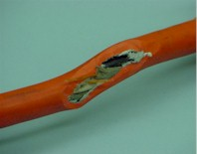
Clues that Electrical Hazards Exist
Tripped circuit breakers or blown fuses
Warm tools, wires, cords, connections, or junction boxes
GFCI that shuts off a circuit
Worn or frayed insulation around wire or connection
Courtesy OSHA
Notes:
There are “clues” that electrical hazards exist. For example, if a GFCI keeps tripping while you are using a power tool, there is a problem. Don’t keep resetting the GFCI and continue to work. You must evaluate the “clue” and decide what action should be taken to control the hazard.
There are a number of other conditions that indicate a hazard.
Tripped circuit breakers and blown fuses show that too much current is flowing in a circuit. This could be due to several factors, such as malfunctioning equipment or a short between conductors. You need to determine the cause in order to control the hazard.
An electrical tool, appliance, wire, or connection that feels warm may indicate too much current in the circuit or equipment. You need to evaluate the situation and determine your risk.
An extension cord that feels warm may indicate too much current for the wire size of the cord. You must decide when action needs to be taken.
A cable, fuse box, or junction box that feels warm may indicate too much current in the circuits.
A burning odor may indicate overheated insulation.
Worn, frayed, or damaged insulation around any wire or other conductor is an electrical hazard because the conductors could be exposed. Contact with an exposed wire could cause a shock. Damaged insulation could cause a short, leading to arcing or a fire. Inspect all insulation for scrapes and breaks. You need to evaluate the seriousness of any damage you find and decide how to deal with the hazard.
A GFCI that trips indicates there is current leakage from the circuit First, you must decide the probable cause of the leakage by recognizing any contributing hazards. Then, you must decide what action needs to be taken.

Slide 34
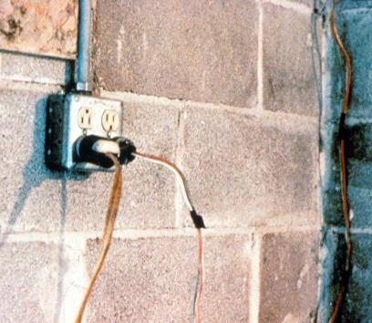
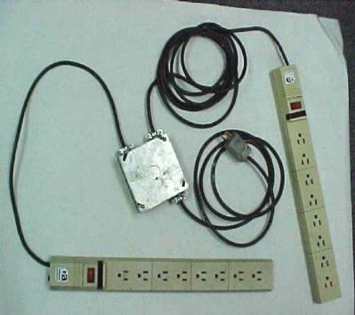
Hazard – Defective Cords & Wires
Photos represent cords that have been manipulated and used in an unsafe manner other than the manufacture recommend use. Photos courtesy of OSHA.
Notes:
Extension cords may have damaged insulation. Sometimes the insulation inside an electrical tool or appliance is damaged. When insulation is damaged, exposed metal parts may become energized if a live wire inside touches them. Electric hand tools that are old, damaged, or misused may have damaged insulation inside. If you touch damaged power tools or other equipment, you will receive a shock. You are more likely to receive a shock if the tool is not grounded or double-insulated.

Slide 35
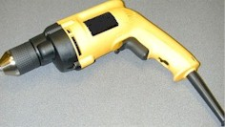
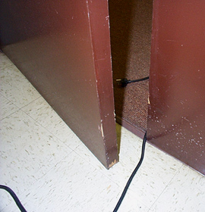
Control – Ground Tools & Equipment
Ground power supply systems, electrical circuits, and electrical equipment
Frequently inspect electrical systems to insure path to ground is continuous
Inspect electrical equipment before use
Don’t remove ground prongs from tools or extension cords
Ground exposed metal parts of equipment
Photos courtesy of OSHA
Notes:
A typical extension cord grounding system has four components:
a third wire in the cord, called a ground wire;
a three-prong plug with a grounding prong on one end of the cord;
a three-wire, grounding-type receptacle at the other end of the cord; and
a properly grounded outlet.
Two kinds of grounds are required by the standard:
1. Service or system ground. In this instance, one wire, called the neutral conductor or grounded conductor, is grounded. In an ordinary low-voltage circuit, the white (or gray) wire is grounded at the generator or transformer and again at the service entrance of the building. This type of ground is primarily designed to protect machines, tools, and insulation against damage.
2. For enhanced worker protection, an additional ground, called the equipment ground, must be furnished by providing another path from the tool or machine through which the current can flow to the ground. This additional ground safeguards the electric equipment operator if a malfunction causes the metal frame of the tool to become energized.

Slide 36
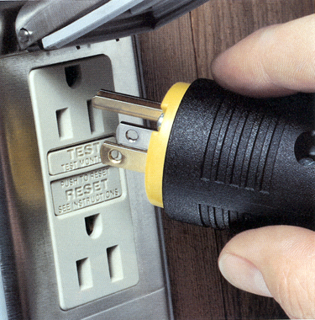
Power Tool Requirements
  Have a three-wire cord with ground plugged into a grounded receptacle, or
  Be double insulated, or
  Be powered by a low-voltage isolation transformer
Courtesy OSHA
Notes:
Common Examples of Misused Equipment = OSHA Violations
* Using multi-receptacle boxes designed to be mounted by fitting them with a power cord and placing them on the floor.
* Fabricating extension cords with ROMEX® wire.
* Using equipment outdoors that is labeled for use only in dry, indoor locations.
* Attaching ungrounded, two-prong adapter plugs to three-prong cords and tools.
* Using circuit breakers or fuses with the wrong rating for over-current protection, e.g. using a 30-amp breaker in a system with 15- or 20-amp receptacles. Protection is lost because it will not trip when the system's load has been exceeded.
* Using modified cords or tools, e.g., removing ground prongs, face plates, insulation, etc.
* Using cords or tools with worn insulation or exposed wires.

Slide 37
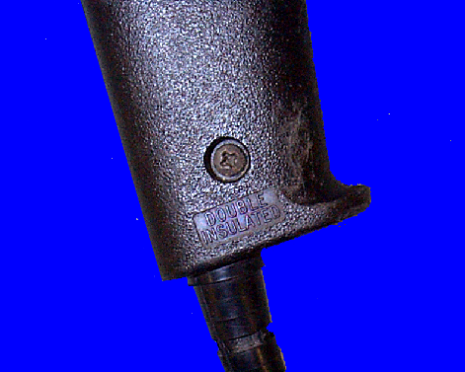
Preventing Electrical Hazards - Tools
Inspect tools before use
Use the right tool correctly
Protect your tools
Use double insulated tools
  Double Insulated marking
Courtesy OSHA
Notes:
* Use tools and equipment according to the instructions included in their listing, labeling or certification.
* Visually inspect all electrical equipment before use. Remove from service any equipment with frayed cords, missing ground prongs, cracked tool casings, etc. Apply a warning tag to any defective tool and do not use it until the problem has been corrected.

Slide 38
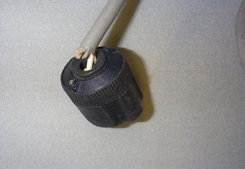
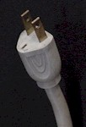
Hazard – Improper Grounding
Tools plugged into improperly grounded circuits may become energized
Broken wire or plug on extension cord
Most frequently violated OSHA standards
Photos courtesy OSHA
Notes:
The most frequently violated OSHA electrical regulation is improper grounding of equipment and circuitry. The metal parts of an electrical wiring system that we touch (switch plates, ceiling light fixtures, conduit, etc.) should be grounded and at 0 volts. If the system is not grounded properly, these parts may become energized. Metal parts of motors, appliances, or electronics that are plugged into improperly grounded circuits may be energized. When a circuit is not grounded properly, a hazard exists because unwanted voltage cannot be safely eliminated. If there is no safe path to ground for fault currents, exposed metal parts in damaged appliances can become energized.
Extension cords may not provide a continuous path to ground because of a broken ground wire or plug.
Electrical systems are often grounded to metal water pipes that serve as a continuous path to ground. If plumbing is used as a path to ground for fault current, all pipes must be made of conductive material (a type of metal). Many electrocutions and fires occur because (during renovation or repair) parts of metal plumbing are replaced with plastic pipe, which does not conduct electricity.

Slide 39
Control - Assured Equipment Grounding Conductor Program
Program must cover:
  All cord sets
  Receptacles not part of a building or structure
  Equipment connected by plug and cord
Program requirements include:
  Specific procedures adopted by the employer
  Competent person to implement the program
  Visual inspection for damage of equipment connected by cord and plug
Notes:
Reference 1926.404(b)(1)(iii)
Assured Equipment Grounding Conductor Program (AEGCP).
The employer shall establish and implement AEGCP on construction sites covering all listed above which are available for use or used by employees. This program has the following minimum requirements:
- Daily visual inspections,
- Periodic test inspections (3 months at most for temporary cords and cords exposed to damage, 6 months for fixed cords not exposed)
- Written description,
- A competent person to implement the program, and
- Record of the periodic tests.
When portions of the building(s) or structures(s) which have been completed and no longer expose employees to weather or damp and wet locations, or to other grounding hazards, GFCIs or an assured equipment grounding program may not be required when approved extension cords are plugged into the permanent wiring at construction sites.

Slide 40
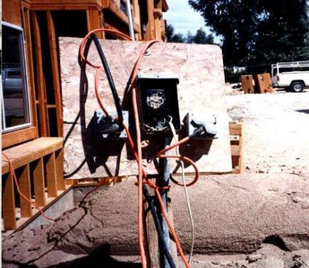
Hazard – Overloaded Circuits
Hazards may result from:
Too many devices plugged into a circuit, causing heated wires and possibly a fire
Damaged tools overheating
Lack of overcurrent protection
Wire insulation melting, which may cause arcing and a fire in the area where the overload exists, even inside a wall
Courtesy OSHA
Notes:
If the circuit breakers or fuses are too big (high current rating) for the wires they are supposed to protect, an overload in the circuit will not be detected and the current will not be shut off. A circuit with improper overcurrent protection devices – or one with no overcurrent protection devices at all – is a hazard.

Slide 41
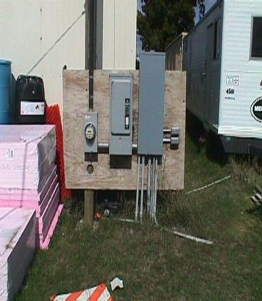
Control - Electrical Protective Devices
Automatically opens circuit if excess current from overload or ground-fault is detected – shutting off electricity
Includes GFCI’s, fuses, and circuit breakers
Fuses and circuit breakers are overcurrent devices. When too much current:
    Fuses melt
    Circuit breakers trip open
Courtesy OSHA
Notes:
To prevent too much current in a circuit, a circuit breaker or fuse is placed in the circuit. If there is too much current in the circuit, the breaker “trips” and opens like a switch. If an overloaded circuit is equipped with a fuse, an internal part of the fuse melts, opening the circuit. Both breakers and fuses do the same thing: open the circuit to shut off the electrical current
The basic idea of an overcurrent device is to make a weak link in the circuit. In the case of a fuse, the fuse is destroyed before another part of the system is destroyed. In the case of a circuit breaker, a set of contacts opens the circuit. Unlike a fuse, a circuit breaker can be re-used by re-closing the contacts. Fuses and circuit breakers are designed to protect equipment and facilities, and in so doing, they also provide considerable protection against shock in most situations. However, the only electrical protective device whose sole purpose is to protect people is the ground-fault circuit-interrupter.

Slide 42
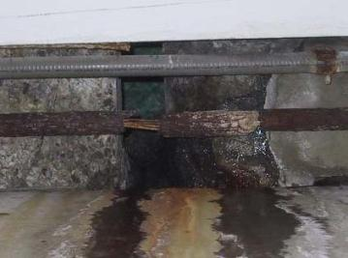
Avoid Wet Conditions 1.1
If you touch a live wire or other electrical component while standing in even a small puddle of water you’ll get a shock.
Damaged insulation, equipment, or tools can expose you to live electrical parts.
Unsafe condition
Photo of corroded pipe exposing electrical conductors. Photo courtesy of OSHA.
Notes:
A damaged tool may not be grounded properly, so the housing of the tool may be energized, causing you to receive a shock.
Improperly grounded metal switch plates and ceiling lights are especially hazardous in wet conditions. If you touch a live electrical component with an uninsulated hand tool, you are more likely to receive a shock when standing in water. But remember: you don’t have to be standing in water to be electrocuted. Wet clothing, high humidity, and perspiration also increase your chances of being electrocuted.
Use extra caution when working with electricity when water is present in the environment or on the skin. Pure water is a poor conductor, but small amounts of impurities, like salt and acid (both are in perspiration), make it a ready conductor.

Slide 43
Avoid Wet Conditions 1.2
Improperly grounded metal switch plates & ceiling lights are especially hazardous in wet conditions.
Wet clothing, high humidity, and perspiration increase your chances of being electrocuted.

Slide 44
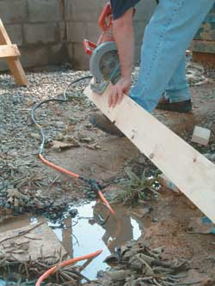
What if I work in wet conditions with electricity?
Avoid working in wet conditions, whenever possible
Use approved electrical equipment for wet conditions
Do not stand in wet areas and operate electrical equipment
How many unsafe acts can you identify?
Courtesy OSHA
Notes:
Trainers Notes:
Remind the class that, based on Ohms Law, working in wet conditions greatly reduces the resistance and puts workers at increased risk of electrocution. Using the hierarchy of controls, the highest level of protection comes from eliminating the hazard: avoid working in wet conditions, whenever possible. If that can’t be done, using approved electrical equipment can help.
Ask the class how many things they can see that are wrong in this picture. Make sure they note the patched cord running through the puddle.

Slide 45
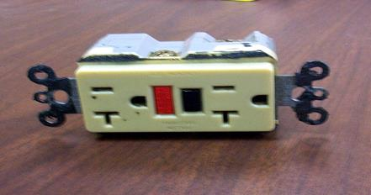
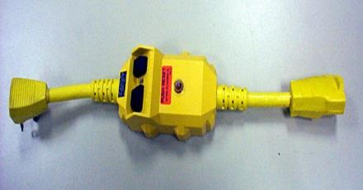
Control – Use GFCI
(ground-fault circuit interrupter)
Protects you from shock
Detects difference in current between the black and white wires
If ground fault detected, GFCI shuts off electricity in 1/40th of a second
Use GFCI’s on all 120-volt, single-phase, 15- and 20-ampere receptacles, or have an assured equipment grounding conductor program.
Photos courtesy OSHA
Notes:
GFCI:
Matches the amount of current going to an electrical device against the amount of current returning from the device.
Interrupts the electric power within as little as 1/40 of a second when the amount of current going differs from the amount returning by about 5 mA
Must be tested to ensure it is working correctly.
NEC requires GFCI’s be used in these high-risk situations:
Electricity is used near water.
The user of electrical equipment is grounded (by touching grounded material).
Circuits are providing power to portable tools or outdoor receptacles.
Temporary wiring or extension cords are used.
There is one disadvantage to grounding: a break in the grounding system may occur without the user's knowledge. Using a ground-fault circuit interrupter (GFCI) is one way of overcoming grounding deficiencies.

Slide 46
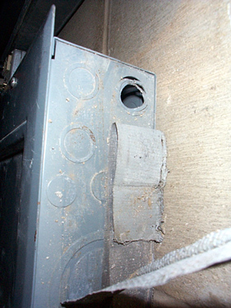
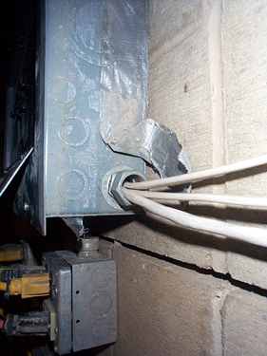
Hazard – Isolate Electrical Parts - Cabinets, Boxes & Fittings
Photos courtesy OSHA
Notes:
Conductors entering boxes, cabinets, or fittings. Conductors entering boxes, cabinets, or fittings shall be protected from abrasion, and openings through which conductors enter shall be effectively closed. Unused openings in cabinets, boxes, and fittings shall also be effectively closed.
Covers and canopies. All pull boxes, junction boxes, and fittings shall be provided with covers. If metal covers are used, they shall be grounded. In energized installations each outlet box shall have a cover, faceplate, or fixture canopy. Covers of outlet boxes having holes through which flexible cord pendants pass shall be provided with bushings designed for the purpose or shall have smooth, well‑rounded surfaces on which the cords may bear.

Slide 47
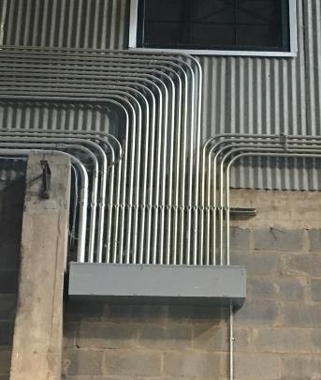
Preventing Electrical Hazards – Proper Wiring and Connectors
Courtesy Doug Zemler

Slide 48
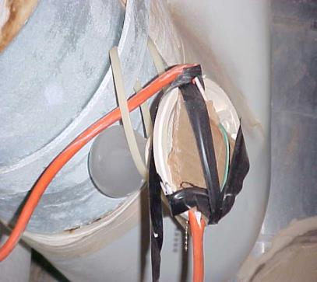
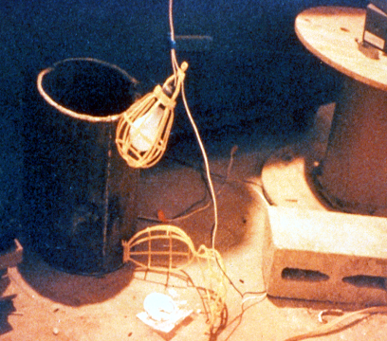
Temporary Lighting 1.1
Protect from contact and damage
Do not suspend by cords unless designed to do so
Photos courtesy OSHA
Notes:
Reference 1926.405(a)(2)

Slide 49
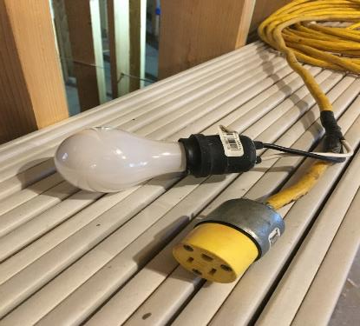
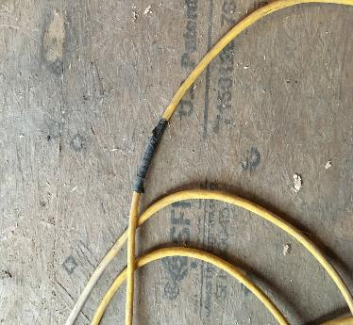
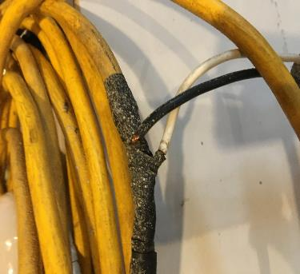
Temporary Lighting 1.2
Home made temporary lighting setup.
Photos courtesy Doug Zemler

Slide 50
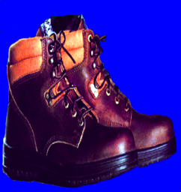
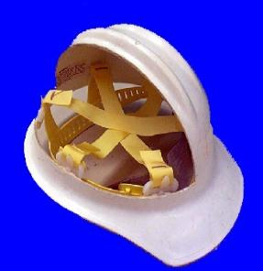
Preventing Electrical Hazards - PPE
    Proper foot protection (not tennis shoes)
    Rubber insulating gloves, hoods, sleeves, matting, and blankets
    Hard hat (insulated - nonconductive)
Photos courtesy OSHA
Notes:
Personal protective equipment (PPE) should always be the last line of defense against a hazard. If the hazard is unavoidable, and cannot be addressed in any other safe manner, then employees must be fitted with proper PPE.
Safety shoes should be nonconductive and protect your feet from completing an electrical circuit to ground. They can also protect against open circuits of up to 600 volts in dry conditions. These shoes should be used with other insulating equipment and in connection with active precautions to reduce or eliminate the potential for providing a path for hazardous electrical energy.
When it is necessary to handle or come close to wires with a potential live electrical charge, it is essential to use proper insulating PPE to protect employees from contact with the hazardous electrical energy.
Specific types of hard hats are needed when performing electrical work.
A “Class B” Electrical/Utility type hard hat protects against falling objects and high-voltage shock and burns.

Slide 51
Summarize
Takes very little electricity to cause harm.
Current, not voltage, causes electric shock.
Burns are the most common shock related injury received by people working with electricity.
Electrical accidents occur from unsafe equipment, unsafe work environment or unsafe work practices.

