Slide 1
Introduction to
Drill Press Safety
This material was produced under Susan Harwood grant number SH-31214-SH7 Occupational Safety and Health Administration, U.S. Department of Labor. The contents in this presentation do not necessarily reflect the views or policies of the U.S. Department of Labor, nor does the mention of trade names, commercial products, or organizations imply endorsement by the U.S. Government.

Slide 2
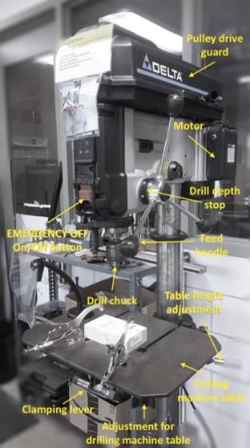
Introduction: What’s a Drill Press?
The Drill Press, also called the Drilling Machine, is a device for producing holes in hard substances. The drill is held in a rotating spindle and is fed into the workpiece, which is usually clamped in a vise resting on a table.
The components of a drill press

Slide 3
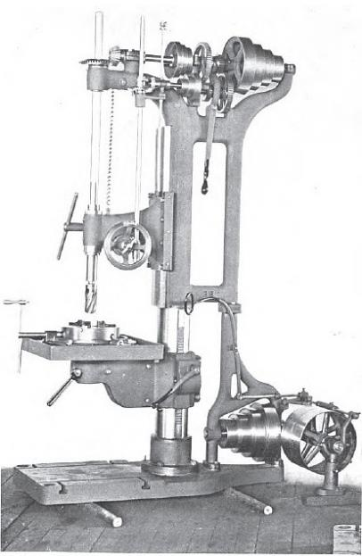
Introduction: Early Drill Press
The first drill presses appeared in blacksmith and machine workshops more than 200 years ago. They were built for cutting metal and were powered by a hand crank.
An early version of the drill press

Slide 4
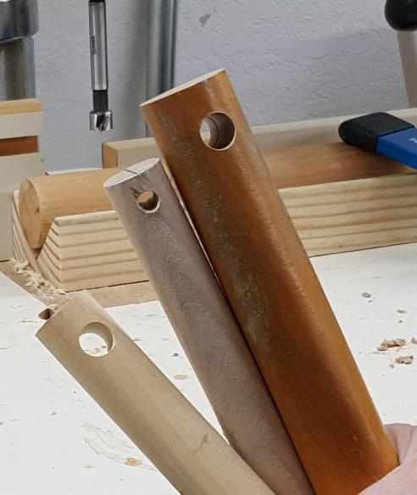
What it Does: What is a drill press used for?
Drill presses are primarily used to drill or enlarge a cylindrical hole in a workpiece or part such as the ones shown in the image here. They can also be used for reaming, countersinking, counterboring, and tapping.
An example of holes made using the drill press

Slide 5
Safety: Who is OSHA?
With the Occupational Safety and Health Act of 1970, Congress created the Occupational Safety and Health Administration (OSHA) to assure safe and healthful working conditions for working men and women by setting and enforcing standards and by providing training, outreach, education and assistance.
OSHA is part of the United States Department of Labor. The administrator for OSHA is the Assistant Secretary of Labor for Occupational Safety and Health. OSHA's administrator answers to the Secretary of Labor, who is a member of the cabinet of the President of the United States.
Notes:
OSHA was started to protect workers in the work place. Before OSHA there was no organization that tracked work place injuries. There were also no safety standards for employers.
OSHA has 2 branches, the Enforcement Branch and the Collaboration Branch.
The Enforcement Branch investigates complaints and serious accidents.
The Collaboration Branch works on education, such as the Susan Harwood Grant.

Slide 6
Safety: Know your rights
Under federal law, you are entitled to a safe workplace.
Your employer must provide a workplace free of known health and safety hazards.
If you have concerns, you have the right to speak up about them without fear of retaliation. You also have the right to:
Be trained in a language you understand
Work on machines that are safe
Be provided required safety gear, such as gloves or a harness and lifeline for falls
Be protected from toxic chemicals
Request an OSHA inspection, and speak to the inspector
Report an injury or illness, and get copies of your medical records
See copies of the workplace injury and illness log
Review records of work-related injuries and illnesses
Get copies of test results done to find hazards in the workplace
Notes:
Read the rights to the trainees and point them to the posters available around the workplace where they can refer to for more information.
Extra resources can be found at https://www.osha.gov/workers/index.html

Slide 7

Hazards: Machine-related injuries
Possible machine-related injuries include:
Crushed fingers or hands
Amputations
Blindness
Blindness is a possible machine-related injury
Notes:
Many accidents result from persons working on, or around, moving machinery. These accidents could have been prevented by the installation and proper maintenance of guarding. The goal of this training is to make the guarding of all equipment as easily understood as possible and re-inforce the safe working procedures that must always be in place around dangerous equipment.
This list of accidents is as long as it is horrifying.
Safeguards are essential for protecting workers from needless and preventable injuries. Where the operation of a machine can injure the operator or other workers, the hazard must be controlled or eliminated.
National Emphasis Program on Amputations*. CPL 03-00-019, (August 13, 2015). Describes policies and procedures for implementing a National Emphasis Program (NEP) to identify and to reduce workplace machinery and equipment hazards which are causing or likely to cause amputations.
Resource: https://www.osha.gov/dte/outreach/construction_generalindustry/gi_outreach_tp.html
https://safetyresourcesblog.com/2014/08/16/osha-quickcards-download-here-all-free-englishspanishother/

Slide 8
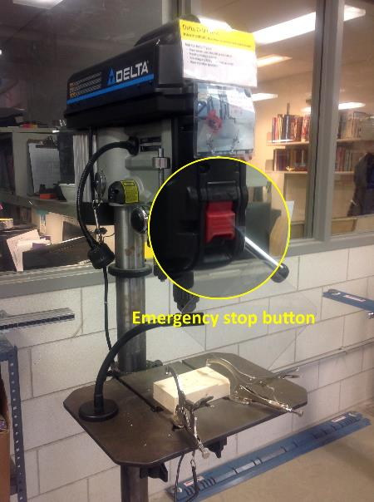
Hazards: Preventing injuries and amputations
To avoid getting injured:
Get trained and authorized to operate the Drill Press
Identify OFF SWITCH, EMERGENCY STOP (as seen in picture)
Use a drill of an appropriate size and type
The emergency stop button on a drill press
Notes:
Explain not to take the machines for granted. Accidents can happen very quickly. Machine users need to keep their fingers and hands away from the Point of Operation. Wear safety glasses to protect their eyes and closed toe sturdy shoes to protect their feet. Machine users need to put long hair up in a ponytail or bun and not wear loose clothing or dangling jewelry to protect themselves from getting caught up in rotational hazards.

Slide 9
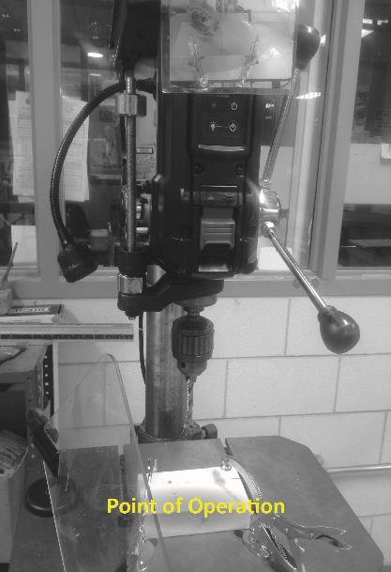
Hazards: Point of operation
Be aware of the point of operation, which is the area on a machine where work is performed on the material being processed. The point of operation on the Drill Press cannot be completely guarded and therefore can cause injury when the users’ hands come in contact with the drill bits.
A chip guard is needed for protection from the point of operation.
The point of operation of a drill press
Notes:
Explain to trainers that the following situations still exist in some work places. Some types of accidents are related to poor on non-existent machine guarding can be getting fingers caught where the work is being done (Point of Operation). Getting dangling jewelry, loose clothing, or hair caught in the drill chuck (rotational hazard). Or trying to grab something while the chuck is spinning ( reaching in)

Slide 10
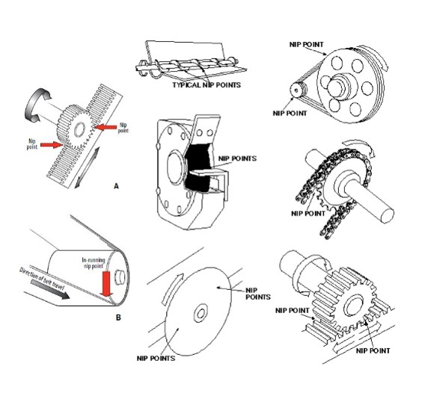
Hazards: Nip points and rotating parts
In-running nip points are commonly found among rotating or reciprocating parts. They
occur in two scenarios:
When machine parts move
toward each other
When machine parts run past a
stationary object
Examples of nip points in different mechanisms
Notes:
Explain to trainers that the following situations still exist in some work places. Some types of accidents are related to poor on non-existent machine guarding can be getting fingers caught where the work is being done (Point of Operation). Getting dangling jewelry, loose clothing, or hair caught in the drill chuck (rotational hazard). Or trying to grab something while the chuck is spinning ( reaching in)

Slide 11
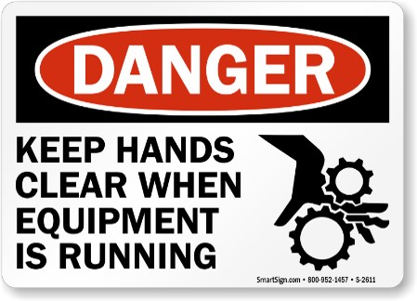
Hazards: Hazard Signage
To prevent injuries, be aware of hazard signages next to the machinery.
An example of hazard signage
Notes:
These hazards need to be pointed out because they are present each time the drill press is used and they may change depending on the operations being performed.

Slide 12
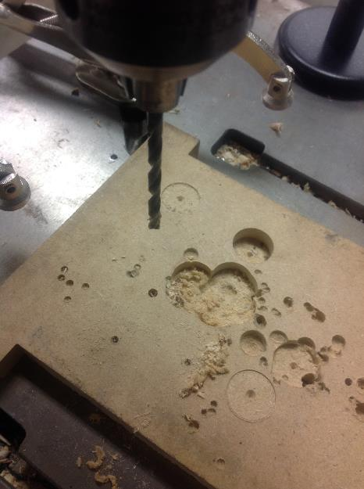
Hazards: Flying chips and wood dust
Drilling can cause chips, sparks and wood dust to fly in different directions.
An example of wood dust generated by drilling
Notes:
When operating the drill press utilize a magnetic chip shield in between you and the point of operation. Demonstrate how the chip shield is to be used.

Slide 13
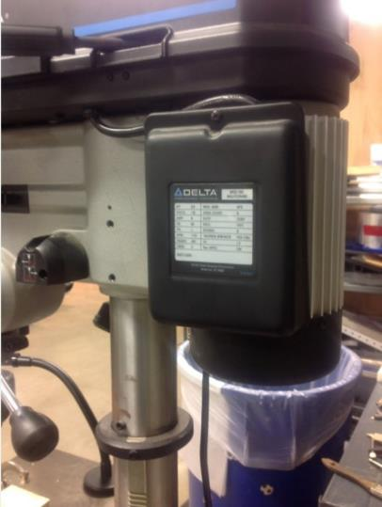
Hazards: Power transmission device
The power transmission device is the component which transmits energy to the part of the machine performing the work. These components can include flywheels, pulleys, belts, connecting rods, couplings, cams, spindles, chains, cranks, and gears. Severe or even fatal injuries can occur from coming into contact with hazardous energy.
The power transmission of this drill press
Notes:
The guards on the Drill Press are the Pulley Guard and Magnetic Chip Shield.
The Chip Shield must always be used when the spindle of the Drill Press is turning.
The Pulley Guard should not be opened unless the Drill Press is unplugged.

Slide 14
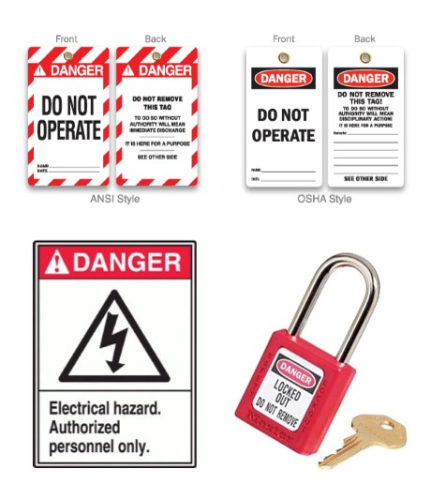
Hazards: Lockout/Tagout
Lockout/tagout procedures are safeguarding methods to prevent injury due to hazardous energy sources. If you see the machines with the signs featured in the image or that are under lock and key, please stay away and do not touch or attempt to start it.
Examples of Lockout/tagout equipment

Slide 15
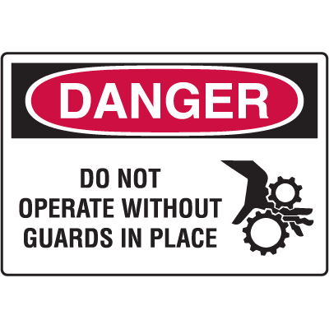
Hazards: Best practices
Set the guard to clear stock/workpiece
Wear Personal Protective Equipment (PPE) at all times
Clean up and clear work area
An example of hazard signage
Notes:
Personal Protective Equipment may be a bit uncomfortable or bulky, but needs to be worn to protect the user from injury.

