Slide 1
RESPIRABLE CRYSTALLINE
SILICA
Essential Elements & Implementation of
The OSHA Silica Standard
(29 CFR 1926.1153)

Slide 2
Acknowledgement
UNITED STATES
DEPARTMENT OF LABOR
Occupational Health and Safety Administration (OSHA)
Susan Harwood Training Grant
SH-05039 -SH8
This material was produced under a grant (SH-05039-SH8) from the Occupational Health Administration, U.S. Department of Labor. It does not necessarily reflect the views or policies of the U.S. Department of Labor, nor does it mention of any trade names, commercial products, or organizations implying endorsement by the U.S. Government.
Notes:
This material was produced under a grant (SH-05039-SH8) from the Occupational Health Administration, U.S. Department of Labor, by Wayne State University. It does not necessarily reflect the views or policies of the U.S. Department of Labor; nor does it mention of any trade names, commercial products, or organizations implying endorsement by the U.S. Government.

Slide 3
Disclaimer
The materials presented herein are for information and awareness purposes. In no instances and under no conditions should they be used as a reference for compliance with the OSHA Respirable Crystalline Silica Standard ( 29 CFR 1926.1153). The link to obtain a copy of the standard is provided below.
OSHA RESPIRABLE CRYSTALLINE SILICA STANDARD (29 CFR 1926.1153)
Notes:
Wayne State University declares that the materials presented herein are for information and awareness purposes only. In no instances and under no conditions should they be used as a reference for compliance with the OSHA Respirable Crystalline Silica Standard ( 29 CFR 1926.1153). The link to obtain a copy of the standard can be found in OSHA RESPIRABLE CRYSTALLINE SILICA STANDARD (29 CFR 1926.1153).

Slide 4
Overview
    Introduction
      Worker Rights under the OSH Act
      Training Process
      Respirable Crystalline Silica and Silica Exposures
      Health Risks Associated with Silica Exposure
    The Respirable Crystalline Silica Standard for Construction
      Background and Overview
      Permissible Exposure Limit (PEL)
      Action Level (AL)
Notes:
An overview of the whole respirable crystalline silica training is presented herein. This training covers workers rights under OSH Act, health hazards associated with silica exposure, specific workplace tasks that could expose employees to silica, and specific measures that can be implemented to protect employees from harmful exposure to silica. The contents of the new silica standard are covered in this presentation.

Slide 5
Overview – cont.
    Silica Exposure Control Methods
    Silica Control Compliance – Hierarchy of Controls
        Engineering Controls
        Workplace Controls
        PPE
      Specified Exposure Control Methods
        Table 1
      Alternative Control Methods
        Exposure Assessment
          Performance Option
          Scheduled Monitoring Option
        Reassessment of Exposures
        Employee Notification
        Mandatory Provisions for Silica Exposure Controls
Notes:
An overview of the our respirable crystalline silica training is presented herein. This training covers workers rights under OSH Act, health hazards associated with silica exposure, specific workplace tasks that could expose employees to silica, and specific measures that can be implemented to protect employees from harmful exposure to silica. The contents of the new silica standard are covered in this presentation.

Slide 6
Overview – cont.
    Mandatory Requirements for Silica Exposure Control
      Written Exposure Control Plan
      Competent Person
      Medical Surveillance
      Communication of Silica Hazards (HazCom)
      Recordkeeping
    Compliance Summary
Notes:
Refer to the notes under the previous slide.

Slide 7

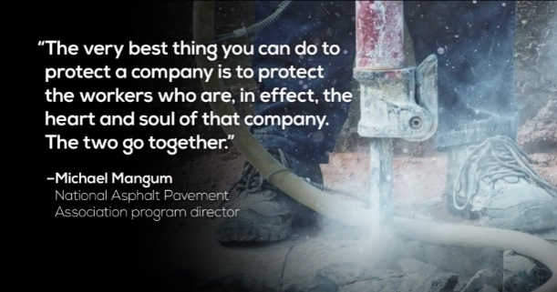
Purpose of This Training
  OSHA has issued a new standard (CFR 1926.1153) to curb respirable crystalline silica related diseases in the US workers by limiting their exposure to respirable crystalline silica
  The training provided here aims at
    Increasing workers’ awareness of the serious health hazards of silica dust
    Providing the knowledge necessary to perform work safely when there is silica exposure, and ways to limit silica exposure to levels below the Permissible Exposure Limit (PEL)
Notes:
The training provided here aims at
Increasing workers’ awareness of the serious health hazards of silica dust
Providing the knowledge necessary to perform work safely when there is silica exposure, and ways to limit silica exposure to levels below the Permissible Exposure Limit (PEL)
Properly trained workers are more likely to realize the severity of silica hazards, and be prepared for identifying which work operations can lead to silica exposure, as well as knowing how they can work safely around crystalline silica-containing dust by using engineering and workplace controls, and personal protective equipment.

Slide 8

Worker Rights under OSH Act
Right to Know and Whistleblower Provisions
Workers are entitled to safe and healthful working conditions. The OSH ACT provides workers with the right to:
      Ask OSHA to inspect their workplace
      Review employers’ records of work-related
      injuries and illnesses
      Get copies of their medical records
      Get information and training about hazards and their
      prevention
Workers have the right to know and understand hazardous chemicals they use and how to work with them safely. (29 CFR 1910.1200)
Employers may not retaliate by taking unfavorable personnel action against them for whistleblowing.
  For more information refer to the hyperlink below
  Whistleblowers’ Rights
Notes:
Workers are entitled to working conditions that do not pose a risk of serious harm to them. To help ensure a safe and healthful workplace, the OSH Act gives workers with the right to ask OSHA to inspect their workplace; to use their rights under the law without fearing retaliation and/or discrimination; and to receive information and training about existing hazards and the methods of their prevention. Under the OSH Act, workers also have the right to ask for the OSHA standards that apply to their workplace; get copies of test results regarding the hazards in the workplace; review records of work-related injuries and illnesses; and get copies of their medical records.
29 CFR 1910.1200 is designed to make information about hazardous chemicals that are present in work places available to exposed employees.
The hazard communication standard applies to any business as long as the business uses hazardous chemicals, regardless of the number of individuals employed.
Workers may file a complaint with OSHA if the employer retaliates by taking unfavorable personnel action against employees for whistleblowing.
Employers cannot punish workers in any way for:
Reporting an injury or illness;
Complaining to the employer, union, OSHA or other agencies about safety and health problems;
Filing safety and health grievances;
Participating in safety and health committees; or
Participating in OSHA inspections and other OSHA-related activities.
If the employer retaliates against the employee because of exercising his/her legal rights, the worker must contact OSHA as soon as possible. The complaints must be filed within the legal time limits. An employee can file a complaint with OSHA by visiting or calling the local OSHA office or sending a written complaint to the closest OSHA regional or area office. Written complaints may be filed by facsimile, electronic communication, hand delivery during business hours, U.S. mail (confirmation services recommended), or other third-party commercial carrier.
If a worker is fired, demoted, transferred or discriminated against in any way for using his/her rights under the law, he/she must file a complaint with OSHA within 30 days.

Slide 9

The Training Process – Step by Step
Notes:
A typical training session flowchart is presented above. Training starts with sign-up to collect demographic and background information on the trainees. This is followed by a pretest consisting of 25 questions that aim to measure the existing knowledge level of the trainees on topics covered in the new respirable crystalline silica standard. This will establish a baseline that can be compared to the posttest results to assess the effectiveness of the provided training. The third step in a typical session is the lecture part where the previously outlined module is covered slide by slide. After this, the trainees are given the posttest which is identical to the pretest. Improvement of scores from pretest to posttest will signify learning attributable to training. Lastly, trainees fill out the opinion survey designed to measure the trainees’ reaction to the training program and experience. This feedback is used to make an overall assessment of the training, and to establish strategies for improving the module and training delivery.

Slide 10
SIGN-UP
PLEASE FILL OUT THE SIGN-UP SHEET
Notes:
Trainer distributes the sign-up sheet to the trainees.

Slide 11
PRETEST
PLEASE START THE PRETEST
( maximum 10 MIN)
Notes:
Trainer hands out the “Pretests” to the trainees.

Slide 12
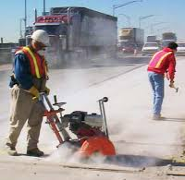
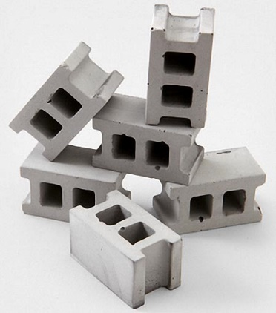
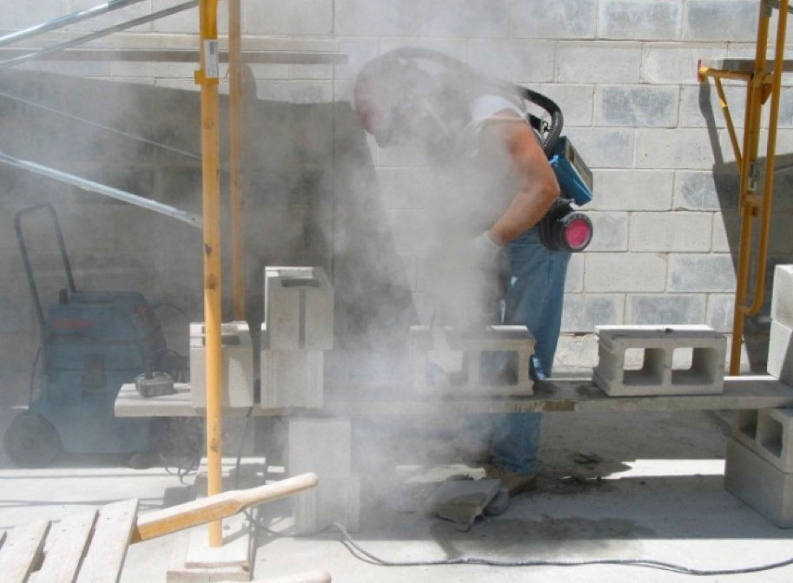
What is Respirable Crystalline Silica?
Crystalline silica is a common mineral found in many naturally and man-made construction materials. Examples:
  Sand
  Concrete
  Brick
  Block
  Stone
  Mortar
Silicon Dioxide
SiO₂
Respirable crystalline silica – size ≤1/100 of beach sand, generated by
  Cutting
  Sawing
  Grinding
  Drilling
  Crushing and abrasive blasting
Notes:
The term “silica” refers specifically to the compound silicon dioxide (SiO²). It is the most abundant compound in the earth’s crust, making up 59% of its total composition. (https://www.britannica.com/science/silica). Silica is a major component of sand, rock, and mineral ores. Silica in crystalline form has three varieties: quartz , tridymite and cristobalite. Quartz is by far the most abundant and the most common form of crystalline silica. Quartz (crystalline silica) is a common mineral found in many naturally occurring and man-made materials like sand, portland cement, concrete, brick, block, stone and mortar used at construction sites.
Crystalline silica may become respirable sized particles (very small particles typically at least 100 times smaller than ordinary sand found on beaches or playgrounds) by high-energy operations like cutting, sawing, grinding, drilling and crushing silica containing material, stone, rock, concrete, brick, block and mortar, or when abrasive blasting with sand.
Handheld masonry saw without dust controls creates silica dust while cutting cinder blocks. (Photo courtesy of New Jersey Department of Health).

Slide 13
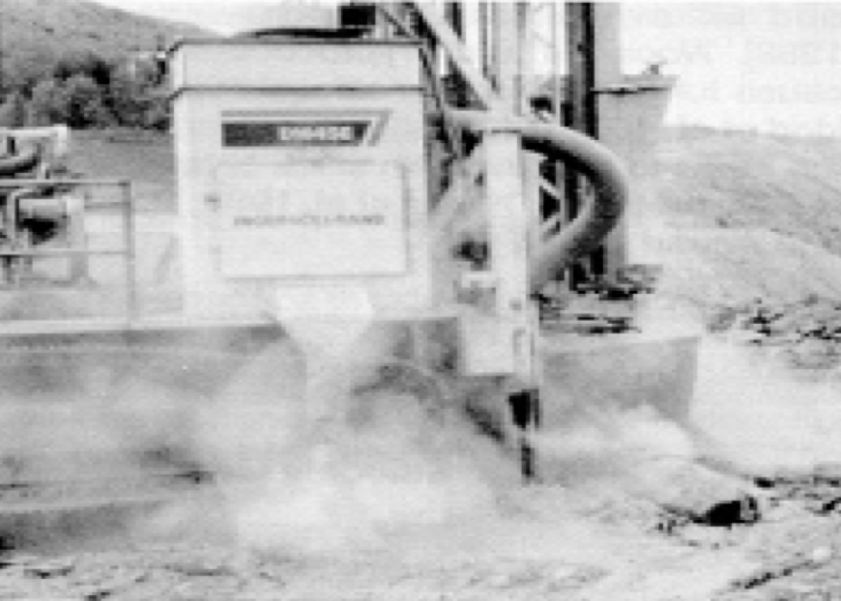
Construction Activities Likely to Cause Silica Exposure
Construction activities that may result in severe silica exposure include, but are not limited to:
  Jack hammering
  Masonry building construction
  Masonry or concrete building demolition
  Brick and concrete block cutting and sawing
  Tuckpointing
  Tunneling
  Earthwork and rock crushing
  Road construction and repair
  Rock/well drilling
  Abrasive blasting with sand or other silica- containing materials
  Abrasive blasting on silica-containing materials e.g. concrete.
  Concrete mixing and drilling or mixing concrete for post holes
  Pouring concrete footers, slab foundation, and foundation walls
  Removing concrete form work.
  Others
Earth-drilling rigs operated with no dust controls may produce high levels of silica in the air. (Photo courtesy of NIOSH).
Notes:
Certain construction activities may result in severe silica exposure. These activities can be listed as: jack hammering, masonry building construction, demolition (masonry or concrete building), brick and concrete block cutting and sawing, tuck pointing and tunneling operations, earthwork and rock crushing, road construction and repair, rock/well drilling, abrasive blasting* (Sand or blasting with other silica containing materials), blasting on silica-containing materials (e.g. concrete), concrete mixing and drilling or mixing concrete for post holes; pouring concrete footers ,slab foundations ,and foundation walls; removing concrete form work and others.
*Note that silica generated by sand blasting can be generated from the abrasive charge or the surface being sand blasted, or both.

Slide 14


WARNING!!!
ALWAYS REMEMBER
SILICA IS MORE THAN JUST A DUST !
Notes:
Construction workers should know that “Silica is more than just a dust !” Exposure to fine silica dust may have adverse health effects.
Educating workers about silicosis is crucial, since there may be lifelong health complications, including fatal consequences. For example, in the image presented above the worker is aware of importance of personal protective equipment usage, and he uses gloves, hard hat, as well as hearing protection. However, he misses an important PPE, a “respirator” to protect himself from heavy silica exposure. Also, the dust cloud visible in the picture most likely indicates that either the required engineering controls are not being used, or they are ineffective.

Slide 15

Health Risks Associated with Silica Exposure
Exposure to respirable crystalline silica has been linked to
  Silicosis – An irreversible, often disabling, and sometimes fatal fibrotic lung disease
    Typically occurs after many years of low to moderate exposures to silica dust.
    If one has silicosis, Tuberculosis (TB) may also be developed
  Lung cancer
    Occurs after exposures to very high concentrations of silica
  Chronic obstructive pulmonary disease (e.g., bronchitis )
  Kidney and immune system diseases
Notes:
Employers are required to protect their employees in construction from the hazards associated with silica exposure.
Workers exposed to respirable crystalline silica are at increased risk of developing serious adverse health effects. Exposure to fine (respirable sized) particles of crystalline forms of silica may lead to silicosis, an irreversible, often disabling, and sometimes fatal fibrotic lung disease. Other harmful or fatal consequences are lung cancer, chronic obstructive pulmonary disease (COPD), and activation of latent TB infections.
It should be understood that the higher the cumulative exposure of a worker, the higher the risk of health effects.

Slide 16
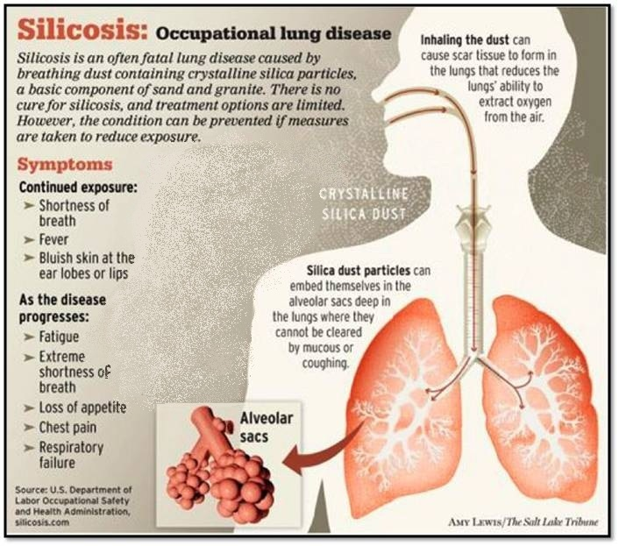
Silicosis
There are 3 types of silicosis:
    Acute form:
  Intense exposure to respirable dust of high crystalline silica content for a relatively short period (few months to less than 2 years)
    Accelerated form:
  Resulting from about 5-10 years of heavy exposure to respirable dusts of high crystalline silica content
    Chronic form:
  Most common form
  Less intense exposure of more than 20 years
Notes:
There are several stages of silicosis. Early stages may go completely unnoticed. Continued exposure may result in the exposed person noticing a shortness of breath upon exercising, possibly having fever and occasionally bluish skin at the ear lobes or lips. Silicosis makes a person more susceptible to infectious diseases of the lungs, like tuberculosis. Progression of the disease leads to fatigue, extreme shortness of breath, loss of appetite, pain in the chest, and respiratory failure, which all eventually may lead to death. Employees with these symptoms should immediately receive further evaluation and treatment.
There are three different forms of silicosis: acute, accelerated, and chronic.
Acute silicosis is a rare disease caused by inhalation of extremely high (intense) levels of respirable crystalline silica particles and is almost always fatal.
Accelerated silicosis generally occurs within 5-15 years of exposure and results from heavy levels of exposure to respirable crystalline silica.
Chronic silicosis is the most common form of silicosis, which can result from less intense exposure; it occurs usually after more than 20 years of exposure to respirable crystalline silica.

Slide 17
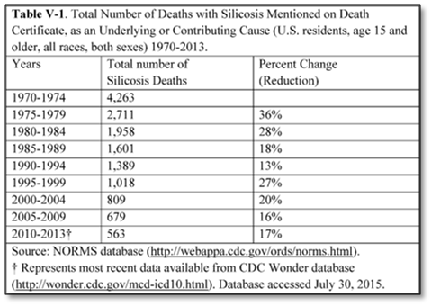

Silicosis Mortality Rate (US)
Over time, silicosis-related mortality has diminished in the US but has not been stopped.
Especially in the past decade,
mortality rate for silicosis has
remained relatively constant.
Construction industry has led
all others in silicosis mortality rate.
Source: Norms database (www.cdc.gov)
Notes:
According to the information published by the Centers for Disease Control and Prevention (CDC) between 1970 to 2013, silicosis was an underlying or contributing cause of death recorded on 14,991 death certificates. Further, Construction industry led all others in silicosis mortality rate. Over time, silicosis-related mortality has declined in the U.S., but has not been eliminated. We see a relatively stable trend especially in the past decade. Since the year 2000, there have been 100 to 150 silicosis cases in the US. (https://www.cdc.gov/mmwr/preview/mmwrhtml/mm6423a7.htm)
OSHA estimates that about two million construction workers are exposed to respirable crystalline silica in over 600,000 workplaces, and more than 840,000 of these workers are exposed to silica levels that exceed the new permissible exposure limit (PEL). (OSHA fact sheet; https://www.osha.gov/Publications/OSHA3681.pdf)

Slide 18
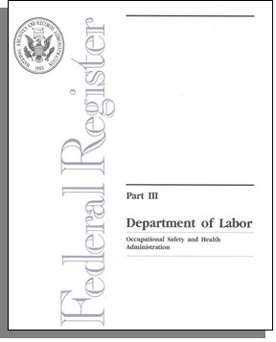
OSHA’s Respirable Crystalline Silica Standard
Background and Overview
OSHA has issued standards for
  General Industry and Maritime, and
  Construction
The new standards are estimated to cut exposure by as much as 5 times
The standard limits worker exposures and requires
to take other steps to protect workers.
It establishes new Permissible Exposure Limit (PEL) and an Action Level (AL).
  Previous PEL was 100 μg/m³; now it is 50 μg/m³
  Previous AL was 50 μg/m³; now it is 25 μg/m³
Notes:
The U.S. Department of Labor first highlighted the hazards of respirable crystalline silica in the 1930s, after a wave of worker deaths. The department set standards to limit worker exposure in 1971, the year OSHA was created. It is believed, however, that the old/current standard is mostly outdated and does not adequately protect workers from silica-related diseases. Furthermore, it is being observed that workers are being exposed to silica in new industries such as stone or artificial stone countertop fabrication and hydraulic fracturing. A full review of scientific evidence, industry consensus standards, and extensive stakeholder input provide the basis for the Final Rule, which was proposed in September 2013.
The new crystalline silica rule was issued due to the previous construction and shipyard PELs being based on an old method of measuring worker exposures to silica, which is no longer used today. Furthermore, the previous limits were inconsistent, allowing permissible levels for construction and shipyards to be more than twice as high as the levels in general industry. According to OSHA, the revised rule will reduce the risk of disease among workers who inhale respirable crystalline silica, and will provide the same level of protection for all workers covered under the Act. (https://www.osha.gov/ silica/Silica_FAQs_2016-3-22.pdf)
OSHA estimates that the rule will save over 600 lives and prevent more than 900 new cases of silicosis each year, once its effects are fully realized. The Final Rule is projected to provide net benefits of about $7.7 billion, annually. (https://www.osha.gov/silica/)

Slide 19
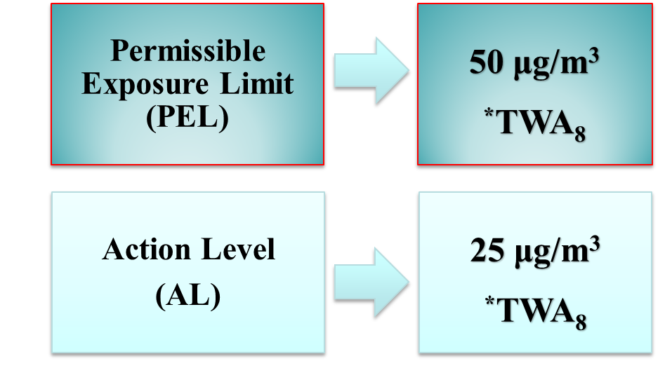
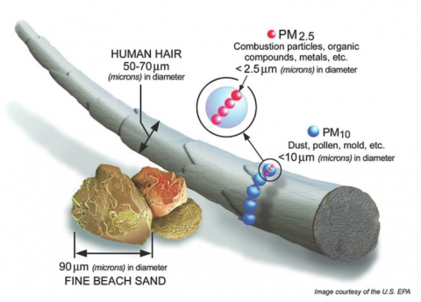
New OSHA Standard - Permissible Exposure Limit and Action Level for Construction Industry
Illustration: courtesy U.S. EPA
*TWA₈ = 8-hour time-weighted average exposure limit
If dust containing silica is visible in the air, there is a higher likelihood/chance that permissible exposure limit (PEL) is exceeded !
Notes:
The standard requires employers to limit worker exposures to respirable crystalline silica and to take additional steps to protect workers.
It establishes a new Permissible Exposure Limit (PEL) and an Action Level (AL) averaged over an eight-hour workday. The previous PEL was 100 micrograms per cubic meter (μg/m³ ) for the general industry; now it is 50 μg/m³ . This means that during the course of any 8-hour work shift, exposures can fluctuate, but the average exposure to respirable crystalline silica cannot exceed 50 μg/m³.
Action level is set to 25 μg/m³, which means where the concentration of an airborne silica is at or above this level (25 μg/m³) for an 8-hour time weighted average, it will trigger the requirements for the application of the standard.
As a general rule, if a dust containing silica is visible in the air, there is a higher likelihood/chance that permissible exposure limit (PEL) is already exceeded !

Slide 20

OSHA Silica Standard
Application Rule
Applies to all occupational exposures to respirable crystalline silica in construction work
  Exception:
  The standard does not apply if the exposure is below the allowed AL as an 8-hour time-weighted average (TWA) under any foreseeable conditions
Notes:
The Respirable Crystalline Silica Standard (29 CFR. 1926.1153) applies to all related occupational exposures in construction work, except where employee exposure will remain below 25 micrograms per cubic meter in the air under any foreseeable conditions ; that is 25 μg/ m³ averaged over an 8-hour period (TWA).

Slide 21
Exposure Assessment Example
Main Purpose of assessing employee exposures is preventing employees from being exposed to silica above PEL
Employers following alternative exposure control methods must assess the 8-hour TWA exposure for each employee
TWA = (Ca Ta + Cb Tb+ . . . +Cn Tn) ÷ 8
Example: Given - 2 hours exposure at 100 µg/m³; 2 hours exposure at 50 µg/m³; and 4 hours exposure at 10 µg/m³
TWA = (2 x 100 + 2 x 50 + 4 x 10) ÷ 8 = 42.5 µg/m³
Because 42.5 µg/m³ is higher than 25 µg/m³ (AL) but below 50 µg/m³ (PEL), exposure assessment is required (standard applies).
Notes:
The main purposes of assessing employee exposures are:
Identifying where exposures are occurring;
Helping the employer select control methods and ensure their effectiveness;
Preventing employees from being exposed to silica above the PEL;
Providing employees with information about their exposure levels; and
Giving the PLHCP performing medical examinations information about employee exposures.
Exposure assessment requires construction employers following alternative exposure control methods to assess the 8-hour TWA exposure for each employee who is or may reasonably be expected to be exposed to respirable crystalline silica at or above the action level of 25 μg/m³ as an 8-hour TWA.

Slide 22
Silica Exposure Control Methods for Construction
First step: Determine if the new standard applies to the work.
Refer to Slide 49
Second step: If it applies, new standard provides two alternatives 1. Specified exposure control methods
    Laid out in Table 1 of the construction standard (www.osha.gov)
    The table lists 18 common tasks covering various types of equipment found on construction sites
    Describes the engineering controls (Specified Exposure Control Methods) when working with materials containing silica
  2. Alternative exposure control methods
    Measure workers’ exposure to silica and independently decide on which dust control methods work best to limit exposures to PEL
Notes:
The first step for an employer is to determine if the standard applies to his/her work. If an employer answers “no” to the question “Could employees be exposed to respirable crystalline silica at or above 25 µg/m3 as an 8-hour TWA under any foreseeable conditions, including the failure of engineering controls, while performing construction activities?” , no further action is required under the new silica standard. However, if the answer is “yes”, then that work is covered by the standard and must comply with its requirements.
Employers have two options for limiting employee exposure to respirable crystalline silica:
Specified exposure control methods which requires employers to fully and properly implement protections for the tasks or equipment listed in Table 1 of the standard (can e viewed at https://www.osha.gov/pls/oshaweb/owadisp.show _document?p_table= STANDARDS&p_id=1270 )
The specified exposure control method of the standard is essentially covered in Table 1. This table lists 18 common tasks/equipment using various types of tools or equipment found on construction sites. It specifies the engineering controls for the tasks based on the location and the duration of the exposure.
Employers who choose to follow Table 1 for any given task are required to fully and properly implement the engineering controls for each employee engaged in tasks which are creating silica exposures.
It should be noted that employers who comply with Table 1 by fully and properly implementing its recommendations, are not required to conduct exposure assessments or comply with a PEL requirement for their employees.
Employees engaged in any Table 1 task are the equipment operator, helpers, laborers and other employees who are assisting with the task, or any other employee responsible for completing the task. When Table 1 requires respiratory protection, employers must provide respirators to all employees engaged in the task.
Implementing Table 1 “Fully and properly” means controls are in place; the tools and equipment are properly operated and maintained according to manufacturers’ instructions; and employees understand how to use them. A small amount of dust can be expected from the equipment when it is operating according to the manufacturer’s intent; however, a noticeable increase in dust generation during the task is a sign that engineering controls are not effective and not operating correctly. When this happens, prompt corrective actions are required.
Alternative exposure control methods. An employer who chooses this option must determine the levels of respirable crystalline silica that employees are exposed to, and must further independently decide on and use engineering and work practice controls to limit employee exposures to a PEL of 50 micrograms per cubic meter of air (50 μg/m3) as an 8-hour time-weighted average (TWA). This employer must also supplement the controls with respiratory protection when necessary.

Slide 23
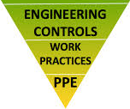
Silica Control Compliance - Hierarchy of Controls
The methods of compliance section of the standard requires employers to protect employees following the hierarchy of controls, which relies on
              Engineering and work practice controls for reducing exposures, and only allows for respirator use, in addition to those controls, when feasible engineering controls cannot reduce employee exposures to levels below PEL
              Even when employers demonstrate the infeasibility of engineering and workplace controls, they must still use feasible controls to reduce exposures to the lowest possible level, and then use respiratory protection along with those controls.
Notes:
Employers must use engineering and work practice controls to reduce and keep employee exposure to respirable crystalline silica to or below the PEL. If feasible engineering and work practice controls are not effective in reducing employee exposures to or below the PEL, employers must still use feasible controls to reduce exposures to the lowest possible level, and then use respiratory protection along with those controls.
Respiratory protection is necessary under the following conditions
Where exposures exceed the PEL during periods necessary to implement feasible engineering and work practice controls; and/or
Where exposures exceed the PEL during tasks, such as some maintenance and repair tasks, for which engineering and work practice controls are not feasible.

Slide 24
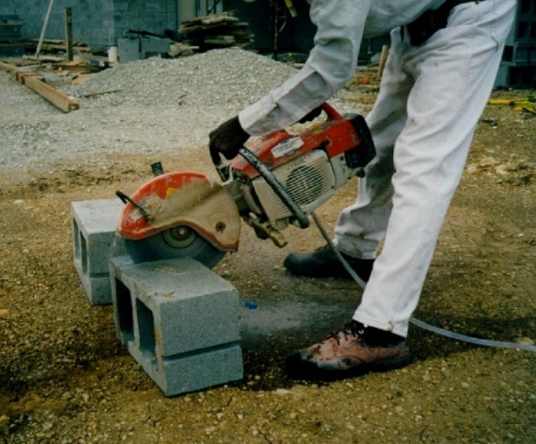
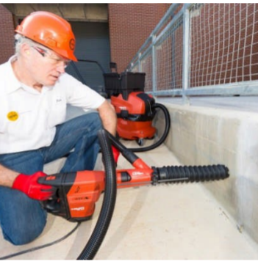
Engineering Controls for Silica Exposure (Table 1)
Two main engineering controls methods are used to control silica dust
Integrated Water Delivery Systems (IWDS)
  Concrete cutting without water generates large amounts of dust. Using water usually reduce levels to below the PEL
  Water is supplied by either a pressurized container, or a constant water source such as a hose connected to a faucet
Vacuum Dust Collection Systems (VDCS)
  VDCSs include dust collector (hood or shroud), vacuum, hose and filter(s).
  Good method for reducing silica exposures, but may not reliably keep exposure below PEL
Notes:
1st photo: Handheld masonry saw using water for dust control while cutting cinder blocks. (Photo courtesy of New Jersey Department of Health).
2nd photo: Worker drilling into concrete with a rotary hammer equipped with a shroud and dust collection system. https://www.osha.gov/Publications/silica/OSHA_FS-3630.pdf

Slide 25

Engineering Controls for Silica Exposure -
Integrated Water Delivery Systems
IWDSs are required for several types of equipment
  - when using such tools and equipment
  An adequate supply of water for dust suppression is needed (at the flow rates specified by the manufacturer)
  The spray nozzle must be working properly to apply water at the point of dust generation
  The spray nozzle should not be clogged or damaged
  All hoses and connections must be intact.
Handheld power saw use without any dust control while cutting concrete. (Photo courtesy of North Carolina Department of Labor).
Notes:
Integrated water systems (IWDS) are required for several types of equipment. IWDS must be developed specifically for the type of tool in use so they will apply water at the appropriate dust emission points based on tool configuration, and do not interfere with other tool components or safety devices. To effectively minimize dust emissions for tasks with the wet method
an adequate supply of water for dust suppression is needed (at the flow rates specified by the manufacturer);
the spray nozzle must be working properly to apply water at the point of dust generation;
the spray nozzle should not be clogged or damaged; and
all hoses and connections must be intact.

Slide 26
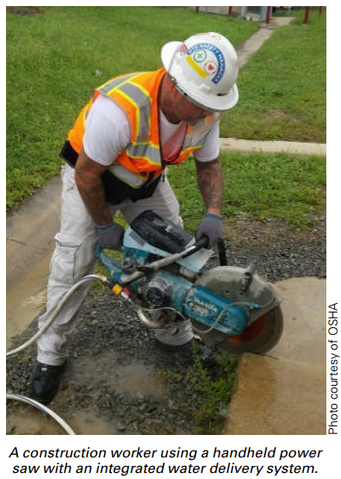
Engineering Controls for Silica Exposure
Integrated Water Delivery Systems – cont.
When using wet methods, effective control of the dust depends on the following factors
  Dust particle size
  Dust particle velocity
    Higher the velocity, higher the flow rate
  Spray nozzle size and location
  Use of surfactants or other binders
  Environmental factors (water hardness, humidity, weather, etc.)
Therefore, it is necessary to follow manufacturers’ instructions when determining the required flow rate for dust suppression systems.
Notes:
When using wet methods, effective control of the dust depends on the following factors
Dust particle size
Dust particle velocity
Note that higher the velocity is the higher the flow rate
Spray nozzle size and location
Use of surfactants or other binders
Environmental factors (water hardness, humidity, weather, etc.)
Therefore, it is necessary to follow manufacturers’ instructions when determining the required flow rate for dust suppression systems.

Slide 27
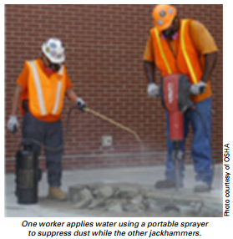
Engineering Controls for Silica Exposure
Integrated Water Delivery Systems – cont .
Also;
  Limit the secondary exposure by cleaning up any slurry generated, and the procedure should be described in the employer’s Written Exposure Control Plan
  In cold temperatures, with risk of water freezing, additional work practices should be followed
    e.g., insulating drums, wrapping drums with ice melting heat tape, or environment-friendly antifreeze additives
  Electrical Safety - Use ground-fault circuit interrupters (GFCIs) and watertight, sealable electrical connectors for electric tools and equipment on construction sites
Notes:
In order to limit the secondary exposure, workers should dispose of water containing silica (slurry) in a way that prevents the silica from becoming re-suspended in the air, If the silica is allowed to become airborne, it can contribute to employee exposures. Freezing temperatures complicate the use of water. In cold temperatures, where there is a risk of water freezing, additional work practices should be followed to prevent it; they include insulating drums, wrapping drums with ice melting heat tape, or using environmentally-friendly antifreeze additives. Adding environmentally –friendly additives will not only prevent supply water from freezing, but will also prevent the water from freezing on the ground. This is a good way to prevent slipping hazards, as well. As an alternative, chipping away the ice, or using deicing compounds or sand may be used to control the slipping hazards.
When using wet methods for dust control, ground-fault circuit interrupters (GFCIs) and watertight, sealable electrical connectors for electric tools and equipment provide for electrical safety.

Slide 28
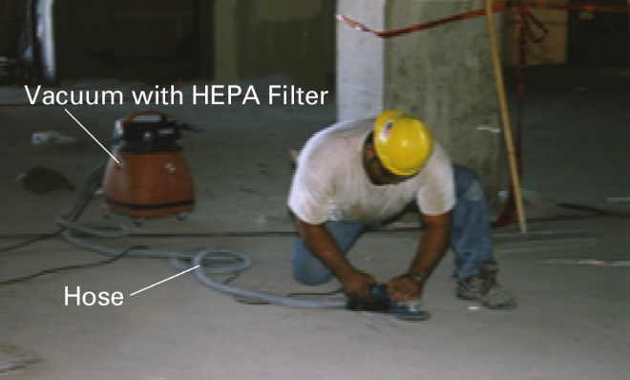
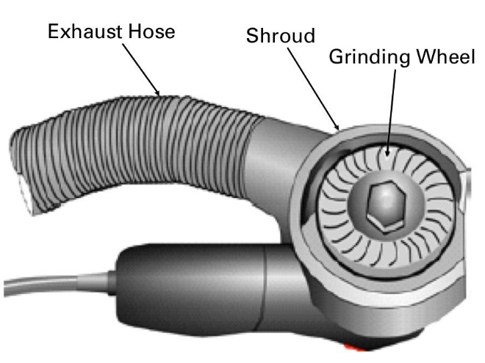
Engineering Controls for Silica Exposure - Vacuum Dust Collection Systems
Commercially available dust collection systems (i.e., Local Exhaust Ventilation) are required for several equipment
  Must effectively capture dust generated by the tool being used
  Must not introduce new hazards, such as obstructing or interfering with safety mechanisms
VDCSs include a dust collector (hood or shroud), vacuum, hose and filter(s)
  Use a vacuum with enough suction to capture dust at the cutting point.
  Use a HEPA filter in the vacuum exhaust, and a pre-filter or cyclonic separator to improve vacuum efficiency.
  Use a hose size recommended by the manufacturer.
  Use a hood or shroud that is recommended by the manufacturer.
Grinder with attached VDCS. (Photo courtesy of the University of Washington). Detail of grinder with VDCS attachment. (Courtesy of NIOSH).
Source: OSHA Small Entity Compliance Guide for the Construction Silica Standard
Notes:
When wet methods cannot be implemented, an alternative is to use of vacuum dust collection (VDC) systems. VDC systems can be purchased as a kit. This system includes a dust collector (hood or shroud), vacuum, hose, and filter(s). These vacuum dust collection systems must effectively capture dust generated by the tool being used and must not introduce new hazards, such as obstructing or interfering with safety mechanisms.
In order for a vacuum dust collection system to be effective, one must use
a vacuum with enough suction to capture dust at the cutting point;
a HEPA filter in the vacuum exhaust, and a pre-filter or cyclonic separator to improve vacuum efficiency;
a hose size recommended by the manufacturer; and
a hood or shroud that is recommended by the manufacturer.

Slide 29
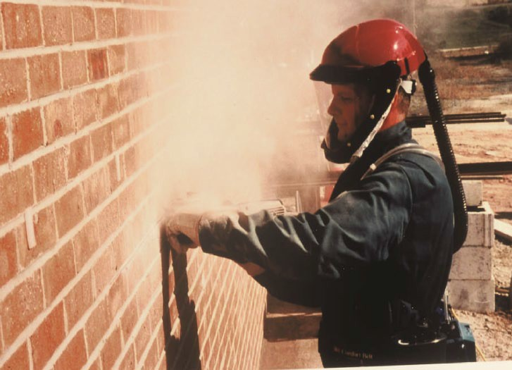
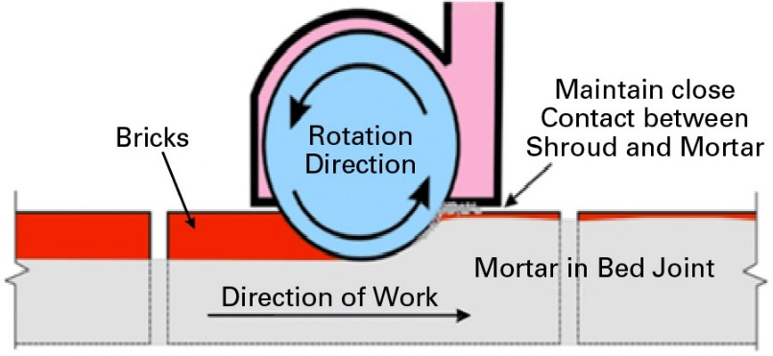
Engineering Controls for Silica Exposure - Vacuum Dust Collection Systems – cont.
For best results, employees must
  Keep the vacuum hose clear and free of debris, kinks and tight bends
  Follow the manufacturer’s directions on how to reduce dust buildup on the filter.
  Change vacuum-collection bags as needed.
  Set up a regular schedule for filter cleaning and maintenance.
  Avoid exposure to dust when changing vacuum bags and cleaning or replacing air filters.
  Keep the grinder at the appropriate angle.
Worker grinding without dust controls. Note the use of shielded Powered Air-Purifying Respirator. (Photo courtesy of CPWR).
Minimizing the gap between the shroud and uncut mortar. (Illustration courtesy of NIOSH).
Notes:
For best results with vacuum dust collection systems, employees must
make sure that all hoses are clear and free of debris, kinks and tight bends and cracks;
ensure that appropriate filters and dust bags are in good condition and changed or emptied as needed (may be necessary several times per shift under some circumstances);
check the entire system daily for signs of poor dust capture or dust leaks;
use high-efficiency (HEPA) filters for maximum dust control;
review manufacturers’ operating specifications and recommendations for their equipment; and
Avoid exposure to dust when changing vacuum bags and cleaning or replacing air filters.

Slide 30
Workplace Controls for Silica Exposure
OSHA also requires workplace controls to eliminate exposure to silica dust:
Safety program and training
  Employers must train employees covered by the standard on
    Health hazards associated with silica exposure
    Specific workplace tasks that could expose employees to silica
    Specific measures the employer is implementing to protect employees
    The contents of the silica standard.
  Training must be provided at the time employees are assigned to a position involving exposure to silica
  Additional training must be provided if
    the employer asks an employee to perform a task that is new to that employee
    the employer introduces new protections
    an employee is working in a manner that suggests he/she has forgotten what was learned in training.
Notes:
Along with the engineering controls, OSHA also requires workplace controls to eliminate exposure to silica dust. One of the administrative controls is the safety program and training. Under the Respirable Crystalline Silica Standard, employers must train employees covered by the standard on
Health hazards associated with silica exposure
Specific workplace tasks that could expose employees to silica
Specific measures the employer is implementing to protect employees
The contents of the silica standard 29 CFR 1926.1153
The training must be provided at the time employees are assigned to a position involving exposure to silica. The employer must make sure that employees trained under the silica standard can demonstrate knowledge and understanding of the standard. Additional training must be provided if the employer asks an employee to perform a task that is new to that employee, and/or when the employer introduces new protection methods and/or an employee is working in a manner that suggests he or she has forgotten what was learned in a previous training. The silica standard does not require the employer to use any particular method for training employees. Employers could use methods such as hands-on training, videotapes, slide presentations, classroom instruction, informal discussions during safety meetings, written materials, or any combination of these methods to train the employees.
Employers must cover the cost of training and must pay the employees for the time spent in training.

Slide 31
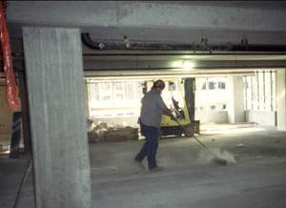
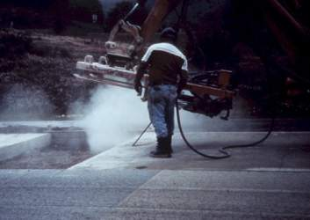
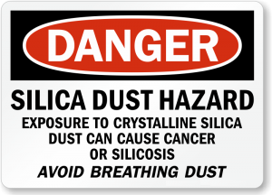
Workplace Controls for Silica Exposure – cont.
Housekeeping
  Standard limits the use of certain cleaning methods to prevent unnecessary exposures to employees
  When likely to contribute to exposure, employers must not allow
    Dry brushing or dry sweeping
    Using compressed air for cleaning of surfaces or clothing, unless accompanied by a ventilation system that effectively captures the dust
    The above methods can be used, when other methods such as wet sweeping and/or HEPA-filtered vacuuming are not feasible; the employer must show why they are not feasible.
Regulated Areas for Construction
  Restrictions for access to work areas to minimize numbers of exposed employees
Unsafe housekeeping practice without dust controls. (Photo courtesy of Virginia DOLI).
Notes:
As another workplace control, the standard requires all construction employers covered by the standard, including those who fully and properly implement the control methods specified in Table 1, to avoid certain housekeeping practices. Cleaning methods such as dry sweeping, dry brushing, and use of compressed air can cause respirable crystalline silica dust to become airborne and be inhaled by employees. Therefore, the silica standard limits the use of these cleaning methods to prevent unnecessary exposures to employees. Standard states that, when it is likely to contribute to employee exposure to respirable crystalline silica, EMPLOYERS MUST NOT ALLOW:
dry brushing or dry sweeping, unless methods such as wet sweeping and HEPA-filtered vacuuming are not feasible;
cleaning of surfaces or clothing with compressed air, unless the compressed air is used together with a ventilation system that effectively captures the dust cloud, or no other cleaning method is feasible.
Employers are required to use other cleaning methods such as wet sweeping and HEPA- filtered vacuums whenever feasible, because such methods reduce employee exposures. Employers are not required to follow these housekeeping requirements when cleaning ordinary soil, large debris, and non-silica- containing materials, such as sawdust.
To prevent unnecessary exposure, the standard also requires employers to regulate areas of concern by restricting access to areas of potential high exposure. Scheduling certain tasks when others are not around, telling employees to stay out of areas where dust is generated, moving employees to an area where they are not exposed to dust, or posting warning signs are some examples of regulating the exposure areas.
Picture source: http://www.doli.virginia.gov/

Slide 32
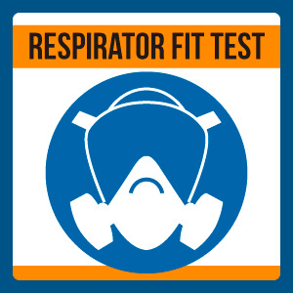
PPE for Silica Exposure
Respiratory Protection - LAST LINE OF DEFENSE !
When VDCSs and wet cutting are not feasible, or do not reduce silica exposures to PEL, workers need respiratory protection.
  Respirators must fit properly to prevent leaks around the edges
  Fit-testing must be done with the same make, model, style, and size of respirator that will be used before first wearing a respirator
  Only wear the model and size of respirator that you were fit tested with
  It is not permitted to have
    Facial hair that comes between the sealing surface of the facepiece and the face or that interferes with valve function
    Any condition that interferes with the face-to-facepiece
    seal or valve function
Notes:
Employers who follow the specified exposure control methods listed in Table 1 must provide respiratory protection where required by Table 1.
Employers who follow alternative exposure control methods must provide respiratory protection:
where exposures exceed the PEL during periods necessary to install or implement feasible engineering and work practice controls; and/or
where exposures exceed the PEL during tasks, such as some maintenance and repair tasks, for which engineering and work practice controls are not feasible; and/or
during tasks in which the employer has implemented all feasible engineering and work practice controls but exposures remain above the PEL.
When vacuum dust collection systems and/or wet methods are not feasible or do not reduce silica exposures to PEL, workers need respiratory protection as a last line of defense. Respirators must fit properly to prevent leaks around the edges. Fit-testing must be done with the same make, model, style, and size of respirator that will be used before first wearing a respirator. Fit testing may be conducted by using the quantitative method or the qualitative method. Employees must only wear the model and size of respirator that they fit tested with. Employers should not permit employees to have facial hair that comes between the sealing surface of the facepiece and the face, or that interferes with valve function or any condition that interferes with the face-to-facepiece seal or valve function.

Slide 33
Respiratory Protection
Must comply with requirements of the Silica Standard, and with OSHA’s Respiratory Protection Standard (29 CFR 1910.134).
Assigned Protection Factor (APF) means the workplace level of respiratory protection that a respirator or class of respirators is expected to provide to employees when the employer implements a continuing, effective respiratory protection program as specified by the Respiratory Protection Standard.
EMPLOYERS MUST PROVIDE
AND EMPLOYEES MUST USE
APPROPRIATE RESPIRATOR (APF)
IF IT IS REQUIRED BY THE SILICA STANDARD
OR
ENGINEERING CONTROLS CAN NOT GET EXPOSURES BELOW PEL
Notes:
To comply with the silica standard, employers must provide employees with appropriate respirators with specified Assigned Protection Factor (APF) where required. Assigned Protection Factor (APF) signifies the workplace level of respiratory protection that a respirator or class of respirators is expected to provide to employees, when the employer implements a continuing, effective respiratory protection program in compliance with the Respiratory Protection Standard (29 CFR 1910.134).
Employers following the specified exposure control methods must provide the respiratory protection as required in Table 1.
Employers who follow alternative exposure control methods must provide respiratory protection
where exposures exceed the PEL during periods necessary to install or implement feasible engineering and work practice controls; and/or
where exposures exceed the PEL during tasks for which engineering and work practice controls are not feasible, and/or
during tasks in which the employer has implemented all feasible engineering and work practice controls but exposures remain above the PEL.

Slide 34
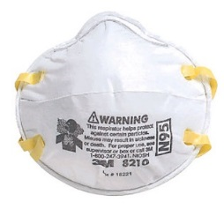

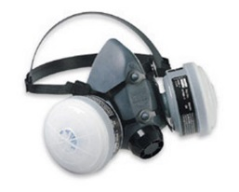
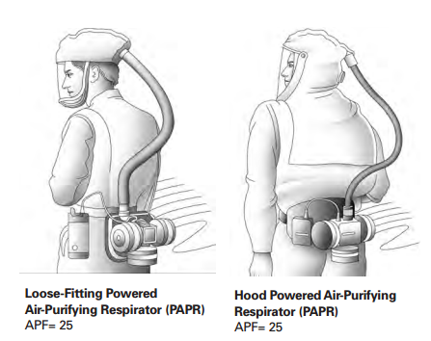

Compliance with OSHA 29 CFR 1910.134 – Respiratory Protection Standard
Providing employees with appropriate respirators requires compliance with OSHA 29 CFR 1910.134 - Respiratory Protection Standard, which requires
  A written respiratory protection program
  Medical evaluation to determine if the employee is fit to wear a respirator
  Employee training in proper use, limitations, and storage of the respirator selected for use
  Fit testing to determine that the respirator selected for use fits properly
  Procedures and schedules for respirator maintenance
APF=10 Needs to be fit tested
Notes:
Where respirator use is required, employers must comply with all requirements of the Respiratory Protection Standard (OSHA 29 CFR 1910.134). These requirements are summarized as follows:
A written respiratory protection program must be in place.
There must be medical evaluation to determine if the employee is fit to wear a respirator
Training must be provided to employees on proper use, limitations, and storage of the respirator selected for use.
Fit testing must be done to determine that the respirator selected for use fits properly.
Procedures and schedules must be implemented for respirator maintenance.

Slide 35
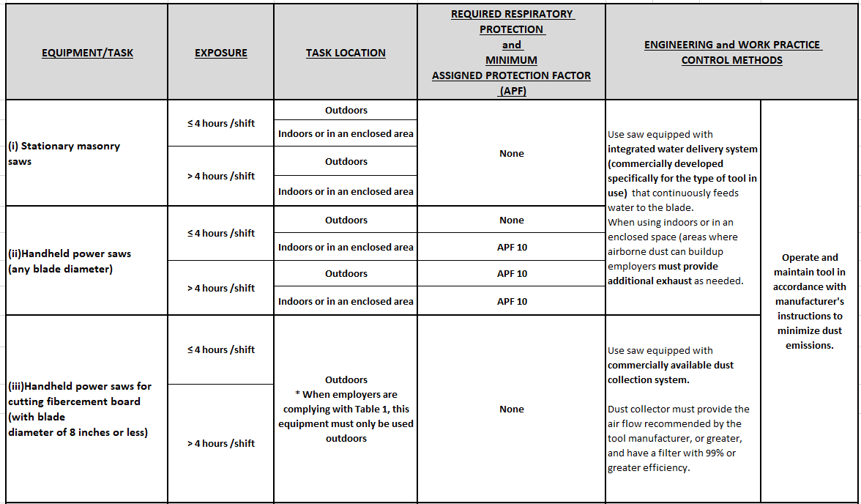
Specified Exposure Control Method TABLE 1 - Silica Control Compliance for Construction
How to read Table 1:
Identify the equipment/task that will be used
Determine the silica exposure duration of worker(s) engaged in the task
  ≤ 4 hours/shift
  > 4 hours/shift
Identify the task location
  indoors , or
  enclosed area, outdoors
Comply with the engineering and work practice control methods listed in Table 1
  Operate and maintain machine in accordance with manufacturer’s instructions to minimize dust emissions.
If Table 1 calls for respiratory protection for the identified location and determined exposure duration:
  Along with the engineering controls, you must provide the required respirator with the minimum assigned protection factor (APF)
Notes:
For each employee engaged in a task in Table 1, employers who choose to follow the Table for that task are required to fully and properly implement the engineering controls, work practices, and respiratory protection specified in Table 1. Table 1 lists 18 common tasks using various types of tools or equipment found on construction sites. These equipment/tasks are grouped as:
Stationary masonry saws; hand held power saws; walk-behind saws; drivable saws;
Rig-mounted core saws or drills; handheld and stand-mounted drills (including impact and rotary hammer drills);
Dowel drilling rigs; vehicle-mounted drilling rigs;
Jack hammers and hand held powered chipping tools;
Hand held grinders; walk-behind milling machines and floor grinders;
Drivable milling machines;
Crushing machines; and
Heavy equipment and utility vehicles when used to abrade or fracture silica-containing materials (such as hoe-ramming or rock ripping) or during demolition activities, and for tasks such as grading and excavating.
If an employer can not find the equipment used for a job or task in Table 1 , s/he will need to follow the alternative method of exposure controls.
Respirator requirements in Table 1 are indicated by task duration and task location, as “less than or equal to 4 hours/shift” or “greater than 4 hours/shift”. Each of the following scenarios is considered a “shift” for purposes of determining the maximum amount of time that an employee may spend on tasks covered in Table 1 without respiratory protection:
A standard 8-hour work period;
A day with a break between work periods (e.g., four hours on, two hours off, four hours on);
Work periods longer than eight hours;
Double shifts within a single day; and
A work period spanning two calendar days (e.g., 8 p.m. until 4 a.m.)
Note that the task duration time starts when the operator begins using the tool, and continues to be counted until he/she completes the task.
Several Table 1 entries distinguish between locations of tasks performed as “outdoors” or “indoors, or in an enclosed area.” Indoors or in an enclosed areas” mean areas where airborne dust can build up unless additional exhaust is used. Employers following Table 1 are required to provide a means of exhaust as needed to minimize the accumulation of dusts generated by tasks performed in these areas. Exhaust system necessary may include portable fans (box fans, floor fans, axial fans), portable ventilation systems, or other systems that increase air movement and assist in the removal and dispersion of airborne dust.

Slide 36
TABLE 1 - Silica Control Compliance for Construction – An Example
DISLAIMER: This Table is for training and awareness purposes only. It should not be used as a standard for compliance purposes.
Notes:
This slide provides an example of how Table 1 can be used.

Slide 37
Alternative Silica Exposure Control Methods
Employers opting for not implementing Table 1 must follow the alternative exposure control methods approach
This approach involves
  • Assessing employee exposure to silica
  Limiting exposure to the PEL using feasible engineering and work practice controls
  Providing respiratory protection when necessary.
Options for assessing silica exposures are
  • Performance option
  • Scheduled monitoring option
Notes:
Employers who conduct tasks not listed in Table 1, or do not fully and properly implement the engineering controls, work practices, and respiratory protection described in Table 1 of the specified exposure control methods approach, must follow the alternative exposure control methods approach. This approach involves:
Assessing employee exposure to silica;
Limiting exposure to the PEL using feasible engineering and work practice controls; and
Providing respiratory protection when necessary.
There are two options for implementing the Alternative Silica Exposure Control Method: Performance option and Scheduled monitoring option

Slide 38
Exposure Assessment – Performance Option
  Performance Option offers flexibility to determine silica exposure for each employee based on any combination of air monitoring data or objective data (must reflect workplace conditions)
  Examples of objective data
    Air monitoring data from industry-wide surveys
    Historic air monitoring data
    Calculations based on the composition of a substance
  Air monitoring procedures and requirements for obtaining data is covered in Appendix A of the Standard
  Objective data can be obtained on employee exposure from existing sources of air monitoring data or material composition analysis.
Notes:
The performance option gives employers flexibility to determine the 8-hour TWA exposure for each employee based on any combination of air monitoring data or objective data.
Both types of data can effectively characterize employee exposures to respirable crystalline silica, and are described as follows:
Air monitoring data: Such data are obtained through the results of air monitoring conducted and analyzed according to the procedures and requirements in Appendix A under the responsibility of the employer to meet the requirements of the standard.
Objective data: This type of data encompasses information that demonstrates employee exposure to respirable crystalline silica, associated with a particular product or material, or a specific process, task, or activity. Air monitoring data from industry-wide surveys, historic air monitoring data, and data derived from calculations based on the composition of a substance are some examples of objective data.

Slide 39
Exposure Assessment - Scheduled Monitoring Option
Under this option, employers must
  Collect air samples from the employee’s breathing zone outside respirators, so they represent exposure that would occur without the use of the respirator
  Initial monitoring is conducted as soon as work begins
  Exposure monitoring includes, at a minimum, one full-shift sample taken for each job function in each job classification, in each work area, and on each shift.
  Characterizing each employee’s exposure may involve monitoring all exposed employees, or a smaller number of employees (using representative sampling).
Notes:
The scheduled monitoring option lets employers know when and how often they must perform exposure monitoring to measure employee exposures. Employers selecting the scheduled monitoring option must ensure that
Results represent the employee’s TWA exposure to silica over an eight-hour workday;
Samples are collected from the employee’s breathing zone;
Samples are collected outside respirators so that they represent the exposure that would occur without the use of the respirator;
Initial monitoring is conducted as soon as work begins, so exposure levels and control measures can be determined;
Exposure monitoring includes, at a minimum, one full-shift sample taken for each job function in each job classification, in each work area, and on each shift;
It is important to note that characterizing each employee’s exposure may involve monitoring all exposed employees, or a smaller number of employees (using representative sampling). Representative monitoring is allowed when several employees perform the same job on the same shift and under the same conditions.

Slide 40
Reassessment of Exposures
Under either option of exposure control
  Employer must reassess exposures whenever a change in production, process, control equipment, personnel, or work practices may occur, resulting in increased exposure to silica at or above AL.
Example - Reassessment is not required when a task is moved from an indoor to an outdoor location, or when a product is replaced with that has lower silica content (check SDS to determine % silica) keeping the same process.
  Note that the reverse is not true! Moving from outdoor to indoor location, or a new product with higher silica concentration may critically change employee exposure requiring reassessment.
Notes:
The employer must reassess exposures whenever a change in production, process, control equipment, personnel, or work practices may occur, potentially resulting in increased exposure to silica at or above the action level (AL).
Employers do not have to conduct additional monitoring simply because a change has occurred, so long as the change is not reasonably expected to result in new or additional exposures to respirable crystalline silica at or above AL. For example, reassessment is not required when a task is moved from an indoor to an outdoor location, or when a product is replaced with another product that has lower crystalline silica content ( based on Safety Data Sheet - % silica) in the same process. However, if a task is being moved from outdoors to indoors; or when a product is replaced with another product that has higher crystalline silica content then a reassessment will be necessary.

Slide 41
Employee Notification with Corrective Action
Employers must notify each affected employee of the results of the exposure assessment within 5 working days of completing it.
Employers must either notify each employee in writing or post the results in a location accessible to all affected employees
For exposures above PEL, written notification must also describe the corrective action employer is taking to reduce employee exposures to or below PEL.
Notes:
Employers must notify each affected employee of the results of the exposure assessment within 5 working days of completing it. Employers must either notify each employee in writing or post the results in a location accessible to all affected employees.
When an exposure assessment reveals exposures above the PEL, the written notification must also describe the corrective action the employer is taking to reduce employee exposures to or below the PEL.
Corrective actions include engineering controls. However, if engineering controls are not feasible or the employer needs more than 5 days to identify the right engineering controls, respiratory protection is the corrective action that would be described in the written notification.

Slide 42
Mandatory Provisions for Silica Exposure Control
For all control methods, construction employers under the standard are required to
  Establish and implement a written exposure control plan that identifies tasks that involve exposure and methods used to protect workers, including procedures to restrict access to work areas where high exposures may occur
    Provide respiratory protection when required;
  Designate a competent person to implement written exposure control plan
  Communicate silica related hazards to employees (HazCom compliance)
  Restrict housekeeping practices that expose workers to silica, where feasible alternatives are available
  Offer medical exams including chest X-rays and lung function tests -Every 3 years for workers who must wear a respirator for 30 or more days per year
  Train workers on work operations that result in silica exposure and ways to limit exposure
  Keep records of workers’ silica exposure and medical exams
Notes:
All employers covered by the standard (generating silica exposure at or above the AL of 25 μg/m³ ) are required to comply with the following mandatory requirements, whether they use Table 1 or Alternative Method of Exposure Controls.
They must
Establish and implement a Written Exposure Control Plan, including respiratory protection as needed, and designate a competent person to oversee activities under that plan;
Restrict housekeeping practices that expose employees to respirable crystalline silica where feasible alternatives are available;
Offer medical exams to employees who will be required to wear a respirator under the standard for 30 or more days a year;
Communicate hazards and train employees; and
Keep records of medical examinations of workers; additionally, the worker’s silica exposure assessments if they are following the alternative control method.

Slide 43
Written Exposure Control Plan
All employers covered by the standard must develop and implement a Written Exposure Control Plan. (SAMPLES can be generated at Silica-safe.org or can be viewed in OSHA Small Business Compliance Guide - https://www.osha.gov/ Publications/OSHA3902.pdf)
  This includes employers who fully and properly implement the specified exposure controls in Table 1.
Written exposure control plans must include and describe
  Tasks involving exposure to silica
  Engineering controls, work practices, respiratory protection for each task
  Housekeeping methods used to limit exposure
  Procedures used to restrict access to work areas, when necessary, to limit the number of employees exposed to respirable crystalline silica
The Plan must be reviewed and evaluated at least once a year and updated as necessary
It must be available to each employee covered by the standard, their designated representative, and representatives from OSHA or NIOSH, upon request.
Notes:
All employers covered by the standard must develop and implement a Written Exposure Control Plan. This plan must be reviewed and evaluated at least once a year and updated as necessary. Also, it must be available to each employee covered by the standard, their designated representative, and representatives from OSHA or NIOSH, upon request. Sample Written Exposure Control Plans can be generated at the Center for Construction Research and Training (CPWR) website, www.silica-safe.org, or OSHA Small Business Compliance Guide - https://www.osha.gov/ Publications/OSHA3902.pdf)
Below is a list of what the employer must include in each section of the written exposure control plan, with examples of the types of information that could be included.
The plan must include a description of workplace tasks involving exposures to respirable crystalline silica. Employers must list all tasks that employees perform that could expose them to respirable crystalline silica dust. This section could also describe the equipment used and factors that affect exposures, such as types of silica-containing materials handled in those tasks (concrete or tile), weather conditions (wind or humidity), soil types (clay versus rock), and if tasks are done outdoors versus indoors or in enclosed locations.
The plan must include a description of engineering controls, work practices, and respiratory protection used to limit employee exposure to respirable crystalline silica for each task. For each task that employees perform, employers must describe types of controls used, like a dust collector with manufacturer’s recommended air flow and a HEPA filter with 99 percent efficiency, effective work practices, as in checking that water nozzles are not plugged, and if required, appropriate respiratory protection, like a respirator with an APF of 10. Employers could also describe signs that controls are not working effectively, such as an increase in visible dust. This section of the written exposure control plan is especially important for construction employers who use controls in Table 1, because they are not required to measure exposures to make sure that controls are working. Therefore, including information such as manufacturer’s instructions for operating and maintaining tools to decrease dust, when possible, demonstrates that the employer has a complete understanding of those instructions and is using them to control dust. Describing those instructions in the written exposure control plans also lets employees know what the employer needs to do to protect them.
The plan must include a description of the housekeeping methods used to limit employee exposure to respirable crystalline silica. In this part of the written exposure control plan, employers must list acceptable cleaning methods that will be used to prevent employees from being exposed and any protections that are needed if certain cleaning methods have to be used. This section must be in compliance with the requirements of the Housekeeping section of the Standard. This section of the written plan would include cleaning methods that are acceptable (wet sweeping), cleaning methods that are unacceptable because acceptable cleaning methods are not feasible (dry sweeping), and special instructions (use local exhaust ventilation if compressed air must be used). Hygiene-related subjects, such as not using compressed air to clean clothing, could also be addressed in this section of the written exposure control plan.
The plan must include a description of the procedures used to restrict access to work areas, when necessary, to limit the number of employees exposed to respirable crystalline silica and the levels to which they are exposed, including exposures generated by other employers or self-employed workers. This part of the plan must describe how the employer restricts access to prevent exposures, such as: Scheduling certain tasks when others are not around, posting warning signs etc. Employers following the alternative exposure control methods approach must restrict access where an exposure assessment shows that exposures are above the PEL. When following Table 1, employers must restrict access when employees are engaged in tasks that require respirator use under Table 1. The employer or competent person must also restrict access, when needed, for exposures generated by another employer or self-employed person.

Slide 44
Competent Person
The employer must designate a competent person to implement the written exposure control plan
Competent person is an individual who
  Is capable of identifying existing and foreseeable silica hazards
  Is authorized to promptly eliminate or minimize these hazards; and
    Has the knowledge and ability to implement the written exposure control plan.
He/she makes frequent and regular inspections of job sites, materials, and equipment
The standard does not require specific training for a competent person.
COMPETENT PERSON
Notes:
Under the crystalline silica standard, the employer must designate a competent person to frequently and regularly inspect job sites, materials, and equipment to implement the written exposure control plan.
Competent person is defined as an individual who
Is capable of identifying existing and foreseeable silica hazards
Is authorized to promptly eliminate or minimize these hazards; and
Has the knowledge and ability to implement the written exposure control plan.
An employer can designate any of his/her employees as a competent person as long as they meet the above capabilities. The standard does not require specific training for a competent person. The employer is responsible for determining what training is necessary to provide the scope and nature of the knowledge and ability for the competent person, so the written exposure plan can be successfully implemented.

Slide 45


Medical Surveillance
Employers must offer medical examination to workers who will be required to wear a respirator under the standard for 30 or more days a year.
Medical Surveillance is intended to
  Identify silica-related diseases so that employees with those diseases can take actions to protect their health
  Determine if an employee has any condition, such as a lung disease, that might make him/her more sensitive to silica exposure
  Determine employee’s fitness to use respirators
  Note that it is different than medical evaluations needed to comply with OSHA 1910.134
Notes:
The standard specifies which employees must be offered medical surveillance, when and how often the examinations must offered, and the tests that make up the medical examinations. Medical surveillance must be provided at no cost to employees, and at a reasonable time and place.
Employers must make an initial and periodic medical examination available to employees who will be required by the silica standard to wear a respirator for 30 or more days per year in the upcoming year (the next 365 days). If the employee is required to wear a respirator at any time during a day, that counts as one day of respirator use. Also, respirator use with past employers does not count toward the 30-day threshold.
Medical surveillance is intended to identify respirable crystalline silica-related diseases so that employees with those diseases can take actions to protect their health; also such surveillance will help to determine if an employee has any condition that might make him/her more sensitive to silica exposure. Note that this medical surveillance is different than the medical evaluation needed to comply with the Respiratory Protection Standard - OSHA 1910.134.

Slide 46
Medical Surveillance - Requirements
The standard requires a written medical report be provided to the employee as well as detailed information related to employee's health, any work restrictions, and recommendations for any further evaluation or treatment.
The employer does not receive a copy of this report.
The standard requires employer to obtain a written medical opinion from PLHCP, containing
  the date of the examination;
  a statement that the examination has met the requirements of the silica standard; and
  any recommended limitations on the employee’s use of respirators.
Sample Medical Forms
in
Appendix B of the OSHA Standard
An employee may provide written authorization or written opinion to employer, which may also include recommended limitations on employee's exposure to respirable crystalline silica, and referral to a specialist.
Notes:
The employer must ensure that the PLHCP explains the results of the medical examination to the employee and gives the employee a written medical report within 30 days of each medical examination performed. Only the employee receives the written medical report, and the employer does not receive a copy of this report. The report must contain:
A description of the medical examination results, including any medical condition(s) that would place the employee at increased risk of material impairment of health from exposure to respirable crystalline silica (any health condition that might make the employee more sensitive to exposure). The report must also describe any medical conditions that require further evaluation or treatment;
Any recommended limitations on the employee’s use of respirators;
Any recommended limitations on respirable crystalline silica exposure; and
A statement that the employee should be examined by a specialist if the chest X-ray ( from the B-reader) provided under the silica standard shows evidence of silicosis in employees exposed to silica or if the PLHCP otherwise recommends referral to a specialist.
The standard requires employer to obtain a written medical opinion from physicians or licensed health care professionals within 30 days of the medical examination. This must contain only the following information: the date of the examination; a statement that the examination has met the requirements of the silica standard; and any recommended limitations on the employee’s use of respirators. Appendix B of the standard provides sample medical forms.
If employee provides written authorization written opinion provided to employer may also include recommended limitations on employee's exposure to respirable crystalline silica, and referral to a specialist.

Slide 47
Communication of Silica Hazards - Safety Data Sheets (SDS)
SDS’s contain data for all materials or products containing hazardous substances
  If a material or product contains crystalline silica in quantities greater than 0.1%, there must be a safety data sheet for it
Manufacturer's responsibility: Manufacturers must obtain or develop a safety data sheet for each hazardous chemical they produce or import
Employer's responsibility: Employers must ensure access to safety data sheets for all hazardous materials at the workplace
SILICA CONTAINING MATERIALS
SAFETY DATA SHEET
(SDS)
Notes:
OSHA's hazard communications standard (HCS) requires manufacturers or producers of materials, which contain a chemical that can cause health or physical hazards to make users aware of the potential hazard(s) through safety data sheets (also referred to as material safety data sheets) and labels.
Safety Data Sheets contain data for all materials or products containing hazardous substances. If a material or product contains crystalline silica in quantities greater than 0.1%, there must be a safety data sheet for it
Manufacturer's responsibility: Manufacturers must obtain or develop a safety data sheet for each hazardous chemical they produce or import
Employer's responsibility: Employers must ensure access to safety data sheets for all hazardous materials in the workplace. Also, each employee must be is trained in accordance with the provisions of HCS and 1926.1153 paragraph (i)(2).

Slide 48
Recordkeeping
Per OSHA’s Access to Employee Exposure and Medical Records regulation (29 CFR 1910.1020), employers must maintain records
  Medical records (PLHCP written medical opinion to employer)
  Air monitoring data - if employers perform air monitoring to comply with the standard.
  Objective data - if employer relies on objective data
Exposure and medical records must be kept and made available to
  Employees, their representatives, OSHA
  RECORDS TO MAINTAIN
  FOR AT LEAST
  30 YEARS!!!
Notes:
Records can demonstrate employer compliance with the standard, and can assist in diagnosing and identifying workplace- related illnesses. Therefore, as appropriate, employers are required to make and keep accurate records of air monitoring data and objective data used to assess employee exposures to respirable crystalline silica under the standard, as well as records of medical surveillance provided under the standard.
Exposure and medical records must be kept and made available to employees, their representatives, and OSHA per OSHA’s Access to Employee Exposure and Medical Records regulation (29 CFR 1910.1020). Exposure records (including air monitoring and objective data) must be kept for at least 30 years, and medical records must be kept for at least the duration of employment, and 30 years

Slide 49
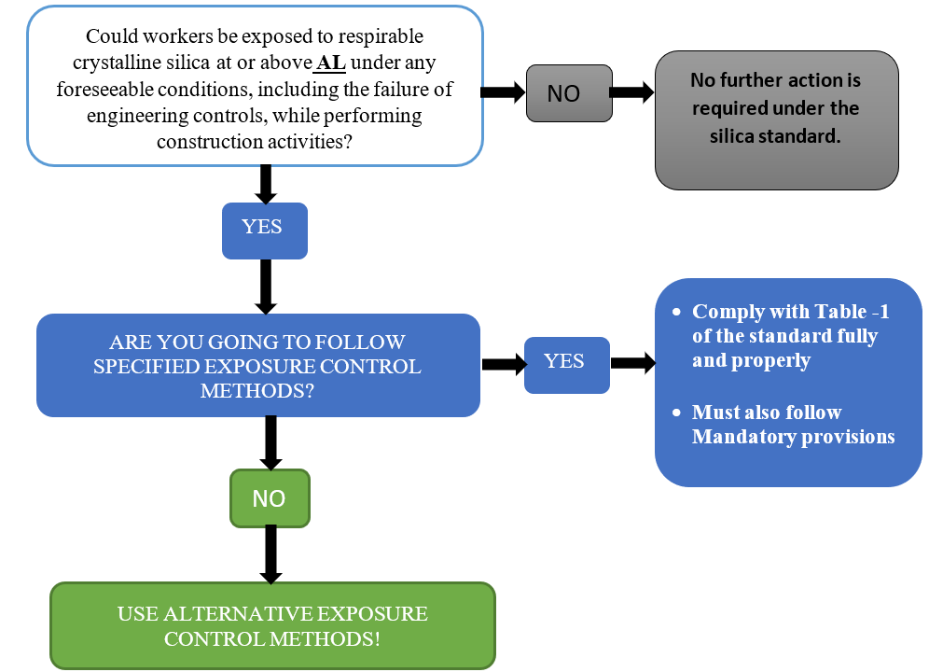
COMPLIANCE WITH THE STANDARD - SUMMARY
Notes:
This slide presents a schematic flow chart on compliance with the Silica Standard, covering when construction work will or will not come under the Standard.

Slide 50
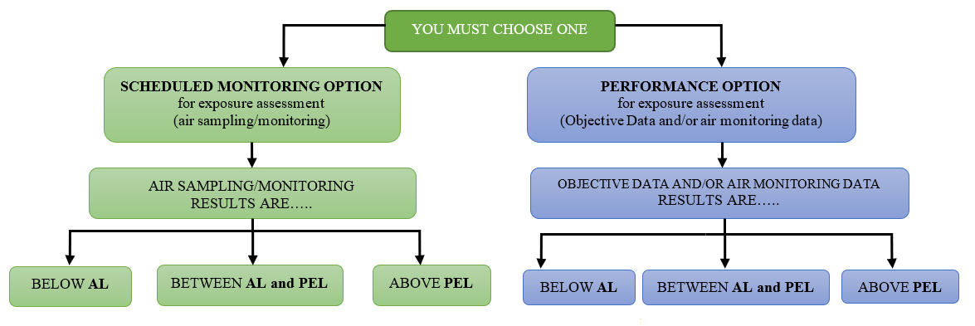
Alternative Silica Exposure Control Options - Summary
Notes:
Employers who conduct tasks not listed in Table 1, or do not fully and properly implement the engineering controls, work practices, and respiratory protection described in Table 1 of the specified exposure control methods approach, must follow the alternative exposure control methods approach. This approach involves:
Assessing employee exposure to silica;
Limiting exposure to the PEL using feasible engineering and work practice controls; and
Providing respiratory protection when necessary.

Slide 51
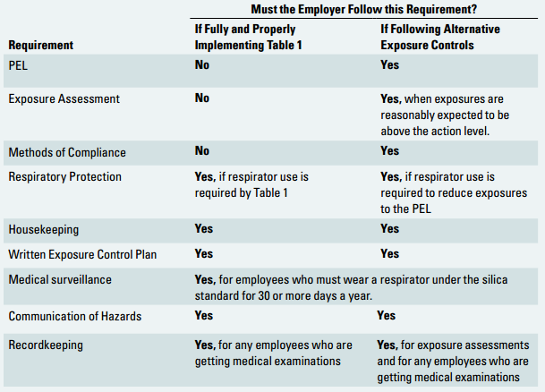
COMPLIANCE WITH THE STANDARD - CHECKLIST
Source: OSHA Small Entity Compliance Guide for the Construction Silica Standard
Notes:
Prior to meeting the requirements of the Respirable Crystalline Silica Standard, employers must determine whether the silica standard applies to their jobsites. If the employees can be exposed to respirable crystalline silica at or above 25 µg/m3 as an 8-hour TWA under any foreseeable conditions, while performing construction activities, then s/he has a choice for complying with the standard by using either the specified exposure control methods (Table 1) or the alternative exposure control methods.
The roadmap presented in the above slide displays the requirements that the employer must meet under the standard, based on the compliance method they follow.

Slide 52
Additional Resources
Additional resources for trainees:
    OSHA Silica Website <https://www.osha.gov/silica/>
    OSHA silica exposure brochure <https://www.osha.gov/dte/library/silicosis/si_gi.pdf>
    OSHA Safety and Health Topics Page
    <https://www.osha.gov/dsg/topics/silicacrystalline/index.html>
    OSHA Small Business Compliance Guide
    <https://www.osha.gov/Publications/OSHA3902.pdf>
    CPWR Silica Website <https://www.silica-safe.org>
Notes:
Further information can be gathered from the sources and documentations presented above.

Slide 53
THANK YOU!

