Slide 1
Name That Pictogram
This material was produced under grant number SH-27673-SH-5 from the Occupational Safety and Health Administration, U.S. Department of Labor. It does not necessarily reflect the views or policies of the U.S. Department of Labor, nor does mention of trade names, commercial products, or organizations imply endorsement by the U.S. Government.

Slide 2
Health hazard/toxicity

Slide 3
Flame/flammables

Slide 4
Exclamation Mark/irritant

Slide 5
Gas cylinder/gases under pressure

Slide 6
Corrosion/burns

Slide 7
Exploding bomb/explosives

Slide 8
Flame over circle/oxidizers

Slide 9
Environment/aquatic toxicity

Slide 10
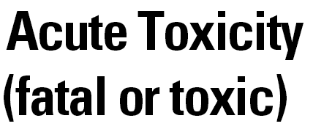
Skull and crossbones/acute toxicity

