Slide 1
Sección 5
Sistemas de protección contra caídas adicionales

Slide 2
Aviso legal
Este material fue elaborado gracias al subsidio número SH-31198-SH7 de la Administración de Salud y Seguridad Ocupacional, del Departamento de Trabajo de los Estados Unidos. Su contenido no necesariamente refleja las opiniones o políticas de dicho Departamento. La inclusión de nombres o productos comerciales u organizaciones no implica la aprobación por parte del gobierno estadounidense.
Esta presentación está destinada a discutir las Reglamentaciones Federales únicamente; sus requisitos estatales individuales pueden ser más estrictos ya que muchos estados operan su propia OSHA estatal y pueden haber adoptado estándares de construcción que son diferentes de la información presentada en esta capacitación. Si vive en un estado con un plan estatal aprobado por OSHA, debe comunicarse con su administrador local para obtener más información sobre los estándares aplicables en su estado.
Estos materiales están destinados solo para fines informativos.
No se hace ninguna declaración en cuanto a la minuciosidad de la presentación.
Notes:
This material was produced under the Susan Harwood training grant number SH-31198-SH7 from the Occupational Safety and Health Administration, U.S. Department of Labor.

Slide 3
Aviso legal, cont.
Esta presentación no tiene la intención de proporcionar una capacitación basada en el cumplimiento, la intención es abordar la concientización sobre de peligros en la industria de la construcción residencial (es decir, la construcción de viviendas) y reconocer los riesgos presentes que se superponen en muchos lugares de trabajo de construcción.
Las fotografías que se muestran en esta presentación pueden representar situaciones que no cumplen con los requisitos de seguridad aplicables de OSHA.
No se ofrece ni se da ninguna sugerencia legal, y no se pretende ni se establece ninguna relación abogado-cliente. Si se requiere asesoramiento legal u otro tipo de asistencia de un especialista, se deberán buscar los servicios de un profesional competente.
Es responsabilidad del empleador y de sus empleados cumplir con todas las normas y reglamentaciones de seguridad de OSHA y de la jurisdicción en la cual trabajan.
Notes:
Please read the disclaimer for legal purposes, this is required under the Susan Harwood Training Grant program.

Slide 4
Información de copyright © 2018
Este material es propiedad con derechos de autor de Job-Site Safety Institute y la Asociación Nacional de Constructores de Viviendas. Conforme con la reglamentación federal, OSHA se reserva la licencia de usar y difusión de dicho material con el propósito de promover la seguridad y la salud en el lugar de trabajo. El Job-Site Safety Institute y la Asociación Nacional de Constructores de Viviendas autorizan a los empleadores y profesionales de seguridad y salud en el lugar de trabajo a utilizar este material, distribuido por o a través de OSHA, en sus lugares o prácticas de trabajo, de acuerdo con las pautas contenidas en el material.
A este fin, se concede permiso para utilizar dicho material con derechos de autor únicamente con fines no comerciales, educativos, personales o académicos. El material puede ser utilizado e incorporado en otros programas de seguridad y salud en el lugar de trabajo, con la condición de que no se cobre ninguna tarifa por el uso posterior del material. Se prohíbe el uso del material para cualquier otro propósito, en particular el uso comercial sin una autorización previa expresa y por escrito del titular de los derechos de autor. Además, cualquier modificación al material está prohibida sin la autorización previa, expresa y por escrito de los propietarios de los derechos de autor.
Notes:
Note that the these materials are copyrighted by the Job-Site Safety Institute and the National Association of Home Builders. Permission is granted to use such copyrighted material in accordance with the terms on the slide.

Slide 5
Objetivos de aprendizaje: Sección 5
Identificar tipos de sistemas de protección contra caídas adicionales y “alternativos” contra caídas.
Discutir los posibles usos y limitaciones del uso de una forma "alternativos" de protección contra caídas.
Identificar los requisitos claves y las prácticas de seguridad básicas para cada sistema de protección alternativo.
Comprender cuándo es necesario un plan escrito de protección contra caídas.
Notes:
Discuss the learning objectives for Section 5. In this section we will identify additional fall protection systems as well as “alternative” fall protection. We will also discuss uses and limitations of these types of systems and identify key requirements for each alternative protection system. Lastly, we will understand when a written fall protection plan is necessary.

Slide 6
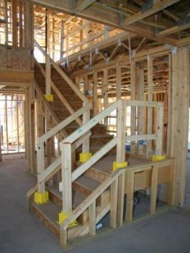
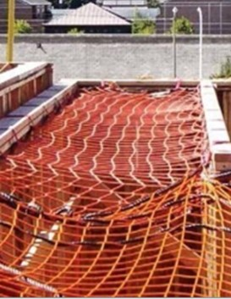
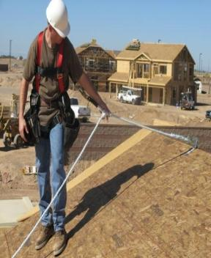
Recordar de la protección convencional contra caídas
3) Sistema Personal de
detención de caídas
(PFAS)
1) Barandillas de Seguridad
2) Redes de seguridad
Notes:
As a reminder, the three conventional forms of fall protection are guardrails, safety nets and personal fall arrest systems.

Slide 7
Sistemas de protección contra caídas adicionales
En esta sección aprenderemos sobre:
Pasamanos y balaustradas
Cubiertas para orificios en el piso
Zonas de acceso controlado
Sistemas de dispositivo de posicionamiento
Protección alternativa contra caídas
Notes:
Addtiaonal fall protection systems covered in this section are:
Handrails and Stairrails
Floor Hole Covers
Controlled Access Zones
Positioning Device Systems
Alternative Fall Protection

Slide 8
Pasamanos y balaustradas - Requisitos
Larguero superior
36 pulgadas (90 cm) por encima de la banda de rodadura verticalmente en línea con el travesaño del peldaño
Instalar la balaustrada a 3" (7,6 cm) de la pared
Larguero intermedio
A medio camino entre el larguero superior y el soporte lateral de la escalera
Tablón de protección para los pies
Mínimo de 3 1/2 pulgadas (4 pulgadas nominales) (10.2 cm)
Requisito de peso
Al menos 200 lb. (90.9 kg)
Notes:
Explain the requirements for handrails and stairrails.
The toprail must be placed 36 inches above the tread and in-line with the riser, and placed 3 inches from the wall.
The midrail should be halfway between stair stringer and toprail.

Slide 9
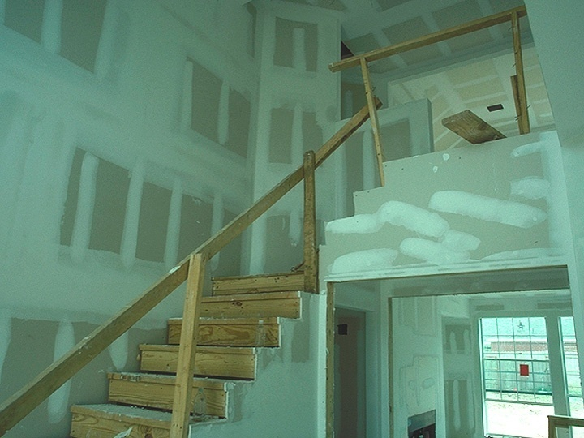
Identificar los peligros
¿Cuántos peligros identifica en esta foto?
Notes:
Discuss the hazards you see in this photo. An example of a hazard could be a missing midrail in the top portion of the guardrail. Also, will this system be capable of withstanding 200 pounds of force downward and outward?

Slide 10
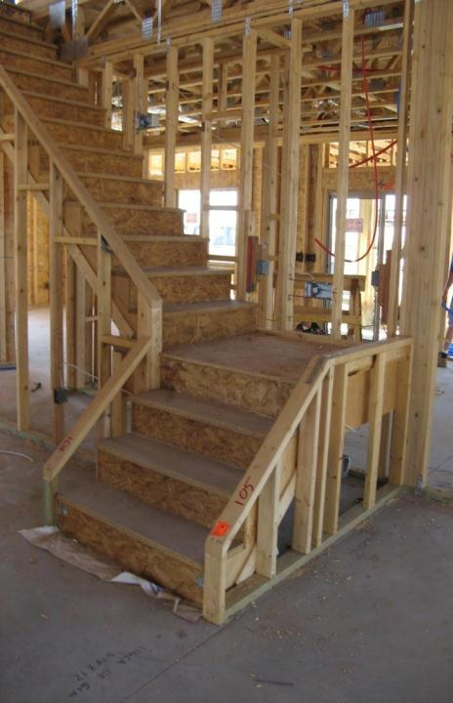
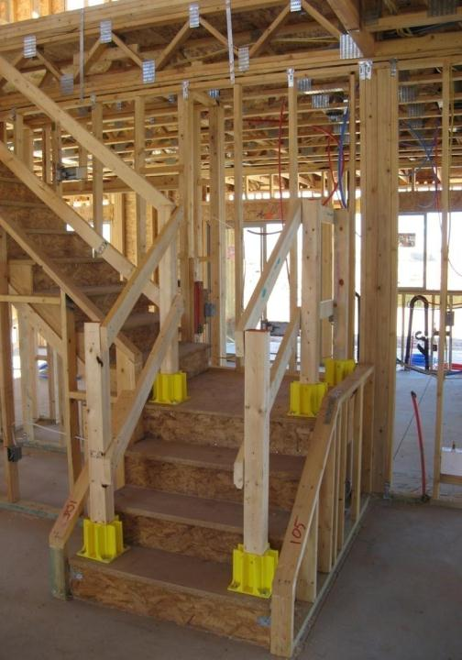
Sistema de bota de barandilla
Notes:
Describe the properly installed guardrail boot system utilized on the picture on the right.

Slide 11
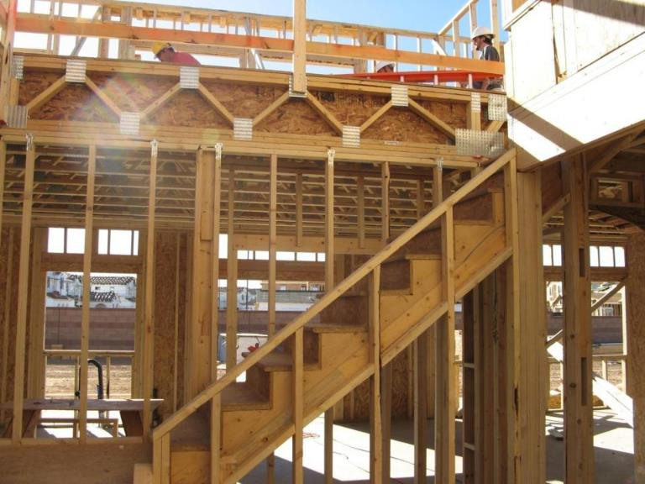
Identificar los peligros
¿Cuántos peligros identifica en esta foto?
Notes:
This photo shows missing handrails on a stairway under construction.

Slide 12
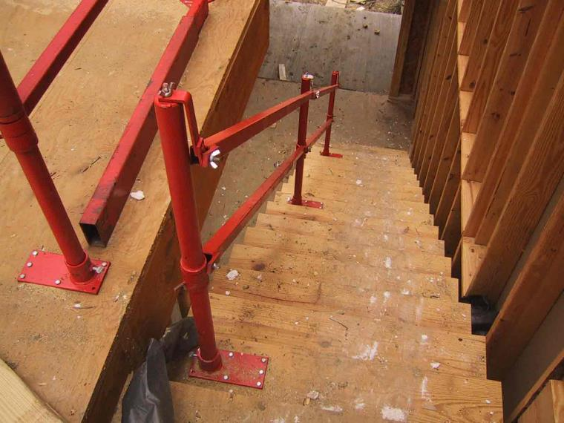
Solución de pasamanos y balaustradas
Notes:
Properly installed metal adjustable guardrail system. Image shows a steel stairrail and hand rail solution installed to a stairway under construction.

Slide 13
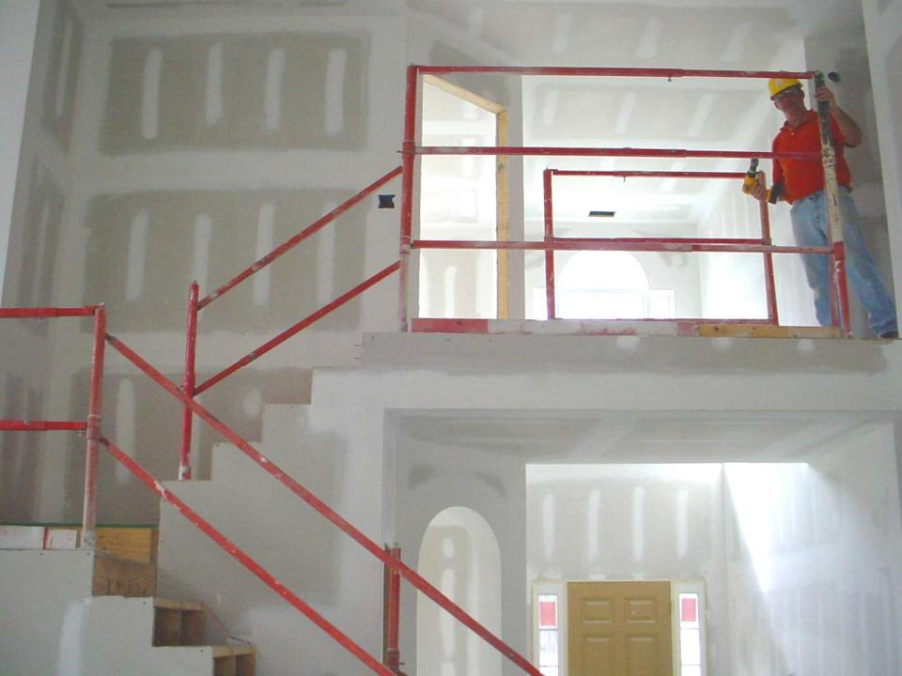
Instalación de balaustradas
Instale un riel superior de 36 pulgadas (90 cm) de alto para permitir que una de las barandillas sirva como pasamano y balaustrada.
Notes:
Properly installed metal adjustable guardrail system. By installing a toprail 36 inches high, allows one railing system to serve as both a hand rail and stairrail.
Discuss how this particular system can be modified to protect workers on stilts by adding a double top rail.

Slide 14
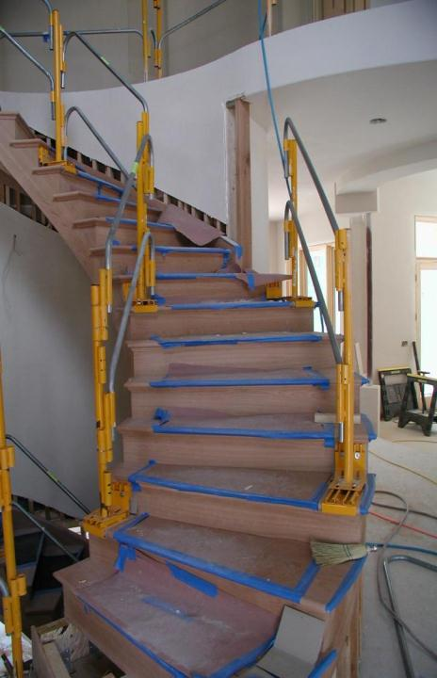
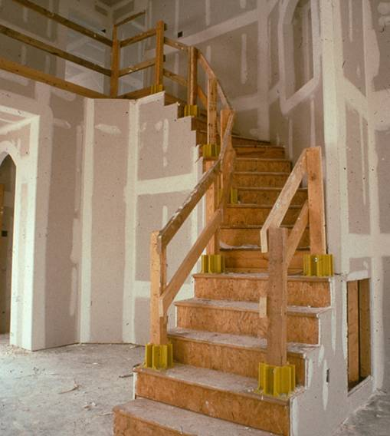
Soluciones de balaustradas
Más soluciones de pasamanos y balaustradas
Notes:
Discuss these two temporary guardrail systems used on a stairway.

Slide 15
Cubiertas para orificios
Asegure y marque las cubiertas que protegen a los trabajadores de tropezarse o pisar a través de un orificio, y evitar que los objetos caigan a través de un orificio
Protecciones contra caídas por peligros en esta categoría:
Orificios en el piso
Notes:
A hole cover is a secured and marked cover which protects workers from tripping or stepping into or through a hole on walking/working surfaces and keeps objects from falling through a hole.

Slide 16
Las cubiertas de los orificios son necesarias para:
Cualquier orificio más grande que 2" x 2" (5 x 5 cm), como:
Aberturas de chimeneas
Claraboyas
Aberturas de escaleras de sótanos
Registros de calefacción, ventilación y aire acondicionado (HVAC)
Recortes de piso de plomería
Notes:
Hole covers must be used on any hole larger than 2 inches by 2 inches. Examples of these openings include:
Fireplace openings
Skylights
Basement stair openings
Floor heating, ventilating, and air-conditioning (HVAC) registers
Plumbing floor cutouts

Slide 17
Requisitos de las cubiertas de orificios
Las cubiertas de orificios deberán ser:
Capaz de soportar al menos dos veces la carga máxima prevista
Asegurar que no se muevan clavándolas en su lugar u otro método efectivo
Marcar de forma bien visible que indique la ubicación de orificio
Notes:
Define:
Window and Wall Openings
Unprotected Sides and Edges
Floor Holes

Slide 18
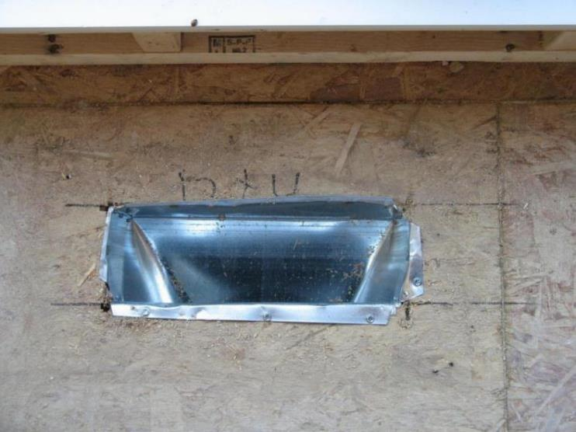
Las cubiertas de orificios deben soportar 2 veces la carga prevista
Cubra las aberturas del piso de más de 2 pulgadas por 2 pulgadas (5 x 5 cm) con material para sostener de manera segura la carga de trabajo.
Notes:
Discuss whether this floor hole cover is capable of withstanding at least two times the maximum anticipated load?
It is also missing the wording “hole” or “cover” or “hole cover”

Slide 19
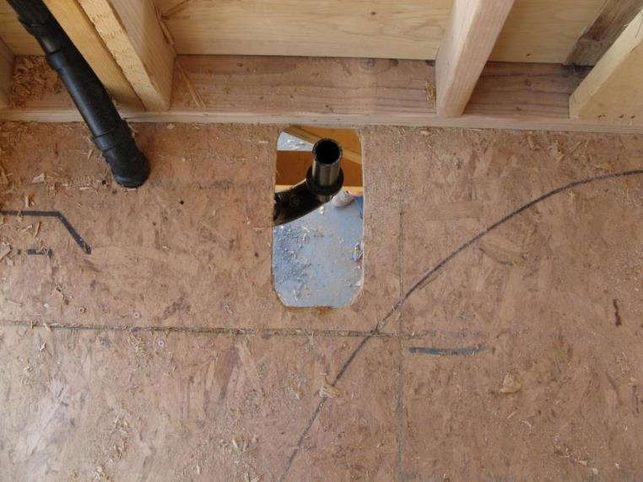
Identificar los peligros
¿Cuántos peligros identifica en esta foto?
Notes:
Image shows an improper floor hole cover as the cover poses an impalement hazard, does not appear secured to prevent displacement, and is missing the words hole or cover.

Slide 20
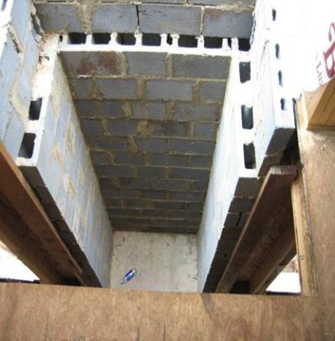
Identificar los peligros
¿Cuántos peligros identifica en esta fotografía?
Notes:
These photos show floor hole hazards that are uncovered.

Slide 21
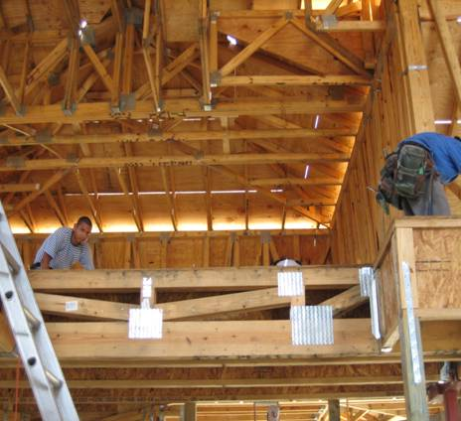
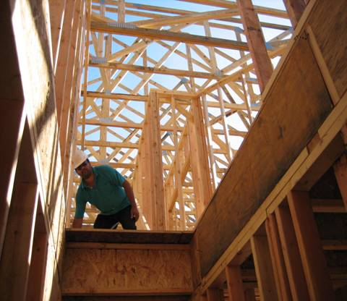
Identificar los peligros
¿Cuántos peligros identifica en esta fotografía?
Notes:
These photos show floor hole hazards that are uncovered and potentially a ladder placed at an improper angle.

Slide 22
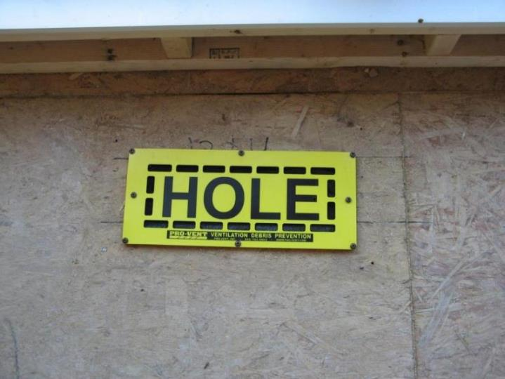
Claramente marcado “Orificio” o “Cubierta”
Notes:
This is a picture of a properly installed floor hole cover. This is a Pro-Vent system that can be used to also prevent debris from entering a ventilation system.

Slide 23
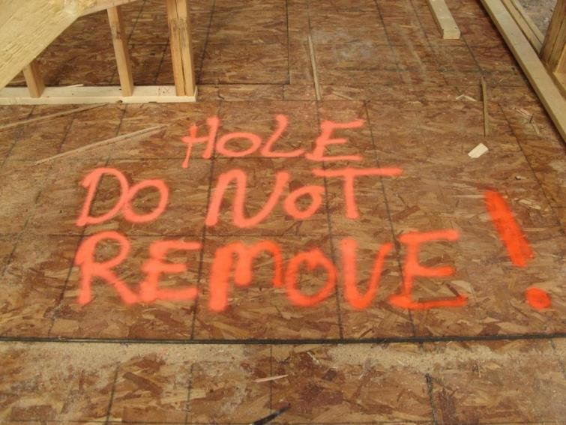
Claramente marcado “Orificio” o “Cubierta”
La pintura naranja brillante es una buena forma de asegurarse de que se vean los peligros.
Notes:
This hole cover is clearly marked and must be properly secured to prevent displacement. It is a best practice to use a bright colored spray paint to be sure that workers know not to remove covers.

Slide 24
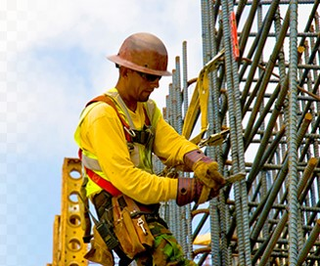
Sistemas de dispositivo de posicionamiento
Es un sistema que evita que los trabajadores se caigan.
No detiene en caso de una caída.
Diseñado en primer lugar para evitar las caídas.
Notes:
A fall positioning device system prevents workers from falling by holding you in-place and preventing you from falling in the first place.

Slide 25
Sistemas de dispositivo de posicionamiento
Se usan para alejar a los trabajadores de cualquier peligro de caída de forma segura, o bien para posicionarlos en un lugar de trabajo donde no puede ocurrir una caída.
NO están diseñados para detención de caídas.
Se deben armar de modo tal que un trabajador no pueda descender en caída libre más de 2 pies (60 cm).
Debe afianzarse a un punto de anclaje capaz de resistir 3.000 libras (1.361 kg).
Notes:
Discuss instances where a positioning system may be used. Examples include encroachment to floor holes or wall openings. This system is designed to prevent workers from ever reaching an area where a fall may occur. Also discuss using shorter lanyards attached directly to the D-ring and the anchor point to securely hold a worker in place to prevent falls from occurring.

Slide 26
Sistemas de dispositivo de posicionamiento
Inspeccione en busca de por desgastes, daños, deterioros o componentes defectuosos antes de CADA USO.
Puede usar cinturones corporales para los sistemas de dispositivo de posicionamiento, no así para sistemas de detención de caídas.
La mejor práctica es usar un arnés de cuerpo entero incluso cuando se usa un sistema de dispositivo de posicionamiento.
Notes:
Similar to a PFAS, a positioning device system must be inspected before each use. You can use a body belt as a positioning device system but not for fall arrest.

Slide 27
Sistemas de dispositivo de posicionamiento
Un cinturón para sujetar el cuerpo o sistema de arnés para el cuerpo armado de manera que le permita al empleado quedar sujetado en una superficie vertical elevada y trabajar con ambas manos mientras se inclina libremente.
Notes:
Discuss how a positioning device system may be used to stabilize a worker while working at heights.
There are limitations to this system in a residential construction environment.

Slide 28
Protección alternativa contra caídas
Construcción residencial Excepción*
Cuando los empleadores pueden demostrar que usar sistemas “convencionales” de protección contra caídas es inviable o que crea un peligro mayor, deberán desarrollar e implementar un plan de protección contra caídas, según sea necesario, de acuerdo con §1926.502 (k).
Notes:
Discuss how a positioning device system may be used to stabilize a worker while working at heights.
There are limitations to this system in a residential construction environment.

Slide 29
¿Qué significa “Inviable”?
Inviable significa:
Imposible de realizar trabajos de construcción usando sistemas convencionales de protección contra caídas o
Es tecnológicamente imposible usar protección convencional contra caídas.
Fuente: 1926.500 (b)
Notes:
These examples are found directly in OSHA’s Preamble to the 1994 Subpart M-Fall Protection rulemaking record.
Note: There is a presumption that it is feasible and will not create a greater hazard to implement one of the conventional fall protection methods (personal fall arrest system, guardrails, or safety nets); and accordingly the employer has the burden of establishing that it is appropriate to implement a fall protection plan that complies with 1926.502(k).

Slide 30
Ejemplos de inviabilidad
OSHA cree que no sería razonable esperar que un constructor de viviendas alquile una grúa cuando el lugar de trabajo es de difícil acceso (terreno o ubicación remota) o cuando el constructor de viviendas tiene solo un techo para levantar.
OSHA no espera que los constructores construyan andamios alrededor de todo el perímetro de una casa, o tomen otras medidas extremadamente onerosas como levantar estructuras separadas (postes de teléfono, por ejemplo) y encordar una línea de vida para usar como punto de fijación para equipos personales de detención de caídas.
Fuente: Preámbulo a la Norma definitiva de protección contra caídas, Sección 3 - III. Resumen y explicación de la Norma definitiva, 9 de agosto de 1994
Notes:
OSHA does not consider "economic infeasibility" to be a basis for failing to provide conventional fall protection for employees performing residential construction work.
Note: There is a presumption that it is feasible and will not create a greater hazard to implement one of the conventional fall protection methods (personal fall arrest system, guardrails, or safety nets); and accordingly the employer has the burden of establishing that it is appropriate to implement a fall protection plan that complies with 1926.502(k).

Slide 31
¿Qué significa “crear un peligro mayor”?
Peligros creados por el cumplimiento de la norma, que son mayores que los creados por el incumplimiento de esta.
Fuente: Preámbulo a la Norma definitiva de protección contra caídas, Sección 3 - III. Resumen y explicación de la Norma definitiva, 9 de agosto de 1994
Notes:
If an employer can demonstrate that conventional fall protection (i.e., guardrail systems, safety net systems, or personal fall arrest systems) is infeasible or presents a greater hazard, a written, site specific fall protection plan meeting the requirements of 1926.502(k) can be implemented.
The employer has the burden of establishing that it is appropriate to implement a fall protection plan.
Note: There is a presumption that it is feasible and will not create a greater hazard to implement one of the conventional fall protection methods (personal fall arrest system, guardrails, or safety nets); and accordingly the employer has the burden of establishing that it is appropriate to implement a fall protection plan that complies with 1926.502(k).

Slide 32
Establecer el “Peligro mayor”, cont.
OSHA reconoce que, independientemente de la capacidad del empleador para planificar por anticipado la protección contra caídas, puede haber casos en los cuales la instalación o el uso de sistemas convencionales de protección contra caídas presenten un riesgo mayor al que estarían expuestos los empleados que realizan el trabajo de construcción.
OSHA espera que un empleador que busque esgrimir ese caso indique específicamente de qué forma el cumplimiento del requisito de los sistemas convencionales de protección contra caídas plantearía un peligro mayor.
OSHA evaluará cada caso en relación con los méritos particulares.
Fuente: Preámbulo a la Norma definitiva de protección contra caídas, Sección 3 - III. Resumen y explicación de la Norma definitiva, 9 de agosto de 1994
Notes:
Discuss: Employers must evaluate the use of conventional fall protection systems, and other work practices covered under OSHA standards (i.e. ladders, scaffolding or aerial lifts) prior to implementing any alternative work practices and establishing a written, site-specific fall protection program.
If an employer can demonstrate that conventional fall protection (i.e., guardrail systems, safety net systems, or personal fall arrest systems) is infeasible or presents a greater hazard, a written, site specific fall protection plan meeting the requirements of 1926.502(k) can be implemented.
The employer has the burden of establishing that it is appropriate to implement a fall protection plan.
Note: There is a presumption that it is feasible and will not create a greater hazard to implement one of the conventional fall protection methods (personal fall arrest system, guardrails, or safety nets); and accordingly the employer has the burden of establishing that it is appropriate to implement a fall protection plan that complies with 1926.502(k).

Slide 33
Plan de Protección contra caídas
Esta opción está disponible para aquellos dedicados al trabajo de “construcción residencial” que puedan establecer que la protección convencional contra caídas no es factible ni crea un peligro mayor.
Nota: Es presunción de OSHA que la protección contra caídas convencional es factible y no creará un peligro mayor, y es responsabilidad del empleador establecer que es apropiado implementar un plan de protección contra caídas.
Notes:
Discuss: Employers cannot use alternative fall protective measures until it has been documented and proven that conventional fall protective systems are either infeasible/their use creates a greater hazard.
This includes OSHA’s Appendix E to Subpart M, employers must exhaust all conventional means of providing fall protection prior to implementing a fall protection plan that meets the requirements of 1926.502(k).

Slide 34
Plan de Protección contra caídas
Plan por escrito y específico para el sitio, que identifica y evalúa los riesgos de caídas en el lugar de trabajo, establece los métodos de protección que se utilizarán y evalúa la capacidad de los trabajadores para seguir las normas de trabajo relacionadas y utilizar el equipo de forma segura.
Una Persona calificada desarrolla el plan.
Una Persona competente implementa el plan.
Notes:
Discuss: Employers must evaluate the use of conventional fall protection systems, and other work practices covered under OSHA standards (i.e. ladders, scaffolding or aerial lifts) prior to implementing any alternative work practices and establishing a written, site-specific fall protection program.
If an employer can demonstrate that conventional fall protection (i.e., guardrail systems, safety net systems, or personal fall arrest systems) is infeasible or presents a greater hazard, a written, site specific fall protection plan meeting the requirements of 1926.502(k) can be implemented.
The employer has the burden of establishing that it is appropriate to implement a fall protection plan.
Note: There is a presumption that it is feasible and will not create a greater hazard to implement one of the conventional fall protection methods (personal fall arrest system, guardrails, or safety nets); and accordingly the employer has the burden of establishing that it is appropriate to implement a fall protection plan that complies with 1926.502(k).

Slide 35
Plan de Protección contra caídas, cont.
OSHA considera que la implementación de un plan de protección contra caídas, que describe medidas alternativas de protección contra caídas, es un “último recurso”.
Permitido solo donde se hayan agotado las otras opciones de protección contra caídas.
Fuente: Preámbulo a la Norma definitiva de protección contra caídas, Sección 3 - III. Resumen y explicación de la Norma definitiva, 9 de agosto de 1994
Notes:
Discuss: Employers must evaluate the use of conventional fall protection systems, and other work practices covered under OSHA standards (i.e. ladders, scaffolding or aerial lifts) prior to implementing any alternative work practices and establishing a written, site-specific fall protection program.
If an employer can demonstrate that conventional fall protection (i.e., guardrail systems, safety net systems, or personal fall arrest systems) is infeasible or presents a greater hazard, a written, site specific fall protection plan meeting the requirements of 1926.502(k) can be implemented.
The employer has the burden of establishing that it is appropriate to implement a fall protection plan.
Note: There is a presumption that it is feasible and will not create a greater hazard to implement one of the conventional fall protection methods (personal fall arrest system, guardrails, or safety nets); and accordingly the employer has the burden of establishing that it is appropriate to implement a fall protection plan that complies with 1926.502(k).

Slide 36
Plan de Protección contra caídas
Un plan de protección contra caídas deberá identificar cómo y dónde se usará la protección contra caídas en el lugar de trabajo y también las prácticas de trabajo seguro que se utilizarán.
NOTA: Antes de implementar el plan de protección contra caídas (1926.502 (k)) el empleador tiene la carga probar por qué el uso de la protección convencional contra caídas no es factible o crea un riesgo mayor.
Notes:
A written fall protection plan identifies and evaluates fall hazards on a jobsite, establishes the protection methods to be used, and assesses the ability of workers to follow related work rules and use equipment safely.
The plan identifies protective methods for hazards in this category: Leading Edges

Slide 37
Plan de Protección contra caídas
Documenta las razones por las cuales el uso de sistemas convencionales de protección contra caídas no son factibles o su uso crea un riesgo mayor.
Incluye una discusión escrita de otras medidas que se tomarán para reducir o eliminar el peligro de caída.
Identifica las ubicaciones donde no se puede usar la protección convencional contra caídas y luego clasifica estas áreas como zonas de acceso controlado (CAZ).
Notes:
Discuss what is required in a fall protection plan, and refer back to the definition of “qualified person” and “competent person” (if needed).
Note: the employer has the burden to establish that conventional fall protective systems are either infeasible or their use creates a greater hazard.

Slide 38
Plan de Protección contra caídas, cont.
Debe ser por escrito y específico para el sitio.
Un plan escrito elaborado para el uso repetitivo en un estilo/modelo de casa en particular se considerará específico para el sitio con respecto a un sitio en particular solo si se tienen plenamente en cuenta todas las cuestiones relacionadas con la protección contra caídas en ese lugar.
Notes:
Previously under OSHA’s Interim Fall Protection Compliance Guidelines for Residential Construction, employers had the option to utilize a fall protection plan without prior showing of infeasibility/greater hazard and without having a written site-specific fall protection plan.
Beginning June 16, 2011 employers engaged in residential construction that establish that conventional fall protection systems are either infeasible or create a greater hazard and implement a fall protection plan meeting the requirements of 1926.502(k) will be required to establish a written and site-specific fall protection plan.

Slide 39
Plan de Protección contra caídas, cont.
Plásmelo por escrito y consérvelo en el lugar de trabajo.
Debe mantenerse vigente y actualizado.
Implementación/supervisión por personas designadas.
Deberá incluir:
Las razones por las cuales las protecciones “convencionales” contra caídas son inviables o crean un peligro mayor.
Las medidas alternativas tendientes a reducir o eliminar los riesgos de caídas.
La ubicación y qué personas pueden trabajar en la Zona de acceso controlado (CAZ).
Notes:
Discuss the requirements of a fall protection plan.
If an employer can demonstrate that conventional fall protection (i.e., guardrail systems, safety net systems, or personal fall arrest systems) is infeasible or presents a greater hazard, a written, site specific fall protection plan meeting the requirements of 1926.502(k) can be implemented.
The employer has the burden of establishing that it is appropriate to implement a fall protection plan.

Slide 40
Establecer una zona de acceso controlado (CAZ)
El Área de trabajo designada/restringida que puede tener mayores riesgos relacionados con riesgos de caídas que no está protegida contra este peligro y/o caída de materiales.
Restringir el acceso a los procesos encontrados en esta categoría de riesgo:
Bordes salientes
Notes:
A controlled access zone is a designated/restricted work area that may have increased hazards related to otherwise unprotected fall hazards and/or falling material.

Slide 41
Requisitos para una CAZ
La persona competente debe:
Determine dónde colocar los límites de una CAZ.
Asegurarse de que los requisitos del plan de protección contra caídas estén vigentes antes de que comience el trabajo en una CAZ.
Monitorear a los trabajadores mientras están en una CAZ; corregir cualquier práctica o condición insegura inmediatamente.
Notes:
In a CAZ, a competent person must determine where to place the boundaries, ensure that the requirements of the fall protection plan are in place and monitor workers while they are in a CAZ. They must also correct any unsafe practices or conditions immediately.

Slide 42
Requisitos para una CAZ
La zona de acceso controlado debe ser:
Apostada en el perímetro a simple vista.
Claramente visible para una persona que se acerca al área.
Restringida al personal autorizado.
Notes:
In a CAZ, the area must be posted at the perimeter, clearly visible to anyone approaching the area and restricted to unauthorized personnel.

Slide 43
Sección de evaluación
La siguiente sección pretende proporcionar un foro abierto para la discusión entre los asistentes y los instructores.
Nota: Las prácticas y procedimientos mostrados podrán o no cumplir con la intención de los requisitos de la Subparte M-Protección ante Caídas de OSHA; verifique con su Oficina Local de OSHA antes de implementar los procedimientos alternativos de protección contra caídas.
Notes:
Instructor: Please review this slide with student attendees.
The following slides are meant to start discussions regarding when it may be appropriate to implement alternative fall protection procedures and a written fall protection plan.
This section is intended to assist employers in their efforts to comply with fall protection requirements for residential construction work. The Occupational Safety and Health Act requires employers to comply with safety and health standards promulgated by OSHA or by a state with an OSHA-approved state plan.
The burden is on each employer to determine when it may be appropriate to use alternative fall protection procedures, and should check with their Local Area OSHA Offices prior to implementing these procedures on a jobsite.

Slide 44
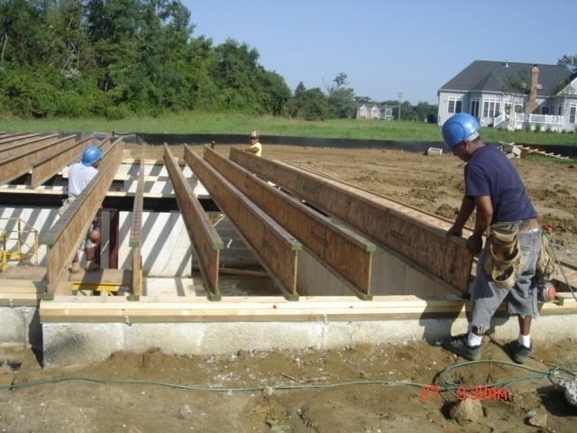
Discutir los riesgos de caídas
Discutir: ¿Se requiere protección convencional contra caídas?
Notes:
Engage the audience and facilitate a discussion on this picture.
The worker is exposed to an interior fall hazard of 6 feet or more, however one might argue that is infeasible or creates a greater hazard to use a conventional fall protection system.
What type of conventional fall protection methods can be used to protect this worker from an interior fall hazard?
Explain the safe work practices that should be utilized to safety protect workers who are performing these tasks, which should include the use of conventional fall protection systems (personal fall arrest systems, guardrails, or safety nets) and ladders and scaffolding.
This picture shows the installation of floor joists and the worker is working from the ground to set them into place; however they are exposed to an interior fall hazard of 6 feet or more.
Discuss the installation of the floor joist, and the process to do so.
Limitations of conventional fall protection systems during the installation of floor joists may include:
Lack of a suitable anchor point to withstand 5000 pounds or twice the intended load from a falling worker.
Manufacturers of the floor joists may prohibit inserting anchor points that may cause the joist to crack or fail.
Manufacturers of personal fall arrest system components may prohibit the anchor point to be placed at ground level, or below a workers ‘D’ ring on their harness.
Clearance distance below a worker, which is needed when using a personal fall arrest system, may not be sufficient to prevent the worker from contacting the next lower level, should a fall occur.
Manufacturers may have differing installation/usage requirements; always refer to the manufacturers’ instruction prior to use.
Note: It is important to remember that employers must demonstrate why conventional fall protection is either infeasible or creates a greater hazard for each part of a task prior to implementing alternative fall protection measures and a written fall protection plan. There are numerous parts of each job task that goes into the construction of a house, and throughout the duration of a specific task there may be a combination of conventional and alternative safe work practices that may be utilized. In order to remain in compliance with OSHA’s Subpart M- Fall Protection regulation employers have the burden of establishing a written argument as to why alternative fall protection procedures were used and where conventional fall protection systems were either infeasible or created a greater hazard.

Slide 45
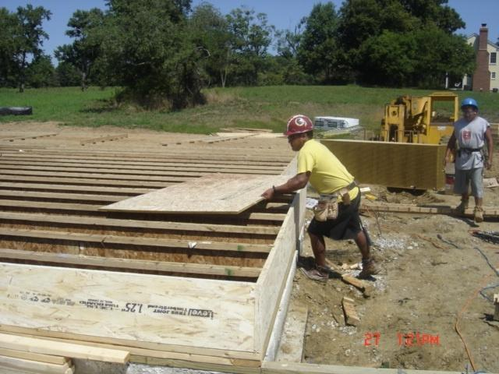
Discutir los riesgos de caídas
Discutir: ¿Se requiere protección convencional contra caídas?
Notes:
Engage the audience and facilitate a discussion on this picture.
The worker is exposed to an interior fall hazard of 6 feet or more, however one might argue that is infeasible or creates a greater hazard to use a conventional fall protection system.
What type of conventional fall protection methods can be used to protect this worker from an interior fall hazard?
Explain the safe work practices that should be utilized to safety protect workers who are performing these tasks, which should include the use of conventional fall protection systems (personal fall arrest systems, guardrails, or safety nets) and ladders and scaffolding.
This picture shows the installation of floor joists and the worker is working from the ground to set them into place; however they are exposed to an interior fall hazard of 6 feet or more.
Discuss the installation of the floor joist, and the process to do so.
Limitations of conventional fall protection systems during the installation of floor joists may include:
Lack of a suitable anchor point to withstand 5000 pounds or twice the intended load from a falling worker.
Manufacturers of the floor joists may prohibit inserting anchor points that may cause the joist to crack or fail.
Manufacturers of personal fall arrest system components may prohibit the anchor point to be placed at ground level, or below a workers ‘D’ ring on their harness.
Clearance distance below a worker, which is needed when using a personal fall arrest system, may not be sufficient to prevent the worker from contacting the next lower level, should a fall occur.
Manufacturers may have differing installation/usage requirements; always refer to the manufacturers’ instruction prior to use.
Note: It is important to remember that employers must demonstrate why conventional fall protection is either infeasible or creates a greater hazard for each part of a task prior to implementing alternative fall protection measures and a written fall protection plan. There are numerous parts of each job task that goes into the construction of a house, and throughout the duration of a specific task there may be a combination of conventional and alternative safe work practices that may be utilized. In order to remain in compliance with OSHA’s Subpart M- Fall Protection regulation employers have the burden of establishing a written argument as to why alternative fall protection procedures were used and where conventional fall protection systems were either infeasible or created a greater hazard.

Slide 46
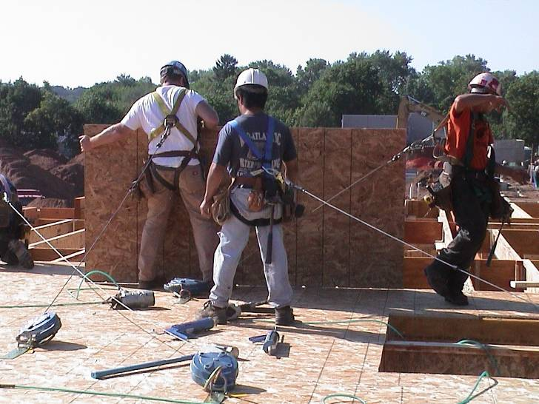
Discutir los riesgos de caídas
Discutir: ¿Es esta la aplicación correcta para la protección convencional contra caídas?
Notes:
This picture shows three workers attached to separate self-retracting lifelines (SRL) to protect from fall hazards of 6 feet or more.
Discuss the installation of floor sheathing.
Limitations of conventional fall protection systems during the installation of floor sheathing may include:
Lack of a suitable anchor point to withstand 5000 pounds or twice the intended load from a falling worker.
Installation of guardrail system could involve more risk, due to the duration of the fall exposure.
Manufacturers of the floor joists may prohibit inserting anchor points that may cause the joist to crack or fail.
Manufacturers of personal fall arrest system components may prohibit the anchor point to be placed at ground level, or below a workers ‘D’ ring on their harness.
Clearance distance below a worker, which is needed when using a personal fall arrest system, may not be sufficient to prevent the worker from contacting the next lower level, should a fall occur.
Manufacturers may have differing installation/usage requirements; always refer to the manufacturers’ instruction prior to use.
Note: It is important to remember that employers must demonstrate why conventional fall protection is either infeasible or creates a greater hazard for each part of a task prior to implementing alternative fall protection measures and a written fall protection plan. There are numerous parts of each job task that goes into the construction of a house, and throughout the duration of a specific task there may be a combination of conventional and alternative safe work practices that may be utilized. In order to remain in compliance with OSHA’s Subpart M- Fall Protection regulation employers have the burden of establishing a written argument as to why alternative fall protection procedures were used and where conventional fall protection systems were either infeasible or created a greater hazard.

Slide 47
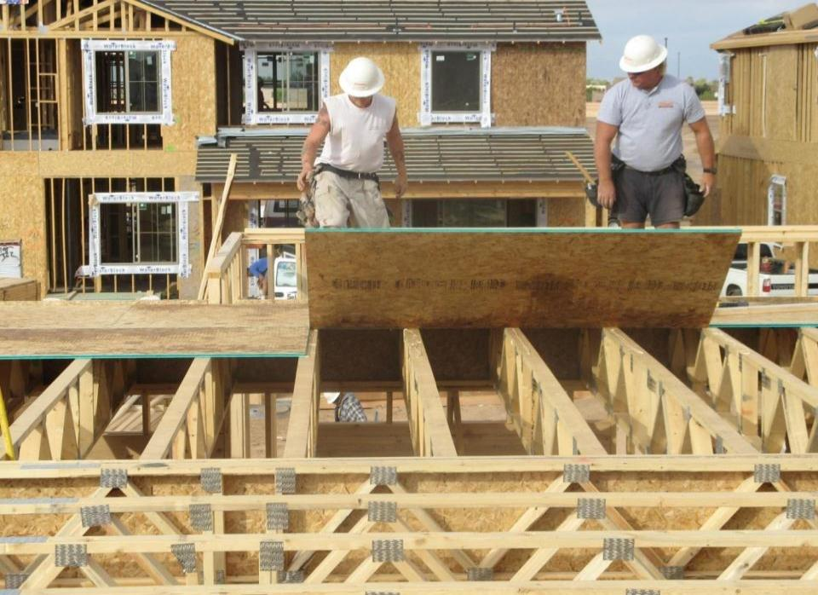
Discutir los riesgos de caídas
Esta imagen muestra el uso de los procedimientos convencionales y alternativos de protección contra caídas, que aún requieren el uso de un plan de protección contra caídas escrito y específico del sitio.
Notes:
Discuss: Employers must evaluate the use of conventional fall protection systems, and other work practices covered under OSHA standards (i.e. ladders, scaffolding or aerial lifts) prior to implementing any alternative work practices and establishing a written, site-specific fall protection program.
This picture shows the installation of the second row of sheathing, and utilizes both guardrails to protect from an exterior fall and the use of alternative safe work practices that show workers working from a previously established deck.
If an employer can demonstrate that conventional fall protection (i.e., guardrail systems, safety net systems, or personal fall arrest systems) is infeasible or presents a greater hazard, a written, site specific fall protection plan meeting the requirements of 1926.502(k) can be implemented.
The employer has the burden of establishing that it is appropriate to implement a fall protection plan.
Limitations of conventional fall protection systems during the installation of floor sheathing may include:
Lack of a suitable anchor point to withstand 5000 pounds or twice the intended load from a falling worker.
Installation of guardrail system could involve more risk, due to the duration of the fall exposure.
Manufacturers of the floor joists may prohibit inserting anchor points that may cause the joist to crack or fail.
Manufacturers of personal fall arrest system components may prohibit the anchor point to be placed at ground level, or below a workers ‘D’ ring on their harness.
Clearance distance below a worker, which is needed when using a personal fall arrest system, may not be sufficient to prevent the worker from contacting the next lower level, should a fall occur.
Manufacturers may have differing installation/usage requirements; always refer to the manufacturers’ instruction prior to use.
Note: There is a presumption that it is feasible and will not create a greater hazard to implement one of the conventional fall protection methods (personal fall arrest system, guardrails, or safety nets); and accordingly the employer has the burden of establishing that it is appropriate to implement a fall protection plan that complies with 1926.502(k).

Slide 48
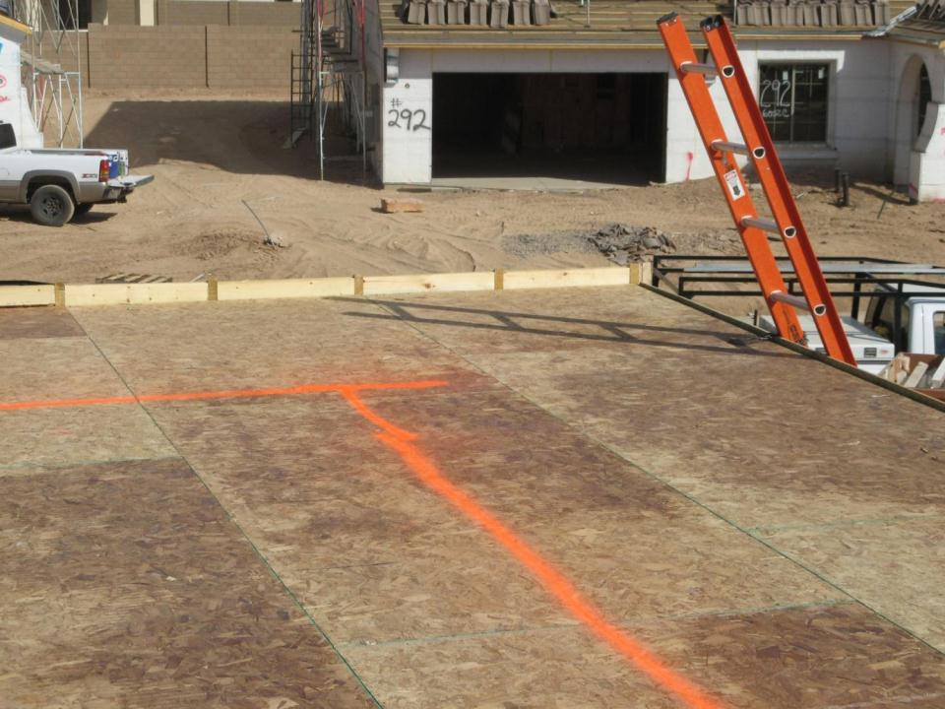
Discutir los riesgos de caídas
Discutir: ¿Se puede proporcionar protección convencional contra caídas?
6 pies (1,80 metros)
Los empleadores deberán agotar primero todas las opciones para proporcionar protección convencional contra caídas u otros métodos de trabajo cubiertos por las reglamentaciones de OSHA, antes de implementar un sistema de monitoreo de seguridad y una línea de advertencia.
Notes:
Discuss: Employers must evaluate the use of conventional fall protection systems, and other work practices covered under OSHA standards (i.e. ladders, scaffolding or aerial lifts) prior to implementing any alternative work practices and establishing a written, site-specific fall protection program.
This picture shows the installed deck of floor sheathing in preparation for the installation of exterior walls. There is a warning line painted that is part of a safety monitor system. This shows an example of an alternative fall protection procedure.
If an employer can demonstrate that conventional fall protection (i.e., guardrail systems, safety net systems, or personal fall arrest systems) is infeasible or presents a greater hazard, a written, site specific fall protection plan meeting the requirements of 1926.502(k) can be implemented.
The employer has the burden of establishing that it is appropriate to implement a fall protection plan.
Limitations of conventional fall protection systems during the installation of exterior walls may include:
Lack of a suitable anchor point to withstand 5000 pounds or twice the intended load from a falling worker.
Installation of guardrail system could involve more risk, due to the duration of the fall exposure.
Manufacturers of the floor joists may prohibit inserting anchor points that may cause the joist to crack or fail.
Manufacturers of personal fall arrest system components may prohibit the anchor point to be placed at ground level, or below a workers ‘D’ ring on their harness.
Clearance distance below a worker, which is needed when using a personal fall arrest system, may not be sufficient to prevent the worker from contacting the next lower level, should a fall occur.
Manufacturers may have differing installation/usage requirements; always refer to the manufacturers’ instruction prior to use.
Note: There is a presumption that it is feasible and will not create a greater hazard to implement one of the conventional fall protection methods (personal fall arrest system, guardrails, or safety nets); and accordingly the employer has the burden of establishing that it is appropriate to implement a fall protection plan that complies with 1926.502(k).

Slide 49
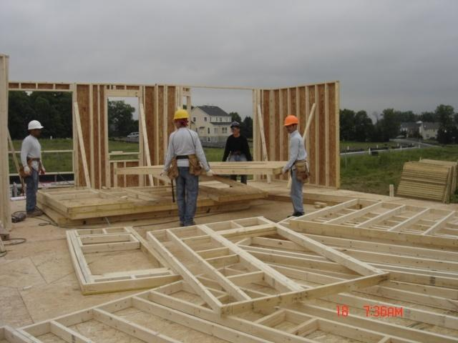
Discutir los riesgos de caídas
Discutir: ¿Se puede proporcionar protección convencional contra caídas?
Notes:
Discuss: Employers must evaluate the use of conventional fall protection systems, and other work practices covered under OSHA standards (i.e. ladders, scaffolding or aerial lifts) prior to implementing any alternative work practices and establishing a written, site-specific fall protection program.
This picture shows the installed deck of floor sheathing in preparation for the installation of exterior walls. Workers are in the process of erecting the 2nd floor exterior walls.
If an employer can demonstrate that conventional fall protection (i.e., guardrail systems, safety net systems, or personal fall arrest systems) is infeasible or presents a greater hazard, a written, site specific fall protection plan meeting the requirements of 1926.502(k) can be implemented.
The employer has the burden of establishing that it is appropriate to implement a fall protection plan.
Limitations of conventional fall protection systems during the installation of exterior walls may include:
Lack of a suitable anchor point to withstand 5000 pounds or twice the intended load from a falling worker.
Installation of guardrail system could involve more risk, due to the duration of the fall exposure.
Manufacturers of personal fall arrest system components may prohibit the anchor point to be placed at ground level, or below a workers ‘D’ ring on their harness.
Clearance distance below a worker, which is needed when using a personal fall arrest system, may not be sufficient to prevent the worker from contacting the next lower level, should a fall occur.
Manufacturers may have differing installation/usage requirements; always refer to the manufacturers’ instruction prior to use.
Note: There is a presumption that it is feasible and will not create a greater hazard to implement one of the conventional fall protection methods (personal fall arrest system, guardrails, or safety nets); and accordingly the employer has the burden of establishing that it is appropriate to implement a fall protection plan that complies with 1926.502(k).

Slide 50
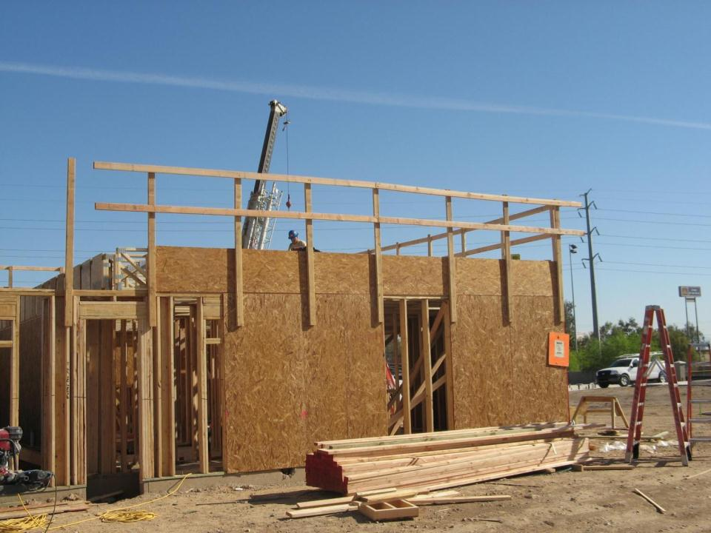
Discutir los riesgos de caídas
Esta imagen muestra el uso de barandas de protección para proteger contra riesgos de caídas en exteriores.
Notes:
This picture shows the installation of floor sheathing, and utilizes guardrails to protect from an exterior fall hazard. It is unclear what type of conventional or alternative fall protection is provided to the workers on the floor deck.
Discuss: Employers must evaluate the use of conventional fall protection systems, and other work practices covered under OSHA standards (i.e. ladders, scaffolding or aerial lifts) prior to implementing any alternative work practices and establishing a written, site-specific fall protection program.
If an employer can demonstrate that conventional fall protection (i.e., guardrail systems, safety net systems, or personal fall arrest systems) is infeasible or presents a greater hazard, a written, site specific fall protection plan meeting the requirements of 1926.502(k) can be implemented.
The employer has the burden of establishing that it is appropriate to implement a fall protection plan.
Limitations of conventional fall protection systems during the installation of floor sheathing may include:
Lack of a suitable anchor point to withstand 5000 pounds or twice the intended load from a falling worker.
Installation of guardrail system could involve more risk, due to the duration of the fall exposure.
Manufacturers of the floor joists may prohibit inserting anchor points that may cause the joist to crack or fail.
Manufacturers of personal fall arrest system components may prohibit the anchor point to be placed at ground level, or below a workers ‘D’ ring on their harness.
Clearance distance below a worker, which is needed when using a personal fall arrest system, may not be sufficient to prevent the worker from contacting the next lower level, should a fall occur.
Manufacturers may have differing installation/usage requirements; always refer to the manufacturers’ instruction prior to use.
Note: There is a presumption that it is feasible and will not create a greater hazard to implement one of the conventional fall protection methods (personal fall arrest system, guardrails, or safety nets); and accordingly the employer has the burden of establishing that it is appropriate to implement a fall protection plan that complies with 1926.502(k).

Slide 51
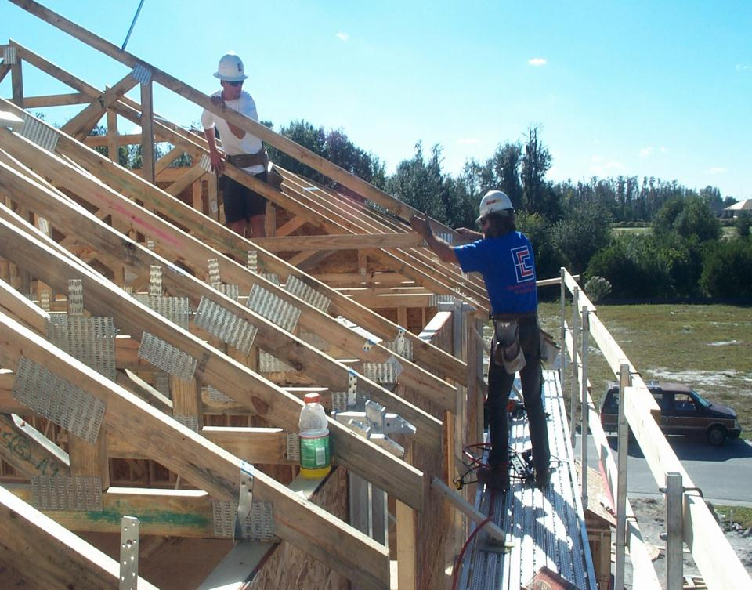
Discutir los riesgos de caídas
Discutir: ¿Se puede proporcionar protección convencional contra caídas?
Esta imagen muestra el uso de los procedimientos convencionales y alternativos de protección contra caídas, que aún requieren el uso de un plan de protección contra caídas escrito y específico del sitio.
Notes:
This picture shows the use of both conventional and alternative fall protection procedures utilized to set and brace roof trusses. Employers must determine and evaluate each job task to determine when and where conventional fall protection can be provided, prior to implementing alternative fall protection procedures.
Discuss: Employers must evaluate the use of conventional fall protection systems, and other work practices covered under OSHA standards (i.e. ladders, scaffolding or aerial lifts) prior to implementing any alternative work practices and establishing a written, site-specific fall protection program.
If an employer can demonstrate that conventional fall protection (i.e., guardrail systems, safety net systems, or personal fall arrest systems) is infeasible or presents a greater hazard, a written, site specific fall protection plan meeting the requirements of 1926.502(k) can be implemented.
The employer has the burden of establishing that it is appropriate to implement a fall protection plan.
Limitations of conventional fall protection systems during the installation of roof trusses may include:
Lack of a suitable anchor point to withstand 5000 pounds or twice the intended load from a falling worker.
Roof trusses are not designed to resist lateral impact loads.
A falling worker attached to a single roof truss could cause all the trusses to collapse.
Installation of guardrail system could involve more risk, due to the duration of the fall exposure.
Manufacturers of the roof trusses may prohibit inserting anchor points that may cause the truss to fail.
Clearance distance below a worker, which is needed when using a personal fall arrest system, may not be sufficient to prevent the worker from contacting the next lower level, should a fall occur.
Manufacturers may have differing installation/usage requirements; always refer to the manufacturers’ instruction prior to use.
Note: There is a presumption that it is feasible and will not create a greater hazard to implement one of the conventional fall protection methods (personal fall arrest system, guardrails, or safety nets); and accordingly the employer has the burden of establishing that it is appropriate to implement a fall protection plan that complies with 1926.502(k).

Slide 52
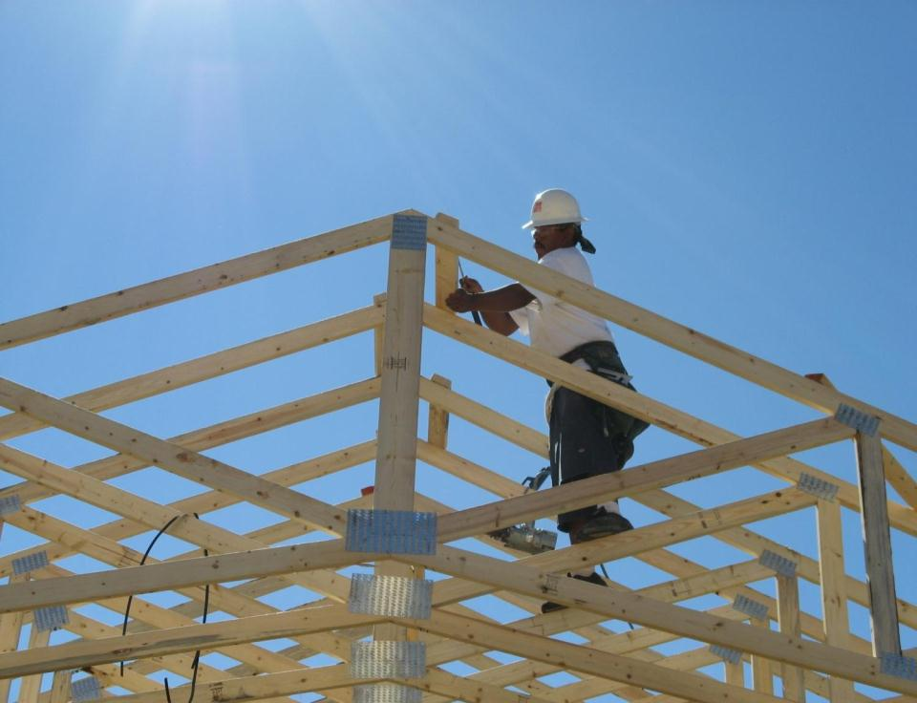
Discutir los riesgos de caídas
Discutir: ¿Se puede proporcionar protección convencional contra caídas?
Los empleadores deberán agotar primero todas las opciones para proporcionar protección convencional contra caídas u otros métodos de trabajo cubiertos por las reglamentaciones de OSHA antes de implementar procedimientos alternativos de protección contra caídas.
Notes:
Discuss: Employers must evaluate the use of conventional fall protection systems, and other work practices covered under OSHA standards (i.e. ladders, scaffolding or aerial lifts) prior to implementing any alternative work practices and establishing a written, site-specific fall protection program.
If an employer can demonstrate that conventional fall protection (i.e., guardrail systems, safety net systems, or personal fall arrest systems) is infeasible or presents a greater hazard, a written, site specific fall protection plan meeting the requirements of 1926.502(k) can be implemented.
The employer has the burden of establishing that it is appropriate to implement a fall protection plan.
Limitations of conventional fall protection systems during the installation of floor joists may include:
Roof trusses are not designed to resist lateral impact loads.
A falling worker attached to a single roof truss could cause all the trusses to collapse
Lack of a suitable anchor point to withstand 5000 pounds or twice the intended load from a falling worker.
Manufacturers of the roof trusses may prohibit inserting anchor points that may cause the truss to fail.
Manufacturers of personal fall arrest system components may prohibit the anchor point to be placed at ground level, or below a workers ‘D’ ring on their harness.
Clearance distance below a worker, which is needed when using a personal fall arrest system, may not be sufficient to prevent the worker from contacting the next lower level, should a fall occur.
Manufacturers may have differing installation/usage requirements; always refer to the manufacturers’ instruction prior to use.
Note: There is a presumption that it is feasible and will not create a greater hazard to implement one of the conventional fall protection methods (personal fall arrest system, guardrails, or safety nets); and accordingly the employer has the burden of establishing that it is appropriate to implement a fall protection plan that complies with 1926.502(k).

Slide 53
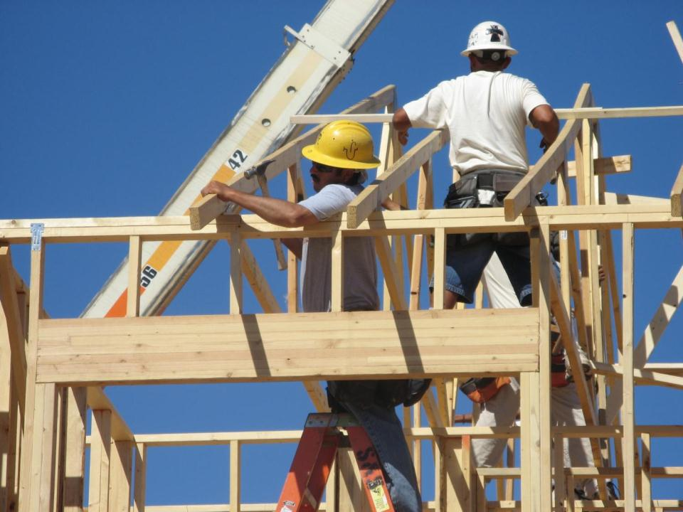
Discutir los riesgos de caídas
Discutir: ¿Se puede proporcionar protección convencional contra caídas?
Notes:
This picture shows the use of both ladders and alternative fall protection procedures utilized to set and brace roof rafter portions. Employers must determine and evaluate each job task to determine when and where conventional fall protection can be provided, prior to implementing alternative fall protection procedures.
Discuss: Employers must evaluate the use of conventional fall protection systems, and other work practices covered under OSHA standards (i.e. ladders, scaffolding or aerial lifts) prior to implementing any alternative work practices and establishing a written, site-specific fall protection program.
If an employer can demonstrate that conventional fall protection (i.e., guardrail systems, safety net systems, or personal fall arrest systems) is infeasible or presents a greater hazard, a written, site specific fall protection plan meeting the requirements of 1926.502(k) can be implemented.
The employer has the burden of establishing that it is appropriate to implement a fall protection plan.
Limitations of conventional fall protection systems during the installation of roof rafters and while stick framing may include:
Lack of a suitable anchor point to withstand 5000 pounds or twice the intended load from a falling worker.
Roof rafters are not designed to resist lateral impact loads.
Roof structures are unstable until some sheathing is installed.
A falling worker attached to a single rafter could cause the entire roof portion to fail.
Installation of guardrail system could involve more risk, due to the duration of the fall exposure.
Manufacturers of the roof trusses may prohibit inserting anchor points that may cause the truss to fail.
Clearance distance below a worker, which is needed when using a personal fall arrest system, may not be sufficient to prevent the worker from contacting the next lower level, should a fall occur.
Manufacturers may have differing installation/usage requirements; always refer to the manufacturers’ instruction prior to use.
Note: There is a presumption that it is feasible and will not create a greater hazard to implement one of the conventional fall protection methods (personal fall arrest system, guardrails, or safety nets); and accordingly the employer has the burden of establishing that it is appropriate to implement a fall protection plan that complies with 1926.502(k).

Slide 54
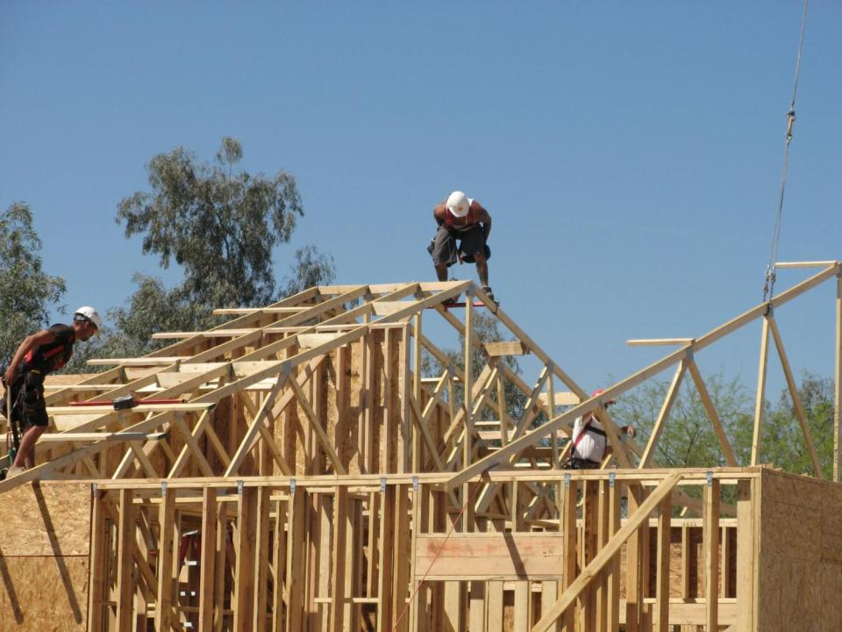
Discutir los riesgos de caídas
Esta imagen muestra el uso de procedimientos convencionales de protección contra caídas, preste atención a los sistemas personales de detención de caídas.
Notes:
This picture shows the use of a personal fall arrest system utilized to set and brace roof rafter portions. Employers must determine and evaluate each job task to determine when and where conventional fall protection can be provided, prior to implementing alternative fall protection procedures.
Discuss: Employers must evaluate the use of conventional fall protection systems, and other work practices covered under OSHA standards (i.e. ladders, scaffolding or aerial lifts) prior to implementing any alternative work practices and establishing a written, site-specific fall protection program.
If an employer can demonstrate that conventional fall protection (i.e., guardrail systems, safety net systems, or personal fall arrest systems) is infeasible or presents a greater hazard, a written, site specific fall protection plan meeting the requirements of 1926.502(k) can be implemented.
The employer has the burden of establishing that it is appropriate to implement a fall protection plan.
Limitations of conventional fall protection systems during the installation of roof rafters and while stick framing may include:
Lack of a suitable anchor point to withstand 5000 pounds or twice the intended load from a falling worker.
Roof rafters are not designed to resist lateral impact loads.
Roof structures are unstable until some sheathing is installed.
A falling worker attached to a single rafter could cause the entire roof portion to fail.
Installation of guardrail system could involve more risk, due to the duration of the fall exposure.
Manufacturers of the roof trusses may prohibit inserting anchor points that may cause the truss to fail.
Clearance distance below a worker, which is needed when using a personal fall arrest system, may not be sufficient to prevent the worker from contacting the next lower level, should a fall occur.
Manufacturers may have differing installation/usage requirements; always refer to the manufacturers’ instruction prior to use.
Note: There is a presumption that it is feasible and will not create a greater hazard to implement one of the conventional fall protection methods (personal fall arrest system, guardrails, or safety nets); and accordingly the employer has the burden of establishing that it is appropriate to implement a fall protection plan that complies with 1926.502(k).

Slide 55
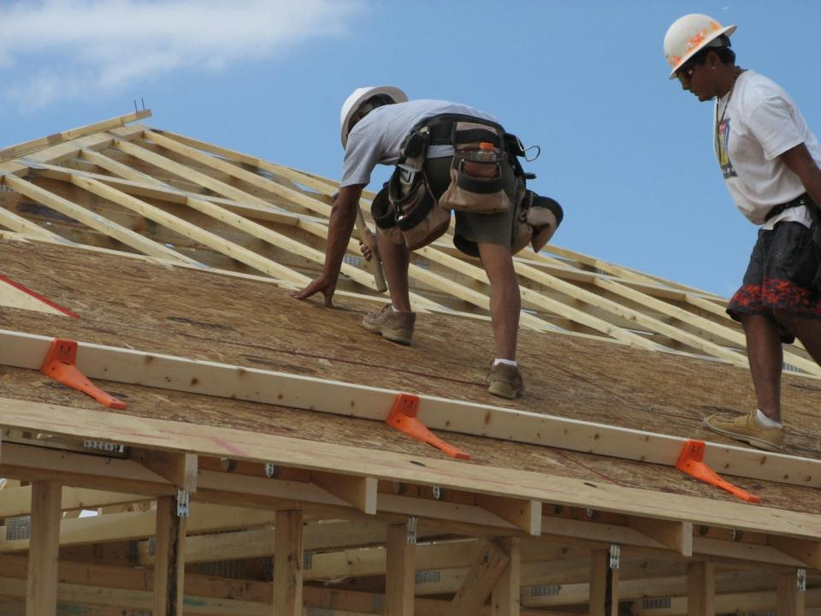
Discutir los riesgos de caídas
Discutir: ¿Se puede proporcionar protección convencional contra caídas?
Los empleadores deberán agotar primero todas las opciones para proporcionar protección convencional contra caídas u otros métodos de trabajo cubiertos por las reglamentaciones de OSHA antes de implementar procedimientos alternativos de protección contra caídas.
Notes:
Install slide guards on steep pitched roofs after the first row of sheathing is installed.
OSHA’s new compliance directive has not outlawed the use of slide guards or safety monitors.
Now, employers must first demonstrate that it is infeasible to comply with the provisions of the standard, or that it creates a greater hazard.
Then they can use those systems as part of a written, site-specific fall protection plan that meets the requirements of 1926.502(k).
Slide guards cannot simply be used in lieu of conventional fall protection methods under 1926.501(b)(13). However, slide guards may be used as part of a written, site-specific fall protection plan that meets the requirements of 1926.502(k) if the employer can demonstrate that the use of conventional fall protection (i.e., guardrail, safety net, or personal fall arrest systems) would be infeasible or create greater hazards.
Discuss: Employers must evaluate the use of conventional fall protection systems, and other work practices covered under OSHA standards (i.e. ladders, scaffolding or aerial lifts) prior to implementing any alternative work practices and establishing a written, site-specific fall protection program.
If an employer can demonstrate that conventional fall protection (i.e., guardrail systems, safety net systems, or personal fall arrest systems) is infeasible or presents a greater hazard, a written, site specific fall protection plan meeting the requirements of 1926.502(k) can be implemented.
The employer has the burden of establishing that it is appropriate to implement a fall protection plan.
Limitations of conventional fall protection systems during the installation of roof sheathing may include:
Roof trusses are not designed to resist lateral impact loads.
Roof structures are unstable until some or all sheathing is installed
Lack of a suitable anchor point to withstand 5000 pounds or twice the intended load from a falling worker.
Installation of guardrail system could involve more risk, due to the duration of the fall exposure.
Manufacturers of the roof trusses may prohibit inserting anchor points that may cause the truss to fail.
Manufacturers of personal fall arrest system components may prohibit the anchor point to be placed at ground level, or below a workers ‘D’ ring on their harness.
Clearance distance below a worker, which is needed when using a personal fall arrest system, may not be sufficient to prevent the worker from contacting the next lower level, should a fall occur.
Manufacturers may have differing installation/usage requirements; always refer to the manufacturers’ instruction prior to use.
Note: There is a presumption that it is feasible and will not create a greater hazard to implement one of the conventional fall protection methods (personal fall arrest system, guardrails, or safety nets); and accordingly the employer has the burden of establishing that it is appropriate to implement a fall protection plan that complies with 1926.502(k).

Slide 56
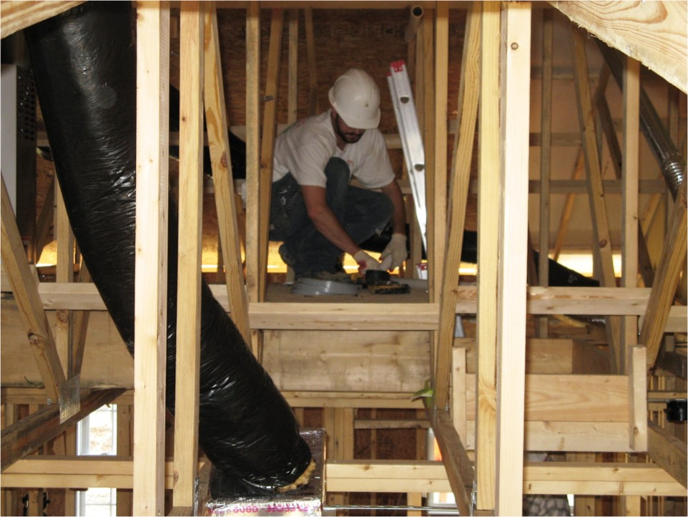
Discutir los riesgos de caídas
Discutir: ¿Se puede proporcionar protección convencional contra caídas?
Notes:
Discuss: Employers must evaluate the use of conventional fall protection systems, and other work practices covered under OSHA standards (i.e. ladders, scaffolding or aerial lifts) prior to implementing any alternative work practices and establishing a written, site-specific fall protection program.
This picture shows an installed working platform in the attic, which is an example of an alternative fall protection procedure.
If an employer can demonstrate that conventional fall protection (i.e., guardrail systems, safety net systems, or personal fall arrest systems) is infeasible or presents a greater hazard, a written, site specific fall protection plan meeting the requirements of 1926.502(k) can be implemented.
The employer has the burden of establishing that it is appropriate to implement a fall protection plan.
Limitations of conventional fall protection systems while performing attic work may include:
Even if an anchor point is used, the use of a personal fall arrest system through rafters and trusses creates an added swing fall hazard.
Installation of anchor point exposes a worker to a fall hazard when they are unprotected while installing the anchor point in the peak of the attic.
A falling worker attached to a single roof truss could cause all the trusses to collapse.
Lack of a suitable anchor point to withstand 5000 pounds or twice the intended load from a falling worker.
Manufacturers of the roof trusses may prohibit inserting anchor points that may cause the truss to fail.
Manufacturers of personal fall arrest system components may prohibit the anchor point to be placed at ground level, or below a workers ‘D’ ring on their harness.
Clearance distance below a worker, which is needed when using a personal fall arrest system, may not be sufficient to prevent the worker from contacting the next lower level, should a fall occur.
Manufacturers may have differing installation/usage requirements; always refer to the manufacturers’ instruction prior to use.
Note: There is a presumption that it is feasible and will not create a greater hazard to implement one of the conventional fall protection methods (personal fall arrest system, guardrails, or safety nets); and accordingly the employer has the burden of establishing that it is appropriate to implement a fall protection plan that complies with 1926.502(k).

Slide 57
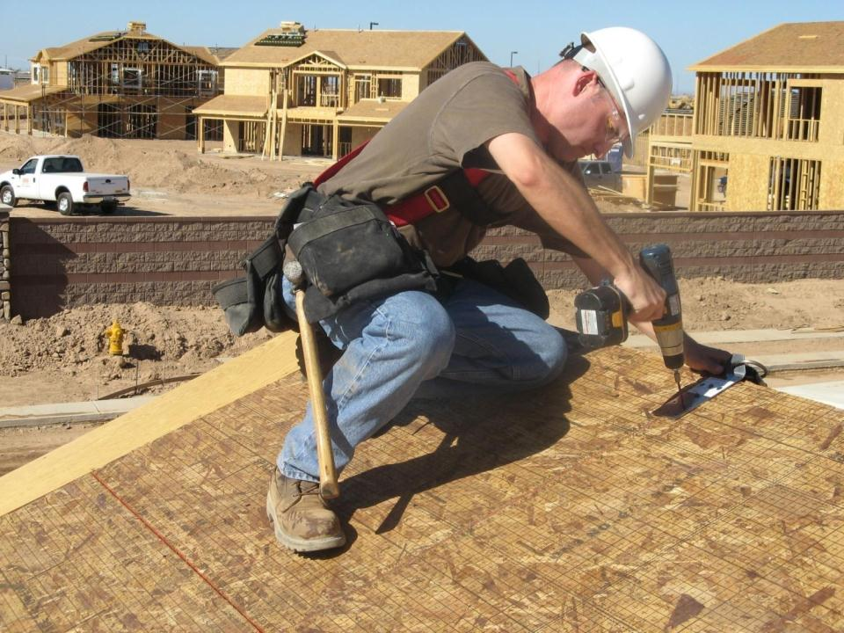
Discutir los riesgos de caídas
Discutir: ¿Se puede proporcionar protección convencional contra caídas?
Notes:
This picture shows the installation of an anchor point prior to performing roofing work.
Employers must determine and evaluate each job task to determine when and where conventional fall protection can be provided, prior to implementing alternative fall protection procedures.
Discuss: Employers must evaluate the use of conventional fall protection systems, and other work practices covered under OSHA standards (i.e. ladders, scaffolding or aerial lifts) prior to implementing any alternative work practices and establishing a written, site-specific fall protection program.
If an employer can demonstrate that conventional fall protection (i.e., guardrail systems, safety net systems, or personal fall arrest systems) is infeasible or presents a greater hazard, a written, site specific fall protection plan meeting the requirements of 1926.502(k) can be implemented.
The employer has the burden of establishing that it is appropriate to implement a fall protection plan.
Discuss: How can you provide conventional fall protection for this worker who is installing anchor points?
Note: There is a presumption that it is feasible and will not create a greater hazard to implement one of the conventional fall protection methods (personal fall arrest system, guardrails, or safety nets); and accordingly the employer has the burden of establishing that it is appropriate to implement a fall protection plan that complies with 1926.502(k).

Slide 58
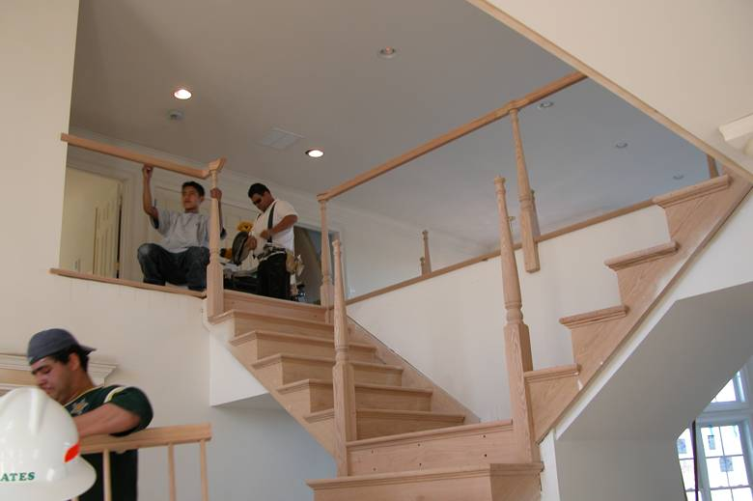
Discutir los riesgos de caídas
Discutir: ¿Se puede proporcionar protección convencional contra caídas?
Notes:
This picture shows installation of permanent stair rails. Employers must determine and evaluate each job task to determine when and where conventional fall protection can be provided, prior to implementing alternative fall protection procedures.
Discuss: Employers must evaluate the use of conventional fall protection systems, and other work practices covered under OSHA standards (i.e. ladders, scaffolding or aerial lifts) prior to implementing any alternative work practices and establishing a written, site-specific fall protection program.
If an employer can demonstrate that conventional fall protection (i.e., guardrail systems, safety net systems, or personal fall arrest systems) is infeasible or presents a greater hazard, a written, site specific fall protection plan meeting the requirements of 1926.502(k) can be implemented.
The employer has the burden of establishing that it is appropriate to implement a fall protection plan.
Limitations of conventional fall protection systems during the installation of permanent stair rails may include:
Hand rail is custom built on the jobsite, which requires the carpenter to measure and cut frequently. This also requires the installer to go up and down the stairs to measure, cut and level the rail components. The use of a personal fall arrest system would require the carpenter to attach to an anchor point at 6 feet and then detach hundreds of times, in addition to an added slip, trip and fall hazard introduced into a small working surface, i.e. stairway.
Manufacturers may have differing installation/usage requirements; always refer to the manufacturers’ instruction prior to use.
Note: There is a presumption that it is feasible and will not create a greater hazard to implement one of the conventional fall protection methods (personal fall arrest system, guardrails, or safety nets); and accordingly the employer has the burden of establishing that it is appropriate to implement a fall protection plan that complies with 1926.502(k).

Slide 59
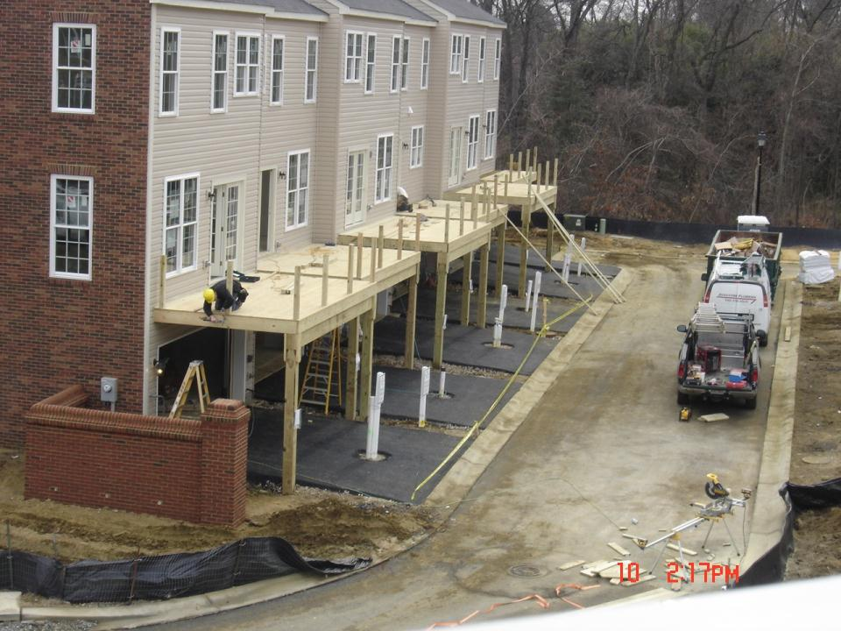
Discutir los riesgos de caídas
Discutir: ¿Se puede proporcionar protección convencional contra caídas?
Notes:
This picture shows the construction of decks attached to a home. Employers must determine and evaluate each job task to determine when and where conventional fall protection can be provided, prior to implementing alternative fall protection procedures.
Discuss: Employers must evaluate the use of conventional fall protection systems, and other work practices covered under OSHA standards (i.e. ladders, scaffolding or aerial lifts) prior to implementing any alternative work practices and establishing a written, site-specific fall protection program.
If an employer can demonstrate that conventional fall protection (i.e., guardrail systems, safety net systems, or personal fall arrest systems) is infeasible or presents a greater hazard, a written, site specific fall protection plan meeting the requirements of 1926.502(k) can be implemented.
The employer has the burden of establishing that it is appropriate to implement a fall protection plan.
Limitations of conventional fall protection systems during the construction of decks attached to the home may include:
Clearance distance below a worker, which is needed when using a personal fall arrest system , may not be suitable to prevent the worker from contacting the next lower level, should a fall occur.
The use of guardrails would prevent the carpenter from installing permanent portions of the deck.
Manufacturers may have differing installation/usage requirements; always refer to the manufacturers’ instruction prior to use.
Note: There is a presumption that it is feasible and will not create a greater hazard to implement one of the conventional fall protection methods (personal fall arrest system, guardrails, or safety nets); and accordingly the employer has the burden of establishing that it is appropriate to implement a fall protection plan that complies with 1926.502(k).

