Slide 1
Fall Prevention in Residential Construction
Fall hazard awareness, prevention, solutions, and rescue.

Slide 2


Welcome!
This training is provided as a service to the residential construction industry by:
jssafety.org nahb.org/safety
Notes:
Provide an overview of JSI and NAHB.
Job-Site Safety Institute (JSI) is a nonprofit organization dedicated to conducting safety research for residential and commercial job-sites. JSI serves as a research center where educational institutions and industry leaders collaborate and exchange ideas to increase awareness of the inherent dangers of a construction site.
The National Association of Home Builders (NAHB) helps its members build communities. Since it was founded in the early 1940s, NAHB has served as the voice of America’s housing industry. We work to ensure that housing is a national priority and that all Americans have access to safe, decent and affordable housing, whether they choose to buy a home or rent.

Slide 3
Disclaimer
This material was produced under grant number SH-31198-SH7 from the Occupational Safety and Health Administration, U.S. Department of Labor. It does not necessarily reflect the views or policies of the U.S. Department of Labor, nor does mention of trade names, commercial products, or organizations imply endorsement by the U.S. Government.
This presentation is intended to discuss Federal Regulations only - your individual State requirements may be more stringent as many states operate their own state OSHA and they may have adopted construction standards that are different from information presented in this training. If you live in a state with an OSHA approved state plan, you should contact your local administrator for further information on the standards applicable in your state.
These materials are meant for informational purposes only.
No representation is made as to the thoroughness of the presentation.
Notes:
This material was produced under the Susan Harwood training grant number SH-31198-SH7 from the Occupational Safety and Health Administration, U.S. Department of Labor.

Slide 4
Disclaimer, cont.
It is not the intent to provide compliance-based training in this presentation, the intent is more to address hazard awareness in the residential construction (i.e. home building) industry, and to recognize the overlapping hazards present in many construction workplaces.
Photos shown in this presentation may depict situations that are not in compliance with applicable OSHA/safety requirements.
No legal advice is offered or implied, and no attorney-client relationship is intended or established. If legal advice or other expert assistance is required the services of a competent professional person should be sought.
It is the responsibility of the employer and its employees to comply with all pertinent OSHA/safety rules and regulations in the jurisdiction in which they work.
Notes:
Please read the disclaimer for legal purposes, this is required under the Susan Harwood Training Grant program.

Slide 5
Copyright Information © 2018
This material is the copyrighted property of the Job-Site Safety Institute and the National Association of Home Builders. By federal regulation, OSHA reserves a license to use and disseminate such material for the purpose of promoting safety and health in the workplace. The Job-Site Safety Institute and the National Association of Home Builders hereby authorizes employers and workplace safety and health professionals to use this material, distributed by or through OSHA, in their workplaces or practices in accordance with the guidance contained in the material.
To this end, permission is granted to use such copyrighted material solely for non-commercial, instructional, personal, or scholarly purposes. The material may be used and incorporated into other workplace safety and health programs on the condition that no fee may be charged for the subsequent use of the material. Use of the material for any other purpose, particularly commercial use, without the prior, express written permission of the copyright owner/s is prohibited. Furthermore, any modification to the material is prohibited without the prior, express written permission of the copyright owners.
Notes:
Note that the these materials are copyrighted by the Job-Site Safety Institute and the National Association of Home Builders. Permission is granted to use such copyrighted material in accordance with the terms on the slide.

Slide 6
Course Agenda
Section 1: Introduction / Overview of Fall Protection - 30 minutes
Section 2: Ladders - 30 minutes
Section 3: Scaffolds - 45 minutes
Section 4: Conventional Fall Protection - 60 minutes
Section 5: Additional Fall Protection Systems - 60 minutes
Section 6: Rescue - 15 minutes

Slide 7
Course Objectives
Recognize common fall hazards in residential construction.
Identify when fall protection is required.
Determine which protection system to use for a given fall hazard.
Understand the key requirements and basic safety practices for each protection system.
Understand the safety requirements and practices for ladders and scaffolding.

Slide 8
Section 1
Overview of fall protection

Slide 9
Learning Objectives: Section 1
State why fall protection is important.
Identify common fall hazards in residential construction.
Define “residential construction”.
Understand the importance of fall protection training.
Understand competent and qualified persons requirements.
Notes:
Discuss the learning objectives for Section 1. Elaborate on the 5 key learning objectives. Allow time for attendees to read and understand what will be taught during the first section and take time to answer any questions.

Slide 10
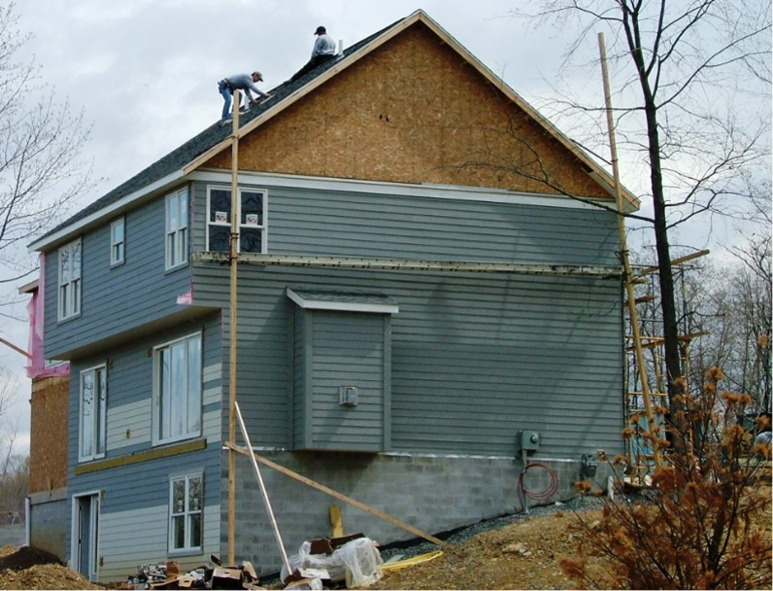

Fall Protection – Unsafe Photos
Notes:
Briefly discuss the fall hazards present in the picture shown. We will discuss these hazards in greater detail throughout the course of this presentation.

Slide 11
Introduction To Fall Protection
The goals of this course are to help you:
  Understand how to identify, correct or eliminate fall hazards on your job sites.
  Understand the regulatory requirements to protect and train workers to prevent falls on home building job sites.
  Gain a more thorough understanding of OSHA regulations applicable to home building.
Notes:
Discuss the goals of the course, including:
Understand how to identify, correct or eliminate fall hazards on your job sites.
Understand the regulatory requirements to protect and train workers to prevent falls on home building job sites.
Gain a more thorough understanding of OSHA regulations applicable to home building.

Slide 12
Introduction To Fall Protection, cont.
Participants can use the information from this seminar to:
  Provide training to employees.
  Develop fall protection best practices for employees to use on the jobsite.
  Understand the types of conventional fall protection systems that can be used on home building jobsites.
Notes:
Discuss the many benefits that participants of this class can expect to receive. They include but are not limited to:
Providing training to employees
Developing fall protection best practices
Implementing a fall protection plan, as needed, in accordance with 1926.502(k)

Slide 13
Why Is Fall Protection Important?
Falls are the leading cause of serious and fatal injuries in residential construction.
Between 2003 and 2010: 1,917 workers died in the U.S. residential construction industry.
  Nearly half (45.3%) of the fatalities were from falls.
  In the residential roofing industry, 80.2% of fatalities were from falls.
  Falls from ladders accounted for 23.0% of fatal falls in residential construction.
Notes:
Discuss the importance of taking proactive steps to protect workers from fall hazards in the residential construction industry.
Emphasize that falls are the leading cause of fatalities in the construction industry to really open participants eyes about the severity of this hazard and the injuries associated with it.
Source: https://www.cpwr.com/sites/default/files/publications/DongFatalFallsInResidentialConstructionKF.pdf (Bureau of Labor Statistics’ Census of Fatal Occupational Injuries)

Slide 14


How far is too far to fall?
More than 40% of fatal falls occurred from heights 15 feet or lower.
  15 feet is only 5-yards on a football field.
  15 feet is only 1.5 times the height of a basketball rim.
Notes:
Explain that serious injuries and fatalities can occur when falling from heights of less than 15 feet. Compare the height of a basketball hoop to the height of 15 feet, or the length of 5-yards on a football field.

Slide 15
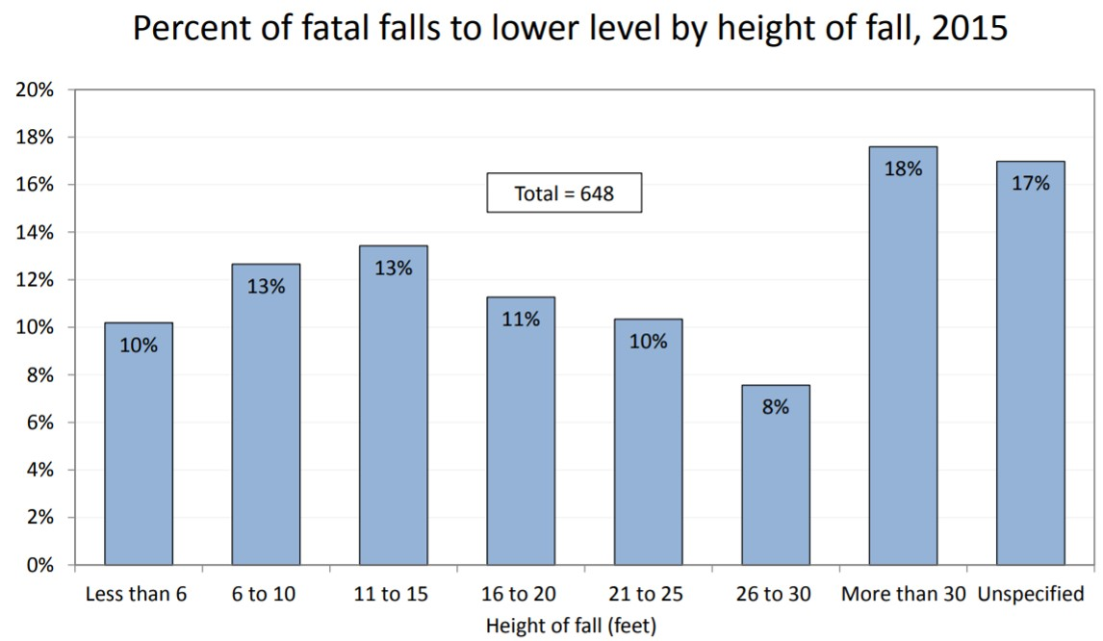
Percent of fatal falls to a lower lever by height of fall, 2015
Source: U.S. Department of Labor, Bureau of Labor Statistics
Notes:
In 2015, the total for falls to lower level was 648 fatal work injuries. Of the cases where height of fall was known (538 cases), more than 2 out of every 5 fatal falls were falls of 15 feet or less. About one in five cases with a known height involved falls from more than 30 feet.

Slide 16
Top 10 OSHA Citations FY2017
Top 10 OSHA Citations in Construction
1. Fall Protection – duty to have fall protection.
2. Scaffolding – general requirements.
3. Ladders
4. Fall Protection – training requirements.
5. Personal Protective Equipment – eye and face protection.
6. Personal Protective Equipment – head protection.
7. Hazard Communication – toxic and hazardous substances.
8. Scaffolds – aerial lifts.
9. General Safety & Health Provisions
10. Fall Protection – fall protection systems, criteria.
Notes:
Discuss the top 10 OSHA Citations in Construction for FY2017. Emphasize that 5 of the top 10 most frequently cited standards are related to fall protection.

Slide 17
FY2017 OSHA Top 10 by the Numbers
32,000 citations were issued by OSHA in its top 10 most frequently cited categories.
$2,600,000 ($2.6M) – largest citation issued by OSHA after a single visit to one employer.
6,887 violations issued for OSHA’s #1 most frequently cited standard – fall protection.
  4,252 citations were related to failing to provide conventional fall protection.
Notes:
Emphasize that OSHA has the authority to issue substantial monetary citations against companies who fail to comply with their regulations. For example, in FY2017 OSHA issued a $2.6 Million fine to an employer after a single visit to their jobsite.

Slide 18
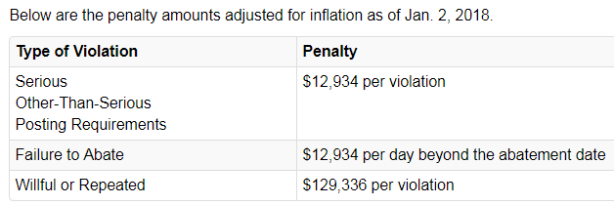
Did you hear about OSHA Fines Going
In 2016, OSHA increased fines by 78%.
OSHA last raised fines in 1990.
Notes:
Discuss that in 2016 OSHA increased fines by 78%. The new maximum penalties for serious, fail to abate, and willful or repeated violations are shown in the slide.

Slide 19
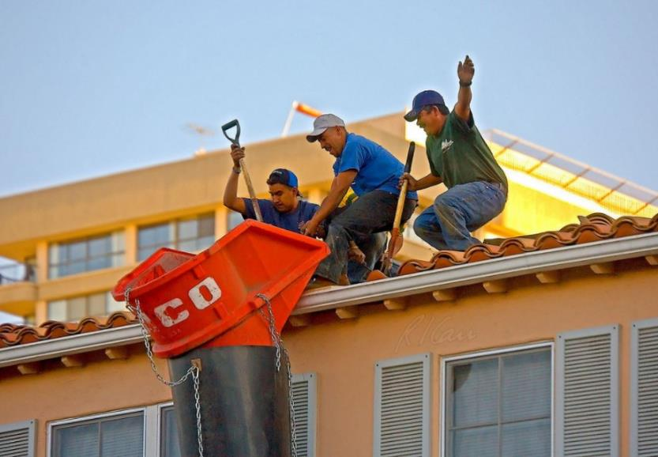

Fall Protection – Unsafe Photos
Notes:
Photo depicts workers along the leading edge of a building without conventional fall protection. Use this as a talking point to see if attendees think this is acceptable or not.

Slide 20
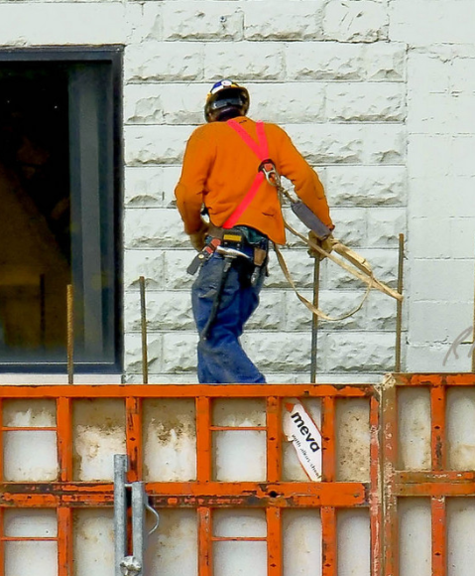

Fall Protection – Unsafe Photos
Notes:
Image shows a worker not tied off to an approved anchor point. Use this as a discussion to see if attendees can identify the hazards.

Slide 21
What does OSHA require for fall protection?
Workers exposed to a fall hazard 6 ft. (1.8 m) or more above lower levels must be protected by conventional fall protection (i.e., guardrail systems, safety net systems or PFAS).
Notes:
OSHA requires the use of conventional fall protection if workers are exposed to fall hazards 6 ft. or more above a lower level when performing construction.

Slide 22
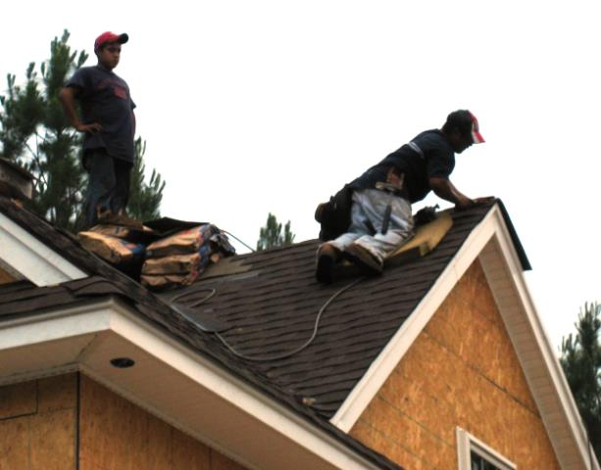

Overview of Regulations
6 feet is the trigger height for when fall protection is required for construction sites.
Notes:
6 feet is the trigger height at when fall protection is required on construction sites.

Slide 23
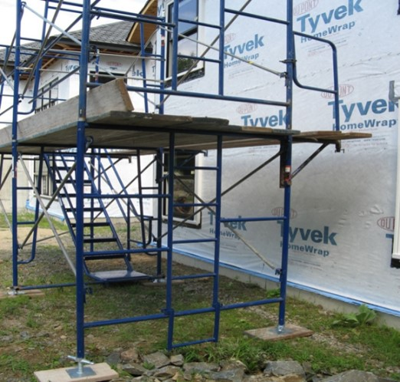
Overview of Regulations
There is a 10 foot trigger height when working on scaffolding.
Notes:
10 feet is the trigger height at when fall protection is required when working off a scaffold.

Slide 24
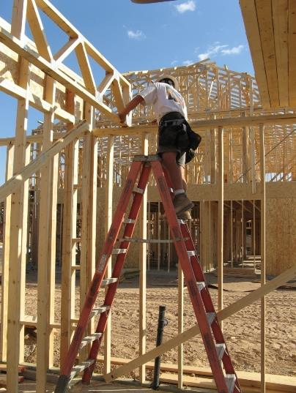
Overview of Regulations
There is no trigger height for fall protection systems when working on ladders.
Notes:
There is no trigger height for when fall protection is required when working off a ladder.

Slide 25

Requirements on Jobsites
Some OSHA State-Plan states may have different trigger heights of when conventional fall protection is required on residential jobsites.
These states include, but may not be limited to:
  California
  Kentucky
  North Carolina
  Arizona
  Washington
  Oregon
Notes:
Discuss how some states may have different trigger heights for when conventional fall protection is required on residential jobsites.

Slide 26
Where Do You Start?
Understand OSHA Fall Protection Regulations.
Evaluate fall hazards and implement conventional fall protection systems.
Train workers to identify hazards.
Appoint a competent person responsible for fall protection on the jobsite.
Develop a written fall protection plan, as needed, in accordance with §1926.502(k).
Notes:
Discuss the initial steps that must be taken to comply with OSHA fall protection regulations, and protect workers on a residential construction jobsite.
Fall protection plans, as needed, in accordance with OSHA’s §1926.502(B)(13) regulation will be discussed in Section 6 of the training presentation.

Slide 27
Fatal Accidents
What are the fall hazards?
Accident #1
A worker was walking along a one-story pitched roof on a residential structure as he was installing flashing around PVC pipe roof vents. He was near the peak of the roof, when he fell through a fireplace chimney opening.
The worker fell at least 20 ft. (6.1 m) to the fireplace pit area and was killed.
The roof hole had been covered with approximately 1½ inch (3.8 cm) flat Styrofoam sheeting.
Notes:
Discuss this first accident scenario thoroughly. Ask the audience if they have had experience with these hazards, and discuss protective measures that could have been taken to prevent this fatality from occurring.
Encourage audience participation and discussion.

Slide 28
Fatal Accidents, cont.
What are the fall hazards?
Accident #2
A drywall finisher was sanding the ceiling in a second floor hallway.
He was standing on an open-sided floor above the concrete first floor, when he slipped off the edge and fell 10 ft. (3 m) to the first floor and sustained fatal injuries.
Guardrails had been in place previously but had been removed to move supplies such as doors, drywall, and windows to the second floor.
Notes:
Discuss the second accident scenario thoroughly. Ask the audience if they have had experience with these hazards, and discuss protective measures that could have been taken to prevent this fatality from occurring.
Encourage audience participation and discussion.

Slide 29
Fatal Accidents, cont.
What are the fall hazards?
Accident #3
A carpenter were on site to perform gutter work on a house.
The worker was climbing an extension ladder that was set up on stone pavers to access the roof.
While climbing the ladder, the victim fell to the ground below when the base of the ladder slipped out and then the ladder fell to the left.
Notes:
Discuss the second accident scenario thoroughly. Ask the audience if they have had experience with these hazards, and discuss protective measures that could have been taken to prevent this fatality from occurring.
Encourage audience participation and discussion.

Slide 30
What is “Residential Construction”?
Residential construction is defined as construction activity that combines these two elements:
  Residence Requirement: the end-use of the building must be a home or dwelling.
  Wood Frame Construction Requirement: building must be constructed using traditional wood frame construction materials and methods. This includes limited use of structural steel in a predominantly wood framed home, such as a steel I-beam to support wood framing.
Notes:
Define residential construction, discuss what is included and excluded and provide examples.

Slide 31
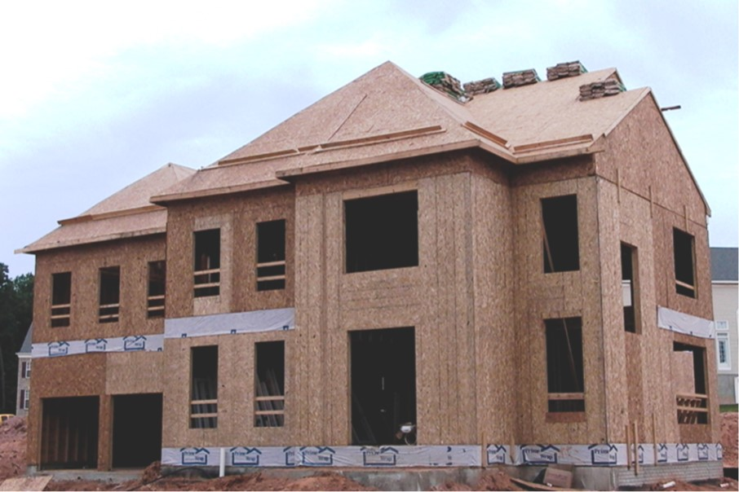
Is This “Residential Construction”?
Notes:
Discuss the picture of a large single-family house and why this is considered residential construction.
This picture shows slide guards installed on the steep-pitch roof; OSHA’s new compliance directive has not outlawed the use of slide guards or safety monitors.
Now, employers must first demonstrate that it is infeasible to comply with the provisions of the standard, or that it creates a greater hazard.
Then they can use those systems as part of a written, site-specific fall protection plan that meets the requirements of 1926.502(k).
Slide guards cannot simply be used in lieu of conventional fall protection methods under 1926.501(b)(13). However, slide guards may be used as part of a written, site-specific fall protection plan that meets the requirements of 1926.502(k) if the employer can demonstrate that the use of conventional fall protection (i.e., guardrail, safety net, or personal fall arrest systems) would be infeasible or create greater hazards.
Encourage discussion and participation from the audience.
Refer to the definition of residential construction for further clarification.

Slide 32
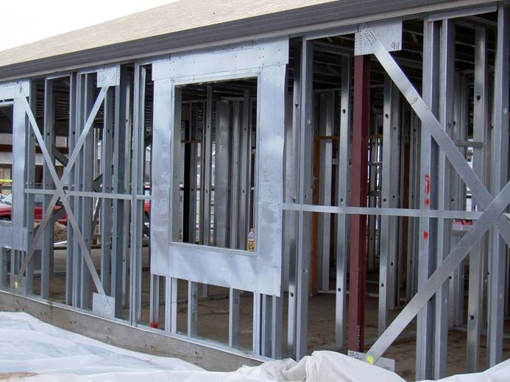
Is This “Residential Construction”?
Notes:
Discuss that this can be either a residential home, or a small commercial building. Note that just because it has steel framing does not automatically exclude this from the definition of residential construction.

Slide 33
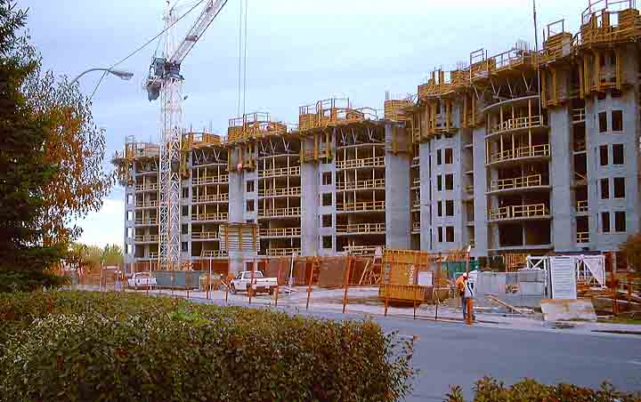
Is This “Residential Construction”?
Notes:
Discuss this picture of a multi-family housing complex. Note the differences in construction methods from a typical single-family home, i.e. large worker crane, concrete forms, etc.
Engage the audience and facilitate a short discussion about the picture above.

Slide 34
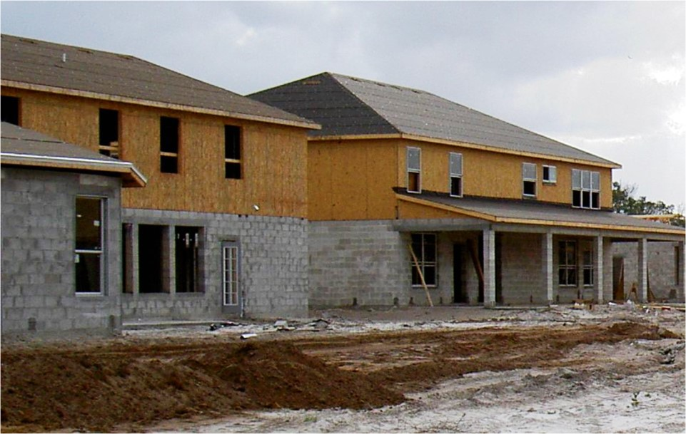
Is This “Residential Construction”?
Notes:
Yes, OSHA considers block wall home construction “residential construction”. OSHA STD 03-11-002 states the agency “has decided that it is consistent with the original purpose of 1926.501(b)(13) to treat the construction of residences with masonry brick or block in the exterior walls as residential construction.”

Slide 35
Evaluate Fall Protection Systems
Competent person must evaluate the appropriate protective systems, this involves:
  Choose the appropriate system for each unique hazard and situation
  Ensure employees are properly trained on fall protection systems chosen
  Understand manufacturer’s recommendations and limitations of fall protection systems
Notes:
Discuss the important role the competent person plays in determining and evaluating the appropriate fall protective system for each fall-related hazard on the jobsite.

Slide 36
What is a Competent Person?
Through training, someone may be designated as a “Competent Person” for safety-related concerns on a jobsite, including fall hazards/fall protection.
The Competent Person is responsible for:
  Choosing the best system for each unique hazard/situation.
  Ensuring employees are properly trained on the fall protection systems being utilized.
  Understanding the recommendations and limitations of the fall protection systems utilized.
Notes:
Discuss that a Competent Person is responsible for understanding appropriate types of fall protection, choosing the right fall protection system for each hazard and ensuring workers are trained.

Slide 37
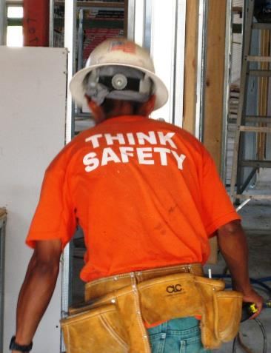
Competent Person
On a jobsite, the Competent Person is also responsible for:
  Identifying existing and predictable fall hazards.
  The authority to stop work and eliminate those hazards.
  Authority to take prompt corrective actions.
Notes:
Discuss that the competent person is also responsible for the identification of existing and predictable hazards, has the authority to stop work and take prompt corrective actions.

Slide 38
Fall Protection Training
Employers must train employees to:
Understand the correct procedures for erecting, maintaining, disassembling, and inspecting the fall protection systems.
The use and operation of guardrail systems, personal fall arrest systems, safety net systems, warning line systems, safety monitoring systems, controlled access zones, and other methods of fall protection to be used.
Notes:
Note: Remember that you must evaluate the use of conventional fall protection systems prior to implementing alternative fall protection systems (i.e. warning lines, safety monitors, controlled access zones).
Discuss the many training requirements when workers are exposed, or have the potential to be exposed to fall hazards on a residential construction jobsite.
1926.501(b)(10)
"Roofing work on Low-slope roofs." Except as otherwise provided in paragraph (b) of this section, each employee engaged in roofing activities on low-slope roofs, with unprotected sides and edges 6 feet (1.8 m) or more above lower levels shall be protected from falling by guardrail systems, safety net systems, personal fall arrest systems, or a combination of warning line system and guardrail system, warning line system and safety net system, or warning line system and personal fall arrest system, or warning line system and safety monitoring system. Or, on roofs 50-feet (15.25 m) or less in width (see Appendix A to subpart M of this part), the use of a safety monitoring system alone [i.e. without the warning line system] is permitted.
Subpart M 29 CFR 1926.503 lists the training requirements for employees exposed to fall hazards.
State that the training must
Facilitate a short discussion from the audience about some of the training they conduct, successful methods of training, the length of the training, and the content.

Slide 39
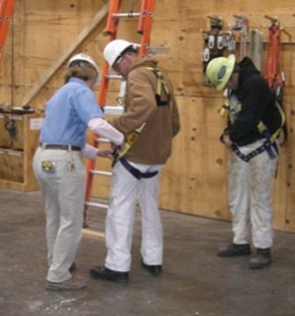
Fall Protection Training, cont.
Employers must train employees on:
Proper use of fall protection equipment.
  Example: always inspect harness before each use and use approved anchor points.
Notes:
Photo: http://www.elcosh.org/record/document/1991/32.jpg
Discuss the many training requirements when workers are exposed, or have the potential to be exposed to fall hazards on a residential construction jobsite.
Subpart M 29 CFR 1926.503 lists the training requirements for employees exposed to fall hazards.
State that the training must
Facilitate a short discussion from the audience about some of the training they conduct, successful methods of training, the length of the training, and the content.

Slide 40
Fall Protection Training, cont.
Employers must train employees on:
The nature of fall hazards in the work area.
Correct procedures for erecting, maintaining, disassembling and inspecting the fall protection systems to be used.
The use and operation of conventional fall protection systems.
The role of each employee in the fall protection system used.
Notes:
Discuss the many training requirements when workers are exposed, or have the potential to be exposed to fall hazards on a residential construction jobsite.
Subpart M 29 CFR 1926.503 lists the training requirements for employees exposed to fall hazards.
State that the training must
Facilitate a short discussion from the audience about some of the training they conduct, successful methods of training, the length of the training, and the content.

Slide 41
Fall Protection Training, cont.
Employers must train employees on:
The limitations on the use of mechanical equipment during the performance of roofing work on low-sloped roofs.
The correct procedures for the handling and storage of equipment and materials and the erection of overhead protection.
The role of employees in fall protection plans.
Notes:
Discuss the many training requirements when workers are exposed, or have the potential to be exposed to fall hazards on a residential construction jobsite.
Note: Remember that you must evaluate the use of conventional fall protection systems prior to implementing alternative fall protection systems (i.e. warning lines, safety monitors, controlled access zones).
Subpart M 29 CFR 1926.503 lists the training requirements for employees exposed to fall hazards.
State that the training must
Facilitate a short discussion from the audience about some of the training they conduct, successful methods of training, the length of the training, and the content.

Slide 42
Fall Protection Training, cont.
Employers must certify training:
Written certification must include:
  Name of employee trained
  Date of training
  Signature of person conducting training
Latest training certification must be maintained
Retrain employees when employer has reason to believe it is necessary or changes have been made to fall protection.
Notes:
Discuss the many training requirements when workers are exposed, or have the potential to be exposed to fall hazards on a residential construction jobsite.
Subpart M 29 CFR 1926.503 lists the training requirements for employees exposed to fall hazards.
State that the training must
Facilitate a short discussion from the audience about some of the training they conduct, successful methods of training, the length of the training, and the content.

Slide 43
Competent Person Responsibilities
Designated competent person:
Responsible for identifying existing and predictable hazards
Has authority to eliminate fall hazards
Has authority to stop work if unsafe conditions exists
Has authorization to take prompt corrective actions to eliminate them
Notes:
Discuss the definition of a competent person, their varied roles and responsibilities on a jobsite.
Optional discussion, ask the audience if they have ever served, or are a competent person, and what they have done in their role to fix any fall hazards that may have been present.

Slide 44
Qualified Person
A qualified person:
  Has a recognizable degree, experience, professional standing, or through extensive knowledge, training and experience has demonstrated the ability to resolve subject matter issues.
  Responsible for design, installation, use and supervision of anchorage points as part of a complete personal fall arrest system.
Notes:
Define a qualified person, and some of the roles they are required to perform on a residential construction site, i.e. preparing a fall protection plan.
Anchorages shall be designed, installed and used under the supervision of a qualified person, as part of a complete personal fall arrest system that maintains a safety factor of at least two. Source: Subpart M- Fall Protection

