Slide 1
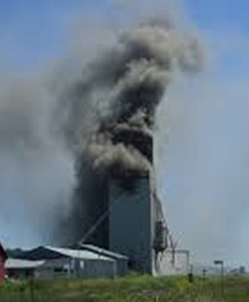
Prevention of Grain Dust Explosions
How do explosions occur?
What are common ignition sources?
How combustible is grain dust?
How can I prevent explosions in my facility?
Preventative tools for dust controls & maintenance
Grain dust explosion chamber demo
To schedule a session, please contact:
Workshop is funded through grant number SH-31232SH7 from the Occupational Safety and Health Administration of the U.S. Department of Labor. It does not necessarily reflect the view or policies of the U.S. Department of Labor, nor does mention of trade names, commercial products, or organizations imply endorsement by the U.S. government

