Slide 1
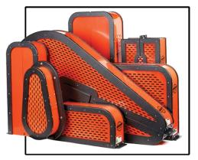
Machine Guarding
Susan Harwood Training Grant

Slide 2
Disclaimer
This material was produced under grant 46F6-HT30 from the Occupational Safety and Health Administration, U.S. Department of Labor. It does not necessarily reflect the views or policies of the U.S. Department of Labor, nor does mention of trade names, commercial products, or organizations imply endorsement by the U.S. Government.
Revisions were made to this material under grant number SH-31240-SH7 from the Occupational Safety and Health Administration, U.S. Department of Labor.

Slide 3
What is OSHA?
OSH Act is the federal law that established the Occupational Safety and Health Administration (OSHA)
OSHA sets and enforces workplace safety and health standards

Slide 4

Your Rights As A Whistleblower
Whistleblower: One who informs on a person or organization engaged in illegal activity.
Your Rights: You are protected from retaliation. Employees are entitled to a workplace free from known health and safety hazards. An employer cannot retaliate by taking adverse action for reporting safety concerns.
File a Complaint: (800) 321-OSHA (6742)

Slide 5

Employer Responsibilities
Employers must provide safe workplaces environment
Comply with OSHA standards, rules, and regulations
Provide safety training
More information on this can be found at www.osha.gov
Notes:
General Duty Clause

Slide 6

Employee Responsibilities
Read and follow safety posters and signs
Comply with OSHA rules and regulations
Use your personal protective equipment (PPE) when required
Report hazardous conditions and job related injuries ASAP

Slide 7

Statistics
In 2016, 5190 people died from fatal workplace injuries

Slide 8

Lesson Objectives
Key Parts of Machines
Hazards to be Guarded
Motions and Actions
Guarding Methods
General Requirements
Power Transmission Apparatuses
Hand and Power Tools

Slide 9

Quiz Time!

Slide 10
Key parts of machines
Point of operation: where work is performed on the material, such as cutting, shaping, boring, or forming of stock.
Power Transmission Device: transmits energy to the part of the machine performing the work
  Includes flywheels, pulleys, belts, connecting rods, couplings, cams, spindles, chains, cranks, and gears.

Slide 11
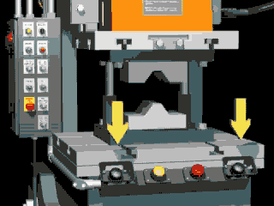
Key parts of machines cont.
Operating Controls: a mechanical or electrical power control shall be provided on each machine to make it possible for the operator to cut off the power from each machine without leaving his position at the point of operation.
Other moving parts: can include reciprocating, rotating, and transverse moving parts, feed mechanisms, and auxiliary parts of the machine

Slide 12
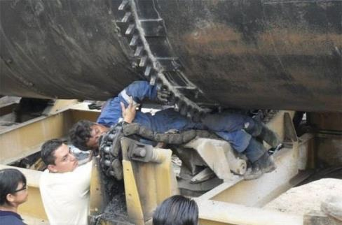
What hazards exist?
Crushed by or drawn into equipment-Eg. Amputation, such as severed limbs
Struck by moving parts
Struck by failed components or particles

Slide 13
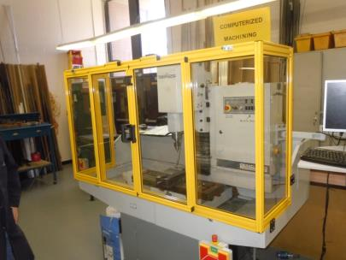
Hazards to be Guarded
Things to guard include
  In-running nip points
  Rotating equipment
  Flying chips or sparks
  Belts or gears
  Parts that impact or shear

Slide 14

Rotating Parts
Can grip hair, clothing, and/or jewelry
Can force the body into a dangerous position
Projecting pieces increase risk

Slide 15
Caught Between Fans
https://www.youtube.com/watch?v=R1uHk7Z6z24
Notes:
Slide: 15 – Beyonce Hair Caught in Fan Montreal
Video: https://www.youtube.com/watch?v=R1uHk7Z6z24
Beyonce singing Halo

Slide 16

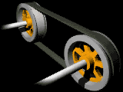
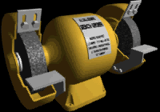
In-Running Nip Points
Between 2 rotating parts
Between rotating and tangential parts
Between rotating and fixed parts which shear, crush, or abrade

Slide 17
Caught in the Middle
https://www.youtube.com/watch?v=-31yge5m5dc
WARNING: Graphic images/Language
Notes:
Slide 16: - Guy gets his leg stuck in a machine
Video: https://youtu.be/-31yge5m5dc

Slide 18
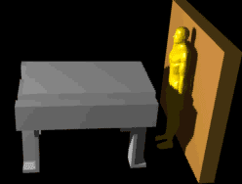
Reciprocating Parts
Risk of being struck between stationary and moving part

Slide 19
Transverse motion
Continuous straight line motion
Worker struck or caught in pinch or shear point by the moving part.

Slide 20
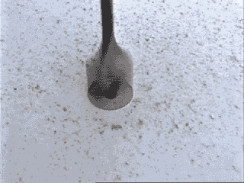
Cutting action
Direct injury from cutting action
Flying chips or scrap materials can strike head
Saws, drills, lathes, mills

Slide 21
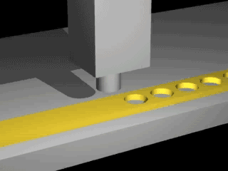
Punching action
Danger at point of operation where stock is inserted, held, and withdrawn by hand
Ram that stamps materials
(typical punching operation)

Slide 22
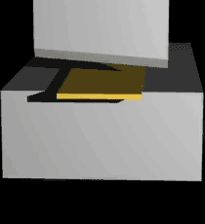
Shearing action
Powered blade that shears materials
Hazard at point of operation where stock is inserted, held, and withdrawn by hand.
(typical shearing operation)

Slide 23
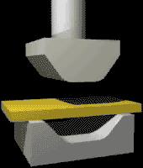
Bending action
Power applied to a slide to stamp/shape materials
Hazard at point of operation where stock is inserted, held, and withdrawn
(typical bending operation)

Slide 24


Machine Actions & Motions

Slide 25
Guarding Principles
Prevent contact between hazardous moving parts and body or clothing
Secure guard: not easily removed
Protect from objects falling into machinery
Create no new hazards: eliminate sharp/rough edges
Create no interference with job/comfort/speed
Allow safe lubrication: without removing guards if possible
Notes:
e.g. locating oil reservoirs outside the guard, with a line leading to the lubrication point, will reduce the need for the operator or maintenance worker to enter the hazardous area.

Slide 26
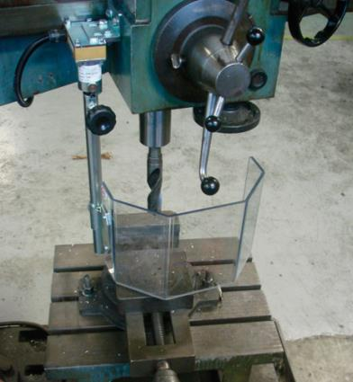
Guarding Methods
Location / distance
Guards
  Fixed
  Interlocked
  Adjustable
  Self-adjusting

Slide 27
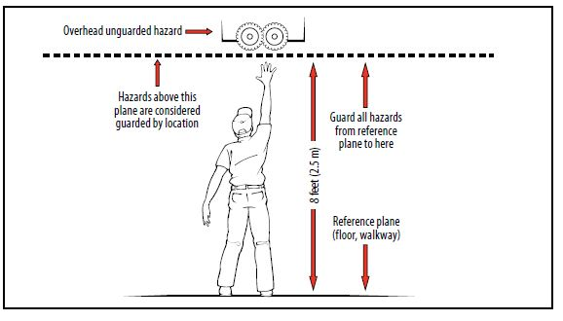
Safeguarding by Location/Distance
Location of hazardous parts that is inaccessible or not a hazard during normal operation
Must maintain safe distance
Training, warning, communication necessary
In this example, the hazard can be left unguarded because it is more than 7 feet above the floor (or working level).

Slide 28
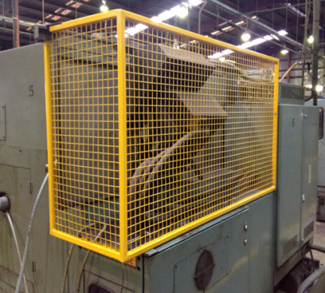
Fixed Guard
Barrier is a permanent part of machine
Preferable over other types

Slide 29
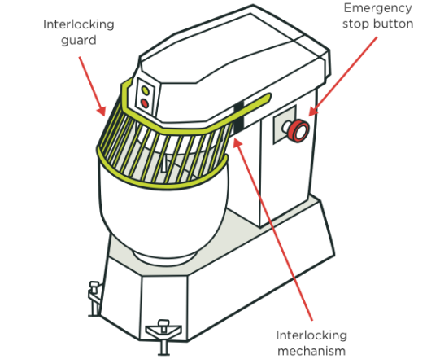
Interlocked Guard
Stops motion when guard is opened or removed

Slide 30
Adjustable Guard
Barrier may be adjusted for variable operations
  What are the drawbacks?
https://www.youtube.com/watch?v=cMyzL1RykRY
Notes:
Trainer verbally provides this list to the trainees—
-Hands may enter danger area—protection may not be complete at all times.
-May require frequent maintenance and/or adjustment.
-Guard may be made ineffective by the operator.
-May interfere with visibility.

Slide 31
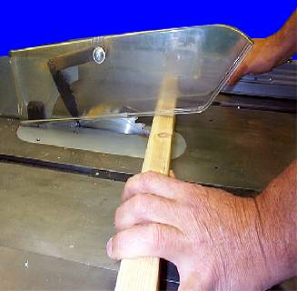
Self-Adjusting Guard
Adjusts according to size/position of material
Circular table saw self-adjusting guard

Slide 32
Devices and Gates
Devices
  Photoelectric (presence sensing)
  Pullback
  Restraint
  Safety controls
    tripwire cable, two-hand control, etc.
  Gates

Slide 33
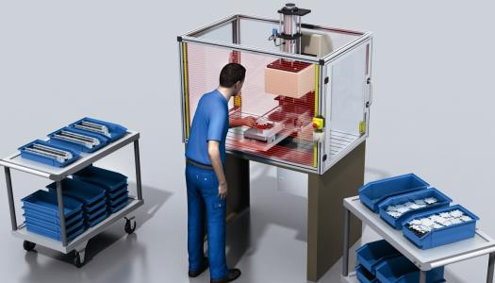
Photoelectric
Presence Sensing Devices
Uses light sources and controls to interrupt machine’s operating cycle
Machine stops when light field is broken

Slide 34
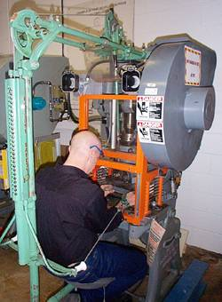
Pullback Devices
Cables attached to operator’s hands or wrists
Removes hands from point of operation during danger period
  What are the drawbacks?
Notes:
Trainer review with trainees (list of drawbacks)
-Limits movement of operator.
-May obstruct workspace around operator.
-Adjustments must be made for specific operations and for each individual.
-Requires frequent inspections and regular maintenance.
-Requires close supervision of the operator’s use of the equipment.

Slide 35
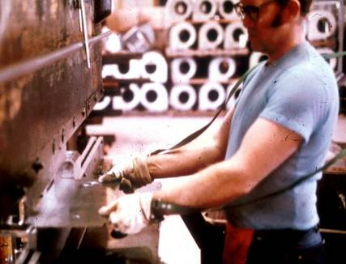
Restraint Devices
Cables attached to fixed point and wrists or hands
Adjustable to let hands travel in predetermined area
May be accompanied by hand-feeding tools
Notes:
Trainer review with trainees (list of drawbacks)
-Limits movement of operator
-May obstruct work space
-Adjustments must be made for specific operations and each individual
-Requires close supervision of the operator’s use of the equipment

Slide 36
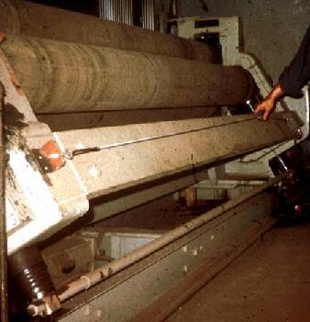
Safety Tripwire Cable
Device located around the perimeter of or near the danger area
Operator must be able to reach the cable to stop the machine
Notes:
Trainer review with trainees list of drawbacks:
-All controls must be manually activated
-May be difficult to activate controls because of their location
-Only protects the operator
-May require special fixtures to hold work
-May require a machine brake

Slide 37
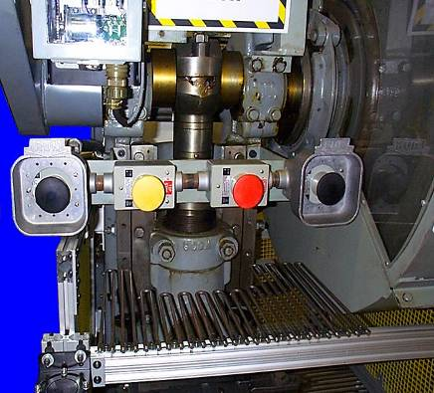
Two-Hand Control
Requires constant pressure on both pads to activate the machine
Hands on controls at safe distance while machine is in dangerous cycle

Slide 38
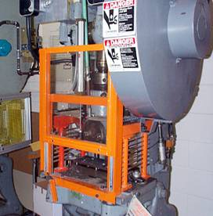
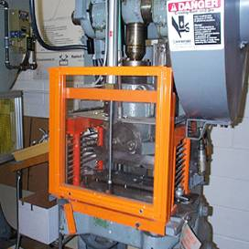
Gate
Must close fully to protect user before cycle will start
Gate Open
Gate Closed

Slide 39
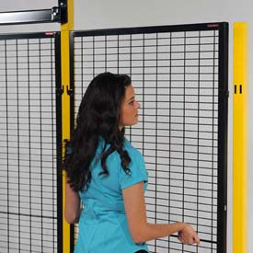
Feeding and Ejection Methods, Robots, and Miscellaneous Aids
Feeding & ejection methods
  Automatic and/or semi-automatic feed and ejection
Robots
Miscellaneous aids
  Awareness barriers
  Protective shields
  Hand-feeding tools

Slide 40
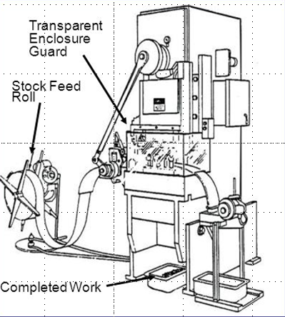
Feeding and Ejection Methods
Operator is not required to place hands in danger area
Operator can manually feed stock with assistance of feeding mechanism
Often does not require operator to be involved once machine is started

Slide 41
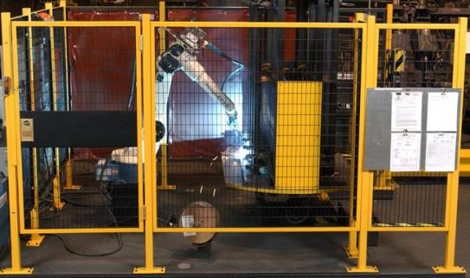
Robots
Best used for redundant tasks where hazards are present
Suitable for operations with high stress factors
Operations must be guarded

Slide 42
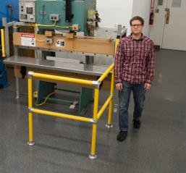
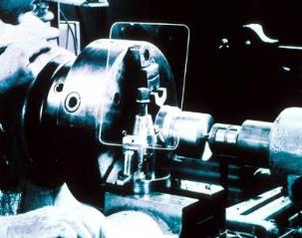
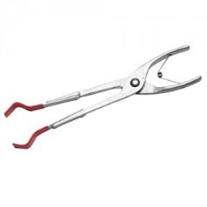
Miscellaneous Aids
Awareness barriers
Protective shields
Special hand tools
Not to be used as a stand alone barrier,
they provide an extra source of safety!

Slide 43
Machinery &
Machine Guarding

Slide 44
General Requirements-1
One or more types of guarding to protect from hazards.
  Barrier guards
  Two-hand tripping devices
  Electronic safety devices
Affixed to machine where possible
  Guard must not cause its own hazard

Slide 45
General Requirements-2
Point of operation guarding:
  Guarding required if exposes employee to injury
    According to OSHA standards or
    Keep any part of body out of danger zone
  Hand tools to permit material handling – in addition to guards, not instead
  Examples of machines requiring guards on point of operation

Slide 46
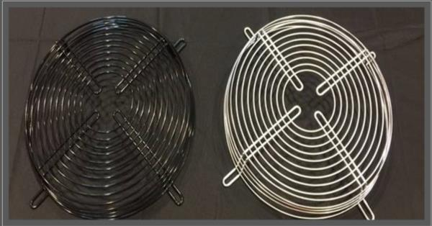
General Requirements-3
Revolving barrels, drums, and containers must be guarded by an interlocked enclosure so they cannot turn without a guard in place.
Exposure to fan blades: guard openings ≤1/2 inch

Slide 47
Anchoring Fixed Machinery
Machines designed for a fixed location must be anchored to prevent moving
This pedestal grinder is designed for anchoring, but is not anchored

Slide 48
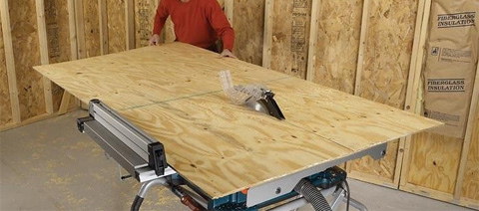
Woodworking Machinery
A wood machine that is intended to process wood
  Usually powered by electric motors
Hazards
  Point of operation
  Other moving parts
  Kickbacks
  Flying particles

Slide 49
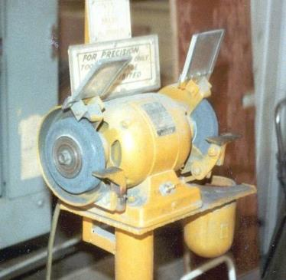
Abrasive Wheel Machinery
Abrasive wheels must be guarded
Guard design dependent on type of work and type of wheel

Slide 50
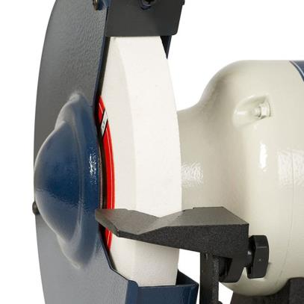
Abrasive Wheel Work Rests
Work rests:
  Rigid, clamped in place securely
  Adjusted to within 1/8 inch of wheel
  Never adjusted while in motion

Slide 51
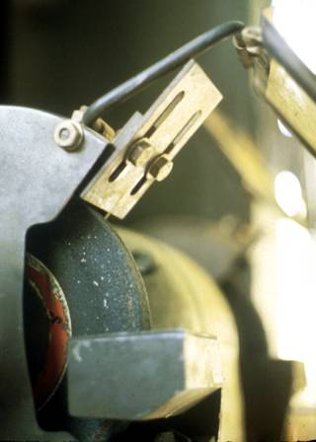
Abrasive Wheel
Exposure Adjustment
Adjustable tongue guard must never be more than ¼ inch from wheel
To be used when operator stands in front of opening: Adjustable for decreasing wheel size.

Slide 52
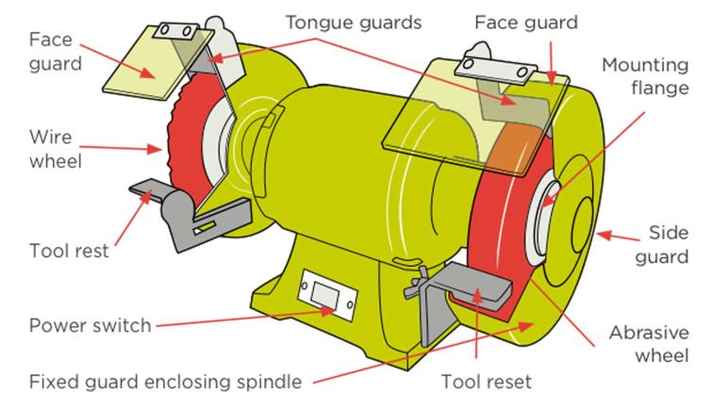
Machine Guard Example
Notes:
Explain “tool reset” is the same as “work rest”

Slide 53
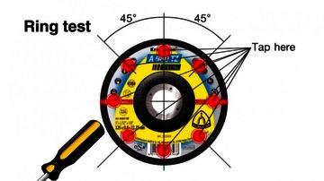
Abrasive Wheel Ring Test
Inspect for damage and ring test immediately before mounting
  Tap with light nonmetallic implement (screwdriver for light wheels, wooden mallet for heavier wheels)
  If sound is dead, cracked ring may not be used
Check spindle speed against maximum speed for wheel
Wheels must be dry and free of sawdust

Slide 54
Ring Test Video
https://www.youtube.com/watch?v=52n8_-6cooY

Slide 55
Mechanical Power Transmission
Apparatus

Slide 56

Flywheels
Flywheels 7 feet or less above the ground shall be guarded.
Must be enclosed with a sheet, metal or woven wire.
Guard rails must be used between 15 to 20 inches from flywheel rim
Toe board must be used if the flywheel is within 12 inches of the floor or extends into a pit

Slide 57
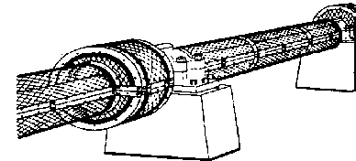
Shafting-1
Each continuous line of shafting shall be secured in position against excessive end movement
Inclined and vertical shafts shall be securely held in position against endwise thrust
*Particularly inclined idler shafts

Slide 58
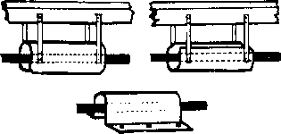
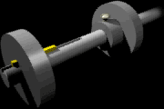
Shafting-2
All exposed parts of horizontal shafting 7 ft. or less above the floor shall be guarded (except: runways used for oiling or running adjustments) by a stationary casing, or by a trough
Troughs must enclose sides and top, or sides and bottom of shafting as location requires
Notes:
Explain if they plan to use a trough instead of a stationary casing, they must check out 29 CFR 1910.219(c)(2)(ii) for additional requirements on building a trough.

Slide 59
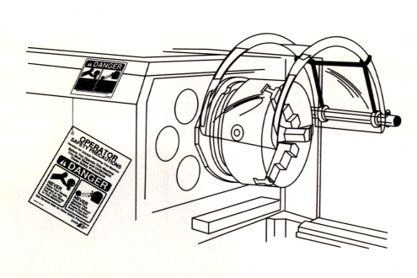
Shafting-3
Projecting end shafts shall present a smooth edge and project not more than 1/2 the diameter of the shaft
Unused keyways shall be filled up or covered

Slide 60
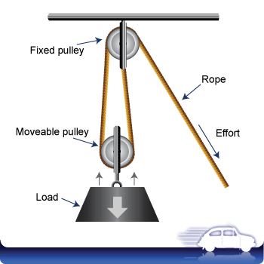
Pulleys
Wheels with grooved rims around which a cord passes
Pulleys, any parts of which are seven feet or less from the floor or working platform, shall be guarded in accordance with the OSHA standards specified in paragraphs (m) & (o) of 29 CFR 1910.219
Pulleys serving as balance wheels (e.g., punch presses) on which the point of contact between belt and pulley is more than six feet six inches from the floor or platform may be guarded with a disc covering the spokes

Slide 61
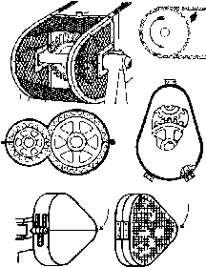
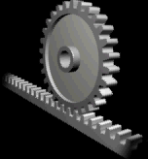
Gears, Sprockets, & Chains
Gears, sprockets and chains shall be guarded by one of the following methods:
  By a complete enclosure; or
  By a standard guard at least seven feet high, extending six inches above the mesh point of the gears
  By a band guard covering the face of the gear and having flanges extended inward beyond the root of the teeth on the exposed side.

Slide 62
Keys, Set-Screws,
& Other Projections
  Projecting keys, setscrews, and other projections in revolving parts must be removed, made flush, or guarded by metal cover.

Slide 63

Collars & Couplings
Shaft couplings must be constructed as to present no hazard from bolts, nuts, setscrews, or revolving surfaces.
Permitted where they are covered with safety sleeves or countersunk and do not extend beyond the flange of the coupling

Slide 64
Hand and Power Tools

Slide 65

General Industry
Employer is responsible for safe condition of tools and equipment
  Including equipment furnished by employee
Compressed air must not be used for cleaning unless:
  Reduced to <30 p.s.i.
  Only with effective chip guarding and PPE

Slide 66

Portable Powered Tools
Portable circular saw
>2 inch guarded
  Automatic return to covering position
Switches and controls:
  Constant pressure control for circular and chain saws (a safety device that when tool is not in use it is supposed to stop working
  Other controls for other tools as appropriate

Slide 67
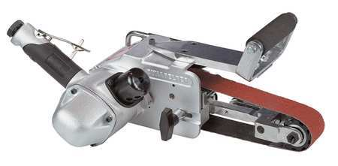
Portable Powered Tools Cont.
Portable belt sanding machine >2 inches must be guarded
  At each nip point
  Unused run of sanding belt guarded against accidental contact
Cracked saws: remove from service
Grounding: Meet 29 CFR 1910 Subpart S

Slide 68


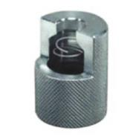
Pneumatic Powered
Tools & Hoses
Tool retainer to prevent ejection
Airhose designed for applied pressure and service

Slide 69

Post Test Time!

Slide 70

Evaluation

Slide 71

THANK YOU!

