Slide 1
Health and Safety for Caregivers:
- Kitchen and Bathroom Chemical Hazards
- Introduction to OSHA
This material was produced under grant number SH-31223-SH7 from the Occupational Safety and Health Administration, U.S. Department of Labor. It does not necessarily reflect the views or policies of the U.S. Department of Labor, nor does its mention of trade names, commercial products, or organizations imply endorsement by the U. S. Government.

Slide 2
Get to Know One Another!
What’s your name?
What do you do?
What’s your favorite movie?

Slide 3
Learning Objectives
By the end of this training module, participants will be able to:
Identify the potential health risks of the chemicals present in kitchen and bathroom household cleaning products
Communicate safety strategies to reduce the risk of adverse chemical

Slide 4
MODULE 1:
Kitchen and Bathroom Chemical Hazards

Slide 5

Chemicals can be dangerous
  Every cleaning product – even “green” ones - contains chemicals.
  Chemicals are important: they allow the product to kill germs and control infection.
  However, many chemicals in common products are potentially harmful to you and your Consumer.
  Some chemicals: known or suspected to cause cancer, birth defects, asthma, other serious health effects.

Slide 6
Chemicals can be dangerous
  Cleaning product manufacturers don’t need to disclose specific chemicals in products (only CA and NY have laws requiring disclosure).
  We have to rely on the caution messages on product labels with regard to the presence of allergens, environmental toxicants, and chemicals linked to harmful health effects.

Slide 7
Chemical Exposure

Slide 8
Never mix chemicals
  One of the most important rules of using kitchen and bathroom cleaning products:
  NEVER MIX!
  Do not mix bleach and ammonia. Ammonia can be found in some glass and window cleaners, urine (cat litter boxes, diaper pails); some interior and exterior paints.

Slide 9
Never mix chemicals
  Do not mix bleach with acids (vinegar, some glass and window cleaners, dishwasher detergents, and many other cleaners
  contain acids).
  Do not use two drain cleaners together, or
  one right after another.
  Do not mix:
    Baking soda and vinegar
    Hydrogen peroxide and vinegar
    Bleach and rubbing alcohol
    (“Common Cleaning Products Can Be Dangerous When Mixed,” n.d.; Freedman, 2016)

Slide 10
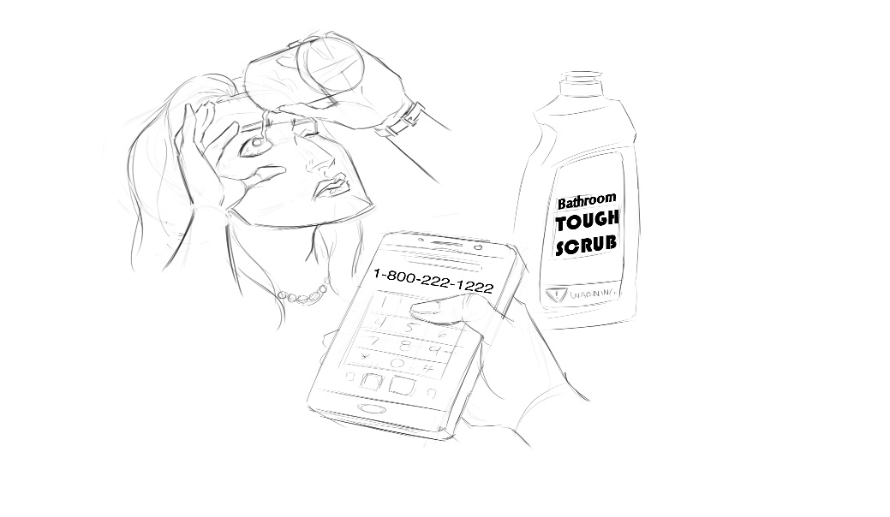
Symptoms and First Aid
Eye Exposures
You may get red, itching, burning, or watery eyes
from chemical splashes and fumes exposure.
FIRST AID:
    Get medical attention as soon as possible following an injury, especially if you have eye pain, blurred vision or loss of any
    vision.

Slide 11
Symptoms and First Aid
Eye Exposures
The following steps can and should be taken until medical assistance is obtained:
  Immediately flush eye with water for at least 15 minutes. Place the eye under a faucet or shower, use a garden
  hose, or pour water into the eye from a clean container
  (remove contact lenses first if you wear them).
  Do not try to neutralize the chemical with other
  substances.
  Do not apply bandage.

Slide 12
Symptoms and First Aid
Skin Exposures
After the chemical touches your skin, you may get a rash, a burn, or general irritation.
FIRST AID:
    Immediately wash skin.
    Then, get medical attention as soon as possible.

Slide 13
Symptoms and First Aid
Inhalation (breathing in) and Ingestion (swallowing)
If you breathe the chemical in or swallow it in any amount, you may have breathing trouble such as wheezing, coughing, shortness of breath, or chest
pain. You may also experience headache, dizziness,
and nausea.
FIRST AID:
    Call Poison Control Center: 1–800–222–1222
    Seek immediate medical attention.

Slide 14
Working Safely with kitchen and bathroom chemicals

Slide 15
Chemical Safety Strategies
Anytime you work with chemicals, there is a risk of exposure. However, you can keep yourself – and the consumer – much safer by following these strategies.
Working Safely with Household Cleaners
General Tips
  Read the label.
  Keep products out of reach of children and pets.
  Keep products in their original labeled containers.
  Never place chemicals into unmarked containers or containers labeled for a different substance.

Slide 16
Chemical Safety Strategies
Working Safely with Household Cleaners
General Tips
  Store products in locations as indicated on the
  label (i.e., away from heat).
  Keep containers closed when not in use.
  NEVER mix different cleaning products.
  Keep the Poison Control Center number posted
  in the home: 1–800–222–1222

Slide 17
Chemical Safety Strategies
Using the Products
  Read the label.
  For spray products, spray on the sponge, towel,
  or rag, rather than on the surface area.
  Turn spray nozzles away from your face and eyes (and those of anybody else!)
  Work in well-ventilated area (i.e., open a window
  or use a fan).

Slide 18
Chemical Safety Strategies
Use PPE (Personal Protective Equipment)
  Check the label for recommendations.
  Use thick, well-fitted household cleaning gloves.
  This is the best way to keep corrosive and
  irritating cleaning products away from your skin.
  Use a household odor respirator or dusk mask.
  Make sure it fits properly.

Slide 19
Chemical Safety Strategies
Use PPE (Personal Protective Equipment)
  Use chemical safety glasses. Make sure they fit
  you properly.
  Use protective footwear. Waterproof and slip-
  proof shoes will prevent chemicals reaching your
  feet and stop you from slipping.
  Find less dangerous chemicals for cleaning (i.e., baking soda, vinegar); Check products for the
  EPA’s “Safer Choice” label.
  Make your own safe cleaning products. See end
  of Handout 4, Chemical Safety Strategies.

Slide 20
MODULE 3:
Introduction to OSHA

Slide 21

Filing a Complaint with OSHA
  If you believe your workplace is
  unsafe or unhealthy, tell your
  employer.
  You have the right to file a
  complaint with OSHA.
  File a complaint by mail, by telephone or online
  If there is an emergency, use the telephone to file your complaint.
  OSHA will keep your complaint confidential.

Slide 22
Filing a Complaint with OSHA
  You have the right to file a complaint without fear of retaliation.
  If you believe your employer has retaliated against you for complaining, you can file a Whistleblower Complaint.
  See Handout 10 in your Participant Handbook for information on how to file. You can also visit: www.osha.gov

Slide 23
References
Aguirre, S. (2016, December 12). 7 Important Parts of a Cleaning Product Label [Make your best home.]. Retrieved from https://www.thespruce.com/parts-of-a-cleaning-product-label-1900744
Amarelo, M. (2017, October 16). Calif. Governor Signs Cleaning Product Disclosure Law. Retrieved from http://www.ewg.org/release/calif-governor-signs-cleaning-product-disclosure-law#.WeyhfROPLeS
Cleaning Label Signal Words. (2017, February 2). Retrieved from http://www.ecocenter.org/cleaning-label-signal-words
Common Cleaning Products Can Be Dangerous When Mixed. (n.d.). Retrieved from http://health.utah.gov/enviroepi/activities/FNTSIP/Common Cleaning Products Can Be Dangerous When Mixed.pdf
Decoding the Labels. (n.d.). [Retrieved from http://www.ewg.org/guides/cleaners/content/decoding_labels#.WeylKROPLeQ
Freedman, L. (2016, December 15). Cleaning Products You Should NEVER Mix [Philosophy: Life should be full of pleasures, not chores. Let us help you keep it that way.]. Retrieved from http://www.goodhousekeeping.com/home/cleaning/tips/a32773/cleaning-products-never-mix/
Hemmings, H.C. & Egan, T.D. (2012). Pharmacology and physiology for anesthesia ebook. Elsevier Health Sciences. NIOSH Pocket Guide to Chemical Hazards. (2007). Cincinnati, OH: Department of Health and Human Services Centers for Disease Control and Prevention National Institute for Occupational Safety and Health. Retrieved from http://www.cdc.gov/niosh
Protecting Your Eyes at Work. (n.d.). Retrieved from https://www.aoa.org/patients-and-public/caring-for-your-vision/protecting-your-vision
Risk at Work - Personal protective equipment (PPE). (n.d.). Retrieved from http://www.hse.gov.uk/toolbox/ppe.htm
Safer Choice. (n.d.). Retrieved from https://www.epa.gov/saferchoice
Types of Household Cleaning Products. (n.d.). Retrieved from http://www.healthycleaning101.org/types-of-household-cleaning-products/
U.S. Department of Health and Human Services, Centers for Disease Control and Prevention, National Institute for Occupational Safety and Health, DHHS (NIOSH). (2014). Caring for yourself while caring for others. Retrieved from https://www.cdc.gov/niosh/docs/2015-102/default.html

