Slide 1

Fall Prevention
Susan Harwood Training Grant
Day 1

Slide 2
Disclaimer
This material was produced under grant SH-19506-09 from the Occupational Safety and Health Administration, U.S. Department of Labor. It does not necessarily reflect the views or policies of the U.S. Department of Labor, nor does mention of trade names, commercial products, or organizations imply endorsement by the U.S. Government.
Revisions were made to this material under grant number SH- 31240-SH7 from the Occupational Safety and Health Administration, U.S. Department of Labor.

Slide 3
What is OSHA?
OSH Act is the federal law that established the Occupational Safety and Health Administration (OSHA)
OSHA sets and enforces workplace safety and health standards

Slide 4

Your Rights As A Whistleblower
Whistleblower: One who informs on a person or organization engaged in illegal activity.
Your Rights: You are protected from retaliation. Employees are entitled to a workplace free from known health and safety hazards. An employer cannot retaliate by taking adverse action for reporting safety concerns.
File a Complaint: (800) 321-OSHA (6742)

Slide 5

Employer Responsibilities
Employers must provide safe workplaces environment
Comply with OSHA standards, rules, and regulations
Provide safety training
Notes:
General Duty Clause

Slide 6

Employee Responsibilities
Read and follow safety posters and signs
Comply with OSHA rules and regulations
Use your personal protective equipment (PPE) when required
Report hazardous conditions and job related injuries ASAP

Slide 7
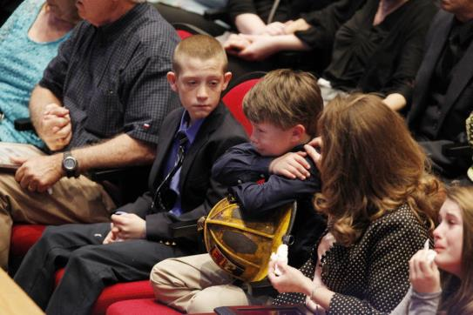
Statistics
In 2016, 5190 people died from fatal workplace injuries

Slide 8

Lesson Objectives
When fall prevention tools are needed
How to recognize fall hazards
Use of personal fall arrest systems
Use of guard rails
Use of safety nets

Slide 9

Quiz Time!

Slide 10
What Can I Do to Stay Safe?
Make sure you can tell when a work site is risky for falls from heights.
When a work site has a fall risk, take Fall Prevention steps, they will keep you safe!

Slide 11

Fall Prevention and Arrest
Stopping or preventing falls
Catching falls
Restraints or positioning devices
Guardrails
Warning lines
Controlled access zones
Controlled decking zones
Safety monitors
Fall arrest
Safety nets
Catch platforms
Notes:
Explain what each of the items in the boxes means.

Slide 12
Preventing Falls
Prevent falling by using guardrails or other ways to hold workers back from hazardous areas
If a fall occurs, arrest (stop) the fall
Provide rescue as soon as possible
Notes:
Prevention should be first – always strive to prevent the fall
Positioning, including restraint, should be second, to provide safe access to the work location. Fall arrest may also be required
Fall arrest is employed after the fall, so is one of the least-desirable approaches, assuming, as it does, that an employee will fall and that all systems will function properly to arrest the fall.
Retrieval assumes the fall arrest system has already worked, and must be employed as quickly as possible to minimize further injury or damage.
The key is that all steps must be taken as part of a systematic approach to fall protection, but the most effort and priority should be applied to preventing falls in the first place

Slide 13
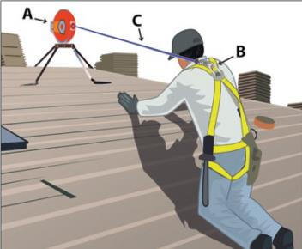
PFAS Examples
What work situations might require you to use a PFAS (personal fall arrest system)?

Slide 14
When do you need a PFAS?
Elevator shafts
Ladder side rails
Decking and plywood
Roofs
Wall openings
Bricklaying
Residential or commercial construction
Tower construction
Scaffold ladders and platforms
Skylights
Walkways and ramps
Near open sides and edges
Near Holes
When using concrete forms and rebar
Excavations
Notes:
Where should I expect fall prevention to be provided?
When an employee is on a walking/working surface that has an unprotected edge.
When an employee is constructing a leading edge.
When an employee may fall through a hole in the walking/working surface.
When an employee is working on the face of formwork or reinforcing steel.
When employees are on ramps, runways and other walkways.
When employees are working at the edge of an excavation, well, pit, or shaft.
When employees are working above dangerous equipment (even employees working less than six feet over dangerous equipment must be protected).
When an employee is performing overhand bricklaying and related work.
When an employee is performing roofing work.
When an employee is engaging in precast concrete erection (with certain exceptions).
When an employee is engaged in residential construction (with certain exceptions).

Slide 15
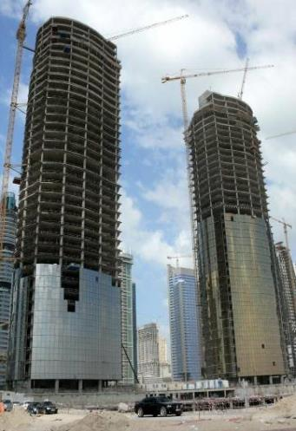
Tower Construction
Many construction fatalities happen on these sites
Workers fall while being distracted
Falls from towers are the most common fatality on construction sites

Slide 16
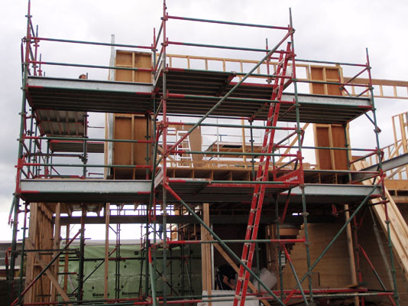
Scaffold Ladders & Platforms

Slide 17
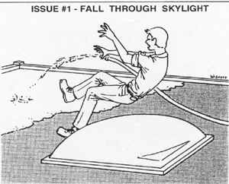
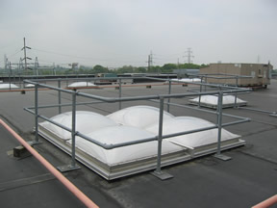
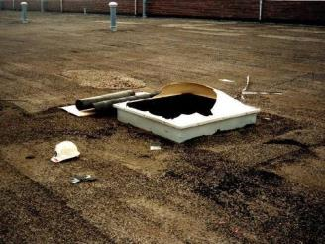
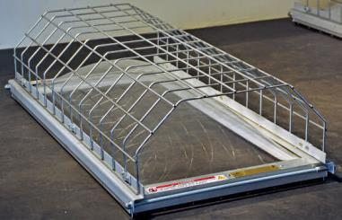
Skylights and Other Openings
Notes:
Serious falls occur from fully open to an unsecured skylight from covered opening to plastic domes or corrugated translucent panels, when a worker sits, stands, steps on, or backs into the dome design.

Slide 18
Remembering Joe
https://www.youtube.com/watch?v=I_8cymt7wlk
Notes:
Day 1-Slide 18: Preventing Falls Through Skylights
Video: https://www.youtube.com/watch?v=I_8cymt7wlk

Slide 19
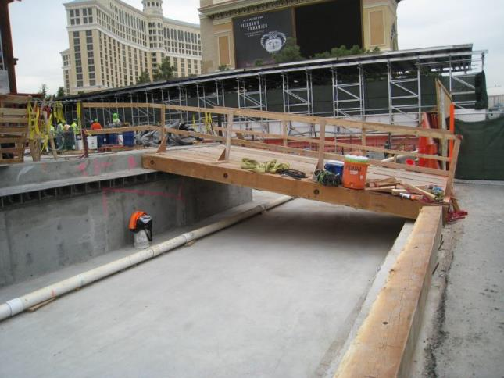
Walkways and Ramps
Notes:
Reference 1926.501(b)(6)
Ramps, runways, and other walkways must be protected by guardrail systems when employees can fall 6 feet or more.
The walking/working surface must be strong enough to support employees safely. If not, employees may not work on the surface. This knowledge will be gained during frequent and regular inspections made, as required, by competent persons designated by the employer.

Slide 20
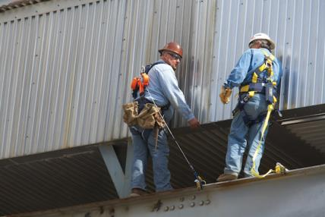
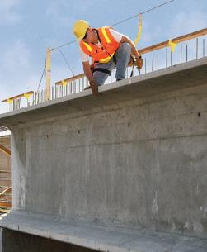
Open Sides and Edges
Leading Edge
  The unprotected side and edge of a floor, roof, or formwork such as a deck.

Slide 21
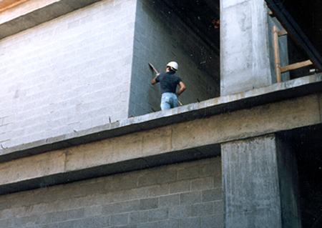
Open Sides and Edges-1
Unprotected edge
Notes:
Reference 1926.501(b)(1)
Explain what would be equivalent to a guardrail

Slide 22
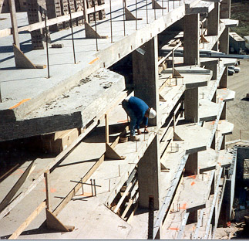
Open Sides and Edges-2
Notes:
1926 Subpart M – Fall Prevention
Explain what would be equivalent to a guardrail

Slide 23
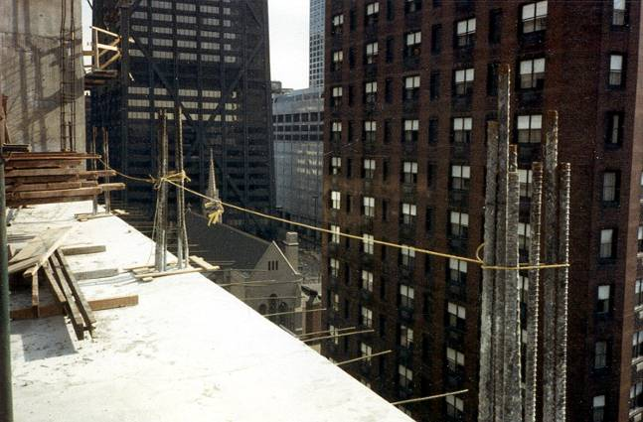
Open Sides and Edges-3
Notes:
What’s wrong with this?
Install guard rail meeting the criteria of OSHA Reference 1926.502(b)

Slide 24
Leading Edge Work: Prevention
https://www.youtube.com/watch?v=G991LcaZQd8
Notes:
Ask class what could have been done to prevent this fall.
Day 1-Slide 24: Leading Edge Work: Prevention Video (v-Tool): Falls in Construction
Video: https://www.youtube.com/watch?v=G991LcaZQd8

Slide 25
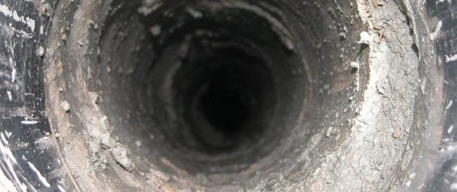
Holes
Protect any opening bigger than 2 inches by 2 inches
Extreme danger when hole is 1 foot by 1 foot
Stay 6 feet away!
Notes:
Serious falls occur from fully open to an unsecured skylight from covered opening to plastic domes or corrugated translucent panels, when a worker sits, stands, steps on, or backs into the dome design.

Slide 26
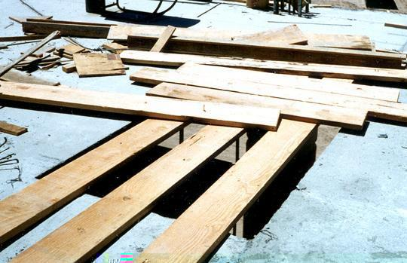
Improperly Covered Hole
Notes:
Reference 1926.501(b)(4)

Slide 27
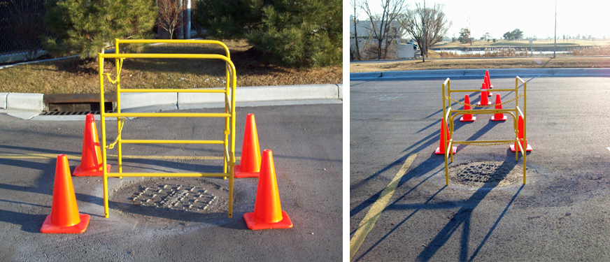
Properly Barricaded Manhole
Notes:
Reference 1926.501(b)(4)
Explain what a personal fall arrest system is.

Slide 28
Floor Opening Falls
https://www.youtube.com/watch?v=UYMb1XZ83zQ&start=55
Notes:
What could have been done to protect the fatality?
Covered the hole.
Put barricade around the hole
Use Personal Fall Arrest Systems
Use safety net
Day 1-Slide 28: Falls in Construction/Floor Openings
Video: https://www.youtube.com/watch?v=UYMb1XZ83zQ&start=55

Slide 29
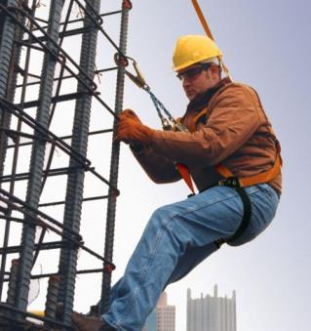
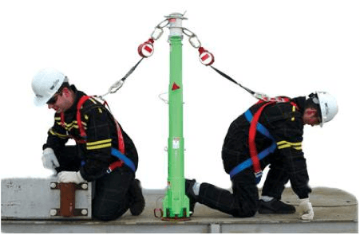
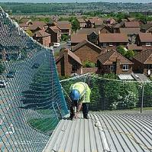
Concrete forms and rebar
Fall Protection
  Personal Fall Arrest Systems
  Safety Nets
  Positioning Device Systems
Notes:
Reference1926.452(g) Employees on a form scaffold can be exposed to falls of less than 10 feet.

Slide 30
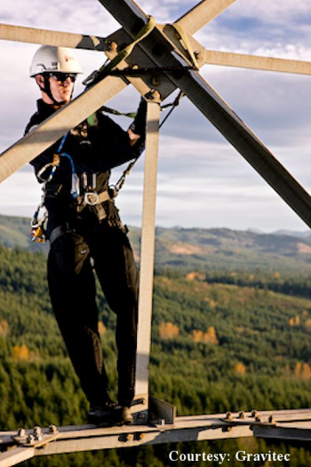
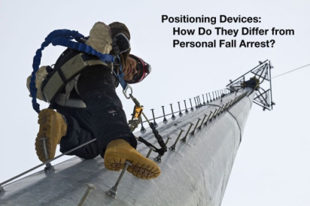
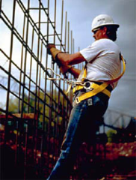
Positioning Device Systems

Slide 31
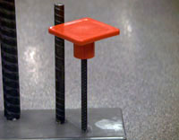
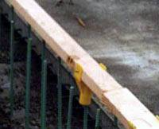
Rebar Safety
Cover all protruding ends of steel rebar with rebar caps
Bend rebar so exposed ends are no longer upright
Use a personal fall arrest system while working at any height above rebar not completely inside concrete
Notes:
Reference 1926.701(b)

Slide 32
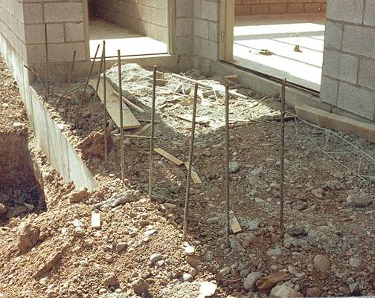
Unguarded Rebar

Slide 33
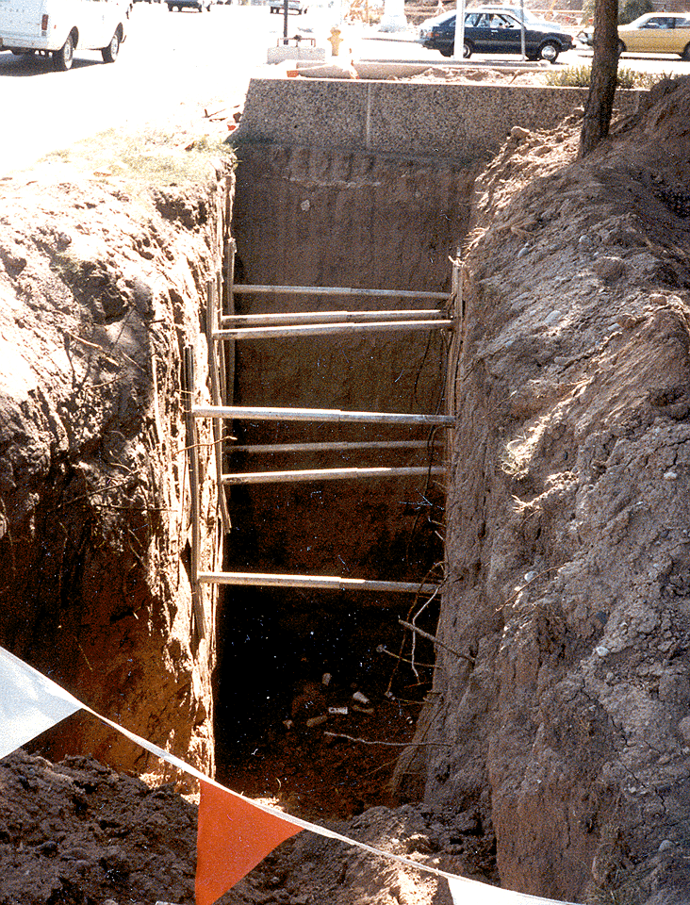
Excavations
In addition to needing guarding, this excavation is not properly shored
Notes:
Reference 1926.501(b)(7)
Employees at the edge of an excavation 6 feet or more deep shall be protected from falling by guardrail systems, fences, barricades, or covers.
If walk-ways are used to permit workers to cross over excavations, guardrails are required on the walkway if the fall would be 6 feet or more to the lower level.

Slide 34
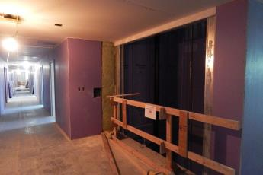
Elevator Shafts
Hazards
  Workers are curious and look in.
  Use barricades (something to block the opening) in open space of elevator shafts
  Inspect barricade systems often.
Notes:
Emphasize that there are certain requirements for barricading an open space, which will discussed later on

Slide 35
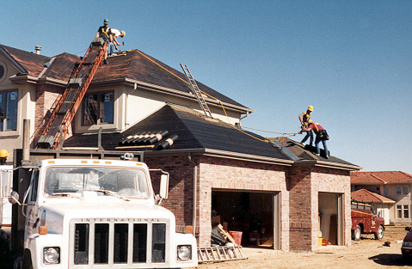
Roofs
Workers must be protected from falls of
6 feet or more.
Notes:
Explain about installing guard rail and using Personal Fall Arrest System

Slide 36

Activity

Slide 37
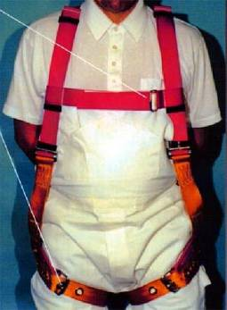
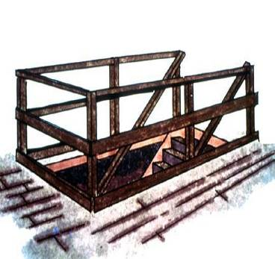
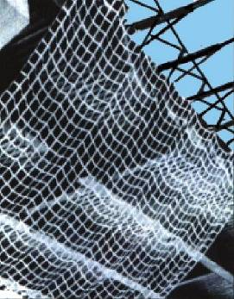
Fall Prevention Options
Personal Fall
Arrest System
(PFAS)
Guardrails
Safety Net
Notes:
Explain what a personal fall arrest system is

Slide 38
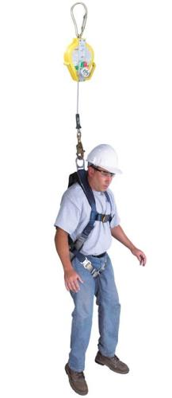
Fall Distances
Personal Fall Arrest System
  Free fall total: 6 feet
  Will slow your fall
  Total fall distance will be 9 feet, 6 inches
Notes:
See interpretations for additional guidance.

Slide 39
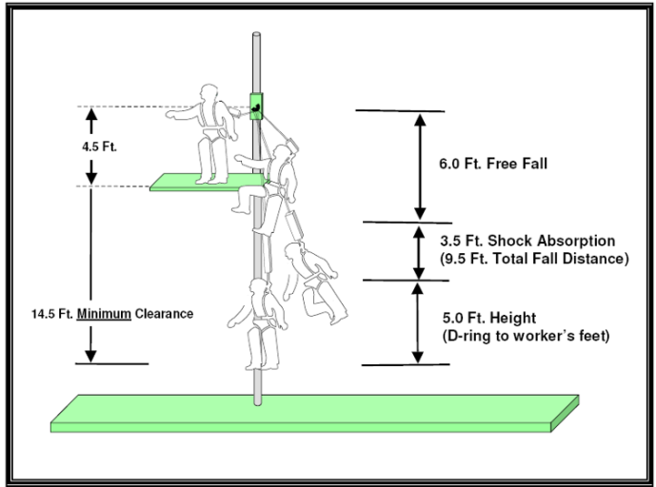
Illustration
Notes:
Explain this diagram.

Slide 40
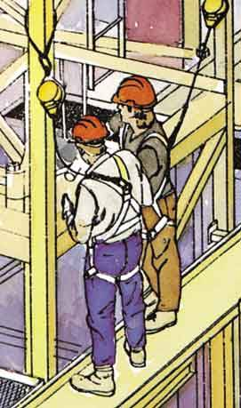
Personal Fall Arrest Systems
They allow freedom of movement so you can do your job.

Slide 41
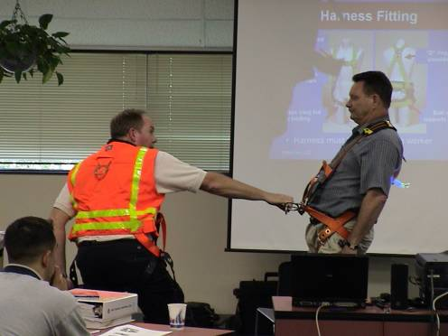
Training
Workers must be trained in proper use.

Slide 42
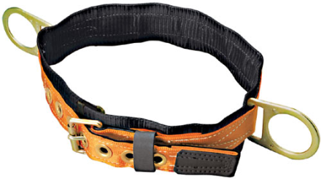
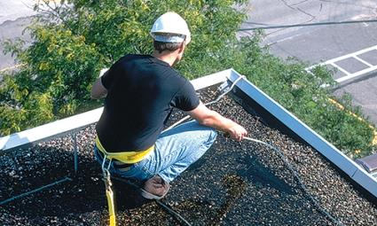
Body Belts
Not acceptable as a personal arrest system for a vertical fall!

Slide 43
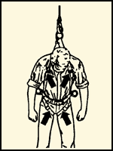
PFAS Deployment
Once a Personal Fall Arrest System has been used in a fall, it must be removed from service right away.

Slide 44
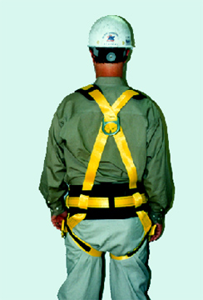
PFSA Inspection
Prior to each use
Damage and other deterioration
Defective components
Is expired
Notes:
Reference 1926.502(d)
What will my personal fall arrest system do to protect me?
A personal fall arrest system places the employee into a body harness that is fastened to a secure anchorage so that he/she cannot fall. Body belts are not acceptable as personal fall arrest systems. A few key requirements:
There should be no free fall more than 6 feet.
There should be prompt rescue after a fall.
Personal Fall Arrest Systems must be inspected prior to each use.
Personal Fall Arrest Systems must not be used until they have been inspected by a competent person.

Slide 45
PFAS Components
  Body Harness
  Attachment Location
  Vertical Lifeline/Lanyard
  Webbing
  Anchorages
  Horizontal Lifeline
  Connectors

Slide 46
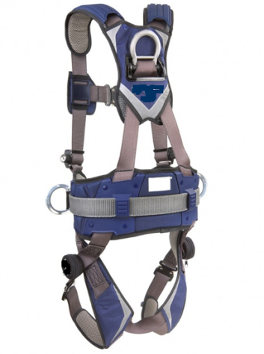
Personal Fall Arrest System

Slide 47
Body Harness
Body harnesses are designed to lower stress forces during falls

Slide 48
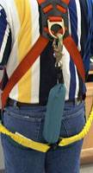
Body Harness Attachment Location
The attachment must be located in the center of the wearer’s back, near the shoulder level

Slide 49
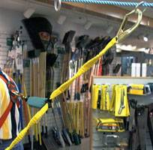
Vertical Lifeline/Lanyard
Vertical lifelines/lanyards must have a minimum breaking strength of 5000lbs.
Each worker must be attached to a separate vertical lifeline, expect during the construction of an elevator shaft.

Slide 50
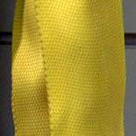
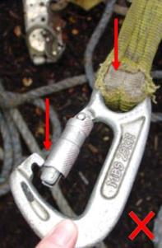
Webbing
Ropes and straps used in lifelines and lanyards must be inspected prior to each use.
Made from synthetic fibers
Safe
Unsafe

Slide 51
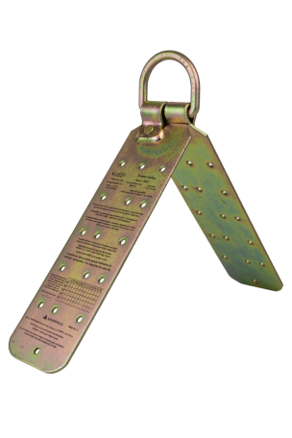
Anchorages
Should be used only for the PFAS system
Must support at least 5,000lbs PER WORKER

Slide 52
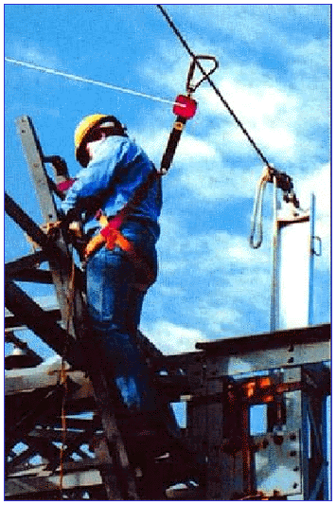
Anchor Safety Factor
Design
  Safety factor of at least 2
  Must be supervised by a qualified person
Notes:
Explain what a safety factor of at least 2 means.
Explain what a qualified person means.

Slide 53
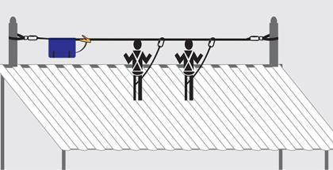
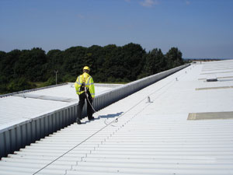
Horizontal Lifeline
Should be designed and installed by a qualified person
Safety factor of at least 2

Slide 54
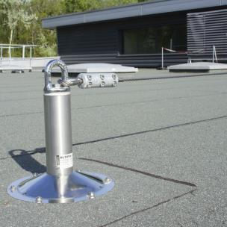
Horizontal Lifelines
On work platforms, the devices used to connect to a horizontal lifeline must be able to lock in both directions on the lifeline

Slide 55


Connectors
Must be made of strong materials and free from rust
Must have smooth surfaces and edges!
Notes:
Must be made from drop-forged, pressed formed steel, or equivalent materials

Slide 56

D Rings
Must meet high standards for strength
Notes:
Minimum tensile strength of 5,000 lbs.
Proof-tested to a minimum tensile load of 3,600 lbs without cracking, breaking or becoming permanently deformed.

Slide 57

Snaphooks
Must meet high standards to ensure you are protected from falls.
Notes:
Minimum tensile strength of 5,000 lbs
Proof-tested to a minimum tensile load of 3,600 lbs without cracking, breaking, or becoming permanently deformed.
Locking-type, double-locking, designed and used to prevent the disengagement of the snaphook.

Slide 58

Demonstration

Slide 59

Temporary Guard Rail
Top Rail
Mid- Rail
Toeboard
Top rails should be at least 42 inches tall
Toe boards should be at least 3 1/2 inches high

Slide 60

Temporary Guard Rail Specs
These must be 42 inches high AND plus or minus 3-inches above walking working level
They must have toe boards at least 3 ½ inches high
When there is no wall least 21 inches high, other strong guards are required
Surfaces should not be jagged
Notes:
Height between 39 and 45 inches
Toe boards of at least 3 ½ inches high.
Midrails, screens, mesh, intermediate vertical members, or equivalent intermediate structures, must be installed when there is no wall least 21 inches high.
Capable of 200 pounds of force applied within 2 inches of the top edge, in any direction and at any point along the edge
Surfaces should not be jagged.

Slide 61


Temporary Guard Rails
Notes:
Does this one have a toe board?

Slide 62


Improperly Installed Guardrails

Slide 63

Safety Nets
A safety net is being used under the roof of this building

Slide 64

Safety Net Inspections
Remove objects fallen into the safety net
Inspect for wear, damage, and other problem at least once a week.
There should be a recent certification record for each net installation.

Slide 65
Calculating Fall Distance
Safety nets must extend outward from the outermost projection of the work surface as follows
Vertical distance from working level to horizontal plane of net | Minimum required horizontal distance of outer edge of net from the edge of the working surface
Up to 5 feet | 8 feet
5 to 10 feet | 10 feet
More than 10 feet | 13 feet

Slide 66

Safety Net Fall Distance Calculations

Slide 67
Test Review-1
Who is primarily responsible for providing employees with a fall protection system?
  The manufacturer of the fall protection system
  The employer
  The employee
  The insurer

Slide 68
Test Review-2
You should report an accident immediately after it occurs so that____
  Someone else can use the machine
  First-aid can be applied if necessary
  Everyone else can see what's going on
  Your supervisor can hide the evidence

Slide 69
Test Review-3
The ultimate responsibility for on-the-job safety rests with______
  You
  Your supervisor
  Human resources
  OSHA

Slide 70
Test Review-4
The most common causes of injury on a construction site are _____
  Fires
  Choking
  Falls
  Faulty equipment

Slide 71
Test Review-5
A floor hole wider than ______ must be protected.
  12 inches
  24 inches
  2 inches
  19 inches

Slide 72
Test Review-6
A fall arrest system is required when a worker is operating at a height of ?
  3 feet or more
  6 feet or more
  10 feet or more
  None of the above

Slide 73
Test Review-7
At what height do open‐sided floors in construction require guardrails?
  1 foot
  2 feet
  4 feet
  6 feet

Slide 74
Test Review-8
An anchorage point for a Fall RESTRAINT system must be capable of supporting?
  5,000 pounds
  1,500 pounds
  12,000 pounds
  3,000 pounds

Slide 75
Test Review-9
When fall arrest equipment is used, employers must assure that _________.
  All equipment is properly inspected before each use
  Users have calculated total fall distance
  A rescue plan is in place to rescue a fallen employee
  All of the above

Slide 76
Test Review-10
What items and/or elements and/or approaches can be legally and safely used to help prevent falls during roof construction activities:
  Guardrails
  Covering holes and openings with sheathing
  Ensuring workers are properly and adequately trained
  All of the above

Slide 77

QUESTIONS?

