Slide 1

Notes:
INSTRUCTOR NOTE: This module should be presented by a knowledgeable, experienced and trained instructor with experience in grain handling and storage, as well as the OSHA grain handling standard.
This module & the accompanying video are based on FEDERAL OSHA regulations. States governed by OSHA approved state plans have OSHA-approved job safety and health programs operated by individual states instead of federal OSHA. Some of their regulations may differ. It is up to the instructor to inform participants of the differences or to warn participants some regulations may differ and they should check with their state regulations.
INSTRUCTOR MANUAL –
The Powerpoint® notes pages are the instruction manual for this module. The note pages have been formatted to help guide the instructor through key points and discussion points for each slide.
The orange box in the upper right hand corner provides key points to cover designated by the
Animated slides are identified in the key notes box and by a
Instructions for the animation are given at the beginning of the discussion points.
Discussion points and audience participation questions are contained in the body of the notes pages. These are intended as talking points to either further explain the slide contents or engage the audience. Modules are designed for 120 minute sessions.
Review notes below
.Edúcate y Sobrevive

Slide 2
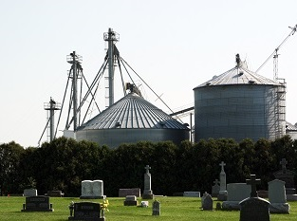

Reduciendo
Riesgos de Entrada al Compartimiento de Granos
29 de julio, 2014, Napoleón, ND
Este fin de semana otro agricultor murió en un accidente de silo.
Es el tercero que ocurre en nuestra área de observación en menos de 6 meses.
trabajadores de emergencia llegaron a las 3:30 p.m. Miércoles, encontraron a Blatti “con sus extremidades inferiores atrapadas en el sistema de sinfín de granos, con maíz rodeando su cuerpo hasta los muslos,” y “con grano adicional que se elevaba 30 pies en el aire inclinándose hacia él.”
se encuentra el cuerpo de Tim Hansen en el fondo de un silo bajo 10 pies de maíz. Tim Hansen había sido un propietario de negocio local, un respondedor de emergencias, y ex jefe de bomberos además de haber cultivado con su hijo por 15 años. El conocía los peligros.
Notes:
Leave the title screen up for a moment and point out the headlines. These are just a few of the headlines yearly in the grain industry. The incident with the auger entanglement occurred in Kane County, Illinois, June 2014. The victim who KNEW the dangers was located in Dixon, Nebraska in July 2014.
Take the opportunity to SURVEY the audience. The grain industry is composed of several subgroups of audiences. Your audience will dictate what areas need to be covered more thoroughly and how to present information. Farm audiences need to be addressed through “Best practices” rather than regulation. Commercial audiences need to understand when an OSHA standard is applicable.
If the participants are mostly workers the information concerning developing policies will not be as applicable as they would not be the ones responsible for their development. However, they should KNOW the policies of the company. Presentation of the slides should center around discussion of their knowledge of the policy & procedures of their employer.
Encourage farmers to use the information to develop simplified policy & procedure that address the main preventive techniques such as LOTO.
Survey the audience
Point out headlines

Slide 3
Introducción
El video y módulo Reduciendo Riesgos de Entrada al Compartimiento de Granos es parte de un programa educativo sobre los peligros encontrados en las áreas de manejo de grano, incluyendo los compartimientos de grano y sus alrededores. Su propósito es ayudar a los participantes a identificar y reducir los riesgos en el lugar de trabajo.
Notes:
Explain this module is part of a series.
Other modules
Overview of Grain Handling Safety and Storage (introductory module)
Lock out Tag out mini module
Entanglement Hazards and Guarding
Falls Hazards and Protection
Grain Bin Entry
Lifeline Protection System
Characteristics of Confined Spaces (in Agriculture)
Curriculum part of a series
Accompanies training video
Have participants complete the pre-test and collect them.

Slide 4
Descargo de Responsabilidad
Este material fue producido bajo el número de concesión SH-27664-SH5 de la administración de seguridad y salud ocupacional, Departamento de trabajo de los Estados Unidos. No necesariamente refleja las opiniones o políticas del Departamento de trabajo de los Estados Unidos, ni la mención de nombres de oficios, productos comerciales u organizaciones implican el aval del gobierno de los Estados Unidos.
Notes:
Explain – GHSC received funding from OSHA. In order to comply with the grant we do need them to sign in and need to collect the following information:
Supervisor or worker. This information is for statistical purposes to show the types of population receiving training.
Employer. This is to establish an employer/employee relationship as covered under OSHA. Volunteer rescue workers who may be attending should list their employer; not the volunteer rescue squad. Farmers should list the registered business name of their farm. Farm employees should provide the business name listed on their paycheck.
OSHA does NOT contact the employer.
GHSC may contact the attendee or employer for follow-up evaluation in compliance with grant requirements.
Explain sign-in sheet.
Explain funding from OSHA

Slide 5
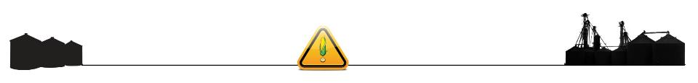
Derechos de los Empleados
Los empleados tienen derecho a condiciones de trabajo seguras y saludables que NO representen riesgo de algún daño severo.
Los trabajadores tienen derecho a un salario justo por las horas trabajadas de acuerdo con la ley.
Notes:
Explain - All DOL grants require that employees are informed of their rights. In this instance we want to emphasize employees are entitled to a safe and healthy working environment AND to fair receive compensation for their work.
Remind employees – it is the employee’s responsibility to follow the safety practices, policies, and procedures of their employers.
Tell participants their rights also include the right to report unsafe conditions to the OSHA hotline without retribution.
More information about employee rights can be found on the OSHA website: www.osha.gov or the Department of Labor website www.dol.gov .
It is ESPECIALLY imperative for youth/young workers to access information and know their rights, what to expect, and how to get help if needed.
Explain employee rights.
Remind employees need to follow company rules

Slide 6
Responsabilidad del Empleador
Los empleadores tienen la responsabilidad de proveer un lugar de trabajo seguro y saludable.
Encontrará mas información sobre los derechos del empleador & los empleados en la pagina web ww.osha.gov.
Notes:
Explain employers have a legal responsibility to provide a safe workplace. This means they must ensure the regulations which govern their business are instituted and followed. This applies to 1 employee or more.
DISCUSS - It is the employers’ responsibility to know the rules and laws – federal and state.
Emphasize – It is employers’ responsibility to ensure employees, know, understand and follow regulations and company policies.
STRESS - If employers are unsure of the regulations they should consult with the appropriate agency. Every state has an on-site consultation program jointly funded by OSHA and the state which provides assistance in learning and complying to the regulations.
The OSHA website provides contact information for each state’s on-site consultation program.
Illinois Department of Labor has the on-site consultation program in Illinois.
Employers should also know and understand the state’s laws as they may be more restrictive than OSHA. Contact the state department of labor.
Explain employer responsibility.
Check with appropriate agency if unsure of regulations

Slide 7
Protección al Denunciante
Los empleadores no pueden castigar o discriminar a los empleados que han utilizado sus derechos para reportar condiciones de trabajo inseguras o insalubres o problemas ambientales ante un empleador, la OSHA, u otra oficina de gobierno. Los empleados pueden llamar, escribir o enviar correo electrónico a la oficina OSHA del área en un plazo de 30 días para reportar actos de represalias por el empleador.
Para información sobre protección al denunciante vaya a ww.whistleblowers.gov
Notes:
Explain - All DOL grants require that employees are informed of their rights. In this instance we want to emphasize employees are entitled to a report unsafe and unhealthy working environments and not be retaliated against by their employer with personnel discipline actions, termination, etc..
Remind employees – it is the employee’s responsibility to follow the safety practices, policies, and procedures of their employers.
Tell participants their rights also include the right to report unsafe conditions to the OSHA hotline without retribution.
More information about employee rights can be found on the OSHA website: www.osha.gov or the Department of Labor website www.dol.gov .
It is ESPECIALLY imperative for youth/young workers to access information and know their rights, what to expect, and how to get help if needed.
Explain whistleblower protection.
Employees have the right to report unsafe or unhealthy work places feel from retaliation

Slide 8
Objetivos de Aprendizaje
Al finalizar este módulo, los participantes serán capaces de:
Identificar actividades que puedan reducir la necesidad de una entrada posterior al compartimiento de granos.
Describir alternativas para la entrada al compartimiento de granos.
Explicar los componentes clave para un proceso de entrada seguro al compartimiento de granos.
Notes:
Introduce the learning objectives. These are the knowledge the participant should acquire as well as tasks or skills they should learn to perform.
Explain – the module was designed to seek interaction from the participants. Questions will be asked throughout to generate discussion.
Encourage – the sharing of ideas, information, experiences so everyone can learn.
Objective explanation for instructor
Objective 1 – activities include harvesting techniques, preventive maintenance, & proper storage of grain – all which maintain grain condition.
Objective 2 – several alternatives including opening/closing sumps; opening second sump; using fans to dry out; using equipment such as grain vacs, compressed air, whips; using a professional.
Objective 3 – Train, Plan, Prepare, before bin entry which are critical parts of the process before the final component of “Act” – entering the bin.
Objectives 4 – the permit or checklist ensures all critical safety issues are addressed before entry – LOTO, grain condition, atmosphere, training, worker protection such as lifeline use. However, it also provides a written record of the entry in case there are problems.
Go over learning objectives with participants.
Encourage participation and discussion

Slide 9
Objetivos de Aprendizaje
Al finalizar este módulo, los participantes serán capaces de:
Explicar el propósito de un permiso/lista de control para la entrada al compartimiento de granos y describir de que trata un permiso.
Notes:
Introduce the learning objectives. These are the knowledge the participant should acquire as well as tasks or skills they should learn to perform.
Explain – the module was designed to seek interaction from the participants. Questions will be asked throughout to generate discussion.
Encourage – the sharing of ideas, information, experiences so everyone can learn.
Objective explanation for instructor
Objective 1 – activities include harvesting techniques, preventive maintenance, & proper storage of grain – all which maintain grain condition.
Objective 2 – several alternatives including opening/closing sumps; opening second sump; using fans to dry out; using equipment such as grain vacs, compressed air, whips; using a professional.
Objective 3 – Train, Plan, Prepare, before bin entry which are critical parts of the process before the final component of “Act” – entering the bin.
Objectives 4 – the permit or checklist ensures all critical safety issues are addressed before entry – LOTO, grain condition, atmosphere, training, worker protection such as lifeline use. However, it also provides a written record of the entry in case there are problems.
Go over learning objectives with participants.
Encourage participation and discussion

Slide 10
Temas a Desarrollar
Comprendiendo la Entrada al Compartimiento
Condiciones y Peligros del Grano
Evitar la Entrada al Compartimiento
    Reducir la necesidad de entrada
    Alternativas para la entrada
Procedimientos SEGUROS de la Entrada al Compartimiento
    Entrenar
    Planear
    Preparar
    Actuar
Repaso
Notes:
Introduce the topics to be covered in this section.
NOTE: the order of this curriculum is slightly different than the video.
Review topics that will be discussed

Slide 11
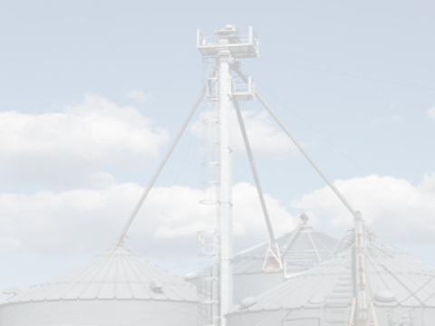
1
Comprenda la Entrada al Compartimiento de Granos
Notes:
This section introduces Bin Entry as a process – a concept that may be unfamiliar to participants.
Workers may not consider the company policies or their training requirements as integral to the task of entering a grain bin.
Farm personnel may not see bin entry as other than a task that needs to be done.
The section talks about the changes in production necessitating the need to change how we THINK about bin entry as well as how we practice bin entry.
Introduce section content
Background material will help gain an appreciation of the need for safe bin entry process
Concept of bin entry as a process and not just a task may be new

Slide 12
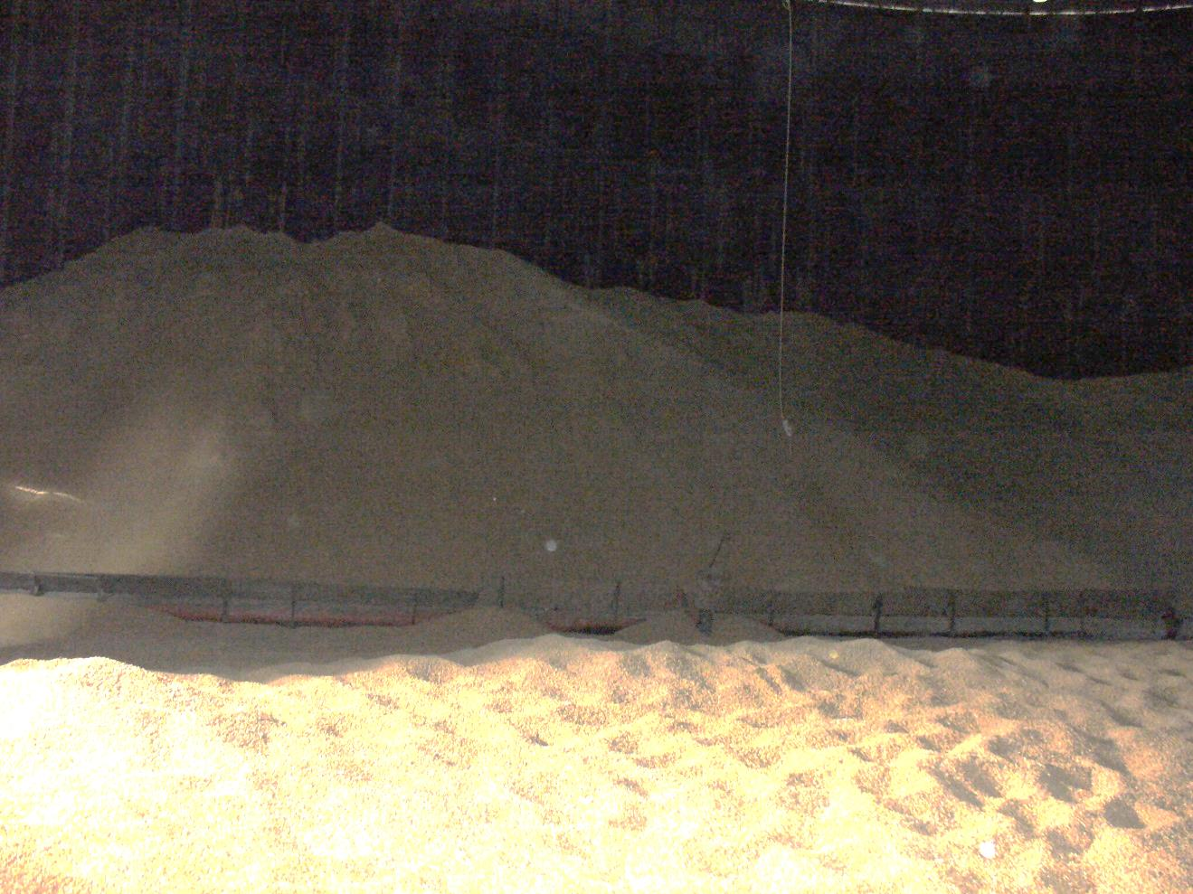
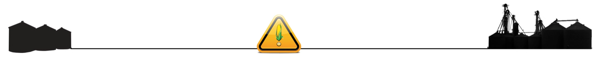
La entrada al compartimiento es el último recurso.
ENTRADA INAPROPIADA
Consecuencias Devastadoras
  Lesiones
  Muerte
  Pérdida de propiedad
Afecta a todas las edades;
niveles de habilidad
EVITABLE
¡UTILICE PROCEDIMIENTOS DE ENTRADA SEGURA RECONOCIDOS!
Notes:
Emphasize – Incidents which occur in the grain environment are PREVENTABLE. The “best practices” shared today are those which will assist in preventing incidents.
ASK – HOW MANY PARTICIPANTS HAVE ENTERED A GRAIN BIN? Has anyone participated in a rescue? Has anyone ever experienced a hazardous situation (entrapment, engulfment, entanglement, fall or other) or known someone who has?
Stress – Bin Entry is a last resort. This may be a new concept to participants.
DISCUSS – Explore participant’s views on the concept of bin entry as a last resort. Ask if they consider it as a last resort to accomplish a task or correct a problem or they consider it as a first alternative. Ask workers to share what they think the company views are on bin entry. Does the company restrict entry?
Explain – the consequence of an improper entry not only affect the worker (entrant) but the employer, co-workers, family, friends, rescue workers and community.
Emphasize bin entry is a last resort
The hazards it poses have a high level of risk if not done properly
Gain an understanding of audience by asking their experience with bin entry

Slide 13
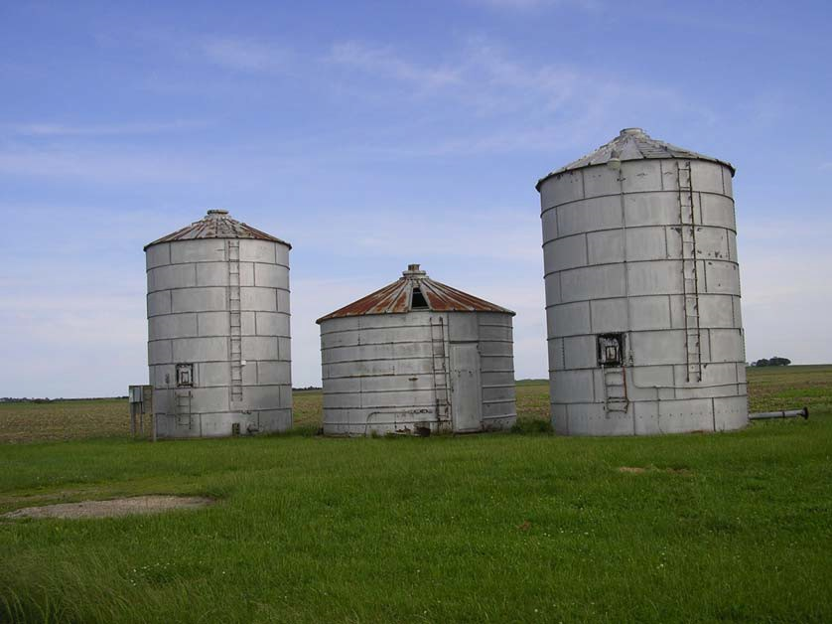
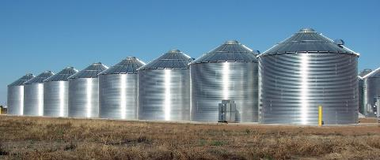
Necesidad creciente de
Prácticas Recomendadas.
El almacenamiento de grano está cambiando:
Compartimientos mas grandes
Se mueve mayor volumen
Las velocidades de llenado y descarga están aumentando
La capacidad de almacenamiento está creciendo
Mayor y mas grande almacenamiento en-granja
Notes:
Discuss - Higher yields as are increasing exposure as more grain is moved, stored and transported. Bins that were constructed for one fill/empty cycle per year may be experiencing multiple cycles. Additionally, grain may be stored longer than originally anticipated and the equipment to monitor the grain while in storage may not be in place.
Stress - Following safe grain bin entry procedures are vitally important now as more grain is moved more often, faster, and storage is bigger.
Farmers are not necessarily bringing their harvest straight to the elevator but may be storing more on-site with larger capacity storage, dryers, conveyors, bucket systems, catwalks, etc. They may not realize handling this kind of volume and using larger more sophisticated systems requires a change in “how business is done”.
Grain storage is changing which is necessitating stronger use of Best Practices for safe bin entry

Slide 14
Colisión de Crecimiento
Producción de maíz 43.5%
Almacenamiento en-granja 11.9%
Almacenamiento fuera de granja 24.6%
Tamaño del silo 133%
Atrapamientos 64.9%
2003-2013
Mediados 60’s hasta hoy
1993-2013
1993-2013
1994-2014
Mas de 2/3 de la capacidad de almacenamiento de EEUU es en-granja
Notes:
Explain - The majority of on-farm storage is exempt from OSHA enforcement. Increasing #’s of entrapments are occurring at these facilities. Best Practices are based on OSHA guidelines and should be followed to protect the farmer and workers even if the facility is exempt.
Explain – At the same time commercial storage capacity is increasing along including mega sized bins. They are storing, moving, and transporting large volumes of grain throughout the country and world.
Corn production has increased 39% in the last 20 years. 1979 had the then highest record of corn production at 7.94 Billion bushels. The 2016 production was 15.15 Billion bushels – Over 37 years that is a 47.59% increase.
Increased production has driven the need for more storage capacity. In the past 20 years, farm storage has increased 22% with 2016 showing an estimated capacity of 13.1 billion bushels. Six states in the US have 59% of the on-farm storage capacity with 3 of those states holding 37.4% - Iowa; Minnesota and Illinois. Off-farm, that is commercial storage increased 17% during this same period with a 2016 capacity of 11.1 Billion bushels. Taking a look back 1980 off-farm storage was a mere 7.12 billion bushels reflecting a 56% storage increase over 36 years. To meet the demand, bins have become larger. Today, mega sized bins can hold over a million bushels compared to the mid-60’s representing a 133% increase in size! Other storage options such as temporary flat storage and ground piles are also gaining popularity.
Culture needs to change in order to bring safe work practices to the farm – especially as they often work alone.
DISCUSS – If this is have a farm audience, discuss throughout the training how to adopt and implement best practices on the farm in a way that is manageable and accounts for working alone. When it is important to ensure there is another person helping with a task – such as bin entry. How can it be done?
Information sources:
Storage capacity and corn production: USDA annual grain stock reports.
Entrapment data: Purdue University PASID
Bin size growth: “How to Properly Address Engulfment Hazards”, 2010 Safety, Health and Environmental Quality Conference, July 28-19, 2010, Omaha NE. Presenter: Wayne Bauer - Director of Safety & Security at Star of the West Milling Co.
Review the information pointing to the growth and rise in engulfments
Engulfments are not the only hazard – has the most complete data

Slide 15
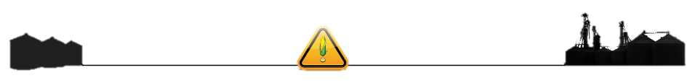
Incidentes de atrapamiento por estado.
1964-2014
Purdue University PASID,
March 30, 2015 (updated)
Notes:
Discuss - Purdue data suggests an upward tend in # of entrapments even though the percentage resulting in death is decreasing.
This is most likely due to several factors – better reporting; more awareness & trng with local rescue teams; availability of grain rescue tubes.
ASK – what other factors may contribute to the trends..
Point out the states with higher engulfment numbers
Disuss why deaths are decreasing though number of entrapments is rising

Slide 16
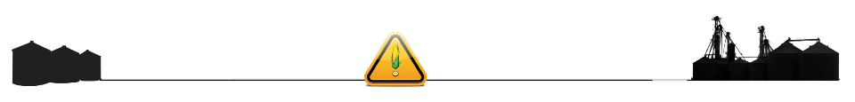
La seguridad es una responsabilidad compartida.
Empleador
Lugar de trabajo seguro y saludable
Trabajador Sigue las reglas y
procedimientos
Gerente
Se adhiere a las prácticas seguras y las hace cumplir
Notes:
STRESS - All persons are responsible for safety.
Employers – need to know their federal and state safety and labor regulations.
Managers – they are the front line people to enforce safe practices. They should be setting the example and standard for the workers to follow. They should also be familiar with safety regulations.
Workers are accountable for following the employer’s rules and procedures. However, if they feel unsafe, they should understand they have the right to address the employer and report the incident to OSHA.
DISCUSS – One of the most important ways to prevent unsafe acts is to ensure job tasks do not conflict with the job role and workers understand & can apply rules & procedures in similar situations. If the worker is having problems doing this, the employer/manager needs to provide additional training & supervision before allowing independent completion of job tasks.
All are responsible for safety
Review the different i

Slide 17
La entrada segura al compartimiento es un proceso planeado.
Supervisores
Trabajadores
Procedimiento de la política o instrucciones de trabajo
Razón para la Entrada
Permiso o Lista de Control
Entrada utilizando Prácticas Recomendadas
Entrenar
Planear
Preparar
Actuar
Notes:
STRESS – SAFE bin entry is a planned process.
Explain - The discussion today will be centered around the entire Bin Entry Process.
EMPHASIZE - Bin entry begins long before the time it is decided to enter a bin. Planning & training need to occur before bin entry. Deciding on entry and preparing for it are part of the latter part of the process. Preparing and acting comes after there are plans in place to help guide the decision making process about whether to enter.
STRESS – it is very important to understand bin entry is not something you “just decide”. Bin entry is a planned response to the need to resolve an issue or accomplish a work task that cannot be done some other way. SAFE bin entry ANTICIPATES and CONTROLS situations.
Planned process – may be a new concept
Planning for bin entry begins prior to any need to enter the bin
4 critical parts – train, plan, prepare, act

Slide 18
Condiciones de Grano & Peligros
1
Formas más comunes en que ocurren incidentes.
Notes:
Explain - Before you can appreciate the bin entry process you have to understand how major incidents occur. How these incidents happen directly impacts the entry process as a safe entry process is meant to avoid these situations.
This section will cover common types of incidents but is not all inclusive.
Introduce section
Understanding relationship between grain condition and hazards is critical to bin entry process

Slide 19
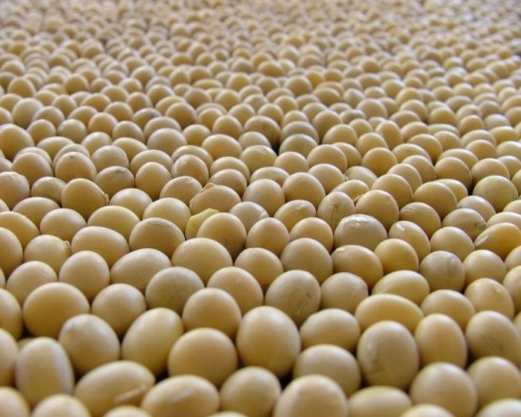
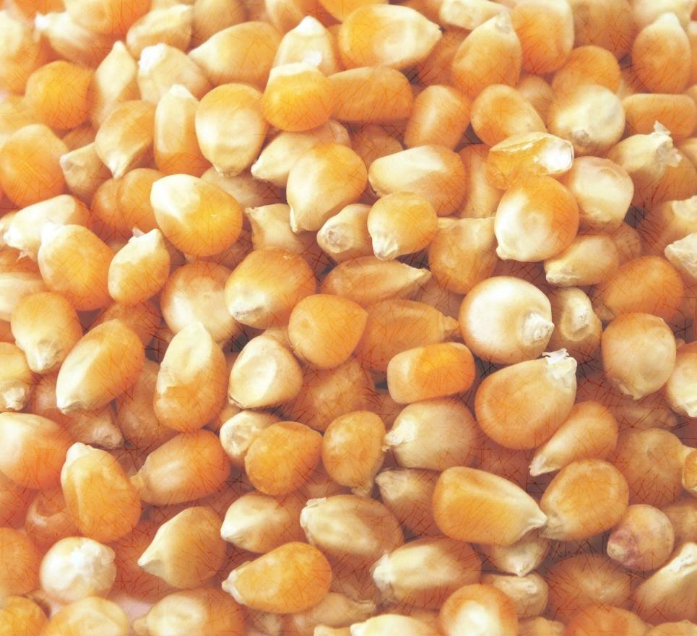
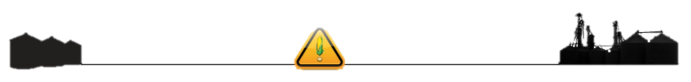
La condición del grano afecta la entrada.
Buena condición del grano
Mala condición del grano
Reduce el potencial de peligros
Disminuye la necesidad de entrada
Crea peligros
Aumenta la necesidad de entrada
Los incidentes ocurren:
Cuando hay peligros presentes
Cuando no se consideran los peligros al hacer tareas de trabajo
La mayoría de los incidentes ocurren con grano en mal estado.
Notes:
ANIMATED SLIDE – Click once for “take home” safety message.
STRESS – Grain condition is the biggest factor in incidents which cause injury and fatalities and is the leading reason people enter the bin. Poor grain condition can create a hazardous environment.
EMPHASIZE - grain hazards are exacerbated when the work tasks being performed do not take know or potential hazards into account and other methods are not used to reduce hazard potential.
ANIMATED SLIDE
Grain condition DOES affect bin entry.
Most incidents occur with out of condition grain

Slide 20
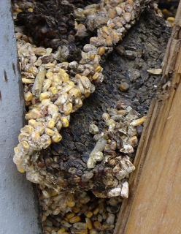
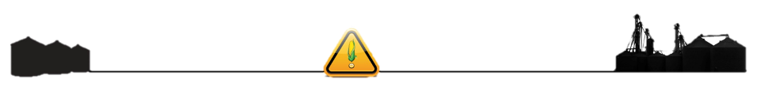
Buen Grano – Reduce la entrada al compartimiento.
Buena Condición
Aroma dulce
Temperatura fresca
Bajo contenido de humedad
Movimiento continuo
Ángulo natural de reposo 22° - 28°
Mala Condición
Olor mohoso, agrio
Temperatura alta
Alto contenido de humedad
Parte superior con costra
Color poco natural
Inclinación poco natural
Notes:
Discuss the indicators of good grain condition and poor grain condition.
Stored grain is an asset and should be properly cared for. Storing grain for a better price later is common, but if the condition of the grain deteriorates it may not be a more profitable course of action especially if it comes at the price of a life.
EMPHASIZE – grain that is in good condition and kept in good condition significantly reduces the need for entry under hazardous circumstances.
Discuss – some will argue there is no need to enter a bin if grain is being properly monitored. Others will say the only way to ensure the grain is staying in good condition is to enter and check it frequently. Ask participants their views and how often they may actually enter the bin.
Review characteristics of grain in good condition vs bad condition
Good condition grain SIGNIFICANTLY decreases need fro later entry

Slide 21
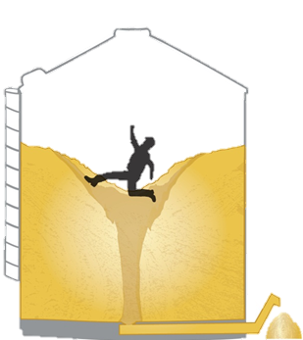
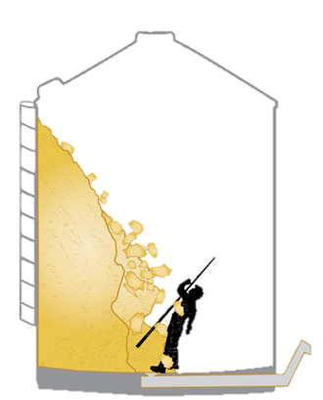
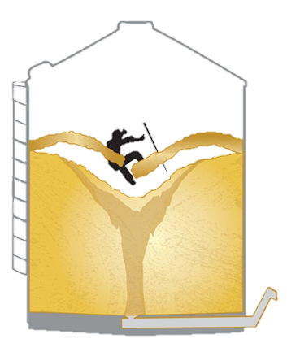
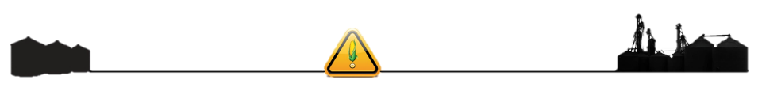
Mal grano riesgo de inmersión.
MAL GRANO
Atasca - sumideros & equipo
  Grano en movimiento
Potencial de avalancha
  Acumulación en pared
  Pirámides, torres
  Cono hacia arriba o hacia abajo
Grano puenteado o con costras
Notes:
Explain - bad condition grain increases engulfment risks. Bins are entered to resolve the problems created by out of condition grain. These problems contribute to or are the hazards associated with bin entry.
Each of the situations above will be explored in more detail
Bad grain can cause sumps & equipment to plug during unloading.
Formations are the typical ways bad grain will manifest in a bin.
Bridging/Crusting
Avalanche can occur with there is sidewall build up, pyramids, cone up or cone down or other types of grain towers.
Introduce hazards caused by poor grain condition

Slide 22
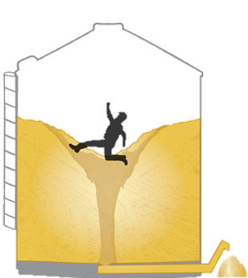
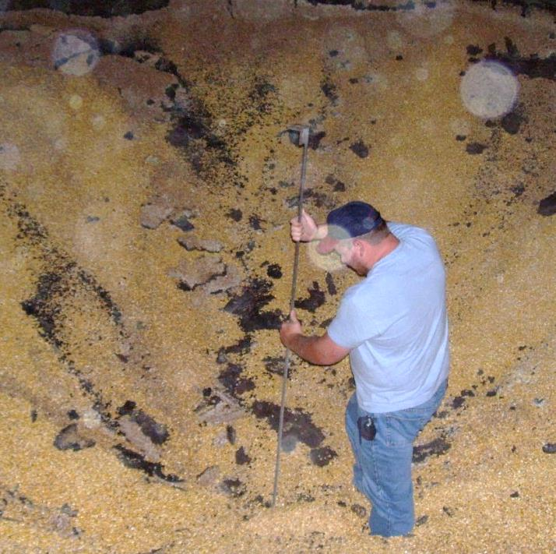
Peligro #1 – Grano en Movimiento
Causa #1 de Inmersión por Granos
CAUSA:
Falta de Candado/Etiqueta (LOTO)
TAREA DE TRABAJO:
Destapar una zona de extracción
“Caminar por el grano”
NUNCA
Entre en el compartimiento cuando el equipo de descarga está en funcionamiento para mover el grano!
El trabajador puede quedar atrapado en segundos!
Notes:
ANIMATED SLIDE – Click ONCE. Text will be replaced with safety warnings. GO through information on screen BEFORE clicking.
Explain how bad condition grain can increase engulfment risks.
Out of condition grain can cause draw off (sumps) & equipment to plug during unloading.
Flowing grain is the danger.
Hazard occurs when unloading equipment is running and the plug breaks causing the grain to start flowing again.
Person in the bin trying to break up the clog gets caught in the flow and quickly sucked down.
Safety
When sumps or equipment is plugged NEVER enter the bin to unclog it by rodding or other means when the equipment is running.
The sudden dislodge of the plug will create instant flow pulling the worker down into the grain within seconds and completely burying in less than a minute – can often result in death.
ANIMATED SLIDE
EMPHASIZE LOTO
Explain it is not the job task but the flowing grain it creates when equipment is running that is the hazard
NEVER enter the bin with equipment running - #1 cause of fatalities.

Slide 23
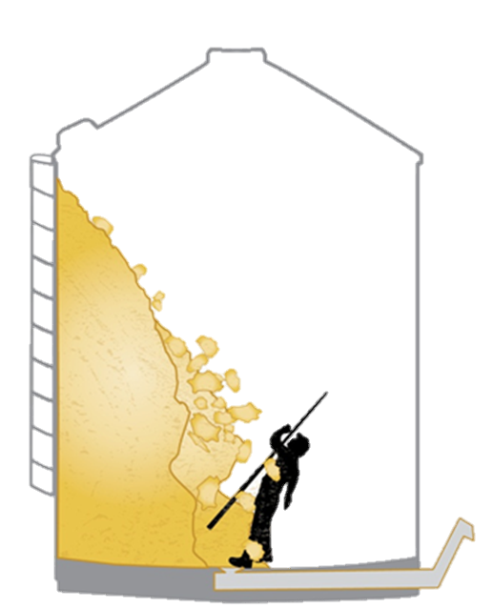
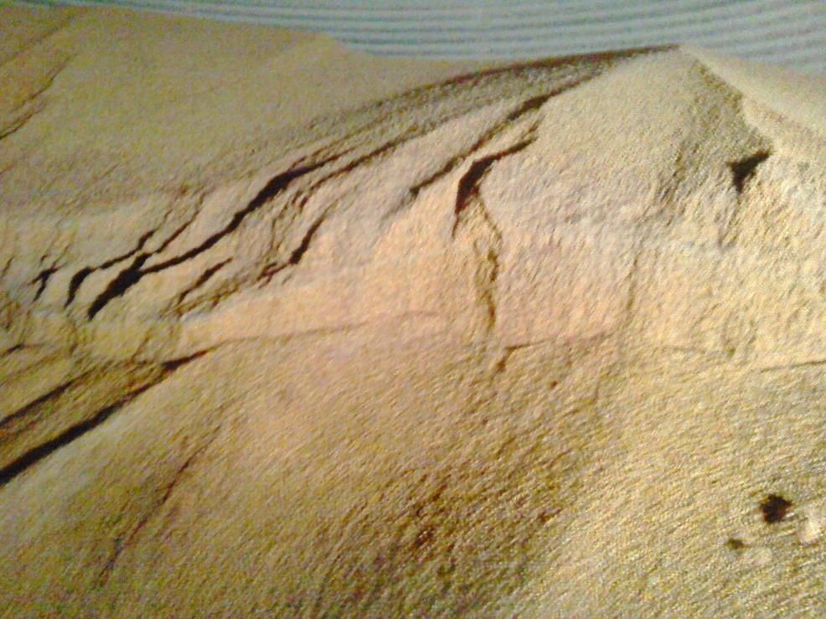
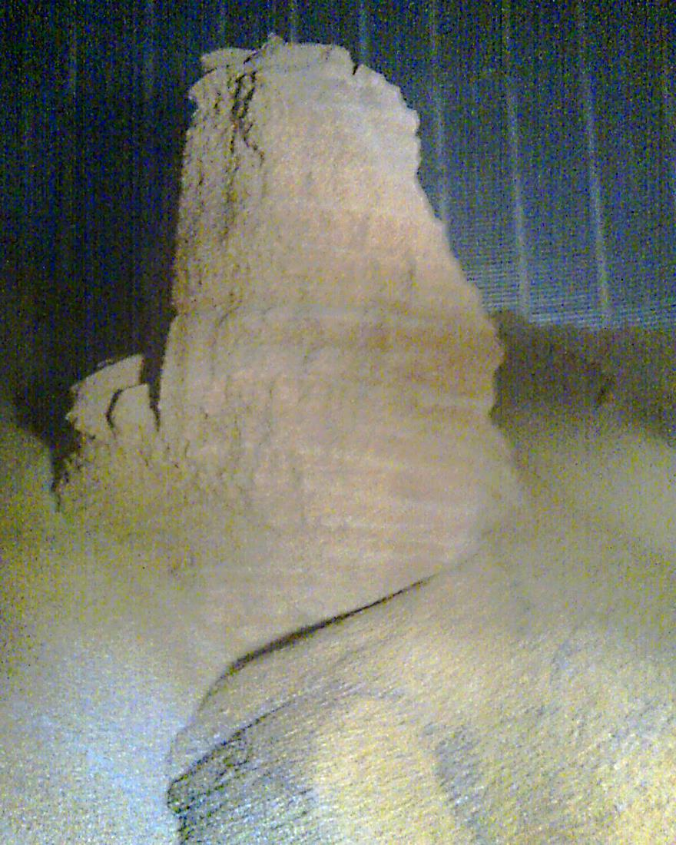
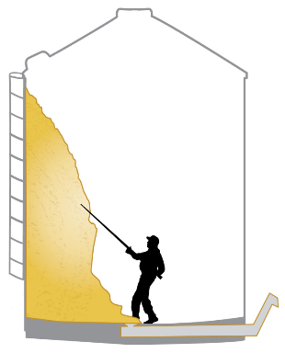
Avalancha – Pirámides y Acumulación en Pared Lateral
CAUSA:
Mala condición del grano
TAREA DE TRABAJO:
Rompiendo la pirámide
Derribando el grano
Mantente SOBRE el grano!
Notes:
ANIMATED SLIDE – Click ONCE. Text will be replaced with safety warnings. GO through information on screen BEFORE clicking.
Knocking down pyramids, towers, and side wall build-up is a common work task.
Towers are formed when the out of condition grain clumps together in masses.
These types of grain structures are deceiving as they may appear to all be crusted and packed. Once a worker breaks through the crust, the inside may be crumbly, causing the pile to quickly dislodge . In other words, dislodging part of the mass can cause the rest to break apart and avalanche down.
WARN - Even a few feet of towering or built up grain can be dangerous when it falls if a worker is below the grain level. The force of the avalanching grain can knock a worker over and render him helpless.
SAFETY – ALWAYS stay above the grain surface and work from the top down on any pyramids, towers, grain clinging to the side.
DISCUSS – Worker went alone inside a nearly empty bin to knock down product from the sides. The grain dislodged and knocked him over burying him in about 3 feet of grain. He was not able to, raise his head, get to his knees or stand up.
ANIMATED SLIDE
Common work task
Invite participants to share experiences of towers or other avalanche hazards they may have seen.
ALWAYS stay above the grain!

Slide 24
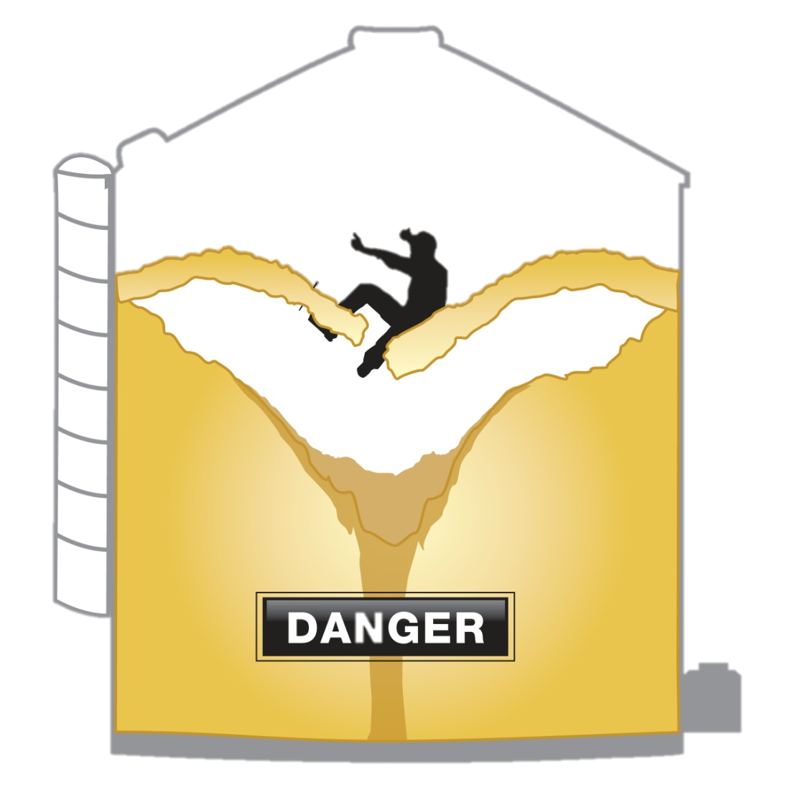
Peligro – Grano Puenteado
CAUSA:
Se forma una cavidad debajo de la superficie durante la descarga
TAREA DE TRABAJO:
Podría ser rutina tal como monitorear el grano
ADVERTENCIA:
Peligro Oculto
Notes:
Stress – Bridged grain is hidden danger as it cannot be seen. Breaking through the crust plunges the worker down and the grain on the sides will quickly flow inward on top of the worker.
Explain - Bridging/Crusting occurs when grain forms a hard crust over a void.
STRESS – Hazard - When stepped on the worker can break the crust and plunge downward into the grain. Gravity will cause the sides to cave inward quickly flowing inward on top of the worker.
Discuss – Indicators of potential bridging conditions:
Crusty surface – normally sink about 12” in good grain – between ankles to knees. If not sinking, sign of problems.
Movement – good grain has a rolling movement.
Angle of Repose – natural angle of repose (how the grain will naturally pile up) is between 22-28° depending on the type of grain. If it appears steeper than the natural angle, it indicates potential problems.
Uneven slopes – Grain and other flowing material normally forms a singular mound or slope. If there are noticeable uneven slopes in the bin, it is an indication of potential problems.
Prior removal not seen – LARGE INDICATOR OF PROBLEM. If grain was previously removed from the bin and it doesn’t look like it, there is great potential for bridging conditions.
SAFETY –When any of these conditions are present and bridging is ALWAYS wear a lifeline to protect against falling into the cavity.
Bridging conditions cannot be seen
They are dangerous because they are hidden.
Lifelines protect against engulfment hazards

Slide 25

¿Cuál es el plan para los peligros?
¿Entras en el compartimiento?
¡QUEDATE
FUERA!
¿Te mantienes fuera?
Notes:
Animated slide. Click once after asking 1st question. Each question and stop sign will appear in timed sequence.
Discuss – What do you do if these hazards are present or may potentially be present in the bin and you have to complete a task? CLICK
The smart choice is “Stay OUT”. However, that still leaves the task to be completed.
INTRODUCE - The next section will explore ways to PREVENT the hazard from occurring – that is “bad grain condition” – reducing the need for future entry. It will also explore ALTERNATIVES to entering the grain bin to take care of problems or ways to take care of the problems more efficiently while in a bin. .
ANIMATED SLIDE
Introduce and emphasize the concept of staying out of the bin.
This flows into the next section on reducing need for entry and alternatives to entry – both ways to avoid the hazards

Slide 26
Mejorar la calidad del grano en la cosecha.
Técnicas de cosecha
Ajuste, combine las velocidades del ventilador, cóncavos, cernedores
Minimizar el material extraño
  Vainas, tallos, granos dañados
  Reducir la formación de grumos
  Disminuir el deterioro
  Evitar tapones posteriores en
  sumideros
  Cribar el grano antes de almacenarlo
Notes:
Explain - How grain is harvested directly affects its quality initially and in the long term – which also impacts profits.
Adjusting harvesting equipment to retain the maximum amount of grain, yet get rid of the most “trash” is one way to improve long term quality during storage.
Trash or foreign material such as pods, stalks, damaged grain, etc. tends to clump together and increase deterioration. These clumps of foreign material are good food and habitation spots for insects, & molds which also lead to more deterioration.
Soybean pods are a good example. The pods tend slide to the outer walls of the bin and pile where they are in contact with higher levels of moisture due to condensation – thus spoiling more quickly and causing deterioration of the rest of the bins contents. When these chunks of spoiled pods break loose they clog sumps and other equipment.
Other foreign material (trash) tends to accumulate in the center of the bin. As it begins to deteriorate, it causes hot spots as air flows is interrupted by the broken grain. .
Another method to reduce foreign material is by screening the grain before putting it in storage. This helps remove the fines which cause grain to deteriorate. Fines can be used for livestock feed.
Discuss – one of the disincentives to screening (or cleaning) grain before storage is the added weight of the fines in market grain. Grain grading, therefore price, is not adversely affected by the foreign material. Market value will however decrease if the grain is spoiled.
Harvesting plays an important role in bin entry especially on farm storage
Reducing the foreign material in stored grain decreases spoilage and loss of product value

Slide 27
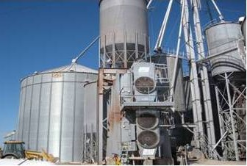
Almacenar el grano apropiadamente.
Secar – niveles de humedad recomendados
Mantener fresco – instalar cables de temperatura
Airear
Revisar el grano con
frecuencia
Extracción por el centro
del compartimiento
  Redistribuir residuos y
  material extraño del centro
Notes:
One the grain is harvested and cleaned it is ready to be put into storage.
Stress - Poor storage and maintenance of the grain is where many of the problems start which lead to bad grain condition.
Dry the grain to the recommended moisture level. Moist grain begins to mold & clump together. Moisture content is 15% for corn, 12% for beans, 19% for wheat.
Use temperature cables to help monitor grain temperature. Hot spots indicate spoilage. Usually keep temperature within 10 - 15° of the outside ambient temperature or to keep grain cool during spring and summer keep it 40-50°. (see below).
Aerate the grain – keep air flowing. Pockets of fines cause disruption in airflow which encourages “hot spots” to occur. Uneven slopes also interferes with uniform air flow during aeration. The surface of the grain should be leveled to allow for better airflow patterns. If condensation builds up inside bin, it can cause the product to become moist and lead to spoilage. Air flow is also needed to help cool hot spots which develop. Take advantage of cool temperatures to aerate.
Check the grain frequently and monitor temperature to indicate when grain needs to be aerated more, moved, or otherwise taken care of. Install temperature cables.
Coring the bin helps redistribute the fines that accumulate in the center.
Agriculture.com 3/19/15 Jessie Scott
The old-school recommendation was to warm the grain to within 10° to 15° of the outside temperature. For the last 20 years, the recommendation has been to keep the grain cool, about 40°F., during spring and summer. Some are now suggesting warming the grain up to 50°F. for storage over summer.
“If you are going to sell by June 1, you can leave grain cold,” says Gary Woodruff, GSI. “If you’re going to bring it up to temperature for a later sell, I’d stop at 50°F. to 60°F.”
Ken Hellevang, North Dakota State University Extension Engineer, recommends keeping the grain near 40°F. “Part of the reason for the lower temperature trend the last several years is that insect infestation and mold growth are going to flourish in the 70°F. to 90°F. temperature range,” he explains. “If you can keep the temperature below 50°F., the insects are dormant.”
Proper storage techniques are the leading factor in grain deterioration.
It does not pay to store wet grain or not monitor it frequently
Coring the bin helps reduce the accumulation of foreign material in the center and is a good management practice

Slide 28
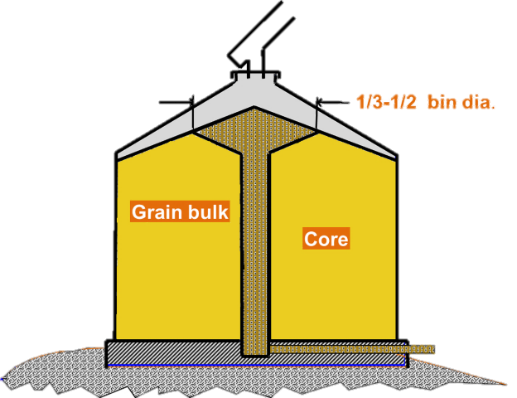
Vaciar por el centro para eliminar residuos del grano.
Remover 5-10% del grano
  Por el centro
Agregarlo de nuevo
Aplanar la superficie
del grano
  Ayudar al flujo de aire
Notes:
Coring the bin after filling it helps remove and redistribute the fines (foreign material) that accumulates in the center and causes deterioration and later plugged sumps.
To core a bin
Remove 5-10% of the grain from the center.
Refill the bin. The fines can be sold for livestock feed or put back in. A distributer at the top of the bin used during loading helps distribute seeds & fines.
Flatten the grain surface to assist with better airflow.
After coring the bin make sure to flatten out the surface to assist air flow during storage
This will help decrease deterioration of the grain

Slide 29
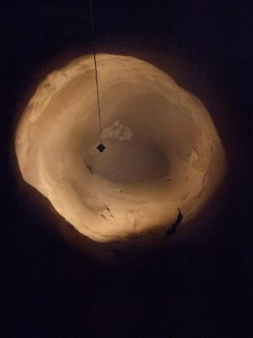
Utilice alternativas en vez de la entrada.
Espere
Encienda ventiladores
Abra y cierre puertas o el 2ndo
sumidero
Llene y vacíe el compartimiento
Empujar el grano con varilla – en túnel
O en el exterior
Aspirar el grano
Aire comprimido
Azotar el grano con látigo hidráulico
Contratar – Un profesional de limpieza de silos
Cortesía de
Pneumat Systems, Inc.
Notes:
Explain – there are many alternatives to bin entry that can be utilized to resolve the issues typically leading to bin entry. The condition or problem that needs to be addressed will help determine the alternative best suited for the needs.
STRESS – the alternatives should be strongly considered or tried before making the decision to enter a grain bin.
They provide a safer alternative than bin entry OR a safer method of completing a task during entry.
In some instances the alternatives may be more effective in resolving the issue or less costly over the long run when personnel and time costs are considered.
One alternative is to just Wait – grain will often fall naturally especially for pyramids, build-up, etc. when it drys out. Many forget this is an alternative to entry as they either don’t have the time to wait or don’t think waiting will significantly resolve the issue.
A second alternative (often used in conjunction with waiting) is to run the Fans to dry out grain and increase air flow to break apart chunks naturally. They may then crumble & fall.
Contract the services of a bin cleaning professional or reclaim specialist. These services have trained professionals and equipment to resolve the issue. When there are large pyramids/towers or side-wall build up or other avalanching conditions, STRONG consideration should be give to using a professional.
Equipment such grain vacs, compressed air, whips assist with make grain flow problems resulting from sidewall build up, pyramids and plugs .
Explain - The next several slides will look more closely at some of the alternatives to bin entry or the use of equipment in performing some bin entry tasks.
The next several slides will look at alternatives to entry or a safer method of accomplishing a work task during entry
Alternatives should be tried BEFORE any entry
Waiting is not a popular choice but should be considered. When used in conjunction with fans it might correct the issue.

Slide 30
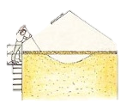
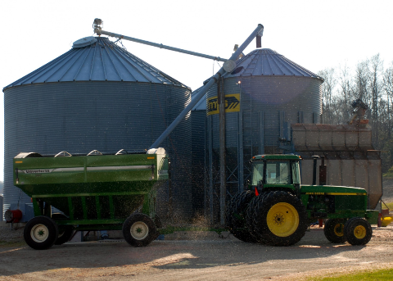
Alternar – llenar y vaciar.
Revise el grano frecuentemente durante la descarga
Sin entrar
Descubra peligros
Encienda ventiladores
Alternar – Retorno de grano y descarga de grano
  Exponer una porción de la pirámide
  Quiebre el grano desde afuera; arriba
clumps, pyramids, side build-up
Notes:
Without entering check grain frequently during unloading to discover any clumping, pyramids, sidewall build-up, etc. when they first appear. This allows for better management of a potentially hazardous situation.
Try to dislodge the problem grain by first using the alternatives listed – least invasive methods first.
Run fans – attempt to dry out the grain so it will crumble and fall naturally.
Alternate between emptying & filling (loading & unloading) grain in the bin. The friction/movement will often help break up the problem grain and avoid having to enter the bin.
If the problem grain persists, unload some of the grain to expose a small portion of the pyramid, sidewall build-up or other problem grain. With the small portion (3-4 ft max) exposed attempt to break up the grain. STAY ABOVE THE SURFACE OF THE GRAIN!!! From the outside, poke at grain with long handle (or extension rod).
Enter as a last resort.
Ensure LOTO is done.
Use harness & lifeline, other appropriate PPE, and all safety measures are taken to enter a bin and break up problem grain.
Picture isb.vt.edu
While unloading grain check it frequently.
If towers appear in the bin or product is clinging to the sides, it is easier to take care of them before they become massive.
Expose a small portion and work from the top down

Slide 31
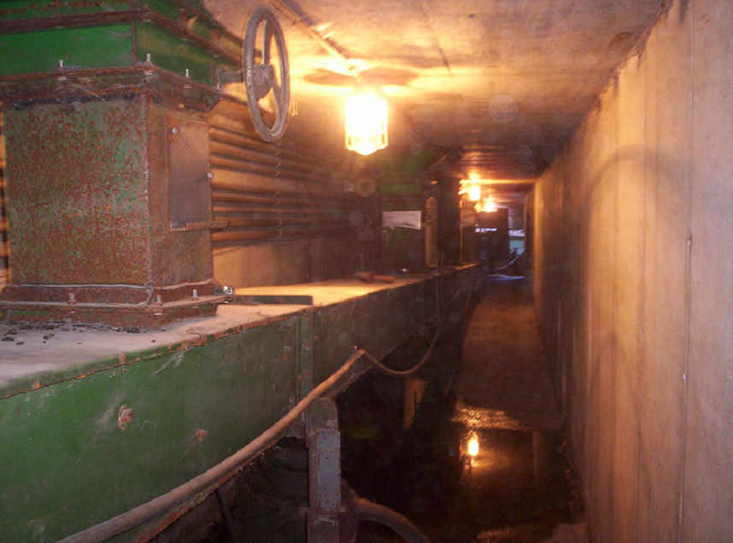
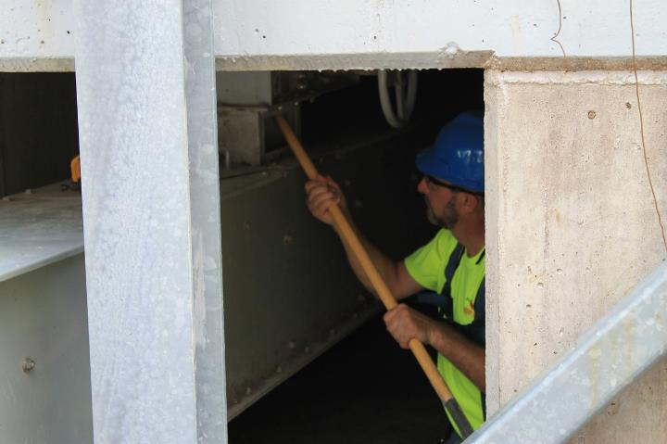
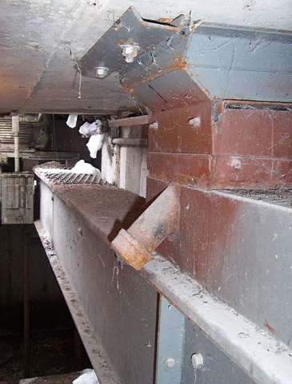
Empujar el Grano con Varilla – DE FORMA SEGURA
Abertura para empujar el grano
Túneles de Recolección
Utilice una vara extensible para alcanzar o golpear el grano
Repita como sea necesario
Notes:
ANIMATED SLIDE – Click once and it changes to show someone rodding from the underneath tunnel.
Rodding to unclog a sump, along with other activities to get grain to flow, are common tasks often associated with entrapments & engulfments.
“Walking down the grain” or other similar activities are prohibited by OSHA.
Rodding the grain by itself poses little hazard if done properly .
Most incidents occur when someone is IN the bin rodding at a clogged sump and the unloading equipment is running. As soon as the rodding dislodges the clog the grain begins to flow entrapping the worker.
PROPERLY RODDING THE GRAIN INVOLVES:
LOTO equipment.
Rodding up through the unload system from outside the bin in the tunnel under the bin.
Rodding down while outside the bin at an access location.
It involves a long pole or other tool to push/poke against the material clogging the hole.
ANIMATED SLIDE
The work task of rodding grain is common.
The task is not dangerous but when done INSIDE the bin with equipment running it is often deadly
Rod from underneath.

Slide 32
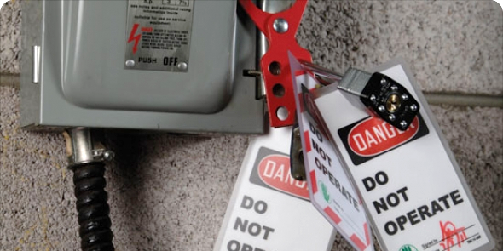
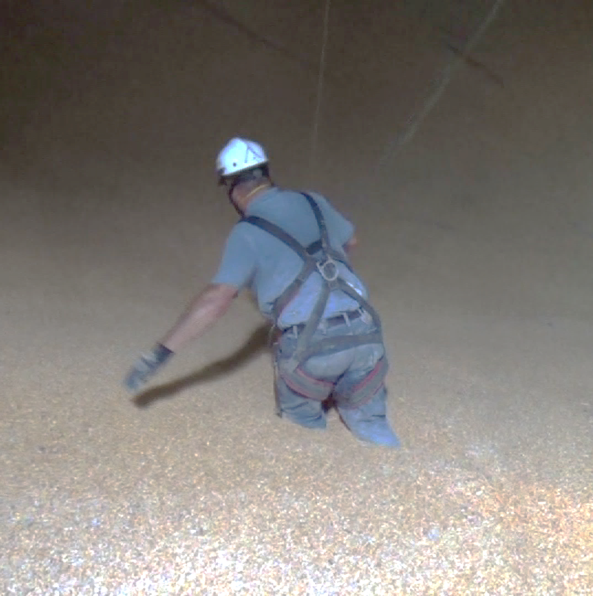
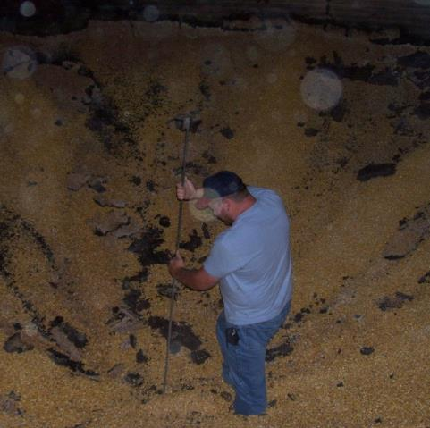
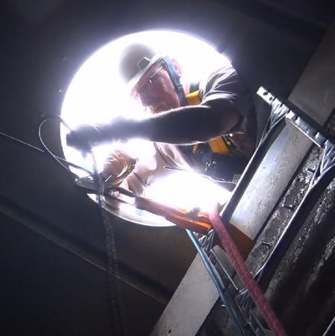
Empujar el Grano con Varilla – Sin túnel
Candado/Etiqueta (LOTO)
Arnés de cuerpo
Cuerda Salvavidas
Observador
Notes:
ANIMATED SLIDE - Click once and the pictures, etc change to safety message.
RODDING FROM INSIDE THE BIN:
If it is impossible to reach the clog from outside or there is no tunnel.
First, LOCK OUT & TAG OUT unloading equipment, gates, loading systems, etc.
The bin entrant MUST wear a body harness and SECURED lifeline.
There MUST be an observer outside monitoring all activity.
If grain is low & entering from side - sump guards must be installed immediately upon entry into the bin.
Workers are never to enter with equipment running!
ANIMATED SLIDE
If you cannot rod from underneath try rodding from the access hatches.
If bin entry needs to occur, LOTO equipment
Enter with a lifeline

Slide 33
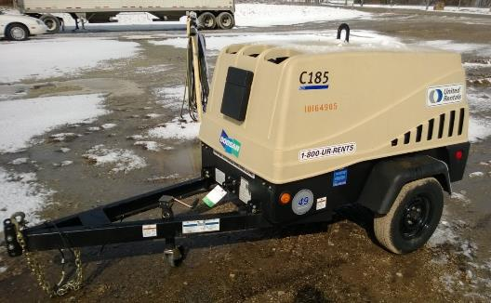
El aire comprimido deshace las pirámides de grano
Mecanismo de control y seguridad
Resguardo contra objetos volantes
Evaluar las necesidades de EPP (Equipo de Protección Personal
Notes:
Compressed air can be effective at breaking up pyramids.
Use of compressed air is covered in OSHA standards and letters of interpretation. The regulations refer to the types of valves and protection against dead ending for over 30 PSI (pounds per square inch). This is to allow for control of the delivery of the air and to avoid injury to worker using the compressed air.
When using compressed air the worker needs to be highly aware of the potential hazards and guard against them
Flying objects - Flying objects could cause serious injury, become embedded in eyes, etc.
Dust - Compressed air can create an excessive amount of grain dust.
Assess PPE needs according to contact with potential hazards
Protection for personal exposure as well as potential ignition sources for suspended dust need to be mitigated.
OSHA references follow:
https://www.osha.gov/pls/oshaweb/owadisp.show_document?p_table=DIRECTIVES&p_id=1742 February 14, 1972
https://www.osha.gov/pls/oshaweb/o197wadisp.show_document?p_id=24112&p_table=INTERPRETATIONS
https://www.osha.gov/pls/oshaweb/owadisp.show_document?p_table=INTERPRETATIONS&p_id=18716 Exception to pressure at 30 psi to a grain elevator
The grain handling standard under 1910.272(j)(3) states “The use of compressed air to blow dust from ledges, walls, and other areas shall only be permitted when all machinery that presents an ignition source in the area is shut-down, and all other known potential ignition sources in the area are removed or controlled.”
Applicable standard is 29 CFR 1910.242(b) states: “Compressed air used for cleaning. Compressed air shall not be used for cleaning purposes except where reduced to less than 30 p.s.i. and then only with effective chip guarding and personal protective equipment.” 1910 subpart M 1910.169 Compressed Gas and Compressed Air Equipment Standard Number:1910.169 Title: Air receivers.
Letter of Interpretation - April 14, 1978 “Enclosed is a copy of the Occupational Safety and Health Administration Program Directive 100-1, dated February 14, 1972. In short, the use of compressed air for cleaning purposes at pressures greater than 30 P.S.I. is permissible, if the outlet or source is fitted with a relief device that drops the pressure to less than 30 P.S.I. if the flow is dead ended. Air guns used with long pipes are acceptable, if they meet the requirements of 29 CFR 1910.242(b).
Compressed air is a good alternative to entry.
It is generally blown from outside the bin
Be aware of other hazards such as flying objects and PPE needs

Slide 34
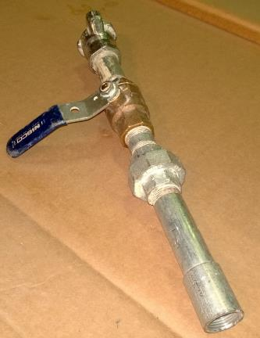
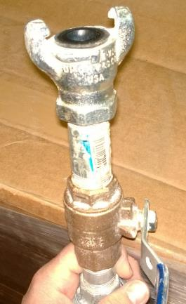
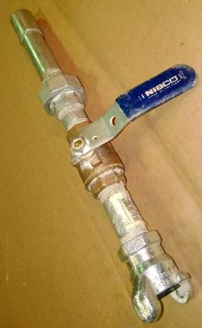
Utilizar el hardware adecuado para el control y la seguridad del aire comprimido
Extremo de control
Extremo de conexión
Extremo roscado para extensión
Notes:
To properly use compressed air it must have the correct hardware for control & safety.
Control & Safety mechanism - outlet or source fitted with a relief device that drops the pressure to less than 30 P.S.I. if the flow is dead ended. Use of a long handle to keep worker from hazard area.
Refer to the Letter of Inertpretation and standards listed on the previous slide.
To use compressed air make sure it is fitted with the correct hardware that allows the worker to control the air.
The correct hardware protects the worker from hazards

Slide 35
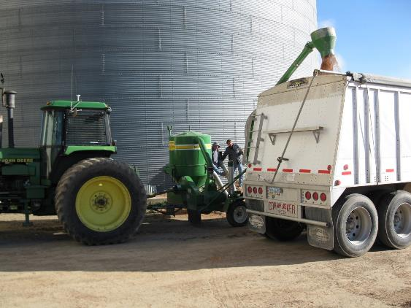
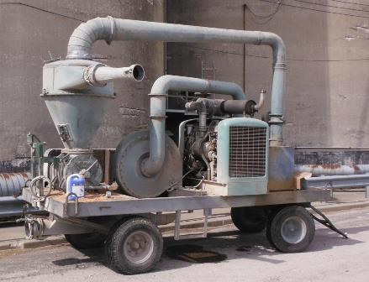
La aspiradora de granos puede librar de peligros
Candado/Etiqueta
Comunicar a la
persona que opera
Notes:
A grain vac can help clear up many problems with out of condition grain as well as quickly empty out grain (such as grain inside a rescue tube).
When using a grain vacuum other safety precautions must be still be completed as the worker is generally using the vacuum inside the bin.
LOCK OUT & TAG OUT all other energized equipment – loading/unloading, gates, etc.
An observer present.
Maintain communication with those operating the vacuum as well as the generator.
Grain vacs are becoming more popular.
A grain vac is used inside a bin – all bin entry safety precautions must be in place for its use – LOTO oberservor, communication

Slide 36
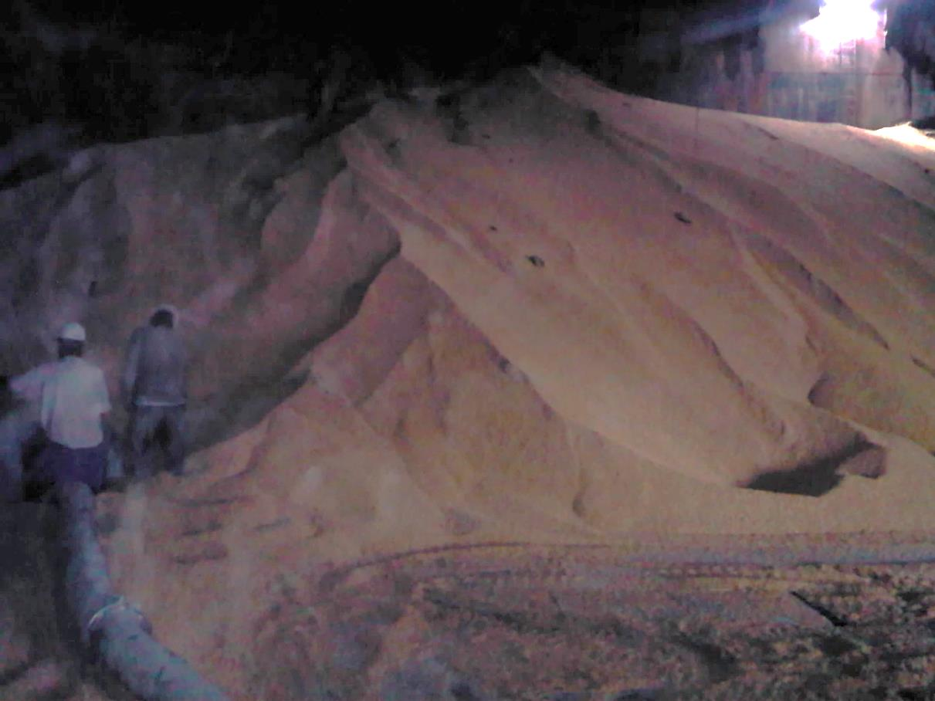
Peligros potenciales de aspirar el grano.
No aspire el grano debajo de una persona o sus pies
Escape de grano
  Aspiradora
  Tractor
  Camión
Evaluar las necesidades de EPP
Notes:
Explain – The use of a grain vac poses other hazards that need to be considered.
Engulfment – vacuum away from area where operator or others are located. Vacuuming from beneath a person, ones’ feet or immediate surrounding area can create an entrapment/engulfment hazard.
Atmosphere – exhaust from the vacuum, tractor & truck can settle in the bin displacing oxygen and creating a hazardous atmosphere.
Dust & other health/safety issues –
The grain vac can create large amounts of dust which can obscure vision, and create respiratory issues.
Workers should wear appropriate PPE when using grain vacs such as googles & dust masks.
Hearing – exposure to prolonged , loud noise. Assess hearing protection needs.
Appropriate footwear, clothes, clothing.
Dust clouds also have explosive potential – training on ignition sources may be necessary.
Be aware of the hazards grain vacs pose when being used.
There have been incidents of engulfment because the grain sucked the grain from underneath themselves or others.
Dust and noise need to be considered as additional hazards.

Slide 37
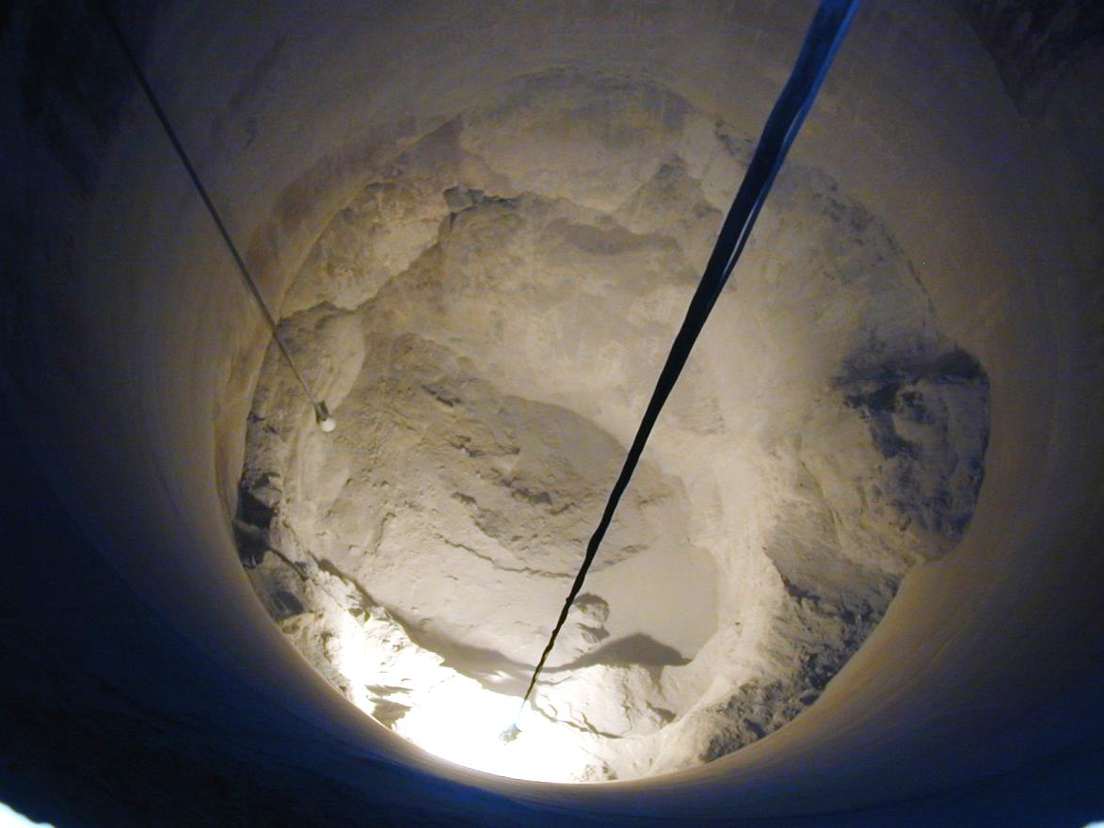
El látigo hidráulico reduce la acumulación y las pirámides de grano.
No requiere entrar
Generalmente es portátil
Evaluar si hay otros peligros
Evaluar necesidades de EPP
Puede crear polvo en exceso
Cortesía de
Sistemas Pneumat , Inc.
Notes:
There are different types of bin whips (pneumatic, hydraulic) available to help clear sidewall build-up, pyramids/towers.
Stress - Whips do not require bin entry. The operator controls the whip from outside. They are lowered from a top access point and usually are portable from one bin to another.
Potential for whip to become entangled with temperature cables although many have a reverse feature to resolve this issue.
Explain - Fall hazards are a consideration. The operator should be protected with a properly guarded platform or other area or be using a personal fall protection system.
Other PPE considerations are dust & noise exposure. Respiratory, eye, and ear protection need to be assessed as well as clothing.
Alternative that does not require entry.
Equipment is portable
Assess hazards for appropriate PPE

