Slide 1
Chemical Hazards in Meat & Poultry Processing & Packing
Hazard Communication, Respiratory Protection, and Process Safety Management
Notes:
This material was produced under a grant #SH-29660-SH6 from the Occupational Safety and Health Administration, U.S. Department of Labor. It does not necessarily reflect the views or policies of the U.S. Department of Labor, nor does the mention or trade names, commercial products, or organization imply endorsement by the U.S. government.
Tell students this information is in Section 5 of the course notebook.

Slide 2
Disclaimer
This material was produced under grant number SH-29660-SH6 from the Occupational Safety and Health Administration, U.S. Department of Labor. It does not necessarily reflect the views or policies of the U.S. Department of Labor, nor does mention of trade names, commercial products, or organizations imply endorsement by the U.S. Government.

Slide 3
Learning Objectives
After completing this module, learners will be able to:
  Identify the main elements of OSHA’s hazard communication standard
  Explain what a respirator is and how the employer requirements differ if respirator use is required or voluntary
  Understand when process safety management standard applies and the main requirements.
Notes:
This section will cover the main points of three OSHA standards, Hazard Communication, Respiratory Protection, and Process Safety Management. Tell the students what section in the course notebook the copies of these slides are located. Also point out any supplementary materials you may choose to include/provide to them on these topics.

Slide 4
Chemical Hazards Present in Food Processing
Detergents and disinfectants
  Alkaline and acid detergents, chlorine, hydrogen peroxide, ozone, quaternary ammonia compounds (”quats”), PAA
Refrigerants
  Ammonia, carbon dioxide
Ingredients and additives
Other: biologicals
Notes:
Workers in Meat Packing Plants, including cleaning crews, are exposed to hazardous chemicals. Potential health effects of chemicals exposures include skin rashes, eye, nose and throat irritation, burns to the skin and eyes from splashes, cough, shortness of breath, and other symptoms, depending on the chemical.
The alkaline agents are the most common.
The acid agents usually are combined in a sequence with the alkaline for a greater scope of cleaning and disinfection.
The chlorinated agents are the most commonly used, in all its formulations, to sanitize. They are always very corrosive and can generate chlorine gas if misused or mixed with other chemicals.
Iodine has been used as an antimicrobial agent from 1880 and remains effective against bacteria, viruses, yeasts and molds.
Clip art graphic of spray bottle; type often used for cleaning products

Slide 5
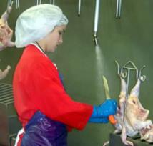
Chemical Hazards of Food Processing - Detergents
Alkaline detergents – sodium hydroxide, nitrous oxide, sodium silicate, trisodium phosphate.
  Frequently used and can vary in strength; have sodium or potassium salts; corrosive
Acidic detergents – hydrochloric acid, sulfuric acid, phosphoric acid, acetic acid
  Vary in strength; corrosive to skin and mucous membranes (e.g., eyes, nose),
  respiratory irritatant
Chlorine – a disinfectant that is sometimes added to water for washing poultry.
  May cause respiratory irritation and breathing difficulties. Can generate chlorine gas.
Hydrogen peroxide – sometimes used as disinfectants. These chemicals may cause eye, nose and respiratory irritation.
Notes:
Each facility must conduct an inventory of the hazardous chemicals present at their workplace. These are some common chemicals used in the food processing industry for cleaning, sanitizing and disinfecting.
Some of these chemicals may have a distinctive smell (ammonia, PAA, acetic acid), while others, (carbon dioxide, carbon monoxide from combustion engine forklifts) have no warning properties at all.
Photo: Worker spray washing poultry carcasses (Credit—CDC/NIOSH, Workplace Safety and Health Topics, Poultry Industry Workers)

Slide 6
Chemical Hazards of Food Processing – Detergents
Ozone —an unstable gas form of oxygen and is a broad-spectrum biocide and disinfects against viruses, bacteria, biofilms, fungi and protozoa. May cause eye, nose and throat irritation, headaches, lung irritation, oxygen deficiency.
Quaternary ammonia (“quats”) – a type of synthetic detergent used in ordinary environmental sanitation of surfaces such as floors, walls, and other surfaces. Has surfactant and disinfecting properties.
Peracetic acid/Peroxyacetic acid (PAA) – may be used as a disinfectant in some poultry processing/meatpacking plants and has been associated with respiratory irritation.
Notes:
These are common detergents or disinfectants used in processing or cleaning of surfaces within the processing plants.

Slide 7
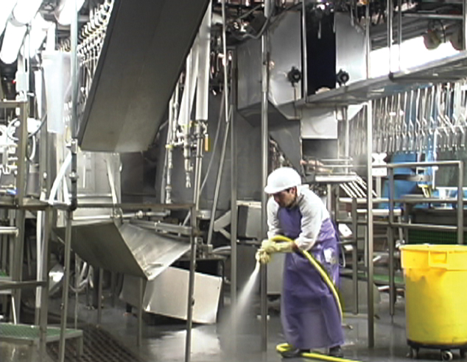
Exposure to Heat and Chemicals
Notes:
Exposure to heat and chemicals may occur during sanitation processes, which is often conducted during third shift, so when fewer employees are working in the areas.
Photo: worker using pressure water hose to clean and sanitize poultry processing area.

Slide 8
Chemical Hazards of Food Processing -Refrigeration
Ammonia – may be used in poultry processing and meatpacking
plants for refrigeration. Ammonia may cause irritation of the eyes
and respiratory tract.
Carbon dioxide – in the form of dry ice, it is used to keep meat cold. Inhaling carbon dioxide can cause an increase in the breathing rate, which can progress to shortness of breath, dizziness and vomiting.
Notes:
Each facility must conduct an inventory of the hazardous chemicals present at their workplace. These are some common chemicals used in the food processing industry for refrigeration.

Slide 9

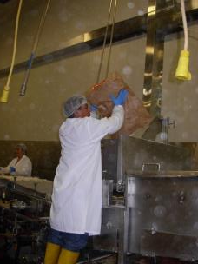
Additional Airborne Contaminants
Food additives
Sensitizers of natural/synthetic origin
Dust from flour, seeds (breading/further processing)
Vapors from preparation or cooked food processes
Particulate from animal cleaning processes or cleaning equipment
Notes:
The food industry generates a variety of pollutants into the air from their various processes. These contaminants may be in the form of powders, aerosols or vapors generated from the handling of main ingredients, addition of food additives, cooking processes, mixing or preparation, or simply as a result of cleaning processes.
Top photo: teaspoons of spices as examples of spices that might be added to breading for further processing of meat or poultry products.
Bottom photo: employees dumping a large back of breading/flour mixture into processing equipment…generating dust.

Slide 10
Hazard
Communication
Standard
29 CFR 1910.1200
Notes:
This standard is often confused by employers who, understandably, assume it applies to ALL hazards. In fact the intent of the standard is to address only “chemicals” in the workplace. However, “chemical” exposure is interpreted to have a wide application. It includes chemicals that are found in containers, as well as chemicals that are not contained. Piped chemicals are included. Raw materials such as steel, wood, concrete can also be included IF work processes—such as welding, sanding, or grinding—cause workers to have an exposure to the chemical contents of the materials. Chemical exposures may also be caused by workplace processes, e.g., operating a forklift produces carbon monoxide. Cleaning, sanitation and disinfection activities may expose workers to harsh chemicals and vapors. Physical hazards (such as UV radiation) or biological hazards (pathogens) are not typically covered by the hazard communication standard----but they are covered by separate standards.

Slide 11
Purpose
To insure that the hazards of all chemical produced in or imported into the U.S. are evaluated
Hazards transmitted to
  employers
  employees
Employees have both a need and a right to know the hazards and identities of the chemicals they are exposed to at work
Notes:
The purpose of the standard is to ensure that the hazards of workplace chemicals are evaluated prior to their entry into the workplace, and that the resulting hazard information is delivered to employers and employees who will be exposed to these hazards. This OSHA rule was first published in 1983, and since that time the standard has been one of the most frequently cited OSHA standards. The standard applies to both general industry and to construction. The standard was revised in 2012 and we will cover those specific changes as well.
Hazard Communication/Chemical Safety: Two of OSHA’s top ten most highly cited topics for food processing facilities, it’s important for employees to be educated on chemicals and how to safely handle them. In food manufacturing, harsh chemicals are used for washdown and other cleaning and sanitation processes.
Top graphic: working in full body protective clothing,SCBA respirator, and gloves.
Bottom graphic: graphic of a drum of flammable material being hit by a hand truck.

Slide 12

Global Harmonization System (GHS)
Implementation Period: December 2013 through June 2016
Standardizes Hazard Classification
Labels: pictograms and warnings
Standardizes Safety Data Sheets
Information and Training
Affects nearly 40 million workers and 5 million workplaces.
Notes:
GHS: aka “Globally Harmonized System of Classification and Labeling of Chemicals”
Final Standard was published March 2012, after several years of background effort. It is a revision to the OSHA Hazard Communication (aka HazCom) standard, and to other standards that reference HazCom.
Implementation Period: December 2013 through June 2016
Uses UN (international) system to CLASSIFY the hazards of chemicals
Labels, Pictograms, and Hazard warnings are defined
Safety Data Sheets are standardized to 16 elements of information that must appear in a uniform order
Employee Training on the revised standard is required
Consistent Classification (both intra- and inter-nationally)
Harmonized across agencies:
OSHA, Consumer Protection Agency, EPA, DOT
Both code Words and Pictograms
Warnings are based on intrinsic hazards of chemicals
Identify the Severity of exposure
Graphic: photo of a hand showing four fingers to illustrate the four main provisions of the GHS 2012 changes to the haz. Comm. Standard.

Slide 13
Basic Program Elements
Written Program
Chemical Hazard Inventory
SDSs (formerly MSDSs)
Labeling
Employee Training
Contractor Training
Hazard
Communication Program
Notes:
The standard requires every employer to have consistent policies covering hazardous materials. These policies MUST be in WRITING, and must cover the topics that are bulleted here. For the audit of an existing workplace, the best place to begin may be with a comprehensive inventory of what chemicals are currently needed for production. Companies tend to accumulate non-essential chemicals over time, and the inventory is a chance to purge these. For larger facilities, supervisors can provide inventories in their respective areas. During the inventory, identify any improperly labeled chemical containers. Use the inventory to assure that the company has an Safety Data Sheet SDS (previously referred to as Material SDS or MSDS) for every chemical on the inventory. Employees must have ready access to these SDS’s. In whatever manner the SDS files are stored (paper/electronic) employees must be capable of accessing the files, in an unimpeded manner, such as may be necessary during an emergency, or for whatever purpose an employee may deem necessary (e.g., for a personal medical evaluation). The hazard communication policy must cover independent contractors. Such contractors must identify the chemicals they will bring with them into your worksite, and the host employer must inform the contractor of what chemicals they will be exposed to when working at the host company site.
Graphic: three-ring binder with words “Hazard Communication Program” on cover.

Slide 14
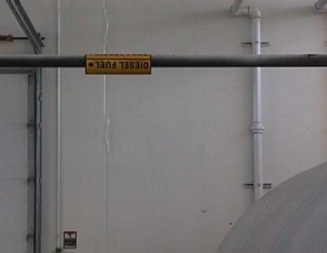
Written Program
  A list of the hazardous chemicals known to be present at the facility along with SDS’s for each chemical
  The methods the employer will use to inform
  employees of the hazards non-routine tasks
  The hazards of chemicals in unlabeled pipes
Notes:
The list of hazardous chemicals may be compiled for the entire facility or by individual departments, as long as all chemicals are included.
Give examples of non-routine tasks employees might do: quarterly/annual preventative maintenance on machines, etc.
Under GHS employers are permitted to use color coding to identify chemicals in pipes. Pipes are not required to be labeled with HCS labels because they are not considered “containers” under the HCS. Employees must be informed of and trained on the hazards associated with chemicals in unlabeled pipes, and the measures employees can take to protect themselves from these hazards.
Photo: Labeled pipe (“Diesel Fuel”) running through a work area.

Slide 15
Workplace Labeling
The employer must ensure that each container of hazardous chemicals in the workplace is labeled, tagged or marked with either:
  The label information on the shipped container, or
  Product identifier and words, pictures, symbols, or combination providing general information on the hazards of chemicals
Labels must be legible, in English (although other languages are permitted as well), and prominently displayed on the container
Notes:
The label that the manufacturer or distributor has affixed on a container should be compliant with the haz. comm. labeling requirements. The employer is required to ensure that these labels remain legible and are not removed. When transferring chemicals to other containers, the items listed above must be included.
Note: there is an exception to labeling of portable containers that are intended only for the immediate use of the employee who performs the transfer into the portable container.

Slide 16
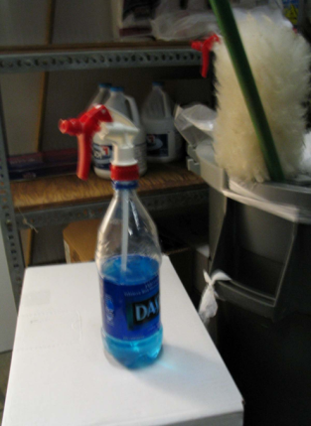
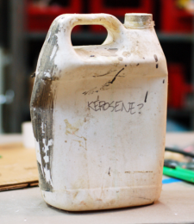
Secondary Labels
OSHA is maintaining the current approach to allowing alternatives to labels on each stationary process container.
The exception for portable containers under the control of the person who filled them with the chemical remains the same.
Notes:
From the Haz. Comm. Std, Definitions section
Re: labeling exception for portable containers:
Immediate use means that the hazardous chemical will be under the control of and used only by the person who transfers it from a labeled container and only within the work shift in which it is transferred.
Photos show two portable containers that are not compliant with the labeling requirements of the hazard communication standard.
Top right (Dasani® water bottle filled with blue liquid and spray nozzle attached): Point out that facilities should never allow the use of food containers for storing any type of chemical. Clearly this bottle does not contain water anymore!
Also, point out label on bottom container—(gallon bottle with “Kerosene?” written in marker on the otherwise unlabeled container). It appears that the original label was removed, but the question mark means that the person who labeled it doesn’t actually know what the container contains. Portable containers must be labeled with the identity and hazards of the chemical (e.g., Kerosene, Flammable, may be fatal if swallowed and enters airways. Skin Irritant. May cause drowsiness or dizziness.)

Slide 17
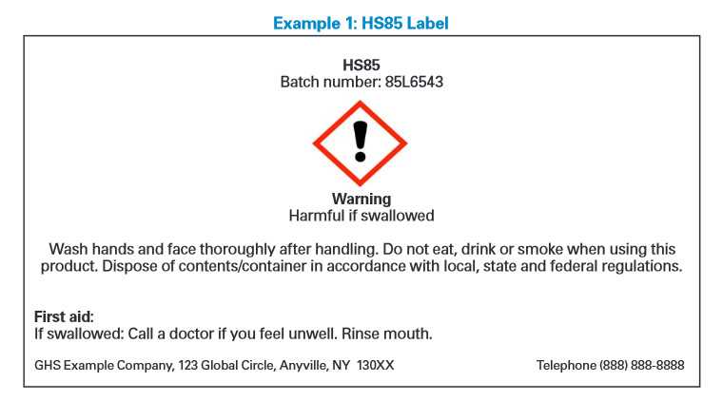
Example of GHS Simple Label
Notes:
Use a pointer to point to label elements;
Product identifier
Signal words
Hazard statements
Pictograms
Precautionary statements
Name, address, and telephone number of the chemical manufacturer, importer, or other responsible party

Slide 18
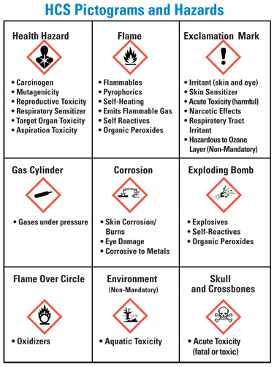
Pictograms
Notes:
This slide displays all nine GHS pictograms. But as previously stated, OSHA is only requiring eight of them (the Environment pictogram is non-mandatory).

Slide 19

Employee Information and Training
Employers must provide employees information and training on hazardous chemicals in their work area:
  At the time of their initial assignment
  Whenever a new physical or health hazard
  the employees have not previously been
  trained about is introduced into their work area
Training may cover categories of hazards
Notes:
If there are pipes or piping systems containing hazardous chemicals within employees’ work areas, the employees must receive effective information and training on these hazards as well. This must include
information on the pipe,
the coding system and,
any other labeling requirements established by other standards that address pipes and piping systems,
the hazards of the chemicals in those pipes,
the methods used to detect a leak from those pipes, and
methods the should follow in the event the pipes leak or rupture.
Workers who are assigned to work on such pipes should also be trained on how to protect themselves from the hazards of the chemicals in the pipes.
It’s critical that employees are educated on the chemicals they handle in the production and cleaning processes. Companies should update their company policy and internal chemical inventories, revise container labeling and material safety data sheets, and provide training on these revisions and the HazCom standards.
Graphic: drawing of instructor with flip chart teaching employees

Slide 20
Required Employee Training
OSHA standard covered
Operations in their work area where chemical is used
Pictograms
Location of program, list of chemicals, and SDS
Detection of chemical
Hazards of chemical
Protection measures
Emergency procedures
Labeling system used
Notes:
It is important to document training and include:
date of training
Who conducted the training
Topics covered
Use an SDS for a hazardous chemical used in your facility in the training. It will increase the relevance of the training information to the employees.
Also, require completion of a quiz to verify employees understood the training. Go over items that students did not completely comprehend or remember. Recommend having a sign-in sheet (with employee signature) to document who attended the training.

Slide 21
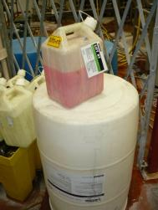
Temp Workers and Hazard Communication:
Shared Responsibility
Staffing Agency
  Generic Policies
Host Company
  Specific Chemicals
Hazard
Communication Program
Notes:
Since these industries often utilize temporary workers, briefly explain the shared responsibility of staffing agencies and host employers for ensuring compliance with the hazard communication standard (and other standards!) (Note: Next slide provides discussion points on who is best suited to provide this information).
Question/discussion for class.
What are the experiences of the class with respect to implementing this standard for temporary workers?
Does the OSHA standard define what compliance expectations are for the host/staffing agency arrangement?
Generic HazCom Training
How to read SDS
Labeling requirements
Pictograms
Elements of HazCom Standard
SDS maintenance
Workplace labeling
Worksite Specific HazCom Training
Chemicals in use
Methods of detection and prevention
Emergency procedures
Written HazCom Program
Graphic: three-ring binder with words “Hazard Communication Program” on cover.
Photo: Storrage room containing cleaning and sanitizing chemicals with close up of 55 gallon drum of sanitizing liquid with 5 gallon bottle of same chemical with label zip tied to the handle.

Slide 22
Shared Responsibility Example:
Hazard Communication
Host employer holds the primary responsibility for training because the host employer:
  uses or produces chemicals
  creates and controls the hazards
  best suited to inform workers of chemical hazards specific to the workplace
The staffing agency maintains a continuing relationship with its employees, and is, at a minimum, expected to inform employees of the requirements of the standard.
Notes:
Elaborate on the reasons why both staffing agencies and host employers have a shared responsibility for ensuring compliance with the hazard communication standards. Also point out which elements of the standard could be implemented by which employer.
Staffing agency: educate its employees on the requirements of the standard and that the employees should expect to be trained by the host employer on 1) the hazards of the chemicals to which they will be exposed; 2) locations of safety data sheets at the facility and how to access them; 3) what PPE they must wear to protect themselves from exposure to chemicals AND where to access the PPE when they need more; 4) what to do in case of exposure to a chemical (i.e., location of eyewash/drench shower stations, where first aid kits are located), who to report the incident to). Some of these requirements include elements of other standards (i.e., First aid).
Host employer: provide the information included in numbers 1-4 above BEFORE the employees begin work. All the elements listed on slide 23 must be covered.

Slide 23
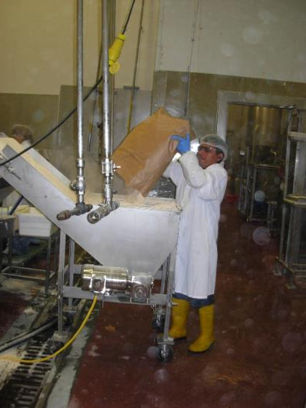
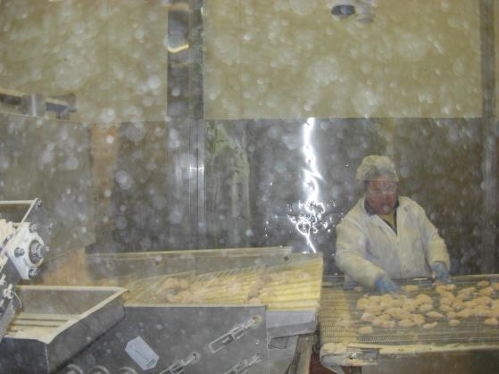
What is hazardous in these photos?
Notes:
These photos may be used for interactive discussion in the course.
These are photos taken from food processing facility. The material in the air is breading material (e.g., flour, spices, etc.). Here’s an opportunity to discuss that while there is no OSHA occupational exposure limit for “breading material,” that there still can be overexposures to total dust materials (also referred to as “particulate not otherwise regulated), and that those components can make employees ill. Discussion of best practice versus legally enforceable. Should also point out that flour and spice dust is combustible (not something we will cover in this course, but another hazard present in the workplace that should be communicated to the employees working there).

Slide 24
What’s a Respirator?
Notes:
Discuss and show actual examples of surgical masks, one-strap masks, bandanas, NIOSH-approved N95s, and half mask respirators. Reference the Letter of Interpretations.
https://www.osha.gov/pls/oshaweb/owadisp.show_document?p_table=INTERPRETATIONS&p_id=28565
https://www.osha.gov/pls/oshaweb/owadisp.show_document?p_table=INTERPRETATIONS&p_id=25342
These letters are both included in the Reference Section.
Spend adequate time defining what a respirator IS (including N95s) and what is required if their use is required. If possible, have some examples to show the students.

Slide 25

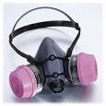
Written Respirator Program Elements
Selection of respirators
Define use and application
Medical evaluation
Fit testing
Training
Maintenance and care
Breathing air quality and use (air supplied respirators)
Program evaluation
Notes:
1910.134(c)(1)(i)
Respirator programs must be WRITTEN and SITE-SPECIFIC. If you use a template or model program, or one from another facility, review it carefully to ensure it is site-specific.
Take this opportunity to explain the difference between a nuisance dust mask (non-NIOSH approved), an N95 (or higher) dust mask (top photo), and an elastomeric/cartridge style mask (bottom photo). Many employees in industry wear dust masks to protect themselves from solvent vapors or other nuisance odors. Employees must understand that dust masks protect against dust or particulates ONLY.

Slide 26
Voluntary vs. Mandatory Respirator Use
1910.134 Respiratory Protection requirement | Voluntary use of dust mask | Voluntary use of elastomeric negative-pressure respirator | Mandatory use of dust mask or cartridge respirator
Written respirator program | No | Yes | Yes
Medical evaluation | No | Yes | Yes
Fit-testing | No | No | Yes
Annual training | No | No | Yes
Appendix D | Yes | Yes | No
Clean, inspect, maintain, store | Yes | Yes | Yes
Notes:
The table on this slide details the OSHA requirements when respirator use is required (i.e., mandatory) versus voluntary.
If an employer requires the use of a respirator (either because the company chooses to require its use OR employees are exposed to a contaminant over the OSHA limits (PEL=permissible exposure limit or STEL=short-term exposure limit) – including a disposable filtering facepiece or “N95 dust mask” – you must comply with the respirator standard (29 CFR 1910.134). If an employer allows employees to wear respirators on a voluntary basis, the requirements that apply depend upon the type of respirator worn by the employee…dust mask (i.e., a filtering facepiece) vs. elastomeric negative-pressure cartridge respirator (refer back to the previous slide to show the two types of respirators).

Slide 27
Process Safety Management (PSM)
29 CFR 1910.119
Notes:
Ammonia refrigeration systems with 10,000 pounds or more of ammonia are a covered process subject to the requirements of the OSHA Process Safety Management (PSM) standard.

Slide 28
Process Safety Management (PSM) in Meatpacking
  Purpose:
    Prevent unwanted releases of hazardous chemicals
  Applicable if facility has ammonia refrigeration systems with 10,000 pounds or more of ammonia.
      This amount is known as threshold quantity (TQ)
    Systems that are co-located or located in close enough proximity such that loss of containment of one system could impact other systems must be considered in the aggregate.
Notes:
The major objective of the PSM is to prevent unwanted releases of hazardous chemicals, especially into locations that could expose employees and others to serious hazards.
PSM requires the following:
If your facility is covered by the PSM standard, you need a team of engineers and employees to generate a set of procedures. This provides a very brief introduction to PSM in ammonia refrigeration. Ammonia refrigeration is covered by PSM if an ammonia refrigeration system contains 10,000 pounds or more of ammonia. Generally the maximum capacity of the system is used for the determination of threshold quantity (TQ). Systems that are separate but co-located, i.e., sharing the same engine room, are to be considered in the aggregate because a failure in one system would jeopardize containment in the other system.
The PSM standard explicitly states that employee participation in establishing and operating a PSM program is an expectation and requirement.
Even if a system has a capacity less than 10,000 pounds and is not covered under the PSM standard, the company is still required to have procedures and training on the system to maintain containment and employee safety.

Slide 29
Process Safety Management (PSM) in Meatpacking
Requirements include:
  Process Safety Information
  Process Hazard Analysis (PHA)
  Operating Procedures
  Employee Training
  Emergency Preparedness, and more.
Notes:
Process safety information: Employers must compile written process safety information as a prerequisite to conducting a process hazard analysis. This includes information concerning process chemicals (e.g., toxicity information; permissible exposure limits), process technology (e.g., chemistry; safe upper and lower limits for items such as temperature, pressures, flows, or compositions), and process equipment (e.g., ventilation system design; safety systems).
Process Hazard Analysis (PHA): The PHA is an organized and systematic effort to identify and analyze the significance of potential hazards associated with the processing or handling of highly hazardous chemicals. It is directed toward analyzing potential causes and consequences of fires, explosions, releases of toxic or flammable chemicals, and major spills of hazardous chemicals. The PHA must be updated and revalidated at least every 5 years.
Operating Procedures: Employers must develop and implement written operating procedures that provide clear instructions for safely conducting activities involved in each covered process, consistent with the process safety information. These often are viewed as the standard operating procedures (SOPs) for operations.
Employee Training: All employees involved with processes involving ammonia use, including maintenance and contractor employees, need to be appropriately trained. 8/ Training must include an overview of the process and the operating procedures, as well as an emphasis on the specific safety and health hazards, emergency operations (including shutdown), and safe work practices. Refresher training must be provided at least every 3 years and training must be documented.
Emergency Preparedness: Employers must implement an emergency accident plan for the entire plant in accordance with 29 CFR § 1910.38.
There are additional items including pre-startup safety review, mechanical integrity (which will be discussed in the next slides), incident investigation, and compliance audits. A workshop using the worksheet included with these materials may be used at the end of this section to reinforce the PSM information provided.

Slide 30
Process Safety Management (PSM) in Meatpacking
The mechanical integrity (MI) of the ammonia system MUST be maintained and documented.
  MI includes OSHA regulations, standards incorporated by reference, governing codes (ANSI, ASTM, CGA, NFPA, AISC, etc.), and Recognized and Generally Accepted Good Engineering Practice (RAGAGEP).
  MI includes
    selecting equipment,
    inspection and testing,
    quality assurance,
    equipment deficiency management,
    program development, and
    continuous improvement of MI program.
Notes:
The mechanical integrity of a system must be maintained and documented. The company must determine and select the correct governing code that will be used for establishing the MI program. A written program is required that defines and establishes the basis for selecting equipment, inspection and testing, quality assurance, equipment deficiency management, program documentation, and the continuous improvement of the MI program.

Slide 31
Process Safety Management (PSM) in Meatpacking
Management of Change (MOC) is
  a process for evaluating and controlling modification to facility design, operation, organization, or activities – prior to implementation – to make certain that no new hazards are introduced and that the risk of existing hazards to employees, the public, or the environment are not knowingly increased.
-- CCPS Guidelines for Management of Change for Process Safety, Wiley, 2008.
  Must establish and implement written procedures to manage changes except "replacements in kind" for a covered process.
  If a change in design or components is required, management of change must be employed, tracked, and analyzed.
Notes:
MOC is a critical aspect to PSM that can ruin an otherwise fine program if not established and followed properly. MOC is a process to make changes to the covered process in a controlled, thought out process so that the PSM system is not compromised. There must be written MOC procedures to manage changes. “Show your work” – when MOC is required, utilize established procedures to analyzed the change and track the changes. MOC requirements can also apply to employee changes, like the retirement of key personnel that are the repository of critical knowledge of the system, such a long-term maintenance supervisor.

Slide 32
Process Safety Management (PSM) in Meatpacking
Operating Procedures - The employer shall develop and implement written operating procedures that provide clear instructions for safely conducting activities involved in each covered process.
Operating procedures must include the following phases:
  Initial start-up
  Normal operations
  Temporary operations
  Emergency shutdown
  Emergency operations
  Normal shutdown
  Start-up following turnaround
  Consequences of deviation
  Steps required to correct or avoid deviation
Notes:
PSM operating procedures are the instructions by which employees will safely operate the system. They also provide information for employees to identify when the system is not operating properly and the proper actions to take.

Slide 33
Process Safety Management (PSM) in Meatpacking
PSM Program must include Safe Work Practices
Lock-out/Tag-out
Confined space entry
Line Opening process equipment or piping
Hot work
Control of entry into facility or engine room by employees, maintenance, contractors, or other support personnel
Notes:
A PSM program must include the use of safe work practices such as: LOTO, confined space entry, line opening process for equipment or piping, hot work, and the control of entry into the facility or area of the covered process (areas of system control like the engine room). The company must know who is in or around a covered process.
OSHA has a Plant Safety self inspection checklist within their eTool for Ammonia Refrigeration:
https://www.osha.gov/SLTC/etools/ammonia_refrigeration/safety/plant_safety.html
Graphic: line art of pipe and valve

Slide 34
Evaluation:
Summary of Hazard Communication, Respiratory Protection, and PSM
What are the typical hazardous chemicals encountered during poultry processing/meatpacking?
Name the four GHS changes to the Hazard Communication standard
Name six basic elements of a hazard communication program
Notes:
Typical Hazardous chemicals: detergents, disinfectants, ammonia chlorine
GHS
Standardizes Hazard Classification
Labels: pictograms and warnings
Standardizes Safety Data Sheets
Information and Training Updates
Hazard Communication Program elements
Written Program
Chemical Hazard Inventory
SDS’s (formerly MSDS’s)
Labeling
Employee Training
Contractor Training

Slide 35
Evaluation:
Summary of Hazard Communication,
Respiratory Protection, and PSM
What are the requirements for an employer if respirator use is required versus voluntary?
Explain the purpose of the PSM standard.
Name the threshold quantity of ammonia that triggers PSM.
Notes:
What are the requirements for an employer is respirator use is required versus voluntary?
The major objective of the PSM is to prevent unwanted releases of hazardous chemicals, especially into locations that could expose employees and others to serious hazards. Requirements include:
Process Safety Information
Process Hazard Analysis (PHA)
Operating Procedures
Employee Training
Emergency Preparedness, and more
At what threshold quantity of ammonia triggers PSM?
10,000 pounds of anhydrous ammonia

