Slide 1
Poultry and Meatpacking Worker Safety
Notes:
The material was produced under grant number SH-29660-SH6 from the Occupational Safety and Health Administration, U.S. Department of Labor. It does not necessarily reflect the views or policies of the U.S. Department of Labor, nor does mention of trade names, commercial products, or organizations imply endorsement by the U.S. Government.

Slide 2
Disclaimer
This material was produced under grant number SH-29660-SH6 from the Occupational Safety and Health Administration, U.S. Department of Labor. It does not necessarily reflect the views or policies of the U.S. Department of Labor, nor does mention of trade names, commercial products, or organizations imply endorsement by the U.S. Government.

Slide 3
Introduction to Ergonomics
Learn the proper use of equipment, tools, and machine controls;
Recognize early symptoms of MSDs and the importance of early reporting ;
Learn the procedures for reporting work-related injuries and illnesses
Learn about the company’s ergonomics process;
Learn how to identify ergonomic risk factors;
Learn the process for reporting ergonomic concerns. io
ion to Ergonomics
3
Notes:
This is from OSHA Publication 3213-12R 2013
Prevention of Musculoskeletal Injuries in Poultry Processing

Slide 4
What is Ergonomics
It is the study of work
It is a way to make jobs/tasks
fit the employees better
It is a way to make work easier
4
Notes:
The employees need to understand the basic concept of ergonomics. Ergonomics is a term that comes from two Greek words “ergos” and “nomos” which could be literally translated as the study of work. Ergonomics is not a new concept, it has been around for decades.
We often discuss ergonomics in terms of fitting the task to the worker. This is opposed to a previous concept where workers were expected to adapt to existing equipment and setups. For example, if the workstations are too high or too low, people will adapt by bending and reaching which can stress the back, shoulders and arms. Traditionally, equipment was designed for the average worker, which meant that it was too low for half of the population and too high for the other half.
If the design fits the worker better, it means that it is also designed to match their physical capabilities better. This fact should make it easier for the worker to perform their job. How the worker interacts with their environment, workstation, equipment and tools to perform their assigned task is very important. The design of the task should minimize the physical and mental stress in the workplace allowing the worker to perform well within their capabilities.

Slide 5
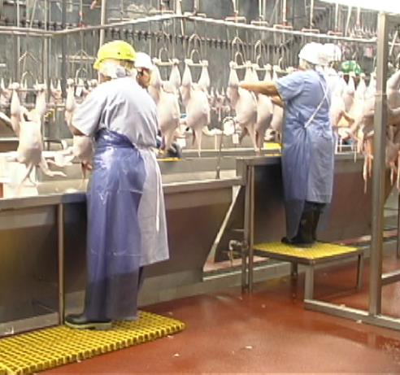
Fitting the Job to the Worker
5
Notes:
When using ergonomics, it is important to get the right equipment for the right individuals. The picture above illustrates a worker that is too small for their workstation and has a special platform to make it the right height for her. The tall person is almost in the correct posture.
Discussion:
Ask the group about the shorter person. Is she in the correct posture? The answer is no since her arms are fully extended just below shoulder height. The platform needs to be raised further to allow the worker to have their elbows down close to the body with the upper and lower arms at a right angle to each other.

Slide 6
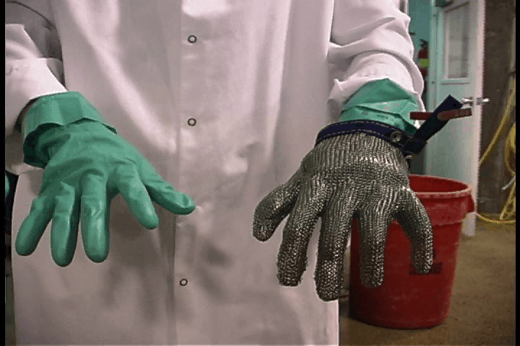
Fitting the Job to the worker
6
Notes:
Another way to think about fitting the work to the worker is PPE. They don’t typically sell one-size-fits-all shoes. They make them in different sizes and shapes to fit different people. Some shoes come in sizes that may fit a range of feet. With shoes like this, they will usually have some type of adjustments that can be made to fit the worker really well. This may even be found on shoes with specific sizes.
Gloves are another example of items where the fit is very important. Gloves that are too loose or bulky can cause grip problems. Ones that are too tight can cause circulation problems.
Discussion :
What kind of situations can you think of where the way something fits is very important?

Slide 7
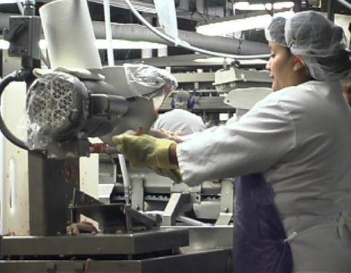
Making jobs easier
7
Notes:
Ergonomics has also been about making the job easier for those who perform the actual work. The picture on the left shows a circular saw used for the cut up operation. New machines, like the one to the right, can cut the whole bird into eight pieces with little worker involvement. The workers just basically load the whole chickens and the machine performs all of the cuts automatically.

Slide 8
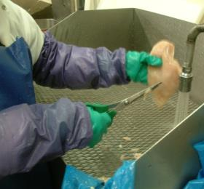
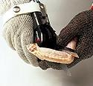
Making jobs easier
8
Notes:
In the pictures above you will see two types of scissors. The first pair is a typical pair of manual scissors that rely on people to open and close them. These are still used throughout the poultry industry. The pair on the right is a pair of pneumatic powered scissors. This pair uses air power to close and open the blades of the scissors. With a tool like this one, the force is lower and consistent, no matter how difficult the part is to cut. There are also spring loaded scissors.
Discussion
What kind of tools or equipment do you use everyday that makes your life easier?

Slide 9
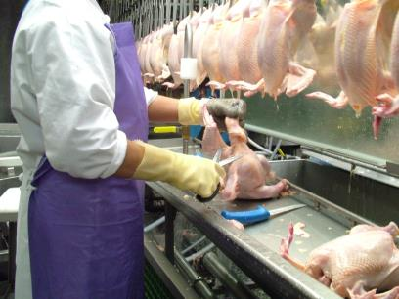
Environmental Factors that can make jobs can more difficult
Poor Lighting
Adequate Lighting
9
Notes:
Lighting is one factor that can cause problems in the work place. If the lighting is too low, you may have trouble seeing your work People will often adjust their posture to compensate for low lighting. If employees find themselves bending down closer to see the work, they may have a lighting problem or an eye problem. Lighting is most critical in areas where inspections or precision cuts are being performed.

Slide 10
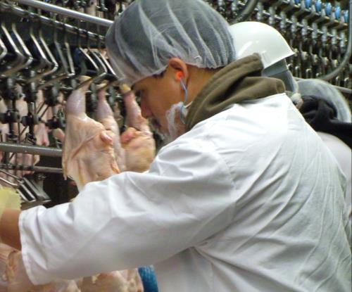
Environmental Factors that can make jobs can more difficult
10
Notes:
Many facilities, like your operation, have many machines that create noise in the workplace. Most facilities are loud enough that they require workers to wear hearing protection to keep from damaging their hearing. Noisy environments like this make it difficult to hear signals or to even communicate.
Discussion
Other than lighting and noise, what other environmental issues in the workplace can make your job harder or more difficult?

Slide 11
How does ergonomics affect you?
It can help you do work safely
It can make you more comfortable
It can prevent injuries
It can result in decreased mistakes and rework
Decreased turnover
11
Notes:
If the job is designed to fit the employees working at those tasks, then it should by nature be safer. Tools will fit hands better so they are less like to slip. Guards and other safety equipment that are designed with some knowledge of ergonomics will protect a larger range of people.
If the job fits you well, it should also be more comfortable. If it is more comfortable, you should be able to work at this job longer without any negative consequences. If the jobs are designed properly, workers should not be straining either physically or psychologically to accomplish their work and in turn are not experiencing injuries.
We are typically more interested in the physical stress, because it can have more immediate impact on the development of injuries. Physical stress can cause muscle pain and discomfort that negatively affects our work tolerance and performance. The mental stress can also cause problems but they are not as readily apparent in most cases. A well designed workplace can improve morale.
Discussion
Discuss the relationship of mental stress and muscle tension

Slide 12
What can you do to help?
Be aware of what is happening in your work area
Go to your supervisor with questions or concerns
Think about how you would improve your workplace and share your ideas with the safety team
Report any symptoms to supervisor or safety people
Be a team player
12
Notes:
Workers need to be aware of the work area around them and anything that seems to cause workers discomfort, stress, etc. This can be you or a co-worker.
If employees have questions or concerns about their job they should immediately talk to their supervisors. The supervisor is the always first person you should talk to. They know about you and your job more than others in the workplace.
If you are having symptoms at work during certain tasks you should talk to the appropriate people at your facility.
The most important part to remember is that you are part of the team that can help protect you and your coworkers. No member of the team is any less important than any other member.

Slide 13
Early Identification of Problems

Slide 14
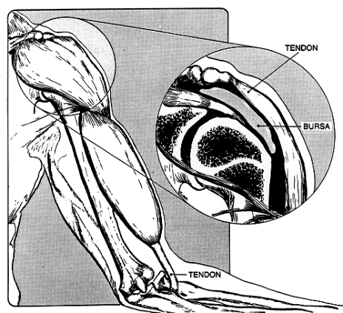
What is an ergonomic related injury or disorder?
  Nerves
  Tendons
  Muscles
  Ligaments
14
Notes:
Ergonomic related injuries and disorders are know by many different names. You may hear these referred to as cumulative trauma disorders, repetitive strain injuries, or musculoskeletal disorders. Most of these injuries or disorders develop overtime. They most often affect the soft tissues of the body like the following:
-Nerves - Nerves are the part of the body that provides both sensory feedback (feeling) and motor control (movement). Injured by directly compressing (sharp table edges) or by swelling of internal structures like tendons that compress the nerves.
-Tendons - Tendons connect muscles to bones. They are rope-like structures that transfer force when muscles contract. These structures can be strained (tear) or can become inflamed (swelling). One of the most common injuries is tendonitis.
-Muscles -Muscles provide movement and support of the body. Muscles can be strained, or torn, or crushed.
-Ligaments -Ligaments connect bones to bones to form joints. They are thick rope like structures. They can be torn (sprain).

Slide 15
Why do these types of injuries occur?
Injuries can result from working incorrectly
  Bad workstation design
  Not adjusting the machines/stands properly
  Bad tool design
Employees try to do things their bodies can’t
  Work too fast, hard, long or in a bad posture
  Pick up an object that is too heavy
  Don’t use proper lifting or cutting technique
15
Notes:
The first bullet should underscore the importance of the employee being aware of their workstation. Second, it is important for the employee to start thinking about how the risk factors cause the injury. Use examples of improper lifting technique or cutting technique to convey this idea.
Discussion:
Who makes adjustments to your workstation?
How do you know how to work safely?
Are there limits as to how much weight you should lift by yourself?

Slide 16
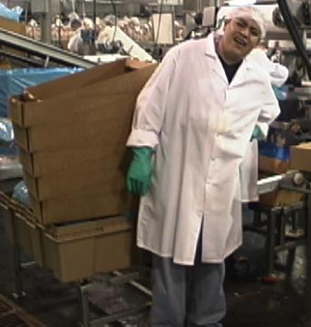
What areas of the body are most often affected?
Hands
Arms
Backs
Shoulders
16
Notes:
There are numerous types of injuries or disorders that affect various parts of the body. Some of these are as follows:
-Hands - Carpal Tunnel Syndrome
- Ganglion Cyst
- Hand Arm Vibration Syndrome
-Arms - Tennis/Golfer’s Elbow
- Thoracic Outlet Syndrome
-Back -Back Pain
-Back Strain
-Shoulder - Rotator Cuff Tendonitis
- Bursitis

Slide 17
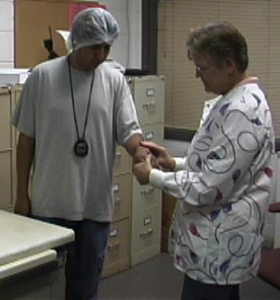
What are the signs and symptoms of these types of injuries?
  Aching
  Burning
  Pain
  Numbness
  Soreness
17
Notes:
Early recognition and reporting. Early reporting of symptoms of MSDs reduces injury severity, the likelihood of permanent disability, and the number and costs of workers’ compensation claims. It also identifies possible risk areas in the plant for intervention

Slide 18
How to report problems
Report pain or discomfort to
your supervisor or facility nurse
The sooner the better
Tell them:
  When you first noticed the pain
  How long it has lasted
  When it is the worst
  What part of the body hurts
  What job you were doing
18
Notes:
Reporting of symptoms is important. You need to let your supervisor or nurse know as soon as possible what is wrong. The earlier employees report problems, the sooner they can be treated. The hope is that we can catch the problems before they become serious disorders or injuries.

Slide 19
Medical Treatment
If the nurse or doctor does give
you treatment or restrictions follow it.
If they tell you to only lift 10 lbs,
don’t lift anything more than that.
Follow the treatment or restrictions
away from work also.
19
Notes:
Employees should understand that the treatment prescribed by the nurse or doctor must be followed. This is because we want the injured person to get well. Often employees are under the impression that the treatment only applies when at work. They should follow the treatment away from work as well.
Conservative treatment. If provided early in the development of an MSD, conservative treatment may eliminate the need for more invasive medical procedures. Conservative treatment may include rest, hot or cold therapy, nonsteroidal anti-inflammatory agents, exercise, or night splints, depending on the nature and severity of the problem
Conservative return-to-work (restricted duty). Modified or restricted work, job accommodations or light duty for a worker with an MSD, can allow the worker to continue to perform productive work for the employer while continuing to allow recovery from injury. Some MSDs require weeks (or months, in rare cases) of restricted work to allow for complete recovery

Slide 20
How do we stay away from problems?
Learn to recognize risk factors
Adjust your workstation properly
Use proper technique for lifting, cutting, etc.
20

Slide 21
Risk Factors and Solutions
21

Slide 22
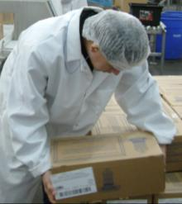
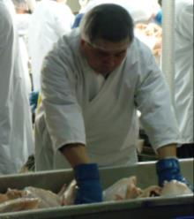
Risk Factors
Force
Awkward Postures
Repetition
Temperature
Vibration
Contact Stress
22
Notes:
The employees need to understand that a risk factor is a something that is likely to cause a workplace musculoskeletal disorder (ergonomic related injury or illness). Sometimes the problem is not with just on of these, it is with a combination of factors. This is especially true with force and repetition. This combined effect can actually increase the chances of developing a workplace musculoskeletal disorder (MSD). In the slides to follow, we will discuss each of these factors as they occur in the poultry industry.

Slide 23
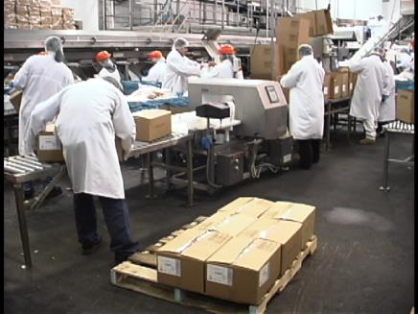
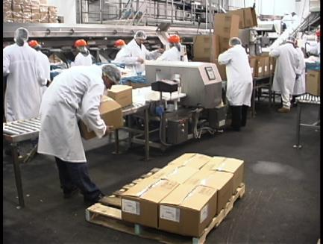
Risk Factors - Force
23
Notes:
We want employees to try and keep the forces they are being exposed to as low as possible. Using good lifting techniques and taking advantage of equipment that is available to them can be of help in reducing their exposure. One typical concern we have in poultry processing is the task of palletizing boxes. You will often have very low stacking (at the floor) as well as very tall stacking (at the shoulder level or as high as the head). The safest lifting range is between knuckle to shoulder height (30-50 inches).

Slide 24
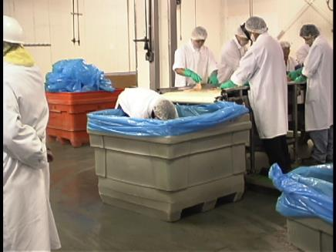
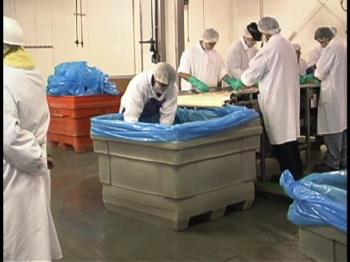
Risk Factors – Force
24
Notes:
This picture could just as easily have gone into the poor posture slide. This worker is using a smaller tote to scoop product out of this larger storage bin. This would be a good candidate for some automated or semi-automated dump mechanism to get the product onto the production line. Facilities could also consider better conveyer systems to bring the product right to this area.

Slide 25
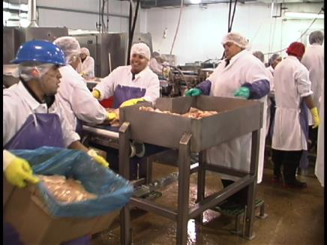
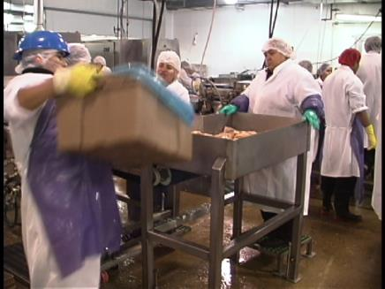
Risk Factors - Force
25
Notes:
Employees often lift and carry in process products in the facility. These totes may be as much as 70 pounds when filled to the proper capacity. Employees may often let the totes become overfilled trying to reduce the number of lifts or carries they have to do during the day. This should be avoided because the totes may weigh as much as 100 pounds when allowed to be overfilled. Facilities may want to consider smaller totes to reduce the weight of the product being lifted at one time. The facilities may also want to consider other types of material handling equipment to reduce or eliminate some of this in-process lifting and carrying.

Slide 26
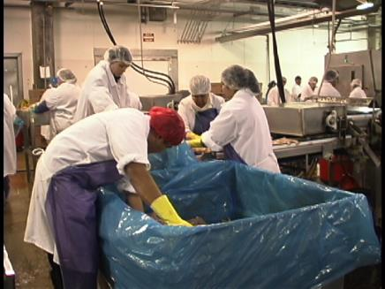
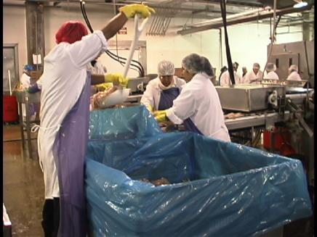
Risk Factors – Force
26
Notes:
Shoveling is one of the most physically demanding tasks in the construction and manufacturing industries. The heavier the product the more strenuous this task.

Slide 27
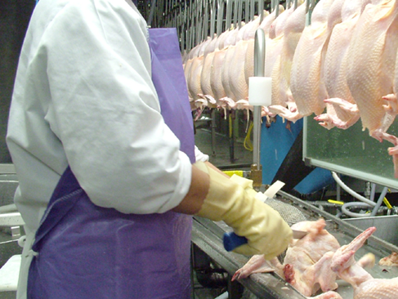
Risk Factors - Force
27
Notes:
Sometime the tools can cause extra forces to be applied by the worker. Tools like knives and scissors if not kept sharp can make it more difficult to do your job. Have employees keep their tools sharp. Have them use the mouse trap sharpeners regularly. Also utilize a comprehensive sharpening program to keep the knives sharp.

Slide 28
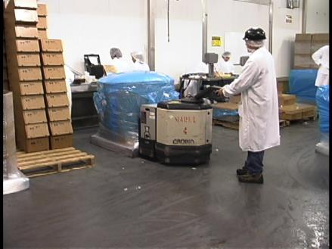
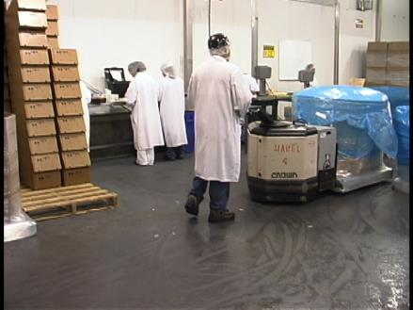
Risk Factors - Force Solutions
28
Notes:
Teach employees to use material handling devices they are given like these powered pallet jacks. Often we see employees carrying in-process totes or just sliding a stack of full totes into position. It is better to convert a carry to a push-pull task.

Slide 29
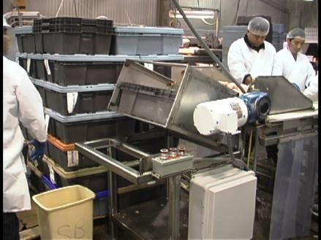
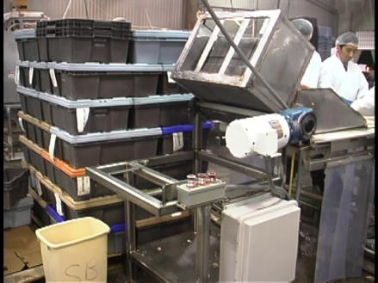
Risk Factors - Force Solutions
29
Notes:
This is a small tote dumper that is used for in-process totes. This allows the worker to place the tote at a comfortable height and then dump it onto the processing line using the mechanism. The dumping activity can often be a problem because the employee has a heavy tote full of chicken parts and has to dump them with exaggerated postures.

Slide 30
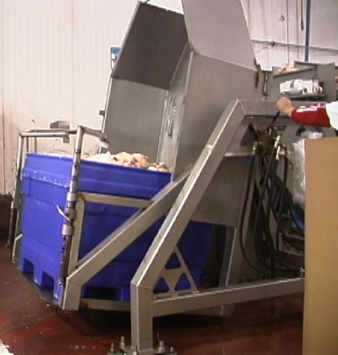
Risk Factors - Force Solutions
30
Notes:
Large totes require large lifts. This example dumps whole large bins of products that come from the chiller as well as product that comes from other plants.

Slide 31
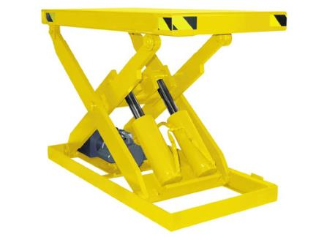
Risk Factors - Force Solutions
31
Notes:
Lift tables could be a good idea help to reduce forces. There are also some palletizing equipment that may be able to automatically palletize and wrap boxes for companies.

Slide 32
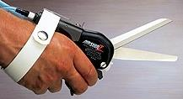
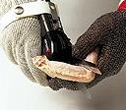
Risk Factors - Force Solutions
32
Notes:
Some cuts are difficult even if the tools are sharp. It may be that people have small hand spans (can’t hold large tools) and can’t apply enough force to complete the cut. It could be that certain parts you are trying to cut are just physically tough to cut with conventional knives or scissors. In these cases, you may want to consider devices like pneumatic powered cutters. Powered tools or devices that weigh more than a few pounds should be counter-balanced to support the weight of the tool.

Slide 33
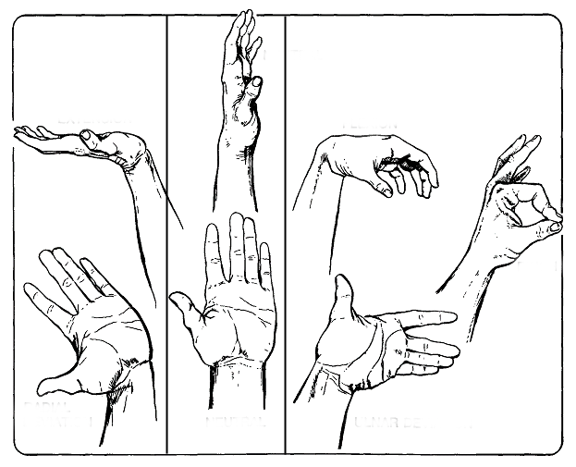
Risk Factors - Awkward Postures
OK
33
Notes:
Employees will now be introduced to some postures that are more harmful to the body and ones that are better. The first concept is that of the neutral posture. This is where the body is most relaxed and where there is the least amount of stress. When work requires the hands and wrists to be deviated, flexed, or extended it is harder on the structure of the hands and wrists.

Slide 34
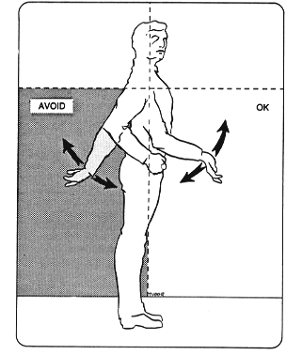
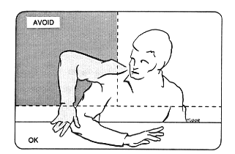
Risk Factors - Awkward Postures
34
Notes:
The neutral posture concept can also be applied to other parts of the body like the arms. We typically think of the neutral posture of the arms as being next to the body and straight down. This slide illustrates better zones of posture and worse zones. The neutral posture falls within the “OK” zones in the pictures above. The postures to avoid are ones that force you to raise the upper arms or ones that require the arm to be extended behind the body.

Slide 35
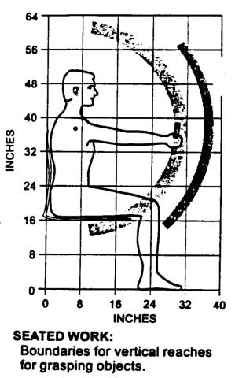
Risk Factors - Awkward Postures
35
Notes:
Forward reaching with arms fully extended creates stress in the shoulder, back and arms. Most work should be done with the elbows down close to the body.

Slide 36
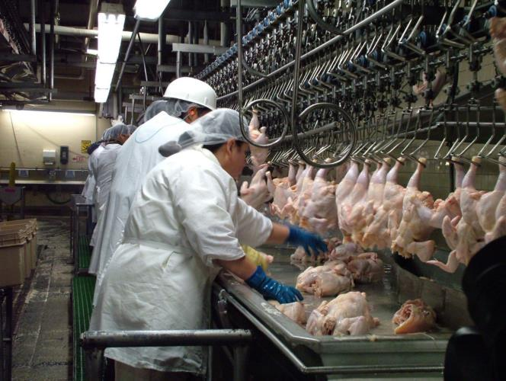
Risk Factors - Awkward Postures
36
Notes:
The location of product is causing the worker to bend slightly at the waist and reach with her arm fully extended. It is better if the worker can reach the product without having to bend at all. Fully extending the arm puts the structures of the arm at greater stress. At times, the worker may actually lean to one side to reach the product.

Slide 37
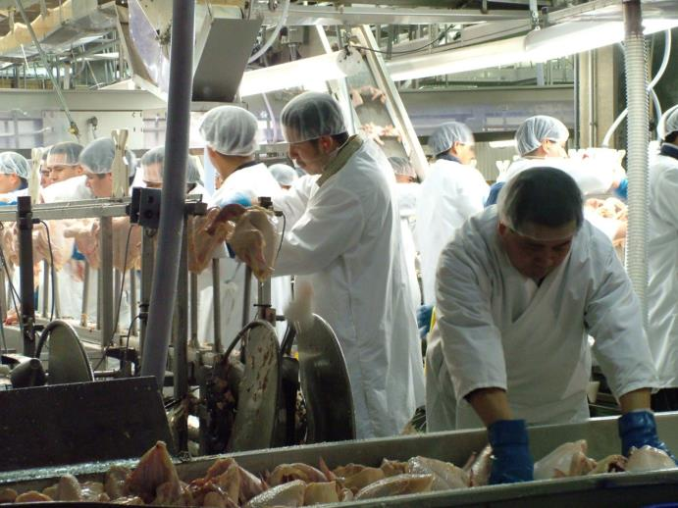
Risk Factors - Awkward Postures
37
Notes:
This worker’s forward reach is more pronounced and hence more stressful. It appears that the supply conveyor is too low or the worker platform is too high. You need to be careful in cases like this to not create new hazards. It would be better to raise the conveyor than to mess with the worker platform. If you lower the platform, you may cause the person to further raise his upper arm to the place the bird onto the cones.

Slide 38
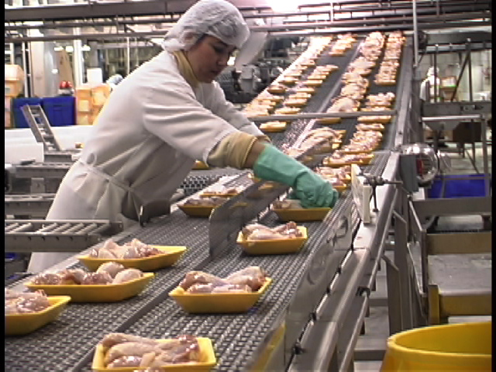
Risk Factors - Awkward Postures
38
Notes:
Here is another forward reach picture. The setup of the conveyor system causes the forward reach. While this is not excessive, it does cause bending at the waist with a full extended arm.

Slide 39
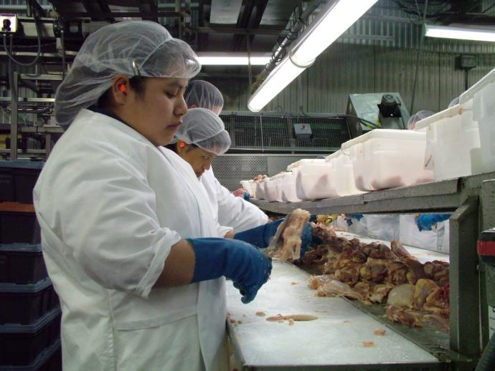
Risk Factors - Awkward Postures
39
Notes:
One of the more common postures we see that concern us is the wrist deviation above. Several things can cause this type of posture. In the picture above, it appears to be the orientation of the work and possibly the tool shape. The worker may be able to reposition the product that she is cutting to eliminate the deviation in her wrist. Selection of a tool that has a curved or pistol shaped handle could be might also be used to reduce the bending of the wrist.
Discussion:
Notice that the left hand holds and supports the product. You would expect reports of discomfort to the left hand from employees. Also note the head tilt angle.

Slide 40
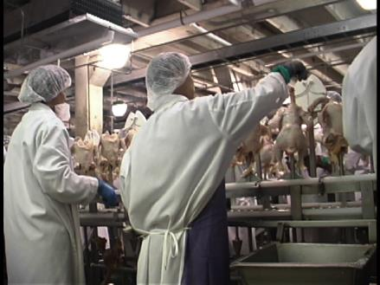
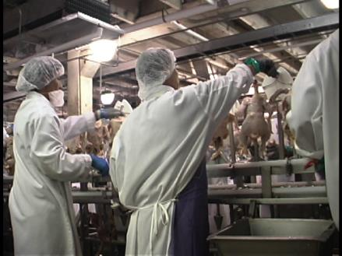
Risk Factors - Awkward Postures
40
Notes:
This person is working with his upper arm raised to sharpen his knife. He actually performs certain cuts with the same or a similar posture. He has probably got his platform adjusted too low. Certain cuts may actually cause the worker to not only have his upper arm raised, but to reach across his body as well.

Slide 41
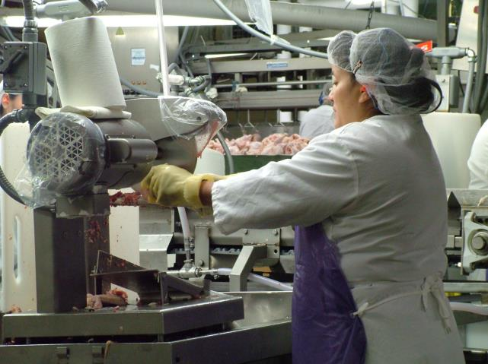
Risk Factors - Awkward Postures
41
Notes:
Here the worker is holding her arms still while the part is being cut by a circular saw. Her arms are almost fully extended. The saw is too high and too far away from the worker.

Slide 42
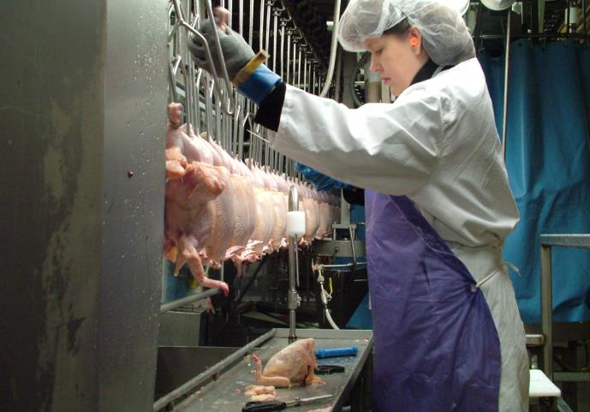
Risk Factors - Awkward Postures
42
Notes:
Another raised arm posture.

Slide 43
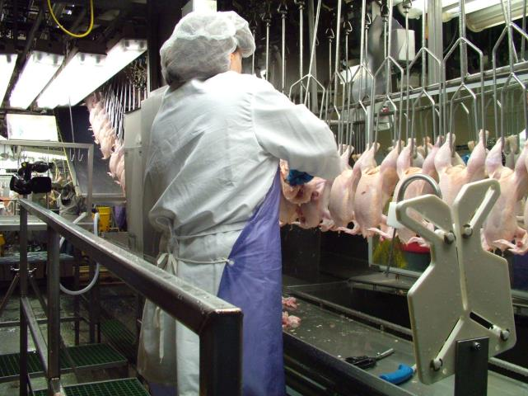
Risk Factors - Awkward Postures
43
Notes:
This worker at a rework area is also working with her arm elevated. Although not as pronounced, it can still be very stressful to the muscles of the shoulder region. This worker also needs to be higher in relation to the product she is working on.

Slide 44
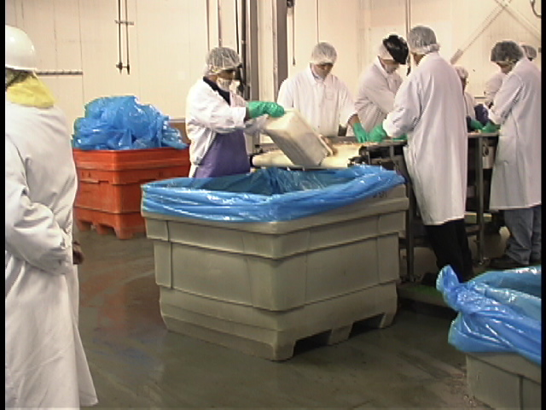
Risk Factors - Awkward Postures
44
Notes:
Here is another example of a wrist deviation. It is the dumping motion that is causing this posture. In this case, there is a good deal of force involved which would increase this worker’s risk of developing a MSD. Items like the powered dumping mechanisms or some vacuum devices may work well to to alleviate this type of problem.

Slide 45
Risk Factors - Awkward Postures
45
Notes:
This is an example of the wrong tool and the wrong work station height. This gentleman is using a full size shovel to load products onto a work station. The bad combination is causing the worker to work with one hand over his head and with an uneven loading of the upper body (weight on one side of the body). Powered dumpers, vacuum transfer, better conveyors to deliver products, etc. may help or eliminate this hazard.

Slide 46
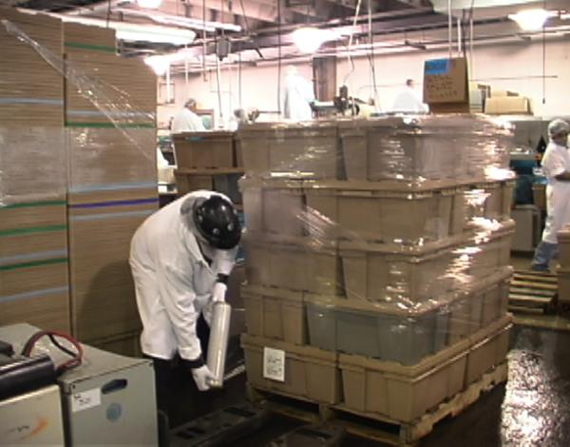
Risk Factors - Awkward Postures
46
Notes:
The worker here is wrapping the pallets with a plastic film. He is already leaning to one side slightly. As he gets lower on the pallet, the sideways leaning will get more pronounced as will the forward bending. Several companies have replaced this operation with an automatic pallet wrapper (palletizer). They have eliminated this operation altogether.

Slide 47
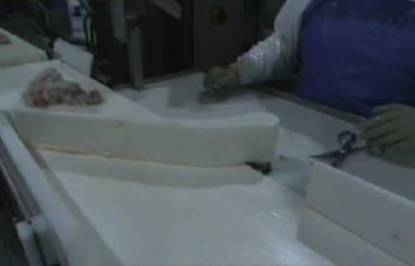
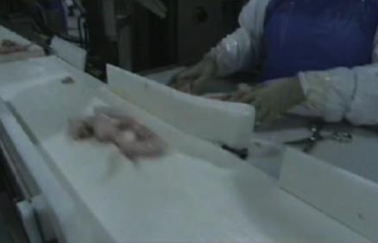
Risk Factors - Posture Solutions
47
Notes:
This conveyor has diverters in place that push the products closer to the workers. This reduces reaches for the employees. The work station above also has some cut outs that scrap or final products can be placed in. Some facilities use chutes in conjunction with these cut outs. This modification can reduce reaches or elevated arms. Some will use multiple conveyors at these operations with the cutouts or chutes going to different conveyors.

Slide 48
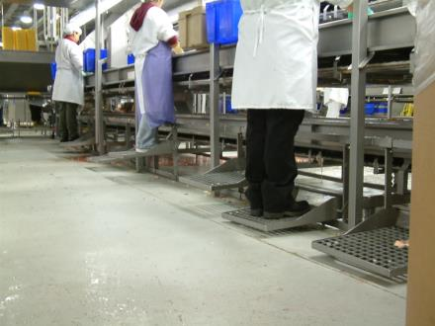

Risk Factors - Posture Solutions
48
Notes:
Most facilities have platforms like these pictured above. Unfortunately, most employees don’t use them properly. We often see these adjusted at the same height even when the workers are of varied heights. Poorly adjusted platforms can be responsible for hand/wrists deviations, elevated upper arms, etc.

Slide 49
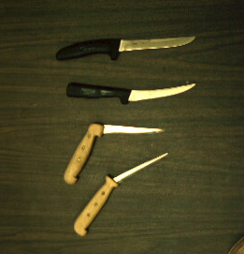
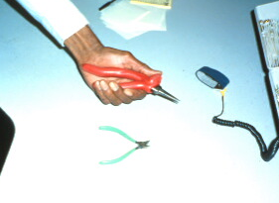
Risk Factors - Posture Solutions
49
Notes:
Some tools have specific angles. In tool selection the curve of the handle should allow the use of a straight wrist when doing the work. The handle should also go across the palm. If it ends in the palm it might damage the soft tissue from contact stress.

Slide 50
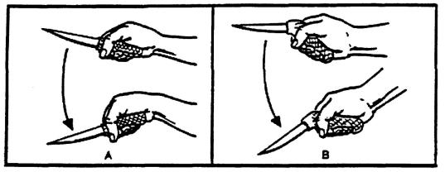
Risk Factors - Posture Solutions
50
Notes:
Two different knives are illustrated in this picture. One is the standard knife handle that is straight and causes the user to bend their wrist when making a vertical cut. The knife on the right is a pistol shaped handle that allows the user to use a straight wrist when making the same cut. This helps to eliminate the bent wrist risk factor.

Slide 51
Risk Factors - Repetition
51
Notes:
Debone and evisceration are machined paced operations and many of the jobs are highly repetitive. This person is working with his upper arm raised to sharpen his knife. He actually performs certain cuts with the same or a similar posture. He has probably got his platform adjusted too low. Certain cuts may actually cause the worker to not only have his upper arm raised, but to reach across his body as well.

Slide 52

Risk Factors – Repetition
52
Notes:
Many tasks in this industry are repetitive. We typically think about repetition during deboning or trimming tasks (machine paced). Certain off line work or rework can also be repetitive. It is more of a concern when these tasks also involve high force, awkward postures, etc. Some of the hand intensive tasks will often involve deviated, flexed, or extended postures. Tasks like palletizing boxes are also a concern because of their weight and the postures required. Shoveling or scooping chicken or ice with scoops or shovels is another one of those tasks because of the postures and the forces.

Slide 53
Risk Factors – Repetition Solutions
Job Rotation
Job Enlargement
Micro Breaks and Rest Pauses
Slow down
Add more people
53
Notes:
Job rotation — Rotating employees into several different jobs during the course of a workshift is a way to distribute work so that each employee spends less time performing the same repetitive tasks. In order for job rotation to reduce muscle/tendon strain and provide adequate recovery time, the different jobs into which workers rotate need to involve the use of different muscles or body parts.
Job enlargement — Designing jobs so they include a wider variety of tasks (or a longer motion pattern) is another way to reduce the frequency and duration of repetitive motions.
Micro breaks or rest pauses — Building short micro pauses between motions or tasks is another way to give muscles and tendons recovery time.

Slide 54

Risk Factors - Temperature
54
Notes:
Cold temperatures in combination with other risk factors may also increase the potential for MSDs to develop (1). Many of the operations in poultry processing occur with a chilled product or in a cold environment.
Cool temperatures are found throughout the facility and are coldest in the freezers. The cooler temperatures can cause physiological responses in the body that make the blood want to move away from the periphery (arms and legs) and into the core of the body. This type of response can be especially a problem when found in conjunction with vibrating tools

Slide 55

Risk Factors – Temperature
55
Notes:
Avoid tight fitting clothing that can cut off circulation. This would be especially true in the hands and arms area, since the body wants to move blood away from these areas back to core of the body when in cold environments. Don’t wear more layers than what you need to stay warm. Especially with gloves this can increase forces because you can not feel well through all the layers and you end up squeezing harder to get the feedback that you are used to.

Slide 56

Risk Factors - Contact Stress
56
Notes:
Leaning or resting of the employees’ arms on hard, sharp surfaces can cause problems. This kind of activity can directly compress nerves and soft tissue in key areas of the body like the arms or hands. You will normally see these on the front edges of workstations, containers, etc. The picture above shows a worker that has a sharp metal lip of workstation digging into the muscles of her arm.
Employees should talk with their supervisor if they find areas like these that they are making contact with on a daily basis. See if there are ways to round the edges on the work surfaces or add pieces that can be easily cleaned.
These areas may also be seen on the under side of the work surfaces or the seats themselves. If these cases are occurring, the employees need to contact their supervisor or the maintenance people. They may be able to adjust or modify the workstation.

Slide 57

Risk Factors - Contact Stress Solution
57
Notes:
The edge of tables and conveyors can put pressure on the soft tissue of the arms and hands. It is better to have rounded edges like the lower figure illustrates.

Slide 58


Risk Factors - Contact Stress
58
Notes:
Sometimes the tools employees use can also be a source of contact stress. The problem is typically on the outside of the fingers and thumbs due to the opening of the scissors. Problems could also be on the inside of the fingers and thumbs if there are great forces required to close the scissors for a certain cut. Spring loaded scissors can help assist the ,more stressful scissor opening operation.
Short handled tools can also apply pressure in the palm and directly compress the median nerve in the middle or soft area of the palm. Handles should go across the palm of the hand and allow the use of a clinched fist (power grip).

Slide 59

Contact Stress Solutions
Risk Factors -
59
Notes:
Notice that the neck cutting power tool (picture on the left) used in turkey processing is counter-balanced to support the weight of the tool. Tool triggers should allow the use of three or more fingers to reduce the likelihood of a painful tendon disorder called Trigger Finger.
In addition to force reduction, powered cutters can also reduce contact stress on the fingers. There are also some self-opening scissors that could be used to reduce contact stress when opening scissors. Make sure that whatever tools you use that they have good quality components. Ensure that they are made as well as the tools they are replacing.

Slide 60
What can you do to help?
Be aware of what is happening in your work area
Go to your supervisor with questions or concerns
Think about how you would improve your workplace and tools and share your ideas with the safety team
Report any symptoms to supervisor or safety people
Be a team player
60
Notes:
Workers need to be aware of the work area around them and anything that seems to cause workers discomfort, stress, etc. This can be you or a co-worker.
If employees have questions or concerns about their job they should immediately talk to their supervisors. The supervisor is the always first person you should talk to. They know about you and your job more than others in the workplace.
If you are having strange symptoms at work during certain tasks you should talk to the appropriate people at your facility. The next module will discuss these symptoms in more detail.
The most important part to remember is that you are part of the team that can help protect you and your coworkers. No member of the team is any less important than any other member.

Slide 61
What do you need to know?
Learn the proper use of equipment, tools, and machine controls;
Recognize early symptoms of MSDs and the importance of early reporting ;
Learn the procedures for reporting work-related injuries and illnesses
Learn about the company’s safety/ergonomics process;
Learn how to identify ergonomic risk factors; and
Learn the process for reporting ergonomic concerns and providing feedback to the employer.
61
Notes:
This is from OSHA Publication 3213-12R 2013
Prevention of Musculoskeletal Injuries in Poultry Processing

Slide 62
What do you need to know?
Proper care, use, sharpening and handling techniques for knives and scissors;
Use of any special tools and devices;
Use of safety equipment, including personal protective equipment (PPE), as it relates to MSD prevention (such as the proper fit of gloves);
Use of proper lifting techniques and lifting devices; and
Use of ergonomic stands and platforms
62
Notes:
This is from OSHA Publication 3213-12R 2013
Prevention of Musculoskeletal Injuries in Poultry Processing

