Slide 1
Poultry/Meatpacking Ergo and Safety Training
The material for this course was produced under grant #SH-29660-SH1from the Occupational Safety and Health Administration, U.S. Department of Labor.
Notes:
The material was produced under grant number SH-29660-SH6 from the Occupational Safety and Health Administration, U.S. Department of Labor. It does not necessarily reflect the views or policies of the U.S. Department of Labor, nor does mention of trade names, commercial products, or organizations imply endorsement by the U.S. Government.

Slide 2
Disclaimer
This material was produced under grant number SH-29660-SH6 from the Occupational Safety and Health Administration, U.S. Department of Labor. It does not necessarily reflect the views or policies of the U.S. Department of Labor, nor does mention of trade names, commercial products, or organizations imply endorsement by the U.S. Government.

Slide 3
Class Agenda and Objectives
Introduction to Poultry/Meatpacking Industry S&H Initiative
Recognition of Hazards in the Industry
Evaluation of Hazards in the Industry
Abatement of Safety and Health Hazards in the Industry
Special Emphasis Topics addressed in training:
  Health-Chemical hazards and Ergonomics
  Safety-Hazardous Energy Control, Electrical, Confined Spaces, Guarding
Summary, Discussion, Final Comments
Notes:
The training will include a focus on safety and health hazards in the poultry/meatpacking industry.

Slide 4
Why Are We Here Today?
Injuries
  Poultry workers are twice as likely to suffer serious injuries on the job, and six times more likely to suffer illnesses, compared to other private sector workers
  In the meat slaughter and processing industry, illness and injury rates are even higher, at rates nearly double those for poultry workers.
Notes:
According to current Bureau of Labor Statistics (BLS) estimates, the poultry and meatpacking industries employ 526,000 workers in 5,350 plants throughout the United States, with over one-third of the nation’s chicken production occurring in the three southern states of Georgia, Alabama, and Mississippi. Poultry workers are twice as likely to suffer serious injuries on the job, and six times more likely to suffer illnesses, compared to other private sector workers. In the meat slaughter and processing industry, illness and injury rates are even higher, at rates nearly double those for poultry workers.

Slide 5
Poultry/Meatpacking Industries are Inherently Dangerous
There are many hazards that are associated with the industries:
  Machine Guarding
  Ergonomics
  Hazardous Chemicals
  Hazardous Energy Control
  Electrical

Slide 6
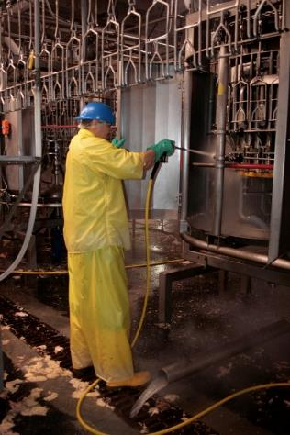
Hazards –Machine Guarding and LOTO
Many of the hazards associated with machine guarding and lockout tag out occur during the sanitation process when guards have to be removed and equipment sanitized.
Production workers may also be exposed to point of operation hazards from the lack of guarding.
Maintenance workers may be exposed to LOTO hazards, lack of machine guarding, and electrical hazards.

Slide 7
Ergonomics
Many production processes require the performance of repeated and sustained manual handling and manual exertion work tasks.

Slide 8
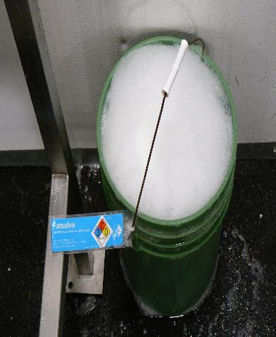
Hazardous Chemicals
Virtually all workers are exposed to chemicals in the workplace:
All-Possibility of contact with Ammonia Refrigerants
Sanitation-Corrosive Detergents
Maintenance-Hexavalent Chromium and solvents from maintaining the equipment

Slide 9
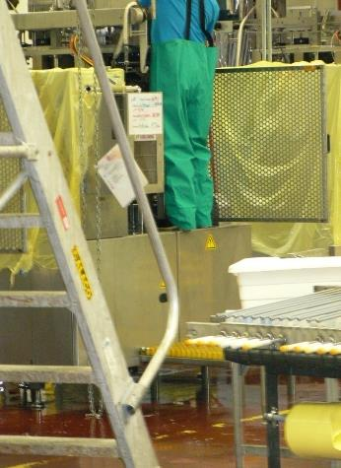
Slips, Trips, and Falls
Sanitation workers
Climbing on equipment without proper fall protection
Using ladders on uneven surfaces and/or equipment
Not replacing floor covers causing trip hazards
Notes:
Assess slip, trip and fall hazards on walking and working surfaces.

Slide 10
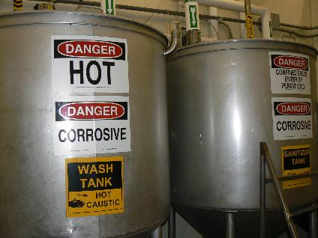
Confined Spaces
Most of the processing plants contain permit -required confined spaces including that pose the potential for employee entrapment and serious injury, Some examples may include:
  pits,
  vats,
  Icehouses,
  Access spaces within production equipment

Slide 11
Electrical Hazards
Electrical hazards at the facilities can be complicated by wet process areas and the sanitation process that may corrode equipment.
Hazard controls are necessary in the areas that include:
  GFCI (to protect workers from serious shock)
  Enclosures to prevent the accumulation of water inside the equipment
Notes:
Electrical hazards at NAICS 311615 sites can be aggravated by the presence of wet -process areas and the industry’s
sanitation standards that require the use of chemical products that may corrode electrical enclosures and equipment.

Slide 12

Protect your health publication
Notes:
June 12, 2015
Dear Poultry Industry Employer,
In accordance with the new poultry inspection rules and to assist the poultry industry in protecting the safety and health of poultry workers, the Food Safety Inspection Service (FSIS) and the Occupational Safety and Health Administration (OSHA) have jointly developed a new worker safety poster, with versions in English and Spanish. These posters must be posted in a conspicuous place or places in your plants where notices to employees are customarily displayed.
It is your responsibility to provide a safe workplace for your employees. If you would like additional copies of the OSHA FSIS poster (in English, Spanish or both) or printed copies of "Prevention of Musculoskeletal Injuries in Poultry Processing," have questions about workplace safety and health, or to request assistance in making sure your workplace is safe, please contact OSHA at 1-800-321-6742 or through www.osha.gov.
Sincerely,
Alfred V. Almanza
Deputy Under Secretary, FSIS, USDA
David Michaels, MPH, PhD
Assistant Secretary of Labor for OSHA

Slide 13
OSHA’s
National Emphasis and Local Emphasis Programs-Poultry and Meatpacking
Region IV (Southeast US)
  Regional Emphasis Programs for Poultry Processing Facilities
Region VI (South Central US)
  Regional Emphasis Programs for Poultry Processing Facilities
Region VIII (Midwest Plains)
  Regional Emphasis Programs for Poultry Processing Facilities
  Poultry Processing Industry Region-wide Local Emphasis Program (LEP

Slide 14
Purpose of the NEP to Address Poultry/Meatpacking
The purpose of the NEP is to accomplish the following:
  Encourage businesses to take action to address the hazards
  Evaluate to determine the status of compliance to address the hazards,
  Design and install appropriate hazard controls to reduce or eliminate the hazards.
Notes:
The intent of this Regional Emphasis Program is to encourage employers to take steps to address hazards, ensure facilities are evaluated to determine if the employer is in compliance with all relevant OSHA requirements , and to help employers correct hazards thereby reducing potential injuries, illnesses and death for their workers.

Slide 15
OSHA Inspections
OSHA has steadily increased the number of inspections to meatpacking facilities:
    2016: 461 inspections
    2015: 422 inspections
    2014: 338 inspections
Notes:
Source: SHRM quoting BLS report

Slide 16
Types of Facilities Inspected
The following types of facilities were inspected in 2016:
  311615 (Poultry): 171
  311611 (Slaughter): 118
  311612 (Processor): 138

Slide 17
OSHA Penalties
Listed below are the standards which were cited by Federal OSHA for the specified NAICS Code during the period October 2015 through September 2016. Penalties shown reflect current rather than initial amounts.
  A total of 505 citations were issued at a cost of $2,244,954

Slide 18
OSHA Background

Slide 19
OSHA “101”
In 1970, Congress created OSHA
  Assure safe and healthful conditions for working men and women
The OSH Act ensures OSHA’s mission by
  Setting and enforcing standards
  Providing training, outreach, education
  Compliance assistance
Notes:
In 1970, with an act of Congress, OSHA was created. Known as the OSH Act, it assured safe and healthful working conditions for men and women by setting and enforcing standards as well as providing training, outreach, education and compliance assistance.
When OSHA was created, an estimated 14,000 workers were killed on the job each year, or about 38 every day. Over the past 40-plus years of protecting workers, OSHA has made great strides in workplace safety and health. However, significant hazards and unsafe conditions still exist in U.S. workplaces. Each year more than 3.3 million working men and women suffer a serious job-related injury or illness. Millions more are exposed to toxic chemicals that may cause illnesses years from now.

Slide 20
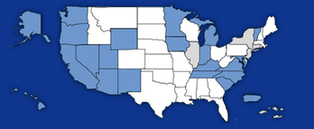
OSHA—Jurisdiction
OSHA coverage includes private sector employers and workers in all 50 states, the District of Columbia, and other U.S. jurisdictions either directly through Federal OSHA or through an OSHA-approved state plan.
Notes:
OSHA covers private sector employers and workers in all 50 states, the District of Columbia, and other U.S. jurisdictions either directly through federal OSHA or through an OSHA-approved state plan.
State plans are OSHA-approved job safety and health programs operated by individual states instead of federal OSHA. An example would be Cal-OSHA (in California) or North Carolina OSHA. OSHA approves and monitors all state plans and provides as much as 50 percent of the funding for each program. State-run safety and health programs must be at least as effective as the federal OSHA program. The following states have approved State Plans (in BLUE on graphic):
Alaska New Mexico
Arizona New York
California North Carolina
Connecticut Oregon
Hawaii Puerto Rico
Illinois South Carolina
Indiana Tennessee
Iowa Utah
Kentucky Vermont
Maryland Virgin Islands
Michigan Virginia
Minnesota Washington
Nevada Wyoming
New Jersey
NOTE: The Connecticut, Illinois, New Jersey, New York and Virgin Islands plans cover public sector (State & local government) employment only (in GREY on graphic).

Slide 21

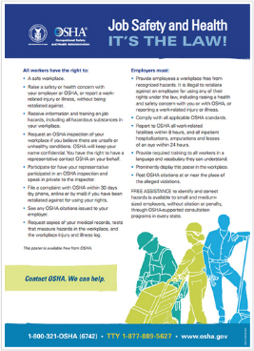
Employer Rights and
Responsibilities
Employers have the responsibility to, at a minimum, comply with the OSH Act;
Employers must perform their due diligence to find and correct safety and health hazards
New 2015 version
Notes:
Employers must also:
Perform tests in the workplace, such as air sampling or noise monitoring, as required by some OSHA standards.
Provide hearing exams or other medical tests required by OSHA standards (if applicable).
Post injury/illness information so that employees can see them.
Prominently display the official OSHA "Job Safety and Health - It's the Law" poster that describes rights and responsibilities under the OSH Act; new poster issued in 2015, however, either poster is still acceptable.
AND employers MAY NOT retaliate or discriminate against workers for using their rights under the OSH Act to report hazards that could lead to or have caused a work-related injury or illness.
Hazard Communication or HazComm will be covered in more detail in a separate module in this course.

Slide 22
Employer Requirements = Employee Rights
workplace free of recognized hazards
appropriate training in a language and vocabulary that workers understand
    hazards,
    methods to prevent harm, and
    the OSHA standards that apply to their workplace
No retaliation against workers who raise safety concerns or report injuries
    whistleblowers.gov
Notes:
Employers have the responsibility to provide a safe workplace free from serious hazards and must follow all OSHA safety and health standards.
Employers must find and correct safety and health problems as their due diligence under the OSH Act. OSHA requires that employers first try to eliminate or reduce hazards by making feasible changes in working conditions rather than relying on personal protective equipment - a.k.a. PPE (e.g. masks, gloves, earplugs); and if an employer provides PPE, then the employer must train the employees on WHEN and HOW to use the PPE.
Any training given by the employer must be in a language that the employees can understand. An example is when an employer is giving training on procedures for how to de-energize or re-energize a piece of equipment by locking out or tagging out (LOTO) the various energy sources to prevent employee entrapment or other hazards from released energy.
Temporary workers are also entitled to the same protection against retaliation as full-time workers. Employers may not take action against employees for participating in protected workplace activities (i.e., filing a complaint, voicing concerns about workplace hazards to supervisors, etc.). Workers also can inform OSHA of other whistleblower items that OSHA enforces, which currently (2014) is 22 different whistleblower statutes covering a variety of workplaces. For more information visit whistleblowers.gov.
The whistleblower document is included in Resource Section.

Slide 23
Workers’ Rights
Workers also have the right to:
  Participate in an OSHA inspection and speak in private with the inspector;
  File a discrimination complaint under Section 11 (c) of the OSH Act, which prohibits discharge or discrimination by “any person” against any employee for OSHA-related activity;
  File a complaint if punished or discriminated against for acting as a “whistleblower” under the additional federal laws for which OSHA has jurisdiction.
Notes:
Participate during an OSHA inspection. They may speak with an inspector in private without retaliation from an employer.
Section 11(c) of the OSH Act prohibits discharge or discrimination by any person against any employee for OSHA-related activity AND authorizes the Secretary to investigate and seek all appropriate relief against any such person. Retaliatory lay-offs or failure to refer a worker who engages in protected activity under OSHA would be grounds for the Secretary to seek remedial - including injunctive - relief in district court.
Employers may not take action against employees for participating in protected workplace activities (i.e. filing a complaint, voicing concerns about workplace hazards to supervisors, etc.). Workers also can inform OSHA of other whistleblower items that OSHA enforces, which currently (2014) is 22 different whistleblower statutes covering a variety of workplaces. For more information visit whistleblowers.gov.

Slide 24
Whistleblower Protection
Temp workers are entitled to the same protections as all other covered workers
Both employers are responsible & can be held accountable for
    Exposing workers to hazards
    Retaliating against workers for reporting hazardous conditions
Protected activities: report injuries, raise concerns to employer/OSHA/other gov’t agencies about unsafe/unhealthful working conditions
Notes:
Employers should promptly report to each other any protected activity by workers, and appropriately investigate and respond to such activity
For example, if after a worker engages in protected activity, the host employer asks the staffing agency to remove the worker from the host’s worksite, and the staffing agency complies, both employers may be investigated to determine if either one, or both, retaliated against the employee, even if the staffing agency places the worker at another worksite.
Retaliation can include:
• Blacklisting
• Demoting
• Denying overtime or promotion
• Disciplining
• Denying benefits
• Failing to hire or rehire
• Firing or laying off
• Intimidation
• Making threats
• Reassignment to a less desirable position, including one adversely affecting prospects for promotion
• Reducing pay

Slide 25
Recordkeeping and Reporting
Employers of 11 or more employees must maintain records of occupational injuries and illnesses as they occur.
Employers with 10 or fewer employees are exempt from recordkeeping unless selected by BLS to participate in the Annual Survey.
Certain low-hazard employers (e.g., retail trade, finance, insurance, real estate) are not required to keep records.
All employers must comply with OSHA standards, display the OSHA poster, and report to OSHA within 8 hours any accident that results in a fatality. Amputations, loss of an eye, or hospitalization of 1 or more employees must be reported within 24 hours.

Slide 26
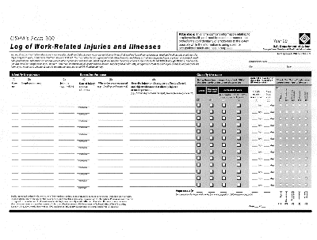
Recordkeeping Forms
Maintained on a calendar year basis
Must be maintained for 5 years at the establishment and be available for inspection
Summary of records for the previous year must be posted from February through April
Must be certified by the highest ranking official working at the establishment.
Notes:
Must be maintained for 5 years at the establishment and be available to OSHA, National Institute for Occupational Safety and Health (NIOSH), and BLS.
Logs must be updated to reflect any changes that occur.
Maintain and post the Log in your workplace.
Do not send any recordkeeping forms to OSHA or any other agency unless you are asked to do so. When conducting its annual survey, the BLS may send you a form in the mail, which must be completed and returned to them.
OSHA Recordkeeping Forms
OSHA 300 Log
OSHA 300A Summary
OSHA 301 Incident Report

Slide 27
Fatality Discussion Workshop
Notes:
Need handout for each student.
Hand out list of eight descriptions of fatalities related to meatpacking
Have teams of two (neighbors) – or more if class size warrants -- pick one and evaluate the data provided (discuss for 5 min.)
Have them review the questions posed on slide 23 and then discuss with the class.

Slide 28
Fatality Discussion Workshop
  What do you think could have happened here based on the information given?
  What (if anything) could have prevented this?
  What topics/OSHA standards/laws might apply to the scenarios?
Notes:
Instructions to Class:
What do you think could have happened here based on the information given?
What (if anything) could have prevented this?
What topics/OSHA standards/laws might apply to the scenarios?
Discuss as a class for 10 minutes.
If you do workshop, SKIP the next slide.

Slide 29
Sources of Reference
www.osha.gov
  E-tools, standards, presentations, etc.
www.oshainfo.gatech.edu
  Free, on-site safety and health consultation
  Completely confidential from OSHA

