Slide 1

T
3
Train
The
Trainer
“Transferring skills and knowledge”
A Port of San Diego Ship Repair Association
Course for Shipyard Workers
This material was produced under grant SH-29629-SH6 from the Occupational Safety and
Health Administration, U.S. Department of Labor. It does not necessarily reflect the views or policies
of the U.S. Department of Labor, nor does mention of trade names, commercial products or
organizations imply endorsement by the U.S. Government.

Slide 2

TRAIN THE TRAINER
“You can help a person catch a fish and feed them for a day or you can teach a person how to fish and they can feed themselves for a lifetime.”

Slide 3
EMPLOYEE DEVELOPMENT
“I believe the desire and ability of an organization to continuously learn from any source, anywhere, and rapidly convert this learning into action is its ultimate competitive advantage.”… Jack Welch, Former-CEO General Electric Company.
The skills and knowledge an organization possesses is fast becoming recognized as its most important asset. A key element of organizational excellence is the skill and knowledge its employees possess. To fully empower an individual, that individual must have the ability to be empowered. To hold employees accountable, they must be capable of performing the activity or the job.
The purpose of this course is to build upon your ability to train others.

Slide 4
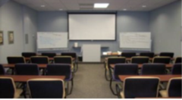
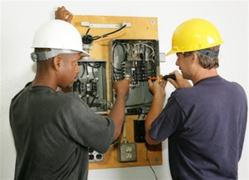
DEFINING TRAINING
“An organized activity designed to bring about change.”
CLASSROOM
ON-THE-JOB

Slide 5
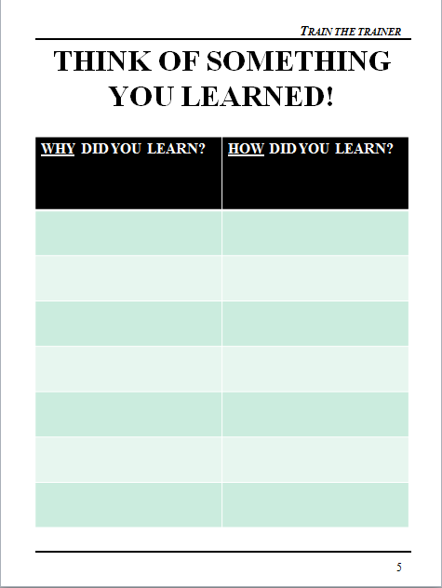
THINK OF SOMETHING YOU LEARNED!

Slide 6
COURSE OBJECTIVES
Upon completion of this training course, the
learners will have the ability to:
Demonstrate four qualities of a good trainer
List four things to prepare for training
Conduct a Training Needs Assessment
Create an effective learning environment
Use at least two types of classroom training media effectively
Use four participative training methods
Use vocal, verbal and visual skills to conduct an effective training class
Assess training effectiveness

Slide 7
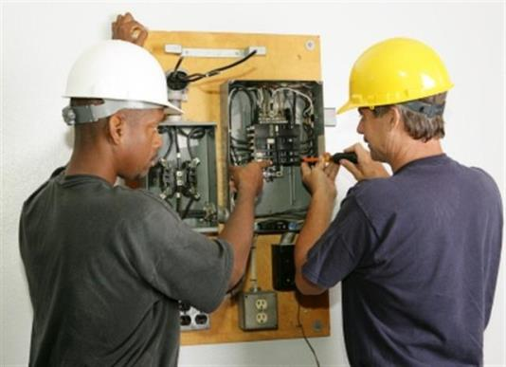
CREATING A LEARNING ENVIRONMENT
The Trainer
The Material
The Physical Space

Slide 8
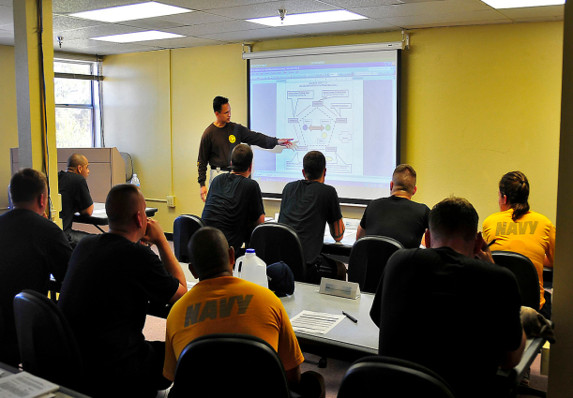
THE TRAINER

Slide 9
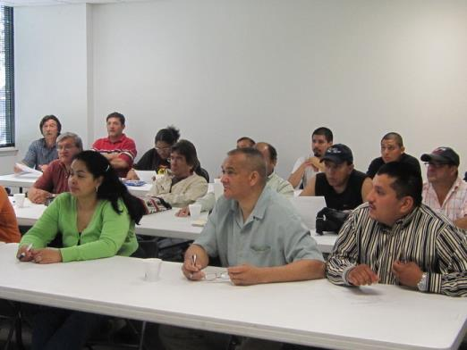
THE QUALITIES OF A GOOD TRAINER
“The mediocre teacher tells. The good teacher explains. The superior teacher demonstrates. The great teacher inspires.”
- William Arthur Ward

Slide 10
NUMBERS!
25
1
26
6
29
2
30
38
41
14
3
13
18
27
4
15
37
16
17
5
39
28
40
42
31
43
32
7
9
44
20
21
34
19
24
36
23
33
22
46
11
10
35
12
48
47
45
8

Slide 11
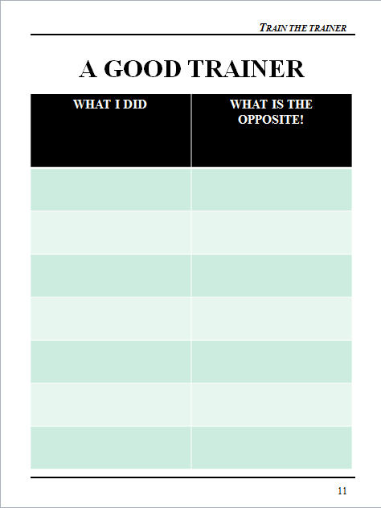
A GOOD TRAINER

Slide 12

THE TRAINER
Don’t…
Rush
Overwhelm
Doubt
Compare

Slide 13
GOOD TRAINER CHARACTERISTICS
Speaks clearly
Organized
Approachable
Patient
Uses a consistent approach
Reads their participant(s)
Knowledgeable
Confident
Prepared
Flexible
Good Listener
Doesn’t downplay task (“This is easy.”)
Has a positive attitude
Makes others feel comfortable
Gives positive feedback

Slide 14
YOUR “TRAINER” RESPONSIBILITIES
As a trainer, please list below what you believe your responsibilities to be:
__________________________________________________________________________________________________________________________________________________________________________________________________________________________________________________________________________________________________________________________________________________________________________________________________________________________________________________________________________________________________________________________________________________________________
____________________________________________________________________________________
____________________________________________________________________________________

Slide 15
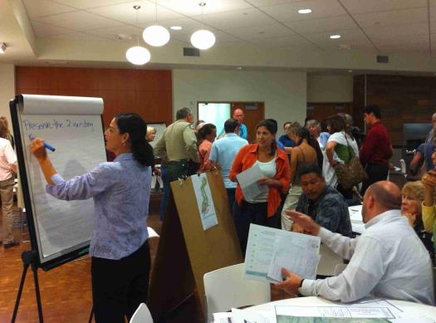
A KEY TRAINER RESPONSIBILITY
Creating a Learning Environment!

Slide 16

PREPARING FOR TRAINING
“You can’t drive a car by looking in the rear view mirror.”
- Deming

Slide 17
PREPARATION KEY ELEMENTS
Know the Material/Task
Know skill/knowledge level of trainees
“Walk Through” the Task/Material
Establish the Physical Environment
Design and Use a Checklist
Anticipate Questions

Slide 18
SAMPLE CHECKLIST
Trainer’s Guide (Notes)
Trainee Books
Handout
Notepaper
Pens
LCD Projector
LCD Screen
Lap Top Computer with course and videos
All Cord(s)
Two Flipchart Stands
Two Flipchart Pads
Set of Flipchart Markers
Masking Tape
Feedback Handout

Slide 19
YOUR CHECKLIST
COURSE TITLE: _________________________
___________________________________________
___________________________________________
___________________________________________
___________________________________________
___________________________________________
___________________________________________
___________________________________________
___________________________________________
___________________________________________
___________________________________________
___________________________________________
___________________________________________
___________________________________________
___________________________________________
___________________________________________

Slide 20

THE MATERIAL

Slide 21

THE MATERIAL
There is a need
Right level
Maintains interest
Purpose and objectives
Digestible chunks

Slide 22
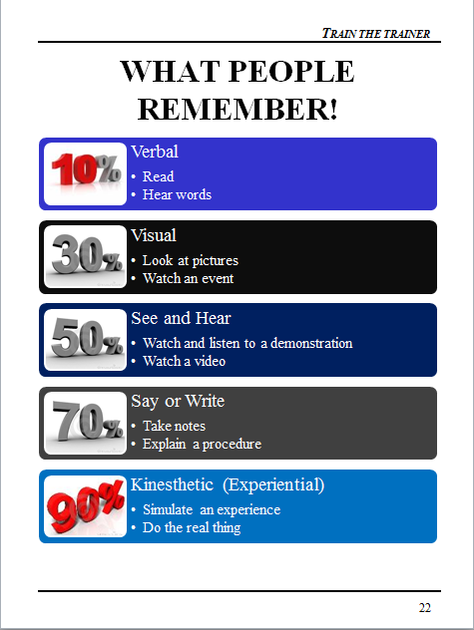
WHAT PEOPLE REMEMBER!

Slide 23

RULE OF THUMB ONE
Tell your audience what you're going to tell them. (Pre-Test)
Tell them. (A variety of training methods)
Then tell them what you told them. (Section Summaries)
Let them tell you! (Questioning, Post-Test)
Notes:
State:
Explain that during the course of this workshop you will be presenting 4 “Rules of Thumb” which are important points. This is the first. Introduce this slide by pointing out that they have probably heard the first three points before during a political speech or debate. Read each bullet. The information in parenthesis are some of the methods that were used in your training to achieve each bullet.
Ask:
If there are questions.
Target Response/Key Points
The last bullet in bold is perhaps the most important.

Slide 24
TRAINING NEEDS ASSESSMENT
Hard Copy – All or select number of employees
  Conducted in meetings, drop-box or mail in
Hard Copy – Focus Group
  Key 6-7 individuals
Electronic Survey
  Free or Pay

Slide 25
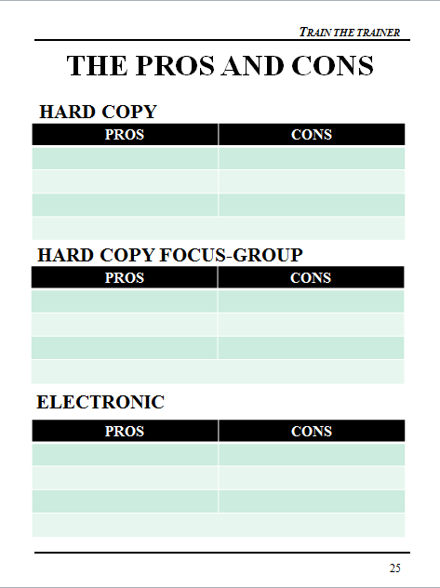
THE PROS AND CONS

Slide 26
TRAINING ASSESSMENT COVER MEMO
Our company has been selected and is participating in a Training Program in partnership with the Port of San Diego Ship Repair Association and OSHA’s Susan Harwood Program.
In order to best determine which training to provide to our employees, we would appreciate if you would complete and return the attached Training Needs Assessment Form to:
Insert trainer name or POC here
on or before ______________________________.
We plan to have our training class during the month of January, 2016.
If you have any questions or comments, please let me know.
Thank you for your input.
Signed,
Trainer from your company

Slide 27
TRAINING ASSESSMENT METHOD ONE
Hard Copy – All or a select number of employees
    Expect 30% return
    Return to trainer, drop-box or point of contact for roll up
    Increases “buy-in”
    Can be done through an interview one-on-one or focus group (see next method)

Slide 28
TRAINING ASSESSMENT METHOD TWO
Hard Copy – Focus Group
Groups of 6-7
Allows discussion
Work Group representation
Faster implementation
Faster roll-up
Less buy-in from participants

Slide 29
TRAINING ASSESSMENT METHOD THREE
Electronic Surveys
Survey Monkey – commonly used
Results to trainer or POC
Results done within survey tool
Specifics to be found on Assessment Tool Websites

Slide 30
ELECTRONIC SURVEYS
Electronic surveys have many advantages over traditional surveys, including a reduction in cost and ease of analysis. Drawbacks to this type of data collection include the potential for selection bias and poorer response rates.
The fast, efficient and often 'free' electronic survey has many advantages over the traditional postal data collection method, including ease of analysis for what can be vast amounts of data. However, to capitalize on these benefits, researchers must carefully consider techniques to maximize response rates and minimize selection bias for their target population.

Slide 31
STRATEGIES
Easily accessible link
Stating the length
Stating the population
Sending up to three reminders
Personalizing each email
Adding the updated response rate to reminder emails
Stating the average time it would take to complete the survey in the title of the email

Slide 32
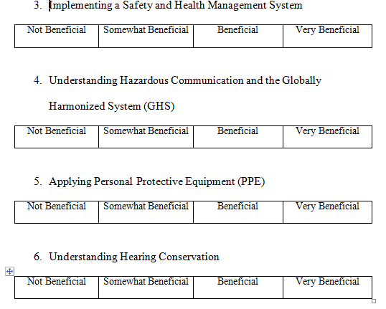
TRAINING NEEDS ASSESSMENT
Sample Assessment

Slide 33
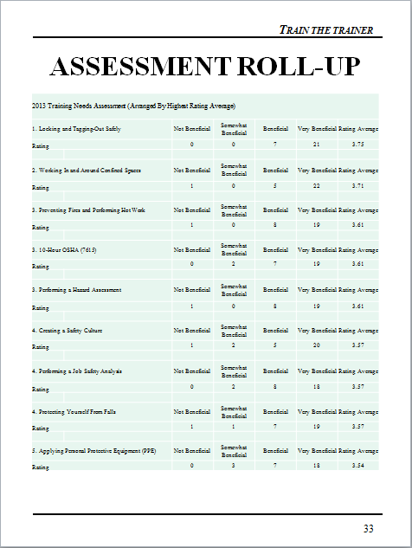
ASSESSMENT ROLL-UP

Slide 34
SAFETY TRAINING RESULTS
The top 8 safety training needs are listed below by highest average score. (Average score in parentheses.)
  1. Locking and Tagging-Out Safely (3.75)
  2. Working In and Around Confined Spaces (3.71)
  3. Preventing Fires and Performing Hot Work (3.61)
  4. 10-Hour OSHA (7615) (3.61)
  5. Performing a Hazard Assessment (3.61)
  6. Creating a Safety Culture (3.57)
  7. Performing a Job Safety Analysis (3.57)
  8. Protecting Yourself From Falls (3.57)

Slide 35

THE PHYSICAL ENVIRONMENT
What’s wrong with this picture?

Slide 36

TRAINING IN A CLASSROOM
The physical environment
The power of questions
Use training media effectively
Participative training methods

Slide 37
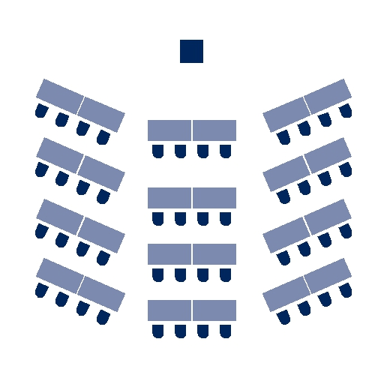
THE PHYSICAL ENVIRONMENT
Listening is purely a voluntary activity!

Slide 38
THE PHYSICAL ENVIRONMENT
List below what you believe to be the optimum physical environment for training.
1.____________________________________________________2.____________________________________________________
3.____________________________________________________
4.____________________________________________________
5.____________________________________________________
6.____________________________________________________
7.____________________________________________________
8.____________________________________________________
9.____________________________________________________
10.___________________________________________________
11.___________________________________________________
12.___________________________________________________
13.___________________________________________________
14.___________________________________________________
15.___________________________________________________
16.___________________________________________________

Slide 39
PHYSICAL ENVIRONMENT ELEMENTS
Temperature
Comfort of Chairs
Space
Distractions
Furniture Arrangement
Lighting
Restrooms

Slide 40
RATING THIS ENVIRONMENT
___ Temperature
___ Comfort of Chairs
___ Room Size & Dimensions
___ Screen or Chart Locations
___ Distractions
___ Furniture Layout
___ Lighting
___ Restrooms

Slide 41
ROOM CHECKLIST
Lighting
How is it controlled?
Is dimmer switch available?
All bulbs/fixtures working?
Windows have shades/blinds?
Do you know how to operate?
Electrical Outlets
Where are they?
Is an extension cord needed?
Do you need an adapter?
Microphone
Are there more than 40 people?
What type of microphone?
Did I practice using it?
Audience Comfort
Temperature Control?
Room dimensions?
Screen location?
Comfort of chairs?
Noise/distractions?
Restroom locations?
Room Set-up
Theater style?
U-shape style?
Herringbone style?
Classroom style?
Conference style?
Buzz style?
Stage
Practice walking/climbing?
Is there a lectern?
Are there lights?
Is it adjustable?

Slide 42
YOUR ENVIRONMENT
WHERE YOU WILL BE TRAINING?
___________________________________________
How can the environment be improved?
___________________________________________
___________________________________________
___________________________________________
___________________________________________
___________________________________________
___________________________________________
___________________________________________
___________________________________________

Slide 43
POP QUIZ!
Please fill in the blanks
What do the trainer, the materials and the physical space create? Fill in the blanks.
A _ _ a _ _ _ _ g E _ _ _ r _ _ _ _ n _
One characteristic of a good trainer is being C _ _ _ _ _ _ _ t .
Designing and using a checklist is a key element in P_ _ _ _ _ _ _ _ for training.
In creating an effective physical space it is important to consider d _ _ _ _ _ c _ _ _ _ _.

Slide 44
TRAINING IN A CLASSROOM
Use training media effectively
Participative training methods
V3 (Vocal, Verbal and Visual)

Slide 45


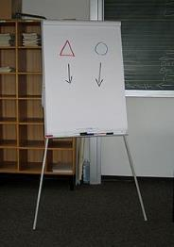
TYPES OF MEDIA
Video
Slides/Multi-media
Flipcharts

Slide 46

USING THE RIGHT MEDIA …RIGHT!
Not the goal!

Slide 47
DEVELOPING AND USING MEDIA
Presenters use media to both increase their persuasiveness and heighten audience retention.
Increase Persuasiveness
  Presenters using visual aids conduct meetings in 28% less time
  Proposals are approved twice as often
Heighten Retention
  Retention increases by about 10%
  Participants learn vocabulary twice as well
  People comprehend about 7% of information delivered verbally. They comprehend 87% when the information is delivered both verbally and visually.

Slide 48
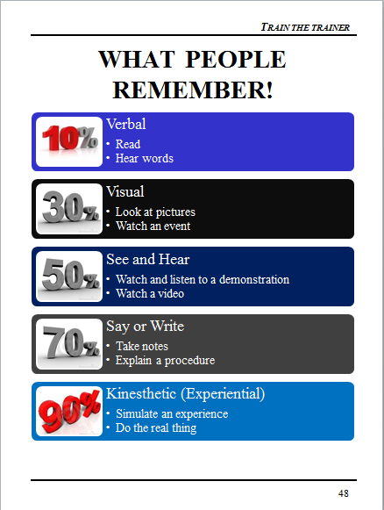
WHAT PEOPLE REMEMBER!

Slide 49


SLIDES WITH DISCUSSION
See and Hear
  Watch and listen to a demonstration
  Watch a video

Slide 50
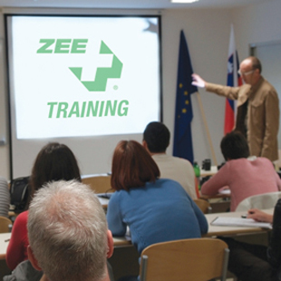

TAKING NOTES WHILE WATCHING A VIDEO
See and Hear
  Watch and listen to a demonstration
  Watch a video

Slide 51


THE PROS AND CONS
The Pros The Cons
VIDEO __________________________ ___________________________
      __________________________ ___________________________
POWERPOINT __________________________ ___________________________
      __________________________ ___________________________
FLIPCHARTS __________________________ ___________________________
      __________________________ ___________________________
HANDOUTS __________________________ ___________________________
      __________________________ ___________________________

Slide 52

REMEMBER!
With any type of projection device, the darker the room the clearer the picture.
However……
The darker the room the more difficult it is to see and hear you.
The darker the room the more difficult it is to take notes.
The darker the room the less audience participation you will receive.

Slide 53
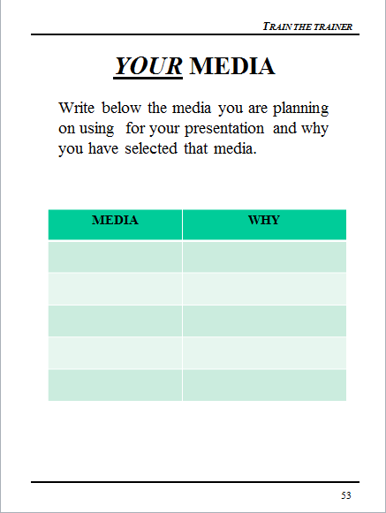
YOUR MEDIA
  Write below the media you are planning on using for your presentation and why you have selected that media.

Slide 54
PARTICIPATIVE
TRAINNG METHODS
Team Competition
Rewards
Pre-Post Testing
Graphics/Pictures
Individual Exercises
Demonstration
Summaries
Videos
Games
Questions
Every training method should
have a learning objective!
Notes:
State:
Explain that these were some of the methods used to transfer learning. This list came from going through the classes and identifying each method. Explain that you will be explaining each method as we move forward.
Ask:
No Questions
Target Response/Key Points
We often have more learning methods than we realize.
Reiterate: Every method should have a learning purpose. Different methods help keep attention, but each method should support your training objectives.

Slide 55

THE POWER OF QUESTIONS
“Judge a man by his questions rather than his answers.”
- Voltaire

Slide 56
OPEN QUESTIONS
Questioning Accomplishes:
  Gathering of information, sharing ideas, learning about a situation
  Obtaining specific information
  Encouraging people to think!!
  Guiding a conversation
  Providing general information or specific information
  Demonstrating that you value the thoughts and feelings of others.

Slide 57
TYPES OF OPEN QUESTIONS
What?….this will focus the training on events
How?….this will focus the training on the process or sequence of doing things
Why?….this will require an explanation
Who can tell me about….
Please explain…
I would like your opinion regarding…
I am interested in your views of…
Tell me your feelings about...

Slide 58
THE DIFFERENCE
Let me tell you why you need to …
You shouldn’t do this because…
The best way to do this is…
My experience in this is…
If you use this tool, be sure to…
I am going to do this because…
Who can tell me why you need to …?
If I were to do this, what would happen?
What do you think is the best way to do this?
What is your experience in this?
How should you use this tool?
Why would I do this?

Slide 59

ANOTHER GOOD REASON TO QUESTION
It makes the trainer’s life a lot easier!

Slide 60
QUESTIONING
In the space provided below, write 5 statements regarding the
training you will be conducting. After finishing those 5
statements, turn them into open ended questions.
STATEMENTS QUESTIONS
____________________________________
____________________________________
____________________________________
____________________________________
____________________________________
____________________________________
____________________________________
____________________________________
____________________________________
____________________________________

Slide 61
TRAINING METHODS
Why use a variety of learning methods?
_________________________________________________________________________________________________________________________________________________________________________________________________________________________________________________________________________________________________________
Notes:
State:
Explain that this is the first “team” activity. Have each table, or group of 2-4 participants brainstorm this together.
While the teams work on this exercise, set up a flipchart to record team scores (see below).
Identify who has the most number of responses and ask them to read them. Give this team 10 points. Ask if any other teams have anything to add. Give those that responded a fruit snack. Explain that you will be using the team competition method for the rest of the workshop.
Ask:
If there are any questions.
Target Response/Key Points
Explain that these are two method that are used consistently in the training. 1) Team competition 2) rewards
Team 1
Team 2
Team 3
Team 4
10

Slide 62

USING DIFFERENT METHODS
Generates interest
People learn in different ways
People learn at different rates
People learn from different experiences
People learn from fun experiences
Notes:
State:
Read slide. Acknowledge those that are the same as the participant responses and point out any that are different.
Ask:
No Questions
Target Response/Key Points
Reiterate that these are the reasons for using a variety of training methods.

Slide 63

REWARDS
Participating
  Reading
  Answering questions
  Providing examples
  Encouraging others
  Offering suggestions
  Others?
Notes:
State:
Explain that this slide provides examples of when rewards (fruit snacks) were used. Read slide.
Ask:
If there are questions
Target Response/Key Points
Remember: You can not use grant funds for fruit snacks!

Slide 64
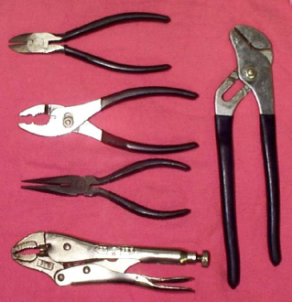
PRE-POST TEST
Circle the letter of the matches the pliers
A B C D E Slipjoint
15. A B C D E Needle nose
A B C D E Multi-groove / Channel Lock
A B C D E Diagonal
18. A B C D E Vise Grip / Locking
A
B
C
E
D
Notes:
State:
This is one example of part of a pre and/or post test. Explain that a variety of testing methods are used, such as; true/false, fill-in-the-blank, connect the picture to the description, put-in-order, etc.
Ask each team to complete the “quiz” on the slide together.
Allow 2 minutes to complete
Ask:
Who would like to share your answers. Pick the first hand that goes up. If they answer correctly give the team 10 points. If they answer incorrectly give the team fruit snacks for participating.
Target Response/Key Points
Learning can and should be fun!

Slide 65
RULE OF THUMB TWO
Seven Slide Rule:
No more than seven slides/pages without a change in media.
Notes:
State:
Explain that this slide means that if you are just lecturing for more than 7 or 8 slides (about 10 minutes) you will lose your audience. If you show more that two videos in succession for over 10 minutes, you will lose your audience.
Ask:
If there are questions.
Target Response/Key Points
If your training materials are great and you are a great trainer it will not matter if your audience is not listening.

Slide 66
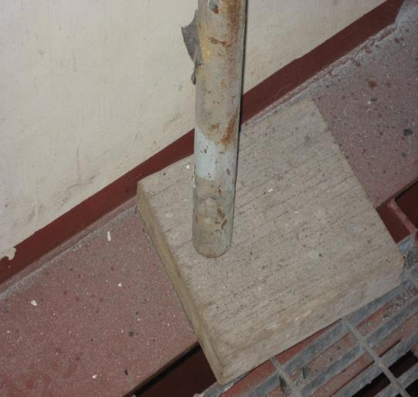

GRAPHICS/PICTURES
Notes:
State:
Explain that pictures are a powerful learning tool. A picture does speak a thousand words. Explain that photos are often used in training sessions to identify what is right and what is not. It is difficult to take your participants to the work site so this is one way of taking the work site to them.
Ask:
What’s wrong with this picture?
Target Response/Key Points
The leg of the scaffold should be held in the middle of the mud sill by a base plate (see next slide)
“What’s wrong with this picture” is a learning tool that teaches right from wrong but also generates discussion.

Slide 67
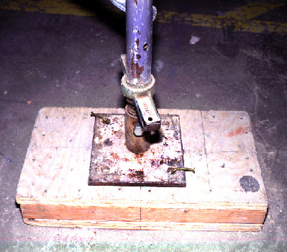
GRAPHICS/PICTURES
Mudsill
Base plate
Notes:
State:
Explain that this is correct.
This leads us to the next slide…
Ask:
No Questions
Target Response/Key Points
None

Slide 68
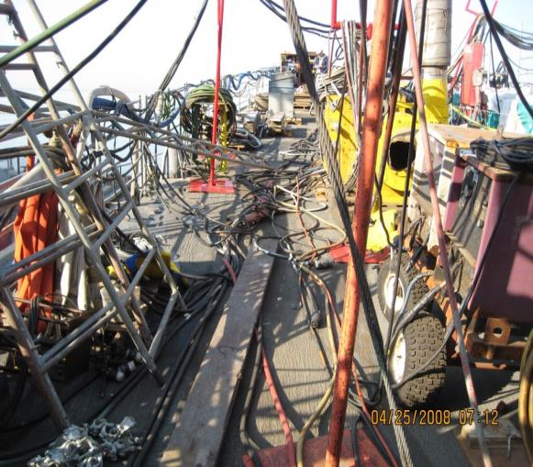
WHAT’S WRONG WITH THIS PICTURE?
dd
Notes:
State:
If time permits, ask the teams to list on a piece of paper “What’s wrong with this picture.”
Reward the team that has the most comprehensive list with 10 points or fruit snacks!
If time does not permit, just explain that this is an example of using the technique and in this photo there are about 10 things wrong with this picture.
Ask:
No Questions
Target Response/Key Points
Reiterate the “Power of the Picture.”

Slide 69

RULE OF THUMB THREE
If you show a negative picture, graphic or example, always show the positive.
Notes:
State:
Read the slide.
Ask:
Why is this important?
Target Response/Key Points
What we see is often what we do. Plus it is difficult sometimes to “see” the opposite of what is being shown.

Slide 70
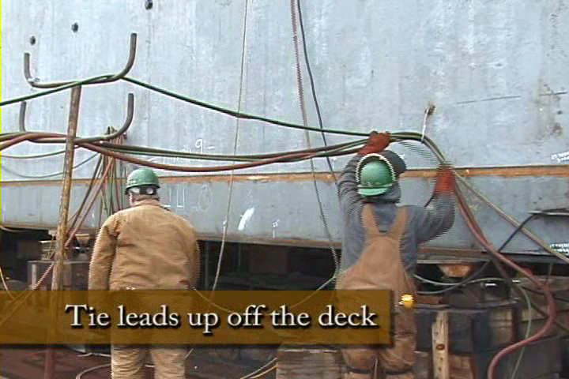
GOOD EXAMPLE!
Notes:
State:
This is an example of “What’s right with this picture.”
Ask:
If there are questions.
Target Response/Key Points
Now the participant knows how to correct a hazard the proper way.

Slide 71
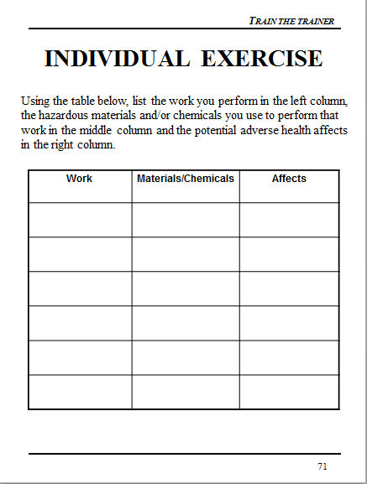
INDIVIDUAL EXERCISE
Using the table below, list the work you perform in the left column,
the hazardous materials and/or chemicals you use to perform that
work in the middle column and the potential adverse health affects
in the right column.
Notes:
State:
Often team exercises are not effective. If you have participants from different organizations that do different jobs, a team exercise may not be effective, and may in fact be confusing. This is an example of an individual exercise.
Ask:
What is the purpose of this exercise?
Target Response/Key Points
To encourage participants to realize that the materials they frequently use, may in fact be harmful to them.

Slide 72
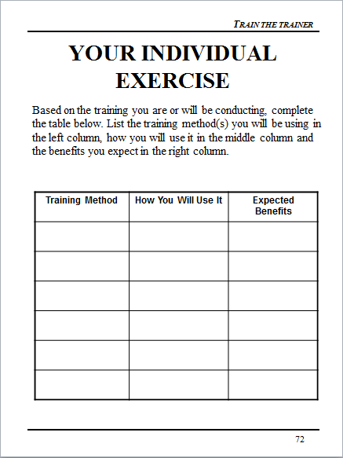
YOUR INDIVIDUAL EXERCISE
Based on the training you are or will be conducting, complete the table below. List the training method(s) you will be using in the left column, how you will use it in the middle column and the benefits you expect in the right column.
Notes:
State:
So far we have covered pre-post testing, team competition, rewards, and individual exercises. Please complete this individual exercise.
Provide about 3 minutes to complete.
Ask:
If anyone would like to share their information.
“What was the objective for this individual exercise.”
Target Response/Key Points
To encourage the participants to integrate additional training methods into their presentations.

Slide 73
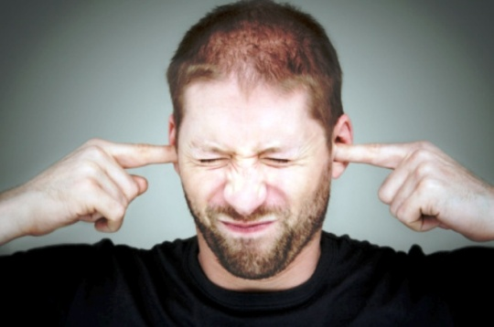

DEMONSTRATION
For a fruit snack, who would demonstrate how to properly put in ear plugs?
Notes:
State:
Many people learn by “doing.” When possible I, or one of the participants, will demonstrate a skill. This can be incorporated into the team competition.
Ask:
Who would like to demonstrate putting in earplugs?
Ask the participants for feedback regarding their demonstration.
(Reward the volunteer with a fruit snack!)
Target Response/Key Points
Demonstrating a skill helps learning stick!

Slide 74
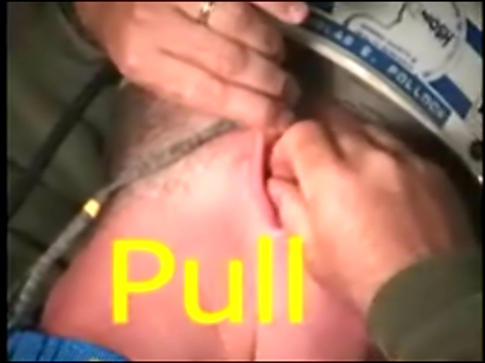
DEMONSTRATION
Notes:
State:
If the ear plugs were not put in correctly, demonstrate the correct way. If so, move on.
Ask:
No Questions
Target Response/Key Points
None

Slide 75

SECTION SUMMARIES
Draw a Line From the Type of Eye Protection
to the Key Feature It Possesses
Notes:
State:
At the end of key training sections, in this case the training module was addressing eye protection, we will often do a review of the training. In this method, using pictures, we are asking the participant to draw a line from the type of eye protection to the best description. Explain that often these summaries help make up the pre-post tests.
If time permits, allow participants to complete this exercise in teams. If not, move on.
Ask:
What is the purpose of this exercise?
Target Response/Key Points
To learn some different types of eye protection and to differentiate the purpose of each.

Slide 76

VIDEO EXERCISE
Step 1: Watch the video
Step 2: Discuss with your team
“What should have been done
differently?” and list below
Step 3: Be prepared to share
your list with the class
_________________________________________________________________________________________________________________________________________________________________________________________________________________________________________________________________________________________________________________________________________________________________________________________________________________________________________________________
Notes:
State:
This is a 6 minute exercise.
Watch the video.
Discuss in your teams “What should have been done differently?”
Feedback to the class your findings
Reward what you consider the “best” answer with 10 points.
Reward all responses with a fruit snack.
Ask:
What did you like about this exercise?
What didn’t you like about this exercise?
Target Response/Key Points
Explain that this activity incorporated the following training methods:
Video
Team Competition
Rewards
Let the participants know that these videos are available on OSHA’s website.

Slide 77

RULE OF THUMB FOUR
When structuring a game or activity, assume the training participants have no idea what you are talking about (See Rule of Thumb One!).
Notes:
State:
It is very important to structure activities in detail. Activities take time and if they are structured incorrectly will cause confusion.
Ask:
If time permits, ask participants to share what they have learned in the past regarding structuring activities.
Target Response/Key Points
Do not rush introducing an activity. Go into detail each step that is expected.

Slide 78

Games
  Stump the Class
  Jeopardy
  Hangman
  Put-In-Order
Notes:
State:
These are some of the learning games we commonly use in training.
Read the list.
Explain that you will be discussing each of these, except for jeopardy, which we have been “playing” during our workshop.
Ask:
No Questions
Target Response/Key Points
None

Slide 79
STUMP THE CLASS
With a partner, write a question from this section (Training Methods) that you believe the rest of the class will be challenged in answering correctly. (Questions must be reasonable! If your instructor can’t answer, it doesn’t count!)
________________________________________________________________________________________________________________________________________________________________________________________________________________________________________________________________________________________________________________________________________________
Notes:
State:
Read the slide and ask each team to write two “reasonable” questions from the material discussed so far.
This may be shortened by asking them to write one question.
Let them know that if they “Stump The Class” their team will be given 10 points.
Ask:
What is the purpose of this exercise?
Target Response/Key Points
Serves as a fun way to review material.
Encourages discussion between team mates.

Slide 80
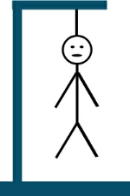
HANGMAN
s _ _ _ _ s _ _ _ _ R _ _ _
The three words above a “rule of thumb”. When you are ready to solve please raise your hand,
discuss with your team, give the answer and an explanation.
Notes:
State:
Hangman is a fun way to reinforce key points. You will need a flipchart and pad.
Explain that the team that solves the “puzzle” must also be able to explain three elements of the “puzzle”.
Explain that the words are a slide header that you recently discussed.
Go around the room and have each team give you a letter. When they give you a letter that fits the words on the slide fill them in. At any time a team can solve the puzzle instead of giving you a letter.
The team that solves the puzzle receives 10 points.
If they are incorrect or cannot provide you with 3 of the elements they will lose 10 points.
The words are Video Benefits.
Ask:
What was the purpose of this exercise?
Target Response/Key Points
A fun way to review key points of a learning objective.

Slide 81
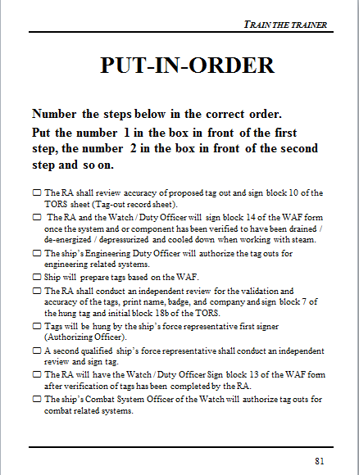
PUT-IN-ORDER
PUT-IN-ORDER
Notes:
State:
This is an example of an exercise used in your Lock Out – Tag Out class. Explain that this is not an exercise that the participants will be completing.
Read the slide instructions and give the participants one minute or so to review.
Ask:
What are the benefits of this activity?
Target Response/Key Points
To learn the proper procedure of Tag Out on a Navy Vessel. It is much more likely to “stick” than simply reading the process because of the involvement and sharing required to complete.

Slide 82


QUESTIONING
Who can tell me the four “Rules of Thumb?”
_________________
_________________
_________________
_________________
Notes:
State:
Speaking of questions….
Ask:
Who can give me one rule of thumb?
Two?
Three?
Four?
Target Response/Key Points
Give the team that can give you the most “rules of thumb” 10 points!

Slide 83
POP QUIZ!
True or False
T or F 1. People remember about 40% of the information they just read.
T or F 2. Using questions is a powerful way to solicit participation from trainees.
T or F 3. When structuring an exercise you should assume your trainees have no idea about what you’re talking about.
T or F 4. When showing a graphic to illustrate the right and wrong way of doing something, you should always show both.
T or F 5. The seven slide rule has to do with the amount of information on each slide.

Slide 84

V3 - DELIVERY
Vocal
Verbal
Visual

Slide 85
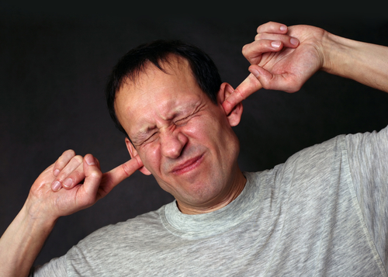
VOCAL

Slide 86
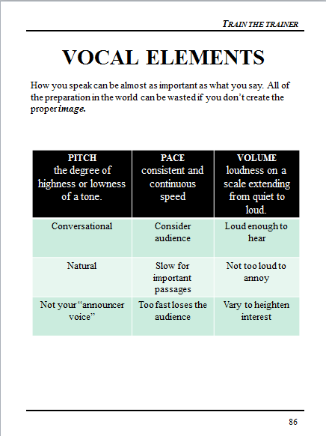
VOCAL ELEMENTS
How you speak can be almost as important as what you say. All of the preparation in the world can be wasted if you don’t create the proper image.

Slide 87
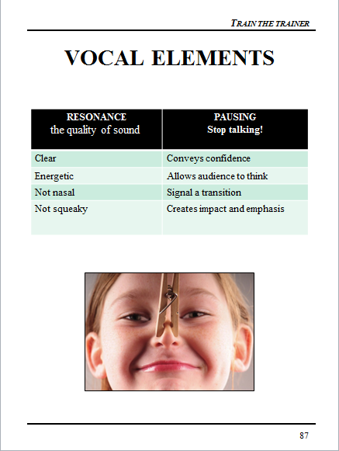
VOCAL ELEMENTS

Slide 88

VOCAL DON’TS
Filler words
Harshness
Breathlessness
Voice change at the end of sentences
Mumbling or slurring

Slide 89

PRACTICE AND FEEDBACK
Practice and honest feedback are effective methods to improve your delivery. One way to do this is to record yourself. Another is to deliver training to an objective person willing to give you honest feedback.

Slide 90
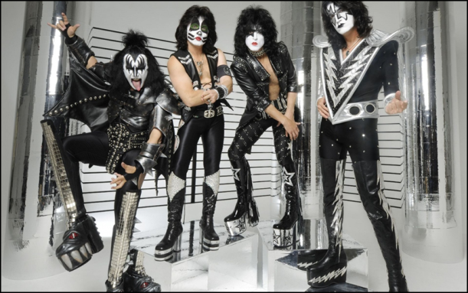
VERBAL

Slide 91
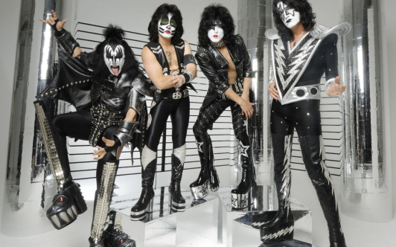
VERBAL
A good rule to follow when making a presentation is KISS (Keep It Short and Simple). Using simple, clear words and phrases makes your meaning clear. Remember, people can process your words 3 times faster than you can speak so keeping key points short reduces the chance that your audience will take “side trips” during your presentation. Using rare words or inflated statements also marks you as a “show-off”.

Slide 92
SIX VERBAL DO’S
Use imagery-words your listeners can picture
Pronouncing words correctly
Using proper grammar
Know the difference between commonly confused words
Emphasize key words
Avoid certain words

Slide 93
VERBAL DO’S
Use imagery-words your listeners can picture, such as..
  Bottleneck vs. problem
  Sticky situation vs. challenge
  Iron fisted vs. strong
  Delighted vs. happy
Pronouncing words correctly, such as….
  Accidentally (not assidently)
  Interesting (not inneresting)
  Toward (not tward)
Using proper grammar, say...
  Phenomenon instead of phenomena
  Regardless instead of irregardless
  Reason is instead of reason is because
  Themselves instead of theirselves

Slide 94
MORE ON WORDS
Usage- know the difference between commonly confused words, such as...
  Affect vs. effect
  Ensure vs. insure
  Farther vs. further
  Imply vs. infer
Emphasis-use techniques to emphasize certain words, such as...
  Change pace to emphasize key points
  Change pitch to create interest
  Change volume to emphasize contrast
  Pause to provide anticipation
Turnoffs-avoid turnoffs such as...
  Fad words
  Slang
  Degrading words
  Profanity
Build your vocabulary-always be on the lookout for new words and practice using them!

Slide 95
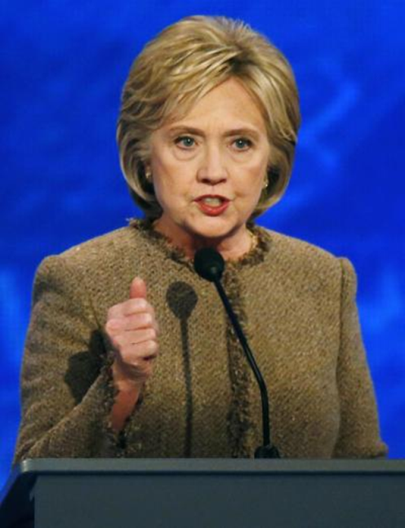
VISUAL

Slide 96
YOUR VISUAL IMAGE
Your voice never conveys your whole message. Nor does your choice of words. A critical part of our presentation success is your personal appearance; your posture, eye contact, facial expressions, head movements, gestures and dress.
Avoid Distractions
  Swaying or rocking
  Pacing too much
  Thumping or tapping
  Staring at notes
  Tugging at ear
  Jingling keys or coins
  Pointing fingers
  Slouching or slumped shoulders

Slide 97
NON-VERBAL DOS
You will connect with your listeners when you look at them. You will feel more relaxed, less isolated and your audience will have more confidence in you.
Eye Contact
  With small group, focus on each person
  With a large group use the 1,2,3,6 and 9 approach or pick out several friendly faces, address each person and move on
Head movements convey information
  Nodding = affirmation
  Shaking = denial
  Tilting = curiosity or uncertainty
  Holding head high = confidence

Slide 98
NON-VERBAL DON’TS
Facial Expression
  Do not tense facial muscles
  Do not smile constantly
  Do not over use poker face
Posture
  Stand straight… but not stiff!
  Point feet at audience with weight evenly distributed
  DO NOT put hands in pockets
      Cross arms
      Wring hands
      Cling for life!

Slide 99
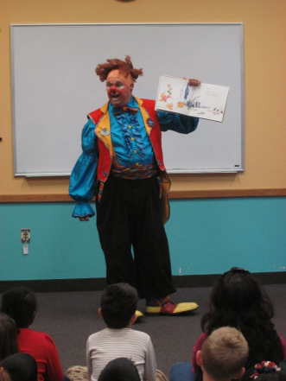
DRESS
  Dress for your audience (audience “level” plus one)
  Be conservative
  Aim for neat

Slide 100

STRESS REDUCERS
Fear: A distressing emotion aroused by an impending pain, danger or evil; or by the illusion of such. According to some surveys, presenting before a group
is a leading “fear creator”. No matter what nervous symptoms you experience before your audience, the secret is to control nervousness - not eliminate it.

Slide 101
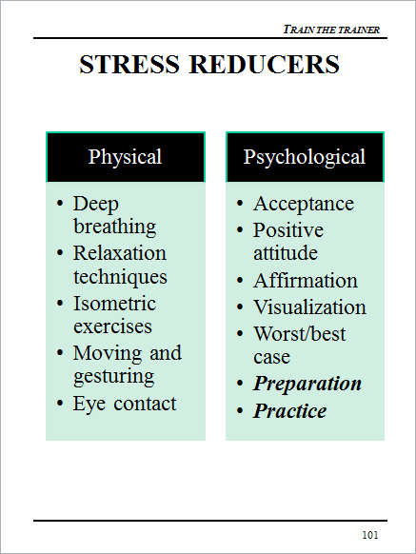
STRESS REDUCERS

Slide 102
POP QUIZ!
True or False
T or F 1. V3 has to do with the three most important variables to writing training objectives.
T or F 2. An imagery word is a word that forms a picture in your mind.
T or F 3. When speaking to your training audience you should pause for emphasis.
T or F 4. When speaking to your audience you should avoid head movements as they are distracting.
T or F 5. You should sometimes use a “poker face” to demonstrate confidence.

Slide 103
YOUR TURN!
Get with a partner or form a group of up to 3 people
Select at least 10 slides from this presentation. The slides should be consecutive.
Divide presentation equally within your team
Prepare and deliver a presentation!

Slide 104
YOUR PRESENTATION
Each presentation should be at least 5 minutes but no more than 10.
Your presentation will be critiqued by your class mates (see following pages).
You will critique others so that we all may learn together!
You and your team have 30 minutes to prepare.

Slide 105

CRITIQUE SHEET
Good Trainer Characteristics (Page 15)

Slide 106

CRITIQUE SHEET
Good Trainer Characteristics (Page 15)

Slide 107
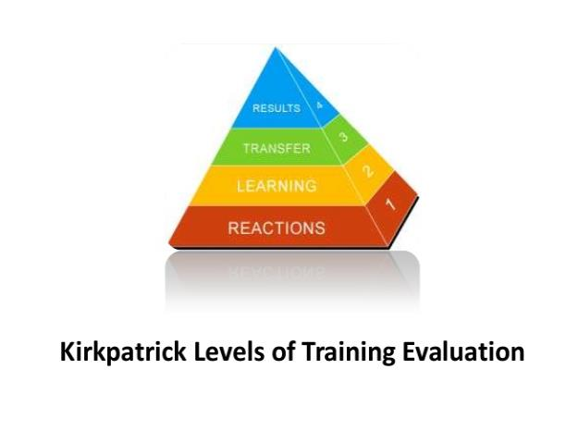
TRAINING EVALUATION
Notes:
What are the different levels of training evaluation required under the Susan Harwood Training Grant Program?
Level 1 – Training Session Reaction Evaluation
Level 1 evaluations measure a participants reaction to the training session and includes the trainee’s perceptions of the quality and usefulness of the training. The results should be used for the improvement of the training program. This type of evaluation can be accomplished through trainee satisfaction surveys regarding both the relevancy of the information taught and the teaching style of the instructor. Level 1 evaluations should be conducted for all training sessions and should be included as part of the training materials development validation process.
Level 2 – Learning Evaluation
Learning evaluations measure the skills, knowledge, or attitude that the trainee retains because of the training. This could be accomplished through pre- and/or post-training evaluations. Alternatively, trainees could be required to perform a new task that was taught during the training and the result evaluated. Level 2 evaluation should be conducted for all training and should be included as part of the training materials development validation process.
Level 3 – Training Impact Evaluations
Training impact evaluations gauge the effect of the training on the trainees’ ability to participate in safety and health activities in the workplace. Grantees should specify at least one measure that is closely linked to the expected outcomes of their planned activities. Examples of such measures could be:
Increases in workers’ involvement in workplace safety as demonstrated by reporting the pre-training level and the level at follow-up three to six months later,
Increases in the number of hazards reported as demonstrated by reporting the pre-training level and the three to six month follow-up level,
Increases in the number of workers participating on safety committees as demonstrated by reporting the pre-training level and the three to six month follow up level,
Increases in the number of reported accident near misses as demonstrated by reporting the pre-training level and the three to six month follow up level,
Increases in the number of formal complaints filed, trainee retention of knowledge, positive impacts of training activities on work practices, etc.
Training impact evaluations are typically conducted three to six months after the training and require the grantees to re-contact trainees by phone, in person, or by survey.

Slide 108
LEVELS OF EVALUATION
Level 1 – Training Session
  Reaction Sheets
Level 2 – Learning Evaluation
  Pre-Post Tests
Level 3 – Training Impact
  Behavior Change

Slide 109
LEVEL 1
Example Methods
  Written survey
  Cards – red, yellow, green (tally results)
  Group session (tally results)
Example Questions
  Was the learning environment conducive to learning?
  What thing could we have done to make the training better?
  How do you feel after participating in this training?
  On a scale of 1 (low) to 5 (high), how would you rate the trainer?
Notes:
Level 1 evaluations can be conducted through a number of methods. Common methods include written surveys, participant cards that are held up and tabulated by the instructor, or through group sessions where the group leader records the results.
Typical Level 1 evaluations typically contain five to 10 questions, and acquire information about the course format, learning environment, course methodology, if the course covered the appropriate topics, and instructor.

Slide 110
LEVEL 1 EXAMPLE RESULTS
Examples of How Results are Reported
  All participants were provided a Level 1 evaluation.
  93% of the class rated the learning environment conducive to training as green (green, yellow, red scale)
  Participants felt the training would have been better if the module on worker’s rights included __________
  Participants felt that after the training session they would be better able to approach their supervisor about a safety hazard
Examples of Modifications as a Result of the Level 1 Survey
  Based on Level 1 Survey results from the first three training sessions, the instructor manual was modified to include ___________
  Based on the Level 1 Survey results from the initial training, Module 1 was modified from a lecture to a hands-on activity
Notes:
This slide lists example results for Level 1 evaluations that should be reported in the close-out report. Examples include:
How many participated in the survey
% or number of respondents to each survey question
List of qualitative results
Any trends or changes to the training that occurred as a result of the Level 1 evaluation

Slide 111
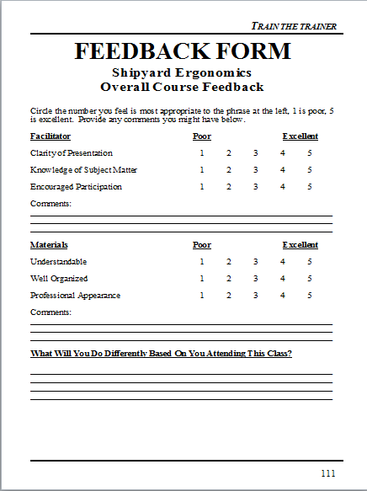
FEEDBACK FORM

Slide 112
LEVEL 2
Example Methods
  Written pre- and post-training evaluations
  Oral pre- and post-training evaluations
  Group session (tally results pre- and post-training for comparison)
Knowledge Questions from Learning Objectives
  When is fall protection required?
  What are the three words for preventing illness related to heat?
  OSHA is a government agency that works on?
Notes:
Level 2 evaluations can be conducted through written or verbal pre and post training evaluations, or as a post training evaluation of the participants proficiency at completing a skill. Pre and post evaluation questions should be the same, so that the results are comparable. The results of the evaluations should be tabulated and reported in the close-out report; preferably on a question by question level.
Level 2 evaluation questions should be based on the course learning objectives. Typical Level 2 questions are multiple choice, fill-in-the-blank, extended answer, true/false, or demonstrating a proficiency in an activity.

Slide 113

SAMPLE POST-TEST
Shipyard Ergonomics
Pre-Test Post-Test
NAME: _________________________________DATE:_________________________
True or False: For each statement below, circle T or F

Slide 114
MIX IT UP!
True / False
Fill In The blank
Multiple Choice
Put-In-Order
Draw a Line To The Picture
Try to avoid subjective questions!

Slide 115
LEVEL 2 EXAMPLE RESULTS
Examples of How Results are Reported
  476 of the 499 participants participated in the pre- and post-training evaluations
  The evaluation consisted of 25 questions
  Pre-training scores ranged from 33% to 68% and post-training scores ranged from 65% to 98%
Examples of Modifications as a Result of the Level 2 Evaluation
  The training evaluation was modified from an individual to group format to increase participation
  Due to low test scores during our first 3 training sessions, the module on wearing PPE was modified for clarification
Notes:
This slide lists examples of Level 2 evaluation results that should be reported in the close-out report. Examples include:
How many participated in the evaluation
Overall pre and post training evaluation results
Question by question pre and post training evaluations
List of qualitative results
Any trends or changes to the training that occurred as a result of the Level 2 evaluation

Slide 116
HOW WOULD YOU TEST THIS CLASS?
____________________________________________________________________________________________________________________________________________________________________________________________________________________________________________________________________________________________________________________________________

Slide 117
LEVEL 3
Example Methods
  Direct mail
  Online survey
  Focus Group
  Telephone survey/in-person interview
Example Questions
  Have any new occupational safety and health measures been implemented as a result of the training? If so, what?
  Have you shared anything you learned in the training with a co-worker or family?
  Has knowledge from the training been applied since you returned to your job? If so, how?
Notes:
Level 3 evaluations should be conducted three to six months following the training session. Each training participant should be offered the opportunity to participate in Level 3 evaluations. Typical response rates are less than 10%. Methods for survey distribution include direct mail, email, online, through focus groups, or through telephone and in-person surveys.
Level 3 evaluation questions should focus on safety and health measures that may have been implemented as a result of the knowledge conveyed during the training.

Slide 118
LEVEL 3 EXAMPLE RESULTS
Examples of How Results are Reported
  10% of the participants responded to the survey and/or participated in the focus groups
  As a result of the training, our company has developed a safety committee
  As a result of the training, our company has initiated completion of job hazard analysis for all positions
Examples of Modifications as a Result of the Level 3 Evaluation
  A one-hour refresher module was added to the Train-the-Trainer curriculum
  Based on feedback, training was expanded to the following states: Florida, Georgia, and Tennessee
Notes:
This slide lists examples of Level 3 results that should be reported in the close-out report. Examples include:
How many participated in the evaluation
Quantitative results
List of qualitative results
Any trends or changes to the training that occurred as a result of the Level 3 evaluation

Slide 119
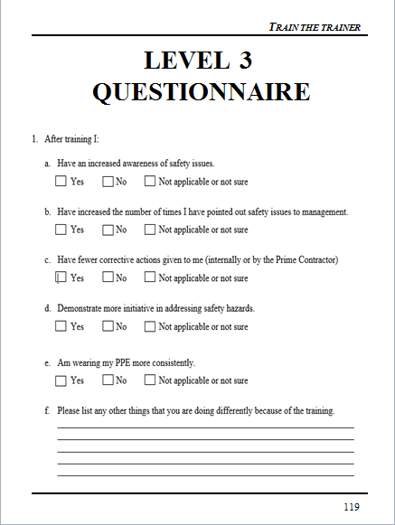
LEVEL 3
QUESTIONNAIRE

Slide 120

QUESTIONS
Notes:
State:
(Tally up the “winners” based on the flipchart scores)
Have the participants give the winners a hand.
Explain to the winners that they just received their reward! for winning!
Also, give them each a fruit snack.
Ask:
If there are questions.
Target Response/Key Points
None

