Slide 1
Hazard Assessment JSA Training Manual
Developed by The Port
of San Diego Ship Repair
Association
Notes:
Hazard Assessment and Job Safety Analysis
There are many definitions for “hazard” but the more common definition when talking about workplace health and safety is:
“A hazard is any source of potential damage, harm or adverse health effects on something or someone under certain conditions at work.”
Basically, a hazard can cause harm or adverse effects (to individuals as health effects or to organizations as property or equipment losses).
“Risk” is the chance or probability that a person will be harmed or experience an adverse health effect if exposed to a hazard. It may also apply to situations with property or equipment loss.
Shipyards have a death and accident/injury rate close to two-times that of general industry. This means that either shipyard workers are exposed to more hazards, and/or the hazards are not controlled.
At the completion of this workshop it is expected that all trainees will be able to better identify, evaluate and control its occupational health and safety risks on an on-going basis.

Slide 2
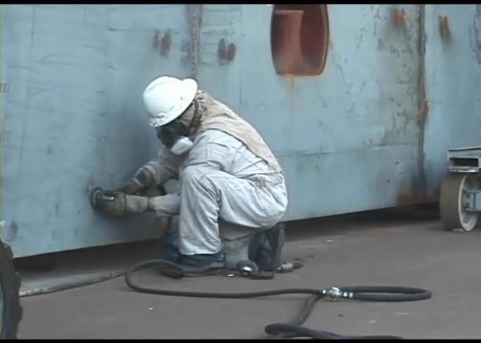
Course Objectives
Notes:
Course Objectives
At course completion it is expected that the training participants will be able to demonstrate:
An understanding of Employer and Employee rights and responsibilities under OSHA
Knowledge regarding the meaning of “No Retribution”
Knowledge on how to report a hazard or file a complaint with OSHA
An understanding regarding hazard assessment terminology
How to conduct a basic hazard assessment
How to conduct a Job Safety Analysis

Slide 3
OSHA
Notes:
OSHA and You!
You have rights!
No retribution
Filing a complaint

Slide 4
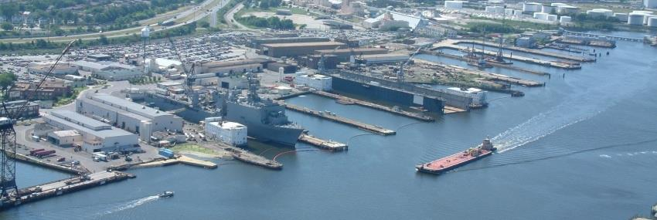
OSHA Exercise
Notes:
Employee’s Responsibilities and Rights
Responsibilities include:
Complying with OSHA standards _____
Wearing required PPE _____
Reporting hazards to supervisor _____
Complying with your organization’s rules and policies _____
Rate yourself on how often you fulfill each of your responsibilities above. “1” is less than 50% of the time; “2” is 50% to 75% of the time; “3” is 75% to 100% of the time. How might your scores impact your risk of injury?
Rights include:
Reviewing standards
Receiving training
Requesting an OSHA investigation (employer or OSHA) and receiving
feedback upon request
Reviewing the OSHA 300 Log

Slide 5
OSHA
5
Notes:
5
5
Employer’s Responsibility
Employers have certain responsibilities under the OSH Act of 1970. The following list is a summary of the most important ones.
Provide a workplace free from serious recognized hazards and comply with standards, rules and regulations issued under the OSHA Act
Examine workplace conditions to make sure they conform to applicable OSHA standards
Make sure employees have and use safe tools and equipment and properly maintain this equipment
Use color codes, posters, labels or signs to warn employees of potential hazards
Establish or update operating procedures and communicate them so that employees follow safety and health requirements
Provide medical examinations and training when required by OSHA standards
Post, at a prominent location within the workplace, the OSHA poster (or the state-plan equivalent) informing employees of their rights and responsibilities.

Slide 6
OSHA
6
Notes:
6
6
More Employer’s Responsibility
Report to the nearest OSHA office within 8 hours any fatal accident or one that results in the hospitalization of 3 or more employees
Keep records of work-related injuries and illnesses. (Note: Employers with 10 or fewer employees and employers in certain low-hazard industries are exempt from this requirement)
Provide employees, former employees and their representative’s access to the Log of Work Related Injuries and Illnesses (OSHA Form 300)
Provide access to employee medical records and exposure records to employees or their authorized representatives
Provide to the OSHA compliance officer the names of authorized employee representatives who may be asked to accompany the compliance officer during an inspection
Not discriminate against employees who exercise their rights under the Act
Post OSHA citations at or near the work area involved. Each citation must remain posted until the violation has been corrected, or for three working days, whichever is longer. Post abatement verifications documents or tags
Correct cited violations by the deadline set in the OSHA citation and submit required abatement verification documentation

Slide 7
OSHA
Notes:
No Retribution
Section 11(c) (1) No person shall discharge or in any manner discriminate against any employee because such employee has filed any oral and written complaints.
Discrimination includes:
Firing or laying off
Blacklisting demoting
Denying overtime or promotion
Disciplining
Denial of benefits
Failure to hire or rehire
Intimidation
Reassignment affecting future promotions
Reducing pay or hours

Slide 8
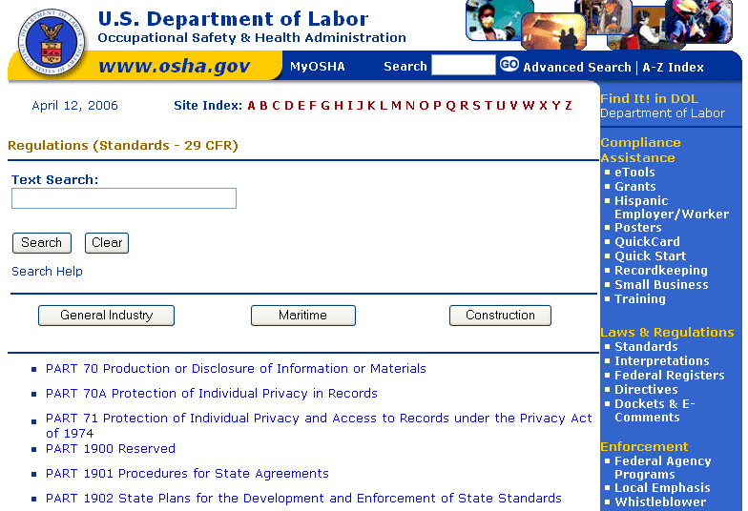
OSHA
Notes:
Resolve With Your Company – Follow your chain of command. Go to your Lead, Supervisor or Safety Technician. However, if this fails you should file a valid complaint.
Online - Go to the Online Complaint Form. Written complaints that are signed by workers or their representative and submitted to an OSHA Area or Regional office are more likely to result in onsite OSHA inspections.
Telephone - your local OSHA Regional or Area Office. OSHA staff can discuss your complaint and respond to any questions you have call 1-800-321-OSHA.
Download and Fax/Mail - Download the OSHA complaint form* [En Espanol*] (or request a copy from your local OSHA Regional or Area Office), complete it and then fax or mail it back to your local OSHA Regional or Area Office. Written complaints that are signed by a worker or representative and submitted to the closest OSHA Area Office are more likely to result in onsite OSHA inspections. Please include your name, address and telephone number so we can contact you to follow up. This information is confidential.

Slide 9
OSHA Exercise
Stump the class!
With a partner, write two questions from this section that you believe the rest of the class will be challenged in answering correctly. (Questions must be reasonable! If your instructor can’t answer, it doesn’t count!)
Notes:
Question One:
_____________________________________________________________________________________________________________________________________________________________________________________________________________________________________________________________________________________________________________________________________
Question Two:
_____________________________________________________________________________________________________________________________________________________________________________________________________________________________________________________________________________________________________________________________________

Slide 10
Introduction
Notes:
Introduction
In this section we will discuss the following:
Definitions
Hazards and Risk
Quiz

Slide 11
Definitions
The following pages contain definitions associated with hazard assessment and controls used in shipyards.
As we go through each lesson, look for these terms being used!
11
Notes:
11
Acceptable Risk – Risk that has been reduced to a level that can be tolerated by the organization having regard to its legal obligations and its own Occupational Health & Safety policy.
Accident - An incident which has given rise to injury, ill health, or fatality.
Competent personnel – Employees with appropriate level of shipyard experience and the ability to recognize hazards, assess risk, and decide on necessary controls.
Harm - Includes death, injury, physical or mental ill health, damage to property, loss of production, or any combination of these.
Hazard - A source, situation, or act with a potential for harm in terms of human injury or ill health, or combination of these.
Incident - A work-related event(s) in which an injury or ill health (regardless of severity) or fatality occurred, or could have occurred.
Fatality - Death due to a work related injury or illness regardless of the time between the injury or illness and death.

Slide 12
Definitions Continued
Notes:
Lost Time Injury - Work related injury or illness, which renders the injured person unable to perform his normal duties on any day following the day of accident.
Nonconformity – A non-fulfillment of a requirement
Review Team – Members of management and hourly personnel who are most knowledgeable about the risks inherent in the area.
Risk - The combination of the likelihood of an occurrence of a hazardous event or exposure(s) and severity of injury or ill health that can be caused by the event or exposure(s).
Risk Assessment - The process of evaluating the risk(s) arising from a hazard(s), taking into account the adequacy of any existing controls, and deciding whether or not the risk(s) is acceptable.
Routine Work – activities that are conducted daily, weekly, monthly or quarterly.

Slide 13
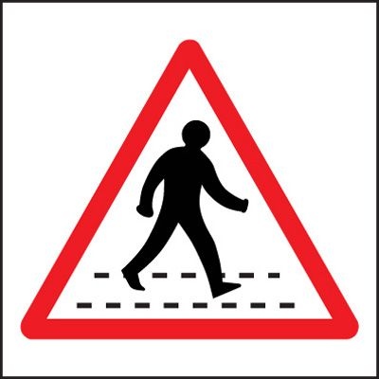
Hazards and Risk
Notes:
Hazard
Employers should identify and abate all hazards.
A hazard is a source, situation, or act with a potential for harm in terms of human injury or ill health, or combination of these.
Act/Situation – Crossing the road
Hazard – Hit by a car
Consequence – Serious injury or fatality
Risk
The combination of the likelihood of an occurrence of a hazardous event or exposure(s) and severity of injury or ill health that can be caused by the event or exposure(s).
Based on the hazard above, what are the factors that would determine the risk? ______________________________________________________________________________________________________________________

Slide 14
Hazards and Risk Exercise
A. Situation/Act | B. Hazards | C. Severity | D. Likelihood | E. Risk
Crossing country road
Crossing street from shipyard to your car
Crossing freeway
Crossing bike path
Crossing shipyard vehicle lane
Notes:
Step 1. Please identify the Hazards (column “B”). Step 2. Rate how likely the hazard is to occur in column “D” as (1) Low, (2) Medium or (3) High. Be prepared to justify your answers. Skip Column “C” and “E”.
In each Situation/Act you will be crossing on foot.

Slide 15
Severity
A. Situation/Act | B. Hazards | C. Severity | D. Likelihood | E. Risk
Crossing country road
Crossing street from shipyard to your car
Crossing freeway
Crossing bike path
Crossing shipyard vehicle lane
Notes:
Now certain hazards are more severe than others. Step 3. Using the work you did on the previous page, please identify the severity of the hazard in column “C” using the rating scale (1) Minor injury, negligible lost time, property damage less than $1,000, (2) 7 days lost time, permanent injury, property damage $10,000 or more, (3) Fatality, 30 days lost time, Property damage $100,000 or more.

Slide 16
Hazard Assessment
A. Situation/Act | B. Hazards | C. Severity | D. Likelihood | E. Risk
Crossing country road
Crossing street from shipyard to your car
Crossing freeway
Crossing bike path
Crossing shipyard vehicle lane
Notes:
Step 4. To assess the risk, multiply the number in the “Severity” column (“C”) by the number in the “Likelihood” column (“D”).
Which has the highest risk?

Slide 17
Introduction Quiz
17
Notes:
17
For each statement below circle T for True or F for False.

Slide 18
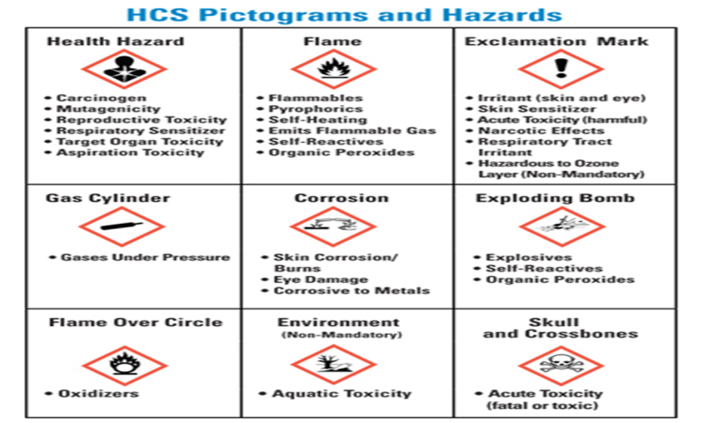
Hazards and Hazard Controls
Notes:
Hazards and Hazard Controls
In this section we will discuss the following:
Shipyard Hazards
Elimination/Substitution
Engineering Controls
Administrative Controls
Personal Protective Equipment

Slide 19
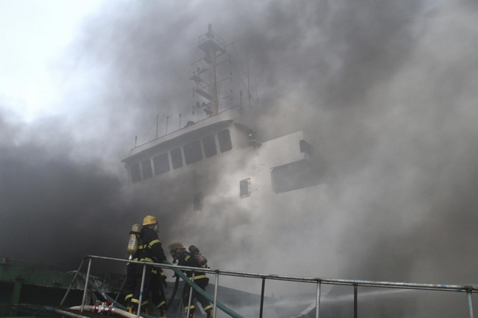
Shipyard Hazards
19
Notes:
19
Hazards Found in the Shipyard
The following are types of workplace hazards you will find in the shipyard and in your shop. Circle the Physical Hazards you are exposed to.
Physical Hazard Related Shipyard Process Example
Pinch hazard Equipment gears rotating
Trips and falls Lines crossing/walk-ways
Vibration and noise Turbines rotating
Electrical hazards Working on electrical boxes
Extreme temperatures Steam plant lighting off
Radiation exposure Radiation leak on nuclear vessel
Confined Space Oxygen deficiency
Fires Oily material ignited while welding
Explosions Brazing material
Cuts and abrasions Using machinery or tools
Death All of the above

Slide 20
Elimination/Substitution
20
Notes:
20
Elimination
The best way to abate a hazard is to eliminate it!
Elimination is the process of removing the hazard from the workplace. It is the most effective way to control a risk because the hazard is no longer present. It is the preferred way to control a hazard and should be used when ever possible.
Example: Work that was once done on the ship is now fabricated in the shop.
Substitution
Substitution is the process of implementing a less hazardous process in place of a more hazardous process.
Example: A new chemical or substance is used instead of a more hazardous chemical or substance.

Slide 21
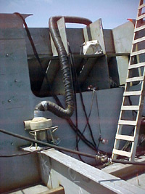
Engineering Controls
21
Notes:
21
Engineering Controls
Controlling a hazard at its source is the best way to protect employees. These controls are called Engineering Controls and focus on the source of the hazard rather than on the employees exposed to the hazard. Depending on the hazard or workplace conditions, OSHA recommends the use of engineering or work practice controls to manage or eliminate hazards.
Types of Engineering Controls:
Initial design specifications
Change process
Enclose process
Isolate process
Ventilation
Example: If a compressor is causing significant vibration, building walls around the compressor is an engineering control that will protect employees from noise.

Slide 22
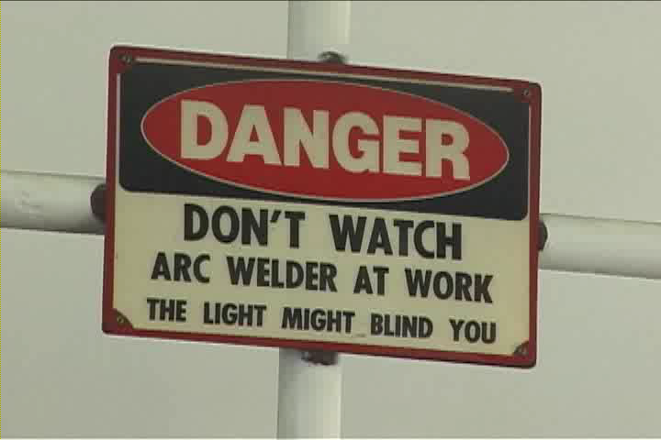
Administrative Controls
22
Notes:
22
Administrative Controls
Administrative controls are work practices, work methods, policies and procedures established by the employer with the goal of reducing exposure to a work-related risk and/or hazard. Administrative controls include:
Rotating workers in jobs that induce body fatigue, such as welders and burners that use vibratory pneumatic tools in tasks such as smoothing welds or removing paint. These pneumatic tools can cause tendon, nerve or neurovascular disorders.
Requiring worker in hot environments (such as tanks) to take breaks in cool areas and providing fluids for re-hydration
Proper housekeeping. Reducing clutter reduces the chances for an incident and minimizes the effects if an accident occurs
Conducting hearing tests
Directing welders to use their hands and not their necks to raise and lower their welding hoods. Using the neck can cause neck trauma
Safety training throughout the organization
Communicating to workers through policies, procedures and signs

Slide 23
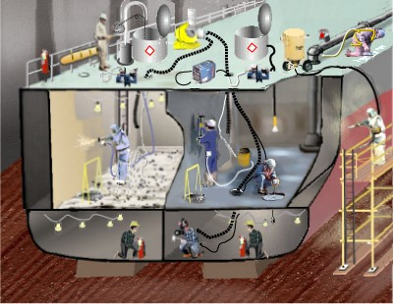
Personal Protective Equipment
Notes:
Personal Protective Equipment (PPE)
Types of general shipyard work personal protective equipment include:
Head Protection
Eye and Face Protection
Foot Protection
Hearing Protection
Respiratory Protection
Hand and Body Protection
Lifesaving Equipment and Personal Flotation Devices (PFDs)
Personal Fall Protection Equipment
In addition to the above mentioned protections additional PPE is required when performing specific types of work processes.

Slide 24
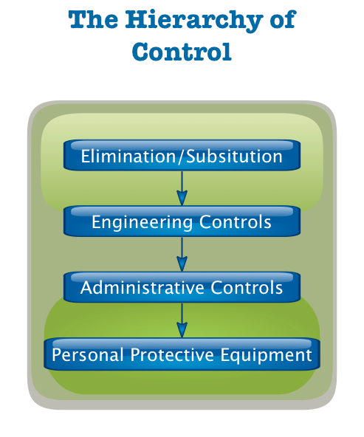
OSHA’s Hierarchy of Controls
Notes:
OSHA’S Hierarchy of Controls
OSHA’s hierarchy of controls is:
Elimination
Engineering Controls
Administrative Controls
Personal Protective Equipment
.

Slide 25
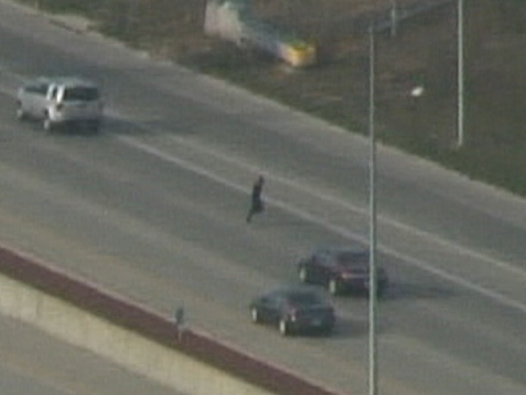
Hazard Control Exercise
Notes:
From pages 14-16, for each hazard, identify a control under each heading that could be implemented to abate the hazard.
Which control is most effective?

Slide 26
Hazards & Hazard Controls Exercise
Notes:
From page 19, identify one of the hazards that you circled and describe below how you might implement each of the controls to abate the hazard.
Hazard ________________________________________________

Slide 27
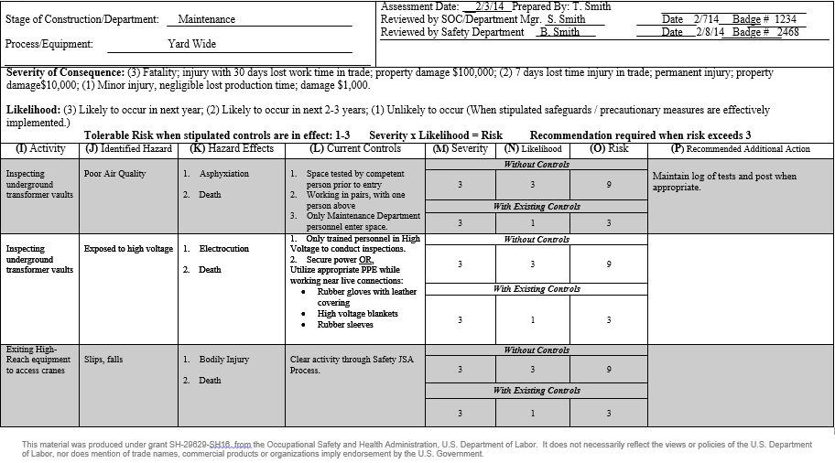
Sample Form
Notes:
This is a sample of an actual Hazard Assessment form used in a large shipyard.
Take a minute to review and be prepared to explain each box.
What could additional recommendation be?
What Hazard Control would it classified as?

Slide 28
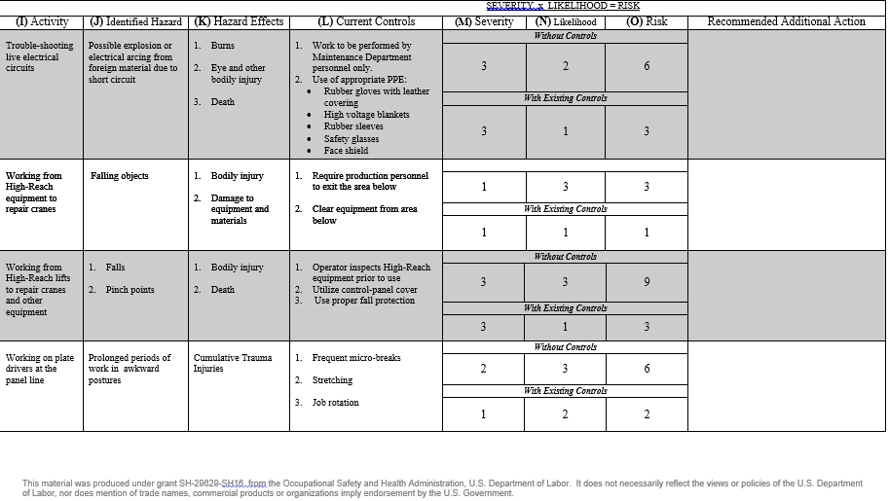
Sample Form
Notes:
This is a sample of an actual Hazard Assessment form used in a large shipyard.
Take a minute to review and be prepared to explain each box.
What could additional recommendation be?
What Hazard Control would it classified as?

Slide 29
Hazards and Hazard Controls Quiz
QUIZ!
QUIZ!
Notes:
For each statement or question below circle the best answer.

Slide 30
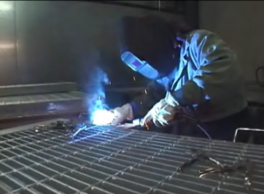
Hazard Analysis
Notes:
Under the OSHA LAW, employers have a responsibility to provide a safe workplace. This is a short summary of key employer responsibilities and is not all inclusive:
Provide a workplace free from serious recognized hazards and comply with standards, rules and regulations issued under the OSH Act.
Examine workplace conditions to make sure they conform to applicable OSHA standards.
Make sure employees have and use safe tools and equipment and properly maintain this equipment.
Use color codes, posters, labels or signs to warn employees of potential hazards.
Establish or update operating procedures and communicate them so that employees follow safety and health requirements.

Slide 31
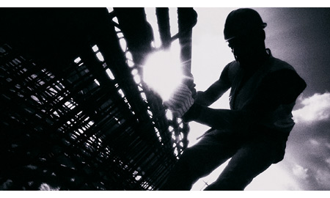
Job Safety Analysis (JSA)
31
Notes:
31
Job Safety Analysis (JSA)
A tried and true method to identify and reduce the risk of workplace hazards is a job safety analysis (JSA).
In a JSA, each basic step of the job is analyzed to identify potential hazards and to recommend the safest way to do the job. Other terms used to describe this procedure are job hazard analysis (JHA) and job hazard breakdown.

Slide 32
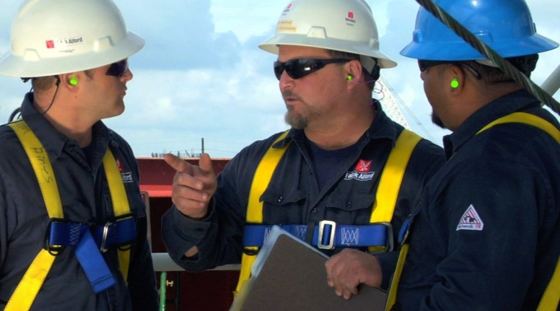
When To Conduct a JSA
Notes:
When To Conduct a Job Safety Analysis
Ultimately, a JSA should be conducted on all work processes. To begin use the list below for guidance.
Jobs with the highest injury or illness rates
Jobs with the potential to cause severe or disabling injuries or illness even if there is no history of previous accidents
Jobs in which simple human error could lead to a severe accident or injury
Jobs that are new or have undergone changes in processes and procedures
Jobs complex enough to require written instructions
Unusual jobs/use of new tools or machinery
Tasks that require the interaction of multiple people or systems
Any task in which an employee/supervisor has safety concerns

Slide 33
When According to the Navy
Notes:
NAVSEA Std. Item 009-74, 3.1.3
3.1.3 A process for performing a Job Safety Analysis/Job Hazard Analysis (JSA/JHA) for:
3.1.3.1 Processes and equipment new to the worksite.
3.1.3.2 Existing processes and equipment that have been involved in mishaps or near misses.
3.1.3.3 Maintain a copy of each JSA/JHA which shall be available for review by the SUPERVISOR upon request.
3.1.4 A process for identification, communication, abatement, and prevention of unsafe conditions and work practices.

Slide 34
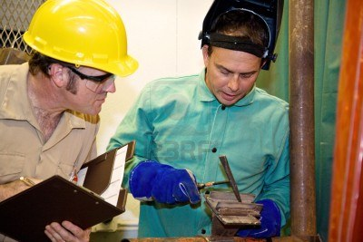
The Benefits of a JSA Exercise
Notes:
The Benefits of a JSA
List below the benefits of conducting a Job Safety Analysis.

Slide 35
The Benefits of a JSA
Notes:
The Benefits of a JSA
Initial benefits from developing a JSA will become clear in the preparation stage. The analysis process may identify previously undetected hazards and increase the job knowledge of those participating. Safety and health awareness is raised, communication between workers and supervisors is improved, and acceptance of safe work procedures is promoted.
A JSA can, and in most cases should, become a written work procedure. This process can form the basis for regular contact between supervisors and workers. It can serve as a teaching aid for initial job training and as a briefing guide for infrequent jobs. It may be used as a standard for health and safety inspections or observations. In particular, a JSA will assist in completing comprehensive incident investigations.

Slide 36
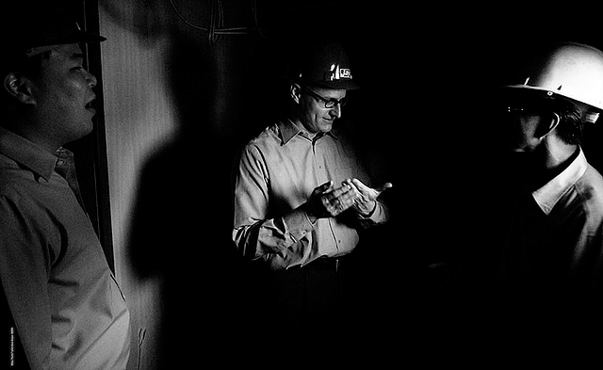
Who Conducts the JSA?
Notes:
Who Should Conduct the JSA
Initially JSA’s are often conducted with a small team such as a Safety Technician, Production Lead or Supervisor, and a Production Worker. However, as the process is better understood through experience and training, many organizations rely on their front-line production workers to perform JSA’s.

Slide 37
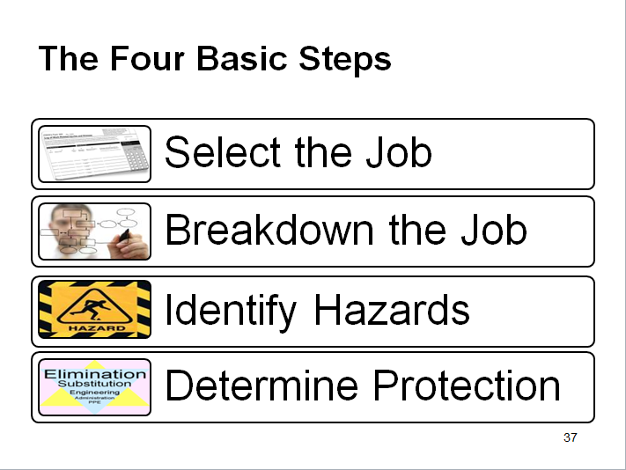
The Four Basic Steps
Notes:
The Four Basic Steps
Four basic stages in conducting a JSA are:
• Selecting the job to be analyzed
• Breaking the job down into a sequence of steps
• Identifying potential hazards
• Determining preventive measures to overcome these hazards

Slide 38
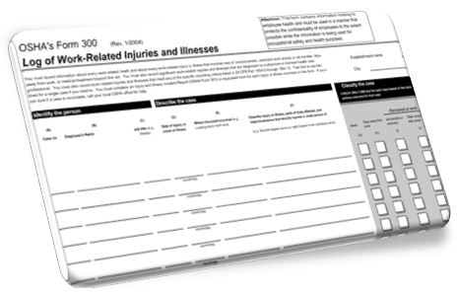
Select The Job
Notes:
Selecting the Job to Be Analyzed
All jobs should be subjected to a JSA. Another consideration is that each JSA will require revision whenever equipment materials, processes, or the environment change. For these reasons, it is usually necessary to identify which jobs are to be analyzed. Even if analysis of all jobs is planned, this step ensures that the most critical jobs are examined first as mentioned in the previous pages.

Slide 39
JSA Exercise
Notes:
Your JSA!
From slides 39 to 47 you will be asked to complete a JSA on a job task that you commonly perform.
Step One. Using the form at the top of this page select a job that you commonly perform and write it in the blank above.

Slide 40
Breakdown The Job
Notes:
Breakdown the Job
After a job has been chosen for analysis, the next stage is to break the job into steps. A job step is defined as a segment of the operation necessary to advance the work.
Care must be taken not to make the steps too general. Missing specific steps and their associated hazards will not help. On the other hand, if they are too detailed, there will be too many steps. A rule of thumb is that most jobs can be described in less than ten steps. If more steps are required, you might want to divide the job into two segments, each with its separate JSA, or combine steps where appropriate.
An important point to remember is to keep the steps in their correct sequence. Any step which is out of order may miss serious potential hazards or introduce hazards which do not actually exist.
Each step is recorded in sequence. Make notes about what is done rather than how it is done. Each item is started with an action verb. This part of the analysis is usually prepared by knowing or watching a worker do the job. The observer is normally the immediate supervisor.

Slide 41
Sample: Breakdown the Job
Notes:
Breakdown the Job
Above is an example of breaking down the job.

Slide 42
Your: Breakdown the Job
Notes:
Breakdown the Job
Step 2. Now, using the form above or continuing with the form you started on page 39, break the job down in column 2.

Slide 43
Identify the Hazards
Notes:
Identify Hazards
Once the basic steps have been recorded, potential hazards must be identified at each step. Based on observations of the job, knowledge of incident and injury causes, and personal experience, list the things that could go wrong at each step.
A second observation of the job being performed may be needed. Since the basic steps have already been recorded, more attention can now be focused on each potential hazards. At this stage, no attempt is made to solve any problems which may have been detected.
To help identify potential hazards, the job analyst may use questions such as those on the following page.

Slide 44
Questions to Support Identifying Hazards
Notes:
Questions to Support Identifying Potential Hazards
To help identify potential hazards, the job analyst may use questions such as those below.
• Can any body part get caught in or between objects?
• Do tools, machines, or equipment present any hazards?
• Can the worker make harmful contact with moving objects?
• Can the worker slip, trip, or fall?
• Can the worker suffer strain from lifting, pushing, or pulling?
• Is the worker exposed to extreme heat or cold?
• Is excessive noise or vibration a problem?
• Is there a danger from falling objects?
• Is lighting a problem?
• Can weather conditions affect safety?
• Is harmful radiation a possibility?
• Can contact be made with hot, toxic, or caustic substances?
• Are there dusts, fumes, mists, or vapor in the air?

Slide 45
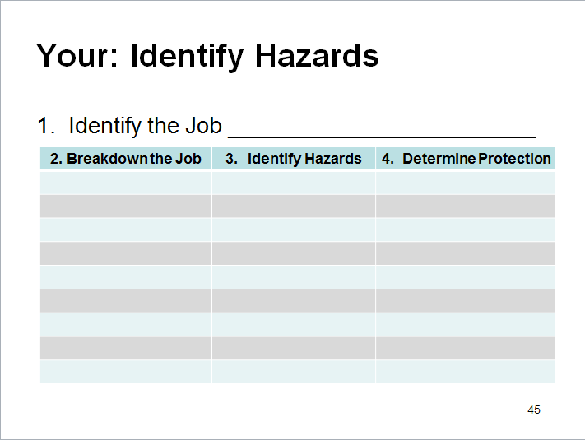
Your: Identify the Hazards
Notes:
Step 3. Now, using the form above or continuing with the form you started on page 39, identify the hazards for each step of the process in column 3.

Slide 46
Determine Protection
Notes:
Determining Preventive Measures to Overcome These Hazards
Elimination/Substitution
Engineering Controls
Administrative Controls
Personal Protective Equipment
See pages 18-24

Slide 47
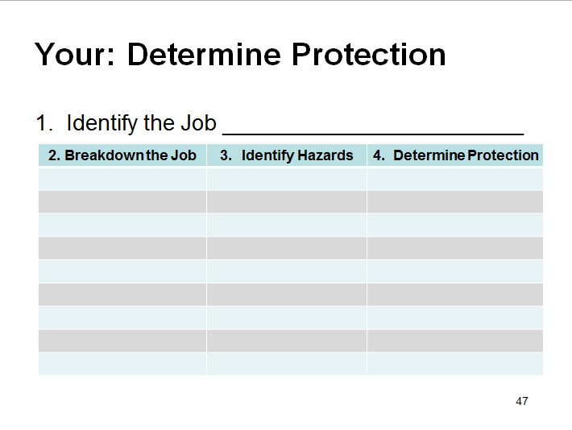
Your: Determine Protection
Notes:
Step 4. Lastly, using the form above or continuing with the form you started on page 39, determine what protection should be used for each step of the process in column 4. Take into consideration Elimination/Substitution, Engineering Controls, Administrative Controls and Personal Protective Equipment (PPE).

Slide 48
Job Safety Analysis
QUIZ!
QUIZ!

