Slide 1

U
H
C
Understanding Hazard Communication
A Port of San Diego Ship Repair Association
Course for Shipyard Workers
This material was produced under grant SH-29629-SH16 from the Occupational Safety and Health Administration, U.S. Department of Labor. It does not necessarily reflect the views or policies of the U.S. Department of Labor, nor does mention of trade names, commercial products or organizations imply endorsement by the U.S. Government.

Slide 2
Understanding
Hazard Communication
An Injury Prevention Course for Shipyard Workers
Understanding
Hazard Communication
An Injury Prevention Course for Shipyard Workers
This material was produced under grant SH-29629-SH16 from the Occupational Safety and Health Administration, U.S. Department of Labor. It does not necessarily reflect the views or policies of the U.S. Department of Labor, nor does mention of trade names, commercial products or organizations imply endorsement by the U.S. Government.
2
Notes:
2
EXERCISE FLIPCHART TARGET ANSWER KEY QUESTION/QUIZ KEY POINT
Use the symbols above as a guide to support you in facilitating your class.
INTRODUCTION – Identify yourself and explain that this class is to support them in understanding and protecting themselves from the hazards associated with harmful chemicals at work.
Read the bottom of Page 1 of the Training Manual

Slide 3
Purpose and Objectives
Course Purpose
Course Objectives
Course Measurement
This material was produced under grant SH-29629-SH16 from the Occupational Safety and Health Administration, U.S. Department of Labor. It does not necessarily reflect the views or policies of the U.S. Department of Labor, nor does mention of trade names, commercial products or organizations imply endorsement by the U.S. Government.
Notes:
Course Purpose:
Read course purpose.
Ask “who uses chemicals to do their job?”
Target answer: All or most.
Key point: This class pertains to all attending
Specific Objectives:
Read and ask if there are questions.
Objective Measurement:
Read and ask if there are questions.

Slide 4

Training Topics
Notes:
Read Training Topics and ask if there are any questions.

Slide 5

Introduction-Pre-Test
Notes:
.
Handout Pre/Post Test and explain by completing this test they will have a good understanding of the material being covered. Explain this will also establish a benchmark to determine how well the trainer conveyed the information.
Ask if there are questions.
Have them circle “Pre” at the top of the test. Have them write the date in the appropriate space. Explain that they will not need to write their names on the pre-test. Allow 5-10 minutes to complete the pre-test and collect the tests. Coordinator will grade tests.

Slide 6
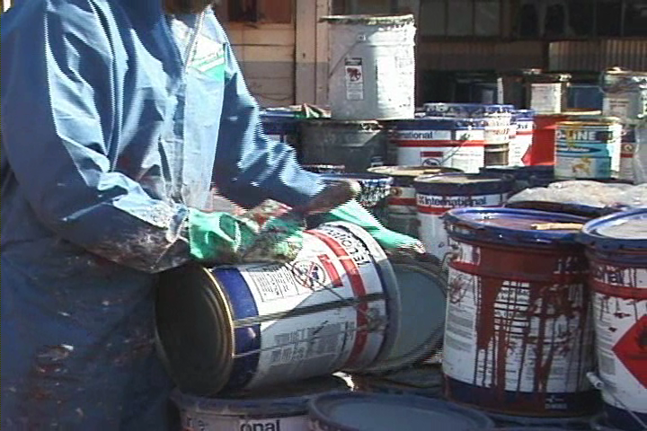
Introduction
Notes:
Hazard Communication Standard
Ask for a participant to read this page.
Thank them.
Ask, “What are chemical manufacturers and importers required to do?
Target Answer: Prepare labels and safety data sheets and convey to customers.
Ask, “What are all employers required to do?”
Target Answer: “Provide and train employees on labels and safety data sheets.”
Ask if there are questions.

Slide 7
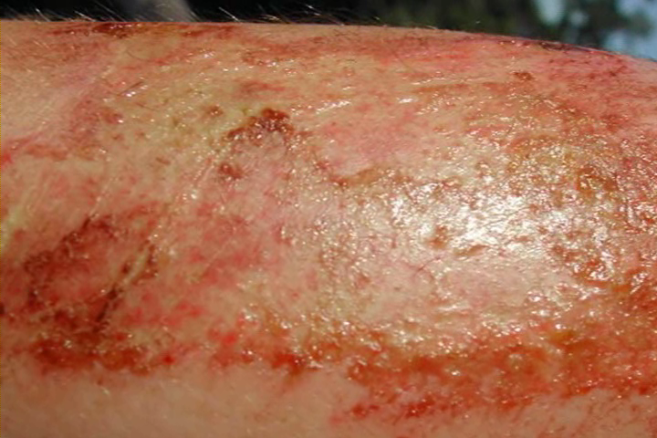
Introduction
Notes:
Related Facts
Ask a participant to read page 6.
Thank them.
Ask if there are questions.

Slide 8
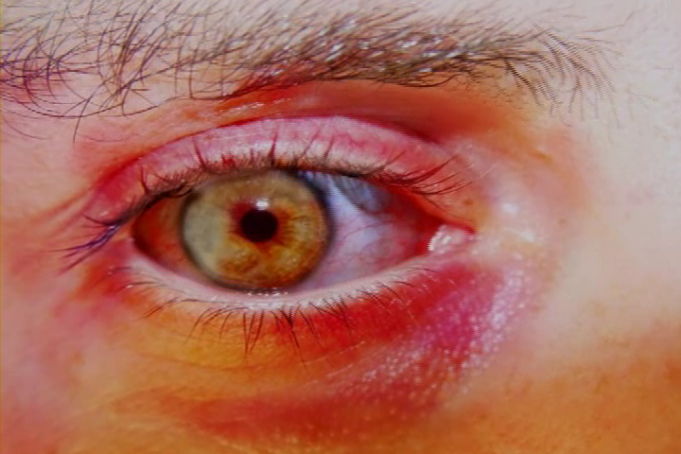
Introduction
Notes:
Health Hazards
Read page 7.
Ask, “Who can tell me, in your own words, the difference between an acute health hazard and a chronic health hazard?”
Target Answer: Acute is immediate and chronic is long-term with repeated exposures.

Slide 9
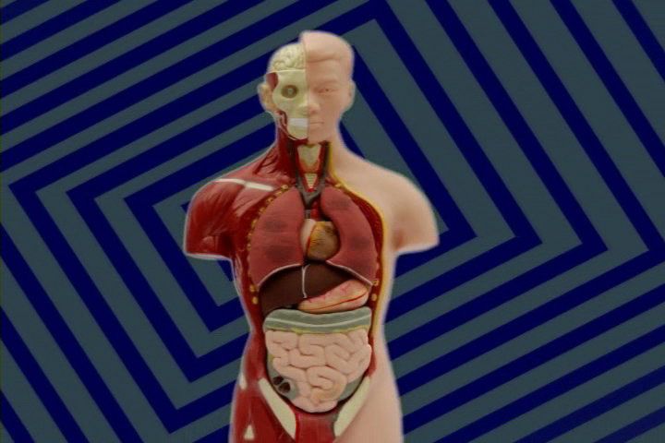
Introduction
Notes:
Hazardous Material Entry Routes
Read page 8.
Ask participants to think of a chemical they use and how it might enter their body.
Target answer will vary based on chemical and work they do.
Key Point: Chemicals can enter your body in a variety of ways and we must protect ourselves.

Slide 10
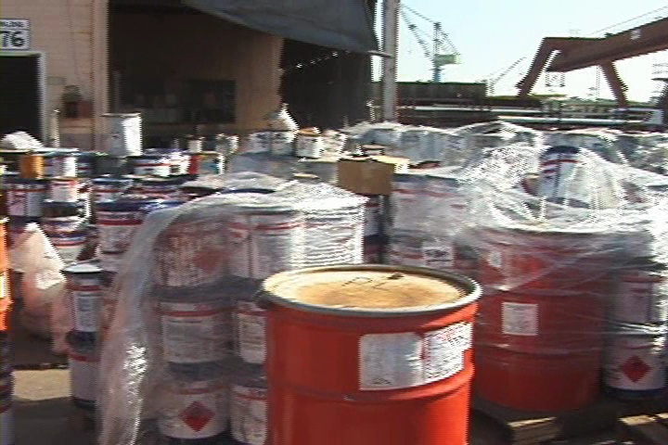
Introduction
Introduction
Notes:
Shipyard Material Hazards
Read page 9.
Explain that these are common chemical hazards found in the shipyard.
Ask participants to put a check mark next to each of the hazards they are exposed to. Allow 2 minutes to complete.
Ask, “How many of you checked multiple hazards?
Key Point: Most all shipyard workers are exposed to many chemical hazards.

Slide 11
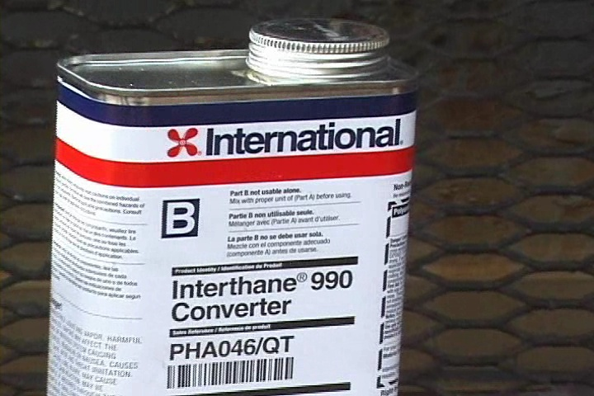
Introduction Exercise
Introduction Exercise
Notes:
Your Exposure!
Read instructions.
Ask participants to do one column at a time (Work then Materials/Chemicals then Effects)
Allow 2 minutes per column. When finished, ask participants, one at a time, to share one of the rows (Work, Materials/Chemicals, Effects) with the class.
Flipchart the Effects
Key Point: We must understand the effects of the chemicals we use and protect ourselves.
In some cases participants may not know the effects of a chemical that they use.
Ask them where they might find that information
Target Answer: SDS

Slide 12

OSHA
Notes:
OSHA and You!
Read the bullets and ask if there are questions.

Slide 13
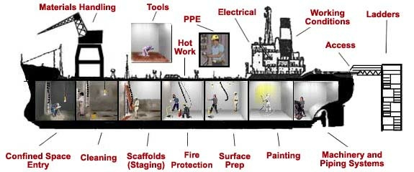
OSHA
Notes:
Employee’s Responsibilities and Rights
For each of the bullets under Responsibilities include:
Ask participants to rate themselves on how they fulfill their responsibilities regarding OSHA compliance next to each bullet.
1 = less than 50% of the time
2 = 50% - 75% of the time
3 = 75% - 100% of the time
Ask the question – “How might your scores impact your risk of injury?”
Target Answer: The higher the score the less the risk.
Read and review the Rights.

Slide 14


OSHA
Notes:
No Retribution
Read page 13.
Be sure participants understand that they are protected from retribution if they file a complaint to OSHA. Reinforce that they are not “telling on a company”, they are reporting a hazard.

Slide 15
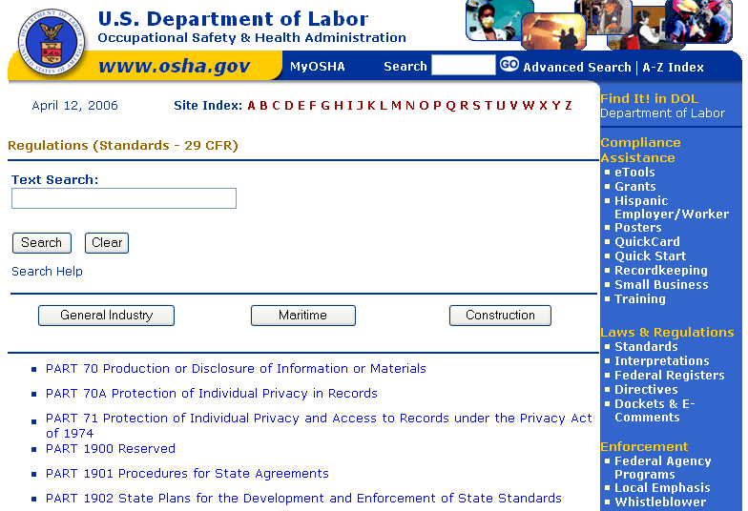
OSHA
Notes:
Resolve With Your Company –
Have the participants read this page to themselves.
Explain that their company chain of command is the most practical first step.
Point out that when reporting a hazard, whether on-line or on the telephone, the information can be confidential.
Ask if there are any questions.

Slide 16
OSHA Exercise
Stump the class!
With a partner, write two questions from this section that you believe the rest of the class will be challenged in answering correctly. (Questions must be reasonable! If your instructor can’t answer, it doesn’t count!)
Notes:
Read the instructions on the page 15.
Explain that the purpose of this exercise is to know the material that was just covered well enough to ask pertinent questions. Another purpose is to do a review of the material in this section.
Reinforce that questions must come from the material found in pages 11 – 14.
Allow up to 5 minutes.
Ask volunteers to “stump the class”. To be time appropriate, ask each team for one question only. Allow 4 questions before you call an end to the exercise.
Acknowledge all participants.

Slide 17
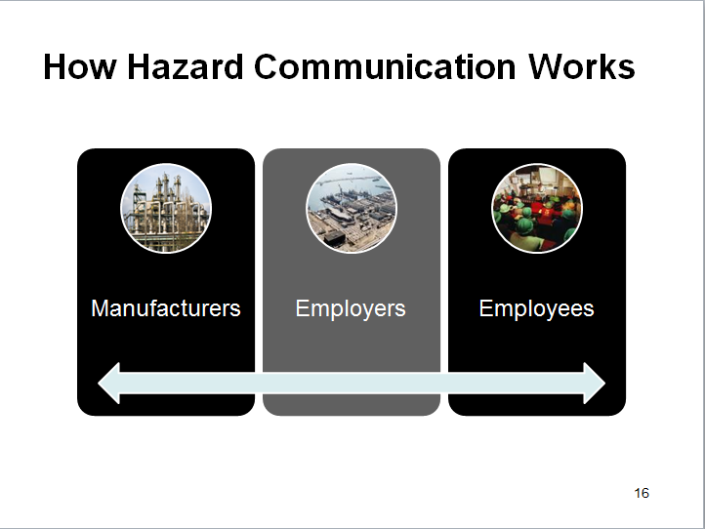
How Hazard Communication Works
Notes:
Ask participants to read page 16 and allow 2 minutes for them to do that.
Ask if there are any questions.

Slide 18

The Hazard Communication Program
Notes:
Manufacturers Responsibilities
Read this paragraph.
Employer Responsibilities
Explain that the list on page 17 are employer requirements that must be in place to comply with the OSHA Standard.
Explain that you will going into detail regarding labeling requirements and SDS requirements.

Slide 19

The Hazard Communication Program
Notes:
Checklist for Compliance With Your Hazard Communication Program
Ask a participant to read the employer compliance checklist on page 18.
Ask if there are any questions.

Slide 20

The Hazard Communication Program
Notes:
Training Requirements
Ask a participant to read page 19 Training Requirements.
Training is not satisfied solely by giving the employee the safety data sheets to read. An employer's training program is to be a forum for explaining to employees not only the hazards of the chemicals in their work area, but also how to use the information generated in the Hazard Communication Program.

Slide 21
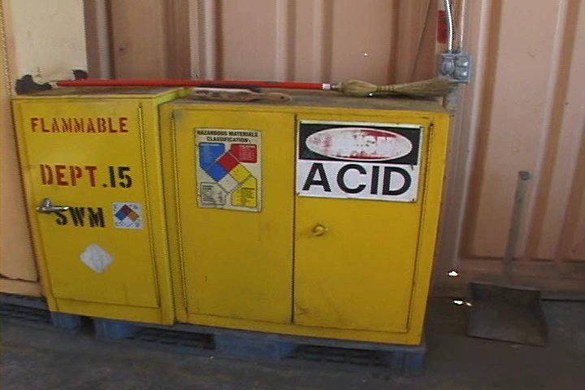
The Hazard Communication Program
Notes:
Related Facts
Ask a participant to read page 20.
Ask if there are questions.

Slide 22
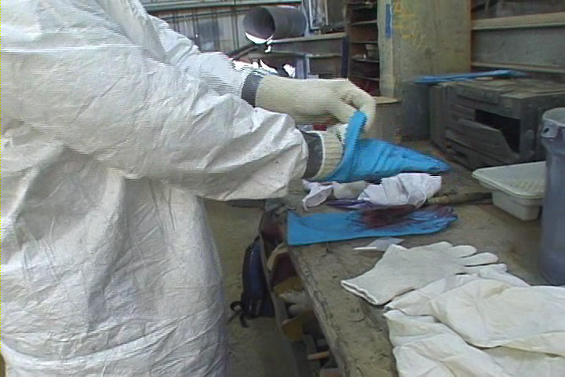
The Hazard Communication Program
Notes:
What Needs to be Trained
Ask a participant to read page 21.
Ask if there are questions.

Slide 23

The Hazard Communication Program Quiz
23
Notes:
23
For each statement below circle ‘T’ for True or ‘F’ for False.
Ask the participants to team up and answer the questions on page 22 collectively.
Allow 4-5 minutes to complete.
Read each question and ask a team to answer. Acknowledge all answers.

Slide 24

GHS– What is it?
Notes:
Ask a participant to read page 21.
Ask if there are questions.

Slide 25

GHS – Why Adopt It?
Notes:
Ask a participant to read this.
Provide example of one or more of the bullets.
Ask a participant to read this.
Provide example of one or more of the bullets.

Slide 26

Hazard Classification
Notes:
Read each bullet.
After finishing the second bullet explain hazard categories as they are not in the training manual. See below:
It’s important to note, the GHS categories are similar yet contradictory to the HMIS/NFPA ratings: The GHS 1 – 4 rating system ranks 4 as the least severe while NFPA’s rank 4 is most severe.

Slide 27

Hazard Classifications
Physical
Health
Notes:
Physical Hazard
Have participants read this column to
themselves.
Recap by saying that the hazards are
classified by three major classes:
Physical
Health
Environmental
Within these classes are more specific
classes listed here.
Health Hazard
Have participants read this column to themselves.
Recap by saying that hazards are classified by Health hazards as well as Physical hazards.
Ask if there are questions.

Slide 28
EXERCISE
Stump the class!
With a partner, write two questions from this section (page 16 to 27) that you believe the rest of the class will be challenged in answering correctly. (Questions must be reasonable! If your instructor can’t answer, it doesn’t count!)
________________________________________________________________________________________________________________________________________________________________________________________________________________________________________________________________________________________________________________________________________________________________________________________________________
Notes:
Read the instructions on the page 27.
Explain that the purpose of this exercise is to know the material that was just covered well enough to ask pertinent questions. Another purpose is to do a review of the material in this section.
Reinforce that questions must come from the material found in pages 23 – 26.
Allow up to 5 minutes.
Ask volunteers to “stump the class”. To be time appropriate, ask each team for one question only. Allow 4 questions before you call an end to the exercise.
Acknowledge all participants.

Slide 29
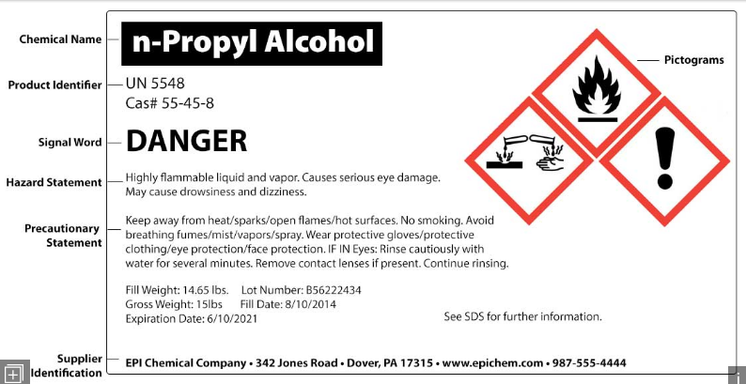
Labeling
Notes:
Requirements
Read page 28.
Ask if there are questions.

Slide 30

Labels
Notes:
Label Requirements
As you read each bullet, point to the location of each on the slide.
Ask if there are questions.

Slide 31

Pictograms And Hazards
Notes:
Explain that it is unlikely that all of the participants will remember each bullet under each pictogram. It is important, however, that they understand what they are handling, working with or even what chemical hazards are in their working environment. To that end, it is important to know what each pictogram represents.
Go through each pictogram and generally explain what each represents.
Explain that there is going to be quiz on the next page, so you are going to give the participants 5 minutes to study. First, you will give them 3 minutes to study by themselves and then 3 minutes to study with their partner.
Ask if there are questions.
Give participants 5 minutes to study by themselves.
Give participants 3 minutes to study with a partner.

Slide 32

Pictogram Exercise
Notes:
Draw a line from the hazard to the correct pictogram
In teams of two ask participants to draw a line from each hazard to the correct pictogram. Ask each team to share one word at a time.
Corrosion
Oxidizers
Health
Acute Toxicity
Flammables
Gas Under Pressure
Aquatic Toxicity
Explosives
Irritant / Respiratory

Slide 33

Label Requirements
Notes:
Label Requirements
Go through the six label requirements and use a pointer to highlight each as you go through them.
Ask if there are questions.
Read:
These requirements do not have to be listed on the in this order.

Slide 34
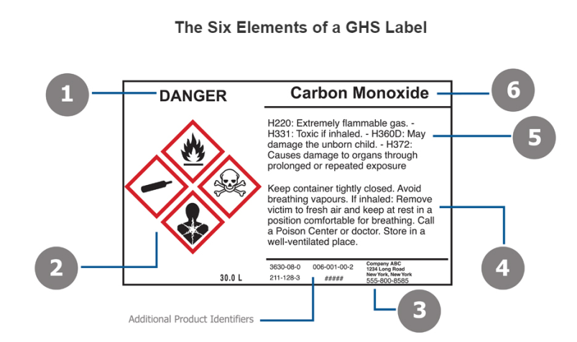
Label Requirements Exercise
Notes:
Label Requirements
Ask participants, in teams of two, to write the requirements below, that they just went over on the previous page, that corresponds with the number above. Give the participants 3 minutes to complete. Ask participants to share their answers one at a time.
Acknowledge all answers.
Product identifier
Signal word (Danger or Warning)
Pictogram(s)
Hazard Statements
Precautionary statement(s)
Name, address, and phone number of the responsible party

Slide 35
Draw A Label (Exercise)
Create a label that complies with the GHS format using the information at the bottom of this page.
Notes:
Now ask the participants, individually, to draw a label based on the information in their training manual. Allow 7-8 minutes to complete. When they are finished, ask participants to share their labels with their partner. Walk around the room and provide input to each group.
Ask if there are questions.

Slide 36
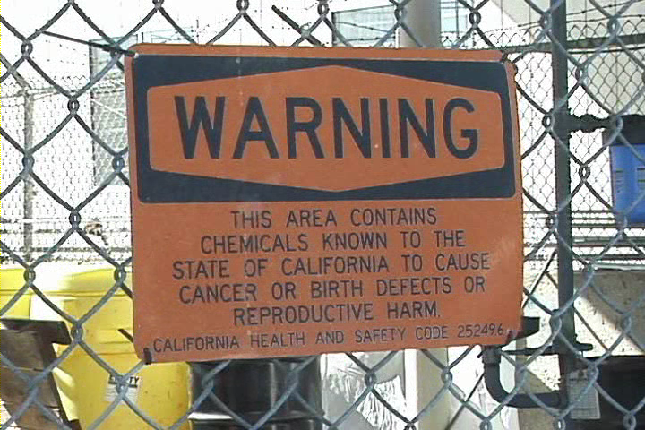
Labeling
Notes:
Exceptions
Ask participants to read page 35 to themselves.
Read the third bullet:
“You are not required to label portable containers into which hazardous chemicals are transferred from labeled containers and are intended only for the immediate use of the employee who makes the transfer”.
Explain that though OSHA allows this, the shipyards where they work do not. All portable containers must be labeled.
Ask if there are questions.

Slide 37
Labeling
37
Notes:
37
For each statement below circle ‘T’ for True or ‘F’ for False.
Ask the participants to team up and answer the questions on page 36 collectively.
Allow 4-5 minutes to complete.
Read each question and ask a team to answer. Acknowledge all answers.

Slide 38

Safety Data Sheets
Notes:
Safety Data Sheets
Read page 37.
Explain that the SDS has taken the place of the MSDS.

Slide 39

SDS
Notes:
Manufacturer and Distributor Requirements
Ask a participant to read the first paragraph.
Ask if there are questions.
Ask a participant to read the second paragraph.
Ask if there are questions.

Slide 40

SDS
Notes:
Employer Responsibilities
Read page 39 and ask if there are questions.

Slide 41

SDS
Notes:
Employee Responsibilities
Ask a participant to read this page.
Reinforce the point: These are your responsibilities!

Slide 42

SDS Questionnaire
Notes:
Read the first sentence and give participants a few seconds to answer. Read each bullet and provide a few seconds to respond.
When finished asked how many participants answered yes to every bullet.
Tell the participants that if they did not answer yes to each bullet their “homework” is to turn the “No” into a “Yes”!

Slide 43

Safety Data Sheets (SDS)
Notes:
MSDS – 1994
Ask participants to read both paragraphs to themselves. Allow about one minute to do this.
SDS – Current
Ask: Just based on these two paragraphs, what are the differences between the old MSDS systems and the SDS system?
Target answer: A universal and consistent order and format.

Slide 44

Safety Data Sheets – 16 Headings
Safety Data Sheets – 16 Headings
Notes:
Reinforce that SDSs have a universal format and 16 information requirements.
Go through each one and ask what the participants believe each section means.
Ask if there are questions.

Slide 45
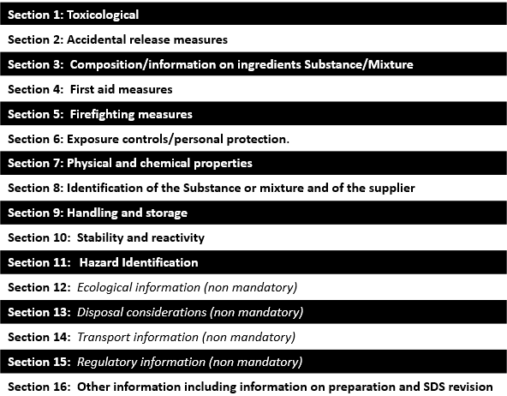
16 Headings Exercise-Put In Order!
16 Headings Exercise-Put In Order!
Notes:
Ask the participants, individually, to put in the proper order. After 3 or 4 minutes ask them to compare their work with that of their partners. Ask them to come to consensus on the proper order. Allow 5-6 minutes to do this. When finished ask if there is any time that would like to share their information.
Acknowledge participation.
Ask if there are questions.

Slide 46
Safety Data Sheets Exercise
Based on the information below, what PPE requirements would you follow in handling Benzene?
_______________
_______________
_______________
_______________
_______________
Where would you find the actual and specific PPE requirements on the SDS?
_______________
Notes:
Ask the participants, individually, to answer the first question (left column) on the screen or the top of their training manual.
Respirator. Face shield. Coveralls or other appropriate body protection. Gloves.
Ask the participants, individually, to answer the second question.
Section 8.
Using the SDS it was much easier to find the information and it left
no room for doubt.

Slide 47
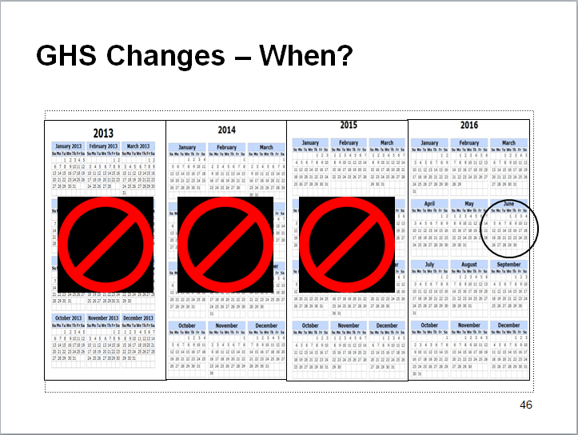
GHS Changes – When?
Notes:
Let participants read page 46 to themselves.
This should be fully implemented in your organizations.

Slide 48

Labeling & SDSs at the MSRs
Notes:
Host Yard Rules!
Read page 47.
Site any examples that reinforce these points.
Ask if there are questions.

Slide 49

Labeling & SDSs at the MSRs
Notes:
Important
Ask a participant to read page 48.
Key points: Know where to dispose of your hazardous waste when working off site and be sure there is a spill kit and fire extinguisher at this location
If you are not sure of a substance someone is using, or the hazards the substance presents, ask to see their SDS.
Know where the SDS’s are kept wherever you are working!

Slide 50
SDS Quiz
50
Notes:
50
For each statement below circle ‘T’ for True or ‘F’ for False.
One question at a time, ask the participants together to answer the questions on page 49.
Ask if there are questions.

Slide 51
Post-Test
Notes:
Hand out Feedback Form and ask participants to complete. Allow 4-5 minutes.
Handout Pre/Post Test and explain by completing this test we will be able to identify how well the trainer conveyed the information. Ask if there are questions.
Have them circle “Post” at the top of the test. Have them write the date in the appropriate space. Ask them to write their names on the prost-test. Allow 5-10 minutes to complete the pre-test and collect the tests. Coordinator will grade tests.

Slide 52

Questions / Comments
Notes:
Ask participants if they have any final questions.
Thank participants for the time and effort.

