Slide 1

Title page
Developed by the Port of San Diego Ship Repair Association
This material was produced under grant SH-29629-SH16 from the Occupational Safety and Health Administration, U.S. Department of Labor. It does not necessarily reflect the views or policies of the U.S. Department of Labor, nor does mention of trade names, commercial products or
organizations imply endorsement by the U.S. Government.
1
Notes:
1
EXERCISE FLIPCHART TARGET ANSWER Key Question/QUIZ
Use the symbols above as a guide to support you in facilitating your class .
INTRODUCTION – Identify yourself and explain that this class is to support them in understanding and using both a Hazard Assessment and Job Safety Analysis.
Read the bottom of Page 1 of the Training Manual
Ask for examples of hazards. Ask for examples of risks.
Handout Pre/Post Test and explain by completing this test they will have a good understanding of the material being covered.
Have them circle “Pre” at the top of the test. Have them write the date in the appropriate space. Explain that they will not need to write their names on the pre-test.
Allow 5-10 minutes to complete the pre-test and collect the tests. Grade during the remainder of class. Facilitator to provide pre- and post-test results to Project Director.

Slide 2
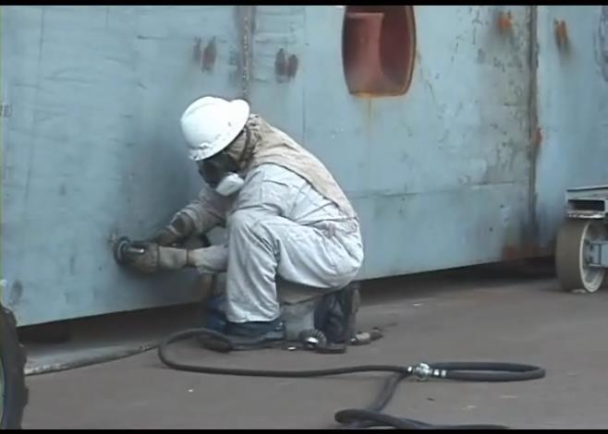
Course Objectives
Notes:
Review the Course Objectives
Explain that this class is being subsidized by an OSHA grant called Susan Harwood.
Ask if there are questions.

Slide 3

OSHA
Notes:
OSHA and You!
Review OSHA origin and purpose.

Slide 4
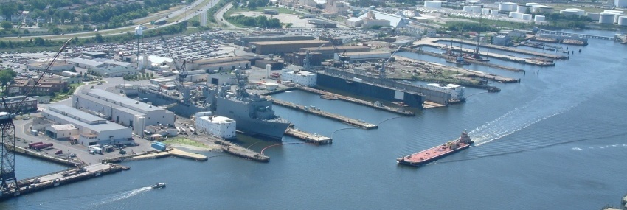
OSHA Exercise
Notes:
Employee’s Responsibilities and Rights
Ask participants to rate themselves on how they fulfill their responsibilities regarding OSHA compliance in the blank space provided.
1 = less than 50% of the time
2 = 50% - 75% of the time
3 = 75% - 100% of the time
Ask the question -- How might your scores impact your risk of injury?
Read and review the rights.

Slide 5

OSHA
5
Notes:
5
5
Employer’s Responsibility
Read and review page.
(Recommend trainer/participant mix of reading aloud.)
Ask if questions or comments.
Ask why the first 5 bullets are bolded?
To meet these Employer Responsibilities Hazard Assessments and Job Safety Analysis should be conducted.

Slide 6

OSHA
6
Notes:
6
6
More Employer’s Responsibility
Say – “Ahhhh, more employer responsibilities.”
Explain that there are additional responsibilities each employer must follow.
Ask for volunteer to read page 6.
Thank the volunteer.
Ask if questions.

Slide 7


OSHA
Notes:
No Retribution
Explain that you suggest that before reporting a hazard to OSHA, you follow the “chain of command” and allow your organization or the host yard to rectify the situation.
Also point out that when you report a hazard to OSHA, you are NOT “telling on an organization”, you are reporting a hazard!
Read the slide and ask if there are any questions.

Slide 8
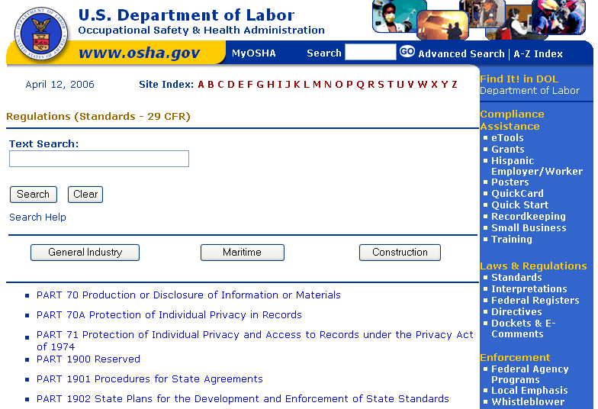
OSHA
Notes:
Resolve With Your Company –
Have the participants read this page to themselves.
Point out that when reporting a hazard, whether on-line or on the telephone, the information can be confidential.
Ask if there are any questions.

Slide 9
OSHA Exercise
Stump the class!
With a partner, write two questions from this section that you believe the rest of the class will be challenged in answering correctly. (Questions must be reasonable! If your instructor can’t answer, it doesn’t count!)
Notes:
Read the instructions on the page 9.
Explain that the purpose of this exercise is to know the material that was just covered well enough to ask pertinent questions. Another purpose is to do a review of the material in this section.
Reinforce that questions must come from the material found in pages 4 – 8.
Allow up to 5 minutes.
Ask volunteers to “stump the class”. To be time appropriate, ask each team for one question only. Allow 4 questions before you call an end to the exercise.
Acknowledge all participants.

Slide 10

Introduction
Notes:
Introduction
Read page 10.

Slide 11
Definitions
The following pages contain definitions associated with hazard assessment and controls used in shipyards.
As we go through each lesson, look for these terms being used!
11
Notes:
11
Definitions
Read the definitions on page 11.
Ask if companies should have acceptable risk?
Yes. If we didn’t live with acceptable risk we would not get out of bed in the morning! Every time we drive, work around the house or cook a meal there is risk of injury. The important thing is that the risk is identified and controls are put in place to abate the risk.
Put out that acceptable risk is the same as tolerated risk which is a quiz question!

Slide 12

Definitions Continued
Notes:
More definitions –
Ask a participant to volunteer to read the definitions on page 12.
Discuss the fact that “Risk” is the combination of likelihood of injury and the severity of injury (LxS = Risk) – and emphasize the importance of preventing injury.

Slide 13

Hazards and Risk
Notes:
Hazard
Read Hazard portion of page 13.
Pause
Read Risk portion of page 13.
Ask participants to answer the question.
Ask if questions.

Slide 14
Hazards and Risk Exercise
A. Situation/Act | B. Hazards | C. Severity | D. Likelihood | E. Risk
Crossing country road
Crossing street from shipyard to your car
Crossing freeway
Crossing bike path
Crossing shipyard vehicle lane
Notes:
Read the instructions for this exercise.
Have each participant complete the grid on page 14 and remove this page from the book.
Allow 2-3 minutes.
Focus on the fact that they are to multiply the number in column C by the number in D and place the total in Column E for each Situation/Act (column A).
Complete the grid on the flip chart while participants are completing this first portion.

Slide 15
Severity
A. Situation/Act | B. Hazards | C. Severity | D. Likelihood | E. Risk
Crossing country road
Crossing street from shipyard to your car
Crossing freeway
Crossing bike path
Crossing shipyard vehicle lane
Notes:
Read the instruction statement above the grid on the lower half page 15.
Have participants complete grid on page 14, the one they removed from their book.
They are to only do column C
Refer to grid on flip chart.
Ask if questions.

Slide 16
Hazard Assessment
A. Situation/Act | B. Hazards | C. Severity | D. Likelihood | E. Risk
Crossing country road
Crossing street from shipyard to your car
Crossing freeway
Crossing bike path
Crossing shipyard vehicle lane
Notes:
Read the statement –
Step 4. To assess the risk, multiply the number in the “Severity” column (“C”) by the number in the “Likelihood” column (“D”) and put the answer in the column labeled “Risk” (“E”).
Refer to grid on flip chart.
Ask “ Which has the highest risk?”
Crossing Freeway
Crossing street from shipyard to car

Slide 17


Introduction Quiz
17
Notes:
17
Have participant complete the quiz on page 17.
Encourage them to work in teams of two or three.
Allow 1 minute.
Review answers one at a time with volunteers to answer.

Slide 18
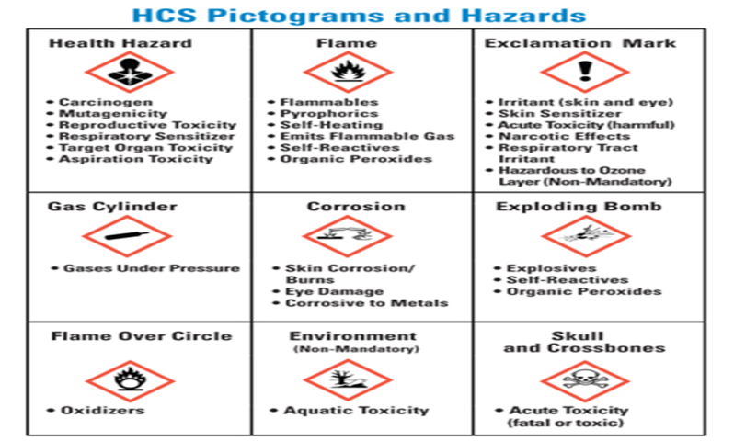
Hazards and Hazard Controls
Notes:
Hazards and Hazard Controls
Review topics to be covered in this section by reading page 18.

Slide 19
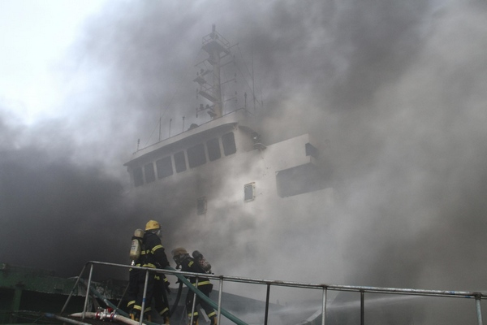
Shipyard Hazards
19
Notes:
19
Hazards Found in the Shipyard
Read the instructions and introduction statement on page 19.
Focus on left column only (Physical Hazard)
Target answers are unique to individual employees,
however, most participants will circle multiple physical
hazards validating the hazards within the shipyard are great.

Slide 20

Elimination/Substitution
20
Notes:
20
Elimination
Ask for a volunteer to read the section and example on Elimination.
Ask if questions.
Substitution
Ask for a volunteer to read the section and example on Substitution.
Ask of questions.
Thank volunteers.
Ask if there are questions.

Slide 21
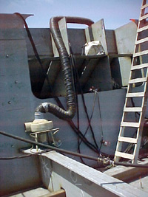
Engineering Controls
21
Notes:
21
Engineering Controls
Read page 21.
Ask if participants have any other examples.
Optional – provide another example from your personal knowledge and/or experience.

Slide 22

Administrative Controls
22
Notes:
22
Administrative Controls
Ask for a volunteer to read page 22.
Ask if questions.

Slide 23
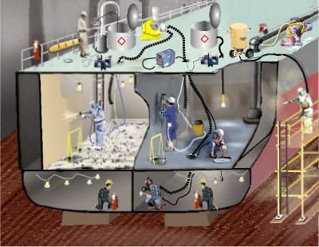
Personal Protective Equipment
Notes:
Personal Protective Equipment (PPE)
Read page 23.
Emphasize additional PPE may be required when performing specific types of work.

Slide 24
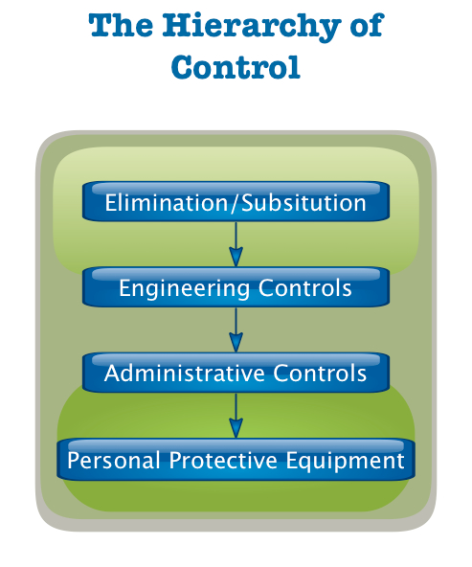
OSHA’s Hierarchy of Controls
Notes:
OSHA’S Hierarchy of Controls
Read page 24

Slide 25
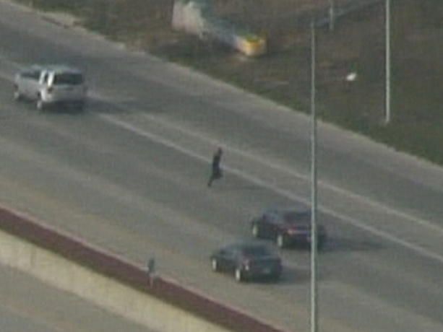
Hazard Control Exercise
Notes:
Read the instructions for the exercise on page 25.
Refer back to pages 14 – 16 in training manual.
Have participants indicate responses. If needed based on time constraints ask participants to do just tow of the “Situation/Acts” (Column “A”).
Allow 3-5 minutes.
Using a different colored marker, lead discussion and chart answers from the group.
Ask -- Which control is most effective?
Target answers should be under the Elimination/Substitution or Engineering control column.

Slide 26

Hazards & Hazard Controls Exercise
Notes:
Read the instructions from page 26.
Have each participant select one of the hazards from page 19 and, write it in on the “Hazard” line. After complete, ask participants to complete the controls to abate the hazard.
Hazard _____________________________________________

Slide 27
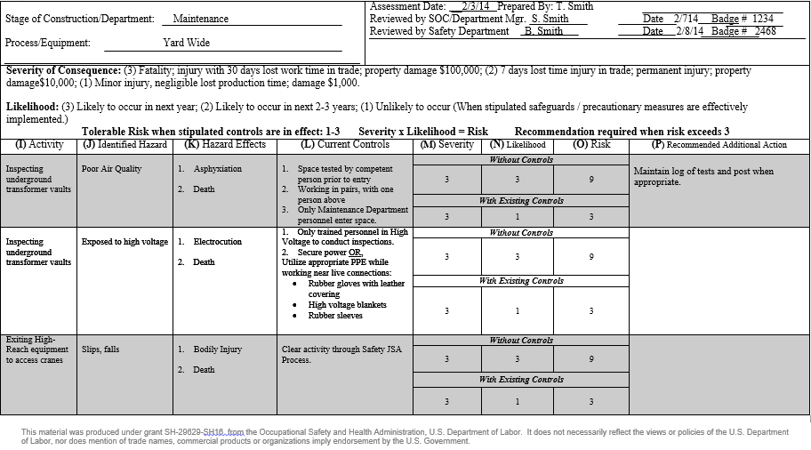
Sample Form
Notes:
Sample Form
Say – “On the screen and in your books you see a sample Hazard Assessment Form.”
Review and explain the form.
Look it over and be prepared to explain each box. Allow 5 minutes.
Ask: For any of the hazards in the assessment, what could an additional recommendation be and what Hazard Control would it be classified?

Slide 28
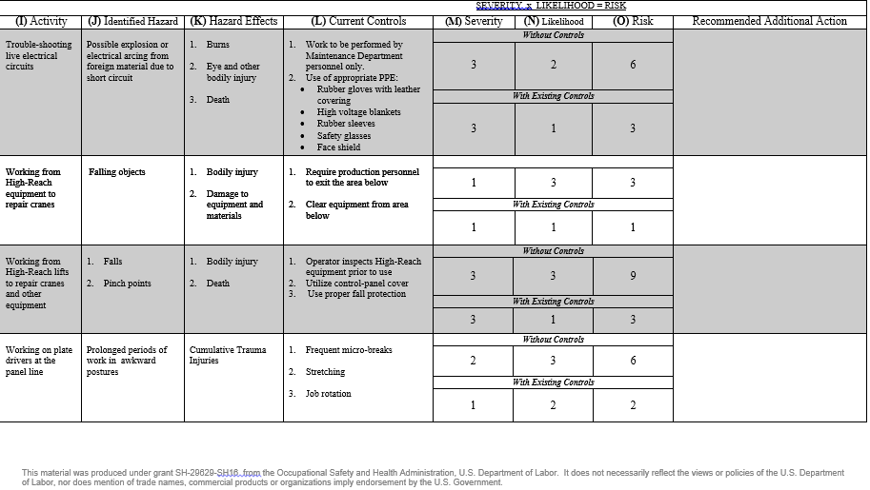
Sample Form
Notes:
Sample Form Continued
Say – “On the screen and in your books you see the continuation of the sample Hazard Assessment Form.”
Say – “Look this over and be prepared to explain each box.” Allow 1 minute.
Ask: For any of the hazards in the assessment, what could an additional recommendation be and what Hazard Control would it be classified?

Slide 29
Hazards and Hazard Controls Quiz
QUIZ!
QUIZ!
Notes:
Have each participant complete the quiz. Allow 1-2 minutes.

Slide 30
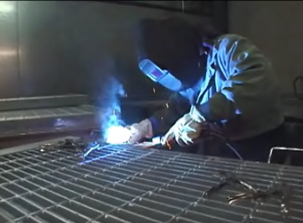
Hazard Analysis
Notes:
Ask for volunteers to read page 30.
Thank participants.
Refer to the first bullet and reread it to the class:
“Provide a workplace free from serious recognized hazards and comply with standards, rules and regulations issued under the OSH Act”……
Emphasize this IS NOT A SUGGESTION. It is part of the Employer’s Responsibilities.

Slide 31
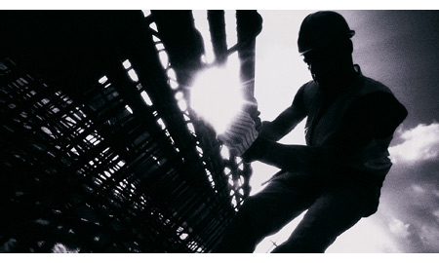
Job Safety Analysis (JSA)
31
Notes:
31
Job Safety Analysis (JSA)
Read page 31.
Ask if questions.

Slide 32

When To Conduct a JSA
Notes:
When To Conduct a Job Safety Analysis
Ask participants to read page 32.
Refer to first statement to emphasize by saying:
“Ultimately, a JSA should be conducted on all work processes.
The list on this page will serve as a guide as you begin.”

Slide 33

When According to the Navy
Notes:
NAVSEA Std. Item 009-74, 3.1.3
Say – This slide references a NAVSEA Std Item.
Read the slide, including the numbers preceding each of the statements.
Emphasize the importance of the detail and requirements from the US Navy.
Ask if questions.
KEY POINT– Emphasize to meet 2nd bullet – 3.1.3.1 , you would have to conduct a JSA when starting a new job in any space.

Slide 34
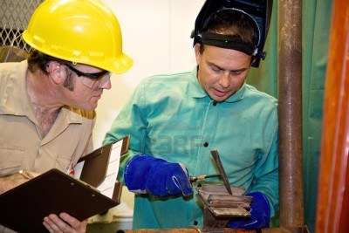
The Benefits of a JSA Exercise
Notes:
The Benefits of a JSA
Say to entire class – “as we move forward, on page 34 of your manual, list any benefits of conducting a Job Safety Analysis.”
Write answers from the group on the flip chart.
Targeted answers --
Identify hazards, increase job knowledge, safety awareness, health awareness, communication, improved communication, safe work procedures promoted, teaching tool, written procedure, assist in investigations.

Slide 35

The Benefits of a JSA
Notes:
The Benefits of a JSA
Read page 35 or ask for volunteer from the class.
Thank volunteer if appropriate.
Say – “As you can see from our answers on the flip chart, we have identified many benefits of a JSA.”
Ask if any questions.

Slide 36
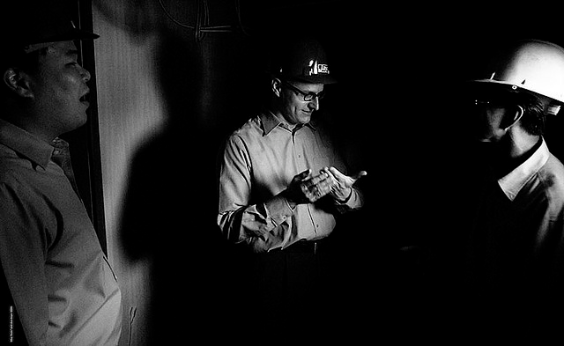
Who Conducts the JSA?
Notes:
Who Should Conduct the JSA
Read page 36.
Say – “Now we’re ready to move on to the Four Basic Steps.”

Slide 37
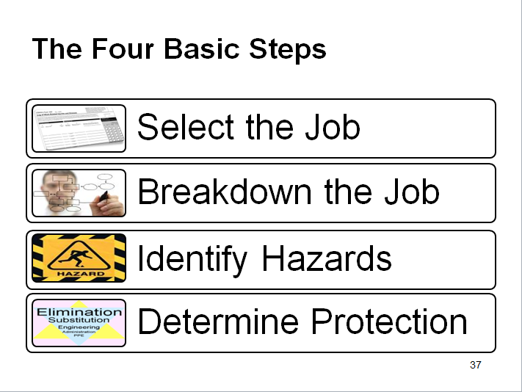
The Four Basic Steps
Notes:
The Four Basic Steps
Read page 37.

Slide 38
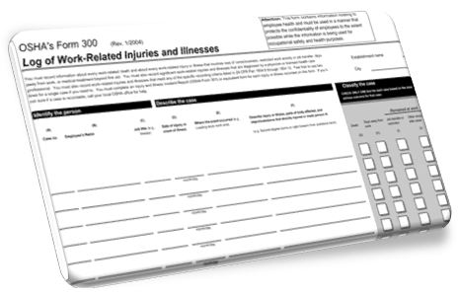
Select The Job
Notes:
Selecting the Job to Be Analyzed
Say – “ok, first a job is selected.”
Ask a participant to read the slide or trainer reads aloud.

Slide 39
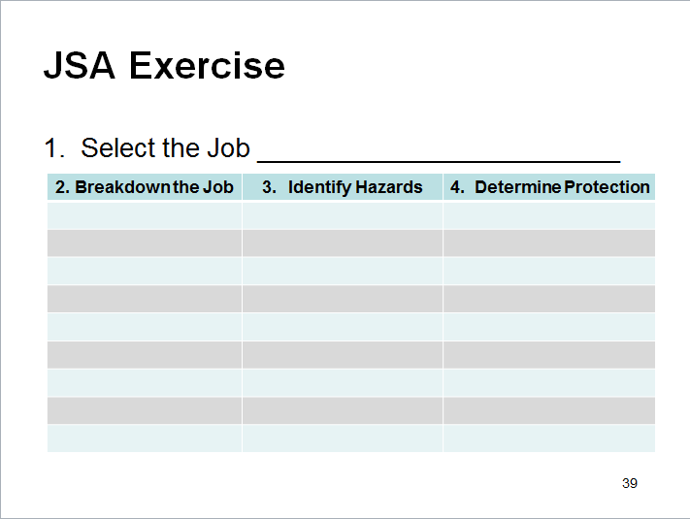
JSA Exercise
1. Select the Job ________________________
Notes:
Your JSA!
Read instructions on page 39.
Ask participants to complete the form by selecting a job they commonly perform and write it in the blank in their training manual next to 1. Select a Job.
Ask participants to remove this page from their training manual for use in remainder of activity.

Slide 40

Breakdown The Job
Notes:
Breakdown the Job
Read the page.

Slide 41
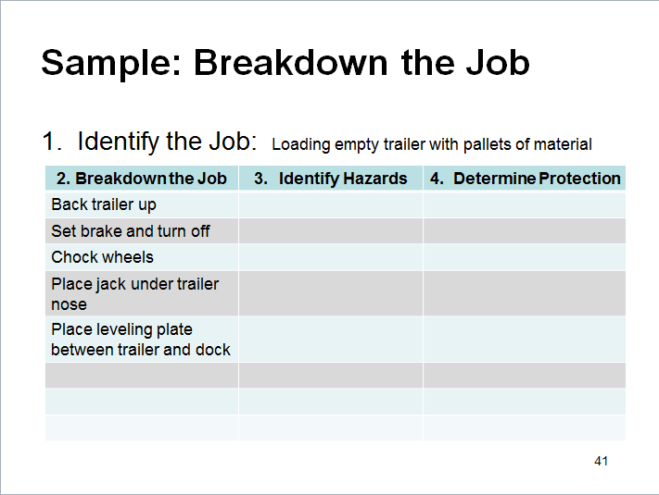
Sample: Breakdown the Job
1. Identify the Job: Loading empty trailer with pallets of material
Notes:
Breakdown the Job
Say – “On the screen and in your training manual, you see an example of the detailed steps, in order, for this job or task.”

Slide 42
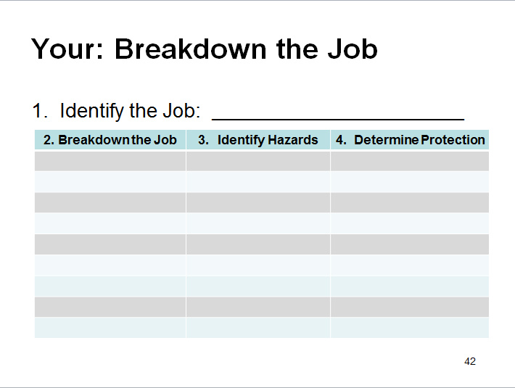
Your: Breakdown the Job
1. Identify the Job: ___________________________________
Notes:
Breakdown the Job
Read the instructions on page 42.
Say – “Using your page 39 from the training manual, please break down your job like in the example on page 41.
Allow 4-5 minutes.
Say – “Ready to move on?”

Slide 43

Identify the Hazards
Notes:
Identify Hazards
Ask a volunteer to read page 43.
(Perhaps by now you have identified a participant in your class that is a good reader and projects loud enough that you could select him/her by name.)
Thank participant by name.

Slide 44
Questions to Support Identifying Hazards
Notes:
Questions to Support Identifying Potential Hazards
Read page 44.
Say – “As you can see, this is a very detailed and orderly process to ensure the efficiency and effectiveness of the JSA. Using these questions as a checklist could also be another form of a JSA.”
Ask if any questions.

Slide 45
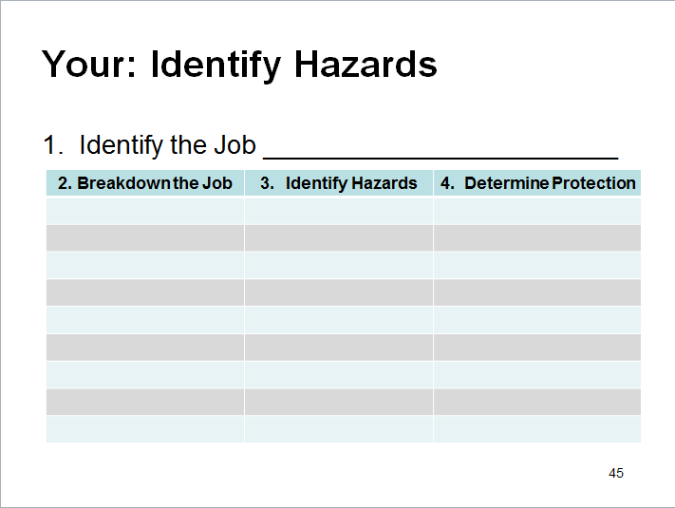
Your: Identify Hazards
1. Identify the Job ________________________
Notes:
Say –”Moving on to page 45, using your page 39 continue to identify the hazards of the job you selected by asking the questions on page 44.”
Allow 3-4 minutes.
Say – “How you all doing? Just one more step!!”

Slide 46

Determine Protection
Notes:
Determining Preventive Measures to Overcome These Hazards
Say – “The last step is to determine protection or prevention methods.”
Read the 4 bullets on page 46.
Any if there are questions.

Slide 47
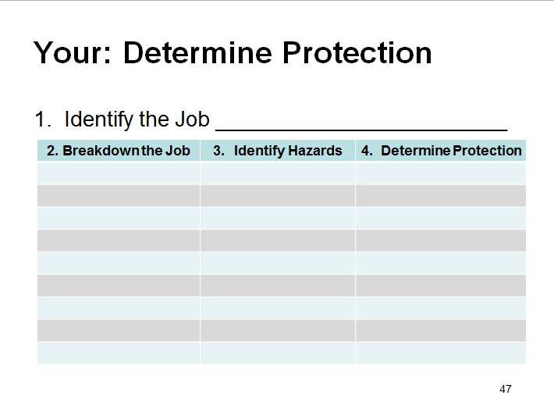
Your: Determine Protection
1. Identify the Job ________________________
Notes:
Read page 47.
Ask the participants to complete column 4 as instructed on their page 39.
Say – “Congratulations -- now you have all completed a JSA!!
Well done!”

Slide 48
Job Safety Analysis
QUIZ!
QUIZ!
Notes:
Targeted Answers indicated.
Go over quiz together.
Conduct Feedback Form
Complete Post-Test

