Slide 1
Fall & Electrical Hazards
Notes:
Have participants sign in on attendance sheets provided by GHSC.
GHSC sign-in sheets are necessary to verify attendance to the U.S. Dept. of Labor who provided grant funds.
Alternatively the instructor can verify attendance by providing date, course name, length of course, instructor name, and number of participants or use the classroom attendance sheet.
Have students complete pre-tests.
Verify attendance.
Administer pre-test to students.

Slide 2
Disclaimers
This material was produced under grant number SH26294SH4 from the Occupational Safety and Health Administration, U.S. Department of Labor. It does not necessarily reflect the views or policies of the U.S. Department of Labor, nor does mention of trade names, commercial products, or organizations imply endorsement by the U.S. Government.
Notes:
GHSC received funding from Occupational Safety and Health Administration (OSHA), a federal government agency, to assist in the development of this curriculum.
While funding was supplied and content reviewed by OSHA, these materials may not reflect their views or policies.
The GHSC is required to keep certain records. Providing GHSC attendance sheets, evaluations, and pre/post test results assists us in meeting record keeping requirements for the grant.
Records can be sent (mail or electronic) to:
Dr. Robert Aherin
University of Illinois – ACES
1304 Pennsylvania Avenue
Urbana, IL 61801
raherin@illinois.edu
GHSC developed these materials with a grant from OSHA under the U.S. Department of Labor.

Slide 3
Course Objectives
Discuss the GHSC Young Worker Position Statement.
Empower young workers to speak up with “Stand T.A.L.L.”
Identify common fall hazards.
Recognize common electrical hazards.
Summarize prevention strategies for falls and electrical hazards.
Notes:
This presentation is designed to help the instructor:
Discuss the Young Worker position statement which provides guidance to help young workers & employers when working in grain handling & storage.
Incorporate “Stand TALL” to empower youth to speak up when they identify hazards or feel unsafe.
Explain to participants the potential fall hazards found in the work environment and learn to identify them.
Discuss common electrical hazards found in the grain environment.
Explore appropriate strategies to prevent injuries involving falls and electrical hazards with participants.
NOTE: All modules in this curriculum series present the same content on slides 2 and 4-7 of the presentation.
If other modules have been presented (Entrapments, Engulfments & Entanglements and/or Other Hazards, PPE & Child Labor Laws), the instructor may want to do a brief review of slides 4-7, to save time.
Slide 8 always introduces and discusses briefly the main grain hazards, highlighting the hazards being covered in the module. If other modules have been presented previously this slide can be used as a quick review.
NOTE: Each module is divided into sections. The sections can be presented individually to allow for greater fexibility.
Animated Slide: Each bullet point appears with a mouse click – total 5 clicks.
Explain today’s lesson objectives.
All GHSC young worker modules contain the first two objectives.
The position statement provides guidance for workers & employers.
Emphasize young workers need to feel comfortable to speak up & ask questions if they are unsure, feel unsafe, or identify hazards in their work area.
The goals of this module are to identify common fall & electrical hazards in the grain environment and understand prevention strategies.

Slide 4




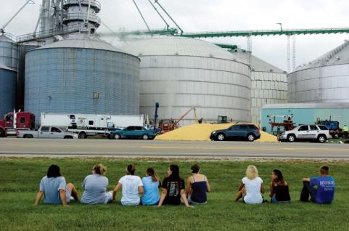

In Memory
Reciting the Lord’s Prayer, Alex asked Will to hold his hand as corn climbed above his head.
Wyatt, 14, screamed for help as the kernels moves past his chest, chin, and over his head within seconds.
“Two people died…One I felt his last heartbeat.”
“There were cars everywhere.”
It took 6 hours and over 300 people to free Will.
People lined the streets anxiously awaiting news.
Notes:
On July 28, 2010 in Mt. Carroll, IL, the four workers pictured were told to break up clumped grain to get it flowing. No formal training or personal protective equipment were provided, and they were unaware of the hazards/risks.
Wyatt Whitebread, age 14 (top right), enjoyed the outdoors, hunting & trap shooting. He was a happy, generous, kind teenager with a ready smile & joyous laugh; loved by all he met. He had been working a couple weeks & “trained” the others. Wyatt’s parents checked out the work & were assured he would only be sweeping out empty bins.
Alex Pacas, age 19 (top left), was the oldest & beloved big brother of 7 children. He loved music, played bass in a church band, and was attending college. It was Alex’s second day of work with his best friend Will. Knowing he was going to die, Alex began to pray with Will, asked him to deliver messages and watch over for his siblings.
Chris Lawton, age 15 (bottom left) was near the inside ladder & left the bin to call for help – he lives wondering if he had stayed would his friend Wyatt be alive today. He was plagued with nightmares, self-doubt, and self-recrimination. Today, Chris serves in the USAF.
Will Piper, age 20 (bottom center) was trapped in the corn inches from his best friend Alex. The rescue tube placed around Will to keep him alive also enclosed Alex’s body. It took 6 hours & over 300 personnel to rescue Will while he could feel Alex under him. Will could not rid himself of the guilt, fear, & loss. He turned to drugs to dull his pain. Will can be seen sitting on the grass by Alex’s grave, talking to his friend and crying. After a long battle, today he is clean & sober, works, attends school & goes on church missions.
Life will never be the same. Chris & Will relive the memory of that day: the sights, sounds, smells and horror of losing their friends.
Alex & Wyatt’s families endure a daily battle of never sharing another moment; creating a new memory; adding a another picture.
From this tragedy, the Grain Handling Safety Coalition was born and works to prevent tragedies like this from happening again
Does anyone in the class know someone who was entrapped or engulfed in grain?
Introduce these young workers and discuss what happened to them.
Explain the origins of the GHSC.
If all modules are presented, instructor can hide duplicate slides.
“Walking down the grain” – refers to workers walking on grain to break up clumps and get the grain flowing for removal. This is often done with the augers running. Once grain starts flowing, it acts like quicksand. Walking down the grain & similar practices are prohibited by OSHA.
Ages listed are at the time of incident.
Image Sources: Whitebread & Pacas families, GHSC, Alex T. Paschal/Sauk Valley Media. Permission granted 2011 by families & individuals to use photos & story anytime for education purposes.

Slide 5

Youth & Grain
Youth = under 18
Do not work in/around grain storage structures:
  unless empty
  when grain is being loaded, unloaded, moved
Properly trained for all tasks
  Experienced & knowledgeable adult
Know ladder & climbing safety
Employers comply with laws
Notes:
GHSC developed a Position Statement for Youth (Young Workers) Working with Grain to ensure the safety of young workers.
As working in and around grain is known to be extremely dangerous, even for adults, special care must be taken to ensure the safety of young workers.
This statement is not exclusive to commercial elevators or farms, but rather a blanket statement for all youth (under age 18).
Youth should NOT enter ANY storage structure, unless it is empty, aerated, and Lock out/Tag out has been done.
Empty infers grain is below knee level & there are no other engulfment hazards present.
Youth should not work inside grain structures (bins, silos, flat storage structures, wagons) when grain is being loaded, unloaded or moved.
Youth must be properly trained by knowledgeable adults.
Youth should be trained to climb and use ladders safely.
Federal labor laws (& some state laws):
May allow 16-17 year olds to engage in tasks not recommended by GHSC.
Though it may be “legal” to perform these tasks, it is strongly recommended to follow the practices outlined by the GHSC position statement to better ensure young workers’ safety.
14 & 15 year olds in non agricultural work – “May NOT be employed in ALL work requiring the use of ladders, scaffolds, or their substitutes.
https://www.dol.gov/whd/regs/compliance/childlabor101_text.htm
Under 16 in agricultural work cannot work from a ladder or scaffold at a height of over 20 feet; http://www.youthrules.gov/know-the-limits/agriculture/hazards.htm
OSHA - www.osha.gov and https://www.osha.gov/youngworkers/
What risk reduction actions are promoted with the statement?
Avoid – not being in or around storage structures or where grain is being moved.
Remove – grain structures must be empty
Training – for all tasks as well as for correct ladder climbing and proper housekeeping.
PPE – for fall protection
Introduce and discuss the GHSC Position Statement for Young Workers Working with Grain.
Emphasize no one under the age of 18 should be in or around grain storage structures when grain is present for their safety.
Discuss employers are responsible to know and comply with state and federal laws regarding labor and safety.
Image Source: Jessie Starkey Photography
Animated Slide: Each main bullet point appears with a click – total 5 clicks.
Instructors should be familiar with the full text of the GHSC’s Youth & Grain Position Statement: http://grainsafety.org/young-workers/
Direct young workers to the U.S. Dept. of Labor websites for OSHA and the Wage & Hour Division for information.

Slide 6

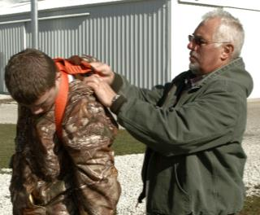
Stand T.A.L.L.
Roles
  Young worker
  Adult
Stand T.A.L.L.
  Talk
  Ask
  Learn
  Live
Notes:
Roles:
Working youth are under 18 years old; also called young workers.
Adults are typically the employer &/or supervisor. On family farms the adult could also be a parent, grandparent or other family member. SEE NOTES.
Emphasize the concept of empowerment through knowledge.
Young workers need to know their rights to a safe & healthy work place, and should speak up whenever they don’t feel safe.
Adults must ensure a safe worksite by assigning age appropriate jobs, mitigating (fixing) hazards and providing personal protective equipment.
Adults should understand young workers are particularly vulnerable to workplace hazards. They have a strong desire to please, as well as appear knowledgeable and mature which may prevent them from asking questions and seeking help.
Adults need to encourage young workers to learn how to “Stand TALL” when working in/around grain by following these guidelines:
TALK – safety with their boss, family and/or other trusted adults.
ASK – be comfortable & confident to seek assistance or clarification when uncertain about how to complete a task or if they have concerns about their safety.
LEARN – how to recognize workplace hazards & strategies to avoid or protect themselves against the hazards, before encountering an unsafe or risky situation.
LIVE – Be safe to go home to family & friends, alive & injury free. They may not get a second chance.
These concepts apply to situations at a “paying” job, when helping out around the family farm, or any ag worksite.
Define roles of young workers and adults.
Introduce Stand TALL curriculum.
Explain the TALL acronym to participants.
Has anyone ever felt unsafe doing a task and spoken up?
Image Source: Left – GHSC; Right - Mac Bailey-MC
The Department of Labor defines employment on a family farm as an immediate family member with a direct relation to the farm employer: parent, spouse, or child, step-children, foster children, step-parents, foster parents. Other relatives, even when living permanently in the same household as the employer, are not considered to be part of the immediate family. Reference: Fair Labor Standards Act, 29 CFR 780.308

Slide 7

Employee Rights
Workers are entitled to:
Safe & healthy working conditions
Fair compensation
Report unsafe or unhealthy working conditions without retaliation
https://www.whistleblowers.gov/
https://www.osha.gov/
Notes:
By law, all employees are entitled to know their rights.
ALL workers:
are entitled to a safe and healthy working environment.
have a responsibility to follow the safety practices, policies, and procedures of their employers.
are to receive fair compensation (pay) for all hours worked.
minimum wage may not apply to agricultural work
should know their pay rate before beginning work
check federal & state wage laws
have the right to report unsafe/unhealthy work conditions without being punished or retaliated against. Young workers can ask a trusted adult to help them or call the nearest local OSHA office.
There are specific timelines & reporting requirements to follow which can be found on the website www.whistleblower.gov.
Find - the nearest OSHA office. Go to www.osha.gov .
On the home page look in the right column labeled “HOW TO…” or go to the “Contact Us” tab at the bottom of the page and click on the hyperlink for “see map of offices”
For more information and resources:
Worker rights - www.osha.gov or www.osha.gov/youngworkers
Wages & child labor laws - www.youthrules.dol.gov
What is the federal minimum wage? States may have a higher minimum wage.
Are there exceptions to minimum wage? YES
What work can you do at your age? Check the hazardous occupations list and exceptions for agriculture at the Dept. of Labor Wage & Hour Division website – https://www.dol.gov/whd/
Explore how the rights of workers apply to all workers.
Explain worker protection rights.
Discuss reporting violations to the US Department of Labor.
Image Source: United States Department of Labor
OSHA is division of the Department of Labor. Though federal OSHA cannot conduct enforcement activities on family farms and/or small farms (≤ 10 non-family employees) employers still must provide a safe work environment. OSHA regulations are considered minimal best safety practices and should be followed. If a workplace injury occurs and OSHA standards were not complied with, it could result in increased liability (lawsuits).

Slide 8

Major Grain Hazards
Entrapment/Engulfment
Entanglement
Falls
Electrical
Other hazards
  Dust
  Struck by
  Noise exposure
Notes:
Major hazards associated with grain handling include:
Engulfment and Entrapment
Entanglement
Falls
Slips and trips in the workplace
Includes falls from ladders or work platforms on bins and silos as well as other height
Electrical
electrocution or shock from overhead power lines or electric sources a person comes in contact with during work
Other hazards: dust, struck by, noise exposure
Identified or known hazards in the workplace such as chemicals & fumigants; ergonomic; confined spaces, etc.
Explain – today’s lesson will talk about the hazards of:
Falls – or height work
Electrical hazards
Other modules include Entrapment/Engulfment & Entanglement and Other hazards, PPE & Federal Child Labor Laws.
The major hazards are based on types of injuries & OSHA violations recorded in the grain industry.
Review the major grain hazards.
Introduce the hazards being covered in today’s lesson.
Image Source: Thinkstock
Content Source: https://www.osha.gov/dep/leps/RegionV/reg5_fy2016_grain-handling_CPL_04-00-lep017.pdf

Slide 9
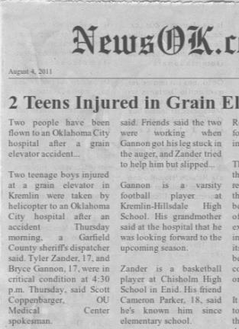

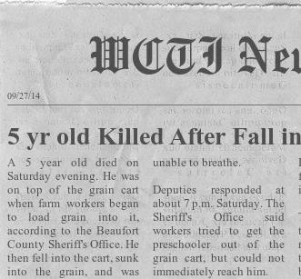
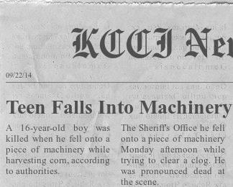
Fall Hazards
Notes:
Transition into the section on fall hazards by discussing news clippings of real life fall incidents in the grain handling “environment”.
Point out the news headlines which show falls in this environment not only cause injuries, but sometimes result in death.
Note some of these injuries are to young children who are not working, but are just in the worksite. Remember, young children and non-working youth should not be in grain handling areas.
After discussing the news clippings, share the following information.
Falls are one of the most commonly encountered hazards in the grain industry.
Falls account for a large number of injuries – both minor and severe – as well as deaths annually.
Falls hazards and the injuries and deaths caused by them are very preventable.
These news clippings can help students understand falls, which can cause injuries and deaths, really do happen.
Instructors can use the news clippings provided or look for others.
To find more examples of these types of injuries, visit aginjurynews.org.
Transition into Falls section
Illustrate falls can have serious consequences – injuries & even death.
Explain why young children need to be kept out of the worksite.
Discuss the frequency of injuries and fatalities as a result of falls.
Describe the types of injuries commonly caused by falls.
Does anyone know of any other incidents they may want to share?
Image Source: AEM pictorial database retrieved from - http://www.aem.org/safety-and-technical/safety/pictorial-database/
News Clip Source:
aginjurynews.org.
“Teen Falls into Machinery During Harvest”: KCCI.COM
“2 Teens Injured in Grain Elevator Accident”: NewsOK.com
“5 Year Old Killed After Fall in Grain Cart”: WCTI12.com

Slide 10
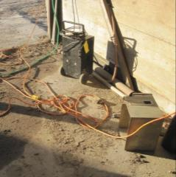
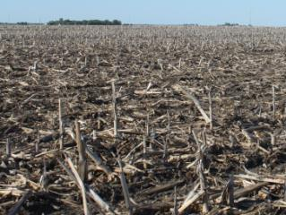
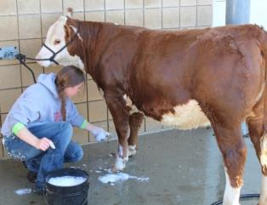
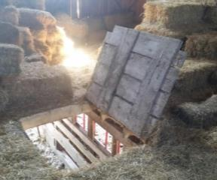

2 Types of Falls
Same Level Fall
Elevated Fall
Most common
Slips & trips
Hit object or surface
  Higher to lower level
  Less common, more severe
  Over 65% < 20 feet
A
B
C
D
Notes:
Same level falls are the most common type of fall and include
slips, trips, and falls to the same surface a person is walking, standing or working on.
a fall into/against objects above the walking/working surface.
Falls occur when a person is too far off his/her center of gravity. A disruption of the normal or expected walking gain results in a sudden loss of balance.
Photos A-C show examples of slip/trip hazards:
A - Cords, ropes other objects, and debris/trash on the ground are trip hazards.
B - Corn stubble and uneven ground can pose a trip hazard.
C - Water and liquids on the floor can cause someone to slip, as well as, ice, oil, mud, and similar slippery substances.
Other common slip hazards include leftover product such as corn kernels, soybeans, spilled feed or wet leaves, grass, etc.
Soybeans (especially on concrete) are like marbles when they move underfoot.
Keep walking/working surfaces clear of trash, debris, spilled product, spills of liquid or oils, ice, mud, etc. to prevent slips, trips same level falls.
While walking/working on uneven ground keep distractions (cell phone use, listening to music, etc.) to a minimum.
Elevated falls are falls from a higher to a lower level. Falls from ladders and work platforms are common sources.
D - an example of a fall hazard through an existing floor opening or other opening such as stairway or ladder way openings; pits; uncovered holes; and unprotected windows.
Although less common than same level falls, elevated falls produce greater injury.
In 2014, of 532 fatal worksite falls where the height was known, across all industries over 65% involved falls of 20 ft. or less.
Explain same level falls.
Illustrate some common causes of this type of fall:
Slips caused by slick surfaces, debris (such as leaves), product (such as soybeans), etc.
Trips caused by uneven surfaces, cords, debris, trash, etc.
Explain elevated falls.
Discuss the frequency and severity of these types of falls.
What other same level fall hazards can you think of?
Looking at the pictures, what are the hazards? How could this be addressed? Could these be addressed?
Can you think of a type of elevated fall that is from a higher level? from a grain bin ladder
What about a fall through a hole? bin opening, hay hole, uncovered unloading pit, “man holes” – entrances to underground tunnels, pits, equipment, etc.
Statistic Source: Retrieved on 3/5/16 from http://www.bls.gov/news.release/cfoi.nr0.htm
Image Sources:
Extension cords – LaMarr Grafft
Corn stubble – Amy Rademaker
Washing cattle - Abs.net.au - Credit: Chris Kick and Farm and Dairy
Floor opening in barn – Austin Rinker

Slide 11
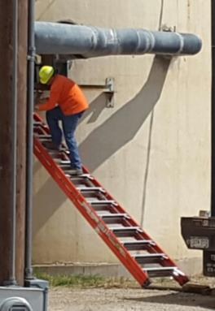
Ladders
Improper use
  main cause of falls
2 ladder categories:
  Portable ladders
  Fixed ladders
All share safety strategies
Free NIOSH Ladder Safety App: http://www.cdc.gov/niosh/topics/falls/
Notes:
Explain while there are many causes for falls, improper use of ladders is one of the most common – as well the most easily preventable.
There are many types of ladders but today’s talk will focus on those used most commonly in grain handling.
Ladders are categorized as either portable or fixed.
Portable ladders can be carried to the worksite.
Fixed ladders are permanently attached to a structure. It could be a ladder with rails & rungs or consist of just rungs attached to the surface.
While each of these ladders are different, there are safety strategies common to all types of ladders which will be discussed in the upcoming slides.
NIOSH has a ladder safety app, available free in both iOS and Android formats. Visit http://www.cdc.gov/niosh/topics/falls/ for more information and to download the free app.
Discuss the picture. This is an example of improper use.
This ladder is not properly set up – not at a 4:1 incline nor are the ladder feet flat and firm on the surface.
The worker is climbing the wrong side.
Emphasize improper ladder use is one of the main causes of elevated falls.
Identify the different types of ladders that will be discussed.
Introduce the safety strategies on the upcoming slides.
NIOSH ladder app provides “user-friendly guides and tools for extension and step ladder selection and safe use.”
Image Source - GHSC

Slide 12
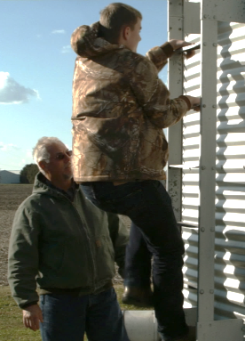
Safe Ladder Use
ONLY 1 person on ladder!
Climb - 3 points of contact
Always face ladder rungs
Stay centered on rungs between rails
Do not overreach
Never carry tools/materials
  Use tool belt or hand line
Notes:
The first rule for ladder safety is always – only 1 person on the ladder.
There are some ladders specifically designed for 2 person use, but most ladders are only meant for one person.
Whenever climbing or working on a ladder, the following safety strategies should be used:
Always have 3 points of contact on the ladder when climbing. This is either 2 hands and 1 foot or 2 feet and one hand. This prevents the climber from becoming unstable if one limb slips during the climb.
Always stay centered between the rails and climb in the middle of the rung.
Do not overreach when working. Overreaching is when the person is no longer centered. It causes a loss of balance and can tip the ladder to the side.
A good tip to remember is the center of your belt buckle (stomach) should be between the ladder side rails when climbing and while working.
Never carry tools or materials that could cause you to lose balance while climbing. Hands must be kept free to climb. Carrying objects interferes with having a firm grip on the ladder and maintaining 3 points of contact. The chances of falling increases when a hand or foot slip occurs.
Use a tool belt securely attached to the body with tools securely attached to prevent them falling out.
Use a hand line to raise tools when in the work position.
Use an assistant to hand materials and tools when in the work position.
Emphasize only one person should be on a ladder.
Discuss the safety strategies for properly climbing and working on ladders.
Content Sources: http://www.americanladderinstitute.org/?page=BasicLadderSafety
https://www.osha.gov/Publications/OSHA3660.pdf
The Instructor Manual Appendix contains “Tips on Ladder Safety” which provides a good summary on ladder safety. It is useful as a handout or review sheet.
Information on youth climbing safely is available in the Youth Agricultural Work Guidelines (formally NAGCAT) published by the National Children’s Center for Rural Agiricultural Health and Safety also available in the Appendix of the Instructor’s Manual
Image Source - GHSC

Slide 13
Personal Ladder Safety Tips
Wear clean, slip resistant shoes
Do not use - tired or dizzy
Do not use - under influence of medicine, alcohol, drugs
Never jump off or slide down
Use fall protection on fixed ladders
Do not use - broke, bent, missing parts
Notes:
Use these ladder user safety tips with all ladder types.
It is very tempting to take shortcuts when using ladders. A typical shortcut is jumping off or sliding down the ladder. However, these types of actions can have serious consequences.
A person can misjudge the distance and land wrong causing a strain, sprain, broken bone or worse.
The person could unintentionally bring the ladder down on top of them or cause it to fall on someone else.
Never use a ladder that is broken, bent, or has missing parts. If unsure, ask an adult or err on the side of caution and do not use.
When using a ladder wear clean, slip resistant footwear. It is also recommended the footwear have heavy soles to prevent foot fatigue. For additional safety, steel toed footwear helps prevent injury in case of falling objects, tripping, etc.
Users should NEVER use a ladder if they are tired, dizzy, prone to imbalance, or fearful of heights.
Sinus and ear infections can affect balance.
Users should NEVER use a ladder when under the influence of medication, alcohol or drugs.
Over the counter medications are also a concern. Many typical allergy, sinus, and cold medications have side effects which could affect the ability to work safely on a ladder.
Certain medications can affect balance, cause drowsiness, slow reactions, and affect judgement. Check the warning labels or with the pharmacist if there are questions about the side affects of medication.
Alcohol or drug consumption and ladder use do not mix. Alcohol & drugs can affect depth perception, judgement, reaction time, as well as cause drowsiness. They can reduce inhibitions leading to taking unnecessary risks.
Use personal fall protection or a ladder safety rail system on fixed ladders.
Discuss these safety tips for ladder use by the climber.
These tips are for use with all ladder types.
Many of the tips involve the individual user’s actions and how they affect ladder safety.
What is inappropriate footwear? Open-toe (sandles, flipflops); dress shoes (slick soles); slip on shoes like Vans or ‘deck’ shoes (they can fall off); etc.
What should you do if asked to use a ladder in the following scenarios?
You are afraid of heights.
You took a double dose of cough/cold medicine before work.
You were tackled in last night’s football game and were dazed.
You came straight to work from an all night party.
What is inappropriate footwear? Open-toe (sandles, flipflops); dress shoes (slick soles); slip on shoes like Vans or ‘deck’ shoes (they can fall off); etc.
Discuss how to talk to your employer if asked to use a ladder in the following scenarios:
You are afraid of heights.
You took a double dose of cough/cold medicine before work.
You were tackled in last night’s football game and were dazed.
You came straight to work from an all night party.

Slide 14
Ladder Use Safety Tips
Use right size ladder for job
Do not use - bad weather
Inspect ladders before use
Ladder feet flat - firm, level surface
Never place on top of other objects
Never exceed max load rating
Do not use within 10 ft. of power lines
Free of oil, grease, debris, etc.
Never move ladder when a person is on it
Notes:
Discuss safety strategies used with all ladders.
Choose the right size ladder for the job. Workers should be able to reach & work facing the job without using the top steps.
Inspect ladders before use for broken or bent rails/rungs/brackets, missing parts, protrusions, etc.
Always place the ladder feet so they are flat on a firm, level surface.
Never place a ladder on top of other objects to gain height – such as crates, beams, vehicles, etc.
Never exceed the maximum load rating for the ladder. This rating tells the maximum weight capacity the ladder can safely carry. Work ladders should be of industrial ratings.
To figure the total amount of weight the ladder will be supporting, add:
Person’s weight + weight of clothing & protective Equipment + weight of tools & supplies carried on the person + weight of tools & supplies stored on the ladder
Do not try to move or reposition a ladder when a person is on it, including yourself.
Never use a ladder within 10 feet of power lines and be extra careful when using metal ladders near electricity. The body can complete an electrical circuit between the electrical power source, the ladder, and then to the ground in the event of a live wire contact incident. An electrical shock while working from a ladder can trigger a fall or cause your heart to stop leading to serious injury or death.
Do not use in bad weather - rain/snow storms, high wind, etc.
Keep rungs clean from slippery substances such as oil & grease and clear of debris.
Discuss safety precautions that should be taken with ladders.
These tips involve the safe set-up and use of ladders.
5 Categories of Ladder Duty Ratings:
Type IAA (Extra Heavy Duty) 375 lbs. pounds
Type IA (Extra Heavy Duty) 300 lbs.
Type I (Heavy Duty) 250 lbs.
Type II (Medium Duty) 225 lbs.
Type III (Light Duty) 200 lbs.
All ladders require a Duty Rating sticker on the side. “A longer ladder does not always have a higher weight capacity. There is no relationship between ladder length & weight capacity.”
Content Sources: http://www.americanladderinstitute.org/?page=BasicLadderSafety
https://www.osha.gov/Publications/OSHA3660.pdf

Slide 15
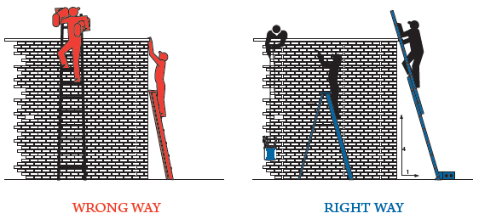
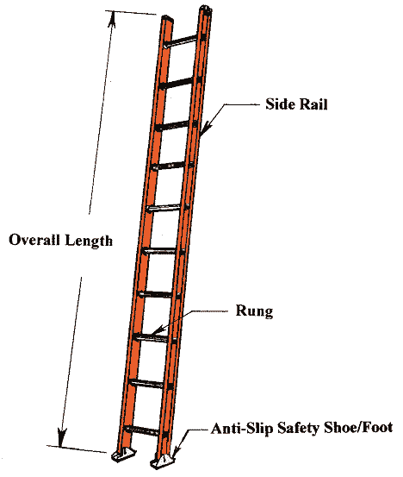
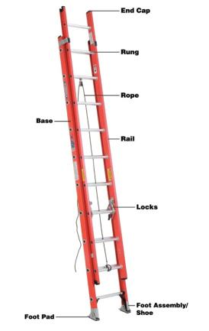
Single & Extension Ladders
Single
Extension
Property:
American Ladder Institute
Notes:
Portable ladders can be a single ladder, a step ladder, an extension ladder or any other type of ladder that can be picked up and moved.
Single and extension ladders have the same safety strategies.
Identify the main parts of the ladders (point to them) – rails, rungs, feet.
Explain the rungs and feet should be anti-slip. If the anti-sleep feature of the feet is missing, the ladder should not be used.
Point out the differences between the single ladder and extension ladder.
Stress the importance of remembering the base of the extension ladder has the feet which should be on the surface.
Emphasize the user should understand how the locks on the extension ladder work and know how to ensure they are securely locked.
Explain single & extension ladders are two common types of portable ladders that share the same safety strategies.
Explain the different parts of the ladder.
Image Source: Single ladder – American Ladder Institute. Extension ladder - OSHA Fact Sheet, Reducing Falls in Construction: Safe Use of Extension Ladders. Retrieved 3/5/16 from https://www.osha.gov/Publications/OSHA3660.pdf

Slide 16
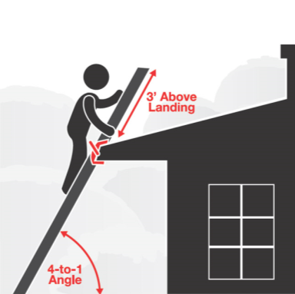
Single/Extension Ladder Set-up
DO
Incline 4:1 ratio
Extend 3 feet
Secure top & bottom
Lock extension ladders
Support at openings
Use ladder levelers on uneven surfaces
Notes:
Why should these strategies be followed?
What would happen if they weren’t?
Animated Slide: Each bullet point, appears with a click – total 5 clicks.
Image Source:
Elcosh – Retrieved from: http://www.elcosh.org/record/document/3721/2.jpg
Explain safety strategies to follow when setting up single or extension ladders.
The set-up of a single or extension ladder is very similar.
Follow these safety strategies when using portable ladders:
Incline ladder in a 4:1 ratio – for each 4 ft. in height, ladder must be 1 foot away from structure.
Extend ladder 3 ft. above the landing surface.
This allows for proper support and transitioning.
Tie off ladder at top for stability and secure ladder at bottom.
A stake can be driven into the ground by the side or back of the ladder feet and tied to the ladder.
Ensure the rungs locks on an extension ladder are secure before climbing.
Support the ladder at any openings it may lean against. When it is necessary to support the top of the ladder at a window opening, a device should be attached across the back of the ladder and extend across the window to provide firm support against the building walls or window frames.
There are only two level ground support points in addition to a top support. Use ladder levelers to achieve equal rail support on uneven surfaces.
The correct ladder length is essential to ensuring safety. A ladder that is too long for the job poses safety hazards.
If ceiling height prevents a ladder from being set-up at the proper angle, it is too long.
It is advised to not extend a ladder more than three (3) feet past the upper support.
No one should climb on rungs past the upper support point of the extension ladder. “The portion of the ladder that extends above the upper support point can act like a lever and cause the base of the ladder to move or slide out.
Content Source: OSHA and the American Ladder Institute.

Slide 17
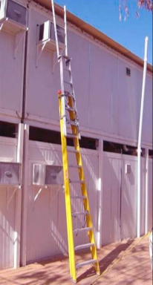
Single/Extension Ladder Safety
Do NOT
Set-up ladder upside-down
Extend length
  tie two ladders together
  tie ladder sections together
Stand above step indicated on label
Notes:
Discuss these common UNSAFE practices of ladder use and possible results.
Do not set-up an extension ladder upside-down - that is, with the Fly Section at the bottom and the Base Section at the top. The Base section has feet and should be at the bottom.
Do not tie or fasten two ladders together or sections of the ladder together to provide a longer length.
Use the proper size extension ladder.
An extension ladder that has frayed ropes, the sections do not properly align, slide, and lock, should not be used.
As stated previously, ladders should never be placed on other objects and/or vehicles to extend their length either.
“Safety standards require a label on the ladder to indicate the highest standing level.” Never stand above the step specified on the label. When standing on a ladder the upper thigh/hip area should be supported.
Stress these are unsafe practices when using a ladder.
Discuss how to stand safely on a ladder.
Content Source: https://www.osha.gov/Publications/OSHA3660.pdf and American Ladder Institute.
Image Source: Elcosh

Slide 18
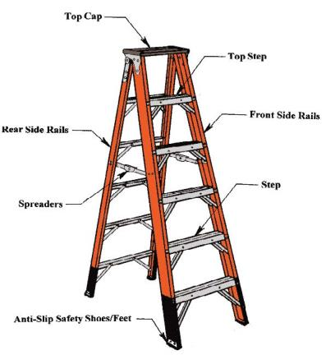
Step Ladder Set-up
DO
Level support for feet
Fully open base & lock spreaders
Set-up close to work
Property:
American Ladder Institute
Notes:
Identify (point to them) and explain the different parts of the step ladder.
Safety strategies specific for step ladders:
Level ground support for all four of the ladder feet.
Spread base fully open and lock the spreaders.
The spreaders when locked should be level and straight. Use a level to check.
The work tray should also be fully extended.
Set up close to the work area so it can be comfortably reached while worker stays centered between the rails and on the rungs.
Why should these strategies be followed?
What would happen if you didn’t follow these strategies?
Explain safety strategies to follow when using step ladders.
Identify step ladder parts.
Animated Slide: Each bullet point will appear on a click – total 3 clicks.
Image Source: American Ladder Institute
Content Source: American Ladder Institute - www.laddersafety.org

Slide 19
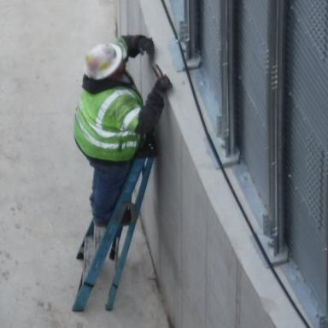
Step Ladder Safety
Do NOT
Climb the side or rear
Step or stand on
  top cap
  top step
  bucket/pail shelf
Use as single ladder
Use in partially open position
Notes:
Discuss these common UNSAFE practices when using a step ladder and possible consequences if done.
Never engage in side or rear climbing of a step-ladder.
Side climbing does not allow the person to stay centered between the rails on the rungs which could tip the ladder.
The back of a step ladder is not meant for climbing. It is usually bars instead of rungs which have a smaller surface that does not allow firm placement of the feet. Additionally, climbing from the rear can act like a lever pulling the front up and causing the ladder to tip.
Do not step or stand on the top cap, top step or bucket/pail shelf.
Standing on the top cap or the step below the top cap (top step) increases the likelihood of losing balance.
The bucket/pail shelf is not meant to be a step and cannot support the weight of a person. These are generally attached by some sort of bracket which can easily bend or become disengaged.
Stepladders are not to be used as single ladders or in the partially open position. This is a common misuse of ladders as shown in the picture.
When used as a single ladder, only 2 feet are on the ground and do not provide the ladder stability.
In a partially open position, the ladder could collapse (fold), causing the person to lose balance as well as the ladder to become dislodged.
Content Source: American Ladder Institute - www.laddersafety.org
Why should these strategies be followed? These are unsafe practices and do not use the ladder properly.
What would happen if you didn’t follow these strategies? The risk of a fall is increased.
Explain these common UNSAFE stepladder practices.
Discuss the possible consequences of these unsafe practices.
Image Source: GHSC

Slide 20
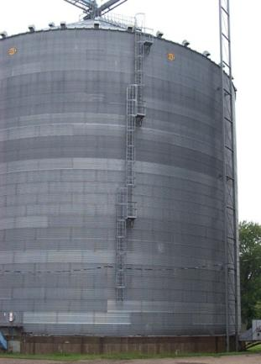
Fixed Ladder Safety
Extend 42” above landing surface
Total length ≥ 24 feet
  Ladder cage
  Personal fall arrest system
  Ladder safety system
Platforms
  Offset ≤ 50 feet
Notes:
Fixed ladders are common on grain bins, silos, and other structures. Farm bins may have stairs instead of a ladder.
A fixed ladder has rails & rungs or individual rungs permanently attached to a structure, building, or equipment.
Fixed ladders should have ladder grab rails and/or cages which extend 42 inches above landing surfaces.
Unlike portable ladders, fixed ladders can have different types of fall protection in place for the user. Look for:
Cages, or a personal fall arrest or a ladder safety system or some combination.
At a minimum, fall protection is needed for a continuous ladder length ≥ 24 feet that protects the worker during a fall for the entire length of the ladder section.
Cages should begin 7-8 feet from the access point; typically the ground.
Ladder sections should be offset with rest (landing platforms) at each offset and/or maximum 50 feet apart. Platforms need railings and toe boards.
NOTE: A new general industry walking/working surface standard finalized November 2016 requires installation of personal fall arrest or ladder safety systems on fixed ladders ≥ 24 feet.
Farm grain bins may not have ladder cages. Young workers should speak with the employer and/or family about using fall protection like a personal fall arrest or ladder rail safety system.
Explain safety strategies to follow when using fixed ladders.
Encourage young workers to ask about fall protection when using fixed ladders with no cages.
Inform students about limitations regarding ladder work in non-agriculture work and agricultural work.
Refer to current OSHA regulations for specific information about fixed ladder fall protection including cages and ladder safety & personal fall arrest systems.
NOTE: Federal Child labor laws prohibits youth under 16 in non-agricultural jobs from engaging in work requiring the use of ladders, scaffolds, or their substitutes. In agriculture workers under 16 are prohibited from working from a ladder or scaffold at a height over 20 feet.
Image Source: GFAI
Content Sources:
OSHA fixed ladder standard 1910.27
https://www.osha.gov/walking-working-surfaces/RegTextWWSFinalRule.pdf
http://www.youthrules.gov/know-the-limits/agriculture/hazards.htm
https://www.dol.gov/whd/regs/compliance/childlabor101_text.htm

Slide 21
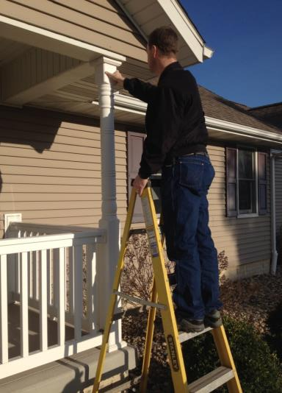
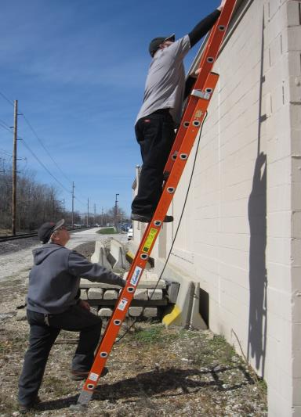
Correct Ladder Use
A
B
Notes:
Discuss the correct ladder use being demonstrated in the pictures.
Picture A shows proper use of a stepladder.
The spreader bars are locked.
He is facing his job site and not leaning off the side of the ladder as he performs work.
He is maintaining 3 points of contact.
He is not exceeding the load limit of the ladder.
Picture B shows proper use of an extension ladder.
The ladder is properly “footed” on a firm flat surface.
A second person is steadying ladder but not on the ladder.
The ladder user is maintaining a minimum 3 points of contact and facing the job.
Identify correct ladder use.
When possible, demonstrate correct ladder use.
Image Sources: Amy Rademaker

Slide 22
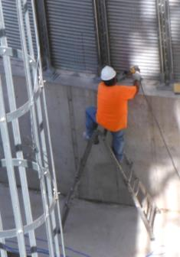
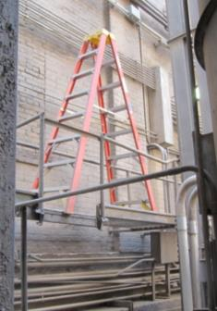
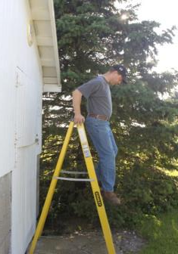
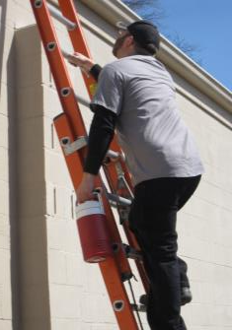
Identify Ladder Safety
Is there anything wrong?
A
B
C
D
Notes:
Discuss what is incorrect with the ladder use in the pictures.
A – Worker is facing the wrong way while descending
B – Worker is carrying something in his hand while climbing, not maintaining 3 points of contact.
C – Worker is standing on top rungs, straddling the ladder.
D – Ladder is placed on unstable work surface
Identify and discuss the correct safety strategy to use.
A – Worker should descend while facing the ladder rungs.
B - Worker should not be carrying something while climbing. A hand line tied to the cooler could be used to raise it after the worker is in position allowing him to maintain 3 points of contact while climbing.
C - reposition the ladder to face the work directly and/or use a longer ladder and/or use a different type of ladder (extension ladder). Stay below the top step.
D – The ladder needs to be repositioned on a solid, stable surface. A different type of ladder and/or different length of ladder may be needed.
Image Sources:
A - Amy Rademaker
B - GFAI
C & D - GHSC
Discuss and evaluate the incorrect ladder use depicted in photos.
Identify the correct strategy to use.
What are possible consequences of this kind of incorrect use?
The worker can easily miss a step or handhold and slip or fall.
Worker can lose stability and fall particularly if another limb slips.
Worker can lose balance and fall or the ladder can become unbalanced.
The ladder can easily tip when worker is climbing.

Slide 23
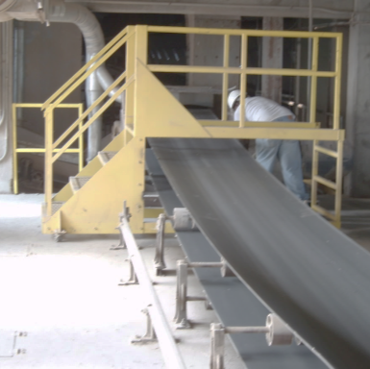
Fall Protection Required
Heights ≥4 feet
Above or next to dangerous equipment
Floor & pit openings
Stair & ladder openings
Work platforms
Notes:
Discuss when fall protection is needed around the workplace
Fall prevention strategies must be in place for height work 4 feet and more from the nearest walking/working surface.
Fall prevention strategies are also needed whenever there is a difference of 4 feet or more between levels where a worker could fall.
More simply, fall protection is needed when the fall potential is equal to or greater than 4 feet such as:
Floor openings and other openings
Stairway openings
dump pit openings, chute openings, hatchways, access holes, and openings for floor machinery
Ladder way and work platform openings, including walkways (sometimes called runways or catwalks)
Above or next to dangerous equipment
Around work platforms, including walkways (sometimes called runways or catwalks)
Around stairs.
Animated Slide: Click once for each main line to appear – total 5 clicks.
Image Source: GHSC
Emphasize fall protection is needed when working at heights equal or greater than 4 feet from the walking/working surface or when there is a difference of 4 feet or more between levels.
Discuss the situations fall protection is required.
Think about your workplace or family farm. What work areas would possibly fall under this broad definition of fall hazard and require some type of fall protection?

Slide 24
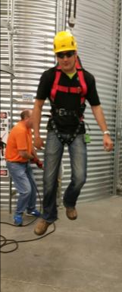
Protect against falls – 2 ways
Restraint – Keeps person from falling
  Structural - railings, barrier, etc.
  Personal fall (restraint) protection system
Arrest – Stops fall when it occurs
  Personal fall arrest system – PFAS
Notes:
There are two basic two basic ways to provide fall protection and two basic types of fall protection.
Fall protection systems can protect by “Restraint” or “Arrest” AND be structural versus personal.
Fall Restraint – keeps the fall from happening.
Structural – a physical or other structure that prevents a fall. Examples include railings, safety nets, floor guards, barriers, etc. It could also include a person “guarding” the fall zone. Structural fall protection is for restraint only.
Personal fall restraint (protection) system is a type of PPE that the worker wears which prevents a fall.
Fall Arrest - stops a fall when it occurs and prevents the person from contact with a lower surface.
Only personal fall protection is used for arrest.
A personal fall arrest system is a type of PPE worn by the worker. It is commonly called PFAS.
The worker MUST be trained to use this type of fall protection.
It is always better to use a structural restraint whenever possible.
Image Source: GHSC
Explain there are 2 ways fall protection can protect workers.
Restraint – keeps a person from falling
Arrest - works after a fall has occurred to stop the person before impact with a lower lever.

Slide 25
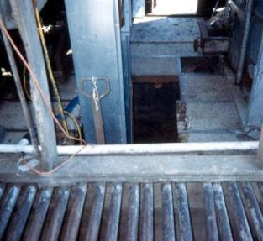
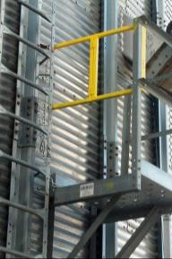
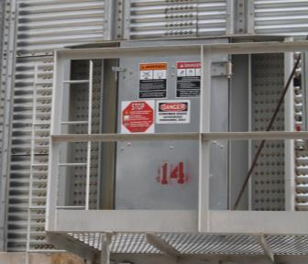
Structural Restraints
Floor holes - grates, covering
Railings – exposed sides
  Top rail, mid-rail & toe board
Ladder/platform entrance
  swing gate, barrier, offset
Uncovered floor opening
Floor Opening Covered
Notes:
There are different types of structural restraints which offer varying levels of protection against falls. The type of structural restraint used depends on the area requiring fall protection.
A railing, guard or barrier is needed:
when there is a height difference of at least 4 feet
the work area is above or next to dangerous equipment
floor openings including stairway, ladder way, work platform openings
around open-sided floors, work platforms, walkways
around stairways and stair landings
at entrances to ladder ways, work platforms, etc.
Floor hole openings (pits, chutes, hatchways, manholes, trapdoors, etc.) must have a cover (can be a grate) and/or railings around it. When a cover is open, the opening must have railings around it or a barricade or must be constantly attended. These can be temporary (but not easily removed).
Railings are the most common type of structural restraint. They are generally constructed of structural steel, pipe, or 2X4 wood.
A standard railing consists of the following:
Railing is present on all exposed sides except entrance to a ramp, stairway, or ladder.
Top rail is 42” high; Mid-rail half way between floor & top rail; and a 4” toe board.
Posts at appropriate intervals according to material used.
Railings withstand a minimum of 200 pounds of pressure applied at any point on the rail – downward or outward.
Ends of railings/handrails do not have a projection hazard.
Entrances to ladder ways, work platforms, etc. must be protected by a swing gate, offset or barrier such as a chain.
Enclosed stairways have a wall on one or both sides. They require handrails -30-34” high. (A combined stair top & handrail is 36-38”).
For more information, see OSHA Standard 1910 Subpart D Walking - Working Surfaces 1910.23; 1910.25, 1910.28 &1910.29
https://www.osha.gov/pls/oshaweb/owadisp.show_document?p_table=STANDARDS&p_id=9715
There are different types of structural restraints depending on the area requiring fall protection.
Discuss when it is necessary to have a structural restraint.
Explore the different types of restraints and their uses.
Explain railings are the most common type of structural restraint.
Image Source:
Left: GFAI
Others: GHSC

Slide 26
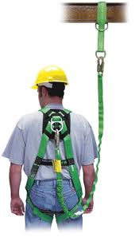
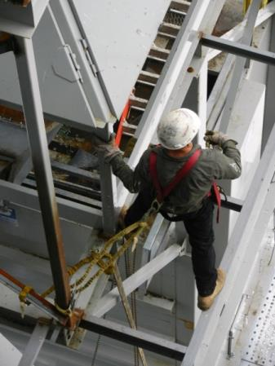
Personal Fall Protection System
Restraint or Arrest
Must be trained to use!
Body Harness
Anchor & Anchor Connector
Body Harness
Connecting Device (lifeline)
Deceleration Device (fall arrest)
Notes:
Personal fall protection systems are considered PPE – personal protective equipment for the user.
Personal fall protection systems are used when structural restraints are not feasible or cannot fully protect a worker.
There are two main categories of personal fall protection systems - Fall Restraint and Fall Arrest.
Different types of personal fall protection systems have different functions but generally provide either protection from a fall occurring (restraint) or protection when a fall occurs by stopping it (arrest).
All personal fall protection systems require components A, B, C, :
Anchor point and anchorage connector – Referred to as anchor point or tie off point.
Body harness –a full body harness that distributes fall forces evenly.
The harness goes over the shoulders, across the chest area, and has loops for the legs to fully support a worker.
A D-ring on the front (can also be on the back) attaches the worker to the connecting device.
Connecting device - joins the body harness to the anchor.
There are many types of connecting devices including lanyards & shock absorbing lanyards, self-retracting lifelines, rope grabs, ascenders & descenders.
Deceleration Device - is used ONLY in fall arrest systems. These devices dissipate the energy during the fall to limit the forces imposed on a person and stop the fall.
Examples of deceleration devices include shock absorbing lanyards, self-retracting lifelines, and rope grabs.
Workers MUST BE TRAINED BEFORE using a personal fall protection system by a qualified person. Workers need to be fully competent in the use of all the components and understand the protections and limitations before using personal fall protection.
Explain personal fall protection systems (PFPS) are a type of PPE – personal protective equipment.
Stress personal fall protection is used when structural restraints are not feasible.
There are two main types – fall restraint and fall arrest.
Identify the main components of the personal fall protection systems.
Discuss when this type of PPE might be used.
Stress – Workers MUST BE TRAINED before using.
When would personal fall protection be used? Often used in grain bins (lifeline) to prevent submersion in grain.
Image Source: Honeywell Safety Products
Refer to OSHA standard 1910.30 for fall protection training requirements including training on fall hazards and fall protection and personal fall protection.

Slide 27
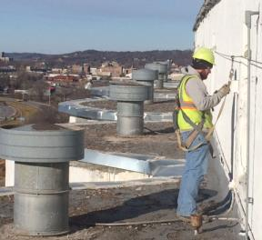
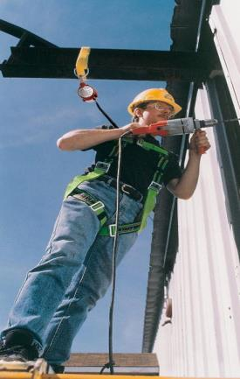
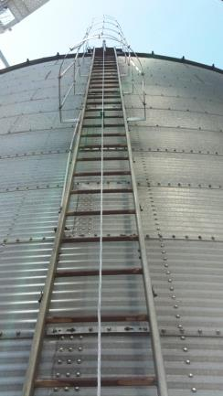
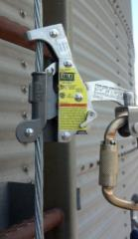
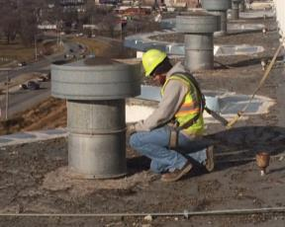
Personal Fall Protection Systems
Restraint
Arrest
Ladder
Notes:
Photos shows examples of different personal fall protection using the basic components shown on the previous slide.
LEFT – Personal Fall Restraint System prevents the worker from falling.
Top picture - worker is connecting to the anchor.
Bottom picture shows the lifeline connected to the worker. The lifeline is short enough to keep him away from the edge.
This photo is on top a commercial elevator with cement bins.
MIDDLE – Personal Fall Arrest System which decelerates and stops a free fall after it occurs.
The anchor connector (yellow strap) is connected to the anchor (beam).
The roundish red/white device under the beam is a retractable lifeline – one type of fall arrest device.
If the worker falls, the device dissipates the energy from the fall, limiting the forces on the worker when the fall is stopped.
The device “grabs” and “locks” the lifeline, holding the worker in place to prevent contact with a lower surface.
The free fall distance of a fall must be less than 6 feet.
Arrest systems are used for workers who could lose their balance while working at heights and fall to a lower level.
RIGHT – Ladder Protection System. These systems prevent a worker from falling off a fixed ladder.
The large picture shows the cable running the length of the ladder.
The inset shows the fall arrest device. The worker is attached to the device with a connector.
As the worker moves up the ladder the device moves along the cable so the worker is always connected.
If the worker slips & falls, the device locks, keeping the worker attached to the ladder, minimizing fall distance and preventing impact with a lower level.
Discuss these different types of personal fall protection systems.
Identify how these systems differ and how they would be used.
Emphasize – Workers MUST BE TRAINED BEFORE using a personal fall protection system
When would these types of fall protection be used?
Restraint – generally on a working surface with open edge like a roof.
Arrest - Often used in grain bins (lifeline) to prevent submersion in grain.
Ladder – on fixed ladders or other climbing structure with long length. Will be required on all ladders 24 feet or more in length.
Image Sources:
Left: GHSC
Middle: Virginia Tech Environmental Health & Safety. www.ehss.edu
Right: GHSC

Slide 28
Falls Summary
Falls are a major hazard.
Can result in severe injury & even death.
Strategies for preventing fall injuries:
  Always use ladders properly
  Guard floor openings, platforms & machinery
  Use railings or handrails on steps
  Fall protection required ≥ 4 feet height -railings or personal fall protection
Notes:
Falls are one of the major hazards encountered when working in agriculture and around grain
Falls can result in severe injury and even death
There are several strategies for preventing injuries from falls
Always use ladders properly
Ensure guards are in place (e.g. floor openings, machinery)
Ensure railings are in place and use handrails on steps
Use personal protection systems whenever needed
Review the main points of Fall Safety.
Stress fall protection should be used whenever a person is working at heights ≥ 4 feet.
Emphasize ladders are a cause of falls largely due to misuse.
Stress personal fall protection systems are a last resort of protection and workers should NEVER use it without proper training.
Note: “Tips on Slips, Trips, and Falls” is a training sheet summarizing falls and safety. It is available in the appendix of the Instructor Manual. Useful for a handout or for a review sheet.

Slide 29
Electrical Hazards
Notes:
This section will talk about electricity and some hazards that might be encountered around grain environments.
Introduce the Electrical Hazard Section.
Image Source: AEM Pictorial Database: http://www.aem.org/safety-and-technical/safety/pictorial-database/
Electrical safety standards for the workplace can be found under OSHA 1910 Subpart S. Most of the information contained in this section corresponds to 1910.303-308. A brief overview can be found at https://www.osha.gov/SLTC/electrical/standards.html
An electrical safety checklist is included in the Appendix of the Instructor Manual.

Slide 30
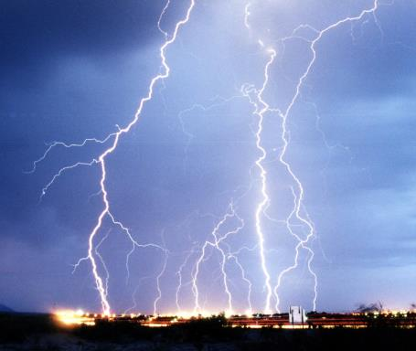
How Electricity Works
Electricity
Looks for path to the ground
Takes fastest, most uninterrupted route
Notes:
Electricity is always looking for a path to the ground.
It will take the fastest, most uninterrupted route to get to the ground – passing through whatever is in its way unless the obstacle interrupts its path.
Electricity will pass through a person to find the ground causing electrocution unless the person is ‘insulated’ against the electrical current.
Has anyone ever received an electrical shock?
Would you like to share what happened? Examples might include contact with an electrical fence or frayed cord.
Image: Wikimedia.org
Lightening over Las Cruces, NM
4 March 2004
Source United States Air Force, VIRIN 040304-F-0000S-002 or unbroken-link (or VIRIN 060822-F-1111A-001)
photo by Edward Aspera Jr.
Discuss how electricity flows.
Emphasize electricity will pass through whatever is in its way to get to the ground unless the obstacle interrupts its path.
Electricity will pass through people to find the ground and can cause electrocution.

Slide 31
Electrical Injuries
Electric shock/electrocution - Current flows through body causing damage
Severity
  Amount of current
  Path of current
  Duration
Causes
  Falls
  Drop tools/objects
  Burns
    Electrical – current
    Thermal – heat
Notes:
Electric shocks/electrocution occur when a body part comes into contact with some type of “live” electricity such as a wire, a damaged outlet, or even a bolt of lightning.
The body serves as a conduit (receptor) for the electricity which causes the current to flow through the body.
The severity of the injury and the amount of damage caused depends upon:
the amount of electricity in the current
the path the current takes
how long the body is exposed to the current.
The lesser the amount of electrical current, the faster/easier it is to “pull back” from the source - disconnecting the body part which ends the exposure and lessens the damage.
Burns may result from electrocution or contact with an electrical source such as an arc blast or hot conductor. Types of burns include thermal or electrical.
Electrical burns are caused by electrical current.
Thermal burns are caused by a heat source.
The type of burn and the severity of the burn depend on the number of layers of skin affected
Most burns are mild, but some may be severe.
Burns, such as those to internal organs, may not always be visible.
A person who experienced a prolonged electrical shock should seek medical attention.
Electric shock can also cause a person to
Fall
Drop tools
Ask participants discussion questions.
Discuss what effects the severity of electrical shock a person receives.
Explore some of the injuries that can be caused by electrical shock.
How could an electric shock cause a fall? (Electric shock causes the muscles to spasm and/or seize, person will fall. If on a ladder, roof, etc., injuries can be severe.)
How would dropping tools or other objects cause injury? (Could drop tool on your own foot, or if up high, could drop objects on people below.)

Slide 32
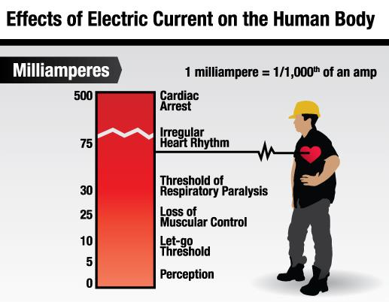
Effect of Electric Current
Women feel effects sooner
2/3 threshold of men
Notes:
The level/amount of current will determine the effect on the body.
The chart lists milliamperes of current on the left and the corresponding effects on the human body on the right.
Levels:
Perception is the initial “tingling” sensation or slight jolt one may receive which isn’t painful but disturbing. Person may feel weak.
5 milliamperes is the “Let Go” threshold. This is the point where a person cannot voluntarily release himself from the source of the electric current.
Around 25 milliamperes a person experiences loss of muscular control – severe muscle contractions; convulsions.
Respiratory paralysis accompanied by extreme pain and difficulty breathing begins around 30 milliamperes.
Ventricular fibrillation (75 milliamperes) – the heart begins to beat fast/unevenly and no longer beats at a steady rate. This can create more severe problems for some.
Cardiac arrest – heart muscles clamp and heart stops beating;
Breathing stops
Body tissues/organs burn
For a typical female, 50 milliamps for 2/10 of a second, and for a typical male, 75 milliamps for 1/2 of a second will send the heart into ventricular fibrilation.
The threshold for women is approximately 2/3 that of men
Statistic source: http://www.highvoltageconnection.com/articles/ElectricShockQuestions.htm
Explore the effects of varying amounts of electricity on the body.
Explain women feel effects at lower thresholds than men.
Image Source: GHSC

Slide 33
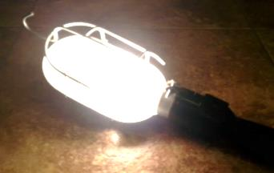
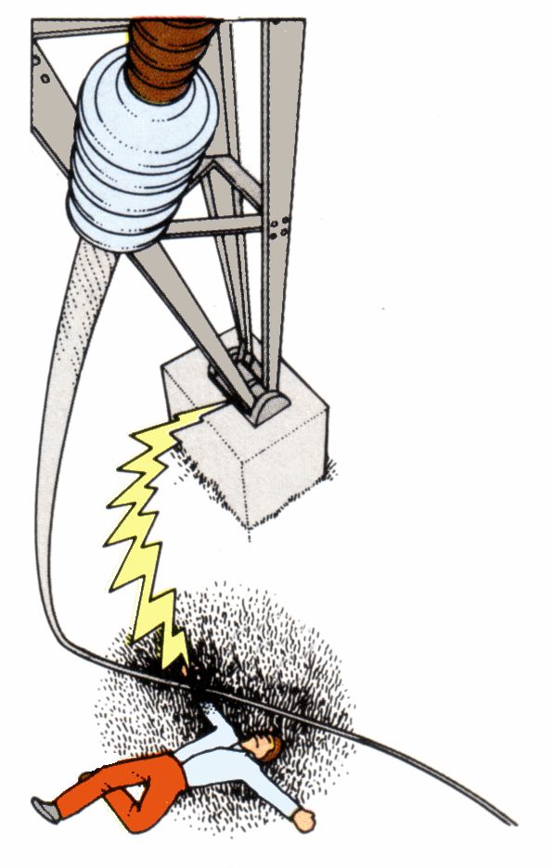
Electrical Effect
60 watt light bulb
Draws ½ amp
½ amp = 500 milliamperes
500 milliamperes can cause death
Notes:
To help you understand how very little electricity is required to cause an injury or death:
A 60 watt light bulb draws ½ amp of electrical current
½ amp is equal to 500 milliamperes
The previous slide showed 500 milliamperes is enough to stop the heart and cause death.
Explain the amount of electricity needed to cause death using a household item.
Image Sources:
Left: Arthur’s Clipart
Right: Ryan Rademaker

Slide 34

Electrical Hazard Consequences
C
Electrocution
  Direct contact
  Contact overhead power lines
Explosions
  Electric spark ignites explosive mix
Fires
  Overloaded circuit
  Faulty wiring cause excess current
Explosions
  Electric spark ignites explosive mix
Notes:
Electrocution occurs when a person comes into contact with an electric current and is injured. Contact is made
Directly with the electrical source – such as touching a bare wire.
Indirectly through equipment – such as hitting overhead power lines with equipment.
Explosions are caused when electricity provides a spark or heat as a source of ignition for an explosive mixture in the atmosphere.
Fires are caused by overloading circuits or excessive current flowing through faulty wiring which sets insulation and/or surrounding materials on fire.
The next slides will show examples of electrical hazards which can result in direct/indirect contact, explosions, and fires.
Animated Slide: Click once for each category to appear – total 3 clicks.
Discuss consequences of electrical hazards.
Explain some causes of types of electrical incidents.
Image Source: iStock

Slide 35

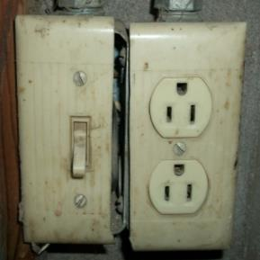
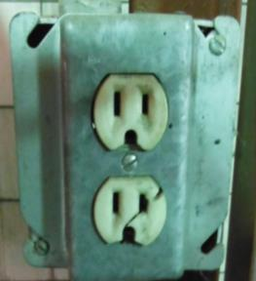
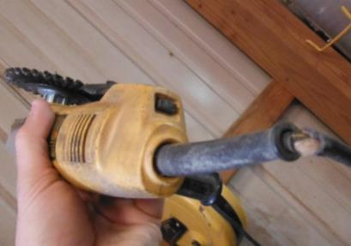
Electrocution – Direct Contact
A
B
Does the picture show a hazard?
C
D
F
Notes:
Direct contact with a live electrical wire/circuit can cause electrical shock or electrocution.
Many common hazards expose a person to direct contact but are simple & inexpensive to fix, when compared costs of an injury.
Insulation integrity - anything compromising the protective coatings or features of an electrical component such as worn or damaged coating covering electrical cords.
Broken, damaged or faulty equipment can include broken outlet covers, damaged cords, damaged receptacles/casings, etc. These hazards are easily overlooked and often not fixed.
Ask participants if the pictures shown have hazards.
After participants answer, click once for ‘no’ symbol to appear. Discuss hazards shown which can lead to direct contact and how contact could occur.
A: Missing ground prong – the third prong (ground prong) is cut off from this plug. If a short develops in the item this plug is attached to, the user may become the ground in the system and electricity will travel through the person.
B: Exposed wires – the light switch cover does not completely conceal electrical wires. Accidental direct contact with live electrical current could occur.
C: Broken outlet leaves person vulnerable to accidental contact with live wires through the plug or other objects
D: Damaged power cord – the insulation is missing around the power cord leaving the wires exposed. This tool should be taken out of service.
In all the examples, replacing the equipment is the best way to correct the hazard. When these hazards are identified in the workplace, the equipment should not be used. Prevent hazards by developing a schedule to check cords, outlet covers, etc.
“Fixing” a damaged cord with electrical tape is not an appropriate means of hazard correction.
Identify some of the most common electrical hazards which can result in direct contact with an electric current.
Insulation Integrity is anything compromising the protective coating and/or features of an electrical component.
Broken or faulty equipment is easily overlooked but can expose people to electrical currents.
Image Sources:
Top Left: Amy Rademaker
All others GHSC
Have you seen similar examples in your workplace or home?
Have you thought of these as potential electrical hazards before?
What are some other ways a person could come into direct contact with an electrical current? (Sticking finger or object into a plug is an example).
ANIMATED SLIDE: After participants have identified if a hazard exists CLICK ONCE – a circle around the hazard will appear first in each picture and then a slash line will appear in each circle.

Slide 36
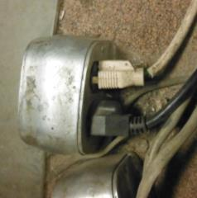
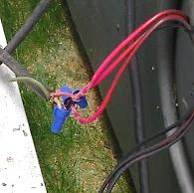
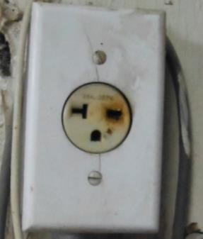
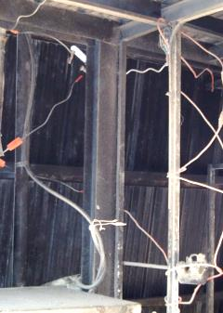
Electrical – Potential Fire Hazard
Bad Splice
Burnt outlet
Poor wiring
Improper Use
Notes:
Potential fire hazards are generally the result of improper use and installation of electrical equipment resulting in overloaded circuits and wiring.
Improper use and installation are common hazards found on many farms, elevators, and homes as people attempt to fix or install their own wiring. While many electrical jobs can be done, they need to be done correctly and the proper components used. A certified electrician should be used for wiring installation and should be called to check work done.
An overloaded circuit occurs when more current is put through the electrical wire or circuit than it was designed to handle. This causes the wire/circuit to heat up which could lead to a fire.
An example of overloaded circuits is plugging too many things into one outlet.
Incorrect wiring can allow too much current to pass through and cause excessive heating, also leading to fires.
Examples include not using the correct size electrical wire, putting too much on one circuit, and not splicing wires correctly.
The following pictures show examples of potential fire hazards:
Bad splice – The splice was not completed or capped correctly and has also left wires exposed to the weather and direct contact.
Burnt outlet indicates the circuit was overloaded and excessive heat generated. The inside wiring should be checked to ensure it was not damaged.
Poor wiring – this is an example of a very bad wiring job. Electrical wiring should be done neatly so the wiring is unobstructed and can be followed from its beginning to end source. Wires should be properly secured/fastened or contained in conduit, etc. The correct size wiring for the application is necessary.
Potential fire hazards are generally the result of improper use and installation of electrical equipment.
Overloading a circuit means more amperage is put on it than the circuit was designed to handle.
Image Sources: GHSC
How many of you know someone who does their own electrical work?
Does this present any risk? Overloading a circuit, bare wire exposed, improper use or installation of equipment, etc.
What is the solution? Have a certified electrician check your work, or even better, have an electrician do the work.

Slide 37
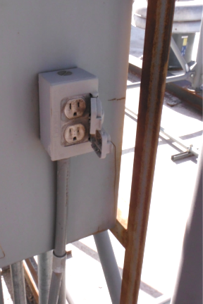
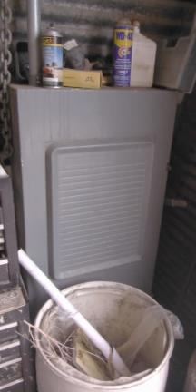

Identify Potential Ignition Source
A
B
C
Notes:
Explosions occur when an electric spark is created. Once ignited the spark can be fed by oxygen or other combustible agents.
An ignition source is anything that can produce an electrical spark.
There are several types of electrical hazards which can be considered ignition sources.
Ask participants if the pictures shown have hazards.
After participants answer, click once and a circle around the hazard will appear followed by a slash line.
Discuss the examples shown of electrical hazards which could be ignition sources and produce sparks.
Photo A - No GFCI. A ground fault circuit interrupter is needed in areas where an electrical outlet is exposed to moisture – such as outside (shown) or by water sources (sink). Moisture can create as short which could spark. Also outlets outside should have covers that are kept closed when not in use.
Photo B - Blocked access and flammables. Areas around electrical access panels (such as a breaker box) need to be kept clear of debris, chemicals, objects, etc.
Blocked access impairs a person’s ability to quickly access and cut off power supplies when needed.
Items stored near wires, panels, etc. could catch fire if the wiring is faulty, becomes hot, etc.
Storing any type of chemical, especially flammable agents, near electrical wires and/or access panels, can lead to fires, explosions or toxic fumes.
Photo C - Screwdriver in light switch. This is dangerous as the metal could contact a live wire creating a spark.
Excessive heat in the wiring/circuits (discussed in previous slide), as well as ungrounded electricity could also potentially spark and produce an explosion.
An ignition source is something that could produce an electrical spark.
An electrical spark could create an explosion when exposed to oxygen and/or other combustible agents.
Poor housekeeping is a common hazard and involves not properly maintaining areas where electrical equipment is located.
Poor workmanship consists of sloppy electrical work.
Corrosive agents (chemicals) and weather can deteriorate electrical boxes, panels, circuits, etc. .
Image Sources: GHSC
ANIMATED SLIDE: After participants have identified if a hazard exists CLICK ONCE – a circle around the hazard will appear first in each picture and then a slash line will appear in each circle.

Slide 38



Other Common Electrical Hazards
Unlabeled panels
Missing knockout & deterioration
Missing plug
Notes:
Common electrical hazards include missing plugs and knockouts as well as unlabeled panels, equipment, boxes.
These hazards because they can lead to more serious problems and exposure to injury.
These are easily identified and fixed.
Image Sources: GHSC
Discuss the examples of other common electrical hazards shown in the pictures and why these are considered hazards.
Unlabeled panel – Unlabeled or incorrectly labeled electrical panels, boxes, control boards, equipment, etc. create a dangerous situation when energy needs to be shut off (especially quickly) or a breaker needs to be reset. A worker could accidently turn on or turn off the wrong equipment putting someone else in danger.
Unplugged knockouts and holes in electrical panel boxes, casings, etc. Openings to electrical wiring allow moisture, dust/debris, rodents/insects/birds/animals to get inside which could cause short circuits, overheating, damage to wires (rodents chewing through them or urinating on them), nests being built, etc.
Deterioration, as shown by the rust on the electrical boxes in the middle picture, is when weather or corrosive agents have caused rust, holes, or other damage to occur to electrical boxes/panels, housing units/casings, circuits, wire insulation, etc. Deterioration indicates the electrical component was not placed in the correct environment. Deterioration creates the potential for moisture to enter, short circuits, excessive current, etc.

Slide 39

Overhead Powerline Hazard
Notes:
Ask participants to identify the electrical hazard in this photo:
Portable grain auger coming in contact with power transmission lines are one of the leading causes of electrocution deaths on farms.
Image Source: Safe Electricity
Identify the electrical hazard in this picture.

Slide 40
Overhead Powerlines
CHECK for overhead power lines
ALWAYS lower & secure auger before transport
AVOID work near power lines
DISCONNECT power if must work near lines
BE AWARE of long tools
REMAIN in vehicle if contact is made
  Call 911
Notes:
Overhead powerlines are extremely dangerous. Contact with them may cause severe injury or death.
To avoid contact with power lines always lower and secure augers before moving them, even for short distances. Lower any tall equipment when transporting & avoid areas with power lines.
Disconnect the electricity to power lines if working near them.
If it is not possible to disconnect the power, contact the utility company. The power company may be able to disconnect the power or put a “blanket” over the lines to prevent contact.
Contact with a power line may result from long tools or a ladder being used.
Be aware of tools being used. Avoid using long tools which could touch the power line. Use tools with non-conductive materials and/or insulated handles
Do not use metal ladders. When working around electrical lines or sources, always use fiberglass ladders or other types made for use around electricity.
Use fall protection as appropriate.
If an auger or other equipment comes in contact with power lines:
The operator should be protected from electrocution if they stay on the tractor or in the vehicle.
The rubber tires on the tractor/vehicle act as natural insulation and direct the electrical energy to the ground and not through the operator.
If the operator would step off the tractor and make contact with the ground at the same time they have contact with the tractor, their body will be the path of least resistance for the electrical current to pass.
This would result in the operator being electrocuted.
If contact is made with a power line or a power line is broken, immediately call 911.
Discuss the safety strategies for working around overhead power lines.
Stress if contact is made while on a tractor or in a vehicle, the operator should stay inside until help arrives to avoid becoming electrocuted.
ANIMATED SLIDE: Click once for each bullet point to appear. Total 6 clicks.

Slide 41

Detasseling Corn
  Supervisor
  Inspect for hazards
  Irrigation equipment off
  Properly supervise workers
  Young workers
  Stay 20 feet from irrigation equipment
  Enter field only when told
Notes:
Supervisors must inspect daily for any hazards in the area and address these hazards before youth enter the worksite. Workers should not enter the worksite until the supervisor indicates it is safe to do so.
Some examples of hazards which may need to be addressed:
Uneven ground (enough to present a hazard)
Damage from recent storms or lightening strikes
Irrigation system operating (producing water)
Standing water in the field
Workers need to be properly supervised (see notes). This includes checking their location at regular intervals to ensure other hazards are not present.
Youth must remain a minimum of 20 feet away form irrigation equipment. Irrigation equipment should not be operating when workers are in the worksite. Workers should only enter the field when directed by the supervisor after the worksite has been properly checked and hazards eliminated or mitigated.
http://www.dailykos.com/story/2011/7/31/1001138/- Why Regulation comes to be: Death in the cornfield, July 31, 2011 D. Steffan
Note: See NAGCAT guideline for detasseling corn at http://www.nagcat.org
Discuss the steps to avoid electrocution while detasseling corn.
Image Source: NAGCAT Guidelines

Slide 42

LOTO Lock Out/Tag Out/Try Out
LOTO controls energy sources
Lock out – De-energize & make ALL energy sources inoperable
Tag out – warn & inform others
Try out – make sure lock out works
Keep others from turning machines on!
Notes:
Before beginning discussion, ask participants if they know what Lock Out – Tag Out (LOTO) is and wait for their answers.
Lock out/Tag out is a critical safety measure to protect workers against injury by controlling all energy sources.
Lock out/Tag out de-energizes all energy sources, including stored energy; isolates the energy source; and makes the energy source inoperable.
Energy sources include electrical, mechanical, hydraulic, pneumatic, chemical, thermal, gravitational, kinetic & others.
Stored energy is residual energy left in a piece of equipment which may enable it to work for a short time even after it is disconnected from the energy source.
An example is a coiled spring or a pneumatic line still containing air.
Before LOTO is performed, ALL energy sources are identified.
Example: before entering a bin , ALL unloading equipment including augers, sump gates, and conveying systems are identified in order to lock them out.
Lock out/tag out consists of 3 basic steps.
Lock out – Follows established procedures to de-energize or disconnect and lock the energy source from being turned on.
A lockout device is placed on the energy-isolating device – such as a breaker panel.
The equipment being controlled cannot be turned on until the lockout device is removed.
Tag out - A tag is placed on the lock to let others know the energy source is locked out, not to turn it on and who locked the energy out.
Try out – Safely try to turn on the equipment to ensure it has been fully locked out BEFORE beginning work.
LOTO ensures the equipment cannot be turned on until the lockout device is removed by the person who put it on.
Image Sources: GHSC
Why is turning off equipment not enough? Others may turn it on and/or stored energy may be present.
Why is it important to “Try Out”? To ensure no energy source was missed and there is no stored energy.
Why tag out? Let’s others know the energy source is disabled and not to turn it on & who is responsible for locking it out and unlocking it.
Lock out/Tag out is a critical safety measure.
LOTO controls energy sources and protects workers.
LOTO has 3 steps:
LOCK OUT - De-energize all energy sources and make them inoperable.
TAG OUT – put a tag on the equipment to inform others
TRY OUT – Check to ensure the lockout is performed correctly.
Grain Handling Safety Coalition (GHSC) video, “Lock Out/Tag Out – Each Time, Every Time”, is a 7 minute video explaining the steps of LOTO. It can be viewed on the GHSC website www.grainsafety.org .
Additional information on LOTO can be found under the OSHA standard 1910.147 or from: https://www.osha.gov/SLTC/controlhazardousenergy/index.html

Slide 43

When to Use LOTO
Before any maintenance/service
  Work near equipment
  Any body part in point of operation
Before entry
  Storage structures
    bins, silos
  Confined spaces
Bypass or remove guard
Notes:
Lock out/Tag out must be done in situations where the operation of equipment could harm a person if it is unexpectedly started.
Before the servicing/maintenance of equipment
While performing tasks near equipment that could harm a worker if the equipment is operational
When any body point is exposed to the point of operation for the equipment during servicing/maintenance
The point of operation is the area on a machine where work is performed.
Whenever a guard protecting contact with the point of operation is by-passed or removed
Before entry into storage structures like bins or silos and confined spaces.
For bins & silos all unloading/conveying equipment must be locked out before entry to prevent engulfment hazards.
LOTO is used when the power source is capable of accepting a lock and when locked it isolates the energy source.
When the power source cannot accept a lock alternative measures must be in place that offer the same level of protection.
Explain LOTO prevents others from turning on equipment or machines unexpectedly.
Discuss when Lock Out/Tag Out is used.
Describe the conditions needed to use Lock Out/Tag Out.
NOTE: 1910.147(c)(2)(iii) After January 2, 1990, whenever replacement or major repair, renovation or modification of a machine or equipment is performed, and whenever new machines or equipment are installed, energy isolating devices for such machine or equipment shall be designed to accept a lockout device.
Image Source: OSHA
http://osha.asu.edu/Resources/Pictures/lockout-tagout2.jpg

Slide 44




LOTO = 1 Lock, 1 key, 1 person
Your lock cannot be opened with another key.
Notes:
Lock out/Tag out protects workers.
Performing Lock out/Tag out is the act of identifying, disconnecting, isolating, and making energy sources non-operational and must be completed by an experienced adult – the authorized person.
Person is trained on the correct procedures to shut down, disconnect, isolate, and lock out the equipment or machine.
Each piece of equipment/machinery has written procedures specifying where every power source is located; type of power; how to shutdown, disconnect & lockout the equipment; and how to start-up the equipment.
There is one lock and one key per person
No one has a key to someone else’s lock.
Ensures no one can remove a lock another person put on.
Prevents others from turning on a power source when someone else may be working.
Lock out/Tag out protects by ensuring only the person who placed a lock can take the lock off.
EACH person who is to work where Lock out/Tag out is done MUST also place their own lock on & keep their key.
ONLY the person/persons assigned the task notify the supervisor when the work is completed and remove their own locks. The authorized person/supervisor is responsible for ensuring no one is in harm‘s way; ends LOTO, and restarts the equipment.
Workers should NEVER go back to an area and work once they have removed their lock. Removing a lock means the worker is done and the machine can be turned on.
All workers must know who is authorized to perform LOTO at the worksite and be trained on the procedures for placing and removing their lock.
The employer is responsible for providing appropriate locks & tags.
Image Sources:
Lock & Key -Master Lock®
Person – Clkr.com
GHSC “Reducing Grain Bin Entry Risks” video
If you are asked to use another person’s key and remove a lock; what should you do? Never remove someone else’s lock. Ask key owner to remove the lock
Explain how Lock out/Tag out protects a worker and the requirements of LOTO.
Each person controls his/her own lock and key.
Stress the significance of removing a lock. When a lock is removed the owner is saying his/her work is done, he/she is has left the work area and the machine can be turned on.

Slide 45

Performing Lock Out/Tag Out
Young workers
  NEVER perform LOTO
    ONLY authorized adult perform
  Trained in LOTO policy
    By competent adult
    Know who can perform LOTO
    Attach own lock & hold key
    Supervised by adult
Notes:
Young workers
Are NEVER responsible for performing Lock Out/Tag Out – the process of identifying, disconnecting, and locking out energy sources.
Only authorized and trained adults should perform LOTO.
ALL workers, including young workers MUST BE TRAINED in Lock out/Tag out policies & procedures. The training must be done by an adult competent in LOTO and include:
Who is authorized at the workplace to perform LOTO
When workers are to place their own lock
How to place and remove their own lock
When the energy sources have been den-energized and locked out, EVERY worker, including young workers, who will be working where the energy has been locked out MUST place their own lock and hold possession of their key.
Young workers should be supervised by an adult when placing and removing their lock.
Before beginning ANY work around equipment, entering any bin, or removing any guard young workers should verify LOTO has been done.
ASK the supervisor.
Physically view the tag.
If trained, and can be done safely, test the equipment to ensure the energy is locked out.
If young workers do not know how to test to ensure LOTO is done, they should ask the supervisor to test it and observe.
Ensure they have placed their own lock on the lockout device.
If in ANY doubt, GET a supervisor and/or insist LOTO is done before working.
Note: workers are responsible for ensuring equipment is locked out and they have placed their own lock before beginning work.
You were told LOTO was done but did not see the tag nor did you place your lock. What do you do? Ask your supervisor to see the lock out and insist your lock be added.
Discuss the young worker’s role and responsibilities for LOTO.
Discuss when a young worker needs to participate in Lock out/Tag out and how to verify it has been done by an authorized person.
Explain what to do in the event that LOTO has not been done.
Image Sources: GHSC

Slide 46

STAND TALL for LOTO!
Young workers
  TALK to supervisor about LOTO
  ASK supervisor if LOTO was done
    LEARN
        Verify LOTO is done
        Put your own lock on
  LIVE - if LOTO is not done, do NOT do the job
Notes:
STAND TALL!
Talk to your employer and make sure you are trained on the LOTO procedures at the workplace.
Know who is authorized to perform LOTO at the workplace.
Verify LOTO has been done by physically viewing the lock out device and tag and testing the LOTO if able to do so safely.
Know when and how to place/remove your lock.
If you are unsure LOTO has been done, check with your supervisor.
If an employer doesn’t do LOTO, you have the right to refuse to do the task.
Lack of Lock out/Tag out is one of the leading causes of entanglements, electrocutions, crush injuries and engulfments.
NEVER perform work or enter a bin if LOTO is not done.
See Questions
You are told to LOTO equipment and you have not been trained, what do you do? State you have not been trained and cannot perform this task.
Discuss how young workers can Stand TALL to ensure LOTO is done.
Explain what to do in the event that LOTO has not been done.
Stress lack of LOTO is one of the leading causes of injuries and engulfments.

Slide 47
If Someone is Electrocuted
Disconnect power source
  Trained & able to do safely
  Assume wire is live; do NOT approach
Immediately call 911
Do NOT physically aid victim
  Must be trained
  Keep victim calm & still
  Must verify energy is disconnected
Insist on medical attention
Notes:
If someone is electrocuted do NOT approach the victim. Assume the power is live.
Shut off the power by disconnecting the appropriate breaker or hitting the disconnect switch. This should be done only if you have been trained, are knowledgeable about the power source and how to disconnect it, and can do it safely.
Immediately call for emergency services.
Do not physically touch the victim until it is verified the energy source is disconnected or you could be electrocuted also.
If there is still power to the area, you can be electrocuted by standing water, metal or other conducting materials in contact with the power source.
Encourage the victim to stay calm and not to move.
Only if trained to respond, and it is verified the power supply is disconnected and not live, should you give a victim aid.
Check respiration and heartbeat.
If trained in CPR, begin immediately, if needed and it is safe to do so.
Insist the victim receive medical attention.
Electrical shock can cause heart irregularities or a heart attack several hours later, even if the person appears fine at the time of the incident.
If you are unsure about the power source or how to aid the victim, wait for emergency/rescue crew.
Discuss what to do if someone is electrocuted.
Discuss the importance of assuming the power is still live and not approaching the victim.
Discuss why a person should not physically touch an electrocution victim.

Slide 48
Electrical Summary
The severity of electrical injury depends on: amount of electricity, path it travels, duration of exposure.
Identify electrical hazards and follow safe procedures to avoid or remove them.
ALWAYS verify LOTO before servicing or working near equipment or entering bins.
Everyone must place their own lock.
Notes:
The severity of an electrical injury and/or if it is fatal is dependent on 3 factors:
The amount of electricity you are exposed to
the path it travels through the body
and the duration of exposure
It is important to be able to recognize electrical hazards.
Follow safe procedures to avoid the electrical hazard if possible or remove the hazard.
Lock Out/Tag Out must be used whenever equipment is being serviced or someone is working around hazardous equipment that may cause injury.
Every person who is working on servicing equipment, entering a bin, or doing any task where lock out/tag out is needed must place their own lock and hold their own key.
Review the main points of the electrical section.
Young workers need to know how to recognize potential electrical hazards.
Lock out/Tag out is a way to avoic and eliminate an electrical hazard before servicing & maintenance of equipment.

Slide 49
Falls & Electrical Hazards Jeopardy Game
Purpose: To test your knowledge on fall and electrical hazards and prevention.
  Using the Fall and Electrical Hazards Jeopardy Game, divide the class into groups and have them play the game.
Notes:
Purpose: To test student knowledge on fall and electrical hazards and prevention.
Debriefing Questions:
Ask the students if they are surprised with how they did in the game.
Ask if there are any topics they want any more clarification on, or if there was a question they didn’t understand.
Supplies:
Falls and Dust Hazards Jeopardy PowerPoint
Directions for game
Key for questions/answers
Jeopardy game PowerPoint is downloadable from http://grainsafety.org/young-workers/. It is in the Young Worker Curriculum section under “Falls and Electrical Hazards”.
Directions for the game are found in this Instructor’s Manual.
Key for questions/answers is also in this Instructor’s Manual.
Use the jeopardy game to evaluate your knowledge of falls and electrical hazards.

Slide 50
References
American Ladder Institute
Bureau of Labor and Statistics
Center for Disease Control
Highvoltageconnection.com
Kake.com
Occupational Safety and Health Administration
Notes:
American Ladder Institute
Bureau of Labor and Statistics
Center for Disease Control
Kake.com
Occupational Safety and Health Administration

Slide 51
Acknowledgements
Abs.net.au - Chris Kick and Farm and Dairy
aginjurynews.org.
American Ladder Institute
Arthur’s Clipart
Association of Equipment Manufacturers (AEM)
Mac Bailey, Marshfield Clinic
Center for Disease Control
Clker.com – Sarah Moe
eLCOSH – Electronic Library of Construction Occupational Safety & Health
LaMarr Grafft
Grain and Feed Association of Illinois (GFAI)
Grain Handling Safety Coalition (GHSC)
Honeywell Safety Products
iStock
Notes:
Abs.net.au - Chris Kick and Farm and Dairy
Slide # 10
aginjurynews.org.
Slide #9
American Ladder Institute
Slide # 15, 18
Arthur’s Clipart
Slide #33
Association of Equipment Manufacturers (AEM)
Slide #9, 29
Mac Bailey, Marshfield Clinic
Slide #6
Clker.com Red Person Outline clip Art Sara Moe 10/5/2011
Slide #46
eLCOSH – Electronic Library of Construction Occupational Safety & Health
Slide # 16, 17
LaMarr Grafft
Slide # 10
Grain and Feed Association of Illinois
Slide # 20, 22, 25,
Grain Handling Safety Coalition
Slide # 6, 11, 12, 19, 23, 24, 25, 27, 32, 35, 36, 37, 38, 42, 44
Honeywell Safety Products
Slide # 26
iStock
Slide # 34

Slide 52
Acknowledgements
Masterlock® Image Library
Occupational Safety and Health Administration
Pacas Family
Alex T. Paschal/Sauk Valley Media
Ryan and Amy Rademaker
Austin Rinker
Jessie Starkey Photography
Safe Electricity
Thinkstock
United States Department of Labor
Virginia Tech Environmental Safety & Health
Wikimedia.org – Edward Aspera Jr.
Whitebread Family
Notes:
Masterlock® Image Library
Slide # 43, 44
Occupational Safety and Health Administration
Slide #15, 45
Pacas Family
Slide # 5
Alex T. Paschal/Sauk Valley Media
Slide #5
Ryan and Amy Rademaker
Slide # 10, 21, 22, 35
Austin Rinker
Slide # 10
Marsha Salzwedel
Jessie Starkey Photography
Slide # 5
Safe Electricity
Slide # 41
Thinkstock
Slide # 8
United States Department of Labor
Slide # 7
Virginia Tech Environmental Safety & Health
Slide # 27
Wikimedia.org – Edward Aspera Jr.
Slide # 30
Whitebread Family
Slide # 4

Slide 53
Resources
www.cdc.gov/niosh/topics/falls
www.marshfieldresearch.org/nccrahs
http://www.marshfieldresearch.org/nfmc/harvesting-health
www.nagcat.org
www.osha.gov
www.osha.gov/youngworkers
www.whistleblower.gov
www.youthrules.dol.gov
Notes:
www.cdc.gov/niosh/topics/falls
www.osha.gov
www.osha.gov/youngworkers
www.whistleblower.gov
www.youthrules.dol.gov

