Slide 1

Notes:
INSTRUCTOR NOTE: The Pre-test can be presented to a group provided answers are recorded. This may be a preferred method for audiences with suspected literacy limitations or audiences which are more difficult to engage. Pre-test slides are hidden following the title slide. The instructor will have to “unhide” the slides in order to display them. Instructions for issuing a group pre-test are on the pre-test slides.
Display this slide as participants arrive.
Remind participants to sign in.
Pass out the Pre-Test or have it near sign in sheet for participants to take.
Have participants complete pre-test as they take their seats.
Explain Pre and Post tests and evaluations provide on-going information to assist GHSC in ensuring materials are updated, relevant, and useful to participants. In addition, these are comply with accepted training/education practices and are required under the grants funding.
Emphasize –Today participants will LEARN so they can LIVE.
IMPORTANT NOTE: If multiple modules are being presented in one day emphasize the continued theme of LEARN & LIVE in this high hazard occupation before each module begins.
Notes may refer you the Instructor Manual (IM) for more information.

Slide 2
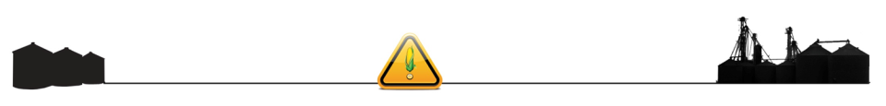
Agricultural Confined Space Hazards
http://www.newser.com/story/210510/father-son-lose-lives-to-manure-pits-deadly-gases.html
http://www.cbsnews.com/news/gas-from-manure-pit-kills-5-on-dairy-farm/

Slide 3
Introduction
This Agricultural Confined Space Hazards module is part of a curriculum series addressing hazards found in grain handling facilities including grain bins and their surrounding area. Its purpose is to assist participants to identify and abate hazards in the work place.
Notes:
Explain this module is part of a series.
Other modules
Overview of Grain Handling and Storage Safety (introductory module)
Lock out/Tag out (mini module)
Entanglement Hazards and Guarding
Fall Hazards & Prevention
Introduction to Lifeline Protection Systems (mini module)
Reducing Grain Bin Entry Risks
Agricultural Confined Space Hazards

Slide 4

Disclaimers
This material was produced under grant number SH-22288-SH1 and revised under grant SH-26294-SH4 from the Occupational Safety and Health Administration, U. S. Department of Labor.
It does not necessarily reflect the views or policies of the U. S. Department of Labor, nor does mention of trade names, commercial products, or organizations imply endorsement by the U. S. Government.
Notes:
Explain – GHSC received funding from OSHA. In order to comply with the grant we do need them to sign in and need to collect the following information:
Supervisor or worker. This information is for statistical purposes to show the types of population receiving training.
Employer. This is to establish an employer/employee relationship as covered under OSHA. Volunteer rescue workers who may be attending should list their employer; not the volunteer rescue squad. Farmers should list the registered business name of their farm. Farm employees should provide the business name listed on their paycheck.
OSHA does NOT contact the employer.
GHSC may contact the attendee or employer for follow-up evaluation in compliance with grant requirements.

Slide 5
Employee Rights
Employees are entitled to safe and healthy working conditions which DO NOT pose a risk of serious harm.
Workers are entitled to be fairly compensated for all hours worked in accordance with the law.
Notes:
Explain - All DOL grants require that employees are informed of their rights. In this instance we want to emphasize employees are entitled to a safe and healthy working environment AND to fair receive compensation for their work.
Remind employees – it is the employee’s responsibility to follow the safety practices, policies, and procedures of their employers.
Tell participants their rights also include the right to report unsafe conditions to the OSHA hotline without retribution.
More information about employee rights can be found on the OSHA website: www.osha.gov or the Department of Labor website www.dol.gov .
It is ESPECIALLY imperative for youth/young workers to access information and know their rights, what to expect, and how to get help if needed.

Slide 6
Employer Responsibility
Employers have the responsibility to provide a safe workplace.
More information about employer & employee rights can be found at www.osha.gov.
Notes:
Explain employers have a legal responsibility to provide a safe workplace. This means they must ensure the regulations which govern their business are instituted and followed. This applies to 1 employee or more.
Discuss - It is the employers’ responsibility to know the rules and laws – federal and state.
Emphasize – It is employers’ responsibility to ensure employees, know, understand and follow regulations and company policies.
Stress - If employers are unsure of the regulations they should consult with the appropriate agency. Every state has an on-site consultation program jointly funded by OSHA and the state which provides assistance in learning and complying to the regulations.
The OSHA website provides contact information for each state’s on-site consultation program.
Illinois Department of Labor has the on-site consultation program in Illinois.
Employers should also know and understand the state’s laws as they may be more restrictive than OSHA. Contact the state department of labor.

Slide 7
Whistleblower Protection
For information about whistleblower protection go to www.whistleblowers.gov
Employers cannot punish or discriminate against employees who have used their rights to report unsafe or unhealthy working conditions or environmental problems to an employer, OSHA or other government office. Employees can call, write or email the OSHA Area office within 30 days to report acts of employer retaliation.
For information about whistleblower protection go to www.whistleblowers.gov
Notes:
Explain - All DOL grants require that employees are informed of their rights. In this instance we want to emphasize employees are entitled to a report unsafe and unhealthy working environments and not be retaliated against by their employer with personnel discipline actions, termination, etc..
Remind employees – it is the employee’s responsibility to follow the safety practices, policies, and procedures of their employers.
Tell participants their rights also include the right to report unsafe conditions to the OSHA hotline without retribution.
More information about employee rights can be found on the OSHA website: www.osha.gov or the Department of Labor website www.dol.gov .
It is ESPECIALLY imperative for youth/young workers to access information and know their rights, what to expect, and how to get help if needed.

Slide 8
Learning Objectives
At the end of this module participants will be able to:
Identify agricultural confined spaces.
Identify hazards of agricultural confined spaces.
Control hazards with appropriate methods.
Understand how to apply the confined space standard.
Notes:
Introduce the learning objectives. These are the knowledge the participant should acquire as well as tasks or skills they should learn to perform.
Explain – the module was designed to seek interaction from the participants. Questions will be asked throughout to generate discussion.
Encourage – the sharing of ideas, information, experiences so everyone can learn.

Slide 9
Topics Covered
Confined Space Issues
Types of Confined Spaces
Confined Space Hazards
Hazard Control in Confined Spaces
Exposure Signs and Symptoms
Applying the Confined Space Standard
Grain Handling vs Confined Space Standard
Summary & Best Practices
Notes:
Introduce the module topics/outline.
Explain the main sections may have subtopics which will be introduced at the beginning of each section.
Subtopics include areas such as coverage of the confined space standard, employer responsibilities, a permit required confined space program requirements, permit requirements, reclassification of a confined space, and alternate procedures.
Stress – this training is intended to be interactive. You’ll be asking for examples of different hazards from the participants and supplementing points in training with real life examples.
State - Part of the goal of this training is to share information and ideas about best practices, look at the realistic ways tasks are performed, discuss barriers to employing safe practices and solutions to those barriers.
Emphasize - We will be discussing what types of incentives are needed in terms of changing perceptions & attitudes and the cost of safety practices.

Slide 10

Common Sources of Entanglement Hazards
Confined Space Issues
Notes:
This section contains a brief overview of some of the issues with confined spaces.
It is intended to raise awareness of the incidents & fatalities which occur with confined spaces and the frequency of these incidents both in agriculture and general industry.

Slide 11
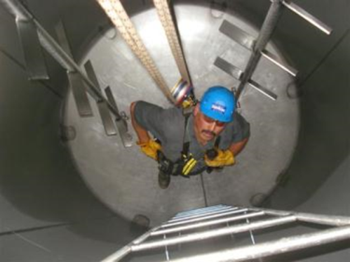
Confined spaces ARE dangerous
Confined Spaces could (contain):
Toxic air
Slip & fall hazards
Unseen hazards
Trap person inside
Notes:
Briefly introduce participants to the what are considered the dangers of confined spaces.
While not all confined spaces are dangerous, a level of appreciation for the dangers which could exist should be developed. Each space should be considered dangerous until it is properly evaluated.

Slide 12
Confined Space Risk
1:1,400 General Industry
1:10 Confined Space
90 annual deaths
5,000+ serious injury
≥ 60% victims – would be rescuers
Ratio of Death/
serious injury
Agriculture
62% fatal
51% engulfment
30% underreported
Notes:
Reported by National Safety Council 5.1.2014 according to OSHA
Greater than 2.1 million workers enter permit spaces annually. (Ozark community college Iowa Harwood Confined Space pp2010)
References http://www.osha.gov/pls/oshaweb/owadisp.show_document?p_table=PREAMBLES&p_id=843
Agricultural Confined Space Hazards – Purdue University PASID
Types of Ag Confined Space incidents include:
Asphyxiations
Entrapment & engulfment
Entanglement & falls
Other – drownings, struck by
Overall 62% fatal
1,873 documented cases 1962-2015
Entrapment & engulfment = 51% of 2015 cases
2015 = 24 grain entrapments
5 year average = 30.2
5 year average 2011 = 40.4
2015 Fatality rate – 58%
In 2012 – 23 entrapments = 35% fatality
2nd highest fatal entrapment in past 5 years
Corn & Soybeans most common type of material
82% occur in exempt farm facilities

Slide 13
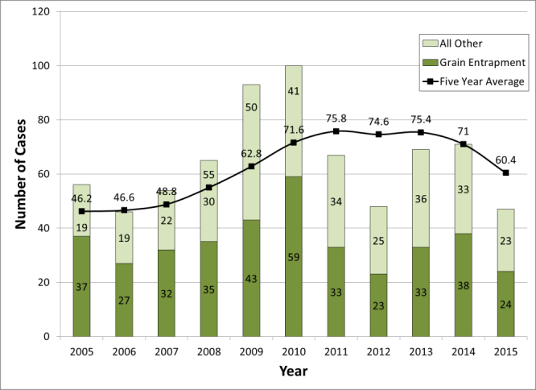
5 Yr Average – Ag Confined Space
5 yr average has climbed steadily from 2002 with 36.8 cases
Purdue University PACSID
Annual # confined space cases recorded 2005 - 2015.
Notes:
2015 = 47 cases; five year average = 60.4%
23% victims were > 60 yrs
Lowest # reported since 2006

Slide 14
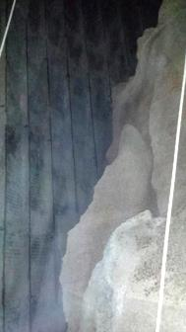
Influences on Confined Spaces
Material stored
Activity carried out
  Working alone
  Particular chemical reaction
  By-pass safety procedures
External environment
  Wind direction changes; running vehicles
Notes:
Injury and fatality incidents are influenced by what is happening in and around the confined space.
Engulfment and drownings result due to a lack of understanding the hazards posed by the material stored in the confined space. Entrapments in grain, for example, most often occur when grain in flowing.
The activities of the entrant play a large role in injury and fatality incidents. In the agricultural environment, working alone is common, and a large part of the work culture. It is a leading factor in delayed emergency action contributing to preventable deaths & serious injuries. No one is around to notice or respond quickly to the emergency. A large challenge is changing the cultural norm to understanding the need to use recognized safety practices such as having others present when performing entry into confined spaces: grain bins, manure pits, tanks, etc.
The agricultural environment produces a variety of chemical reactions which affect the safety of confined spaces. Many common chemical reactions are a natural process such as the decomposition of grain in poor condition or the conversion of manure into gases. Other hazards are chemicals used and/or their application such as anhydrous ammonia for fertilizer treatments.
By-pass safety procedures includes: unsafe entry, lack of guarding, not testing atmosphere, etc.
The industry’s history of independence, freedom from intervention, and time limitations imposed by the environment contributes to a strong cultural attitude fostering a level of complacency or disregard for known safety prevention strategies more widely acknowledged and used in other industries. Generational learning is prevalent; verbally passing down methods & procedures often not taking into account technological and knowledge advancements. Safety procedures are routinely by-passed such as:
Using unsafe entry practices including entering alone, not using appropriate PPE, or not performing an accurate hazard assessment & correction plan prior to entry.
Disabling and removing guards on equipment or not replacing broken and missing guards.
Not testing the atmosphere before entry. Either not understanding/appreciating how hazardous atmospheres develop or relying on experience or other factors to indicate if there is a hazard.
Other factors would include lack of adequate training & experience, inappropriate tasks for worker age or experience, inadequate communication of task responsibility or what tasks & location are being done; old practices to foster appreciation for farming such as allowing young children to ride on tractors or be around hazardous work environments (such as playing in/around gravity wagons).
Inadequate knowledge of the external environment’s effect on a confined space also contributes to incidents. Vehicles operating near the confined space opening can build up carbon monoxide gases; excerbated by changes in wind direction blowing exhaust into the confined space. Wind can also carry chemical applications occurring on adjacent properties. Confined spaces below ground level can contain contaminants from field run-off, flooding, etc. Environmental risks such as ice, rain, strong winds, fog, blowing dust/debris/pollen, etc. can affect vision, contribute to falls, and produce respiratory risks.

Slide 15
Types of Confined Spaces
Types of Confined Spaces
Notes:
Explain this will explore the types of confined spaces (non-permit and permit required) their characteristics and provide numerous examples found in agricultural settings.
The definitions and characteristics of a confined space and permit required confined space will be discussed.
As the different examples are displayed, encourage participants to use the definitions/characteristics to determine if the example would be more likely to be a non-permit or permit required confined space.

Slide 16
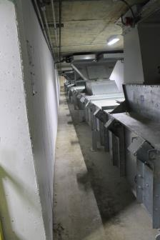
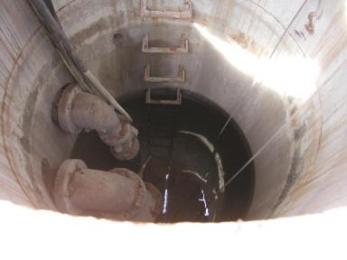
2 Types of Confined Spaces
Non Permit Required
Permit Required
No hazard
No hazard potential
Hazards present
Hazard potential
Notes:
There are two types of confined spaces, “Non Permit Required” and “Permit Required”. A non permit required confined space is a space which has no hazards present and no potential for having hazards present.
Permit Required Confined Spaces have hazards present and/or have the potential for a hazard.
A non-permit required confined space must be re-evaluated whenever a change in use or configuration occurs which could increase hazards to entrants and reclassified if necessary into a permit required confined space.

Slide 17
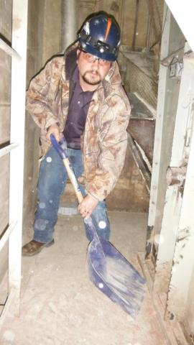
Confined Space: 3 Requirements
Confined Space
Meets ALL 3 criteria
Limited/restricted openings
“Bodily” enter & perform work
Not designed for continuous occupancy
Notes:
A confined space meets all 3 criteria listed.
Limited/restricted openings for entry & exit
Large enough to “bodily” enter & perform work
Not designed for continuous worker occupancy
Limited/restricted opening as not being able to walk upright, to an opening that would restrict the ability of all workers to exit quickly in the case of an emergency. A limited/restricted access does NOT mean it only has one entry point – although that is an example of limited/restricted access. A general rule of thumb is “non-standard door size” should be carefully evaluated.
Large enough to bodily enter & perform work – means a person’s body can be entirely in the space – even if it is bent, crouched or prone. This is an important distinction. A space in which a person could only fit his torso or his hands would not meet this criteria. The term bodily is the deciding factor.
Not designed for continuous worker occupancy. One way to consider this is whether you would put a desk in the space and work there for an 8 hour day, eat & relax in the space, etc. Was the space built with the intention of having a person in it continuously? This can be difficult at times to determine if the space is relatively large and no necessarily uncomfortable. From a 1995 LOI ……… the final rule's definition properly places the focus on the design of the space, which is the key to whether a human can occupy the space under normal operating conditions (1993 LOI such as: provided ventilation, lighting, sufficient room to accomplish the anticipated task, etc.).

Slide 18
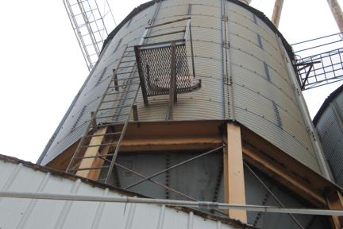
Access – Height, Size, Place
Elevated opening
  ≥ 4 ft above grade
Portal size
  ≤ 24” dimension
Horizontal access
Vertical access
Not properly guarded
Internal obstacles, obstructions, barriers
  Maneuver around
  Large Equipment
Notes:
POINT OUT – This photo shows the following restrictions – elevated access, small portal size, horizontal access & tapered bottom.
Elevation – if an opening is ≥ 4 feet above the grade it also affects entry & exit. This is also restricted access. For rescue purposes an elevated opening would generally require high angle rescue procedures due to the difficulty of packaging and transporting the victim from the portal to the ground. An opening less than 4 ft from the grade usually allows for normal transport of an injured person.
Portal size – a restricted portal size of less than 24” in dimension is too small to allow a rescuer to simply enter a space while using an SCBA. Additionally it is too small to allow for normal spinal immobilization of an injured person. An opening greater than 24” usually allows for relatively free movement into and out of the space.
Horizontal portals are located on the side of the space – as is common with many grain bins. Horizontal openings make the use of retrieval lines difficult.
Vertical portals are located at either the top or the bottom of the PRCS necessitating the need for both entrants and rescuers to climb up or down to enter/exit the space. These would also likely require knowledge of high angle rope techniques and/or special handling of victims to safely retrieve and transport them out of the confined space.
Obstructions inside the space make it more difficult for worker and rescuer entry & exit if they have to maneuver around it. Large equipment, such as ladders and scaffolding which is brought into the space for work purposes would be also be considered obstructions if the positioning & size affect mobility and rescue operations.

Slide 19
3+1 = “Permit Required”
Permit Required Confined Space
Meets 3 confined space criteria
PLUS ONE
Hazardous atmosphere potential
Engulfment potential
Internal configuration - trap or asphyxiate
Other serious safety or health hazard
Notes:
The general industry confined space standard – OSHA 1910.146 – covers entry into “Permit Required Confined Spaces”.
A permit required confined space meets the 3 criteria for a confined space – limited/restricted access, can bodily enter, and not designed for continuous occupancy.
Additionally, if the space has just ONE of the other defining characteristics - it is consider a Permit Required confined space.
Potential to contain a hazardous atmosphere – this is a space that may have stored products which as they break down could release harmful gases; has a combustible dust concentration; is enclosed in such a way it does not have continuous access to fresh air or the access is limited; the space may be infected by outside toxins; etc.
Engulfment potential – a liquid, solid, granular material is present.
Internal configuration – the inside is designed in such a way a person would have a difficult time exiting it or couldn’t exit it without some type of assistance such as another person, a retrieval line, ladders, etc.
Any other recognize safety or health hazard.
ONLY ONE of these 3 additional criteria need be present for the space to be considered permit required.

Slide 20
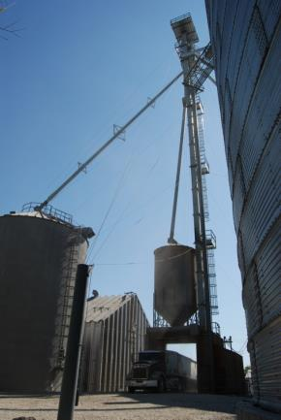
Examples of Confined Spaces
Bins & Silos
Grain dryers
Pits
  Boot, scale, waste, etc.
Tanks
Tunnels
Railcars
Notes:
These are typical types of confined spaces in an agricultural setting.
It is important to keep in mind that each of these may be a confined space, and once classified as such, they may also be a permit required confined space. Just because they are a confined space, however, they do not necessarily have any hazards in them at all.

Slide 21
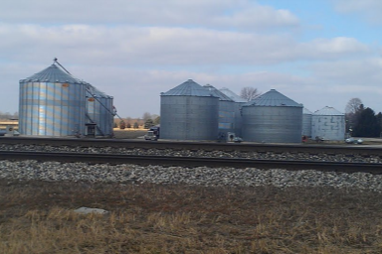
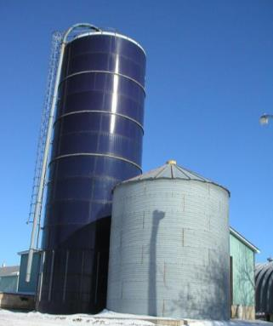
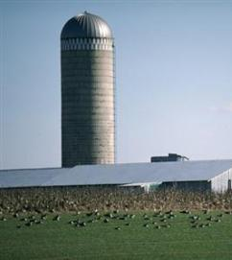
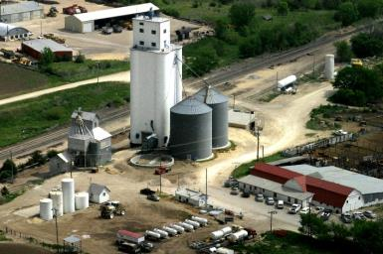
Grain Storage Facilities & Silos
Notes:
Discuss the characteristics that would make these confined spaces or possibly permit confined spaces according to the criteria.
Confined Space – does it have these 3 criteria?
Limited/Restricted access
Able to bodily enter & perform work
Not designed for continuous occupancy.
Permit Required – does it also have one of these criteria?
Potential for atmosphere hazards
Engulfment potential
Internal configuration which could trap or aphyxiate
Other recognized serious health or safety hazards
Silos –
Discuss the characteristics that would make these confined spaces or possibly permit confined spaces according to the criteria.
Confined Space – does it have these 3 criteria?
Limited/Restricted access
Able to bodily enter & perform work
Not designed for continuous occupancy.
Permit Required – does it also have one of these criteria?
Potential for atmosphere hazards
Engulfment potential
Internal configuration which could trap or aphyxiate
Other recognized serious health or safety hazard

Slide 22
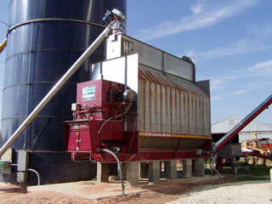
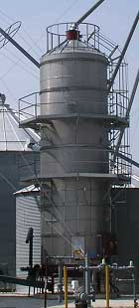
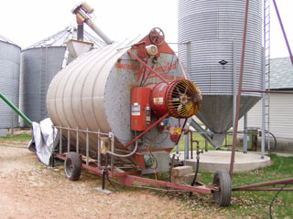
Grain Dryers
Horizontal cross flow dryer
Batch cross flow dryer
Vertical cross flow dryer
Notes:
Discuss the characteristics that would make these confined spaces or possibly permit confined spaces according to the criteria.
Confined Space – does it have these 3 criteria?
Limited/Restricted access
Able to bodily enter & perform work
Not designed for continuous occupancy.
Permit Required – does it also have one of these criteria?
Potential for atmosphere hazards
Engulfment potential
Internal configuration which could trap or aphyxiate
Other recognized serious health or safety hazard

Slide 23
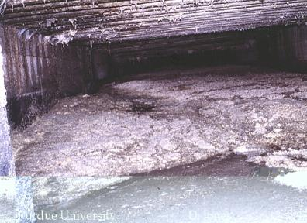
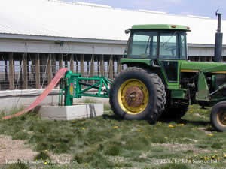
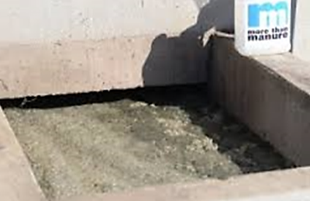
Livestock Waste Storage
Hog Confinement Pit
Notes:
Discuss the characteristics that would make these confined spaces or possibly permit confined spaces according to the criteria.
Confined Space – does it have these 3 criteria?
Limited/Restricted access
Able to bodily enter & perform work
Not designed for continuous occupancy.
Permit Required – does it also have one of these criteria?
Potential for atmosphere hazards
Engulfment potential
Internal configuration which could trap or aphyxiate
Other recognized serious health or safety hazard

Slide 24
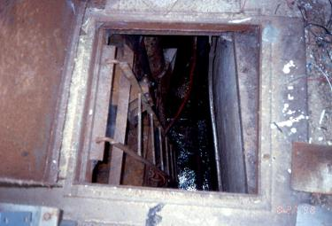
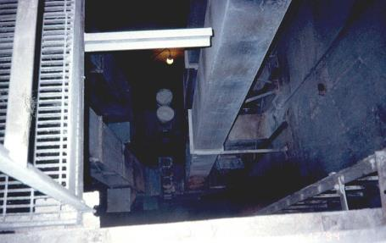
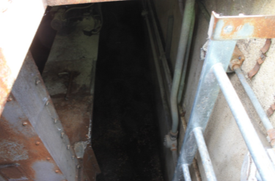
Leg Boot Pits
NOTE: Not all boot pits meet the criteria for a confined space.
Boot Pit & Tunnel
Notes:
Discuss the characteristics that would make these confined spaces or possibly permit confined spaces according to the criteria.
Confined Space – does it have these 3 criteria?
Limited/Restricted access
Able to bodily enter & perform work
Not designed for continuous occupancy.
Permit Required – does it also have one of these criteria?
Potential for atmosphere hazards
Engulfment potential
Internal configuration which could trap or aphyxiate
Other recognized serious health or safety hazard

Slide 25
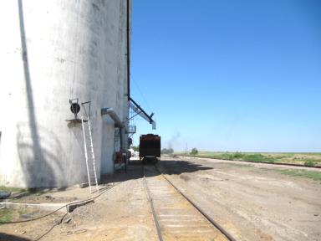
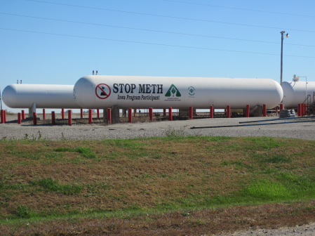
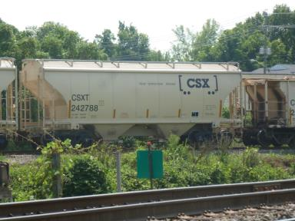
Railcars, Tanks
Loading grain railcar, Kansas
Anhydrous ammonia tank, Iowa farm
Hopper bottom railcar, Tennessee
Notes:
Discuss the characteristics that would make these confined spaces or possibly permit confined spaces according to the criteria.
Confined Space – does it have these 3 criteria?
Limited/Restricted access
Able to bodily enter & perform work
Not designed for continuous occupancy.
Permit Required – does it also have one of these criteria?
Potential for atmosphere hazards
Engulfment potential
Internal configuration which could trap or aphyxiate
Other recognized serious health or safety hazard

Slide 26
Confined Space Hazards
Confined Space Hazards
Notes:
This section will explore the different types of hazards listed previously in more detail.
The goal of this section is to enable participates to be able to evaluate & identify spaces in their work environments and determine if the hazards exist which would result in the space being considered a confined or permit required confined space.

Slide 27
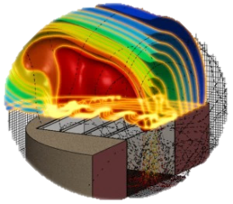

Confined Space Hazards
Hazardous Atmosphere
  Combustible
  Toxic
Engulfment
Internal Configuration
Serious Safety or Health Hazards
  Temperature
  Physical
  Biological
  Ergonomic
Notes:
The hazards we are talking about are atmospheric hazards, engulfment potential, has an internal configuration which has sloped sides which tapers to a smaller cross section which can trap a person, and has any other serious safety or health hazards. We are going to go over each of these hazards in detail.

Slide 28
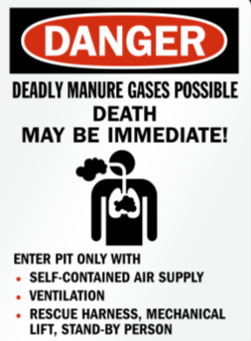
Atmospheric Hazard Exposure
Atmosphere hazards expose workers to:
Death
Incapacitation
Impairment
  Ability to self rescue
Injury
Acute Illness
Notes:
What is a hazardous atmosphere?
A hazardous atmosphere is one which exposes employees to death, incapacitation, impairment, injury, or acute illness.
Impairment is considered the ability to self-rescue from the space due to being overcome by some type of toxic atmosphere.
Can you think of any place at your facility or farm which may have an hazardous atmosphere?

Slide 29
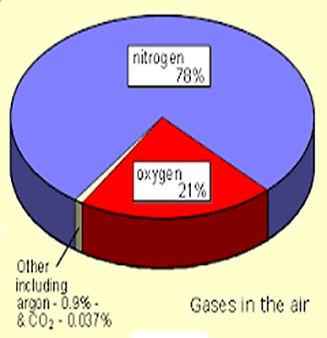
Atmosphere Hazards
Oxygen Deficient <19.5%
Combustible atmosphere
  Oxygen enriched >23.5%
Toxic atmosphere
Notes:
There are 3 main types of atmosphere hazards – oxygen deficient, combustible and toxic.
Our normal atmosphere contains just around 21% oxygen – 20.9%.
Atmosphere hazards are caused when the normal concentration of gases in the air is upset – particularly oxygen.
Oxygen deficient with an oxygen concentration of less than 19.5%.
Oxygen – referred to as O2 , is necessary at a specific concentration range for plants, animals and humans to live.
An environment that has an oxygen concentration less than 19.5% is deficient – the amount of oxygen in the air is not enough to function normally and if the levels are very low it will cause death.
Oxygen deficiency is the primary hazard in confined spaces.
Oxygen is displaced by other gases. Other gases may push oxygen out of the way or consume it. Because of their chemical properties some gases concentrate in certain places. Heavy concentrations leave no room for oxygen. For example, if a gas is heavier than air, it will tend to settle at the bottom.
To understand what the monitor is telling you as it records numbers, it is necessary to understand the exposure threat and the signs and symptoms of exposure. These will be discussed more later.
Some have said that it does not matter if employees understand what the monitor numbers are telling them, it only matters that they evacuate when the monitor sounds an alarm. Employees MUST understand the numbers and MUST understand the signs and symptoms of exposure because equipment can fail and numbers can be within the acceptable entry range and may be dangerous.
Whenever the monitor is dropping below 20.9%, the cause must be investigated and likewise, it the oxygen level is creeping upward, the cause needs to be determined.
When the oxygen reading is not normal, consider testing for gases which could cause displacement. These concentrations could be serious even if the oxygen reading is still within an acceptable range.

Slide 30
Gas, Vapor, Dust Is Combustible
Combustible atmosphere:
Exceed 10% LFL/LEL
  Gas, vapor, mist
  Lower flammable / explosive limit
Airborne combustible dust
  Greater than LFL
  Obscures vision ≤ 5 feet
Usually toxic
Air
Combustible Atmosphere
Gas, vapor, mist, dust
Ignition source
Ignition Triangle
Notes:
Combustible -A hazardous atmosphere is present when there is a flammable gas, vapor or mist which exceeds 10% of its lower flammable limit in the space.
A hazardous atmosphere is present when there is a combustible dust concentration that meets or exceeds its LFL and is approximated as in a suspended state which obscures your vision at 5’ or 1.52 meters.
Combustible atmosphere as well as oxygen enriched is when the oxygen level is above 23.5%.
Combustible atmospheres are usually toxic as well.

Slide 31
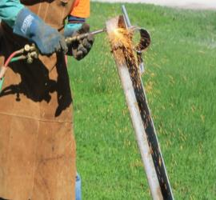
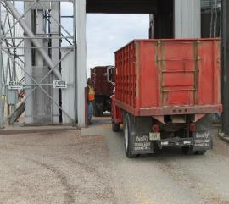
Work Activity May Make Air Toxic
Toxic sources
Product stored
  Decomposition
  H2S, CO2, methane
Activity in space
  Hot Work
Outside sources
  Vehicle exhaust
  Chemical application (drift)
Notes:
A toxic atmosphere is when the permissible exposure limit of a chemical in the air is met or exceeded. Atmospheric concentration of any substance for which a dose or a permissible exposure limit is published in Subpart G, Occupational Health and Environmental Control, or in Subpart Z, Toxic and Hazardous Substances, of this Part and which could result in employee exposure in excess of its dose or permissible exposure limit;
NOTE: An atmospheric concentration of any substance that is not capable of causing death, incapacitation, impairment of ability to self-rescue, injury, or acute illness due to its health effects is not covered by this provision.
Toxic atmospheres can be caused by the different sources listed. Hot work, for example, uses up the oxygen in the space. Vehicle exhaust displaces the oxygen in a space. Decomposition creates gases that also displace oxygen. The wind can carry chemical applications from other places.
When planning to work in a confined space, one needs to consider how toxic gases could be in the space or be introduced into the space.

Slide 32
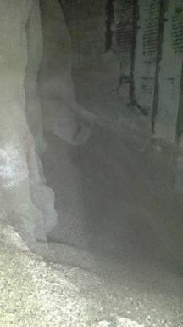
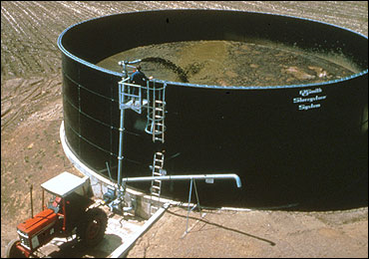
Engulfment hazards
Stored material (liquid/solid)
Allow entrant to sink
Movement - flow/fall
  Add more or introduce
Bridging
Notes:
Confined spaces come in many shapes and forms. These spaces may hold various types of commodities, fuels, manure, or even water.
What does “the potential for an engulfment” mean? Sometimes it means you must do “XYZ” to keep from the products being introduced into the space. We eliminate the chance of this hazard occurring by blocking, barricading and locking out equipment.
Definition for Engulfment under 1910.146 - Engulfment" means the surrounding and effective capture of a person by a liquid or finely divided (flowable) solid substance that can be aspirated to cause death by filling or plugging the respiratory system or that can exert enough force on the body to cause death by strangulation, constriction, or crushing.
Engulfment hazards exist when the stored material has characteristics which allow the entrant to sink – especially to a level where self rescue is not possible.
Engulfment also occurs when the material can fall and surround the individual or it can flow/move and surround the individual.
Bridging occurs when a seemingly solid surface breaks revealing a cavity underneath or in the case of manure pits a liquid.

Slide 33
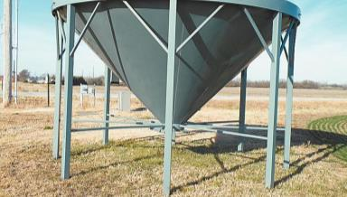
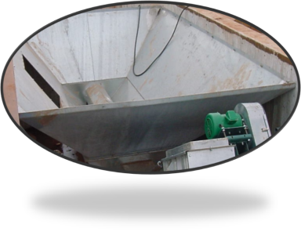
Internal Configuration - Trap
Inwardly converging walls
  Hopper bottom
Floor slopes - tapers to smaller cross-section
Notes:
If the space has an internal configuration such that an entrant could be trapped or asphyxiated by inwardly converging walls or by a floor which slopes downward and tapers to a smaller cross-section such as in a hopper bottom bin or a dump pit.
We must consider this hazard’s presence in addition to the engulfment and/or entanglement hazard.
How are we going to provide a stable working surface and how will we perform a rescue from these spaces?

Slide 34
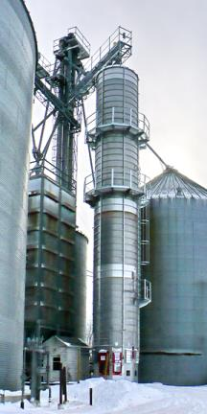
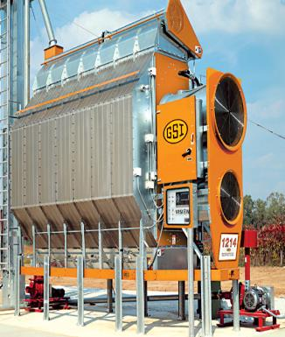
Temperature Hazards
BEFORE entry reach ambient temperature.
Excessive temperatures during use.
Shut down & COOL DOWN before entry.
Notes:
The atmospheric temperature may increase during operation of some equipment.
For example, grain dryers when in use have a temperature anywhere from 120 degrees and corn could be as high as 180 degrees.
There is a hazardous condition and a person may not be able to immediately enter a dryer upon shutting it down.
Employees must wait for ambient temperature to be reached before entering so you are not overcome by the excessive heat.
Other extreme heat and cold hazards in the space also need to be considered and appropriate measures taken to reduce serious health effects and injuries.
In spaces where there is a heat stress potential, and it is not feasible to cool the area, entrants should remain hydrated and take breaks in a cooler environment. Headaches, dizziness, lightheadedness, muscle cramps, and other symptoms of heat exhaustion should be monitored.
Frigid temperatures are also a concern. Hypothermia, frost bite and other health effects can occur. Maintain body heat by covering the head; stay dry; use layers of clothes for better insulation and cover extremities/skin most prone to the effects of cold such as ears, nose, face, fingers, and toes.

Slide 35
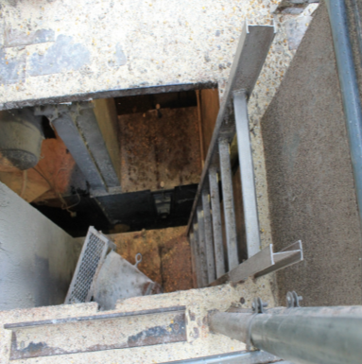
Safety & Health Hazards
Physical Safety Hazards
Falls
  Ladders
Mechanical guarding
Electrical
Falling objects
Drowning
Notes:
Confined spaces often have other physical safety hazards to be aware of.
Falls across all industries is a major hazard – both same level and different level falls. Often confined spaces uses ladders or may have slick/wet surfaces. Use correct fall prevention methods as well as appropriate PPE.
Ensure any mechanical hazards present are appropriately guarded or LOTO.
Watch for falling objects – wear hard hats and when feasible, block or guard openings to prevent objects from falling.
Drowning is an issue in spaces where liquids may be present. Even if there is not much liquid, a slip or fall could render someone incapable of keeping of keeping their airway clear of liquid. Extra care should be taken when there are know liquids in a space.

Slide 36
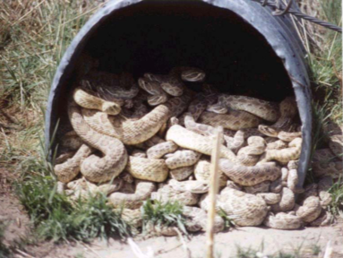
Biologic, Health, Ergonomic
Rodents, snakes, spiders, insects
Health hazards
  Sewage/contaminants
  Bird & animal feces
  Molds, bacteria
Ergonomic
  Strains & sprains
  Restricted or unnatural movement
Notes:
Confined spaces can harbor a myriad of rodents, snakes, spiders and insects some of which may be poisonous. Wearing protective footwear, clothing, and gloves will help protect against bites.
Confined spaces may include many airborne or other health hazards. Bird and animal feces can be particularly harmful. Sewage and other contaminants could be present, especially in below level spaces after a rain if there are known leakage problems or uncovered openings. Damp places will often harbor mildew, molds, and other bacteria.
Rarely discussed, ergonomic issues are a major consideration when working in confined spaces. The need to bend, twist, stoop, possibly lay prone, climb in tight spaces, and have restricted or unnatural body movements can lead to strains and sprains. These injuries can lead to lost work time and rack up medical costs if they do not heal properly or are reinjured. It is worth considering consulting an ergonomic specialist to assist in assessing task performance when working in confined spaces is part of routine operations. There may be better tools or positioning which can be used to assist in the prevention of injuries.
Photo: Confined space PPT - Grantee Name: Georgia Tech Applied Research Corporation Grant Number: SH-16625-07 Grant Year: 2007

Slide 37
Hazard Control in Confined Spaces
Notes:
This section focuses on hazard control in confined spaces.
It will look at the different types of hazards encountered in agricultural confined spaces and the appropriate methods to isolate, eliminate or control the hazards.

Slide 38
Control & Correct Hazards
Correct or control hazards:
Atmosphere
Engulfment
Mechanical
Ignition & Electrical
Personal Protective Equipment (PPE)
  Other methods do not control hazards
Notes:
Confined space hazards can be grouped into main categories.
The use of Personal Protective Equipment (PPE) is a control method when other methods such as engineering controls cannot adequately control the hazard.
Each of these categories will be explored further.

Slide 39
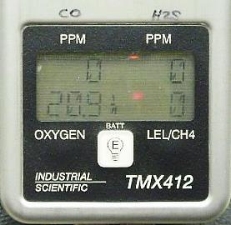
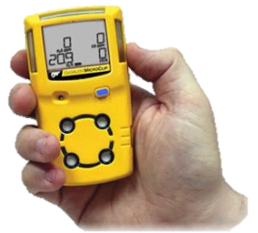
Atmosphere Monitoring - OLP
Low oxygen affects combustible reading
Use multi-gas tester
  Direct read instrument
  Calibrate
  Train Users
Test in order – OLP
  Oxygen Concentration 20.8 - 20.9%
  Lower explosive/flammable limit <10%
  Permissible Exposure Limit
Notes:
Air monitoring is the most effective means to know if atmosphere is hazardous. An air monitor is a device which measures the three main characteristics of a hazardous atmosphere
For us to know if the atmosphere in the space we are about to enter is safe we use a three gas tester which measures
Oxygen, O
Lower explosive or flammable limit, LFL or LEL
and our permissible exposure limit. PEL
MUST measure in this order OLP
Atmospheric monitoring is not successful when the instrument registers the readings in any other order.
The atmospheric monitors contain sensors which measure for conditions which may be present at the facility we are in.
For example if we were working in a facility which conducted fumigations we would need to have a sensor which reads the fumigant we use.
If we have a facility which never does fumigation we would not need to worry about our tester having that type of a sensor.
In agriculture it is common for us to look for oxygen levels, carbon monoxide, carbon dioxide, hydrogen sulfide, combustible dusts, and natural gas or lp.
It is important to remember that the atmospheric monitor must test for gases in the order of oxygen, lower flammable limit, and permissible exposure limit. Failure to test in that order can result in inaccurate measurements of the gases present.

Slide 40
Test Air: Before & During Entry
Conduct Testing:
Initial – BEFORE entry
  NO entry
Upon first entry
  Ensure conditions safe
Periodically DURING entry
  Wear monitor
Notes:
{If you have an atmospheric monitor demonstrate how to properly use the equipment.}
Test the atmosphere before entering and then periodically during entry to ensure safety.
Gases can be introduced from the outside changing the atmosphere and making it toxic after initial safe readings.
The best practice to use is to wear the monitor continuously throughout the entry to make sure the space’s atmosphere is not changing.
CASE STUDY – there have been cases where everything was fine until a gas was introduced to the space inadvertently through an outside source.
There were two electricians in a boot pit and a farmer was applying anhydrous on a field approximately 300 feet away from the boot pit. When the farmer lifted the knives out of the ground the anhydrous leaked out and the cloud drifted across to the boot pit. The smell of anhydrous rushed the electricians out of the boot pit. It should also be noted that extraction of the air must occur without entering the space in any way, shape, or form.
Photo: Davis Hill, Penn State University Extension.

Slide 41
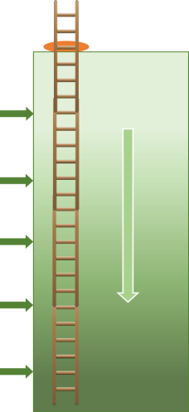
Stratified Atmospheric Testing
20’ Pit Testing
Vertical descent entries:
Gases stratified
Test intervals - 4 feet (1.22 m)
Direction of travel & each side
Slowed rate of progress
  Sampling speed/detector response
Hint:
Use tubing length & time from bump test
4 ft.
Direction of Travel
Notes:
To test the air in a space which requires vertical entry, the tubing used should reach to near the bottom of the space (never expose to liquid) without breaking the plane of entry.
The air should be tested at four foot intervals to check for stratified atmospheric conditions. There will be a slowed rate of progress while waiting the appropriate amount of time for the detector response.
It is important to determine how long the tubing should remain at each level to get an accurate and complete atmospheric reading.
The easiest way to determine this is by connecting the tubing and conducting a calibration and tracking the time it takes for the gas to travel to the monitor for a 4 foot section and “top out.” Then use the same length of tubing for the actual monitoring.
EXAMPLE. If during the bump test it took 5 seconds to travel 10 feet of tubing, then with 10 foot tubing hold the probe in place 5 seconds before moving to the next stratosphere.
Stratified atmospheric conditions occurs when a mixture of gas becomes “overrun” with a certain gas, lets say carbon monoxide.
Carbon monoxide is a heavy gas and the gas displaces oxygen as its concentration builds.
This allows the heavier gas to accumulate at sometimes lethal levels near the bottom of the space while the atmospheric conditions in the upper part of the space is acceptable for entry.
As you climb down the ladder into the space you move into the hazardous atmosphere and can be overcome by the carbon monoxide.
The same situation occurs in hog building pits.
The manure in the pit contains the gases, hydrogen sulfide, methane, carbon dioxide and ammonia.
The gas remains in the pit and the air above the slats remains non hazardous, but as the contents of the pit increases the gas will build up and without pit exhaust fans the hazardous atmosphere will move above the slats.
During times when the pits are being emptied, agitating the contents releases these gases at a higher rate and without continuous ventilation, employee injuries and fatalities have occurred.
Hog buildings have exploded from these gases coming in contact with a heat source and/or the animals inside were killed from exposure to the hazardous atmosphere.

Slide 42
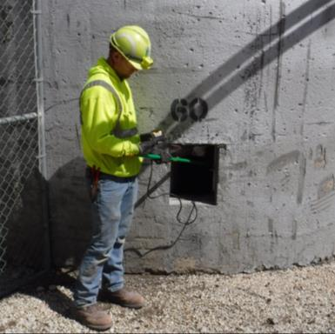
Horizontal Atmosphere Testing
Use wand or secure tubing to handle
Extract air - 4 feet of entry point
  Height entrant’s head
Continue testing
  Direction of travel
  4 ft. intervals
  Wait for results
Notes:
Horizontal entry should be conducted in a similar fashion as stratified testing.
Since horizontal testing requires a wand or rigid structure to attach tubing to, the initial reading may only be able to be completed within a four foot area immediately inside the passage way. Measure approximately the height of the entrant’s head – where they would be first breathing the air.
When the entry process begins continue testing moving in the direction you will be working and pausing to get accurate readings.

Slide 43
Decide Hazard Control Strategy
Ventilate
Reliable air flow
Natural air flow
Re-test after ventilation
Isolate
Prevent toxins from entering
PPE
Respiratory aid
Trained to use
Fit test
Medical clearance
Forced air
Notes:
After initial testing is complete, a control method needs to be put in place to either make the atmosphere space or keep it safe during entry.
There are 3 basic methods of atmosphere control –ventilation, isolation, or the use of PPE.
Ventilation provides a reliable air flow through the space. Ventilation can be either forced air or natural air flow. If hazards were present in the atmosphere, ventilate the space and re-test before entry. The size (cubic feet) and configuration of the space will determine how many complete air exchanges will be needed with mechanical ventilation to make the space safe to enter. Several states have specific requirements. KNOW the requirements for the state you are in regarding ventilation for confined spaces.
Isolation consists of purging, blocking, etc. the space to prevent toxins from entering. This should be done by trained personnel. Before entering the space should be retested to ensure the isolation was effective and continual monitoring of the atmosphere should take place during entry.
Respiratory PPE can be used to supply clean air to an entrant in a space where the hazards cannot be eliminated before entry. Entrants MUST be trained in the use of the type of respirator required – discussed under PPE. Also, when using PPE as atmosphere protection, 2 stand-by persons are to be available with their own respiratory PPE. Whenever using SCBA, SBA, or basically any type or respiratory protection other than a dust mask, the wearer needs to be trained, fit-tested and medically cleared to use it.

Slide 44

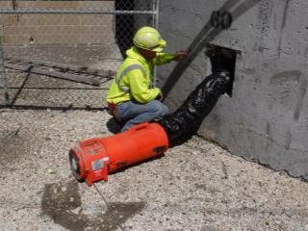
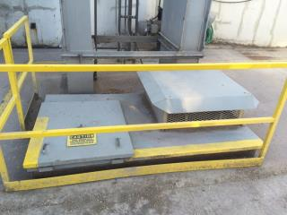
Forced Air Ventilation
Permanent fans - availability
Portable blowers
Blow through work area
Ventilate entire entry
Air exchange rate
Mechanical ventilation recommended
Notes:
Permanent fans – bottom photo – are desirable because they are always available to provide ventilation.
Portable blowers – top photo – are convenient for sites that may have numerous spaces to ventilate such as a commercial grain elevator.
NOTE – blowers are NOT ONE SIZE FITS ALL. When purchasing a portable blower, the size, configuration, contaminants, rate of exchanged, type of environment (in combustible environments like grain blowers must meet NFPA ratings) and other factors must be considered. These factors will determine if the portable blower can be used in different confined spaces.
Ventilate the entire time an entrant is in the space.
IMPORTANT NOTE – Some state plan states may require a minimum number of clean air exchanges prior to entry. CHECK your state’s confined space regulations. The federal OSHA standard does not include a minimum number of clean air exchanges.

Slide 45
Control Engulfment Hazards
Eliminate or control engulfment hazards:
Properly assess conditions
Barricade traffic
Block spouting
LOTO
  Filling & emptying equipment
  Other equipment
Lifeline use
Notes:
Effectively eliminate and control engulfment hazards due to material in the confined space.
Properly assess the conditions of the space and the material. For example, granular products such as grain have a natural angle of repose. When the product is at this natural angle the engulfment potential is minimum.
Prevent material from being introduced into the space or removed from the space by blocking spouting, LOTO filling & emptying equipment, guarding or blocking or LOTO sump gates/holes, and barricading traffic from the area.
Eliminate movement of material by LOTO equipment which may move the material such as conveyors, augers, stirators, blades, etc.
When working with material that has the potential to shift or collapse use a harness and lifeline.

Slide 46
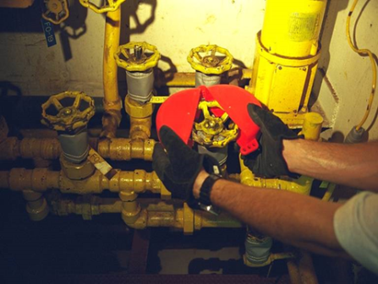
Mechanical Hazard Control
Isolate energy sources
LOTO circuits & lines
Disconnect drives & linkages
Guard or secure moving parts
Notes:
Agricultural confined spaces may have machinery in them which needs to be secured in order to not pose a hazard to the worker. Examples would be bins, silos, boot pits, etc.
Isolate the energy sources and perform LOTO.
Hydraulic, pneumatic, steam, and other lines may need to be bleed, drained, blocked, etc.
Make sure moving parts of machinery such as augers, belts, etc are properly guarded or secure them to prevent from movement.
Photo: Confined space PPT - Grantee Name: Georgia Tech Applied Research Corporation Grant Number: SH-16625-07 Grant Year: 2007

Slide 47

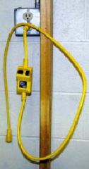

Ignition & Electric Hazard Control
Ignition
Electric
Non-sparking tools
Classified electrical equipment
Grounding
Ground Fault Circuit Interrupters (GFCI)
Lockout transformers
Portable GFCI
Non-sparking wrench - berryllium-copper alloy
Notes:
Use non sparking tools to avoid any potential ignition sources.
Certain confined space environments must follow NFPA guidelines for explosion proof equipment.
Control electrical hazards and possible sparks through proper grounding, use of appropriate GFCI and when feasible isolating transformers.
Photo – wrench description - Adjustable wrench made from beryllium-copper alloy. Strong, non-sparking, non-magnetic, corrosion resistant. Source wikimedia. Author Guy Immega. https://commons.wikimedia.org/wiki/File:Beryllium_Copper_Adjustable_Wrench.jpg
Photo – Portable GFCI. GFCI on wall – elcosh http://www.elcosh.org/document/1624/894/d000543/section8.html
Other – OSHA https://www.osha.gov/SLTC/etools/construction/electrical_incidents/gfci.html

Slide 48
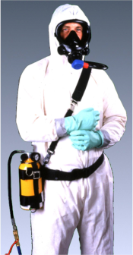
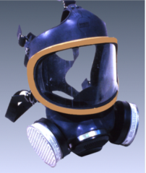
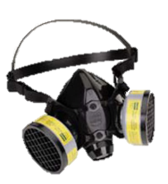
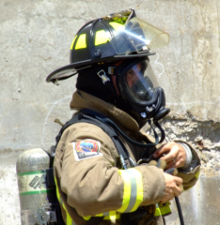
PPE Use – Insufficient Control
Atmosphere supplying respirators
  O2 deficient or IDLH atmosphere
Air purifying respirators
  >OEL and <IDLH
Train, fit test, medical clearance
SAR
APR
SCBA
Notes:
IDLH – Immediately Dangerous to Health or Life.
an atmosphere that poses an immediate threat to life, would cause irreversible adverse health effects, or would impair an individual's ability to escape from a dangerous atmosphere
OEL – Occupational Exposure Limit
Atmosphere supplying respirators are either an SAR – Supplied Air respirator or an SCBA – slef contained Breathing apparatus.
Photo – Supplied-Air Respirator (SAR) with escape cylinder. Pressure-demand supplied-air respirator equipped with a full facepiece in combination with an auxiliary pressure-demand self-contained breathing apparatus - for IDLH conditions in workplace. https://en.wikipedia.org/wiki/Immediately_dangerous_to_life_or_health or http://www.cdc.gov/niosh/npptl/resources/certpgmspt/meetings/09172009/pdfs/3SARoverviewPalcic.pdf
Photo- Self Contained Breathing Apparatus (SCBA) - The term "self-contained" means that the breathing set is not dependent on a remote supply (e.g., through a long hose). An SCBA typically has three main components: a high-pressure tank (e.g., 2,216 to 4,500 psi (15,280 to 31,030 kPa), about 150 to 300 atmospheres), a pressure regulator, and an inhalation connection (mouthpiece, mouth mask or face mask), connected together and mounted to a carrying frame.[1] https://en.wikipedia.org/wiki/Self-contained_breathing_apparatus
Photo half mask APR - https://commons.wikimedia.org/wiki/File:Air-Purifying_Respirator.jpg
Photos full mask APR - https://www.osha.gov/dte/library/respirators/presentation/respiratory_standard.ppt
Respirator Standard Photos Author: AUTHORIZED GATEWAY 2000 USER Last modified by: ... Positive Pressure Respirator Powered Air-Purifying Respirator ...
OSHA office of Training & Education
Make sure wearers are trained, fit tested and medically cleared.

Slide 49

Engulfment PPE: Lifeline Use
Harness & Lifeline
  Engulfment
  Retrieval – feasible
Other – safety & health
  Protective clothing
  Eye & hearing protection
  Gloves, boots, etc.
Notes:
PPE used to protect against engulfment includes a full body safety harness with a D ring in the front or back and a lifeline.
A retrieval line and/or mechanical retrieval device can also be used.
Use of this type of PPE when its use does not pose a greater risk to the entrant.
Other types of PPE are protective clothing when needed for the environment, eye and hearing protection, gloves, boots, etc.
Photo: Confined space PPT - Grantee Name: Georgia Tech Applied Research Corporation Grant Number: SH-16625-07 Grant Year: 2007

Slide 50
Exposure Signs & Symptoms
Exposure Signs & Symptoms
Notes:
This section discusses the exposure signs & symptoms of common toxic gases in agricultural confined spaces.
It does not cover ALL the toxins to which a worker can be exposed.
Employers should provide additional training on other toxins known to be in the work environment if they are not covered in this section.
Handouts are included on exposure symptoms for oxygen, hydrogen sulfide, carbon dioxide and carbon monoxide as well as available as slides at the end of the presentation.

Slide 51

O2 - Oxygen Properties
O₂ Dioxygen - air we breathe
20.8% normal
  Investigate any lower reading
Colorless, odorless, tasteless
Promotes combustion
Oxygen enriched >23.5%
  Highly combustible
Dioxygen
2 oxygen molecules bonded
Notes:
The Oxygen we breathe is called Di oxygen – it is two molecules of oxygen bonded together and found at a normal concentration of 20.8% in the atmosphere.
Oxygen is basically colorless, odorless and tasteless although it can have a blue haze at high concentrations or when condensed.
Oxygen promotes combustion and is necessary for fires to burn.
Especially at higher concentrations, oxygen causes flammable and combustible materials to burn violently when ignited. Attaches to hair, clothing, materials, etc.
Never use pure oxygen to ventilate.
Never store or place compressed tanks in a confined space.
Any oxygen reading that is other than the fresh air amount (20.8) should be investigated since the displacement is occurring from something.
Photo: wikimedia commons.

Slide 52
Too Little Oxygen - Deadly
Oxygen Concentration Effects
23.5%
Oxygen rich. Highly combustible. Oxygen toxicity.
19.5%
MINIMUM FOR SAFE ENTRY
Decreasing ability to work strenuously. Impaired coordination, judgement, breathing.
16.0%
14.0%
Poor judgment. Respiration increase. Rapid fatigue.
12.0%
Respiration increases. Lips blue.
10.0%
Mental failure. Fainting. Nausea. Vomiting. Unconsciousness.
8.0%
≤ 5 minutes recovery possible. 6 minutes 50% fatal. 8 minutes fatal.
6.0%
≤ 6% DEATH
Coma in 40 seconds - DEATH.
Notes:
An oxygen deprived environment is more common in confined spaces and can be deadly.
No one should enter a space if the oxygen reading is below 19.5% and if it is that low should enter with caution and additional safeguards.
Any oxygen reading that is other than the fresh air amount (20.8) should be investigated since the displacement is occurring from something.
Concentrations between 19-15% significantly affects the ability to work – a person will have difficulty breathing, feel ‘clumsy’ and confused, and tire easily. A person will have a difficult time processing information and making a decision. An observer may notice a delay in the entrant responding or the response may seem “odd”. These initial signs can be easily ignored or passed off. Entrants and observers should be diligent in watching for signs of someone being slightly “off” as it could be an indication of oxygen deficiency. The entrant should exit immediately and rescue should be called.
As oxygen content lowers, the symptoms will increase. Rapid breathing and fatigue incur making it difficult for a person to self rescue. If an observer notices an increase in breathing they should get the person to exit immediately as well as call for rescue. If a person feels nauseas they must get help and leave as they will become unconscious quickly.
If an entrant is experiencing ANY signs of oxygen deprivation, a rescuer should not enter without an atmosphere supplied respirator or chances are high the rescuer will also succumb and become a victim.

Slide 53

Oxygen Toxicity: Too Much Oxygen
Oxygen > 23.5%
  Prolonged exposure
  Excess oxygen in body
Signs
  Throat irritation, cough
  Vision changes, ears ringing
  Nausea, twitching
  Irritability, anxiety, confusion, dizziness
  Convulsions
Notes:
Too much oxygen can have harmful effects on the body. Generally this would result from using prolonged exposure to oxygen enriched air – such as when using oxygen tanks under pressure.
Oxygen toxicity occurs when there is an excess of oxygen in the body.
Initial symptoms include throat irritation – a tickle – that develops into coughing as well as vision changes and tinutis – ringing in the ears. If these symptoms develop a user should exit the space, discontinue using an air supply and seek medical attention.
Many effects of oxygen toxicity can be reversed if medical attention is sought immediately.
Damage to eyes, cells, lungs can occur as well as central nervous system damage resulting in convulsions. The convulsions can lead to death as well as advanced damage to lung and cells.
Photo: wikimedia commons.

Slide 54

Carbon Monoxide CO
Odorless, colorless, gas
Highly toxic & flammable
Slightly lighter than air
Combustion by-product
High levels - Quickly collapse
PEL – 50 ppm 8 hr
Notes:
Although it has no detectable odor, CO is often mixed with other gases that do have an odor.
CO is one carbon and one oxygen molecule bonded together.
CO is a common industrial hazard resulting from the incomplete burning of natural gas and any other material containing carbon such as gasoline, kerosene, oil, propane, coal, or wood. Forges, blast furnaces and coke ovens produce CO, but one of the most common sources of exposure in the workplace is the internal combustion engine.
CO is lighter than air and may settle in lower places.
At high levels CO will cause immediate collapse.
The OSHA PEL is 50 parts per million (ppm). OSHA standards prohibit worker exposure to more than 50 parts of the gas per million parts of air averaged during an 8-hour time period.
PEL - Maximum allowable continued exposure 50 ppm for any 8 hour period. Not to exceed 5 days straight. The skin may take on a reddish color.
The symptoms of Carbon monoxide exposure at low levels are very similar to the flu. It is easy to ignore these symptoms. Report promptly complaints of headaches, dizziness, drowsiness, or nausea.
If workers experience any of these symptoms the space should be immediately vacated and not entered until it is tested and ventilated or SCBA is used. Workers should get medical treatment.
PPMs in excess of the PEL subject workers to adverse health effects.
Photo; wikimedia commons.

Slide 55


Danger - Hydrogen Sulfide (H₂S)
Colorless, transparent gas
Most dangerous
  Used in gas chambers
Heavier than air
Flammable – LEL 4.3%
Rotten egg smell low concentration
  Sweet odor high concentration
Deadens sense of smell
Notes:
Have you ever noticed a smell which causes your eyes to water or causes you to cough? If you have worked around animals or grain which is out of condition, you have undoubtedly noticed some of the above symptoms. It would be interesting to know what the concentration of the atmospheric gases were at that time.
Hydrogen sulfide is the 2nd most toxic gas known to man. It was used in the gas chambers to exterminate people quickly.
It is composed of two hydrogen molecules bonded with one sulfar molecule.
H2S has a strong odor of rotten eggs at low concentrations and a sweetish odor at higher locations. Odor should not be used as a warning of exposure since at concentrations of (20-30 parts per million) hydrogen sulfide may deaden the sense of smell by paralyzing the respiratory center of the brain and olfactory nerve. However, although its strong odor is readily identified, olfactory fatigue occurs at high concentrations and at continuous low concentrations. For this reason, odor is not a reliable indicator of hydrogen sulfide's presence and may not provide adequate warning of hazardous concentrations. Hydrogen sulfide is slightly heavier than air and may accumulate in enclosed, poorly ventilated, and low-lying areas.
Workers should be aware of the exposure signs of H2S and take immediate precautions if any symptoms are noticed.
When a rotten egg smell is noticed, workers should be aware H2S is present and monitor the atmosphere continuously. Concentrations moving toward 10 PEL should be considered as potentially harmful l and care should be taken.
If workers smell a sweet order the space should be exited immediately as the concentration is above the PEL.
This is considered a knockdown gas as at high concentrations it immediately knocks a person unconscious with imminent death. Recovery is unlikely.
Sources/Uses - Hydrogen sulfide is produced naturally by decaying organic matter and is released from sewage sludge, liquid manure, sulfur hot springs, and natural gas. It is a by-product of many industrial processes including petroleum refining, tanning, mining, wood- pulp processing, rayon manufacturing, sugar-beet processing, and hot-asphalt paving. Hydrogen sulfide is used to produce elemental sulfur, sulfuric acid, and heavy water for nuclear reactors.
Hydrogen sulfide is regulated by OSHA and has a permissible exposure limit of 20 parts per million (ppm) ceiling concentration and a peak exposure limit of 50 (ppm) for no more than 10 minutes if no other measurable exposure occurs. Inhalation of concentrations of 500-1000 (ppm) will cause rapid unconsciousness and death through respiratory paralysis and asphyxiation.
Photo: wikimedia commons

Slide 56

Hydrogen Sulfide (H₂S) Exposure
False sense of security
Respiratory paralysis
  Depress nervous system
  Delay 72 hours
PEL – 10 ppm 8 hr
  Exposure must be <20 ppm
Short term – 50 ppm 10 minutes once
Notes:
There is a false sense of security about being able to smell hydrogen sulfide. There is also a false sense of security that a person is “okay” after exposure when the full effects may not be seen for 72 hours and can lead to death.
Anyone exposed should seek medical treatment.
Because of the deadening of the sense of smell and the delay in symptom appearance, workers should be extremely careful in areas with known or potential H2S.
Hydrogen sulfide has a strong odor of rotten eggs at low concentrations and a sweetish odor at higher locations. Odor should not be used as a warning of exposure since at concentrations of (20-30 parts per million) hydrogen sulfide may deaden the sense of smell by paralyzing the respiratory center of the brain and olfactory nerve.However, although its strong odor is readily identified, olfactory fatigue occurs at high concentrations and at continuous low concentrations. For this reason, odor is not a reliable indicator of hydrogen sulfide's presence and may not provide adequate warning of hazardous concentrations. Hydrogen sulfide is slightly heavier than air and may accumulate in enclosed, poorly ventilated, and low-lying areas.
Sources/Uses - Hydrogen sulfide is produced naturally by decaying organic matter and is released from sewage sludge, liquid manure, sulfur hot springs, and natural gas. It is a by-product of many industrial processes including petroleum refining, tanning, mining, wood- pulp processing, rayon manufacturing, sugar-beet processing, and hot-asphalt paving. Hydrogen sulfide is used to produce elemental sulfur, sulfuric acid, and heavy water for nuclear reactors.
Hydrogen sulfide is regulated by OSHA and has a permissible exposure limit of 20 parts per million (ppm) ceiling concentration and a peak exposure limit of 50 (ppm) for no more than 10 minutes if no other measurable exposure occurs. Inhalation of concentrations of 500-1000 (ppm) will cause rapid unconsciousness and death through respiratory paralysis and asphyxiation.

Slide 57

CO₂ displaces oxygen
Colorless, odorless, non-flammable gas
Displaces oxygen
Heavier than air
  Settles at bottom
Produced by
  Humans – exhale breath
  Bacterial decomposition
  Combustion of fossil fuels
Notes:
Carbon Dioxide – CO2 is a colorless odorless gas. Does not burn & is not combustible. CO2 displaces oxygen. The PEL is low. OSHA sets the Permissible Exposure Limit at 5,000 parts per million in an 8 hour work day as well as the short term exposure limits (STEL). At 7-10% unconsciousness can occur quickly. CO2 levels should always be checked independent of oxygen levels.
COMPRESSED GAS. Often used in fire extinquishers. Contains refrigerated gas. May explode if heated. CONFINED SPACE HAZARD. ASPHYXIANT. High concentrations can displace oxygen in air and cause suffocation. May cause frostbite.Gas may accumulate in hazardous amounts in low-lying areas especially inside confined spaces, resulting in a health hazard. Closed containers may rupture violently when heated releasing contents. In a fire, hazardous toxins CO & CO2 may be generated.
Carbon dioxide is a common byproduct of most living organisms. Every time we breath, we produce and release CO2 into the air. CO2 is the waste product from the food we burn as energy. We have @ 3.8% concentration of CO2 in each exhaled breath.
Carbon dioxide is primarily a byproduct of bacterial decomposition. When grain decomposes or ferments it produces CO2.
Employees working in grain elevators and silos, where stored grain produces 37% CO2 during oxidation of carbohydrates, are at risk for high levels of CO2 exposure (Nelson 2000; NIOSH 1976).
As with people, "aerobic" or oxygen-using bacteria produce CO2 as a primary metabolic byproduct. In many confined spaces, there is a direct relationship between low concentrations of oxygen & elevated concentrations of CO2.
Never use an oxygen sensor as a method of measuring CO2, instead, always use a dedicated sensor for the measurement of carbon dioxide. As air is primarily nitrogen with 20.9% oxygen, the quantity of CO2 required to displace the oxygen to a low alarm level of 19.5% O2 is approximately 70,000ppm CO2. You will be over exposed to CO2 long before the oxygen sensor reaches its alarm point. http://www.cacgas.com.au/blog/bid/383463/Carbon-Dioxide-CO2-A-Greater-Hazard-Than-Often-Considered
Carbon dioxide is produced during the decay process of organic materials and the fermentation of sugars in bread, beer and winemaking. It is produced by combustion of wood, carbohydrates & fossil fuels such as coal, peat, petroleum & natural gas.
It is one of the most commonly used compressed gases for pneumatic (pressurized gas) systems in portable pressure tools. Carbon dioxide is also used as an atmosphere for welding, although in the welding arc, it reacts to oxidize most metals. It is a versatile industrial material, used, for example, as an inert gas in welding and fire extinguishers, as a pressurizing gas in air guns and oil recovery, as a chemical feedstock and in liquid form as a solvent in decaffeination of coffee and supercritical drying. The frozen solid form of CO2, known as "dry ice" is used as a refrigerant and as an abrasive in dry-ice blasting.
Combustion: The main human activity that emits CO2 is the combustion of fossil for energy and transportation. Landfill: Carbon Dioxide, along with Methane are the primary components in landfill and sewage treatment digester gas. Food Production: CO2 is used in a number of applications in food production. A typical process is to increase plant growth by elevating normal CO2 levels in greenhousesVentilation: There is some degree of risk in crowded badly ventilated places and an Oxygen deficient atmosphere could accompany this problem.
Picture – CO2 molecule wikimedia

Slide 58


Carbon Dioxide Exposure
STOP!!!
Do NOT remove
STOP!!!
Do NOT remove
Grain decomposition or fermentation risk
PEL 5,000 ppm 8 hour day
  30,000 ppm 10 minutes
  40,000 ppm immediately dangerous
7-10% - unconsciousness
In a non-ventilated space, you will succumb to CO₂ poisoning before oxygen deprivation.
WARNING
Oxygen monitor will not detect rise in CO2.
Notes:
Carbon dioxide is primarily a byproduct of bacterial decomposition. When grain decomposes or ferments it produces CO2. Therefore, employees working in grain elevators and silos, where stored grain produces 37% CO2 during oxidation of carbohydrates, are at risk for CO2 exposure (Nelson 2000; NIOSH 1976). As with people, "aerobic" or oxygen-using bacteria produce carbon dioxide as a primary metabolic byproduct. In many confined spaces, there is a direct relationship between low concentrations of oxygen and elevated concentrations of CO2.
OSHA sets the Permissible Exposure Limit at 5,000 parts per million in an 8 hour work day as well as the short term exposure limits (STEL).
In the case of a confined space where CO2 is generated as a byproduct of aerobic bacterial action, a concentration of 19.5 percent O2 (the hazardous condition threshold for oxygen deficiency in most jurisdictions) would be associated with an equivalent concentration of at least 1.4 percent ( = 14,000 ppm) CO2. This is substantially higher than the generally accepted workplace exposure limit for CO2 (5,000 ppm calculated as an 8-hour TWA).
The true concentration of CO2 could be substantially higher if the oxygen deficiency is due to displacement rather than consumption of the oxygen in the confined space. Fresh air contains only 20.9 percent oxygen by volume. The balance consists mostly of nitrogen, with minor or trace concentrations of a wide variety of other gases, including argon, water vapor, and carbon dioxide. Because oxygen represents only about one-fifth of the total volume of fresh air, every 5 percent of a displacing gas that is introduced into a confined space reduces the oxygen concentration by only 1 percent. As an example, consider an oxygen deficiency due to the introduction of dry ice into an enclosed space. In this case, a reading of 19.5 percent O2 would not be indicative of 1.4 percent CO2, it would be indicative of 5 X 1.4 percent = 7.0 percent (= 70,000 ppm) CO2.
The bottom line is that if you wait until the oxygen deficiency alarm is activated, and the deficiency is due to the presence of CO2, you will have substantially exceeded the toxic exposure limit long before leaving the affected area.
Carbon dioxide is heavier than air, with a density of 1.5 times that of fresh air. When carbon dioxide is released into an enclosed or confined space, it tends to settle to the bottom of the space, reaching the highest concentration in the lowest parts of the space. Because of this tendency to settle, as CO2 is produced, it can reach higher and higher concentrations in localized regions of the space (such as the head space immediately above the liquid in fermentation vats).
By Bob Henderson Jul 01, 2006 https://ohsonline.com/Articles/2006/07/Carbon-Dioxide-Measures-Up-as-a-Real-Hazard.aspx

Slide 59
Applying the Confined Space Standard
Notes:
This section will discuss the application of the Confined Space Standard OSHA 1910.146 in agricultural settings including grain elevators.
There are several topics covered:
Extent of coverage
Employer responsibilities
Permit required confined space entry program including Program & personnel requirements
Entry permit
Entry process
Reclassification
Alternate Procedures
The section explains the general provisions needed to comply with the standard and the general requirements of a permit required confined space entry program.
Employers needing assistance in setting up a confined space program should contact their OSHA consultation program.

Slide 60
Applying 1910.146 - Topics
Coverage
Employer responsibilities
Permit required confined space entry program
  Program & personnel requirements
Entry permit
Entry process
Reclassification & Alternate Procedures
Notes:
This section will explore briefly the topics listed and how they are part of compliance to the provisions of the 1910.146 confined space standard.

Slide 61
Confined Space Standard
Extent of coverage

Slide 62

1910.146 Confined Space
Standard applies:
Entry into permit required confined space
General industry; contractors
Purpose
  Protect against hazards of entry
  Requirements for practices & procedures
Notes:
1910.146 confined space standard applies to entry into permit required confined spaces.
It states spaces must be evaluated to determine if they are permit required and is so, the provisions of the standard must be followed.
The purposed of the standard is to protect against the hazards of entry and to put requirements in place for practices and procedures.
The standard applies to general industry & contractors involved at the work site. CONSTRUCTION industry has its own confined space standard. If the contractor falls under the construction confined space standard, the contractor is responsible for ensuring the provisions of that standard are met.

Slide 63
Confined Space Exceptions
1910.146 DOES NOT apply
Grain -1910.272
  Entry into grain storage structures – bins, silos, tanks
  Can use both
Agriculture
  Directly involved crop & livestock production
  Still “Best Practice”
Notes:
Grain Handling Standard covers 1910.272(g) covers entry into bins, silos, tanks, and other grain structures. 1910.272(h) covers entry into flat storage structures. This standard applies to grain elevators, feed mills, flour mills, rice mills, dust pelletizing plants, dry corn mills, soybean flaking operations, and the dry grinding operations of soycake.
HOWEVER - Employers with spaces covered by a specific industry standard must still determine if they have spaces which would qualify as a permit space not covered by the industry specific standard. Therefore, all employers must do an initial evaluation under 1910.146(c)(1).
Grain handling facilities are required to evaluate spaces to determine if bodily entry is possible (entire body), If the space has limited or restricted means for entry or exit, and if the space is designed for continuous employee occupancy.
The facilities that are required to evaluate the spaces must identify the spaces through signage and/or training
Agricultural Standard Industrial Classification codes (SIC) which fall under the scope exemption of the confined space standard include SIC Codes in Major Groups 01 and 02 which are directly related to crop and livestock production are exempt. All other major groups within agriculture will have to be determined on a case-by-case basis.

Slide 64
Confined Space Standard
Employer Responsibilities
Notes:
This section will discuss employer responsibilities for compliance to the confined space standard.

Slide 65
Employer’s Responsibilities
ID & Evaluate Confined Spaces
Develop Written Policies
Prevent Non-authorized Entry
Train Employees
Inform Contractors
Choose Rescue Provider
Revaluate spaces
Include when entry is prohibited.
POLICY
Non-permit spaces
PRCS program
Notes:
Employer’s must determine if a Permit Required Confined Space exists.
They must inform employees – this can be done through signage as well as training employees to identify a PRCS and follow company policy.
Company policy should include when entry is prohibited and a written permit entry program for PRCS and policies for non- PRCS.
Employers are responsible for preventing non-authorized entry into confined spaces through policies, barricading, signage, etc.
Employers must re-evaluate spaces as necessary to determine if they are permit or non-permit required.

Slide 66


Employer - Evaluate & Identify
Evaluate space
  Non-permit required
  Permit required confined space
Identify confined spaces
  Signage
  Training
Notes:
Employers must evaluate spaces to determine if they meet the criteria to be a confined space: if bodily entry is possible (entire body), if the space has limited or restricted means for entry or exit, and if the space is designed for continuous employee occupancy.
Next the employer must determine if the confined space is a permit required confined space for entry.
A non-permit required space meets the criteria for confined space but does not have potential hazards.
A permit required confined space meets the 3 criteria for confined space PLUS has one or more potential hazardous conditions.
Facilitie srequired to evaluate spaces must inform employees by identifying the spaces through signage and/or training to employees to be able to recognize a confined space.
1910.146(c)(2) If the workplace contains permit spaces, the employer shall inform exposed employees, by posting danger signs or by any other equally effective means, of the existence and location of and the danger posed by the permit spaces.
At farms, these spaces might not be identified through signage, but it is helpful if you are able to determine the classification of the spaces you work around and are able to determine what hazards may be present.

Slide 67
KISS Keep It Simple (for) Success
If you have
Permit-Required Confined Space
Options
Employees Do NOT enter
Permit Required Entry
Alternate Entry
Develop
Written Policy
Written Program
Document
Train
Employees
PREVENT entry
Enforce program
Follow all & re-evaluate
Notes:
For non permit required confined spaces, employers should still develop policy and/or work guidelines. For bin entry this is a bin entry program.
If you have a PRCS, you have 3 options – enforce a no enter policy, develop a written entry program or document & develop alternate entry procedures.
Each must allow for employee training.
It is the employers responsibility to develop, implement, and enforce the policies and procedures, and train employees on the policies and procedures they develop.
All options require documentation. Documentation is the employer’s responsibility.
If an employer chooses to have a non-entry policy into permit required confined spaces, the employer MUST prevent employees from entering those spaces.

Slide 68
Train employees to work safe
Before initial assignment; changes
  Job performance shows deficiency
  Annually
Ensure able to perform duties safely
  Hazards, acceptable conditions
  Program, policy,
Certify training
  Date, Employee name
  Trainer signature / initials
Notes:
Employers are responsible for providing appropriate training. ALL employees who will work in a PRCS environment – as entrant, attendant, entry supervisor, rescuer, etc – MUST be trained prior to the start of their initial work assignment. Annual training is recommended to enforce the necessity to follow procedures and be vigilant about confined space hazards
The employer is responsible for ensuring the training provided the employees with the understanding, knowledge & skills needed to perform their job duties safely.
Employees are to receive the training for their designated role so they can perform the responsibilities of that role – such as the entrant role & responsibilities, those of the attendant, entry supervisor, rescue personnel, etc.
All training is to be certified & training record kept on file. Although not required, it is a good idea to include a brief description of the course contents that correspond to certified training dates and also to have a record of employee attendance signed or initialed by the employee. (This can be an attendance roster for the training or individually on the certificate. This allows the employee to verify he/she received training on the contents in the description. The certification of the training needs to be made available for inspection by the employees or an authorized representative of the employee.
MUST retrain when there are changes in job duties BEFORE the change is effective. Space or work has a new hazard employee hasn’t been trained on. Changes in program, policy, procedures, work instructions, etc. Job performance shows deficiency – Must be competent and knowledgeable in duties and use of procedures. Employer is responsible for being aware of the job performance of employees and noticing when an employee is showing deficiencies in their understanding, knowledge and skill needed to safely perform their assigned PRSC job duties.
1910.146(g)(1) The employer shall provide training so that all employees whose work is regulated by this section acquire the understanding, knowledge, and skills necessary for the safe performance of the duties assigned under this section.
1910.146(g)(2) Training shall be provided to each affected employee:
1910.146(g)(2)(i) Before the employee is first assigned duties under this section;
1910.146(g)(2)(ii) Before there is a change in assigned duties;
1910.146(g)(2)(iii) Whenever there is a change in permit space operations that presents a hazard about which an employee has not previously been trained;
1910.146(g)(2)(iv) Whenever the employer has reason to believe either that there are deviations from the permit space entry procedures required by paragraph (d)(3) of this section or that there are inadequacies in the employee's knowledge or use of these procedures.
1910.146(g)(3) The training shall establish employee proficiency in the duties required by this section and shall introduce new or revised procedures, as necessary, for compliance with this section.
1910.146(g)(4) The employer shall certify that the training required by paragraphs (g)(1) through (g)(3) of this section has been accomplished. The certification shall contain each employee's name, the signatures or initials of the trainers, and the dates of training. The certification shall be available for inspection by employees and their authorized representatives.

Slide 69


Ag Confined Space Training
Training for agricultural confined spaces
Hazard awareness
  Agriculture
  Grain storage structures
Lock out/Tag out
Machine Guarding
Notes:
Employers are to provide additional training to any employee whose job duties require that knowledge.
In addition to confined space training, other training topics should include hazard awareness and identification for agricultural work & grain storage structures, LOTO, and machine guarding.
These additional topics are essential to understanding and complying with the confined space standard requirements.
It is a good idea to have a LOTO policy & procedures in place when implementing a confined space entry program.
Awareness of and adherence to proper machine guarding should also be in place to have a more successful confined space program.

Slide 70
Contractors follow PRCS program
When using contractors
Inform PRCS & conditions
Inform company entry policy
  Employees not allowed entry
Ensure use PRCS permit program
Coordinate entry
Notes:
Employers are responsible for ensuring a contractor follows a permit required confined space program.
A company using contractors must inform them of permit required confined spaces and the conditions in them.
If the company has a no confined space entry policy for employees, they must inform the contractor of this. This is to ensure the contractor does not expect an employee of the company to enter the confined space.
The employer must ensure the contractor has an effective confined space entry program and uses it while on the site, if the employer does not have a confined space entry program.
The employer is responsible for coordinating entry into the confined space between its employees and the contractor to ensure the safety of all. They must also meet with the contractor to discuss any problems which were encountered during the entry.
1910.146(c)(8) When an employer (host employer) arranges to have employees of another employer (contractor) perform work that involves permit space entry, the host employer shall:
1910.146(c)(8)(i) Inform the contractor that the workplace contains permit spaces and that permit space entry is allowed only through compliance with a permit space program meeting the requirements of this section;
1910.146(c)(8)(ii) Apprise the contractor of the elements, including the hazards identified and the host employer's experience with the space, that make the space in question a permit space;
1910.146(c)(8)(iii) Apprise the contractor of any precautions or procedures that the host employer has implemented for the protection of employees in or near permit spaces where contractor personnel will be working;
1910.146(c)(8)(iv) Coordinate entry operations with the contractor, when both host employer personnel and contractor personnel will be working in or near permit spaces, as required by paragraph (d)(11) of this section; and
1910.146(c)(8)(v) Debrief the contractor at the conclusion of the entry operations regarding the permit space program followed and regarding any hazards confronted or created in permit spaces during entry operations.
1910.146(c)(9) In addition to complying with the permit space requirements that apply to all employers, each contractor who is retained to perform permit space entry operations shall:
1910.146(c)(9)(i) Obtain any available information regarding permit space hazards and entry operations from the host employer;
1910.146(c)(9)(ii)
Coordinate entry operations with the host employer, when both host employer personnel and contractor personnel will be working in or near permit spaces, as required by paragraph (d)(11) of this section; and
1910.146(c)(9)(iii)
Inform the host employer of the permit space program that the contractor will follow and of any hazards confronted or created in permit spaces, either through a debriefing or during the entry operation.

Slide 71

Choose a Rescue Provider
Employee Rescue
Outside Provider
Provide PPE, equipment
Training
  Entrant, rescue duties
  PPE, equipment use
  CPR, First Aid
  Annual practice rescue
Retrieval device
  Non-entry rescue
Evaluate provider
  Response time
  Have equipment
  Proficient in procedures
Inform of hazards
Access to permit spaces
Notes:
Employers must ensure there is an appropriate rescue/emergency service provider for PRCS entries.
Employers must evaluate the ability of an outside provider to respond timely & effectively to a PRSC emergency. They must inform the outside provider of all the hazards which are contained or potential hazards in the different confined spaces & allow access to those spaces so the provider can develop appropriate procedures if called to respond to an emergency. Appendix F of 1910.146 provides information on how to evaluate a rescue provider.
Simply relying on calling 911 does NOT comply with the requirements of this standard as the nearest rescue service may not have the equipment and/or training necessary to respond to a confined space emergency.
The employer may choose to have an internal rescue team with company employees. This is more likely to happen in rural areas and/or other areas served by volunteer rescue squads who may not have the training, equipment or other resources necessary for a safe confined space rescue.
Some employers elect to have PRCS emergency & rescue service provided by on-site employees. The company must provide the PPE & equipment. The employees MUST be trained on: Proper use of PPE & rescue equipment; Authorized entrant duties; Rescue duties; CPR and first aid at NO COST to employee. At least 1 member of any rescue team must have current certifications in CPR & and first aid. OSHA does not define certification. It is up to the employer to ensure and/or document certification. There must be at least one annual practice. It is to be conducted in an actual PRCS or a representative space and simulated with mannequins or people. 1910.146(k)(2) – (4)
NOTE: What is considered a timely response will vary depending on the specific hazards in the space and/or the confined space itself. Some identified hazards may have other standards to also consider. Timeliness is the ability to reach the victim within a time frame dictated by hazardous conditions.
1910.146(k)(1) An employer who designates rescue and emergency services, pursuant to paragraph (d)(9) of this section, shall:
1910.146(k)(1)(i) Evaluate a prospective rescuer's ability to respond to a rescue summons in a timely manner, considering the hazard(s) identified; Note to paragraph (k)(l)(i): What will be considered timely will vary according to the specific hazards involved in each entry. For example, §1910.134, Respiratory Protection, requires that employers provide a standby person or persons capable of immediate action to rescue employee(s) wearing respiratory protection while in work areas defined as IDLH atmospheres. 1910.146(k)(1)(ii) Evaluate a prospective rescue service's ability, in terms of proficiency with rescue-related tasks and equipment, to function appropriately while rescuing entrants from the particular permit space or types of permit spaces identified;
1910.146(k)(1)(iii) Select a rescue team or service from those evaluated that: 1910.146(k)(1)(iii)(A) Has the capability to reach the victim(s) within a time frame that is appropriate for the permit space hazard(s) identified; 1910.146(k)(1)(iii)(B) Is equipped for and proficient in performing the needed rescue services; 1910.146(k)(1)(iv) Inform each rescue team or service of the hazards they may confront when called on to perform rescue at the site; and 1910.146(k)(1)(v) 1. Provide the rescue team or service selected with access to all permit spaces from which rescue may be necessary so that the rescue service can develop appropriate rescue plans and practice rescue operations.

Slide 72
Confined space entry program
Program and Personnel requirements
Notes:
This section discusses the general requirements needed before entering a permit required confined space that should be included in a PRCS entry program.

Slide 73
PRSC entry program –
General requirements
PRCS entry program
Written program & review process
Authorized personnel
Confined space evaluation procedures
Acceptable entry conditions
Safe entry procedures & equipment
Emergency service provider
Use of written permit
Notes:
This is a list of the general requirements before entering a permit required confined space.
The program verifies to anyone checking up on the facility that you at least have thought about the safety implications and have it down in writing. An review process at least annually is needed for compliance to 1910.146.
The authorized personnel verifies that people have been through a class explaining to them about the need for following safety precautions and how to identify confined space hazards. For a company developing a program, only those employees designated as authorized are able to work in the different job assignments required by a PRCS program.
The evaluation procedures establishes a protocol for entering each different PRCS.
The acceptable conditions verifies that you have checked for hazards and taken the appropriate steps to reduce them to acceptable levels.
Company policy should include when entry is prohibited and a written permit as well as the types of safe entry procedures to be followed and the equipment needed for safe entry.
Finally, a written program address who will provide emergency services.
1910.146(d) contains all the provisions needed in a permit required confined space program.

Slide 74
Authorized Personnel
Designate/train authorized personnel
  Prevent unauthorized entry
Entry supervisor
  Approves & responsible for safe entry
Entrant
  Approve to Enter space & perform specified tasks
Attendant
  Monitors entrant & confined space
Notes:
Authorized personnel are the ones trained for the various duties under a PRCS entry.
They are the ONLY ones who should serve in these capacities.
There are 3 main employee duties – entry supervisor, entrant, and attendant. Each one has specific obligations, duties, and training requirements.

Slide 75

Entry Supervisor = Responsible
Entry conditions acceptable
Authorize & terminate entry
Oversee entry operations
  Exposure symptoms
  Safe work performance
  Verify tests, equipment, rescue
  Remove unauthorized persons
Maintain consistency
Notes:
An entry supervisor is usually a person in a leadership role, but does not have to be a manager or supervisor. They have the knowledge through experience and/or education which helps them identify hazards and how to control them and knows how to safely perform the task.
Entry supervisors will know the signs and symptoms of exposure. They will verify the necessary precautions are taken prior to and during entry and they will maintain consistency with entry procedures.
The entry supervisor is the only person who can give “permission” for entry and cancel or terminate the entry. This person can also be the entrant or attendant.
Picture: Confined space PPT - Grantee Name: Georgia Tech Applied Research Corporation Grant Number: SH-16625-07 Grant Year: 2007
1910.146(j) Duties of entry supervisors. The employer shall ensure that each entry supervisor:
1910.146(j)(1) Knows the hazards that may be faced during entry, including information on the mode, signs or symptoms, and consequences of the exposure;
1910.146(j)(2) Verifies, by checking that the appropriate entries have been made on the permit, that all tests specified by the permit have been conducted and that all procedures and equipment specified by the permit are in place before endorsing the permit and allowing entry to begin;
1910.146(j)(3) Terminates the entry and cancels the permit as required by paragraph (e)(5) of this section;
1910.146(j)(4) Verifies that rescue services are available and that the means for summoning them are operable;
1910.146(j)(5) Removes unauthorized individuals who enter or who attempt to enter the permit space during entry operations; and
1910.146(j)(6) Determines, whenever responsibility for a permit space entry operation is transferred and at intervals dictated by the hazards and operations performed within the space, that entry operations remain consistent with terms of the entry permit and that acceptable entry conditions are maintained.

Slide 76

Entrant Performs Tasks
Entrant trained & authorized to enter confined space
Recognize dangers
  Prohibited conditions
Complete tasks safely
Communicate
Exposure signs & symptoms
Exit when told
Notes:
The entrant also must know through education and or experience the hazards they may encounter, signs or symptoms and consequences of exposure.
The entrant must know how to properly use the equipment. The entrant will communicate with the attendant throughout the entry. Both know the prohibited conditions and the entrant will evacuate upon command.
Picture: Confined space PPT - Grantee Name: Georgia Tech Applied Research Corporation Grant Number: SH-16625-07 Grant Year: 2007
1910.146(h) Duties of authorized entrants. The employer shall ensure that all authorized entrants:
1910.146(h)(1) Know the hazards that may be faced during entry, including information on the mode, signs or symptoms, and consequences of the exposure;
1910.146(h)(2) Properly use equipment as required by paragraph (d)(4) of this section;
1910.146(h)(3) Communicate with the attendant as necessary to enable the attendant to monitor entrant status and to enable the attendant to alert entrants of the need to evacuate the space as required by paragraph (i)(6) of this section;
1910.146(h)(4) Alert the attendant whenever:
1910.146(h)(4)(i) The entrant recognizes any warning sign or symptom of exposure to a dangerous situation, or
1910.146(h)(4)(ii) The entrant detects a prohibited condition; and
1910.146(h)(5) Exit from the permit space as quickly as possible whenever:
1910.146(h)(5)(i) An order to evacuate is given by the attendant or the entry supervisor,
1910.146(h)(5)(ii) The entrant recognizes any warning sign or symptom of exposure to a dangerous situation,
1910.146(h)(5)(iii) The entrant detects a prohibited condition, or
1910.146(h)(5)(iv) An evacuation alarm is activated.

Slide 77

Attendant ensures safety
ONLY duty entrant safety
Remain outside PRCS
Know hazards & exposure signs
Monitor entrant, space, surroundings
Communicate
Evacuate
Summon help
  Non-entry rescue
Notes:
The attendant’s ONLY job duty is to ensure the safety of the confined space entry by remaining outside the PRCS and monitoring the entrant, the space and the surrounding area for signs of hazards. The attendant will perform no other duties which may distract them from their primary duty as attendant.
The attendant keeps an accurate count of entrants in the space and can identify them.
The attendant knows through education and/or experience the hazards they may encounter; prohibited conditions; signs or symptoms & consequences of exposure as well as behavior effects .The attendant knows how to properly use the equipment, and communicate with the entrant other throughout the entry and orders evacuation if necessary.
The attendant must remain outside the space during the entire entry operations, be able to summon rescue services, keep unauthorized persons outside the space and does not enter the space to perform a rescue unless the program allows for the attendant to enter and the attendant is trained for rescue.
The attendant can determine to evacuate the space.
Attendant duties and requirements are found under 1910.146(i).
Picture: Confined space PPT - Grantee Name: Georgia Tech Applied Research Corporation Grant Number: SH-16625-07 Grant Year: 2007

Slide 78
Equipment needs for safe entry
Testing & monitoring
Ventilating
Communication
PPE, harness & lifeline
Lighting
Entry & exit means
Rescue & emergency
Notes:
The employer is responsible for identifying and providing the equipment needed for safe entry and safe work processes during entry. The type of equipment includes but is not limited to those listed.
The employer must make sure the equipment used is designed for the space in which it will be used. FOR EXAMPLE, in situations where there is airborne dust, certain NFPA guidelines govern the type of equipment that is used.
Communication equipment is the equipment used between entrants and attendants during entry.
Entry & exit means includes ladders, stairs, etc which are needed to safely enter and exit the space. Fall protection must be considered.

Slide 79

Retrieval Device: Aids Rescue
Retrieval Systems
Safety harness, lanyard, winch
Required for top entry
  > 5 feet deep
Use by entrant
  For non-entry rescue
  Unless poses hazard OR
  Will not aid rescue
Notes:
Retrieval systems are used to aid in non-entry rescue and are required for confined space vertical entry of greater than 5 feet deep.
The lanyard (or retrieval line) is connected to a winch or a fixed point outside the confined space.
Retrieval systems are used by entrants unless the use of such poses a hazard or will not aid in rescue.
1910.146(k)(3) To facilitate non-entry rescue, retrieval systems or methods shall be used whenever an authorized entrant enters a permit space, unless the retrieval equipment would increase the overall risk of entry or would not contribute to the rescue of the entrant. Retrieval systems shall meet the following requirements.
1910.146(k)(3)(i) Each authorized entrant shall use a chest or full body harness, with a retrieval line attached at the center of the entrant's back near shoulder level, above the entrant's head, or at another point which the employer can establish presents a profile small enough for the successful removal of the entrant. Wristlets may be used in lieu of the chest or full body harness if the employer can demonstrate that the use of a chest or full body harness is infeasible or creates a greater hazard and that the use of wristlets is the safest and most effective alternative.
1910.146(k)(3)(ii) The other end of the retrieval line shall be attached to a mechanical device or fixed point outside the permit space in such a manner that rescue can begin as soon as the rescuer becomes aware that rescue is necessary. A mechanical device shall be available to retrieve personnel from vertical type permit spaces more than 5 feet (1.52 m) deep

Slide 80
Managing Multiple Concerns
Procedures for:
One attendant - multiple entry sites
  Monitor all sites
  Effectively perform duties at all sites
  Respond to emergencies & still perform duties
Multiple employers
  Coordinate operations
  Employees do not endanger each other
Notes:
There may be situations when more than one permit required confined space requires entry at the same time. The employer should address this situation in the PRCS program, specifically in regards to using one attendant.
One attendant can monitor multiple PRCS entry sites provided that the attendant can effectively perform all required attendant duties at all sites.
The one attendant must have the means to respond to emergencies at one or more of the sites while still performing the monitoring duties at the other sites.
There may also be occasions when employees of more than one employer must enter the PRCS simultaneously. The PRCS program must address this possibility to ensure entry operations between the employers and its employees are coordinated so the employees of one employer do not endanger other employees. This situation may be less common with grain elevators and agricultural operations but should be considered and planned for in advance to enable ALL employees to enter and perform tasks safely.
1910.146(d)(6) Provide at least one attendant outside the permit space into which entry is authorized for the duration of entry operations;
NOTE: Attendants may be assigned to monitor more than one permit space provided the duties described in paragraph (i) of this section can be effectively performed for each permit space that is monitored. Likewise, attendants may be stationed at any location outside the permit space to be monitored as long as the duties described in paragraph (i) of this section can be effectively performed for each permit space that is monitored.
1910.146(d)(7) If multiple spaces are to be monitored by a single attendant, include in the permit program the means and procedures to enable the attendant to respond to an emergency affecting one or more of the permit spaces being monitored without distraction from the attendant's responsibilities under paragraph (i) of this section;
1910.146(d)(11) Develop and implement procedures to coordinate entry operations when employees of more than one employer are working simultaneously as authorized entrants in a permit space, so that employees of one employer do not endanger the employees of any other employer;

Slide 81
Entry permit
Requirements
Notes:
This section will discuss the requirements of the entry permit.
Under a permit required confined space entry program a permit must be used.

Slide 82

Permit = Statement of Record
Keep 1 year minimum
Vital information
  Place & time
  People
  Entry authorization
Conditions & Operations
  What was done
Safety Information
Notes:
Why have all this paperwork? The permit is a statement as to the conditions prior to and during entry.
A confined space permit is what is known as a “living document” since it is updated throughout entry and is “alive” until it is cancelled by the entry supervisor.
All involved in the entry should sign-off on the permit to show their agreement with the evaluation and hazard control measures.
Post permits at the point of entry where the attendant has access to it. This permit is a roadmap for rescuers if an incident occurs.
3 types of Information about the entry is on the permit.
Vital identifying information about the space and people involved.
Information about the space conditions and the entry operation including hazards and methods of control.
Safety information including the rescue services number and the equipment, PPE and methods used to protect entrants.
Permit provides:
Easy access to rescue response contact information.
In the event of a rescue the permit will help rescuers determine conditions at the time of entry through time of incident.
Entrant and Attendant have documented evaluation determination by the Entry Supervisor.
Entry Supervisor has proof entrant and attendant reviewed.
Creates a paper trail of successful entries.

Slide 83


Confined Space Entry Permit
Notes:
This is an example of a confined space entry permit.
Some companies use a checklist to first evaluate and identify hazards.

Slide 84

Identify Where, When, Why
Date of entry
Duration
  Expiration
  Time entered
Space being entered
  Location
Entry purpose
  Work tasks
Notes:
The entry permit supplies vital identifying information. It must contain the date of the entry and the duration of the permit – time it expires. Permits cannot go over one shift. If an entry will span more than one shift, the permit needs to be cancelled at the end of the shift and a new permit completed and authorized.
Entry time is not required but a good idea to include as it provides a reference point in the event of an emergency.
The entry permit must identify the confined space being entered and provide its location. It is also helpful to identify the type of confined space. For example, the description “Boot pit tunnel 12” – identifies the specific space as well as the type.
The permit must also state the purpose of the entry and the work tasks to be completed.
1910.146(f) Entry permit. The entry permit that documents compliance with this section and authorizes entry to a permit space shall identify:
1910.146(f)(1) The permit space to be entered;
1910.146(f)(2) The purpose of the entry;
1910.146(f)(3) The date and the authorized duration of the entry permit;
1910.146(f)(4) The authorized entrants within the permit space, by name or by such other means (for example, through the use of rosters or tracking systems) as will enable the attendant to determine quickly and accurately, for the duration of the permit, which authorized entrants are inside the permit space;
NOTE: This requirement may be met by inserting a reference on the entry permit as to the means used, such as a roster or tracking system, to keep track of the authorized entrants within the permit space.
1910.146(f)(5) The personnel, by name, currently serving as attendants;
1910.146(f)(6) The individual, by name, currently serving as entry supervisor, with a space for the signature or initials of the entry supervisor who originally authorized entry;

Slide 85

Identify Who
Entrant name
  Other identifying means
Attendant name
Certify statement
Entry Supervisor name,
  Signature or initials
  Authorizes entry
Notes:
The entry permit supplies vital identifying information about the personnel working the confined entry operation.
The entrant’s name – person who is trained and authorized to enter - should be somewhere on the permit. If a roster or tracking system can be used as long as it effectively and adequately can identify employees in the confined space.
The attendant’s name must also be on the permit.
Providing a place for the entrant and attendant to agree with the hazard evaluations and/or testing is a good documentation practice, as well as to certify they have been trained for their roles.
Lastly, the permit must contain the entry supervisor’s name as well as is/her signature or initials authorizing the entry.
1910.146(f) Entry permit. The entry permit that documents compliance with this section and authorizes entry to a permit space shall identify:
1910.146(f)(1) The permit space to be entered;
1910.146(f)(2) The purpose of the entry;
1910.146(f)(3) The date and the authorized duration of the entry permit;
1910.146(f)(4) The authorized entrants within the permit space, by name or by such other means (for example, through the use of rosters or tracking systems) as will enable the attendant to determine quickly and accurately, for the duration of the permit, which authorized entrants are inside the permit space;
NOTE: This requirement may be met by inserting a reference on the entry permit as to the means used, such as a roster or tracking system, to keep track of the authorized entrants within the permit space.
1910.146(f)(5) The personnel, by name, currently serving as attendants;
1910.146(f)(6) The individual, by name, currently serving as entry supervisor, with a space for the signature or initials of the entry supervisor who originally authorized entry;

Slide 86

Identify Entry Conditions
Potential & known hazards
  Before entry
  During entry
Hazard control
Notes:
The entry permit verifies the conditions of the space informing personnel of known and potential hazards as well as the methods used to isolate, eliminate or control the identified hazards.
The hazard assessment is done BEFORE entry. All hazards should be documented on the permit.
The permit should be updated during the entry if knew hazards are found. Of course if new hazards threaten the safety of the entrant, the entry should be immediately terminated (discussed later).
1910.146(f)(7) The hazards of the permit space to be entered;
1910.146(f)(8) The measures used to isolate the permit space and to eliminate or control permit space hazards before entry;
NOTE: Those measures can include the lockout or tagging of equipment and procedures for purging, inerting, ventilating, and flushing permit spaces.
1910.146(f)(9) The acceptable entry conditions;
1910.146(f)(10) The results of initial and periodic tests performed under paragraph (d)(5) of this section, accompanied by the names or initials of the testers and by an indication of when the tests were performed

Slide 87

Document testing & good air quality
Results of air tests
  Initial
  Periodic
  Time of test
  Name, initials or signature of tester
Acceptable entry conditions
Notes:
The entry permit verifies results of the air monitoring – both the initial and periodic readings. It should contain the time of the test, as well as a place for the signature and/or initials of the testor.
Lastly, the permit must include what are the acceptable entry conditions for the space in accordance with the company permit required confined space program.
The entry should not be authorized if the acceptable entry conditions are not met.
1910.146(f)(7) The hazards of the permit space to be entered;
1910.146(f)(8) The measures used to isolate the permit space and to eliminate or control permit space hazards before entry;
NOTE: Those measures can include the lockout or tagging of equipment and procedures for purging, inerting, ventilating, and flushing permit spaces.
1910.146(f)(9) The acceptable entry conditions;
1910.146(f)(10) The results of initial and periodic tests performed under paragraph (d)(5) of this section, accompanied by the names or initials of the testers and by an indication of when the tests were performed

Slide 88

Exit Conditions & Ending Time
Ending conditions
  Operational
Permit cancellation time
  Does not carry over shifts
  Cancel if new condition develops
Notes:
Under a permit required confined space entry program, the entry supervisor cancels the permit and verifies whether the space is returned to operating condition.
This should be included on the permit to attest to the space conditions after the entry operation is complete and ensure the operation was completed within the stated duration period of the permit.
1910.146(e)(4) The duration of the permit may not exceed the time required to complete the assigned task or job identified on the permit in accordance with paragraph (f)(2) of this section.
1910.146(e)(5) The entry supervisor shall terminate entry and cancel the entry permit when:
1910.146(e)(5)(i) The entry operations covered by the entry permit have been completed; or
1910.146(e)(5)(ii) A condition that is not allowed under the entry permit arises in or near the permit space.
1910.146(e)(6) The employer shall retain each canceled entry permit for at least 1 year to facilitate the review of the permit-required confined space program required by paragraph (d)(14) of this section. Any problems encountered during an entry operation shall be noted on the pertinent permit so that appropriate revisions to the permit space program can be made.

Slide 89

Communication information
Communication method
Entry method
Notes:
The permit provides vital safety and rescue information.
The permit must provide the number of the emergency/rescue services for the attendant to know who to call.
The permit is to identify the communication method the entrant and attendant are using.
The permit is also to identify the types of safety measures in place, the types of equipment provided/being used by the entrant, and the PPE being used. The employer is responsible for ensuring the equipment provided is in good repair, functioning correctly, and employees are trained to use the equipment safely.
If other permits are also in place for the type of work tasks being performed, they are to be included on the confined space entry permit. An example would be a hot work permit.
The permit should also include what rescue equipment is to be used and/or is available at the site.
This information is not just helpful to the people on-site, but to a rescue squad if they are needed.
In this permit we also include where the entry point is located so if an emergency situation does occur, the attendant could quickly let the emergency/rescue service know so they bring the correct equipment and/or technically trained personnel.
Lastly, the permit must include any other information which would be necessary to ensure the safety of those working. The employer’s responsibility is to be aware of the space and its known/potential hazards in order to decide the safety measures to be taken for a confined space entry and to appropriately document these measures.
.
1910.146(f)(11) The rescue and emergency services that can be summoned and the means (such as the equipment to use and the numbers to call) for summoning those services;
1910.146(f)(12) The communication procedures used by authorized entrants and attendants to maintain contact during the entry;
1910.146(f)(13) Equipment, such as personal protective equipment, testing equipment, communications equipment, alarm systems, and rescue equipment, to be provided for compliance with this section;
1910.146(f)(14) Any other information whose inclusion is necessary, given the circumstances of the particular confined space, in order to ensure employee safety; and (15) Any additional permits, such as for hot work, that have been issued to authorize work in the permit space.

Slide 90

Safety & rescue information
Emergency number
Equipment provided
  PPE, rescue, testing, alarms, communication, etc.
Work permits
  Hot work
Other necessary safety information
Notes:
The permit provides vital safety and rescue information.
The permit must provide the number of the emergency/rescue services for the attendant to know who to call.
The permit is to identify the communication method the entrant and attendant are using.
The permit is also to identify the types of safety measures in place, the types of equipment provided/being used by the entrant, and the PPE being used. The employer is responsible for ensuring the equipment provided is in good repair, functioning correctly, and employees are trained to use the equipment safely.
If other permits are also in place for the type of work tasks being performed, they are to be included on the confined space entry permit. An example would be a hot work permit.
The permit should also include what rescue equipment is to be used and/or is available at the site.
This information is not just helpful to the people on-site, but to a rescue squad if they are needed.
In this permit we also include where the entry point is located so if an emergency situation does occur, the attendant could quickly let the emergency/rescue service know so they bring the correct equipment and/or technically trained personnel.
Lastly, the permit must include any other information which would be necessary to ensure the safety of those working. The employer’s responsibility is to be aware of the space and its known/potential hazards in order to decide the safety measures to be taken for a confined space entry and to appropriately document these measures.
.
1910.146(f)(11) The rescue and emergency services that can be summoned and the means (such as the equipment to use and the numbers to call) for summoning those services;
1910.146(f)(12) The communication procedures used by authorized entrants and attendants to maintain contact during the entry;
1910.146(f)(13) Equipment, such as personal protective equipment, testing equipment, communications equipment, alarm systems, and rescue equipment, to be provided for compliance with this section;
1910.146(f)(14) Any other information whose inclusion is necessary, given the circumstances of the particular confined space, in order to ensure employee safety; and (15) Any additional permits, such as for hot work, that have been issued to authorize work in the permit space.

Slide 91
PRCS Entry
Entry Process
Notes:
This next section talks about the actual entry process into a permit required confined space.
Once the evaluation is complete, the testing done, and the permit filled out, the personnel have a responsibility to carry out the entry procedures safely and according to company policy and the standard provisions.

Slide 92
5 Step Entry
Isolate Space
Post Permit
Barricade, sign, etc.
Evaluate & Ventilate Space
From outside
Test Atmosphere & Document
Mitigate hazards
BEFORE entry
During entry
Complete Permit
Review, agree, post
Entry
Work/re-assess
Monitor entrant
Wear monitor
Communicate
Discuss work tasks/PPE
Notes:
PRCS entry has 5 basic steps. The first four steps are completed BEFORE entry and have been previously discussed.
We will now concentrate on the fifth step – entering the space.
Begin the entry with an initial monitoring prior to the process of entering (this is a way to determine the atmospheric conditions have not been compromised.)
It is a best practice to monitor the air continuously during the entry process. This can be done by wearing an air monitor. Every 30 minuties a periodic reading will be documented.
Make sure the entrant and attendant are wearing the personal protective equipment necessary to safely perform the task.
The attendant will remain outside the space observing the task completion by the entrant. The attendant will use visual and/or verbal contact to remain in communication with the entrant. The attendant will monitor the conditions within and outside the space and notify the entrant of any prohibited conditions.
Steps:
Attendant and Entrant will perform their initial monitoring and log it on the periodic readings portion of the permit.
Permit will be posted at the entrance of the space.
Entrant will don required PPE and enter space.
Entrant will perform task(s) listed on the permit. Entrant should not be performing tasks not listed.
Entrant should continually evaluate & report on conditions to the attendant.
The attendant monitors the entrant and the space as well as the surrounding area for hazards, unauthorized personnel, etc. If the attendant suspects the entrant is experiencing signs, symptoms, or behavioral changes due to exposure, the entrant will be ordered to exit the space.
If an unacceptable entry condition arises, the entrant is to notify the attendant and/or entry supervisor.

Slide 93

Supervisor: Entry Preparation
Initial air monitoring
Evaluate space – outside
Complete/sign permit
Meet entrant & attendant
  Safe work process & tasks
  Review evaluation - agree
  Request re-evaluation
Ensure rescue available
DO NOT ENTER
Conditions not documented accurately
Notes:
The entry supervisor determines a job cannot be completed without entering the PRCS.
The entry supervisor evaluates the conditions of the space without entering the space and completes the necessary portions of the permit which explains the process and procedures.
The entry supervisor completes the initial air monitoring discuss the results with the entrant and attendant.
Bump test and calibrate the air monitor!
If the entrant and attendant do not agree with the results or if they question the evaluation the entry supervisor MUST conduct the process in their presence. (OSHA regulation)
The entry supervisor must make sure emergency response personnel are available during the entry.
Communication is extremely important during confined space entry.
Employees should discuss any concerns they have especially about their safety or the safety of your coworker, address the concerns before going into the space.
Employees should Never enter a space they feel has not been accurately evaluated.
If changes to the space occur during entry, stop the entry and re-assess the hazards.
If you agree with the permit which should reflect the conditions of the space before entry - sign the permit. Never feel pressured to compromise your safety and well being.
Employees can request a review of the evaluation procedures and tests and can request they be completed again if they do not feel the information on the permit is accurate.

Slide 94
New Hazards Arise: Abort Entry
Terminate entry immediately
  IDLH
  Unallowable condition
  New hazards
  Exposure signs/symptoms, behavior changes
Order evacuation of space
Cancel Permit
Complete new permit – supervisor
  Document new hazards & mitigation
Notes:
If you encounter an unexpected hazard during the entry process, discontinue the entry immediately, note the hazard on the permit and notify the entry supervisor . The permit may need to be cancelled and a new permit may be needed to complete the task.
The space should only be re-entered if the new hazard is properly controlled.
Whenever there is an IDLH condition, the entrant must exit immediately. No entry into an IDLH situation can be made without the proper PPE.

Slide 95

End entry & close permit.
Document
Exit time
Operating condition
Debrief
Supervisor, entrant, attendant
Cancel & sign permit
Retain 1 year
Supervisor
Annual Review
cANCELED
Permits do not carry over to other shifts
Notes:
We need to “kill” the “living document” by cancelling the permit once the work is completed and entrants have exited the space.
Once entry is completed the space will be determined to be back in working order, or the space may not be back in working order, this should be noted on the permit.
The entry supervisor will “debrief” the entrant and attendant so they can discuss any concerns. The supervisor will cancel the permit and retain the permt for 1 year to perform an annual program/permit evaluation.
Attendant exits when the task is completed or his work shift ends.
Permits DO NOT carry over to other shifts.
The attendant will record the exit time on the permit to document the fact no further atmospheric readings are needed.
Operating condition – After exiting note whether the space is returned to normal operating condition. If the task is incomplete and/or the space is inoperable it is to be documented on the permit. If another shift comes on they would issue another permit to complete the work.
Supervisor will debrief entrant and attendant of any unusual hazards which arose during entry.
Supervisor will cancel the permit and retain the permit for 1 year to perform an annual program/permit evaluation.

Slide 96
Reclassification of confined spaces
Alternate Entry Procedures
Notes:
This section discusses reclassifying a permit required confined space as a non-permit confined space and the steps to be taken.

Slide 97
Reclassify PRCS
NO actual/potential atmosphere hazards
Eliminate ALL hazards
  No entry or follow PRCS
  Test/inspection show none
  Ventilation use - cannot reclassify
Certify per space/entry
Duration
  Hazards remain eliminated
HAZARD FREE
100%
CERTIFIED
Notes:
It is possible to make a permit required confined space into a non-permit required confined space.
The declassification of a space should not be taken lightly, it is necessary that all hazards, other than the potential for an atmospheric hazard, can be eliminated. If the task you are performing creates a hazard, you cannot declassify the space.
The certification of the process needs to be documented and placed outside the entrance to the space.
The space can be declassified for a limited amount of time, usually the end of the entry process or at the end of the worker’s shift, whichever occurs first. Once the space has been declassified, there is no need for an attendant.
1910.146(c)(7) A space classified by the employer as a permit-required confined space may be reclassified as a non-permit confined space under the following procedures:
1910.146(c)(7)(i) If the permit space poses no actual or potential atmospheric hazards and if all hazards within the space are eliminated without entry into the space, the permit space may be reclassified as a non-permit confined space for as long as the non-atmospheric hazards remain eliminated.
1910.146(c)(7)(ii) If it is necessary to enter the permit space to eliminate hazards, such entry shall be performed under paragraphs (d) through (k) of this section. If testing and inspection during that entry demonstrate that the hazards within the permit space have been eliminated, the permit space may be reclassified as a non-permit confined space for as long as the hazards remain eliminated.
NOTE: Control of atmospheric hazards through forced air ventilation does not constitute elimination of the hazards. Paragraph (c)(5) covers permit space entry where the employer can demonstrate that forced air ventilation alone will control all hazards in the space.
1910.146(c)(7)(iii) The employer shall document the basis for determining that all hazards in a permit space have been eliminated, through a certification that contains the date, the location of the space, and the signature of the person making the determination. The certification shall be made available to each employee entering the space or to that employee's authorized representative.
1910.146(c)(7)(iv) If hazards arise within a permit space that has been declassified to a non-permit space under paragraph (c)(7) of this section, each employee in the space shall exit the space. The employer shall then reevaluate the space and determine whether it must be reclassified as a permit space, in accordance with other applicable provisions of this section.

Slide 98
Alternate Entry Procedures
ONLY hazard – actual or potential hazardous atmosphere
  Data supported criteria
NO non-atmospheric hazards
Continuous forced air ventilation keeps safe
Certify per space/entry
Re-evaluate - change in use/configuration
*Use PRCS permit program during data collection.
Notes:
Alternate procedures for entry can be used in spaces which do not have any hazards present other than an atmospheric hazard potential. Continuous forced air ventilation must keep it safe.
Alternate procedures can be used once data has been collected which verifies the space does not normally contain a hazardous atmosphere. After collecting the data and developing the procedures which will allow for safe entry, you still need to do initial air monitoring prior to entering. We always recommend monitoring the air continuously during entry to ensure your safe entry condition has not changed. Once you have your supporting information and your entry procedures written, contacting a compliance officer with OSHA is a good way to determine if you have covered all your bases.
Alternate Procedures are determined individually per space & use of alternate procedures are redetermined for each entry.
Alternate Procedures are under OSHA 1910.146(c)(5).
Reclassification requirements are contained under 1910.146(c)(5) and (6).
Whenever a NON-PERMIT required confined space has a change in use or configuration which could increase hazards to entrants – it MUST be re-evaluated and if conditions warrant reclassified as a permit required confined space.
1910.146(c)(6) When there are changes in the use or configuration of a non-permit confined space that might increase the hazards to entrants, the employer shall reevaluate that space and, if necessary, reclassify it as a permit-required confined space.

Slide 99
Document to reclassify & use AP
Criteria met
Initial Data:
  Volume of space
  Capacity & configuration ventilation equipment
  Identified atmospheric & potential hazards
  Sampling results:
    Ventilation start through time of determination
  Atmosphere hazards created by work in space
Notes:
While the standard does not specifically state how long to keep documentation for alternate procedures and/or reclassification, it is wise to keep it on file, as you would a permit.
Spaces need to be re-evaluated before entries to ensure they still meet the criterial for alternate procedures or reclassification.
The documentation should show that the criteria for the use of alternate procedures has been met.
The Initial data should show the documentation supports the decision to use alternate procedures. Data needs to indicate the size (volume of the space) for air exchange, the ventilation equipment has the capacity to meet the needs of the space. Data should indicate if there were any identified hazards or potential hazards and the correction.
Sampling results are from the start of ventilation through the time the determination is made that the entry conditions are acceptable.
If there is a potential for other hazards to be created by work in the space it should be indicated as well as how you will monitor for the hazards and the action to removes the hazards.

Slide 100
Certify - Reclassification or Use of Alternate Procedures
Certification
Evaluation process
Date & location of space
Available to inspect; Post
Signature – person who evaluated
Notes:
A reclassified PRCS space into a non permit required space must be documented and certified as well as use of alternate entry procedures.
The employer or his representative – like an entry supervisor – complete the certification which includes the evaluation process used to make the determination no hazards exist, the date, the location of the space.
It must be signed by the person who made the determination.
The certification MUST be available for review and inspection.
Entry into a reclassified PRSC or with alternate procedures is the same as an entry into a non-permit space.
HOWEVER, entrants should review the certification and it should be posted near the confined space.
Employees can enter space as long as the recertification is active – which is as long as the non-atomopsheric hazards remain eliminated or generally the end of the task or shift.
WHENEVER there is a change in use or configuration of a space it MUST be re-evaluated to see if it still meets the criteria for alternate procedures BEFORE ENTRY can be made.
1910.146(c)(6) When there are changes in the use or configuration of a non-permit confined space that might increase the hazards to entrants, the employer shall reevaluate that space and, if necessary, reclassify it as a permit-required confined space.

Slide 101
Alternate Procedure Entry
Entrance
  Eliminate hazards safe cover removal
  Guard – falls, falling objects
Test Atmosphere
  BEFORE & during entry - Document
  Oxygen, toxic concentration, flammability
  No hazard while inside; air remains safe
Forced Air Ventilation
  Continuous until everyone leaves
  Air – clean, safe source
  Evacuate
  Evaluate source
  Protect employees BEFORE re-entry
Hazard Develops
Notes:
Emphasis – Continuous Forced Air Ventilation with Clean, Safe Source.
Before making entry under alternate procedures, you have to eliminate any hazards that make removing the cover to the entrance unsafe. Once the access point is opened it needs to be guarded for falls and/or falling objects through the opening. A barrier or guard railing can be put up around the access opening.
Atmosphere testing has to occur BEFORE entry to verify there are no hazards inside the space.
Continuous forced air ventilation must be used while anyone is inside and continued until the last person has left the space. Before entering the air needs to be tested to ensure the ventilation has removed hazards. The ventilation must bring in air from a clean, safe source.
Periodic testing while inside the space needs to occur. It should be documented.
Lastly if any other hazard or an atmosphere hazard develops the space must be immediately evacuated. Before re-entry the source of the hazard needs to be evaluated and corrected.

Slide 102
Reclassification & Alternate Procedures
Hazards eliminated - Do NOT require
PRCS program
  Is non permit required confined space entry
Permit system – entry permit
Personnel duties – no attendant
Rescue, emergency services
Notes:
At issue is the “elimination” of hazards. When all the conditions of alternative procedures are met, the employer does not have to comply with the entry provisions of a PRCS. Again, this means that the ONLY hazard is “actual or potential” atmosphere hazards which is controlled by continuous forced air ventilation that keeps the space safe. All other non-atmospheric hazards have to be eliminated and data has to support that ventilation is sufficient to keep the atmosphere safe for personnel to enter.
Once it has been established the space can use alternate procedures and be entered as a non-permit confined space, it does not require the PRCS program, an entry permit, an attendant, rescue provisions and emergency services.
Spaces that meet the criteria for reclassification also have these advantages EXCEPT when entering a grain storage structure as the exceptions do onot apply.
References include:
1910.146(c)(5)(i) “An employer whose employees enter a permit space need not comply with paragraphs (d) through (f) and (h) through (k) of this section, provided that:”
OSHA Compliance Letter (10/12/95) Interprets the Elimination Provision: “… If the Non-Atmospheric Hazards Were Permanently Eliminated, the Alternate Procedures Could Subsequently Be Applied…”

Slide 103
Standard 1910.272 vs Standard 1910.146
Grain Storage Structures
Grain Handling vs Confined Space Standards
Notes:
This section discusses the similarities and differences between the grain handling standard and the confined space standard and their application to entry into grain storage structures.
February 8, 2005
Dear Mr. Demaray:
Thank you for your April 13, 2004 letter to the Occupational Safety and Health Administration's (OSHA's) Directorate of Enforcement Programs (DEP). Your letter has been referred to DEP's Office of General Industry Enforcement for an answer to your questions regarding OSHA's Permit-Required Confined Spaces (PRCS) Standard, 29 CFR 1910.146 and Grain Handling Standard, 29 CFR 1910.272. Your questions have been restated below for clarity.
Question 1: The Grain Handling Standard does not require grain bins to be identified and posted as permit-required confined spaces. Are grain bins required to be labeled as permit-required confined spaces under 29 CFR 1910.146? Reply: 29 CFR 1910.146(c)(2) requires that employers inform exposed employees, by posting danger signs or by any other equally effective means, of the existence and location of and the danger posed by, permit spaces. An employer who falls within the scope of the grain handling standard may be cited under 29 CFR 1910.272(e)(1)(i) for failing to train employees on general safety precautions, such as recognizing that grain storage structures require special entry precautions. However, in neither standard is labeling the exclusive or specific means of informing employees of the hazards posed by grain bins.
Question 2: Does the Grain Handling Standard, 29 CFR 1910.272, supersede the requirements of 29 CFR 1910.146 with regard to entry into grain bins, silos, tanks, and other grain structures? Reply: 29 CFR 1910.272(g) takes precedence over the permit-required confined space standard for the hazards it addresses.
Question 3: What documentation is required as proof that the supervisor has no reason to suspect "bad" air quality in a grain bin? Reply: The employer is required to issue a permit for entering bins unless the employer or the employer's representative is present during the entire operation. The permit must certify that the precautions contained in 29 CFR 1910.272(g) have been implemented. Although specific results of air testing are not required to be documented under 29 CFR 1910.272(g), an employer would still be required to maintain employee exposure records in accordance with 29 CFR 1910.1020.
Question 4: If employees enter grain bins under the requirements from the Grain Handling Standard, could the employer be cited for violations under the Permit-Required Confined Spaces Standard? Reply: Confined space work that is regulated under 29 CFR 1910.272, such as grain bin entry, is not subject to the provisions of 29 CFR 1910.146 as long as the provisions of 29 CFR 1910.272 protect against all of the hazards within the grain bins.
Question 5: Does an employer with a grain elevator operating under the Grain Handling Standard need only to provide rescue equipment? Reply: No, 29 CFR 1910.272(g)(3) clearly states that an observer shall be stationed outside the bin, silo, or tank being entered by an employee. In addition, 29 CFR 1910.272(g)(5) requires that the employee acting as an observer shall be trained in rescue procedures, including notification methods for obtaining additional assistance.
Question 6: If an employer would need to use the local fire department for rescue, would the training required by the fire department need to follow 29 CFR 1910.146? Reply: OSHA does not have enforcement jurisdiction over local government entities such as local fire departments. However, a prudent employer would preplan to assure that any local emergency entity has the equipment, trained personnel, etc., if it were to rely on that outside service to conduct rescue. An employer could look to guidance in Appendix F to 29 CFR 1910.146 -- Rescue Team or Rescue Service Evaluation Criteria (Non-Mandatory) and 29 CFR 1910.272 Appendix A-2 Emergency Action Plan in choosing an appropriate rescue service.
Thank you for your interest in occupational safety and health. We hope you find this information helpful. OSHA requirements are set by statute, standards, and regulations. Our interpretation letters explain these requirements and how they apply to particular circumstances, but they cannot create additional employer obligations. This letter constitutes OSHA's interpretation of the requirements discussed. Also, from time to time we update our guidance in response to new information. To keep apprised of such developments, you can consult OSHA's website at http://www.osha.gov. If you have any further questions, please feel free to contact the Office of General Industry Enforcement at (202) 693-1850.
Sincerely, Richard E. Fairfax, Director Directorate of Enforcement Programs

Slide 104
Grain Storage Entry & PRCS
Evaluate hazards under BOTH standards
  Generally considered confined space
Covered under 1910.272
  Citations reference 02/08/2005 LOI
  Must always have observer
CAN use 1910.146
  146 exceptions – do not apply
Can use a combination
Notes:
Most grain storage is considered a confined space. Many would meet criteria for a permit required confined space.
Employer can cover entry into grain bins with the grain handling standard, the confined space standard or both. The Standard NUMBER dictates the requirements being followed.
Some companies decide they will use the confined space standard for entering grain storage structures. It is important to know the guidelines employer must operate within. If using 1010.146 for entry into grain storage structures, remember to evaluate not just for confined space hazards but for grain storage structure hazards also. When entering a grain storage structure there must always be an observer present at the opening of the bin.
Keep in mind the Grain Handling Standard is the primary regulatory standard. Citations will be issued under that standard if requirements aren’t met even when using 1910.146 for grain storage structure entry. Reference OSHA’s letter of interpretation 2/8/2005. However, MUST evaluate hazard potential under the requirements of both standards as most grain storage structures are considered confined spaces. When using 1910.146 employer must comply with the atmospheric testing and documentation requirements.
Although company policy may use Confined Space Standards for grain storage structure entry, it is important to note several of the exceptions to 1910.146 DO NOT apply to grain storage structure entry.
1010.146 when a space is reclassified to non-permit required or alternative entry procedures are met there is no need for an attendant. The exception cannot be applied to grain storage structure entry. An observer must always be present. Grain storage structure entry must also always provide for rescue equipment & emergency action plan.
The February 8, 2005 Letter of Interpretation constitutes OSHA's interpretation only of the requirements discussed and may not be applicable to any situation not delineated within the original correspondence.
Question 1: The Grain Handling Standard does not require grain bins to be identified and posted as permit-required confined spaces. Are grain bins required to be labeled as permit-required confined spaces under 29 CFR 1910.146? Reply: 29 CFR 1910.146(c)(2) requires employers inform exposed employees, by posting danger signs or by any other equally effective means, of the existence & location of & the danger posed by, permit spaces. An employer who falls within the scope of the grain handling standard may be cited under 29 CFR 1910.272(e)(1)(i) for failing to train employees on general safety precautions, such as recognizing grain storage structures require special entry precautions. However, in neither standard is labeling the exclusive or specific means of informing employees of the hazards posed by grain bins. Question 2: Does the Grain Handling Standard, 29 CFR 1910.272, supersede the requirements of 29 CFR 1910.146 with regard to entry into grain bins, silos, tanks, and other grain structures? Reply: 29 CFR 1910.272(g) takes precedence over the permit-required confined space standard for the hazards it addresses. Question 4: If employees enter grain bins under the requirements from the Grain Handling Standard, could the employer be cited for violations under the Permit-Required Confined Spaces Standard? Reply: Confined space work regulated under 29 CFR 1910.272, such as grain bin entry, is not subject to the provisions of 29 CFR 1910.146 as long as the provisions of 29 CFR 1910.272 protect against all of the hazards within the grain bins.

Slide 105
Hazard focus for each standard
Atmosphere hazards or potential
Engulfment potential - material
Entrapment potential - space configuration
Catch all - other recognized hazards
Equipment hazards & energy isolation
Atmosphere hazards - when suspected
Engulfment hazard - grain depth
Confined Space .146
Grain Handling .272
Notes:
Each standard has a different hazard focus.
The confined space standard focuses on potential and known hazards – particularly atmosphere hazards. The engulfment & hazard potential criteria is slightly different and the standard has a catch-all for all other potential hazards.
The grain handling standard focuses on the equipment hazards which cause dangerous entry conditions – that is the operation of equipment which can produce flowing grain or entangle workers. Atmosphere hazards only need to be addressed if there is a reason to suspect them. Engulfment potential is based the entrant’s depth in the grain.
In this regard the hazard evaluation is somewhat less involved under the grain handling standard but all hazards must be evaluated for and controlled.

Slide 106


Some requirements the same
Same requirements 146 & 272
Use attendant or observer
Rescue response
Evaluate space/structure before entry
Eliminate or control hazards
Notes:
Similarities between the two include, attendant/observer, the need for rescue response, evaluation of the space and bin, elimination and control hazards.
Both standards emphasize the evaluation of hazards BEFORE entry occurs.

Slide 107
Differences between standards
146
272
  Permit
    Always complete
    Specific obligations
    Always post
    Keep 1 year
  Always test air & document
  Special exceptions
  Rescue equipment from provider
  Permit
    Not always required
    272 pre-entry precautions
    Don’t have to post
    Keep end of entry
  Test air if needed
  Always have observer
  Always provide rescue equipment
Notes:
There are 4 main differences between the confined space standard and grain handling standard that affect entry operations.
Permit
Under confined space standard the permit MUST be completed prior to entry. The confined space standard provides specific obligations the permit must meet, requires the permit to be posted and kept on file for a year.
Under the grain handling standard a permit only needs to be completed if the employer or authorized representative will NOT be present during the entire entry operation – although it is a BEST PRACTICE to complete a permit for every entry. When using a permit, it need only certify that before entry the precautions listed under the standard have been taken. There is no need to post the permit and it only has to be kept on file until the entry is complete.
Atmosphere Testing
MUST be done under confined space standard and documented.
Need only to be done under the grain handling standard if there is reason to believe there are atmosphere problems. The grain handling standard also does not require documentation of the testing, but the employer must maintain employee exposure records in accordance with 29 CFR 1910.1020. (Best practice to always test & document).
Attendant/Observer
Under the confined space standard, reclassification and alternate procedures allows entry to be made without an attendant present.
Under the grain handling standard, there are no exceptions to having an observer present at all times while someone is in the structure.
Rescue
The confined space standard allows for the rescue services to provide the rescue equipment.
The grain handling standard states the employer MUST provide rescue equipment specifically suited to the structure.

Slide 108
SUMMARY &
BEST PRACTICES
Agricultural Confined Spaces
Notes:
This section provides a brief summary of the module content and gives participants – especially those who are not required to follow the confined space standard – BEST PRACTICES.
Instructors should also review the Course Objectives.

Slide 109
Best Practices
Treat all confined spaces as hazardous.
ALWAYS test the air BEFORE entry.
Do NOT enter confined spaces without testing the air.
Oxygen, flammable vapors & toxic chemicals.
Immediately exit the space if an unsafe condition develops.
Borrowed from CPWR confined space toolbox
Notes:
Instructors should remind participants to treat all confined spaces as hazardous until they are properly evaluated BEFORE entry.
All confined spaces should have an atmosphere assessment before entry.
If in a confined space, the entrant should exit immediately if any unsafe condition develops.

Slide 110
Confined Space Summary
CONFINED SPACE 3 criteria
Limited/restricted access
Bodily entry to perform work
Not for continuous occupancy
PERMIT REQUIRED +1 actual/potential
Atmosphere
Engulfment/entrapment
Internal Configuration
Other Hazards
Notes:
Instructors want to the characteristics of a confined space and what makes a confined space permit required.

Slide 111
Permit Confined Space Summary
Always test & ventilate before entry
Complete permit
Trained - duties & safety equipment use
Use harness & lifeline; hoist
Equipment ready for emergency
DO NOT perform rescue unless trained
Notes:
Instructors want to emphasize that a permit space may have the potential for atmosphere hazards.
Confined spaces should be tested and ventilated before entry.
If ventilation cannot correct the atmosphere hazards the correct type of respiratory protection is needed to enter.
Entrants need to be trained in their duties as well as in the proper use of safety & other equipment.

Slide 112

Stay out
When in doubt
STAY OUT!

Slide 113
Questions?
Protect
our most precious resource
OUR WORKERS
Thank you for attending.

Slide 114
HANDOUTS

Slide 115
Too Little Oxygen – Deadly
Oxygen Concentration Effects
23.5%
Oxygen rich. Highly combustible. Oxygen toxicity.
19.5%
MINIMUM FOR SAFE ENTRY
Decreasing ability to work strenuously. Impaired coordination, judgement, breathing.
16.0%
14.0%
Poor judgment. Respiration increase. Rapid fatigue.
12.0%
Respiration increases. Lips blue.
10.0%
Mental failure. Fainting. Nausea. Vomiting. Unconsciousness.
8.0%
≤ 5 minutes recovery possible. 6 minutes 50% fatal. 8 minutes fatal.
6.0%
≤ 6% DEATH
Coma in 40 seconds - DEATH.
Notes:
An oxygen deprived environment is more common in confined spaces and can be deadly.
No one should enter a space if the oxygen reading is below 19.5% and if it is that low should enter with caution and additional safeguards.
Any oxygen reading that is other than the fresh air amount (20.8) should be investigated since the displacement is occurring from something.
Concentrations between 19-15% significantly affects the ability to work – a person will have difficulty breathing, feel ‘clumsy’ and confused, and tire easily. A person will have a difficult time processing information and making a decision. An observer may notice a delay in the entrant responding or the response may seem “odd”. These initial signs can be easily ignored or passed off. Entrants and observers should be diligent in watching for signs of someone being slightly “off” as it could be an indication of oxygen deficiency. The entrant should exit immediately and rescue should be called.
As oxygen content lowers, the symptoms will increase. Rapid breathing and fatigue incur making it difficult for a person to self rescue. If an observer notices an increase in breathing they should get the person to exit immediately as well as call for rescue. If a person feels nauseas they must get help and leave as they will become unconscious quickly.
If an entrant is experiencing ANY signs of oxygen deprivation, a rescuer should not enter without an atmosphere supplied respirator or chances are high the rescuer will also succumb and become a victim.

Slide 116
Co Effect
Effects of Carbon Monoxide at Different Concentrations
PPM | % | TIME | EFFECT
35 | 0.0035 | 6 - 8 hrs | Headache & dizziness with constant exposure.
50 | 0.0050 | 8 hrs | Permissible Exposure Level - in any 8 hour period per OSHA.
100 | 0.01 | 2 - 3 hrs | Slight headache
200 | 0.02 | 2 - 3 hrs | Slight mild frontal headache, discomfort, loss of judgment, loss of vision, irritability. Should not be exposed to this level.
400 | 0.04 | 1 - 2 hrs | Frontal headache & nausea. Life threatening after 3 hours.
800 | 0.08 | 45 minutes | Dizziness, nausea, & convulsions insensible. Collapse within 2 hours & possible death
1,600 | 0.16 | 20 minutes | Headache, tachycardia, dizziness, & nausea. Confusion. Staggering. Death < 2 hours
3,200 | 0.32 | 5 - 10 minutes | Headache, dizziness & nausea. Unconscious 10-15 minutes. Death within 30 minutes
6,400 | 0.64 | 1 - 2 minutes | Headache, dizziness & nausea. Convulsions, respiratory arrest. Death < 20 minutes.
12,800 | 1.28 | 2 minutes | Unconsciousness after 2-3 breaths. Death < 3 minutes.
Notes:
PEL - Maximum allowable continued exposure 50 ppm for any 8 hour period. Not to exceed 5 days straight. The skin may take on a reddish color.
The symptoms of Carbon monoxide exposure at low levels are very similar to the flu. It is easy to ignore these symptoms. Report promptly complaints of headaches, dizziness, drowsiness, or nausea.
If workers experience any of these symptoms the space should be immediately vacated and not entered until it is tested and ventilated or SCBA is used. Workers should get medical treatment.
PPMs in excess of the PEL subject workers to adverse health effects.

Slide 117
H2S effects
Effects of Hydrogen Sulfide H2S
PPM | EFFECT TIME
.00011-33 | Typical background concentrations.
0.01-1.5 | Odor threshold – rotten egg smell.
10 | Permissible Exposure Level – 8 Hours.
20 -30 | Possible fatigue, loss of appetite, headache, irritability, poor memory, dizziness. Intense odor. Above 30ppm odor is sweet or sickeningly sweet.
50 -100 | Mild Irritation - eyes, throat – 1 Hour.
100 | Coughing, eye irritation, loss of smell 2-15 minute. Altered breathing, drowsiness 15-30 minutes. Throat irritation 1 hour. Symptom severity increases. Hemorrhage & Death 48 hours.
100-150 | Loss of smell (olfactory fatigue or paralysis).
200-300 | Significant Irritation. Marked conjunctivitis & respiratory tract – 1 Hour. Pulmonary edema may occur from prolonged exposure 48 hours.
500 - 700 | Staggering, unconsciousness in 5 minutes. Serious eye damage, 30 minutes. Death 30-60 minutes.
700-1000 | Rapid unconsciousness, “knockdown” or immediate collapse 1 to 2 breaths. Breathing stops. Death within minutes.
>1000 | Nearly instant Death.
Notes:
Workers should be aware of the exposure signs of H2S and take immediate precautions if any symptoms are noticed.
When a rotten egg smell is noticed, workers should be aware H2S is present and monitor the atmosphere continuously. Concentrations moving toward 10 PEL should be considered as potentially harmful l and care should be taken.
If workers smell a sweet order the space should be exited immediately as the concentration is above the PEL.
This is considered a knockdown gas as at high concentrations it immediately knocks a person unconscious with imminent death. Recovery is unlikely.

Slide 118
Effects of CO₂ Poisoning
Effects of CO2 Poisoning
% CO₂
(ppm)
SYMPTOMS
30% (300,000)
Coma, convulsions, Death
10% (100,000)
Impaired hearing, nausea, vomiting, loss of consciousness
7.5% (75,000)
Headaches, dizziness, restlessness, breathlessness; increased heart rate & blood pressure; visual distortion
5% (50,000)
Permissible Exposure Limit. Breathing becomes heavy, sweating, pulse quickens
3% (30,000)
2% (20,000)
Shortness of breath, deep breathing
Notes:
CO2 displaces oxygen. The PEL is low. OSHA sets the Permissible Exposure Limit at 5,000 parts per million in an 8 hour work day as well as the short term exposure limits (STEL).
At 7-10% unconsciousness can occur quickly.
CO2 levels should always be checked independent of oxygen levels.

Slide 119
Additional Resources
Manure Pits
  Penn State has several fact sheets & videos at http://extension.psu.edu/business/ag-safety/confined-spaces/manure
Anhydrous ammonia safety
  http://articles.extension.org/pages/63196/anhydrous-ammonia-safety
  https://store.extension.iastate.edu/Product/Play-it-safe-with-anhydrous-ammonia-Safe-Farm
Silo Safety
  http://extension.psu.edu/business/ag-safety/confined-spaces/silo-safety
  http://articles.extension.org/pages/68328/horizontal-silo-safety
Notes:
Review the objectives and discuss with participants what their response to them is.

