Slide 1

Notes:
INSTRUCTOR NOTE: This module should be presented by a knowledgeable, experienced and trained instructor with experience in grain handling and storage, as well as the OSHA grain handling standard.
This module & the accompanying video are based on FEDERAL OSHA regulations. States governed by OSHA approved state plans have OSHA-approved job safety and health programs operated by individual states instead of federal OSHA. Some of their regulations may differ. It is up to the instructor to inform participants of the differences or to warn participants some regulations may differ and they should check with their state regulations.

Slide 2
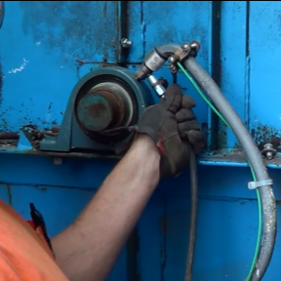

PREVENTIVE MAINTENANCE
BUCKET ELEVATORS

Slide 3
Introduction
This Preventive Maintenance for Bucket Elevators module is part of a curriculum series that addresses hazards found in areas of grain handling facilities including grain bins and their surrounding area. It’s purpose is to assist participants to identify and abate hazards in the work place.
Notes:
Explain this module is part of a series.
Other modules
Overview of Grain Handling Safety and Storage (introductory module)
Lock out Tag out mini module
Entanglement Hazards and Guarding
Falls
Grain Bin Entry
Lifeline Protection System
Characteristics of Confined Spaces (in Agriculture)

Slide 4
Disclaimers
This material was produced under grant number SH-22288SH1 from the Occupational Safety and Health Administration, U. S. Department of Labor.
It does not necessarily reflect the views or policies of the U. S. Department of Labor, nor does mention of trade names, commercial products, or organizations imply endorsement by the U. S. Government.
Notes:
Instructor Notes:
Explain – GHSC received funding from OSHA. In order to comply with the grant we do need them to sign in and need to collect the following information:
Supervisor or worker. This information is for statistical purposes to show the types of population receiving training.
Employer. This is to establish an employer/employee relationship as covered under OSHA. Volunteer rescue workers who may be attending should list their employer; not the volunteer rescue squad. Farmers should list the registered business name of their farm. Farm employees should provide the business name listed on their paycheck.
OSHA does NOT contact the employer.
GHSC may contact the attendee or employer for follow-up evaluation in compliance with grant requirements.

Slide 5
Employee Rights
Employees are entitled to safe and healthy working conditions which DO NOT pose a risk of serious harm.
Workers are entitled to be fairly compensated for all hours worked in accordance with the law.
Notes:
Explain - All DOL grants require that employees are informed of their rights. In this instance we want to emphasize employees are entitled to a safe and healthy working environment AND to fair receive compensation for their work.
Remind employees – it is the employee’s responsibility to follow the safety practices, policies, and procedures of their employers.
Tell participants their rights also include the right to report unsafe conditions to the OSHA hotline without retribution.
More information about employee rights can be found on the OSHA website: www.osha.gov or the Department of Labor website www.dol.gov .
NOTES:
It is ESPECIALLY imperative for youth/young workers to access information and know their rights, what to expect, and how to get help if needed.

Slide 6

Employer Responsibility
Employers have the responsibility to provide a safe workplace.
More information about employer & employee rights can be found at www.osha.gov.
Notes:
Explain employers have a legal responsibility to provide a safe workplace. This means they must ensure the regulations which govern their business are instituted and followed. This applies to 1 employee or more.
Discuss - It is the employers’ responsibility to know the rules and laws – federal and state.
Emphasize – It is employers’ responsibility to ensure employees, know, understand and follow regulations and company policies.
Stress - If employers are unsure of the regulations they should consult with the appropriate agency. Every state has an on-site consultation program jointly funded by OSHA and the state which provides assistance in learning and complying to the regulations.
The OSHA website provides contact information for each state’s on-site consultation program.
Illinois Department of Labor has the on-site consultation program in Illinois.
Employers should also know and understand the state’s laws as they may be more restrictive than OSHA. Contact the state department of labor.

Slide 7
Learning Objectives
At the end of this module, participants will be able to:
Understand basic preventive maintenance procedures for bucket elevators.
Identify components requiring inspection or maintenance.
Notes:
Introduce the learning objectives. These are the knowledge the participant should acquire as well as tasks or skills they should learn to perform.
Explain – the module was designed to seek interaction from the participants. Questions will be asked throughout to generate discussion.
Encourage – the sharing of ideas, information, experiences so everyone can learn.

Slide 8
PREPARE & CONDUCT PREVENTIVE MAINTENANCE

Slide 9
Preventive Maintenance
Timely & Properly
Prevents ignition sources
Protects
  Workers
  Product
  Equipment
Often overlooked – something goes wrong
  Less caution
Notes:
Legs are the work horses of the grain elevator – carrying and moving hundreds of thousands or millions of bushels of product each year.
Being in good working condition is essential to efficient, productive, and profitable operations.
Scheduled, preventive maintenance is often overlooked or put aside until something goes wrong.
Unscheduled work stoppage – in any industry – leads to a more hurried, less cautious approach putting workers at risk of forgetting or bypassing safety measures.
Preventive maintenance of bucket elevator legs is crucial to controlling ignition sources. Most fires and/or explosions at grain storage facilities occur when some component of the conveying system becomes overheated due to friction.
As on-site storage gets larger it will become more critical for farms to use the same precautions and safety measures as the commercial industry.
Using a scheduled maintenance plan, reduces work stoppages, protects workers, can aid in better storage quality of the product and protects the equipment from unnecessary and often destructive wear/tear.

Slide 10
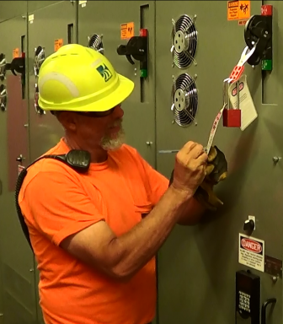
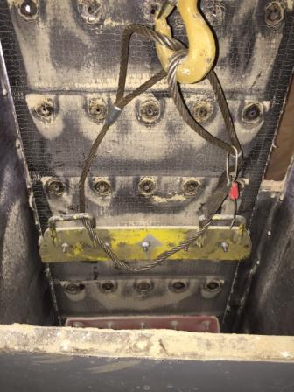
Lock out/Tag out before work
Motor drive to conveyor
Clamp/secure belt
Notes:
Prior to working on energized Bucket Elevator where contact with the belt, buckets, rotating parts, or electricity is possible:
Lockout/tagout the drive motor to the conveyor.
Prior to splitting a belt or working on a belt that could spin due to gravity**: Clamp or otherwise secure the belt from spinning.
This is usually for major maintenance and not something you would need to do for a regular inspection. If gravity can be a hazard – then secure the belt.

Slide 11
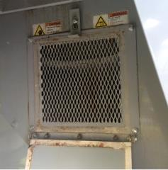

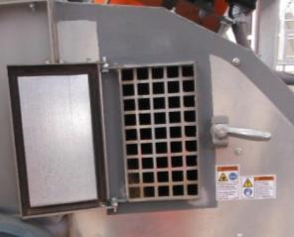
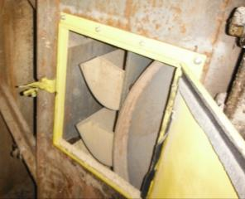
Label & guard inspection doors
Warning labels
Guard mesh - Behind door
  Open without tool
Guarded
Guarded
Unguarded
Notes:
Verify warning labels are on all inspection doors.
Verify Inspection doors with wing nuts, spring clamps, etc.…that don’t require tools to open have guard mesh behind them.
Sign photo: Design ©Clarion Safety Systems. All rights reserved. www.clarionsafety.com. (written permission)

Slide 12
BELT & BUCKET INSPECTION

Slide 13
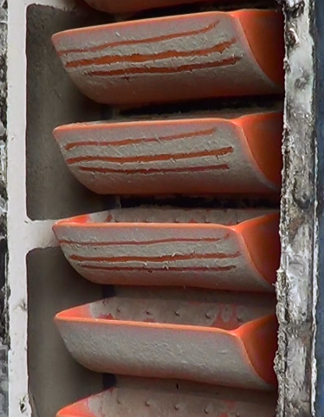
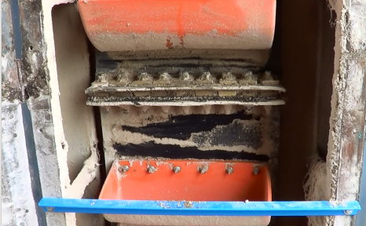
Observe a complete loop
Start at splice or mark
Start at Splice
Starting mark
Notes:
Observe the belt and buckets through a complete loop.
Start at the splice or another “mark” so you know you have inspected all.

Slide 14
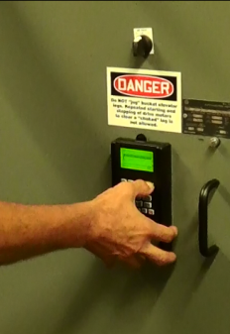
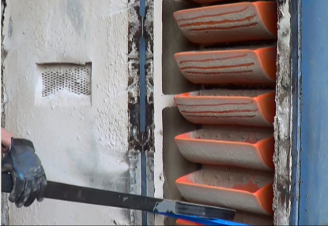
Slowly rotate belt
Variable speed drive
  guarded
Creep drive
Move manually
Manual – use bar
Set Variable Speed Drive
Notes:
Move with variable speed drive if equipped (should be guarded), or
Move with a creep drive if equipped

Slide 15
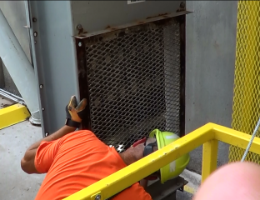
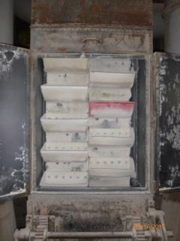
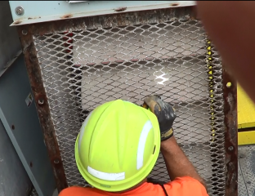
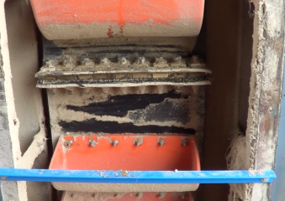
Look front/back for wear & tear
Guarded door -variable speed drive
View of Belt - Open Door
Notes:
Belt Inspection
Look at front of belt
Look at back of belt
Inspect for wear
Inspect for tears

Slide 16
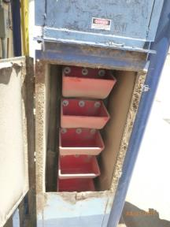
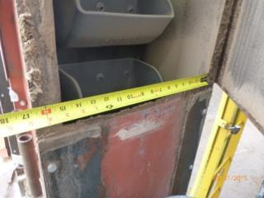
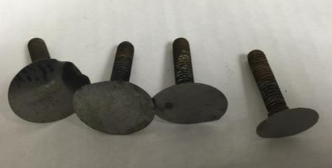
Belt centered in casing
Check Alignment
Begin to wear – sharp edges
View Belt
Sharp edges
Centered in casing
Cracks, rubbing
Separation, bubbling
Missing, worn, loose bolts
Notes:
Belt Inspection
Inspect for severe cracks, rubbing, separation, and bubbling
Look for missing, worn, or loose bolts
Check for centering of the belt in the casing. Out of align increases wear & friction

Slide 17
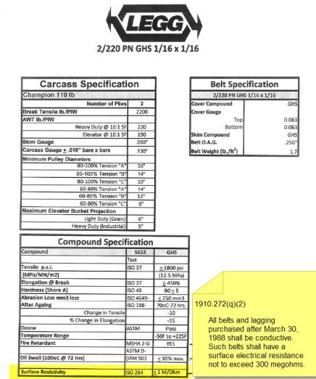
Belt material is conductive
Verify belt material is conductive
Surface electrical resistance ≤ 300 megaohms
Notes:
Belt Inspection
Verify belt is of the correct material
1910.272(q)(2)
All belts and lagging purchased after March 30, 1988 shall be conductive. Such belts shall have a surface electrical resistance not to exceed 300 megohms.

Slide 18
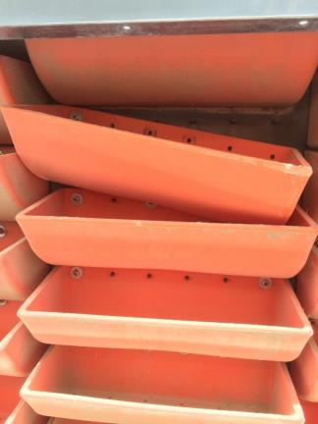
Inspect buckets for unusual wear
Inspect
  Missing/loose nuts & bolts
  Cracked, broken, loose buckets
  Wear patterns & level
Research unusual wear
  Indicate wear point in casing
Missing Nuts & Loose Buckets
Notes:
Bucket Inspection
Look for missing bolts/Nuts
Look for loose bolts/Nuts
Look for cracked, broken, or missing buckets
Look for wear patterns and wear level
Research unusual wear marks, scrapes, etc… that indicate a wear point in casing

Slide 19
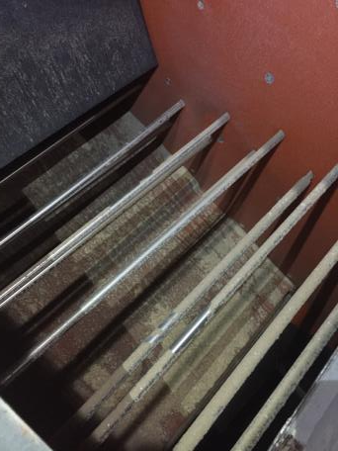
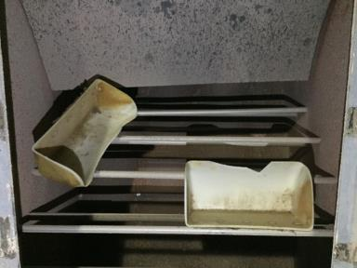
Missing buckets
Not blocking discharge spout
Check bucket catcher on discharge spout
Bucket Catching Bars at Discharge
Buckets Caught on Bars
Notes:
Bucket Inspection - If missing buckets verify they are not blocking discharge spout.
Check bucket catcher on discharge spout if equipped.

Slide 20
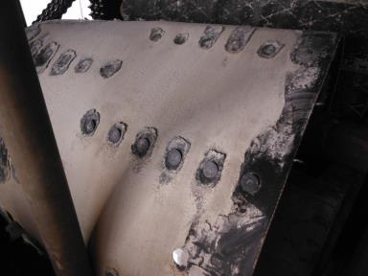
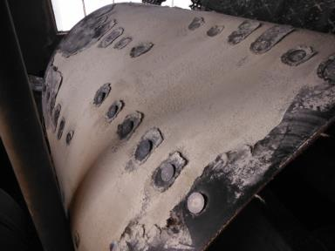
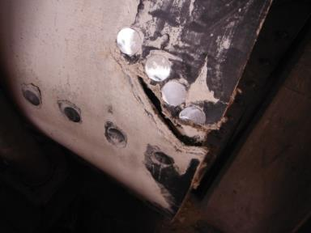
Belt Tear Views

Slide 21
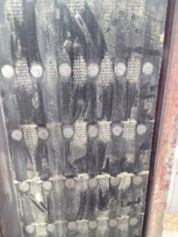
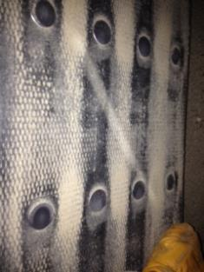
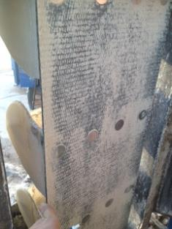
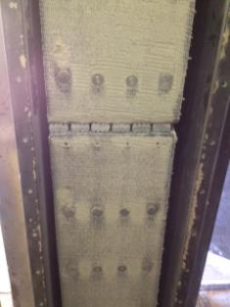
PVC Belt Deterioration

Slide 22
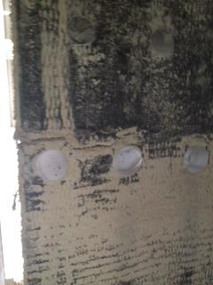
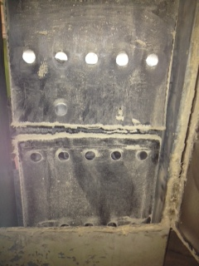
Back side wear examples

Slide 23
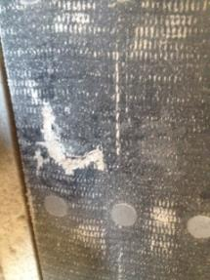
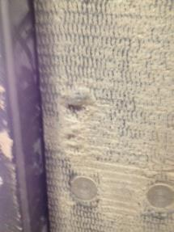
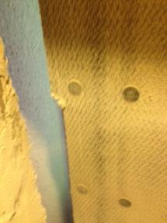
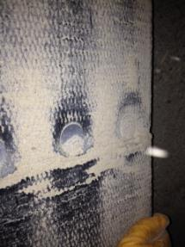
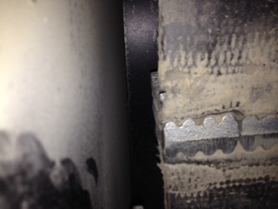
Back side wear on belts

Slide 24
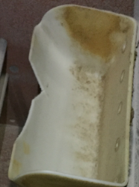
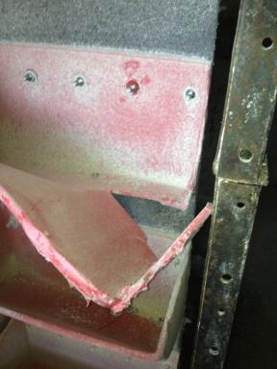
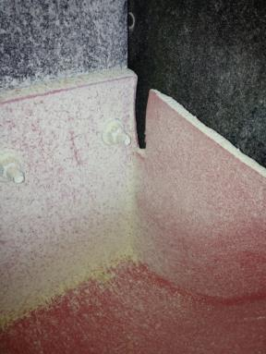
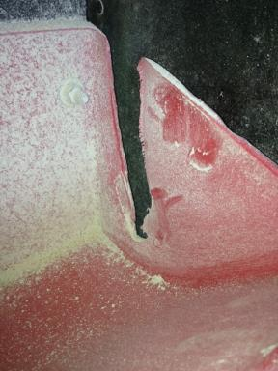
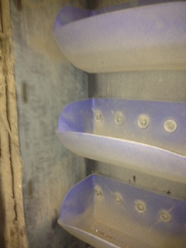
Cracked/broken buckets

Slide 25
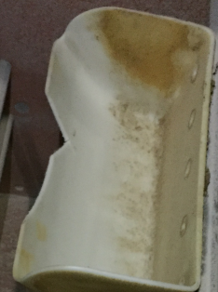

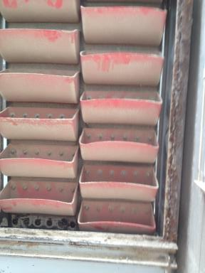
Bucket inspection issues
Crack
Missing bucket

Slide 26
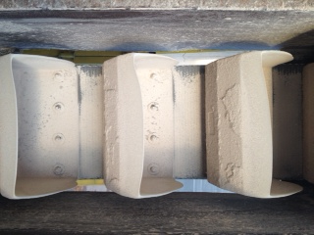
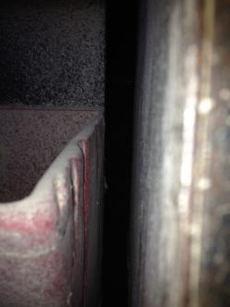
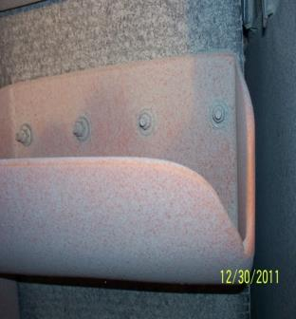
Signs of wear - friction

Slide 27
BELT SPLICES

Slide 28
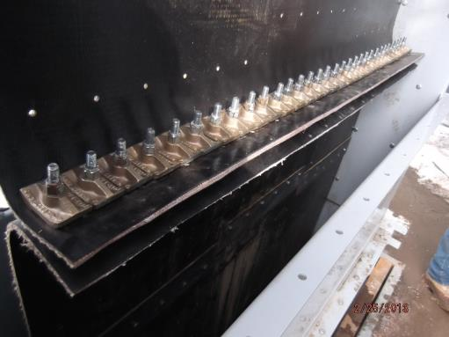
3 types of belt splices
Mechanical Splice
Lap
Butt
Mechanical

Slide 29
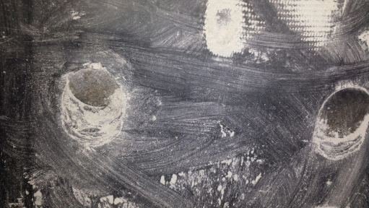
Lap & Butt splice
Torque nuts
Verify bolt condition
Review belt condition
Bolts pulling through belt splice
Notes:
Lap and butt Splice
Torque the Nuts to manufacturer’s specifications
Verify bolt condition
Review belt condition as discussed earlier

Slide 30
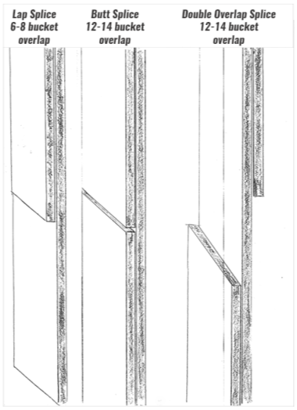
Ensure overlap on splices
Bucket overlap
Lap ≥ 6-8
Butt ≥ 12-14
Double Overlap ≥ 12-14
Pulley Side
Pulley Side
Pulley Side
Notes:
There should be at least 6-8 buckets worth of overlap on lap splices. 12-14 buckets worth of overlap on Butt or Double Lap. Some recommend 16.

Slide 31


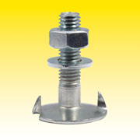
Nuts & bolts of splicing
Best - Large flange nut, no extra washer
Double nut - serrated flange & fender washer
Avoid small flange nuts & separate fender washer
Notes:
Large flange nuts with no extra washer are the preferred connector.
Small flange nuts with separate fender washers have a history of working loose.
If you have serrated flange nuts and fender washers on your splice make sure to double nut them.

Slide 32
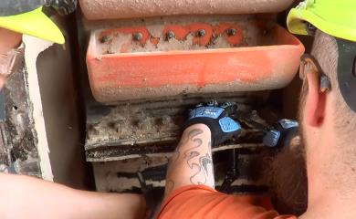


Mechanical splice inspection
Torque nuts
Inspect metal pieces
Belt material at bend
  Verify ‘AB’ non-ferrous
Mechanical Splice
Check Torque of Nuts
Notes:
Mechanical Splice
Torque the Nuts to manufacturer’s specifications.
Inspect the condition of metal pieces.
Inspect the belt material at the bend of the splice.
Verify “AB” Non-ferrous.

Slide 33


Use template for clamp spacing
Incorrectly installed ferrous splice. Clamp spacing too far apart
Use template
Follow manufacturer specification
Notes:
Picture of ferrous splice not installed correctly.
Spacing of clamps is too far apart.
Follow manufacturer specification and use template.
On picture - Should Have Used The Template That Comes From Manufacturer of The Splice. Wrong Spec. of Material.

Slide 34



Torn splices
Torn mechanical splice
Torn lap splice
Torn lap splice

Slide 35
KNEE PULLEY INSPECTION

Slide 36





Knee Pulley – Inspect all parts
Bearings
Pulley
Conduit & bearing sensors
Guarding
Tighten Bearing Mount Use a fitted wrench)
Knee Pulley Fully Guarded
Check Lock Collar
Notes:
Verify guarding is complete and secure
Check conduit and bearing sensors

Slide 37
Knee pulley bearing: look , listen
Visually inspect
  infrared
Listen to it run
Lubricate
  Grease purges
Notes:
While running listen to the bearing.
Visually inspect bearing. Use infrared if available to check bearing
Lubricate bearings until grease begins to purge from the bearings

Slide 38


Knee Pulley - tighten bearing parts
Check Lock Collar
Tighten Bearing Mount
(Use fitted wrench)
Notes:
Check bearing lock collar bolts for tightness.
Tighten bearing mounts. It is better to use a fitted wrench.

Slide 39



Pulley Inspection
Check Bushing Nuts
Knee pulley enclosure opened for inspection
Check Pulley Face
Look for wear, cracks, etc.
Notes:
Inspect the pulley for general condition (wear, cracks, etc.).
Verify bolt tightness on bushings

Slide 40

Damaged knee pulley

Slide 41



Rub blocks must make contact
Placement - belt/pulley contacts rub block
  Check Wiring
Inspection Door
Catches pulley, belt movement
Hanging off mount
Notes:
Inspect for placement to make sure the belt and/or pulley will contact the rub block
Inspect wiring
Inspect for wear
Wear dead center is the worst
Replace if worn more than ½ through or if worn at center
Replace if worn to where it doesn’t protect side casing

Slide 42

Rub block – center wear is worst
Wear - dead center is worst
Replace
  Worn > ½ through or at center
  Doesn’t protect side casing
Worn Rub Block Needs Replaced
Notes:
Inspect for placement to make sure the belt and/or pulley will contact the rub block
Inspect wiring
Inspect for wear
Wear dead center is the worst
Replace if worn more than ½ through or if worn at center
Replace if worn to where it doesn’t protect side casing

Slide 43

Will rub sensor catch future rub?
old rub mark

Slide 44


Test rub block sensor
Test sensor - use manufacturer’s tester
Alternative - freeze spray
  Monitor readout shows temperature drop
Freeze spray on rub block
Watch display change
Notes:
Test sensor
Use manufacturer’s tester if they have one
Another method is to spray with freeze spray
Verify temperature monitor readout shows a drop in temperature

Slide 45


Inspect casing for alignment
Wear points; signs of rubbing
  Use infrared
Signs of settling/out of alignment
Rusted casing & failing supports
Using infrared to look for rubs
Notes:
Inspect for wear points
Inspect for signs of rubbing
Infrared is a great tool
Inspect for signs of settling/out of alignment issues

Slide 46
EXPLOSION VENTS

Slide 47


Explosion vents correctly set-up
Remove shipping bolts
Correct bolts & washers
Not blocked from release
Warning labels
Safety catch cables/straps
Missing bolts
Top of Leg Explosion Vent
Notes:
Inspect for general condition
Inspect to make sure shipping bolts removed
Inspect to make sure correct bolts and washers in place
Verify it is not blocked from being released
Verify they have warning labels
Verify any safety catch cables or straps are in place
LEFT PICTURE – EXPLOSION VENT AT THE TOP OF THE LEG
RIGHT PICTURE– MISSING EXPLOSION VENT BOLTS

Slide 48


Must remove shipping bolts
Shipping Bolts Still on Explosion Vent (You Can See The Labels Broke Off Before The Bolts Were Removed)
Shipping bolts not removed
Labels missing
Warning labels to remove shipping bolts
Must remove shipping bolts before placing into service.
Notes:
Notice Stickers Warning To Remove Shipping Bolts Before Placing In Service
Shipping Bolts Still on Explosion Vent (You Can See The Labels Broke Off Before The Bolts Were Removed)

Slide 49
HEAD SECTION INSPECTION

Slide 50



Check for blockage in discharge
Discharge Throat
Discharge & wiper plate
  Clearance - ¼ to ½ inch
Plug switch
  Activate; ensure monitor picks up signal
Wiper Plate in Discharge
Wiper Plate
Notes:
Inspect discharge for condition and potential blockage
Inspect discharge Wiper plate
Measure clearance of discharge plate 1/4-1/2 inch
Inspect plug switch if equipped
Verify general condition
Activate and make sure monitor picks up the signal

Slide 51


Lining intact & secure to casing
Missing Tiles
Inspect lining of head section
Intact Tiles
Notes:
Inspect lining
Condition
Secure to casing
All intact

Slide 52

Replace worn bucket catchers
Good bars on bucket catchers
Replace bucket catchers before they fail and get into product stream
Notes:
Inspect bucket catchers for wear if equipped
Replace before they could fail and get into the product stream

Slide 53

Lagging should be tight to pulley
Inspect lagging on head pulley
Wear
Tight to pulley
Conductive
Grooves clean, free of material
Notes:
Inspect lagging on head pulley
For wear
Is it tight to pulley
Proper type
Make sure the groves in the lagging are clean
and free of material

Slide 54




Worn, slick, damaged lagging

Slide 55
Head pulley properly aligned
Inspect head pulley
Alignment
  Side to side
  Front to back
General condition
  Face & sides
Measure crown
Check bushing tightness on shaft
Notes:
Inspect head pulley
Inspect alignment side to side and front to back (track measurements for comparison)
Inspect general condition
Look at face and sides
Can measure crown if tracking is an issue
Check bushing tightness on shaft if accessible

Slide 56



Head Pulley
Cracked pulley
Check the crown
Head Section Open for Drive Replacement

Slide 57



Inspect & lubricate bearings
Bearings tight to shaft
Lubricate
  Manufacturer specs
Grease Bearing
Tighten Mounts
Tighten Collar
Notes:
Inspect bearings
Inspect bearings tight to shaft
Bearing sensors attached to bearings
Lubricate per manufacturer’s spec

Slide 58

Ensure belt alignment centered
Can See Alignment in Casing
Inspect alignment
Belt centered
No signs of rubbing
Notes:
Inspect alignment
Belt should be centered
No signs of rubbing

Slide 59



Head section bearing sensors
Inspect bearing sensors – use infrared
  Proper mounting
  Wires intact
  Manufacturer’s tester or freeze spray
Check Bearing with infrared camera
Disconnected Wire
Freeze Spray
Notes:
Inspect bearing sensors in head section – use infrared camera if available
Proper mounting – attached to bearings
Wires intact
Use manufacturer’s tester if they have one
Another method is to spray with freeze spray - Verify temperature monitor readout shows a drop in temperature.

Slide 60


Inspect electrical – head section
Undamaged, sealed, secured conduit
Sealed motor conduit box
Proper rated conduit
Non-sealed
motor conduit box
Conduit open
Notes:
Inspect Electrical
Undamaged and sealed conduit
Sealed motor conduit box
Proper rated conduit
Secured conduit

Slide 61

Inspect drive – oil & drain vents
Oil level - signs of oil leakage
Drain vents clean
Oil Leak
Notes:
Inspect Drive
Oil level
Signs of oil leakage
Drain vents clean

Slide 62



Inspect drive
Coupler condition
  Lubricate
Sheaves/Sprockets
  secure to shafts
  free from wear & in alignment
Worn Coupler
Worn Sprockets & Couplers
Notes:
Coupler
Lubricate coupler per manufacturer’s recommendation
Condition of coupler
Sheaves/Sprockets secure to shafts
Sheaves/Sprockets free from wear and in alignment

Slide 63


Head section drive alignment
Basic alignment
  belt pulleys alignment if equipped
Check belts, tightness & condition
  measure belt deflection
Check Belt
Use String to Check Alignment
Notes:
Basic alignment
Check alignment of belt pulleys if equipped. Use string – hold taught.
Check belts, tightness and condition (measure belt deflection)
Inspect Drive

Slide 64


Grid style coupler inspection
Annual maintenance
Remove cover assembly
Check alignment
Torque all fasteners per spec
Inspect seal ring & gasket
  Replace leaking/worn
Notes:
Grid Style Coupler if equipped
Inspect by removing the cover assembly.
Check alignment
Torque all fasteners per spec.
Inspect seal ring and gasket, replace if leaking or worn.
Remove the grid spring or grid spring segments
Thoroughly clean all components.
Remove both drain plugs and fill with new lube. Grease should purge out the opposite hole. Use long term grease per manufacturer’s specification.
Pack the grid teeth in the hubs and install grid spring or grid spring segments
Frequency – annual maintenance

Slide 65


Grid style coupler inspection
Remove grid spring/grid spring segments
Thoroughly clean all components
Remove both drain plugs; fill
  Grease purges out opposite hole
Pack grid teeth in hubs; install grid
  Use long term grease per manufacturer’s specification

Slide 66


Para flex coupler inspection
Inspect guard
  2”-3” minimum clearance guard to coupler
  Protects work area
Periodically inspect coupler
  Wear, dust/dirt buildup, impede heat dissipation
Inspect increased levels of vibration/noise
Notes:
Para flex Coupler if equipped
Inspect the guard
2” clearance minimum from guard to coupler (<14” coupler)
3” clearance minimum from guard to coupler (>14” coupler)
Able to protect work area if coupler breaks apart
Couplings should be periodically inspected for normal wear, dust/dirt buildup or any similar scenario that would impede heat dissipation.
Increasing levels of vibration and noise could indicate the need for inspection, repair or replacement of the coupling or element.

Slide 67
Gear coupler annual maintenance
Check alignment per manual
Torque all fasteners
Inspect seal ring & gasket
Re-lubricate coupler
  Apply grease - both sides of coupler through lube plug holes
  leave opposite side open as a vent
  use recommended long-term grease
Notes:
Gear Coupler if equipped (annual maintenance)
Check alignment per manual
Torque all fasteners
Inspect seal ring and gasket to determine if replacement is needed.
Re-lubricate coupler. Apply grease to both sides of coupler through lube plug holes leaving opposite side open as a vent (Grease type is important – using recommended long-term grease is preferred by manufacturer – using general purpose grease cuts maintenance interval to ½ the normal maintenance period)

Slide 68



Gear coupler
General purpose grease cuts maintenance interval to 1/2 the normal maintenance period
Notes:
Gear Coupler if equipped (annual maintenance)
Check alignment per manual
Torque all fasteners
Inspect seal ring and gasket to determine if replacement is needed.
Re-lubricate coupler. Apply grease to both sides of coupler through lube plug holes leaving opposite side open as a vent (Grease type is important – using recommended long-term grease is preferred by manufacturer – using general purpose grease cuts maintenance interval to ½ the normal maintenance period)

Slide 69


Inspect head section motor
Electrical connections
  sealed, tight, complete
Physical condition
Signs of oil leakage
Motor Conduit Box Not Dust Tight
Leg Motor
Proper rating
Secure mounting
Basic alignment
Notes:
Inspect Motor
Electrical Connections sealed, tight and complete
Cleanliness
Physical condition
Signs of oil leakage
Proper rating
Grease or Don’t grease depending on company or manufacturer recommendation
Secure mounting
Basic alignment
Motor cooling fan in place, clean, guarded, and operating
Motor cooling fan is not cracked
Sheaves secure to shafts
Sheaves free from wear and in alignment

Slide 70
Inspect head section motor
Grease – as recommended by manufacturer
Motor cooling fan
  In place, clean, operating, no cracks
  Guarded
Sheaves secure to shafts
  Free from wear
  In alignment
Notes:
Inspect Motor
Electrical Connections sealed, tight and complete
Cleanliness
Physical condition
Signs of oil leakage
Proper rating
Grease or Don’t grease depending on company or manufacturer recommendation
Secure mounting
Basic alignment
Motor cooling fan in place, clean, guarded, and operating
Motor cooling fan is not cracked
Sheaves secure to shafts
Sheaves free from wear and in alignment

Slide 71

Sample - greasing motor bearings
Lockout motor
Remove drain plug
Inspect grease drain
  Use mechanical probe to remove blockages
Add 20 pumps new NLGI No. 2 grease - grease inlet
  Use hand operated grease gun
continued
Notes:
Sample Motor Bearing Greasing Instructions
Lockout motor.
Remove the drain plug
Inspect grease drain and remove any blockage with a mechanical probe.
Add 20 pumps of new NLGI No. 2 grease at the grease inlet using a hand operated grease gun.
Run the motor for 15-30 minutes with the drain plug removed to allow purging of any excess grease.
Shut off motor and lockout.
Replace the drain plug.
Return motor to service.

Slide 72
Sample - greasing motor bearings
Run motor 15-30 minutes
  Drain plug removed
  Purges excess grease
Shut off motor & lockout
Replace drain plug
Return motor to service
Follow manufacturer’s instructions for your installation.
Notes:
Sample Motor Bearing Greasing Instructions
Lockout motor.
Remove the drain plug
Inspect grease drain and remove any blockage with a mechanical probe.
Add 20 pumps of new NLGI No. 2 grease at the grease inlet using a hand operated grease gun.
Run the motor for 15-30 minutes with the drain plug removed to allow purging of any excess grease.
Shut off motor and lockout.
Replace the drain plug.
Return motor to service.

Slide 73


Inspect guarding - head section
Ensure guards – complete, secure, painted, not rubbing
Complete guarding
Incomplete guarding

Slide 74
BOOT SECTION INSPECTION

Slide 75




Inspect tail pulley
Bearing Sensor and Bearing
Tail pulley - sides & face
  Pulley clearance to side of leg casing
  Hub
Tail Pulley in Bad Shape
Worn/damaged tail pulleys
Notes:
Inspect tail pulley(sides and face)
Inspect pulley clearance to side of leg casing
Inspect bearings
Inspect bearing tightness to shaft and mount
Clean and Inspect boot, look for debris
Clean out all dust and grain residue (for maintenance and sanitation reasons)
Identify source of foreign debris if possible
Verify operation of boot cleanout slide

Slide 76

Tail pulley - look for cracked hub
Cracked hub on tail pulley
Most common location
Other common area – at edge near face

Slide 77

Tail pulley bearing
Inspect bearings
Bearing tightness to shaft and mount
Bearing & Bearing Sensor

Slide 78
Inspect boot section of leg
Clean & Inspect boot
  Look for debris
Clean out all dust & grain residue
  Maintenance & sanitation
  Identify source of foreign debris
Verify operation of boot cleanout slide
Notes:
Clean and Inspect boot, look for debris
Clean out all dust and grain residue (for maintenance and sanitation reasons)
Identify source of foreign debris if possible
Verify operation of boot cleanout slide

Slide 79

Inspect monitoring components
Inspect plug switch (if equipped)
  Verify general condition
  Activate & ensure monitor picks up signal
Inspect bearing monitors
  Same as head section
Inspect rub blocks
  Same as head section
Bearing Sensor & Speed Sensor
Notes:
Inspect plug switch (if equipped)
Verify general condition
Activate and make sure monitor picks up the signal
Inspect bearing monitors -Same as head section
Inspect any rub blocks - Same as head section

Slide 80
Speed sensors - <20% reduction
Speed sensor – visual inspection
  Mounted on center of shaft
  Wiring & conduit intact
Test
  manufacturer specification or other method
Shut down equipment - belt speed reduced ≤ 20% of normal operating speed
Verify other plant interlocking is functioning
Notes:
Inspect Speed sensors (Will vary by style)
General visual inspection
Mounted on center of the shaft
Wiring and conduit intact
Test per manufacturer specification or other suitable method
Verify it shuts equipment down when the belt speed is reduced by no more than 20% of the normal operating speed.
Verify other plant interlocking is functioning

Slide 81

Inspect take –up mechanism
Mechanical or manual
Frame not bent
Condition of threads
Properly sealed
Measure amount of adjustment left
  Track information
  re-splice belt before adjustment runs out
Mechanical Take-Up
Notes:
Inspect take-up mechanism (Mechanical or Manual)
Measure amount of take-up adjustment that is left. Track this information so you can re-splice belt before adjustment runs out
Verify take-up frame is in good shape and not bent
Verify condition of threads on take-up
Verify take-up is properly sealed and not creating a housekeeping issue

Slide 82

Inspect take-up mechanism
Weighted or Gravity
Frame not bent
Weight stack & support mechanism
  Moves freely
Properly sealed
Measure adjustment amount left & track
Weighted Take-Up
Notes:
Inspect take-up mechanism (Weighted or Gravity)
Measure amount of take-up adjustment that is left. Track this information so you can re-splice belt before adjustment runs out
Verify take-up frame is in good shape and not bent
Verify condition weight stack and support mechanism and that it can move freely
Verify take-up is properly sealed and not creating a housekeeping issue

Slide 83


Look for bent take up mechanism
All take-ups - look for bending, binding, signs of over-stress, etc.
Bent Weighted Take-Up
Bent Weighted Take-Up

Slide 84

Tracking – center of casing
Observe belt running empty & then full
Watch for tracking in center of casing
  Remain toward center
  Not within inch of casing
Belt Tracking to the Left
Notes:
Observe belt running
Should be done empty. Then observe full.
Watch for tracking in the center of the casing. Should remain towards the center and not within an inch of the casing.

Slide 85


Lubrication- rotate bearing if safe
Grease Bearing
Grease rotating bearing
Clean tip of zerk & grease gun
Pump grease into zerk
  fresh clean grease purges under & past seal lip
Clean up excess grease
  Repeat as continues to purge
Blue Grease Begins to purge
Notes:
Grease bearings while bearing is rotating if it is safe to do so.
Clean tip of zerk and grease gun.
Pump proper grease into zerk until fresh clean grease is seen purging under and past the seal lip.
Clean up excess grease that is around the bearing.
May need to come back and clean up grease again as it continues to purge.

Slide 86


Excess Grease
Need to Clean Up Grease

Slide 87





Excess Grease examples
shaft is too long requires guard

Slide 88
Grease leg bearings
Leg bearings - little grease vs high-speed
Manufacturer chart - RPM & run hours
Lubricate before start-up idle equipment
Stay consistent - do not mix greases
  Manufacturer’s recommended or similar
Lower quantity grease frequent intervals more effective
  Vs greater quantity at extended intervals.
Notes:
Usually leg bearings are considered slow moving and require little grease compared to high-speed bearings.
Manufacturer will have a greasing chart based off of RPM and run hours.
Usually monthly is adequate when in operation for busy locations
Always lubricate prior to start-up any idled equipment
Use manufacturer’s recommended grease or similar. Stay consistent, do not mix greases.
Generally, a lower quantity of grease at frequent intervals is more effective than a greater quantity at extended intervals.

Slide 89


Gear Box – annual oil check
Change oil annually
  Send oil samples; follow tribology report
  Install drain valves - sampling & draining
  Follow manufacturer recommendation
Drain valve to drain & get sample
Use pump to pull oil samples
Notes:
Gear Boxes
Change Oil Annually, Or
send oil samples in annually and follow recommendations from tribology report.
Follow manufacturer recommendation if different from above.

Slide 90

Magnet inspection
LOTO & wear gloves
Visually inspect
Clean surface
  Analyze debris
Test magnet strength
  Semi-annual
  Pull tester or informal with hand tool
Return to operating condition
  Seal edges - dust control
Determine cleaning frequency
Notes:
Lockout hazardous equipment and Wear gloves
Visually inspect for worn spots, physical damage, improper position, un-level condition, etc…
Clean surface and put debris in container for analysis and disposal
Inspect debris to determine if it originated from your facility
Test strength of magnet (informally with a hand tool or formally with pull tester) (semi-annual recommended)
Return to operating condition and usually seal the edges for dust control
Reanalyze frequency of cleaning based on findings.

Slide 91

Pull Testing – magnet strength
Clean magnet surface
Select test piece, spacers
  Use same equipment
Zero scale
Attract piece to magnet - center
Pull scale perpendicular to surface
  Repeat 3 times & record results
Identify magnetic degradation - compare
Notes:
Pull testing
Clean the surface of the magnet
Select the appropriate test piece and spacers from the instruction manual (be consistent each time with the same equipment)
Zero the scale
Allow the piece to attract to the magnet (test in the center)
Pull the scale perpendicular to surface, slowly, smoothly, and evenly.
Repeat at least 3 times
Record the results.
Compare with previous results to identify any magnetic degradation

