Slide 1

Process Safety Management
Train-the-Trainer
This material was produced under grant number SH20844SH0 from the Occupational Safety and Health Administration, U.S. Department of Labor. It does not necessarily reflect the views or policies of the U.S. Department of Labor, nor does mention of trade names, commercial products, or organizations imply endorsement by the U.S. Government.
Notes:
Introduction slide

Slide 2
What Rights Do You Have Under OSHA?
You have the right to:
  A safe and healthful workplace
  Know about hazardous chemicals
  Information about injuries and illnesses in your workplace
  Complain or request hazard correction from employer
  Training
  Hazard exposure and medical records
  File a complaint with OSHA
  Participate in an OSHA inspection
  Be free from retaliation for exercising safety and health rights, whistleblower and 11c.
  Employer rights and responsibilities
Notes:
Worker rights under OSHA

Slide 3

Grant Announcement
10-1254-NAT
Sept. 9, 2010
Contact: Diana Petterson Jason Surbey
E-mail: petterson.diana@dol.gov surbey.jason@dol.gov
Phone: 202-693-1898 202-693-4668
US Department of Labor's OSHA awards $8 million
in safety and health training grants
WASHINGTON - The U.S. Department of Labor's Occupational Safety and Health Administration today awarded $8 million in Susan Harwood Capacity Building Grants to 45 organizations, including nonprofit and community/faith-based groups, employer associations, labor unions, joint labor/management associations, and colleges and universities. The grants will assist these organizations in providing safety and health training, and educational programs for workers and employers.
"Ensuring that workers and employers have the information they need is critical to safe and healthy workplaces," said Secretary of Labor Hilda L. Solis. "These grants will help provide training and education aimed at identifying hazards, understanding rights and responsibilities, protecting health and saving lives."
The Susan Harwood Capacity Building Grants support training programs that educate workers and employers in industries with high injury and fatality rates; low literacy, young, limited English proficiency and otherwise vulnerable workers; and small business employers. They fund long-term programs that build safety and health competency within organizations.
OSHA awarded approximately $6.7 million to 30 organizations already providing occupational safety and health training, education and related assistance to their constituents, and that are seeking to expand and develop their capacity. Another $1.3 million in smaller pilot grants was awarded to 15 organizations that seek to lay the groundwork for a robust safety and health education program. The agency received a total of 166 applications for the capacity building grants.
Notes:
Copy of grant announcement to explain grant funding.

Slide 4
Purpose
This section contains requirements for preventing or minimizing the consequences of catastrophic releases of toxic, reactive, flammable, or explosive chemicals. These releases may result in toxic, fire or explosion hazards.
Notes:
Purpose of process safety rule. Preventing catastrophic events.

Slide 5
Process safety management of highly hazardous chemicals
(a) Application.
(b) Definitions.
(c) Employee participation.
(d) Process safety information.
(e) Process hazard analysis.
(f) Operating procedures.
(g) Training.
(h) Contractors.
(i) Pre‑startup safety review.
(j) Mechanical integrity.
(k) Hot work permit.
(l) Management of change.
(m) Incident investigation.
(o) Compliance Audits.
(p) Trade secrets.
Notes:
Sections of the process safety management standard.

Slide 6
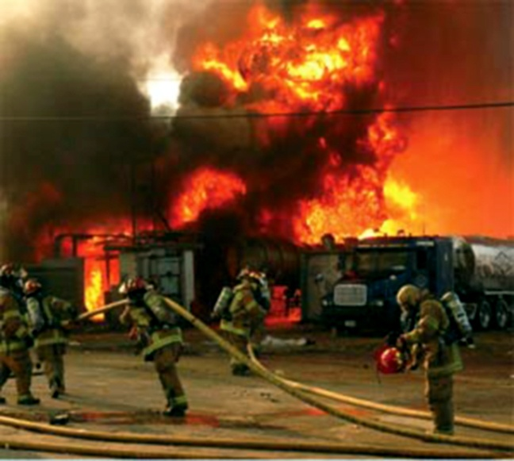
Catastrophic Failure
Notes:
Photo of a catastrophic event to help support the meaning of the previous slide on purpose.

Slide 7
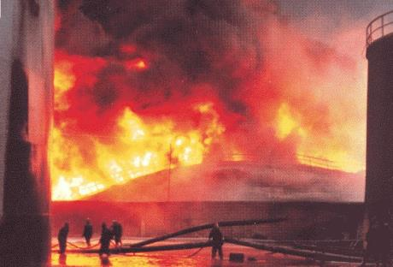
Hazards
Hazards are substances or conditions which can cause injury or harm to people, processes, equipment and the environment and which are associated with the properties and behaviors of process materials.
Notes:
Typically, we tend to think of process hazards as toxic or flammable materials. But even steam, water or compressed air may exhibit hazardous behavior and contribute to major losses.
We have discussed some of the dangerous substances but note there are Hazards other than chemical hazards, e.g. dropped objects.

Slide 8
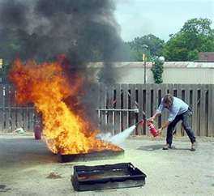
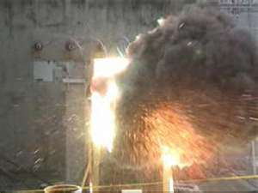
Examples of Hazards
CHEMICAL HAZARDS
Hydrogen
H2S (toxicity)
Nitrogen
Steam
Hot water
Pyrophoric materials
Corrosive materials
Explosive materials
PHYSICAL HAZARDS
Electrical energy
Potential energy
Hydraulic Energy
High temperature surfaces
Radiation
Weather
Security
Notes:
Need to remember Physical Hazards

Slide 9
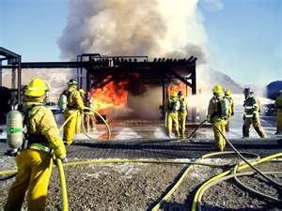
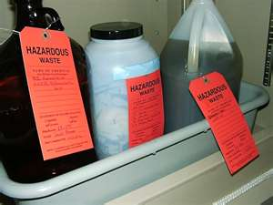
Chemical Hazards
Chemical processes involve mixing and interaction between different materials.
Reactions can release thermal energy or create a rapid increase in volume/pressure which can lead to mechanical failure or loss of containment.
Upsets can cause situations that can interfere with the operation and result in conditions that favor other triggers for loss of containment
  Fouling, Corrosion, Phase Change etc
Notes:
Examples at home and in industry?
Chlorine bleach is extremely reactive. Never mix household bleach with household ammonia, or other cleaning products unless the label specifically permits it. Toxic gases result which have killed people.
If further details are requested, reaction products include:
Chlorine gas
If a greater amount of bleach is added than ammonia, Nitrogen Trichloride, a very toxic, volatile explosive.
If a greater amount of ammonia is added than bleach, Hydrazine, which further reacts to release enough heat to lead to an explosion.
Other common household hazards – Spray Cans, Flykiller…………
Note the requirement to have time or presence of air to turn the hazard into an incident.

Slide 10
Definition of Process Safety
Process Safety –
OSHA Definition:
  “The Purpose of Process Safety is to Prevent or minimize the consequences of catastrophic releases of toxic, reactive, flammable or explosive chemicals that may result in toxic, fire or explosion hazards.”
Secondary Definition:
  A set of principles and practices that deal with the integrity and operation of process plant equipment to prevent catastrophic release of highly hazardous chemicals.

Slide 11
Did You Know?
1 kg of light hydrocarbon can:
  - heat a small home for 2 hours
  - heat 45 kettles of water (500 cups of coffee)
  - produce enough heat to melt steel
  - destroy a home or small office (explosion)
1 kg of toxic vapor can harm people several hundred meters away in 3-5 min
1 kg of toxic waste can contaminate several km of a major waterway.
Notes:
We don’t need a great quantity to material to have a big impact.
Especially toxics where the effect can be miles.

Slide 12
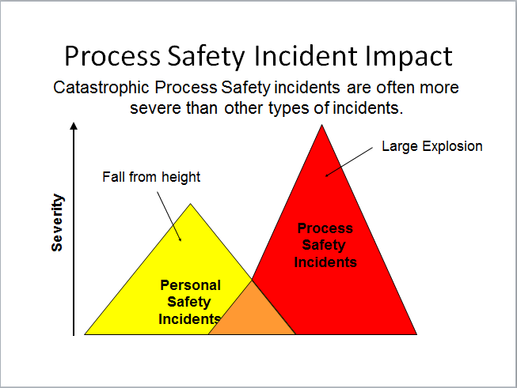
Process Safety Incident Impact

Slide 13
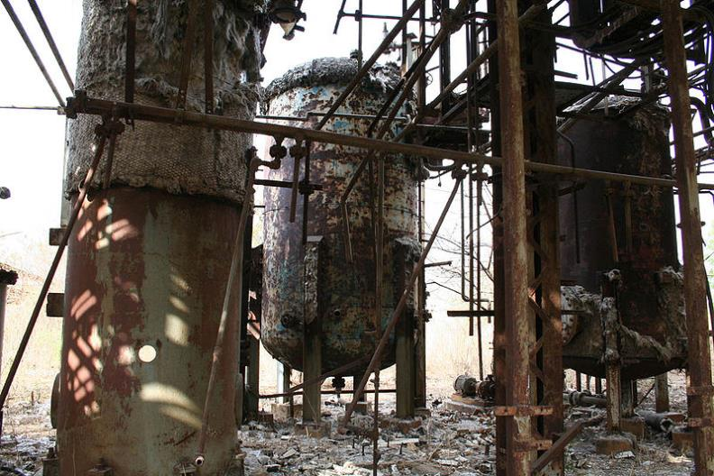
Process Safety Incident Impact
Bhopal, India 1984 – 1754 fatalities, 100,000’s injured
Notes:
Methyl Iso-Cyanate Release – TOXIC RELEASE. Union Carbide.

Slide 14
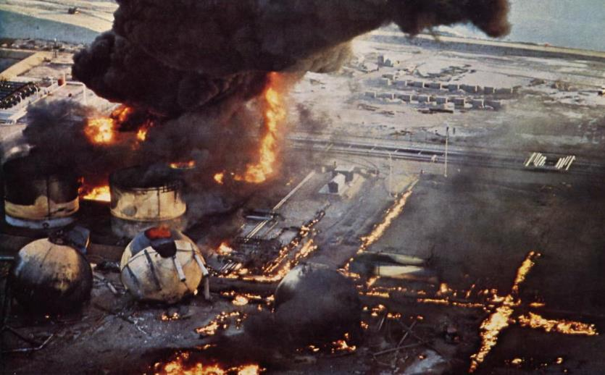
Process Safety Incident Impact
Feyzin, France 1966 – 18 fatalities
Notes:
Leak of LPG – vapor cloud release contacts ignition source.

Slide 15
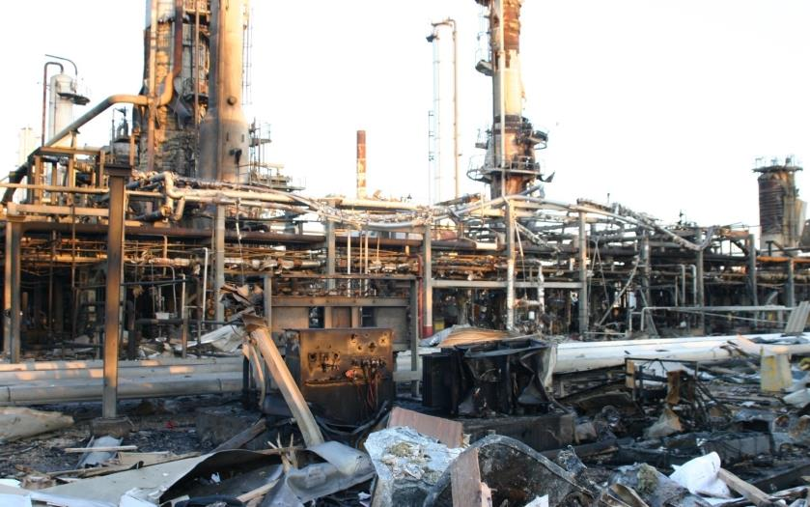
Process Safety Incident Impact
Texas City 2005: 15 fatalities
Notes:
Vapor cloud release “raffinate” contacts ignition source.

Slide 16
Process Safety Incident Impact
Other Examples….
Flixborough - 1974 - 28 Fatalities
Mexico City LPG - 1984 - 542 Fatalities
Piper Alpha - 1988 - 167 Fatalities
Phillips -1989 - 24 Fatalities
Arco Chemicals - 1990 - 17 Fatalities
BP, Texas City, TX – 2005 – 15 Fatalities
Deepwater Horizon – 2010 - 11 Fatalities
Notes:
List of Process Safety Incidents

Slide 17
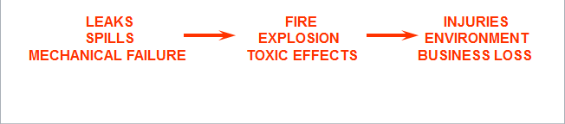
“Keep it in the pipes”
Process Safety focuses on controlling the potential release of hazardous substances caused by:
MECHANICAL FAILURES
PROCESS UPSETS
PROCEDURES / HUMAN ERROR
Notes:
The Hazardous Substance is only likely to cause loss if it is released. Process Safety aims to prevent the release of hazardous substances which could lead to an event and therefore some form of loss or impact.
Release may be through three main areas Failure, Process Upset and Human Error.
There are interventions you can make at each step

Slide 18
Focus: Incident Prevention
People, Plant, Process
OSHA Elements aim to assure integrity of these boundaries.
Notes:
OSHA Elements aim to assure integrity of these boundaries. Image of how failures happen.

Slide 19
What is Covered
Listed chemicals in Appendix A
> 10,000 pounds or 4535.6 kg of flammable liquids or gasses

Slide 20
Process Safety Management
OSHA 1910.119
Performance Based
14 Elements
List of Highly Hazardous Chemicals
Applies to Processes that Exceed the Total Quantity
Exemption for Remote, Um occupioed

Slide 21
Elements of OSHA 1910.119
Employee Participation
Process Safety Information
Process Hazard Analysis
Operating Procedures
Training
Contractors
Pre-Startup Safety Review
Mechanical Integrity
Hot Works Permits
Management of Change
Incident Investigation
Emergency Planning & Response
Compliance Audits
Trade Secrets
Notes:
Elements of PSM standard

Slide 22

Element 1: Employee Participation
Develop a written participation plan
Consult with employees
on PSM development
Provide PSM information access to employees
Notes:
Employee participation section of PSM standard.

Slide 23
Element 2: Process Safety Information
Information used by employees to identify and understand hazards of Process Equipment and Chemicals.
Must be compiled before a hazard analysis.
Includes:
  MSDS’s, Process Chemistry, and Max Intended Inventory
  PFD’s/P&ID’s
  Safe Operating Limits
  Material and energy balances
  Materials of construction and design codes employed
    (ie Electrical Classification, RV design, Ventilation design, safety system design)
Notes:
Process Safety Information section of PSM standard.

Slide 24
Element 3: Process Hazard Analysis
Definition: Systematic way to identify potential hazards and recommend possible solutions
  Techniques: HAZOP, FMEA, What-if, Checklist
Addresses: facility siting, human factors, previous incidents, control failures
Relies on: Proper team and Information (PSI)
Develops: Recommendations
Must: Revalidate every 5 years (Ensure hazards introduced by changes are sufficiently controlled)
Notes:
Process Hazard Analysis section of the PSM standard.

Slide 25

Element 4: Operating Procedures
Written procedures for:
  Startup/Shutdown
  Normal operations
  Temporary operations
  Emergency operations
Must include:
  Operating Limits and Deviations
  Potential Hazards and Controls
    (ie PPE, Safety Systems)
Certified annually
Notes:
Operating Procedures section of the PSM standard.

Slide 26

Element 5: Training
Must include:
  Process Overview
  Safety and Health Hazards
  Procedures (emphasizing emergency)
  Safe Work Practices
Initial training w/refresher at least every 3 years
Documented records and verification of qualification
Notes:
Training section of PSM Standard.

Slide 27
Element 6: Contractors
Contractor definition:
  An individual performing work on or adjacent to a covered process.
  Does not apply to incidental services
    Janitorial, Food and Drink, Mail, or Laundry service
Two Different sets of responsibilities:
  Employer
  Contract Employer
Notes:
Spend more time on the contractor section of the PSM standard. Go into greater detail on each section and define responsibilities.

Slide 28
Element 6: Employer Responsibilities
Evaluate Contractor Safety Performance (prior to selection)
Inform Contractor Of Known Hazards Related to:
    Work Being Performed and the Process
Inform Contractor Of Emergency Plan
Implement Safe Work Practices Covering Work Activities
    Lockout/Tagout, Confined Space Entry, Opening Process Equipment, and Facility Entry.
Periodically evaluate Contractor Performance on Meeting OSHA Obligations (training etc)
Maintain a Contractor Illness/Injury Log

Slide 29
Element 6: Contractor Employer
Contractor Training and Documentation of Comprehension.
Instruct Contractors of:
  Hazards of facility/job and the Emergency Plan
Ensure that Contractors follow the Facility:
  Safe Work Practices
  Safety Rules/Policies
Notify Facility of:
  Hazards of Contract Work Being Performed
  Hazards found during Work
Notes:
Employer section of PSM standard

Slide 30
Element 6: Contractor Provisions
Contractor Safety Oversight
  Evaluate contractor safety program
  Inform contractor of potential hazards: fire, toxic release, applicable plant safety rules
  Develop and implement safe work practices
  Evaluate Contractor performance
Qualified Contractors
  Pre-qualification process
  Safety Training
  Initial/annual orientation
  Job specific training
Notes:
Continuation of Contractor requirement section. The explains why the contractor has to follow the host employer requirements. It also helps the contractor understand the reasons for the increase in safety requirements.

Slide 31
Element 6: Contractor Provisions
Audit Compliance
  Perform Field and Bi-annual record audits on selected contractors
Responsible for:
  use of qualified contractors
  ensuring new contractors are pre-qualified
  ensuring contractor trained properly and provided required information
  Ensure contractor is following rules & procedures
Notes:
Continuation of Contractor requirement section. The explains why the contractor has to follow the host employer requirements. It also helps the contractor understand the reasons for the increase in safety requirements.

Slide 32
Element 7: Pre-Startup Safety Review
Performed on New/Modified Facilities
Ensures the following prior to Start-up:
  Construction is in accordance with design specs
  Procedures are in place
  Changes have been reviewed for hazard (PHA/MOC)
  Actions from hazard review have been resolved
  Employee training is complete.
Notes:
This is one of the most dangerous issues in PSM. Review Element 7 pre-start up safety.
This relate to the BP Texas City (video) explosion cause.

Slide 33
Element 8: Mechanical Integrity
Maintenance Procedures and Training
Inspection/Testing on process equipment and documentation of test.
Frequency and Method per Good Engineering Practices (at minimum).
Deficiencies corrected before further use
Quality assurance program
Notes:
Section 8 is a review of the mechanical integrity requirement for PSM facilities. This section dictates quality control issues for contractors.

Slide 34
Element 9: Hot Work Permits
Issued for hot work ON or NEAR the process
Document:
  Required Fire Protection/Prevented has been implemented prior to work
  Authorized for work
  Equipment where hot work is to be performed.
Notes:
During the presentation review the relevance of hot works and introduce the video in the next slide.

Slide 35
Element 10: Management of Change
Evaluates Hazards of ANY Changes to:
  Chemicals, Technology, Equipment and Procedures
  Before Startup
  Even on temporary changes
Considers the impact on the following:
  Health and safety
  Process safety information
  Operating Procedures
  Training/Inform of employees & contractors
  Technical basis of the change
  Time period and authorization requirements for the change
Notes:
Although management of change is done by the host employer, explain how it impacts the contractors and how change affects the entire process.

Slide 36
Element 11: Incident Investigation
Performed on events which have or could have resulted in a catastrophic chemical release.
Prompt investigation
Involve employees knowledgeable in process
Documentation and Report
Recommendations and findings
Resolutions and corrective actions
Notes:
Incident investigation section of PSM. This section explains the value of investigating incidents.

Slide 37
Element 12: Emergency Planning/Response
Employer MUST have an emergency action plan for entire plant.
Must include:
  Pre-plan for catastrophe
  Train and equip workers
  Drills

Slide 38
Element 13: Compliance Audits
Employer certification/internal evaluation that they comply with this OSHA 1910.119 standard.
Conducted at least every 3 years.
Develop a report of findings
Address deficiencies.

Slide 39
Element 14: Trade Secrets
All PSM related information MUST be made available to those developing PSM information without regard to trade secrets.
  Examples: PSI, PHAs, MOCs, Investigations, Procedures, Emergency planning etc.
  All PSM documents must be made available to employees regardless of trade secrets
Can set Confidentiality agreements as necessary

Slide 40
Process Safety In the Workplace
Essential to preventing incidents as a result of the release of Highly Hazardous Chemicals.
Contractors play a key role by:
  Knowing and following the PSM rules
  Participating in the site safety culture
    Incident Investigations/Shared Learnings
    Raising concerns/Stopping work as necessary
  Following the Facility Safe Work Practices
  Fully understanding the hazards present and emergency action plan
Notes:
Recap of the value of the PSM standard. Review the role that the contractor plays regarding rules, culture and practices.

Slide 41
Training Techniques
Objectives:
  Understand the adult learner
  Identify techniques to enhance adult learning
  Plan a training session
  Assess current skills and areas for improvement
  Recognize effective and ineffective training methods
Notes:
This section provides information regarding the presentation of this material for the trainer. Adult learners have different needs. The training must be effective and directed to the audience.

Slide 42
Principles of Adult Education
Treat learners as adults
Identify learner goals
Focus on the real world
Emphasize how training can be applied
Relate materials to their experiences
Listen and respect their opinions
Encourage discussion
Notes:
This slide is dedicated to the principles of adult education. Techniques are identified that help adult learners to become successful through the support of their instructor.

Slide 43
5 Step Training Plan
Review
Overview
Presentation
Exercise
Summary
Notes:
Review and Overview.

Slide 44
Tips for Successful Presentation
Be prepared
Dress appropriately
Be positive and show enthusiasm
Speak loud enough to be heard
Be flexible and accessible
Make eye contact
Notes:
Tips to successfully train workers.

