Slide 1
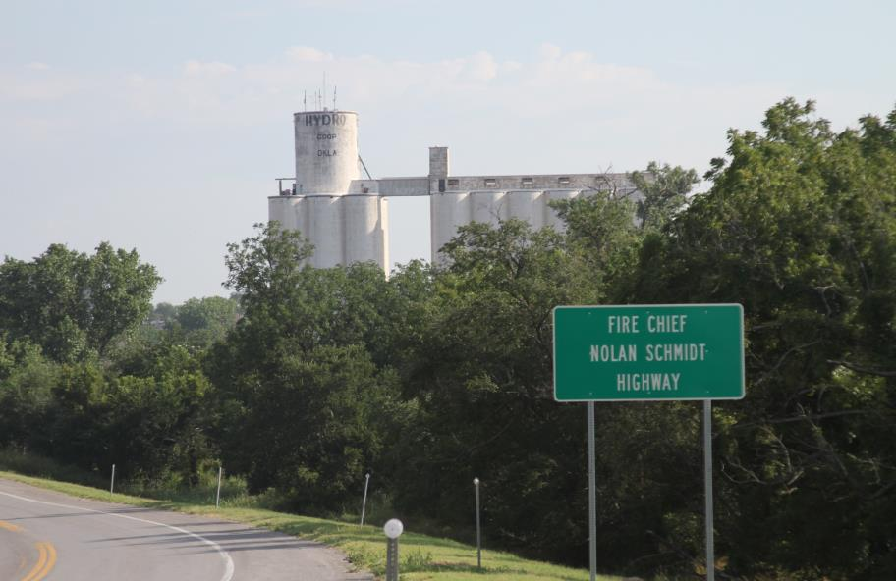
Grain Bin
Emergencies Awareness
Notes:
March 23, 2009 Nolan Schmidt, volunteer fire chief for the Hydro, Oklahoma fire department died fighting a fire inside a Hydro grain bin. Fire Chief Schmidt was one of at least five firefighters who climbed into a bin half full of burning soybeans. Fellow firefighters later cut through the side of the metal bin to remove Schmidt and four other colleagues, who were overwhelmed by thick smoke.
Chief Schmidt and the members of his fire department were dispatched to a report of a possible fire in a large grain bin. Firefighters entered the bin to investigate. Chief Schmidt ordered firefighters to exit the bin. In order to get out of the bin, firefighters had to climb up a long ladder. One of the firefighters in the bin was fatigued and could not complete the climb. Chief Schmidt entered the bin the assist the firefighter. Both firefighters subsequently lost consciousness. Firefighters on the exterior cut a hole in the metal wall of the bin and extricated the two firefighters. Chief Schmidt was transported to the hospital but was pronounced dead. The cause of death was listed as asphyxiation due to probable carbon monoxide toxicity.

Slide 2
Grain Bin
Emergencies Awareness
Notes:
March 23, 2009 Nolan Schmidt, volunteer fire chief for the Hydro, Oklahoma fire department died fighting a fire inside a Hydro grain bin. Fire Chief Schmidt was one of at least five firefighters who climbed into a bin half full of burning soybeans. Fellow firefighters later cut through the side of the metal bin to remove Schmidt and four other colleagues, who were overwhelmed by thick smoke.
Chief Schmidt and the members of his fire department were dispatched to a report of a possible fire in a large grain bin. Firefighters entered the bin to investigate. Chief Schmidt ordered firefighters to exit the bin. In order to get out of the bin, firefighters had to climb up a long ladder. One of the firefighters in the bin was fatigued and could not complete the climb. Chief Schmidt entered the bin the assist the firefighter. Both firefighters subsequently lost consciousness. Firefighters on the exterior cut a hole in the metal wall of the bin and extricated the two firefighters. Chief Schmidt was transported to the hospital but was pronounced dead. The cause of death was listed as asphyxiation due to probable carbon monoxide toxicity.

Slide 3
Module 1
Introduction
Notes:
Change this to work better with a mixed audience of ag workers, family farm members, and initial emergency responders.

Slide 4
Goal
To recognize common hazards that exist during grain bin operations, understand steps that reduce or eliminate these hazards, and identify initial actions that should be taken in the event of an accident at a grain handling facilities.
Audio & Video Clip
from
ABC’s
In An Instant
“Buried Alive”
Notes:
The Goal needs to be written more toward the worker, prevention, and initial emergency actions…. If this goal statement is not defined by the grant.
Previous - To recognize what encompasses a grain bin rescue incident, recognize the hazards associated with such, and the OSHA regulations that regulate grain handling facilities.

Slide 5
Objectives
Identify the OSHA Regulations that directly affect Grain Bin Rescue.
Identify the NFPA Standards that directly affect Grain Bin Rescue.
List the potential hazards associated with grain bin operations.
Identify avenues to mitigate the risk of injury or death from working around grain bin operations.
Summarize what steps to take in the case of someone getting injured within a grain bin.

Slide 6
ACTIVITY 1.1
Name
Employer
Related Experience
Current assignment and responsibilities
Family
Hobbies
Notes:
Change this to work better with a mixed audience of ag workers, family farm members, and initial emergency responders.

Slide 7
WARNING!
Agriculture operations by nature can be inherently dangerous. The best way to avoid injuries and death comes from training, experience, proper use of equipment, repeated practice, and sound judgment. It is up to you to obtain competent instruction and practice sound safety procedures.

Slide 8

OSHA Regulations
29 CFR 1910.272 – Grain Handling Facilities
29 CFR 1910.272 App A – Grain Handling Facilities
29 CFR 1910.272 App B – National Consensus Standards
29 CFR 1910.272 App C – References for Further Information

Slide 9

Rescue Standards
NFPA 1670 (2009 edition) (Organization Standard) – Standard on Operations and Training for Technical Search and Rescue Incidents.
  Awareness
  Operations
  Technician
NFPA 1006 (2008 edition) (Individual Standard) – Standard for Technical Rescuer Professional Qualifications
  Technician Level I
  Technician Level II

Slide 10
NFPA 1670
Standard on Operations and Training for Technical Search and Rescue Incidents (2014 Edition)
  Awareness
  Operations
  Technician

Slide 11
Other Standard Setting Organizations
The National Institute of Occupational Safety and Health (NIOSH) www.cdc.gov/niosh
The American Society for Testing and Materials (ASTM) www.astm.org
The American National Standards Institute (ANSI) www.ansi.org
American Society of safety Engineers (ASSE) www.asse.org

Slide 12
Agricultural – Danger, Disability, Death
60 + corporate grain handling facility sites operating in Oklahoma
Oklahoma Farms 2012 Census
  Number of Farms in Oklahoma 85,000
  Land in Production 34,800,000 acres
  Cash Receipts From Farms $7,038,174,000

Slide 13
Grain Bins and Facilities
Bins
Flat Storage
Gravity Wagons
Grain Buggies
Hopper Bottom Trailers

Slide 14
Agricultural – Danger, Disability, Death
60 + corporate grain handling facility sites operating in Oklahoma
Oklahoma Farms 2012 Census
  Number of Farms in Oklahoma 85,000
  Land in Production 34,800,000 acres
  Cash Receipts From Farms $7,038,174,000

Slide 15
Grain Bins and Facilities
Bins
Flat Storage
Gravity Wagons
Grain Buggies
Hopper Bottom Trailers

Slide 16
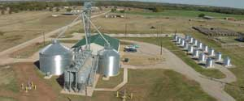

Good Grain Quality
Equals
Safety and Profit
Module 2
Management, Quality and Safety
Stored Product Engineering
Biosystems and Ag. Engr. Dept.

Slide 17

Module 2 Goal
The Grain Bin Emergency Awareness responder will be able to accurately identify the presence of hazards associated with the characteristics of poor grain quality, hazardous structures and dust collection

Slide 18
Module 2 Objectives
Identify the presence of hazards at grain bins and facilities
List the potential hazards associated with grain bin operations
List the dangers of working around poor quality grain
Answer questions about engulfment
Understand what to look for on farms and at facilities
Identify the factors associated with dust explosions
Understand the method for creating a “Culture of Safety

Slide 19
The Facts
Farming…#6 on US Bureau of Labor Standards’ list of most dangerous occupations (adults and children)
Estimated 300+ children die each year in farming accidents in the USA
Under 16 years old account for 20% of farm fatalities
Not to mention permanent disabilities (estimated 1000 each year)

Slide 20
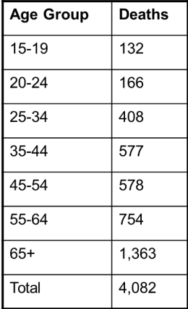
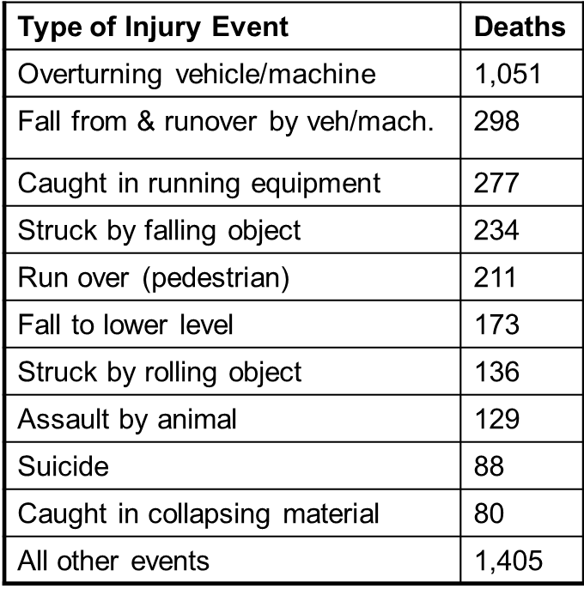
Agricultural – Danger, Disability, Death
Agricultural Production: Death Rate between 2002-2012
Information taken from the Census of Fatal Occupational injuries

Slide 21



Agricultural – Danger, Disability, Death
What can we do lower these numbers?
Awareness thru education and interaction?
FFA
4H
Farm, Ranch and Rural Publications

Slide 22
Grain Handling
2010-11….50+ entrapments and 24 deaths
This year (14-15) on target to exceed that..
77% of grain bin accident victims are unloading bins…with out-of-condition grain.
Trapped in 4-5 seconds, buried in 20 seconds.

Slide 23
How does it happen?
Three ways it can happen; all are associated with unloading poor quality grain:
  Flowing Grain
  Collapse of a Grain Bridge
  Avalanche of a Vertical Grain Wall
Grain Bin or Gravity Wagon…
Trapped in 4-5 sec, buried in 20 sec!!!

Slide 24
Flowing Grain
2 – 3 seconds for engulfment
Why is this worker in the bin??????

Slide 25
Collapse of grain bridge
Out of Condition Grain
Victim may travel 5‘ or more

Slide 26
Avalanche of grain wall
Vibration!!!
Out of condition grain
stuck to the bin wall

Slide 27
If Grain is in good condition….
Reclaim systems work properly
No need to enter the bin!!!
If workers aren’t in the bin, entrapment doesn’t happen!

Slide 28
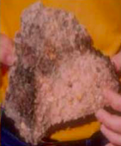
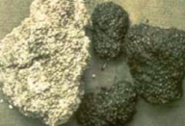
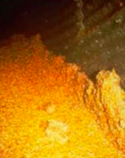

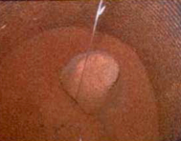
Major Cause:
Out-of-Condition Grain!!!!

Slide 29
What to look for…
Poor grain quality going into the bin
Quality NEVER improves in storage
Management of temperature changes and moisture

Slide 30
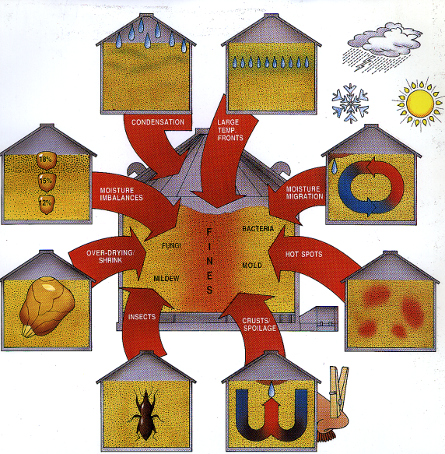
Grain Bin
Emergencies Awareness

Slide 31
What to look for…
Leaky structures
Aeration systems not designed properly
Aeration system mismanagement
Temperature cable malfunctions

Slide 32

Roof Vents and Exhaust Fans
Inadequate or plugged roof vents/exhaust fans
Roof Vents
Passive
Powered
Sizing Vents
Exhaust Fans

Slide 33
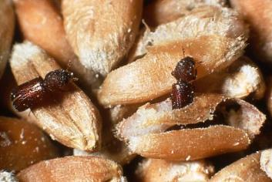
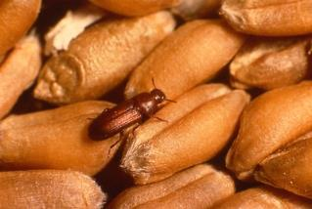
What to look for…
Insect Activity
Do you know your bugs????

Slide 34
What to look for…
Poor sanitation practices
Reclaim system malfunction or poor design
Inadequate dust management

Slide 35
Be Prepared
Use proper equipment if you do have to enter a bin
  Harness
  Anchor Points in Bins
  Bin Entry Kit
  How about the air quality???
  Lock out Tag out…ALWAYS!
Never…ever….ever…. work alone!

Slide 36
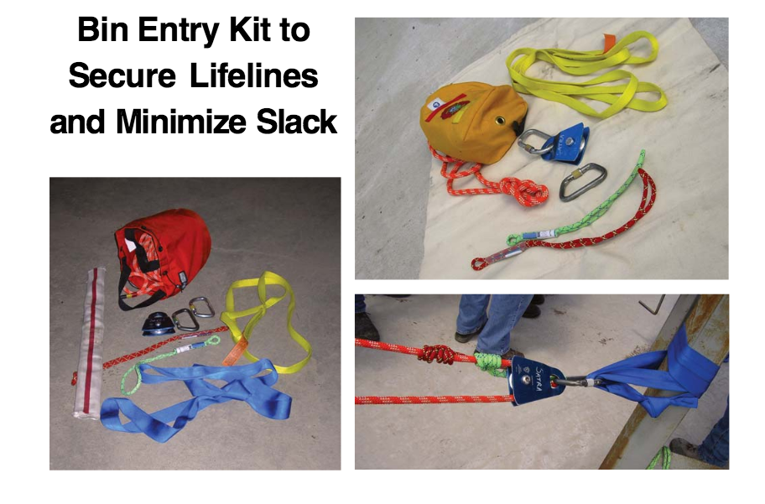
Bin Entry Kit

Slide 37
What to look for…
Poor sanitation practices
Reclaim system malfunction or poor design
AND……
Inadequate dust management

Slide 38
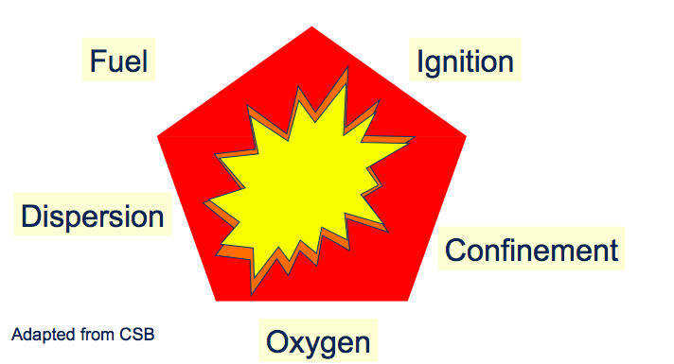
And what about explosions?
Requires 5 things…ALWAYS!

Slide 39
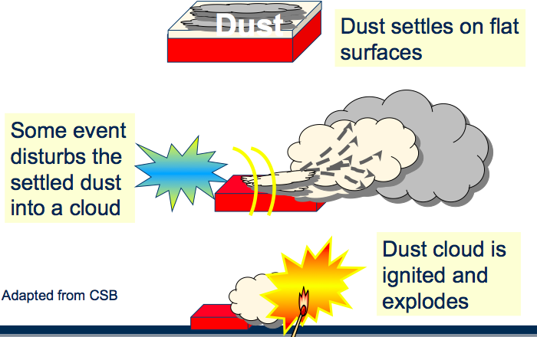
And what about explosions?

Slide 40
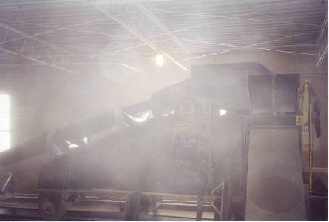

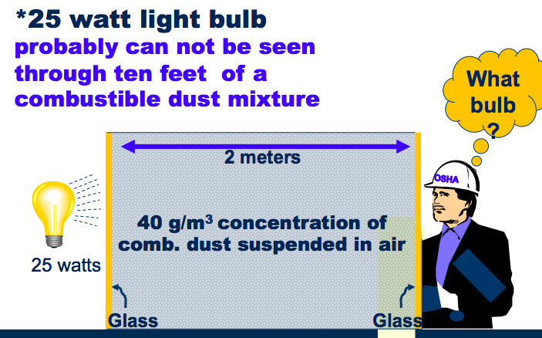

How do you know???
TEN FEET

Slide 41
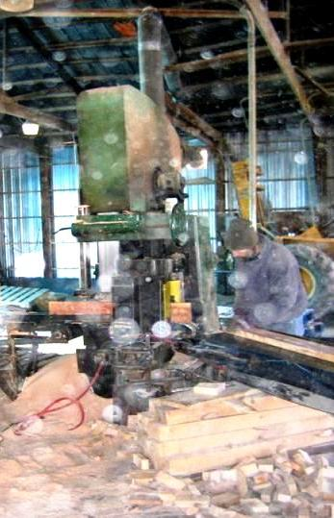
Digital Pictures… spots are dust

Slide 42
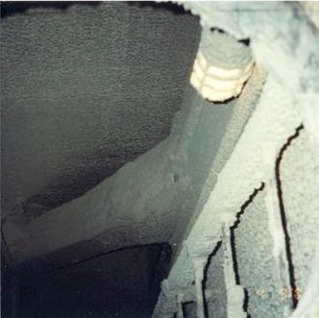
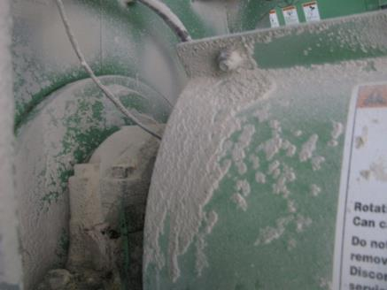
The Remedy?
Keep it CLEAN!

Slide 43
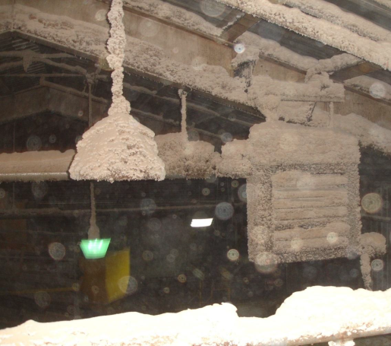
Dust Control
1/8th inch maximum in priority areas
Vacuum preferred with unit outside
Compressed air only when ignition sources in the area removed or controlled
Notes:
In order to have a grain dust explosion, you have to have these same three components; but you will also need a couple more things present in order for an explosion to occur.
Dust in suspension:
Any time there is grain movement you are going to have a certain amount of dust in suspension. The amount will depend on the engineering practices that are in place such as enclosed drag conveyors, dust systems, grain oiling systems, etc. There is a minimum concentration of dust that must be suspended in air in order for an explosion to occur, but that amount is a very small amount. In fact, the minimum is considered to be .04 of an ounce or 1.13 grams per cu. ft. This amount will not completely cover the surface of 1 sq. ft.
Of course during an explosion dust that is lying on the floor, equipment, and ledges or clinging to the walls will become dust in suspension because of the initial explosion, which can in turn trigger secondary explosions. We will talk more about secondary explosions in a little bit.
Of course the more dust that is present, the drier the dust, and the more finely divided the dust, the bigger the boom.
Confinement:
The dust must be confined. The tighter the confinement the more build up of static pressure there will be. If the dust is not confined there is still the danger of a flash fire.

Slide 44
Potential Ignition Sources
Lightening strikes
Open Flames
Welding
Cutting
Electric Arcs and sparks
Electrostatic Discharges
Frictional heating
Smoking
Self-heating/ decomposition/ spontaneous combustion
Grinding
Hot surfaces
Exothermic runaway chemical reactions
Mechanical impacts
Notes:
Low relative humidity is suspected of being a major factor in explosions where static electricity may have been the ignition source and where the grain dust was very dry.

Slide 45
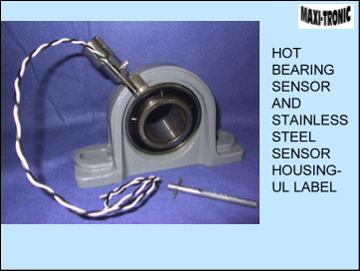
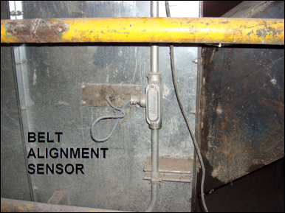
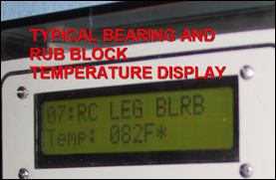
The Remedy?
Eliminate heat source

Slide 46
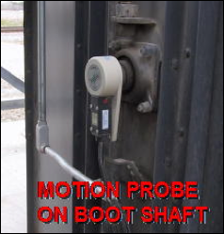
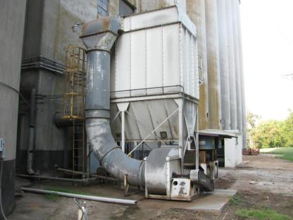
The Remedy?
Eliminate heat source

Slide 47
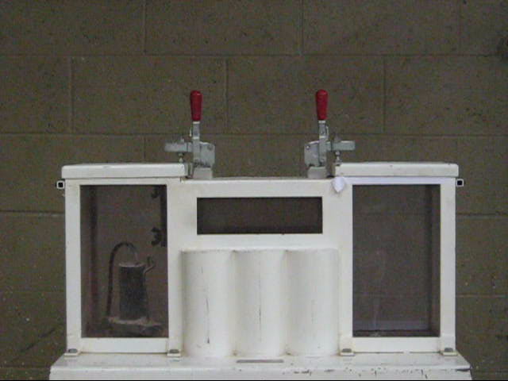
Dust Chamber
Notes:
Replace video

Slide 48
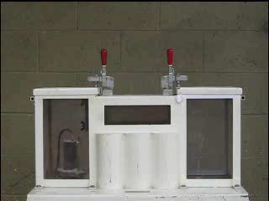
Dust Chamber Slow Motion
Notes:
Replace video

Slide 49
The Remedy?
In other words…
Keep grain in good condition
Maintenance
Caution and Training
Be informed…..

Slide 50
NOT a “Culture of Safety”
Rushed work habits
Seasonal or young workers with little training
“Seasoned” workers getting sloppy
Lack of a “safety culture”

Slide 51
How do we fix it…
Develop “Safety Always” mindset
Follow Best Management Practices
Train yourself, workers and family
Brain storm and talk about “what-ifs”

Slide 52
How do we fix it…
Focus on the details….
Manage GRAIN QUALITY
AND Be Prepared through
Communication….
Teamwork…
Training…..it’s EVERYONE’S job

Slide 53
If Grain is in good condition….
The only good accident is one that is prevented …..
AND….we have a product to sell…for more $$$

Slide 54
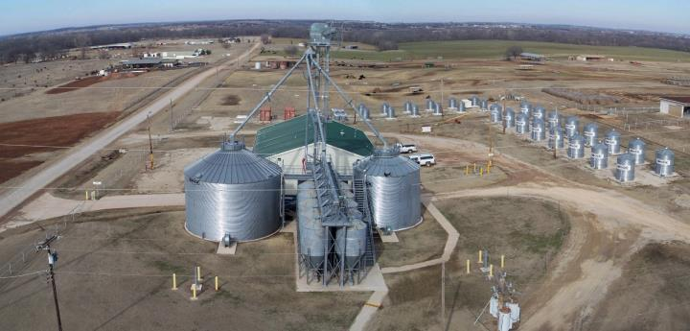
Questions?
Jcarol@okstate.edu
Home of World-Class Stored Product Research
Stillwater, Oklahoma

Slide 55
Module 3
Module 3
Hazard Recognition
Notes:
Change this to work better with a mixed audience of ag workers, family farm members, and initial emergency responders.

Slide 56
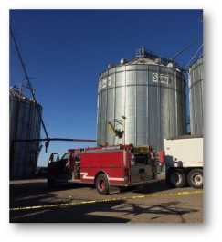
Module 3 Goal
    The First Responder – Grain Bin Awareness level, will understand his/her role and responsibilities as an emergency responder associated with detecting the presence of chemicals and will be able to discuss the dangers involved with grain bin entry

Slide 57
  Module 3 Objectives
Identify the presence of hazards at grain bins and facilities
List the potential hazards associated with pesticides
Answer questions about grain bin entry permits
Define Lock out/Tag out
Discuss the differences: Entanglement, Entrapment and Engulfment
Identify incident priorities
Understand the emergency procedures of you are trapped

Slide 58
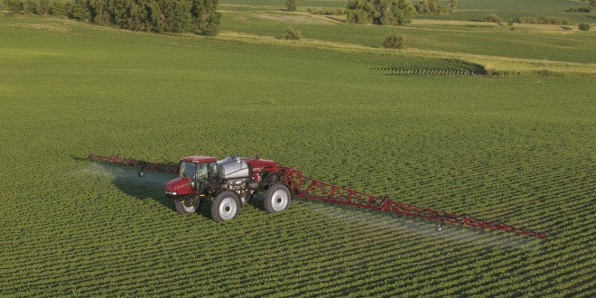
Pesticides
NASS survey shows only 15% of grain was treated
PDP surveys show 80-91% of the grain had detectible residues

Slide 59
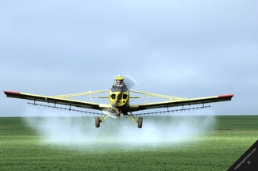
Pesticides
Aluminum Phosphide
Chlorpyrifos-methyl (Reldan)
Lindane (seed treatments)
Diatomaceous earth

Slide 60


Pesticides
What are the potential health effects of pesticides?

Slide 61
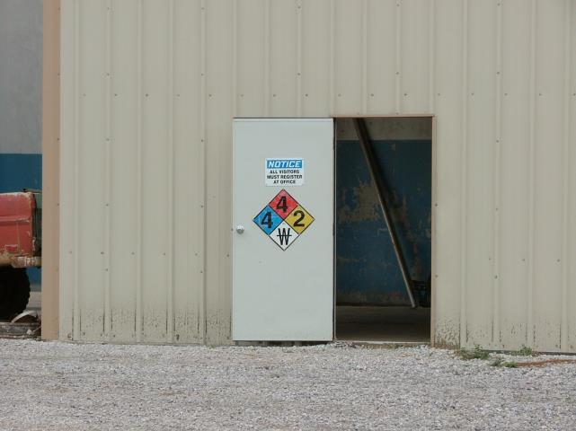

Chemical Hazards
Notes:
Look for and understand signage used by these facilities.

Slide 62
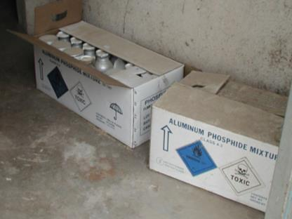
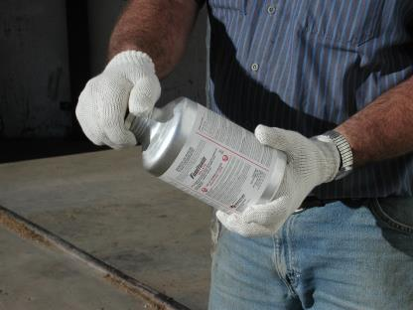
Aluminum Phosphide
Fumitoxin
PhosFume
Phostoxin
Weevil-Cide
Notes:
The active ingredient in these products is Aluminum Phosphide. Aluminum Phosphide release when exposed to moisture. It releases PHOSPHINE GAS.
Wear cotton gloves when handling Aluminum Phosphide. Moisture on the skin can initiate the release of phosphine gas, which can be inhaled. Additionally it is important to remove cooper, gold and silver so that it is not exposed to Hydrogen Phosphide
The gloves and clothing used when handling Aluminum Phosphide should be aerated in a well ventilated area prior to laundering.
After opening the can always make sure the top is tightly closed to keep moisture out.
It is very important that you empty any dust that may left in the container. After handling Aluminum Phosphide always wash your hands before doing anything else.
When you are done with the container properly rinse and dispose of the bottle.
When rinsing the bottle do it in the open air away from buildings and other facilities once rinsed you can check with your local recycler for disposal.
If rinsing it is important that the rinsate be disposed of properly.
Check with local authorities before disposing of the containers.
It the local recycler will not take the container you must poke holes in the container and let air and dispose in a sanitary landfill.

Slide 63
Phosphine Gas
EXPOSURE
LIMIT
0.3
Permissible Exposure Limit (PEL) is maximum amount a person can tolerate without becoming a life threatening condition without using personal protective equipment.
PEL for Phosphine = 0.3 ppm

Slide 64

Health Effects
Once a toxic substance has contacted the body it may have either acute (immediate) or chronic (long term) effects. Example: Spilling acid on your hand will cause immediate harm, i.e. a burn to the skin.

Slide 65
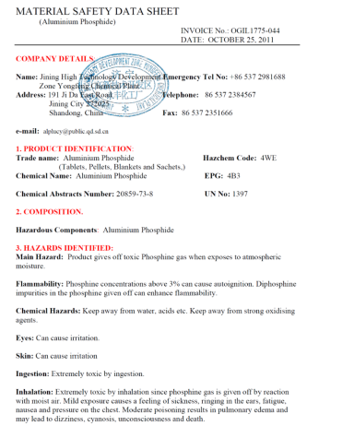
Safety Data Sheets
Safety Data Sheets (SDS) contain information on the product’s ingredients as well as outlining emergency procedures.
SDS should be read and understood before using hazardous chemicals and kept readily accessible in case of an emergency.
Notes:
Take time to review the information on a Phostoxin SDS. Point out the

Slide 66

Routes of Entry

Slide 67
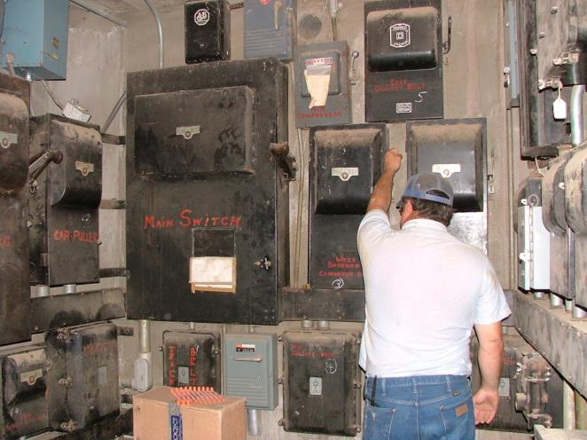
Electrical Hazards

Slide 68
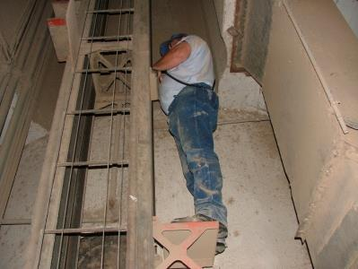
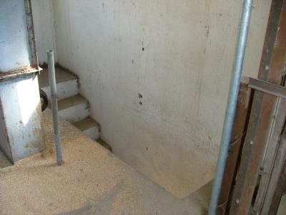
Fall Hazards
Belt Manlifts
Hand Rails
Ladders
Cage lifts

Slide 69
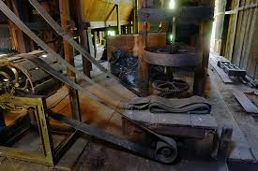
Grain Moving Equipment
Drive Shafts
PTOs
Belts
Chains
Pulleys

Slide 70
Oxygen Deficient Atmospheres
23.5% Maximum for Safe Entry
20.9% Normal Oxygen Level In Air
19.5% Minimum for Safe Entry
16% Impaired Judgment and Breathing
14% Faulty Judgment, Rapid Fatigue
6% Difficulty Breathing – Death Within Minutes
Notes:
Test the air within a bin prior to entry for the presence of combustible and toxic gases. Determine if there is an oxygen deficiency within the bin. If proper monitoring equipment is not available, open vents and operate bin fans long enough to completely exchange the air inside the bin with fresh outside air. Fans should remain on while the worker is inside the bin.

Slide 71

Testing the Atmosphere
Never trust your senses!
Many toxic gases are odorless and cannot be seen.
The level of oxygen can not be determined without a monitoring device.
Test from Outside –
Top to Bottom
Notes:
If monitoring equipment is unavailable aeration of the bin must be conducted long enough to ensure the air in the bin has been completely replaced with fresh outside air. Aeration must continue throughout the entry.

Slide 72
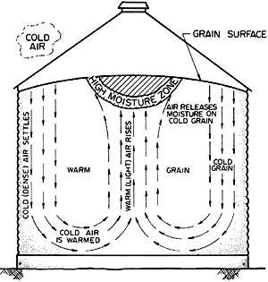
Bin Aeration Systems
Grain bins are commonly equipped with aeration systems which:
Cool grain for safe storage
Dry grain
Prevent moisture accumulation
Reduce lost to insect damage
Notes:
Explain how the difference between temperature inside and outside the bin effect moisture content, moisture movement, and condensation on bin walls. Relate this information to the caking, clumping, and molding of the grain. If outside air is 10°F below the grain temperature aeration should be used to lower the temperature of the grain.
Aeration can also equalize temperatures within the bin, prevent migration and condensation, and control bacteria, insects, mold, and mites.

Slide 73

Characteristics of a Confined Space
Oxygen less than 19.5%
Present/Potential flammable,
Combustible or explosive atmospheres
Present/Potential toxic atmospheres
Engulfment
Area not protected against entry of substances which create possible hazards
Poor natural ventilation
Restricted entry for rescue

Slide 74
Lockout/Tagout
Except for fans and lighting, turn off and lock out all powered equipment:
Heaters
Augers
Conveyer belts
Other grain moving equipment
Notes:
Tum off and lock out all powered equipment associated with the bin, including augers, used to help move grain, so that the grain is not being emptied or moving out or into the bin.

Slide 75

Grain Bin Entry and Permits
Never enter a bin without a “bin entry permit”
Lockout/Tag Out energy sources
Perform atmospheric monitoring
Use a safety harness and lifeline
Provide adequate lighting
Train for safe entry and emergency egress
ALWAYS have someone monitoring the entry from outside the bin
Notes:
Even the individual farm should follow basic safety precautions established by the Confined Space Entry Permit process.
Never enter a grain bin unless it is really truly necessary and follow the entry permit process every time entry must be made.
Always lockout unloading equipment before entering (so they can't be turned on by mistake).
Provide anyone entering the bin a body harness with a llfeline and ensure that it is secured prior to the worker entering the bin.
Provide an observer stationed outside the bin that is at all time in visual and audible contact with the person inside the bin. The observer must be equipped to provide assistance and continuously track the worker in the bin. Never enter a grain bin alone-have an outside observer who can both see and hear you.
Teens and youth do not have the experience, training or qualifications to provide the necessary help you would need.
The outside observer must have a sure and quick method to contact emergency responders in case of an emergency.
Always check oxygen (min 19.5%) and toxic/flammable gas levels (phosphine, C02, dust, etc.) before allowing entry into the bin. Many individual bin owners do not have the equipment necessary to perform monitoring but do have the ability to open vents and allow bin fans adequate time to replace air inside the bin with fresh outside air.
Ensure there is adequate lighting.

Slide 76
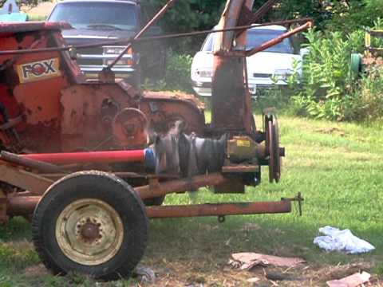
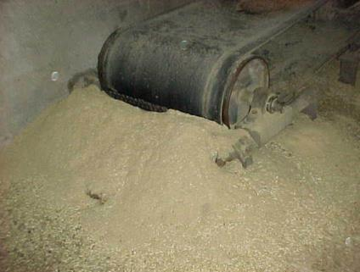
Entanglement

Slide 77
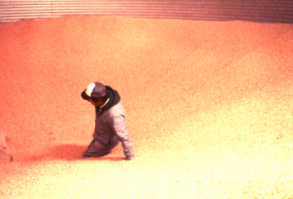
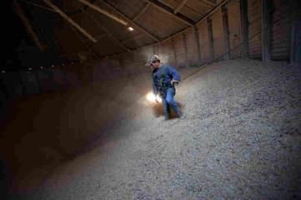
Entrapment
Notes:
Walking on crusted grain over a void in a grain bin or trying to loosen grain stuck to a bin wall are prime opportunities for grain bin entrapments.
Standing on moving grain can be deadly; the grain can act like 'quicksand‘ and bury a worker in seconds. Moving grain out of a bin while a worker is in the bin creates a suction that can pull the worker into the grain in seconds.
Prohibit walking down grain and similar practices where the worker walks on grain to make it flow.

Slide 78
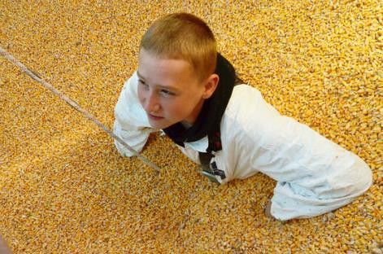
Grain Bin Engulfment
Most occur during unloading
Most bins have an auger
Grain flow is from the top and down the center
Complete entrapment may occur in a few seconds if auger is running
Notes:
Bin entry should never be made underneath a grain bridging condition or where a build-up of grain on the sides could fall and bury the worker.

Slide 79
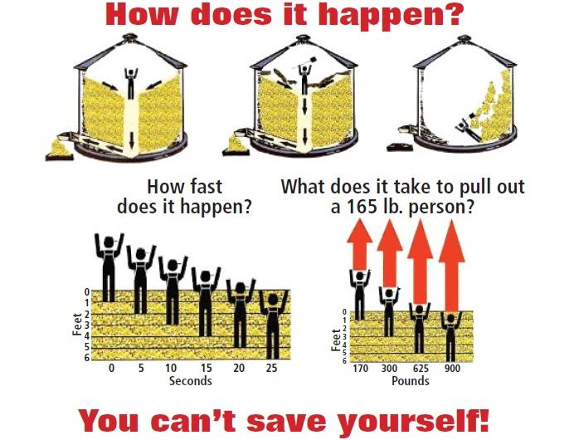
How does it happey?
Notes:
Time is of the essence-if you're engulfed. It takes only 90 seconds for you to die. Therefore, never every risk your or anyone else's life with a shortcut. Follow proper entry procedures!

Slide 80
Crushed Tissue Syndrome
One of the most dreaded injuries in delayed response emergencies.
Severe compressive injury to muscles resulting in muscle cell death. As cells die they produce toxins that can have fatal effect when the compressing load is released. Usually occurs with large muscle mass in lower extremities with prolonged compression of 4+ hours. However cases have been documented in one hour on smaller extremities or any where blood circulation is compromised. Signs and symptoms are few until extrication then it may be to late. Death can occur within minutes, swelling and shock may be delayed, distal pulse may or may not be present. Represents the truest of ALS emergencies. As first responders we should maintain airway, treat for shock and if practical postpone the extrication until ALS is on the scene.

Slide 81
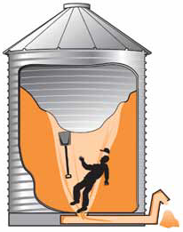
Incident Priorities:
Life Safety
Incident Stabilization
Property Conservation
Notes:
Who’s life safety?
1. Mine
2. My Buddy
3. Everyone Else
Only address the Life Safety portion at this time. We will address the other two later. Explain this to the class.

Slide 82
Factors Leading To Poor Decisions
Accidents are normally caused by a chain of events.
Many of these events are the result of POOR DECISIONS.
Factors leading to POOR DECISIONS include:
“THE DIRTY DOZEN”
Lack of Communication Complacency
Lack of Knowledge Distractions
Lack of Teamwork Fatigue
Lack of Resources Pressure
Lack of Assertiveness Stress
Lack of Awareness Norms
Notes:
The human mind is fallible and error can occur for many reasons, for example, from a misheard message, from memory slip, or from incorrect appreciation of the situation.
These are twelve of the most common human errors or conditions that can act as precursors, to accidents or incidents. These twelve elements influence people to make mistakes. The Dirty Dozen is a concept developed by Gordon Dupont, with Transport Canada in 1993.
For each element on The Dirty Dozen list there are countermeasures that can reduce the possibility of human error causing a problem.

Slide 83

Mode of Operation
Rescue
Recovery
Unknown
“CHECK SIX”
Notes:
One of the “Dirty Dozen” is failure to observe our surroundings. Combat flyers have a phrase “Check Six.” The term comes from the need to check your blind spots (“Six” being six o’clock, behind you). When operating in dangerous environments it can be all too easy to get tunnel vision. In a rescue situation, we can easily become focused on the victim and forget to look up and see the 500 lb. clump of grain stuck to the wall over our head. Observe the entire environment. Other hazards may be waiting for us. Don’t leave blind spots, Check Your Six!

Slide 84

Emergency Actions
If YOU Are Trapped
If you're sinking up to your chest – cross your arms in front of your chest so that you can breathe
Placing a light cloth over your face to keep grain and dust out of your airway
Do not continue to struggle against grain. Additional movement can pack the grain tighter around your body.
Stay clam and listen for the arrival of help.

Slide 85
Emergency Actions
If SOMEONE ELSE is Trapped
Time is of the essence.
TURN OFF all augers, off-loading equipment, and heaters.
Call 911 and summon any help near you.
If bin fans are on, leave them on.
DO NOT enter the bin alone.

Slide 86
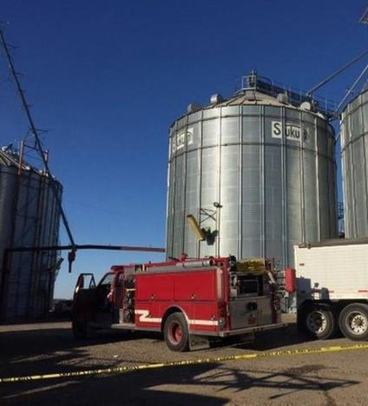
Rescue Procedures
Be sure auger is off
Ventilate the bin with bin ventilation fan
Turn on fan only
Don’t activate heat source
Trapped victims may survive total submersion

Slide 87
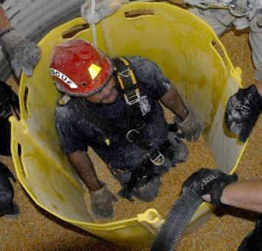
Rescue Procedures
Prevent further pressure on victim by:
  Staying away from area around victim
  Use a ladder, plywood, or other materials to distribute weight
Rescuer protection should be a concern
  Provide safety lines
  Consider respiratory protection

Slide 88
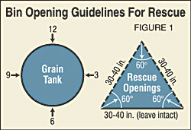

Rescue Procedures
If grain can’t be hand scooped:
  Cut holes in the bin on two opposites sides
  Holes should be semi-circular or V-shaped
  30-40 inches across within the bolt lines
  Victims location dictates location of holes
  Cut just below victim who is submerged
  As low as possible if victim is not visible
Notes:
The side of a bin is cut open and grain is pulled out until a body is visible.

Slide 89



Remember:
Each grain-handling facility is unique in layout, design,
construction, operations, equipment, and personnel.
Each facility warrants individual preplanning.
Be Prepared!

Slide 90

Stored Products Research and Educational Center – Grain Bin Rescue
Oklahoma State video. Stored Products, Grain Bin Safety
Notes:
Oklahoma State video. Stored Products, Grain Bin Safety

Slide 91
Disclaimer
The Technical information presented in this program is in no way meant to qualify the participants as experts in the field of GRAIN BIN EMERGENCIES.
Participation in this program should be considered a learning and sharing experience. The instructors and assistants share with the students information they have gained through actual experience as well as training sessions they have attended. THE IMPORTANCE OF REPEATED PRACTICE AND ADDITIONAL TRAINING CANNOT BE OVER STRESSED.
The methods and procedures presented in this program are NOT to be considered absolute.

Slide 92
Summary
Avoid entering grain bins whenever possible!
If entry must be made:
TURN OFF and lock out all grain moving equipment and dryers
Use a body harness and anchored lifeline
Test the bin’s air (oxygen, flammability, toxic)
DO NOT walk down grain
DO NOT enter below bridged grain or wall build ups
HAVE a trained/equipped observer outside

Slide 93

OSHA DISCLAIMER
Program paid for with assistance from the Occupational Safety and Health Administration Susan Harwood Training Grant.
This material was produced under grant number SH-26295-SH4 from the Occupational Safety and Health Administration, U.S. Department of Labor. It does not necessarily reflect the views or policies of the U.S. Department of Labor, nor does mention of trade names, commercial products, or organizations imply endorsement by the U.S. Government.

Slide 94
Presentation Credits
Oklahoma State University – Fire Service Training
1723 W. Tyler
Stillwater, OK 74078
1-800-304-5727
www.osufst.org
Technical Programs Manager
Principal Contributors:
Oklahoma State University
Triangle Insurance
Collinsville Fire Department

