Slide 1
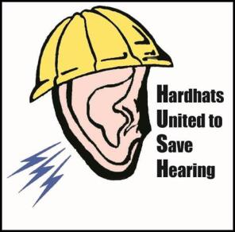
Construction and Hearing Loss Prevention
Construction Noise
&
Hearing Loss Prevention
State Building & Construction Trades Council of California, AFL-CIO
Funded by Federal OSHA, 2015

Slide 2
Funded by OSHA
This material was produced under grant number
SH-26283-SH4 from the Occupational Safety and Health Administration, U.S. Department of Labor. It does not necessarily reflect the views or policies of the U.S. Department of Labor, nor does mention of trade names, commercial products, or organizations imply endorsement by the U.S. Government

Slide 3
Training Topics
Introduction
What’s It Like To Lose Your Hearing?
Hazardous Noise and Hearing Loss
Measuring Noise
Soundscape Activity
Ways to Control Noise
Hearing Protection Devices
Wrap Up

Slide 4
1. Introduction

Slide 5
Training Objectives
1. Discuss what it is like to experience simulated hearing loss.
2. Explain the effects of hearing loss, warning signs of hearing loss and tinnitus.
3. Discuss hazardous noise, causes of hearing loss, noise-induced hearing loss, how we hear, types of noise and common hearing loss devices.
4. Describe how sound is measured, OSHA noise limits in construction, and devices used to measure noise.
5. Identify sources of noise at a construction site.
6. Discuss ways to control construction noise.
7. Review the types of hearing protection devices used in construction and demonstrate how to use an earplug correctly.

Slide 6
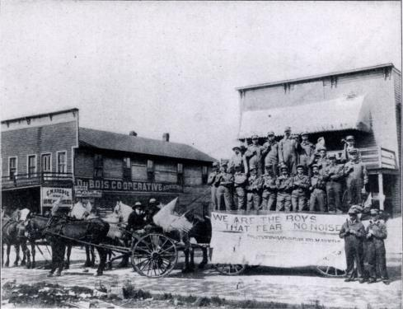
Why Care About Hearing Loss?
Photo courtesy of The International Brotherhood of Boilermakers

Slide 7

How Big Is The Problem?
30 million workers in the U.S. are exposed to hazardous noise at work
50% of construction workers suffer hearing loss
$242 million is spent annually on workers’ compensation for hearing loss disability
Source, CDC

Slide 8
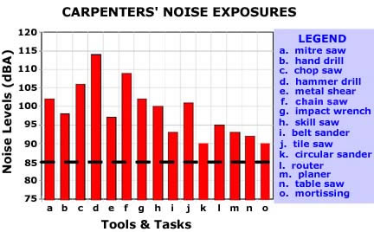
Building Trades Workers and Hearing Loss
The Average 25 Year Old Carpenter Has 50 Year Old Ears!
Chart courtesy of NIOSH

Slide 9
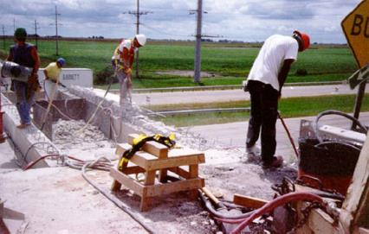
Why Is Noise Accepted?
Can’t do anything about it
Poor planning
Lack of coordination
Photo courtesy of OSHA

Slide 10
2. What’s It Like To Lose Your Hearing?

Slide 11
Present examples of hearing loss
Notes:
Slide entered to replace an audio file
Suggestion: look on-line for a speech discrimination test or video to demonstrate what is heard depending on the degree of hearing loss.

Slide 12
Effects of Hearing Loss
Difficulty communicating with loved ones
Loneliness and depression
Low self-confidence
Increased stress, blood pressure, hypertension and cardio vascular disease

Slide 13
Warning Signs
Do You Have Any of the Following Problems:
Have trouble hearing people talk when there is background noise
People sound like they are mumbling
Often have to ask people to repeat what they say
Turn up the radio or TV a lot
Have difficulty hearing people on the phone
Have constant ringing in your ears

Slide 14

Tinnitus
Constant ringing in ears (or hissing, buzzing, roaring, chirping, or whistling sound)
50 million people in the U.S. have tinnitus

Slide 15
3. Hazardous Noise and Hearing Loss

Slide 16

Causes of Hearing Loss
Exposure to loud noise
Certain drugs and chemicals
Aging
Heredity
Head trauma
Ear infection
Photo, courtesy of OSHA

Slide 17

Noise Induced Hearing Loss (NIHL)
Most common work-related illness
Damage to hearing depends how loud the noise is, and
How long you are exposed to it
Photo courtesy of NIOSH

Slide 18
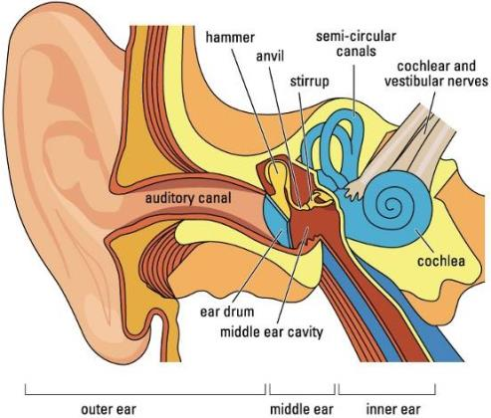
How You Hear
Slide courtesy of Howard Leight, Honeywell

Slide 19
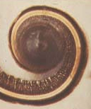
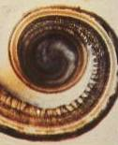
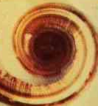
The Cochlea
17-year old girl
Low noise exposure
Normal cochlea
Receptors intact
76-year old man
Low noise exposure
Fewer receptors but still intact
59-year old man
High noise exposure
Damaged cochlea
Receptors destroyed
Missing hair-like nerve cells
Slide courtesy of Howard Leight, Honeywell

Slide 20
How Do You Know It’s Too Loud?
At work you have to:
Shout to be heard an arm’s length away (2-3 feet)
Turn equipment off to talk
Move to a quieter area to talk
After work you:
Hear ringing or humming in your ears
Experience temporary hearing loss

Slide 21
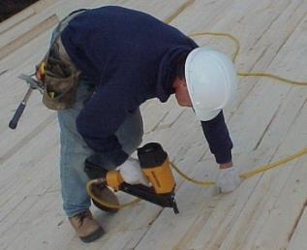
Types of Noise
Continuous
  same noise level over long periods of time
Intermittent
  periods of quiet, interrupted by noise
  most noise exposures are intermittent
Impact or impulsive
  nail gun
Construction has a combination of all noise types
Slide courtesy of Build It Smart

Slide 22
4. Measuring Noise

Slide 23
How Sound Is Measured
-
-
-
-
-
-
-
-
-
-
-
-
-
-
140
130
120
110
100
90
80
70
60
50
40
30
20
10
0
Threshold of pain
Construction noise levels are often above 85 dB
Jet take-off (200’)
Sound is measured in units called decibels (dB)
Jackhammer
An increase of 3 dB means the sound intensity has doubled
Worker exposures to noise should be controlled
below a level equivalent to 85 dB for 8 hours to minimize occupational noise-induced hearing loss. (NIOSH)
Bulldozer
Freeway noise
City traffic
Normal conversation (3’ rule)
Soft whisper (5’)
Threshold of hearing
Illustration courtesy of WISHA
Noise level (dB)

Slide 24
OSHA Noise Limits In Construction
Permissible Noise Exposure Limits (dBA)
Duration per day in hours | NIOSH (recommended) | OSHA (Construction Standard 1926.52)
8 4 2 1 ½ ¼ | 85 88 91 94 97 100 | 90 95 100 105 110 115

Slide 25
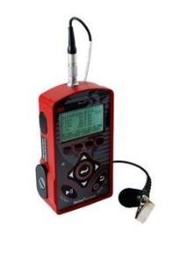
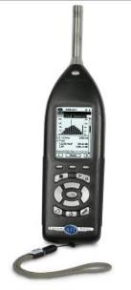
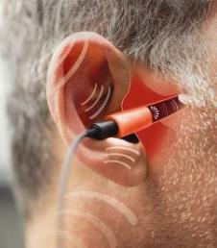
Noise Measurement Devices
PERSONAL DOSIMETER
SOUND LEVEL METER
IN-EAR DOSIMETER
Photo courtesy of Wikipedia
Photo courtesy of Howard Leight, Honeywell
Photo courtesy of Howard Leight, Honeywell

Slide 26

Noise Sources At Work
Noise you create
Noise your trade creates
Noise from other trades
Photo courtesy of LHSFNA

Slide 27
Noise From Hand Tools
Slide courtesy of Build It Smart

Slide 28
Noise From Construction Equipment
Slide courtesy of Build It Smart

Slide 29
Noise off the job
Slide courtesy of Build It Smart

Slide 30
5. Soundscape Activity

Slide 31
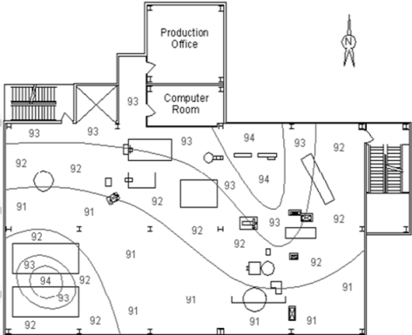
Sample Soundscape
Illustration courtesy of OSHA

Slide 32
Soundscape Activity (Part 1)
Break into small groups
Each group is assigned a different construction phase to analyze for noise
Each group gets set of flipchart pens and flipchart paper
Take 15 minutes to draw your Soundscape
Report back to the large group

Slide 33
6. Ways To Control Construction Noise

Slide 34
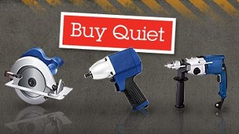
How To Control Noise
Engineering Controls
Administrative Controls
Personal Protective Equipment (PPE)
Photo courtesy of NIOSH

Slide 35
Soundscape Activity (Part 2)
Break into small groups
Take 10 minutes to discuss how you would control the main sources of noise identified on your Soundscape
Report back to the large group

Slide 36
7. Hearing Protection Devices (HPDs)

Slide 37
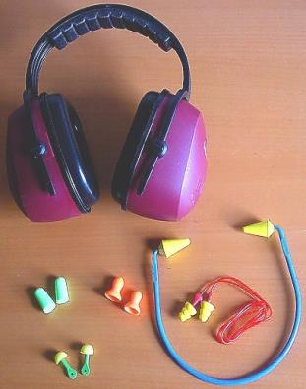
Types of Hearing Protection Devices
Foam (formable) plugs
Reusable earplugs
Custom molded plugs
Banded or semi-aural
Earmuffs
Slide courtesy of Build It Smart

Slide 38
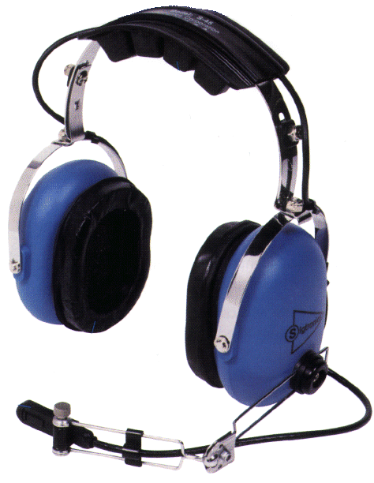
Selecting Hearing Protection
Convenience
Comfort
Communication needs
Hygiene
Noise reduction needed
Hearing ability of worker
Noise level
Slide courtesy of Build It Smart

Slide 39
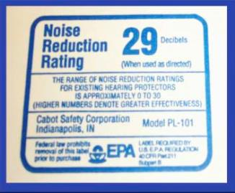
Noise Reduction Rating (NRR)
NRR is measured in decibels
The NRR is found on the earmuff or earplug package
Higher the number, greater the protection
Slide courtesy of WISHA
24

Slide 40
Advantages & Disadvantages
Type | Noise Reduction | Advantages | Disadvantages
Foam Plugs/ Moldable | High | Readily Available | -Hygiene Issues -Take Time to Fit
Reusable (Pre-formed Plugs) | Mid | Quick Fit | -Costly to replace
Banded/ Semi-aural | Low | Quick Fit | -Uncomfortable -If the band is hit it transfers sound to the ear
Earmuffs | High | Quick Fit | -Hot, heavy, cumbersome
Custom | Low to Mid | Quick Fit | -Costly -Replace in 3-5 yrs

Slide 41
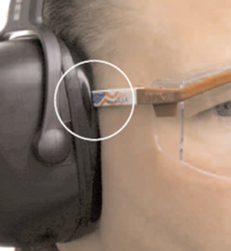
Ear Muffs and Safety Glasses
Photo courtesy of Howard Leight, Honeywell

Slide 42
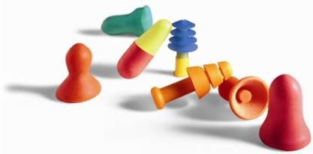
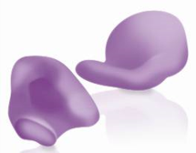
Care and Maintenance
Foam roll plugs
  dispose of foam roll plugs after each use
Reusable plugs
  clean with soap and water, replace when damaged
Custom plugs
  wash in mild soapy water
Photos courtesy of Howard Leight, Honeywell

Slide 43
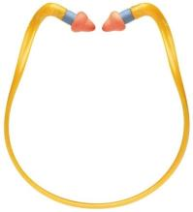
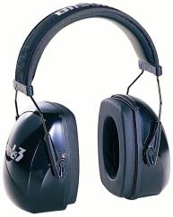
Care and Maintenance
Banded or semi-aural
Clean and replace pods regularly
Earmuffs
Wipe down with damp cloth, or remove cushions and wash in soapy water
Replace cushions if torn or cracked
Photos courtesy of Howard Leight, Honeywell

Slide 44
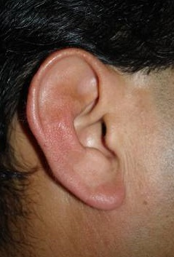
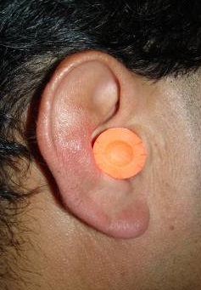
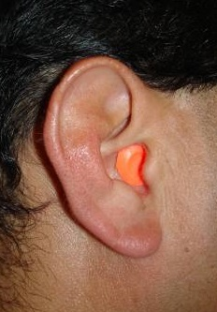
How Much Protection?
0 dB
0 dB
33 dB
EAR #1
EAR #2
EAR #3
Slide courtesy of Howard Leight, Honeywell

Slide 45
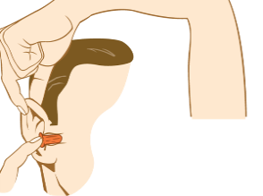
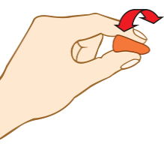
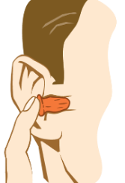
Fitting An Ear Plug
1. Roll
entire earplug into a crease-free cylinder
2. Pull Back ear
by reaching over head with free hand, gently pull top of ear up and out
3. Insert earplug well into ear canal and hold until it fully expands
Slide courtesy of Howard Leight, Honeywell

Slide 46
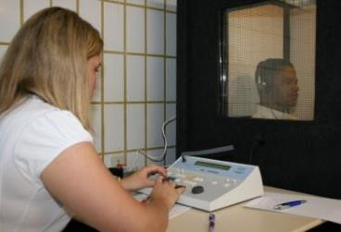
Hearing Test
First test is a “baseline” test
Test once a year
Future tests are compared to baseline
Photo courtesy of Wikipedia

Slide 47
What Employers Should Do To Plan Ahead
Do a walk-around inspection – identify noisy equipment and jobs
Monitor noise levels
Develop a plan for noisy tasks
Schedule noisy work off hours
Buy or rent quieter equipment
Provide different types of HPDs - one size or style may not fit all workers
Provide training on each type of HPDs provided

Slide 48
8. Wrap Up

Slide 49
The end
Hear Today…Hear Tomorrow
You only have one set of ears.
Protect them.
State Building & Construction Trades Council of California, AFL-CIO
Funded by Federal OSHA, 2015

Slide 50
Acknowledgements
American Speech-Language-Hearing Association (ASHA)
Build It Smart
Cal/OSHA
Center for Construction Research & Training (CPWR)
Federal OSHA
Howard Leight, Honeywell Safety Products
Laborers’ Health and Safety Fund of North America (LHSFNA)
The National Institute on Deafness and Other Communication Disorders (NIDCD), NIH
WISHA (Washington Industrial Safety and Health Act)
Worksafe (Canada)
The Commission on Health and Safety and Workers' Compensation, California, Department of Industrial Relations, Worker Occupational Safety and Health (WOSH) Specialist Training Program

Slide 51
Photo Credit and Duplication
Photo credits are given on each slide
No commercial use is allowed for any of this material
This program to be used for instructional, educational purposes only
Fees may not be charged for any of this material

Slide 52

State Building and Construction Trades Council of California (SBCTC), AFL-CIO
Umbrella organization for 160 unions
Represents 350,000 skilled construction workers in California
Developed and presented seven OSHA funded health & safety programs since 2000

