Slide 1
Roofing Industry Fall Protection from
A to Z
This material was produced under grant number SH-26317-SH4 from the Occupational Safety and Health Administration, U.S. Department of Labor. It does not necessarily reflect the views or policies of the U.S. Department of Labor, nor does mention of trade names, commercial products or organizations imply endorsement by the U.S. Government.
Notes:
Welcome attendees and thank them for being there today. Explain how a grant works and that they are in attendance today because the U.S. Government deemed it a step for their safety. And they were willing to provide NRCA money for this. Also explain the binders that were given to them. Remind them that their supervisor agreed to also review this binder and watch the DVD, as a part of the requirements to attend this class.
Grant 10

Slide 2
Course Objectives
By the time you are finished with this class, you should be able to:
Know where to find applicable citations within the OSHA fall-protection standard
Define the regulatory text
Apply fall-protection regulations to jobs
Notes:
Read each objective and explain these will each be taught in detail. Also, go through the class agenda and explain what will be taught and demonstrated.

Slide 3
Pre-Test
Notes:
Many of your classroom attendees may have a fear of test-taking. As you distribute the tests, explain that the goal of this is to measure how much they learn throughout the day. So, they may or may not know anything on this test the first time they take it. The goal is that they do better on it the second time they take it – at the end of the day.

Slide 4
Intro to Roofing Fall Protection
Introduction to Roofing Fall Protection

Slide 5
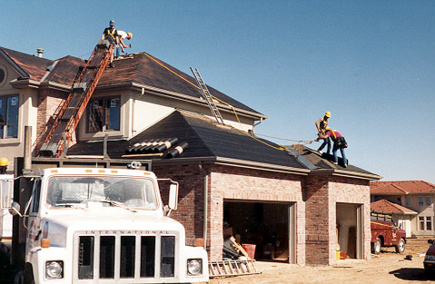
Skill, Craftsmanship and …
Danger
Notes:
Roofing is a trade that requires skill and craftsmanship, but one that exposes roof mechanics to a variety of dangers. This is why our objectives for today are clearly stated and supported by this grant from OSHA. Their job, as a function within the Labor Department of the government, is to keep you, as workers, safe.

Slide 6

In 2013, there were 796 fatal work injuries in construction—
294 of those were from falls.
In 2012, roofing company fatalities accounted for 77 of them— 64 from falls.
Notes:
Statistics taken from the 2013 BLS Census of Fatal Occupational Injuries. 3 roofing company employees died from exposures to substances; 3 died in transportation incidents
Explain, however, that a recent study of commercial and residential roofers published in the Journal of Safety Research, reported that 94% of commercial roofers felt that their level of safety at the job was either “Safe” or “Very Safe”. Only 74% of residential roofers felt that the level of safety at the job was either “Safe” or “Very Safe”.

Slide 7
Scope of Fall Protection
Fall-protection requirements are found in several other subparts besides M:
  L – Scaffolds, guardrail systems
  CC – Cranes and derricks
  R – Steel erection
  S – Tunneling
  V – Constructing electrical transmission lines
  X – Stairways and ladders
Notes:
Explain:
The issues of how to provide fall protection for employees at construction sites are difficult ones. There are so many different types of work and so many different kinds of fall hazards that it is not possible to organize fall protection into a neat set of rules that fit all situations. OSHA reflects this difficulty when it places its rules for fall protection in several different subparts in the Construction Standards, depending primarily on the nature of the work being undertaken. There are separate locations, for example, for fall protection during work on scaffolds, during work on certain cranes and derricks, during work in tunnels, during work on stairways and ladders, during steel erection, etc.

Slide 8
What is OSHA?
What is OSHA?

Slide 9

What is OSHA?
What is OSHA?
Occupational
Safety and
Health
Administration
Responsible for worker safety and health protection
Notes:
OSH Act was signed into law by President Richard Nixon on December 29, 1970 and became fully effective with OSHA beginning operations on April 28, 1971.

Slide 10

OSHA ACT
OSHA Act
“To assure safe and healthful working conditions for working men and women; by authorizing enforcement of the standards developed under the Act; by assisting and encouraging the States in their efforts to assure safe and healthful working conditions; by providing for research, information, education, and training in the field of occupational safety and health; and for other purposes …”
“Be it enacted by the Senate and House of Representatives of the United States of America in Congress assembled, That this Act may be cited as the “Occupational Safety and Health Act of 1970.”
Notes:
Ask someone to volunteer to read the OSH Act out loud.
Ask:
What is the purpose of the OSH Act and to whom does it apply?
Expected Answers:
Applies to working men and women
Applies only to the workplace, not at home
Ask:
How will safety be assured under the Act?
Expected Answers:
Authorizing enforcement of the standards
Assisting the States
Providing research, information, education and training
Ask:
What do you think “for other purposes” means?
Expected Answers:
This is an open door that allows OSHA to add things as they deem necessary

Slide 11
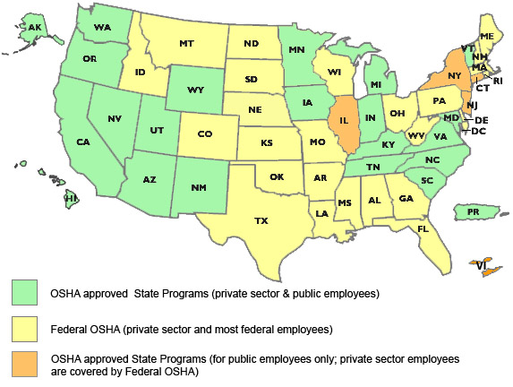
OSHA Approved State Plans
Alaska
Arizona
California
Connecticut
Hawaii
Illinois
Indiana
Iowa
Kentucky
Maryland
Michigan
Minnesota
Nevada
New Jersey
New Mexico
New York
North Carolina
Oregon
Puerto Rico
South Carolina
Tennessee
Utah
Vermont
Virgin Islands
Virginia
Washington
Wyoming
The Connecticut, Illinois , New Jersey, New York and Virgin Islands plans cover public sector employment only
Notes:
27 Total state plan states―currently 22 States and jurisdictions operating complete State plans (covering both the private sector and State and local government employees) and 5 - Connecticut, Illinois, New Jersey, New York and the Virgin Islands - which cover public employees only. (Eight other States were approved at one time but subsequently withdrew their programs).
State plans have to be at least as effective as the federal laws

Slide 12
What Does OSHA Do?
Encourages employers and employees to reduce workplace hazards and implement safety and health programs
Develops and enforces mandatory job safety and health standards
Monitors job-related injuries and illnesses
Provides assistance, training and other support programs to help employers and workers
Notes:
Read and explain the point on the slide. Mention that employees is used to describe the same word as “workers” and they are often used interchangeably.

Slide 13
OSHA Standards
OSHA develops and enforces standards that employers must follow.
Where OSHA does not have standards, employers are responsible for following the OSH Act's General Duty Clause.
Each employer "shall furnish ... a place of employment which is free from recognized hazards that are causing or are likely to cause death or serious physical harm to employees."
Notes:
Explain the following:
General Duty Clause/Sec.5(a)(1) of the OSH Act:
-General Duty Clause encompasses things that fall outside the published standards.
-Employers have a general duty to provide a hazard-free workplace and they must comply with OSHA standards.
-The General Duty Clause relates to”… for other purposes” mentioned in the OSH Act.
-If there is a unique situation found that is NOT free of recognized hazards, but no standard applies, you can be cited for a Sec.5(a)(1)
-General Duty Clause citations are common
-NOTE: Although the General Duty Clause states that employees must comply, there is no hammer. Only employers can be cited.
Elements of a GDC violation:
There was a hazardous condition in the workplace
The hazard was recognized by the contractor or industry
The hazard was likely to cause death or serious physical harm
A means for controlling the hazard existed

Slide 14
Workers have the right to…
Workers Have the Right To…
  Safe and healthful working conditions
  File a confidential complaint with OSHA to have workplace inspected
  Review records of work-related injuries and illnesses
  Receive training, methods to prevent harm, and the OSHA standards that apply to their workplace
  Use their rights under the law without retaliation or discrimination
  Obtain copies of test results done to find hazards in the workplace
  Obtain copies of their medical records
Source: OSHA 3021-09R 2011, www.osha.gov/workers.html
Notes:
Describe this protection in simple terms or by example. This provision advocates for workers who report complaints which provide a hazard in the environment in which they work. The protection protects them from each of the bulleted points.

Slide 15
Employers must
Employers Must…
  Provide a workplace free from serious recognized hazards and comply with standards, rules and regulations issued under the OSHA Act
  Eliminate or reduce hazards by making feasible changes in working conditions
  Not discriminate against employees who exercise their rights under the Act
  Inform employees of hazards through training, labels, alarms, etc.
  Train employees in a language/vocabulary employees can understand
  Keep accurate records of work-related injuries and illnesses
Source: OSHA 3021-09R 2011, www.osha.gov/workers.html
Notes:
Describe this protection in simple terms or by example. This provision advocates for workers who report complaints which provide a hazard in the environment in which they work. The protection protects them from each of the bulleted points.

Slide 16
Whistleblower Protection
Whistleblower Protection
Protects workers from being discriminated against by their employers for exercising the rights under the act and against:
Being fired or laid off
Being blacklisted
Demotion
Being denied promotion or overtime
Pay reduction
Reassignment
Benefits denial
Source: OSHA 3021-09R 2011, www.osha.gov/workers.html
Notes:
Describe this protection in simple terms or by example. This provision advocates for workers who report complaints which provide a hazard in the environment in which they work. The protection protects them from each of the bulleted points.

Slide 17
How to file a complaint
How To File A Complaint
  Go to www.osha.gov/workers.html or call 800-321-OSHA
  Be prepared to provide specific details about yourself, your company and the type of hazard or discrimination being reported
  Note: A signed complaint is necessary, even if originally phoned in
  Keep a confidential record of all details
  Once a complaint is filed or reported, an inspection is normally warranted (see criteria on website)
Source: OSHA 3021-09R 2011, www.osha.gov/workers.html
Notes:
Describe this protection in simple terms or by example. This provision advocates for workers who report complaints which provide a hazard in the environment in which they work. The protection protects them from each of the bulleted points.

Slide 18

Has OSHA Made a Difference?
Yes!
In 1970, an average of 38 workers died every day. In 2012, an average of 12 workers died every day—a decrease of nearly 70 percent
Workplace injuries and illnesses decreased from about 11 per 100 workers to about 3 per 100 workers
Notes:
Describe the reduction of worker fatality rates since OSHA put regulations in place and also ask the class other factors that may have contributed to the reduction. Possible answers include insurance company efforts, company culture shifts, greater safety and health hazard information and controls…

Slide 19
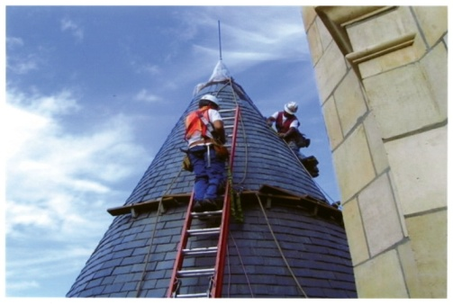
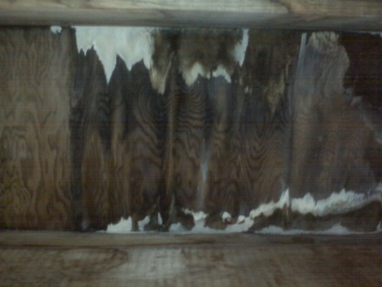
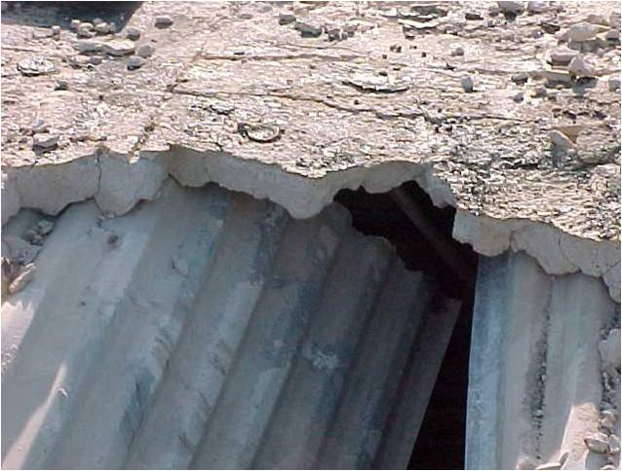
Duty to Have Fall Protection
Employees must be protected whenever they are 6 feet or more above a lower level.
Employees not only must be protected from falls but also from having objects fall on them.
The surface on which work will be performed must be examined and deemed structurally safe.
Notes:
Review the points on the slide and these three basic categories. Note that already they probably recognize something they may or may not have known as a test question.

Slide 20
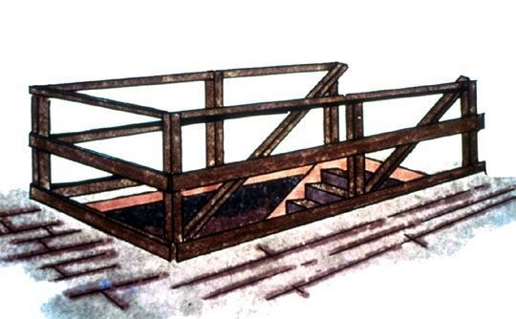
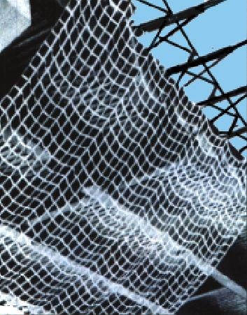
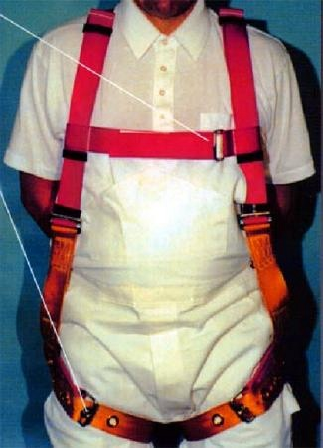
Protection Devices
Workers on unprotected surfaces and edges 6 feet or more above a lower level should be protected by:
  Guardrail system
  Safety-net system
  PFA system
Notes:
Ask students what they think:
What is an unprotected edge versus a leading edge?
General rule: If an employee can fall six feet or more onto a lower level, fall protection must be provided.
What type of fall protection is needed?
In most cases, a guardrail system, a safety net system, or a personal fall arrest system must be used.
In some cases fences, barricades, covers, equipment guards or a controlled access zone may be used.
Employees must be protected not just from falling off a surface, but from falling through holes and from having objects fall on them from above.

Slide 21
Low-slope Roofs
Unique to low-slope roofing work (4:12 or less), it is additionally allowed to:
  Use a warning line and guardrail
  Use a warning line and safety net
  Use a warning line and PFA system
  Use a warning line and safety-monitoring system
  Use a safety-monitoring system only on roofs 50 feet wide or narrower (29 CFR 1926.501[b] [10] and see Appendix A to Subpart M)
Notes:
Explain how “50-foot measurement on irregular roofs” is determined. Note the enforcement in NC and some jurisdictions warning line and the others indicated on the slide.

Slide 22
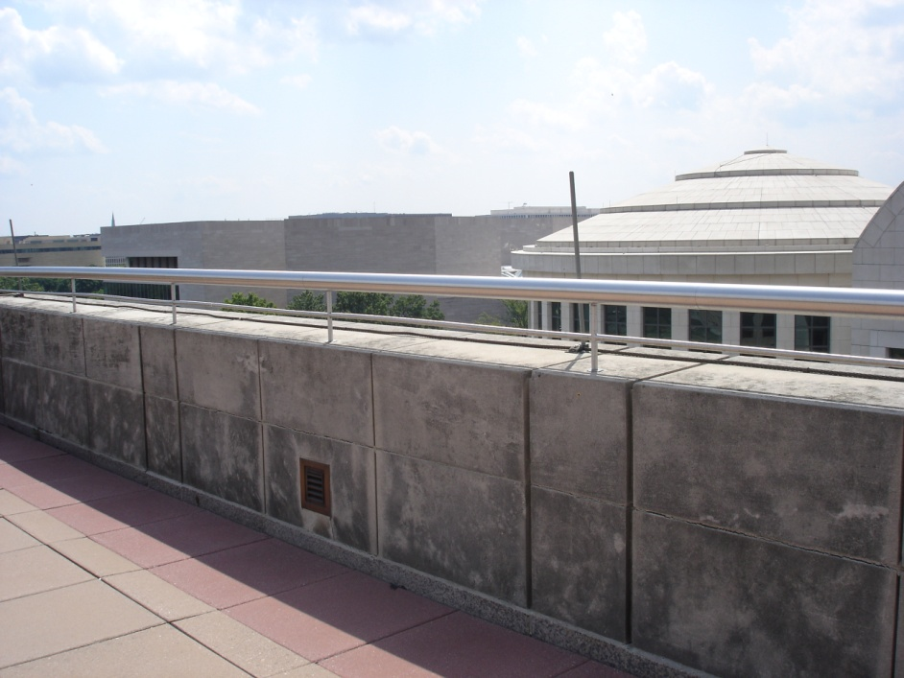
Unprotected side or edge
A side or edge of a roof or other surface without
a parapet or railing of at least 39 inches

Slide 23
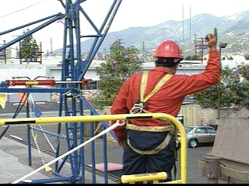
Hoist Areas
Each employee in a hoist area shall be protected from falling 6 feet or more by guardrail or PFA systems.
If a guardrail system or an opening barrier is removed, and the worker must lean through an opening—the employee should be protected with a PFA system.
Notes:
Explain:
Each employee in a hoist area shall be protected from falling 6 ft or more by guardrail systems or personal fall arrest systems.
If guardrail systems or portions thereof must be moved to facilitate hoisting operations, as during the landing of materials, and a worker must lean through the access opening or out over the access opening to receive or guide equipment and materials, that employee must be protected by a personal fall arrest system.

Slide 24
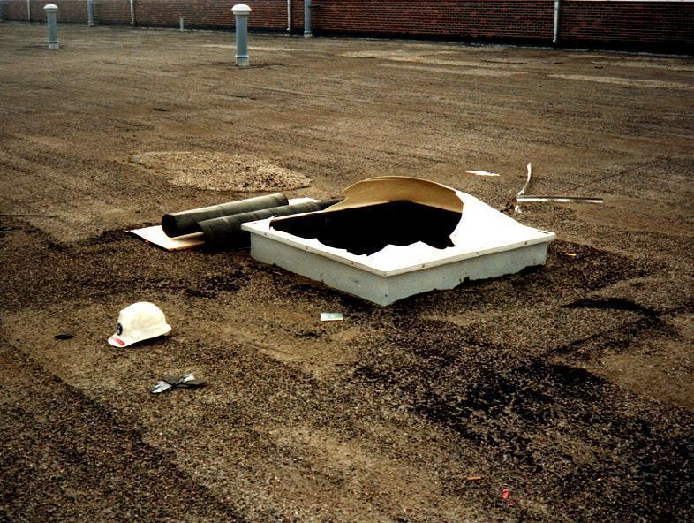
Holes and Skylights
Holes and skylights
(6 feet or more)
  PFA system
  Guardrail
  Cover
Also, protect workers below from objects falling through holes or skylights.
Notes:
Explain:
PFA systems, covers or guardrails systems must be erected around holes 2 inches or larger (including skylights) that are more than 6 ft. above a lower level.
Note: ALL holes must be protected against slips/trips – even if less than 6 ft.

Slide 25
General Rule – All Trades
Steep-slope Roofs
Slopes greater than 4:12
6 feet or more above ground or lower level
  Protect with:
  Safety net
  PFA system
  Guardrail system with toe boards
Notes:
Explain:
Each employee on a steep roof with unprotected sides and edges 6 ft. or more above lower levels, must be protected by guardrail systems with toe boards, safety net systems or personal fall arrest systems.
Slide guards no longer authorized after 6-16-11 for use on steep slope roofs unless conventional fall protection is infeasible or creates a greater hazard.

Slide 26
Fall-protection Plan
In residential construction, if conventional fall-protection is shown to be not possible or creates a greater hazard, a written plan that addresses fall protection issues may take the place of conventional systems if requirements are met, including:
1. Written, site-specific or by style/model and
maintained on site
2. Prepared by a qualified person; maintained by a
competent person
3. Discussion of measures to address fall hazards
Notes:
Direct students to Tab 1 of student manual (in the back of the tab) for a sample Fall-Protection Development plan.

Slide 27
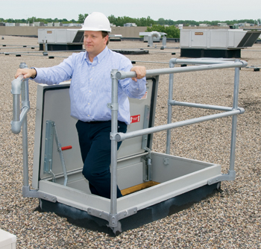
Exception to Subpart M
Subpart M does not apply when workers are inspecting, investigating or assessing a workplace:
    Before work has started
    OR
    After work has been completed
Notes:
Review the points on the slide.
An example of inspection assessment or investigation could be an estimator for a roofing contractor who goes up on a roof to measure the square footage for purposes of preparing a proposal--fall protection would not be necessary under OSHA rules.
Fall-protection still would apply to any individual from the roofing contractor’s company who comes to inspect a roof once the work has started regardless of the fact that they may be doing a quality control inspection, for example, but not engaged directly in roofing work.

Slide 28

Pop Quiz 1
You are in the middle of reroofing a large home with a clay tile roof system. You have contracted with a local supplier to load materials to the roof. You show up at your job and notice the supplier is loading the roof using no fall-protection. You tell the supplier this is not acceptable, and he says OSHA says it's OK.
Should you be concerned? Why?
Notes:
Answer:
This slide is meant to introduce the topic of OSHA Letters of Interpretation and their significance with respect to the regulations and how they are not meant to add requirements not contained in the regulations. Some discussion should be had on how many LOIs circumvent the rule-making process.
Some specific discussion on this might center on OSHA liability and more broad tort or contract liability.
This case could be tricky because clearly the roofing contractor has control of the job-site.
There is an interpretation that allows suppliers to load the roof with essentially no fall protection. The contractor is in a precarious standpoint from an OSHA standpoint if that supplier falls and is killed.
However, the interpretation would likely relieve the contractor of his duty to provide fall protection for the supplier.
Mention the US Supreme Court’s Martin case that ruled that OSHA is not allowed to change the plain meaning of a regulation by an interpretation letter.

Slide 29
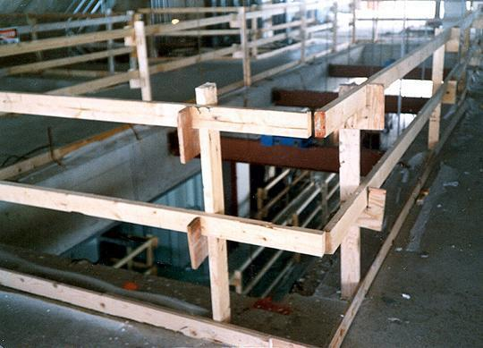
Guardrails
Guardrails
Top rail
Midrail
Toe board
Top rails between 39 and 45 inches tall
Midrails midway between top rail and working surface
Toe boards at least 3 1/2 inches high
Notes:
How do guardrail systems protect employees from falling?
Guardrail systems provide a barrier to protect the employee from falling:
Top edge of the guardrail must be 39-45 inches above the walking/working level.
There must also be protection from falling between the top rail and the walking/working surface. Midrails, screens, mesh, or intermediate vertical members may be used for this protection. There are specific requirements for their installation.
The protective barriers must be strong enough to support a falling employee. Wood, chain and wire rope may be used for top rails and midrails.

Slide 30
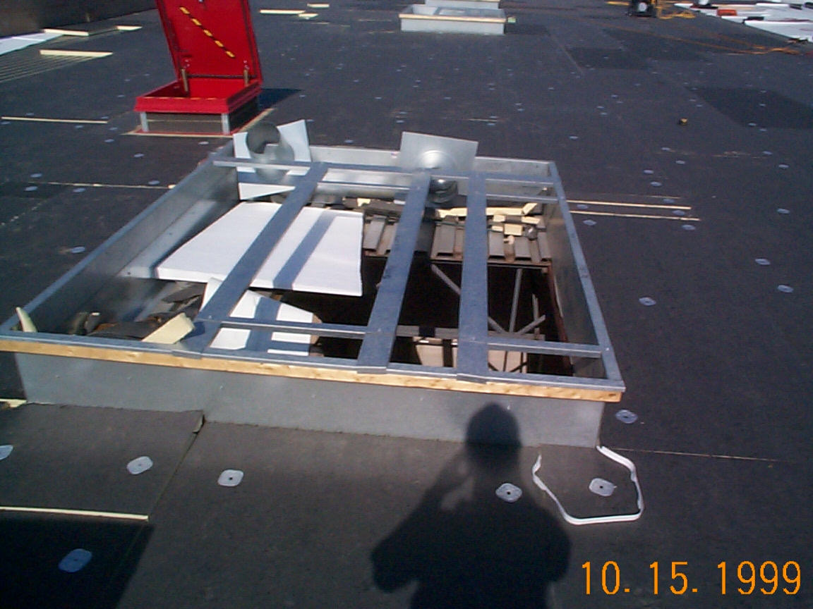
Roof Opening—Not Guarded
Notes:
Explain:
The image shows a covering that does not provide adequate protection-ask class if they see another opening that the OSHA inspector has created while taking this picture (roof hatch).

Slide 31
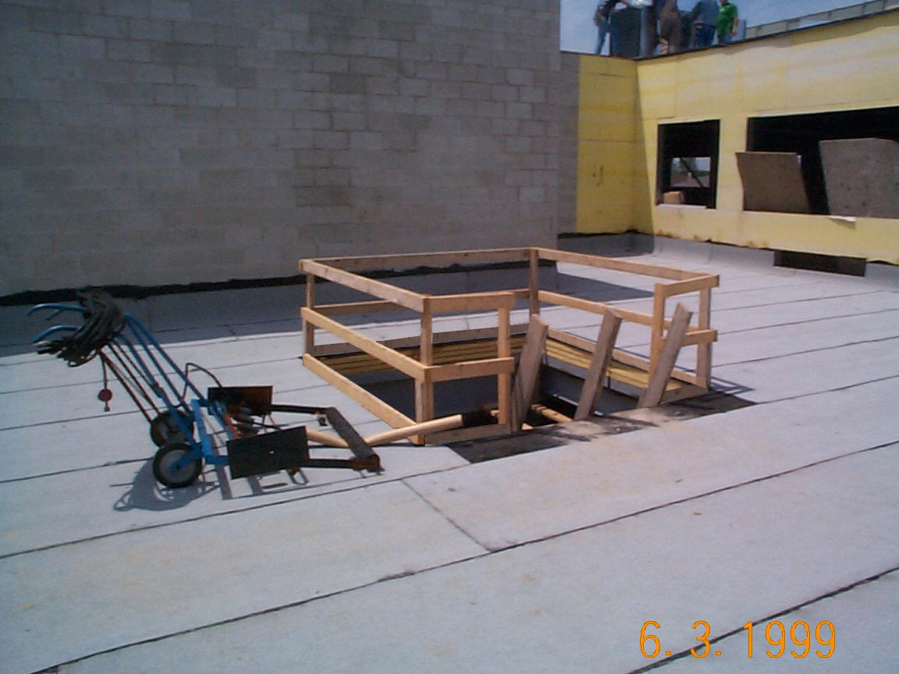
Roof Opening—Guarded
Notes:
Ask students to point out the elements of the properly-guarded hole.

Slide 32

Criteria for safety nets
Criteria for Safety Nets
As close as possible below work surface—no more than 30 feet
Extend out:
  8 feet out for up to 5 feet
  down
  10 feet out for 5 to <10
  feet down
  13 feet out for 10 to 30
  feet down
Notes:
Explain:
Safety net systems catch the employee if he/she does fall. The safety nets:
Must be strong enough to support a falling employee;
Must have sufficiently small mesh openings so the employee cannot fall through the net;
Must be close enough to the surface of the walking/working surface so that the fall into the safety net will not still injure the employee (never more than 30 feet below the walking/working level);
Must be close enough to the edge of the working surface (the outer edge of the net between 8-13 feet from the edge of the walking/working surface, depending on the distance to the walking/working surface) so that the falling employee will not slip past the net.

Slide 33
Warning lines
Warning Lines

Slide 34
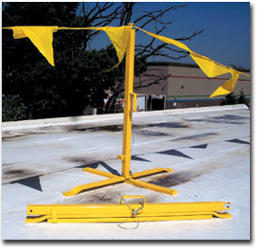
Warning lines
Warning Lines
Definition:
A barrier erected on a roof to warn workers they are approaching an unprotected roof side or edge. Warning lines contain an area inside in which roofing work may take place without fall-protection systems.
1926.500 (b)
Notes:
Review definition on slide.

Slide 35
Criteria for warning lines
Criteria for Warning Lines
Locate 6 feet from the roof edge (when no mechanical equipment is being used)
Erected around all sides of roof work areas
When mechanical equipment is used, lines should be not less than 6 feet from the roof edge parallel to equipment use and not less than 10 feet from the roof edge perpendicular to equipment use
Flagged at no more than 6-foot intervals - Height at 34-39 inches
Tip-over force must be at least 16 pounds
Minimum tensile strength of 500 pounds
Notes:
Review points on slide.

Slide 36
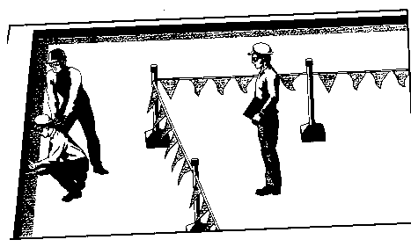
Criteria for Safety Monitors
The monitor’s function is to warn a worker when it appears the employee is unaware of a fall hazard or is acting unsafely. A safety monitor must:
Be a competent person
Be at same level
Be within sight
Be able to communicate
Not have other responsibilities that could distract from monitoring
Notes:
Review points on slide.

Slide 37
Criteria for hole covers
Criteria for Hole Covers
Capable of supporting two times the weight of employees, materials and equipment that may be imposed
Secured
Color coded or marked “Hole” or “Cover”
This hole needs a guardrail or
strong cover.
Notes:
Explain:
Covers must be:
-- able to support at least twice the weight of employees, equipment, and materials that may be imposed on them at one time.
-- secured to prevent accidental displacement from wind, equipment, or workers’ activities.
-- color coded or bear the markings “HOLE” or “COVER.”
Holes - 1926.501(b)(4):
Personal fall arrest systems, covers, or guardrail systems shall be erected around holes (including skylights) that are more than 6 feet above lower levels.
NOTE – All floor holes must be protected against slips/trips – even if less than 6 feet

Slide 38
Pop Quiz 2
You are the foreman of a crew working on a low-slope roof, and you need a safety monitor to watch the work on the gravel stop. Able, your usual safety monitor, is sick, so you ask Baker to put on the vest and act as the safety monitor. Baker dons the vest and continues about his work assisting the installation of the gravel stop. An OSHA compliance officer happens to stop by and notices and compliments you on your warning lines and safety monitor being in place. During your conversation with him, he asks whether he can go on the roof.
Continued on the next slide ➔
Notes:
Answer: It's not an absolute certainty, but the factors are:
1. A safety monitor is to be a competent person. That's one who is trained in the duties of the safety monitoring function—it doesn't appear that Baker has that training.
2. In the state of Washington, the safety monitor cannot have any other duties besides the monitoring function. Federal states enjoy an interpretation that allows the safety monitor to work as long as it doesn't interfere with the monitoring activity. Again, the compliance officer is likely to go and look for the contractor's documentation of training and official assignment of Baker as the safety monitor
Note: The state plan states that require a safety monitor not to work need to be identified.

Slide 39
Pop Quiz 3
Once on the roof, the compliance officer walks up to Baker and asks him what he is doing. Baker says: "I'm the safety monitor." The compliance officer asks how he can monitor while he's working. Baker responds: "Well, Able, our usual safety monitor, is sick today, so the foreman assigned me the job. And I've got to help because it's a two-man job.”
Are you in compliance with OSHA regulations?
Notes:
Answer: It's not an absolute certainty, but the factors are:
1. A safety monitor is to be a competent person. That's one who is trained in the duties of the safety monitoring function—it doesn't appear that Baker has that training.
2. In the state of Washington, the safety monitor cannot have any other duties besides the monitoring function. Federal states enjoy an interpretation that allows the safety monitor to work as long as it doesn't interfere with the monitoring activity. Again, the compliance officer is likely to go and look for the contractor's documentation of training and official assignment of Baker as the safety monitor
Note: The state plan states that require a safety monitor not to work need to be identified.

Slide 40
Personal Fall Arrest Systems
Personal Fall Arrest Systems (PFAs)

Slide 41
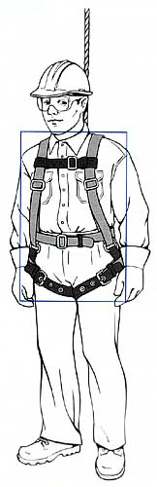
Criteria for PFA Systems
Criteria for PFA systems
Must use body harness
Each employee connected to separate lifeline
Lanyards and vertical lifelines minimum 5,000-pound strength
Self-retracting lifelines limiting fall to 2 feet must have minimum strength of 3,000 pounds
Must limit free fall to 6 feet maximum
Ropes and straps must be synthetic
Notes:
Review the points on the slide.
Explain:
A personal fall-arrest system (PFAs) places the employee into a body harness that is fastened to a secure anchorage so that he/she cannot fall. Body belts are not acceptable as personal fall arrest systems. A few key requirements:
There should be no free fall more than 6 feet. (Discuss rope-grab set-up on a lifeline—removing slack)
There should be prompt rescue after a fall.
PFASs must be inspected prior to each use.
PFASs must not be used until they have been inspected by a competent person.

Slide 42
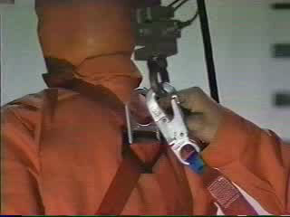
Lanyards
Notes:
Play this video (#1) and reinforce the importance of needing a harness with a shock absorber.

Slide 43
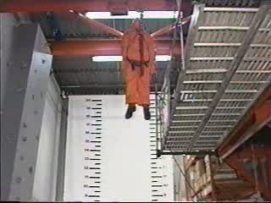
Lanyard with shock absorber
Notes:
Play this video (#2) and explain the effects of the shock absorber compared with the previous video.

Slide 44
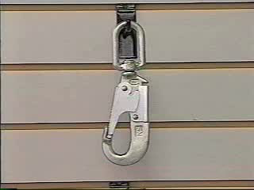
Elements of PFA Systems
Notes:
Play this video (#3) and reinforce (with the live PFA system) the importance of the elements.

Slide 45
Anchors
Anchors

Slide 46
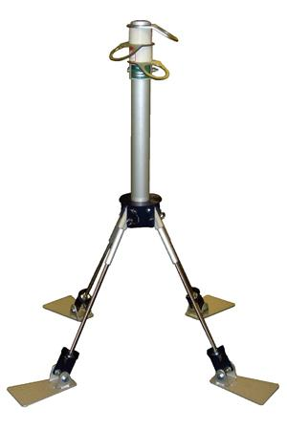
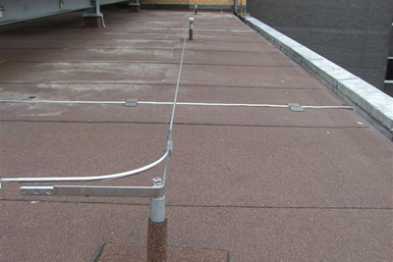
Anchors
Anchors for PFA equipment must be capable of supporting at least 5,000 pounds per worker attached.
Notes:
Discuss certified and improvised anchorages. See ANSI Z 359

Slide 47
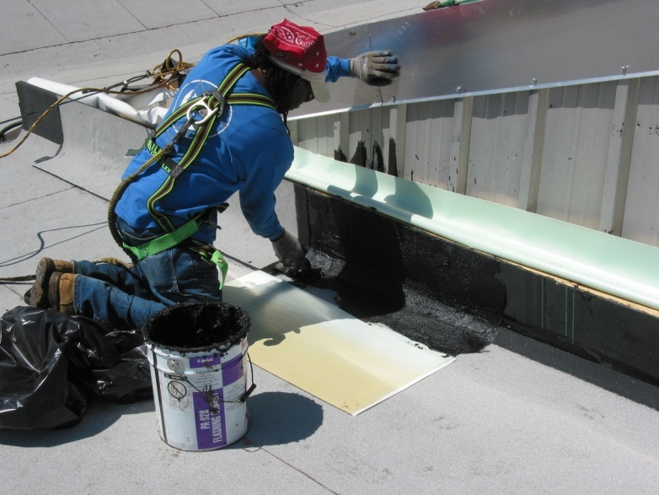
Anchors Must Also…
Be independent of systems
used to support or suspend
platforms
Be designed, installed and used as part of a complete fall-arrest system
Be designed, installed and used under the supervision of a competent person
Notes:
Explain each of these requirements as it relates to safety.

Slide 48
Manufacturer’s Installation Instructions
Anchors must be installed following the instructions from the manufacturer.
Only the type of fasteners described by the manufacturer for use with the anchor may be used.
The quantity of fasteners described by the manufacturer for use with the anchor must be installed.
Notes:
Just like other roofing equipment that is used, remind students that there are manufacturer installation instructions provided for their safety.

Slide 49
Locating Roof Anchors—Residential
Some General Guidelines
Locate at roof peak when possible and at least 6 feet from any exposed roof edge.
DO NOT install roof anchors on unsupported roof structures, such as eaves or gable overhangs.
Notes:
Before starting the roof construction, a plan should be established as to where the roof anchors will be installed. Ask students to raise their hand if their company currently plans for this before the start of a job.
The slide shows some general guidelines for locating roof anchors.

Slide 50
Locating Roof Anchors—Residential
Some General Guidelines
Hip roofs may require a roof anchor at each hip face.
Reduce swing fall hazards on long roof faces by using multiple roof anchors installed at least 6 feet from the rake edge.
Best anchor position is directly above worker.
Notes:
Before starting the roof construction, a plan should be established as to where the roof anchors will be installed.
The slide shows some general guidelines for locating roof anchors.
It’s best to position the anchor directly above the work area of the worker to limit the amount of lifeline extended and thereby minimize swing falls or free fall distances.
Note: Give example of lifeline held at second roof anchor with carabiner.

Slide 51
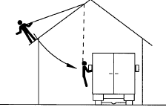
Swing Fall Hazards
Swing Fall Hazard
Gable End Swing Fall
Notes:
Swing Falls:
Swing falls occur when the anchor is not directly above the point where a fall occurs. The force of striking an object while swinging can be great and cause serious injury.
Minimize swing falls by working as directly below the anchorage as possible (the worker must be positioned within 30 degrees of the roof anchor).
Sharp Edges:
Avoid working where the connecting subsystem (i.e. shock absorbing lanyard, self retracting lifeline, full body harness, etc.) or other components will be in contact with, or abrade against sharp edges. If working with equipment near sharp edges is unavoidable, protection against cutting must be provided by using a heavy pad or other means over the exposed sharp edge.

Slide 52
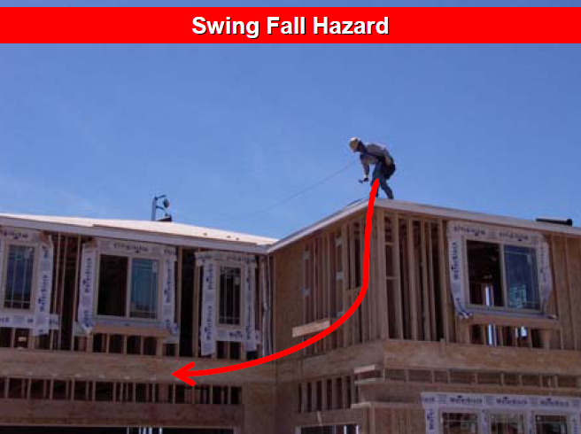
Swing Fall Hazard
Notes:
Swing Falls:
Swing falls occur when the anchor is not directly above the point where a fall occurs. The force of striking an object while swinging can be great and cause serious injury.
Minimize swing falls by working as directly below the anchorage as possible (the worker must be positioned within 30 degrees of the roof anchor).
Sharp Edges:
Avoid working where the connecting subsystem (i.e. shock absorbing lanyard, self retracting lifeline, full body harness, etc.) or other components will be in contact with, or abrade against sharp edges. If working with equipment near sharp edges is unavoidable, protection against cutting must be provided by using a heavy pad or other means over the exposed sharp edge.

Slide 53

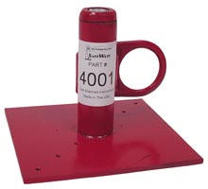
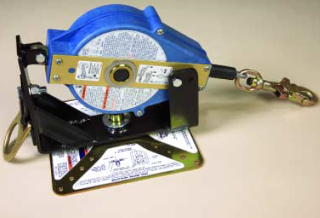
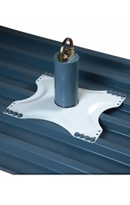
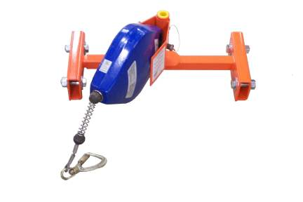
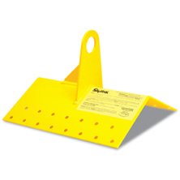
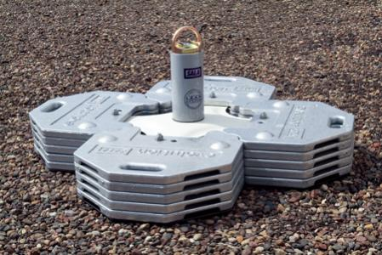
Common Roof Anchors
Wood and Metal Deck
Standing-Seam Roof
Notes:
Instructors should discuss issues related to ridge anchors that have D-rings on each side and DBI roof anchor with single D-ring

Slide 54
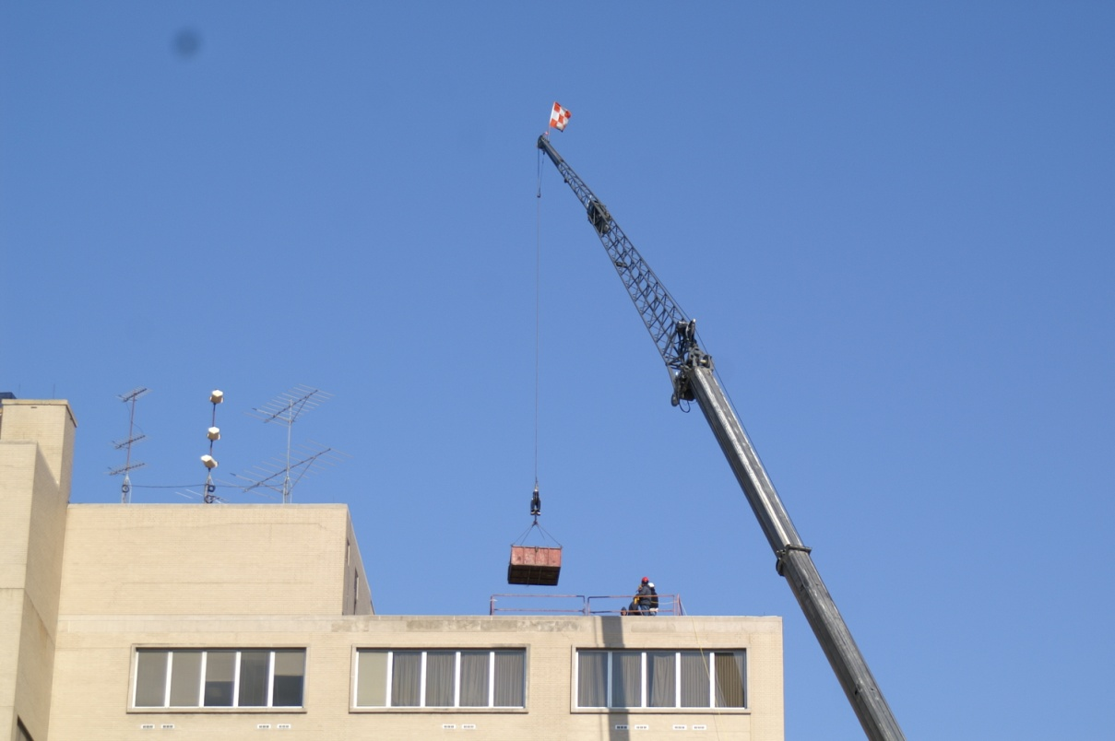
Anchor Quiz
Can a crane’s hook or load line be used as an anchor point for a PFA system?
Notes:
Ask students to spend a couple minutes considering this. Allow about five minutes of discussion from students who think both “yes” and “no”.

Slide 55
New Subpart CC Addresses
29 CFR §1926.1423(j). A PFA system is permitted to be anchored to a crane’s hook or other part of the load line if all of the following are met:
Capable of supporting 5,000 pounds
Operator must be at work site and informed of the use
No load is suspended from the load line
Notes:
5,000 or maintain safety factor of two

Slide 56
Rescue
Rescue

Slide 57
OSHA Standard
the “… employer shall provide for prompt rescue of employees in the event of a fall or shall assure that employees are able to rescue themselves.”
29 CFR 1926.502(d)(20)
Notes:
Ask: What is meant by prompt rescue? In a letter of interpretation, OSHA stated "the word 'prompt' requires rescue be performed quickly—in time to prevent serious injury to the worker."
Rescue should be addressed in your company safety program as part of a fall- protection plan. OSHA's 1926 Subpart M envisions post-fall rescue as a pre-planned event. Workers should be trained in available rescue equipment and specific techniques, along with the hazards of a rescue operation.

Slide 58

Fall Rescue Plan
✓ Rescue should be addressed in your
company safety program as part of its fall-
protection plan.
✓ OSHA's 1926 Subpart M envisions post-fall
rescue as a preplanned event.
✓ Workers should be trained in available
rescue equipment and specific techniques,
along with the hazards of a rescue operation.
Notes:
You should consider several factors when developing a comprehensive fall-rescue plan.
Equipping workers with cell phones or two-way radios will allow them to contact co-workers or emergency responders for assistance.
Telephone numbers for local emergency response agencies must be given to workers before any project begins.
Prepare Crew:
Frequent meetings with the crew: Hold daily meetings with the site crew and review the plan. Your plans need to change when the job changes.
Proper equipment availability: Have on site the right rescue equipment for the type of hazards present. This could include harnesses, ladders, aerial lifts and controlled descent systems.
Assign accountability: Assign responsibility for planning and executing the rescue plan to one or more qualified workers.
Accessible rescue equipment: Rescue equipment must be readily accessible to those responsible for the rescue plan. No time should be wasted looking for a carabiner, rope or other rescue device.

Slide 59
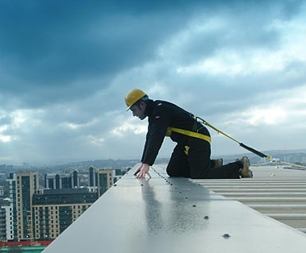

Single Workers
A single worker needs a way to call for help.
But he or she may be injured after a fall and unable to perform self rescue—or even call for help. A better policy is not to have workers work alone.
Notes:
As to whether the OSHA prompt-rescue requirement demands a second employee always be present at job locations, an OSHA interpretation states "... a single worker equipped with communication equipment that enables the worker to obtain help promptly would meet the requirement."
Cell phone or two-way radio: should be in a securable pocket as close to the chest as possible
However, this one-man safe harbor suggested by the standard neglects to consider the possibility that a worker who has been subjected to the forces imposed on his body by fall-arrest equipment will be incapable of using communication equipment for his rescue.

Slide 60

First Step, Call 9-1-1
After a fall, call 9-1-1
  But many rescue workers are not trained in high-angle rescue
    High-angle rescue involves rescuing people from places that can’t be reached by aerial ladders
Implement your rescue plan
Notes:
As with any emergency, a call to 911 should be the first step that those on the scene take in rescuing a fallen worker.
But don't think that the responsibility for rescue is satisfied with that 911 call. Employers should ensure that their rescue plan identifies specific strategies for rescue.
According to one safety expert, second or third injuries or fatalities are not uncommon as a result of unplanned attempts to rescue. And, the fact is, many rescue personnel are not trained in high-angle rescue.
This makes an employer's rescue plan even more important.
High-angle rescue is the act of removing sick, injured of trapped people from very high places that cannot be reached by department aerial ladders. Examples of such places would include industrial cranes, window-washing equipment for high rise buildings and bridge super-structures.

Slide 61

Harness-induced Injury or Death
Suspension Trauma
(a.k.a. orthostatic intolerance, orthostatic incompetence or orthostatic shock)
Some researchers say death can occur after a short time suspended in a harness!
Notes:
The critical focus should be the health implications of suspension trauma and how to minimize or eliminate its effects.
Suspension trauma is a common name for orthostatic incompetence, which is also called orthostatic intolerance.
Ortho is a Greek root, meaning straight (for example, an orthodontist straightens teeth), and static means fixed or stationary.
Orthostatic incompetence results from being in a straight position without movement for a period of time.
We've all heard about what can happen to people standing motionless for some time; for example, in a school assembly. They can faint due to lack of blood flow to the brain. That condition is self-correcting when a person falls over; he/she usually quickly revives because the legs, heart and brain are on the same level, and blood is returned to the heart.
A harness keeps a fallen worker in an upright position. Blood accumulates in the lower extremities.
Most experts agree that unconsciousness, followed by death, can result in less than 30 minutes. Some resources even say that suspension for more than 5 minutes can be deadly!
New Z359 standard states that “contact” should be made with victim within targeted goal of 6 minutes. Contact is meant to be communication or physical contact.

Slide 62
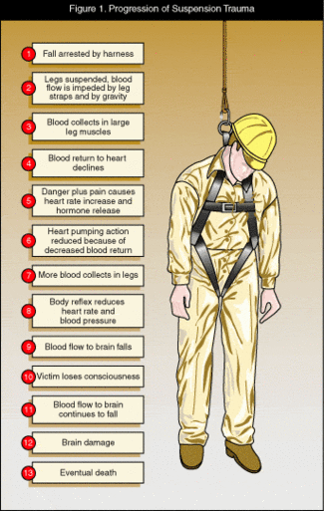
Suspension Trauma
Fall arrested by a harness
Blood flow impeded by leg straps and gravity
Blood collects in large leg muscles
Blood return to heart decreases
Heart rate increase and hormone release from pain and danger response
Heart pumping action reduced because of decreased blood return
More blood collects in legs
Heart rate and blood pressure decrease
Blood flow to brain decreases
Victim loses consciousness
Blood flow to brain continues to decline dangerously
Brain damage
Death
Can occur when legs don’t move and legs are lower than the heart
May be complicated by other injuries from a fall, such as a neck trauma, broken bones, cuts, etc.
Notes:
Ask students if any of them have been a part (or witnessed) a fall at their work place. Allow a few minutes for them to explain what happened.

Slide 63

Signs of Suspension Trauma
-Fainting
-Shortness of breath
-Nausea
-Dizziness
-Sweating
-Hot flushes
-Paleness
-Narrowing of field of vision or loss of vision
-Increased heart rate
Notes:
Describe what can happen in these situations.

Slide 64
Rescue
Two basic elements of rescue:
① Delay orthostatic shock
② Bring the fallen worker to a supporting surface
Notes:
Prepare the Crew
Ordinarily, the greater the number of workers at a job site where a worker has fallen, the easier it will be to bring the worker to safety.
This may involve something as simple as several workers using the fallen worker’s lifeline to pull him back up to the level or deck from which he has fallen.
Generally, it will be quicker and simpler to bring a fallen worker back up rather than lower him.
It is critical that rescuers are protected by personal fall-arrest equipment while attempting the rescue of a fallen worker.

Slide 65
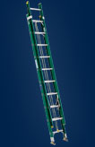
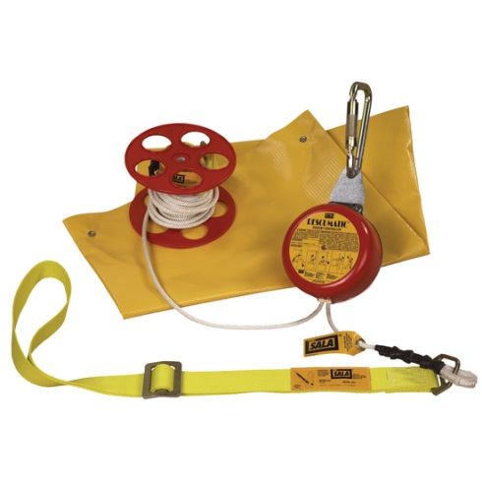
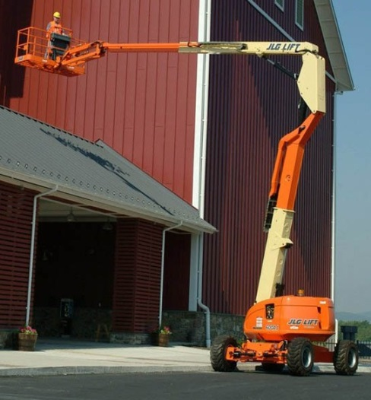
Rescue Equipment
Equipment already on-site: ladders, scaffolds, personnel lifts
Pulleys, winches or descending devices
Notes:
Equipment that is already on the job site can provide the simplest rescue method.
Ladders, personnel lifts and scaffolds are capable of being moved easily and set up quickly to assist in or accomplish the rescue.
Limited additional training is needed for workers rescuing a crew member using this type of equipment because they already should be well-versed in its use.
Pulleys, winches and descending devices also may be used to affect a rescue, but specialized worker training in set-up and use of such equipment should be done prior to equipping crews with any devices.

Slide 66
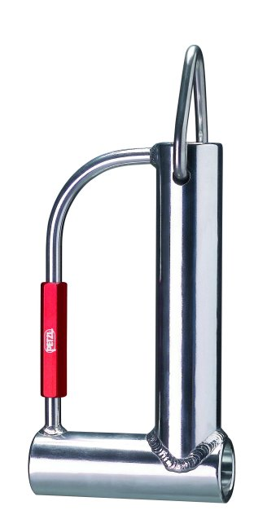
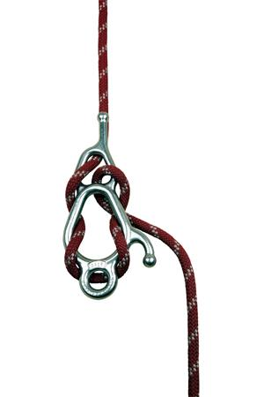
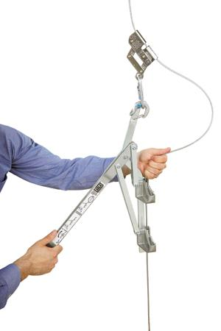

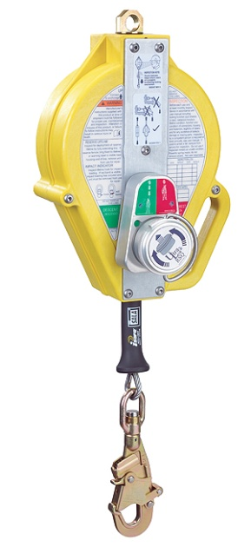
Other rescue equipment
Notes:
Refer back to the stories that were shared with the class to see if any of these pieces of equipment were used. Describe each one and how they are commonly used.

Slide 67
Self-rescue Strategies
Cell phone or two-way radio
Self-rescue lanyard
Suspension trauma straps and slings
Lifeline loop and prussic loop
Foot wrap
Notes:
In some instances, the fallen worker may be required to rescue himself without any assistance from others. This may occur because of the remoteness of the job site or work areas within the project site and/or the absence of other crew members to assist either because others have fallen in the same incident or the worker is operating as a one-man crew.
With appropriate equipment and training, a fallen worker may be able to reach a supporting surface. But this should never be the only rescue option. Workers should also be trained in a variety of self rescue techniques.
Self rescue may be the ability merely to relieve suspension trauma because that is often the most critical condition that can bring about death when a worker is hanging. Naturally, to attempt a self rescue, the fall must not have been so severe as to render the victim unconscious or severely injured.
Some self rescue tools and techniques include:
-Cell phone or two-way radio: should be in an securable pocket as close to the chest as possible
-Self rescue lanyard
-Suspension trauma straps and slings
-Lifeline loop and prussic loop
-Foot wrap

Slide 68
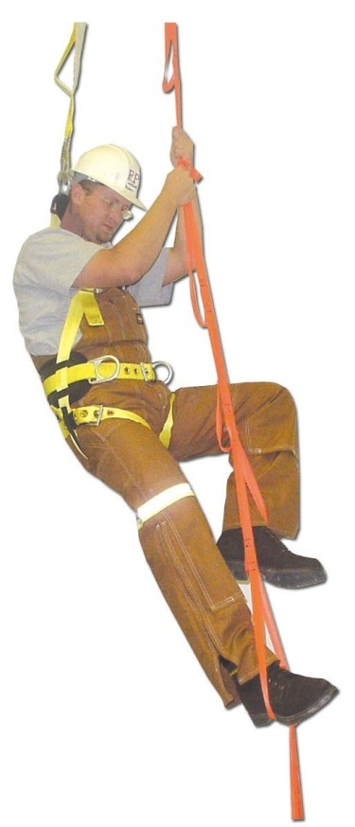
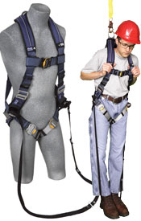
Self-rescue
Self-rescue Lanyard
Suspension Trauma Relief
Notes:
A manufacturer makes a lanyard that deploys a synthetic ladder from the lanyard’s soft pack end that attaches at the rope grab. The fallen worker can use the ladder for suspension-trauma relief or can climb to safety.
Note to instructor: Show self rescue lanyard.
Note to instructor: Demonstrate suspension trauma bands.
Suspension trauma straps and slings—these are adjustable straps that attach to the lower webbing or the side D rings of a harness. A fallen worker adjusts the strap to form a loop under him that is above the level of his feet. He then can pull himself up by grasping the lifeline or lanyard and can step into the strap, thereby relieving pressure on his legs.

Slide 69
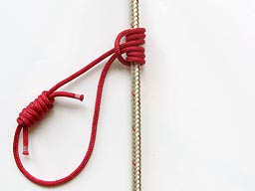
Self-rescue
Prussic Loop
Notes:
Lifeline loop and prussic loops:
—both of these are used to relieve suspension trauma but may be a little more difficult to implement in the field after a fall.
Use of a lifeline loop simply requires the fallen worker to grab the trailing portion of his lifeline that should be hanging next to him. Then, he ties a loop in the lifeline at approximately knee or waist level that is large enough to accommodate one or both of his feet. A bowline is a good knot for this because it will not slip or tighten and trap his feet. He can use the loop to stand in, similar to the straps or ladder described above, to take his weight off of the harness somewhat.
Note to instructor: Demonstrate lifeline loop.
Prussic loops are thinner pieces of rope or webbing that the worker would carry in a pouch on his harness. The ropes are tied to form a circle about 12-18 inches in diameter. The fallen worker would attach one or more loops to the lifeline by encircling the lifeline with a few wraps of the loop, leaving a large loop exposed that he could then place his foot into. The loop holds tight to the lifeline and supports his weight.

Slide 70
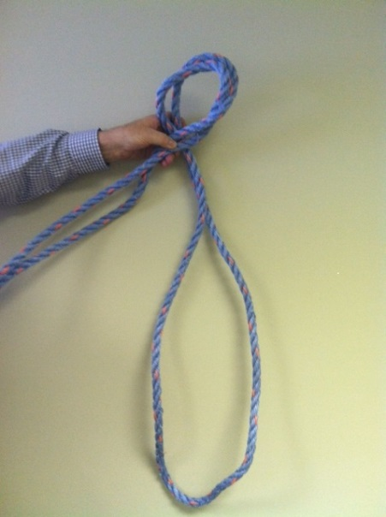
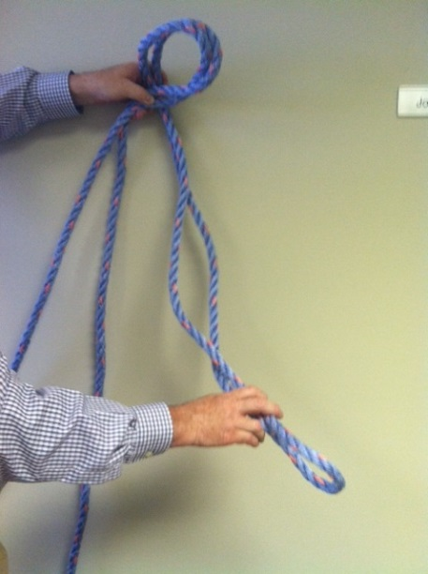
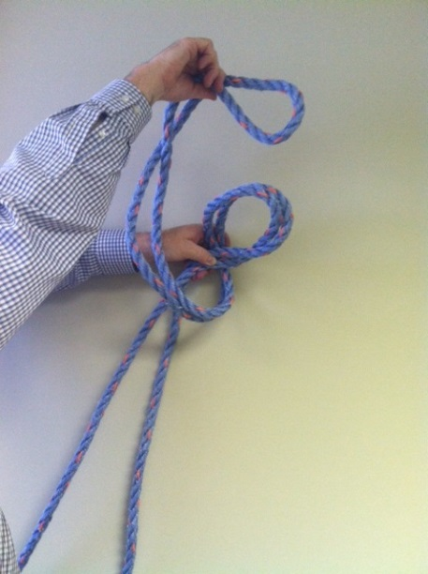
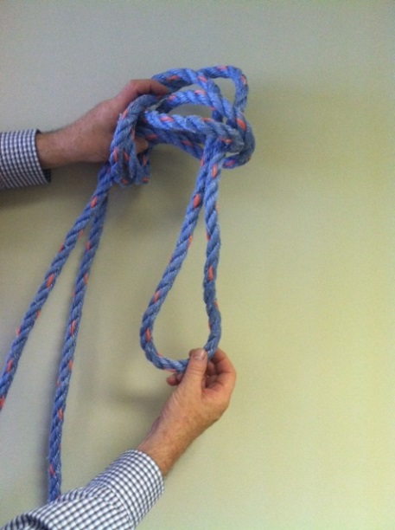
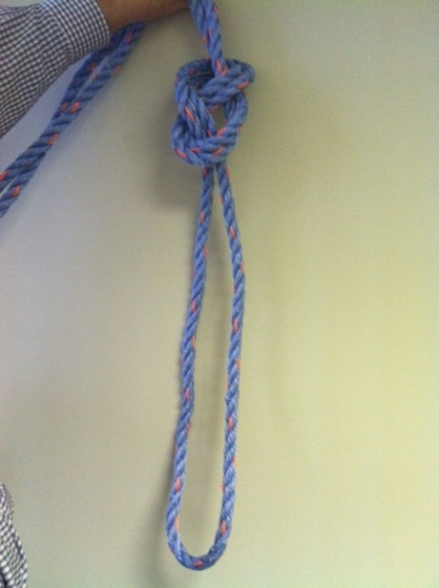



Making a Lifeline Loop
Making a Lifeline Loop
1.
2.
3.
4.
5.
6.
Notes:
Lifeline loop: This is used to relieve suspension trauma but may be a little more difficult to implement in the field after a fall.
Use of a lifeline loop requires the fallen worker to grab the trailing portion of his lifeline that should be hanging next to him. Then, he ties a loop in the lifeline at approximately knee or waist level that is large enough to accommodate one or both of his feet. He can use the loop to stand in, similar to the straps or ladder described above, to take his weight off of the harness somewhat.
Note to instructor: Demonstrate lifeline loop or walk through it step by step.

Slide 71
Self-rescue – Foot Wrap
Step 1
Notes:
Foot wrap—this is a suspension trauma relief technique that also may be used for limited self-rescue situations. It involves wrapping the trailing end of the fallen worker’s lifeline from the inside of his foot around to the outside and bringing it on top of that foot. Then, the worker places his other foot on top of the line crossing over the top of the foot and stands up on it while holding the lines together at about chest level. With some maneuvering, the worker can take pressure off his rope grab enough to move it slowly either up or down on the lifeline. By repeating the process several times, a worker can lower or raise himself while still remaining connected to the lifeline.
Note: If rescue is impossible, or if prompt rescue cannot be performed, it's critical for a fallen worker to pump his legs frequently to activate the muscles and reduce the risk of blood pooling. Footholds can be used to alleviate pressure and provide support for muscle pumping.
Note to instructors: Demonstrate the foot wrap after reviewing this technique on the slides.

Slide 72
Self-rescue – Foot Wrap
Step 2

Slide 73
Self-rescue – Foot Wrap
Step 3

Slide 74
Self-rescue – Foot Wrap
Step 4
Notes:
Provide a demonstration.

Slide 75

Never Cut Lanyard or Lifeline
Notes:
Play the video (#6) and explain:
It is important during any rescue that workers never cut lanyards or lifelines to which fallen workers are connected.
The lanyard or lifeline tension from the weight of the worker should be released by rescue procedures and/or equipment. Arrest systems then may be disconnected only when a worker is at an assured point of safety.

Slide 76

After a Fall – First Aid
Do not recline the rescued worker
  The quick release of pooled blood from the legs can cause cardiac arrest.
A sitting position on the ground and for transport to hospital is recommended.
Administer oxygen if available.

Slide 77
Take Equipment Out of Service
OSHA requires that PFA equipment that has been subjected to “impact loading”—subjected to forces like those during a fall—must be immediately removed from service and not be used again until inspected by a competent person and determined to be undamaged and suitable for reuse.
(29 CFR 1926.502(d)(19))
Notes:
Ordinarily, this applies to the harness, lanyard, lifeline, and anchorage and their component parts.
At a minimum, the harness and lanyard will need to be discarded as a result of impact loading.
Note to instructor: Show damaged harness

Slide 78
Use Backup Training Systems During Rescue Training
Notes:
This video is intended to illustrate the importance of backup fall protection systems during training. The workers injured in this fall were training for rescue situations when a miscommunication caused their only line to be disconnected.

Slide 79

Calculated Clearance

