Slide 1

Respiratory Program
Adapted to Agriculture
Notes:
Introduction of Topic
Introduction of Presenter
Acknowledge Charlotte Halverson’s contribution to presentation

Slide 2

Susan Harwood Training Grant
This material was produced under a grant (SH – 26280 - SH4) from the Occupational Safety and Health Administration, U.S. Department of Labor. It does not necessarily reflect the views or policies of the U.S. Department of Labor, nor does the mention of trade names, commercial products, or organization imply endorsement by the U.S. Government.
Notes:
Explain about the Susan Harwood Training Grant

Slide 3

Focus Areas for Presentation
The primary goal of this presentation is to highlight the components of an effective respiratory protection program for the agricultural workplace.
Upon completion of this presentation, participants will be able to:
Recognize the diverse respiratory hazards unique to agricultural and the justification for a comprehensive respiratory program.
Identify the OSHA respirator standards that apply to an agricultural setting.
Understand key components of an effective respiratory protection program.
Access resources, templates, medical evaluations, and further trainings to effectively implement a respiratory program.
The intended audience for this presentation includes healthcare professionals who provide care in agricultural communities and business owners, managers, and workers in production agriculture.
Notes:
Discuss Primary Goal of Webinar
Goals:
Recognize the diverse respiratory hazards unique to agricultural and the justification for a comprehensive respiratory program.
Identify the OSHA respirator standards that apply to an agricultural setting.
Understand key components of an effective respiratory protection program
Access resources, templates, medical evaluations, and further trainings to effectively implement a respiratory program.
Discuss who the intended audience is

Slide 4

High Risk Areas for Individual Farmer,
Family, and Worker
Respiratory Hazards are one of many
  injuries
  respiratory
  hearing
  chemical exposures
  skin cancer
  musculoskeletal
  health and wellness
  stress
Notes:
Agriculture has multiple high risk areas – as listed on this slide
Respiratory exposures are one of the risks and respiratory hazards are very prevalent and can be complex

Slide 5

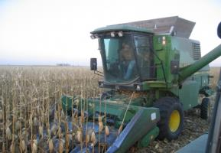
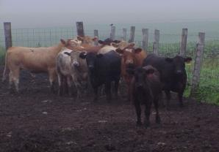
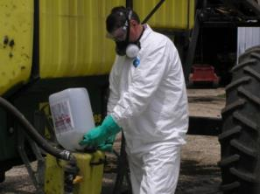
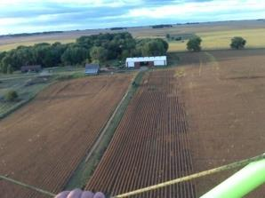
Farming is an Occupation
Not just a life style
Work place can also be home
Notes:
Photos property of AgriSafe Network
Because the work place is also home this adds more complexity to protecting the person and family members who may be exposed to respiratory and other agricultural hazards

Slide 6

Types of Respiratory Exposures
Livestock & Poultry confinements
Confined Animal Feeding Operations (CAFOS)
Pesticides
Grain Handling (many types of grains)
Cotton
Anhydrous Ammonia
Welding
Using gas or diesel engine indoors
Fumigation
Silo Entry
Paint (spraying)
Woodworking
Notes:
Multiple types of operations and exposures
Ag Industry has several types of Respiratory Hazards

Slide 7

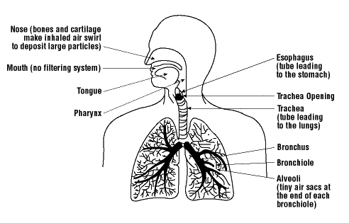
Respiratory System
Resource - CDC/NIOSH
Overview of Pulmonary Anatomy and Physiology Review
Notes:
When we talk about protecting the respiratory system we need to understand the respiratory system includes the “entire” respiratory track which includes from the nose, sinuses, upper airways, bronchioles and lungs.

Slide 8

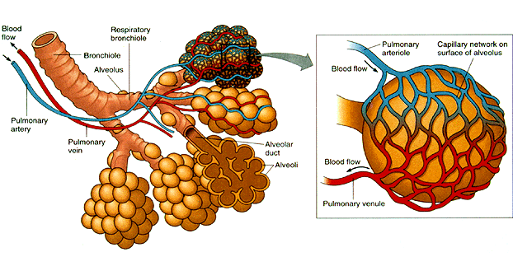
Bronchioles and Alveoli
  Smaller particles can reach the smaller airways and aren’t trapped by mucus or cilia
  Less than10 μm can reach the alveoli and are considered “Respirable “
Notes:
We are concerned about the particles that can reach the tiny airways of the lungs called Alveoli.
Respirable dust along with fumes and gases can reach these areas of the lung where the exchange of oxygen takes place.

Slide 9

General Symptoms
Headache
Dizziness
Runny or sore eyes
Sore throat
Stuffy nose or sneezing
Cough
Wheezing or tightness in chest
Shortness of breath
Nausea or vomiting
Monday morning syndrome
Notes:
There are signs and symptoms that we need to be aware of that can signal problems related to respiratory exposures and illnesses.
Monday morning syndrome – when you are gone for a few days and your symptoms subside and when you you return to the exposures then they come back.

Slide 10

Choosing Appropriate
Respirator Protection
  Understand Respiratory Hazards
  Avoid High Risk Exposures if Possible
  Engineering controls
  Multiple exposures
Notes:
Do you need Respiratory Protection
Decision Tree
Decision 1 – Do you need the Respirator

Slide 11

Appropriate Respiratory Protection
Choosing the right protection
  Right mask for the job
  The right fit for the mask
  Have masks available
  Multiple types of protection may be needed
  Choices can be expensive
  Compliance is an issue
Notes:
Decision 2 – if you do need a Respirator then you need to decide this
Right mask for the job
The right fit for the mask
Have masks available
Choices can be expensive
Compliance can be an issue – going to discuss the Respiratory Standard and Respirator Program

Slide 12

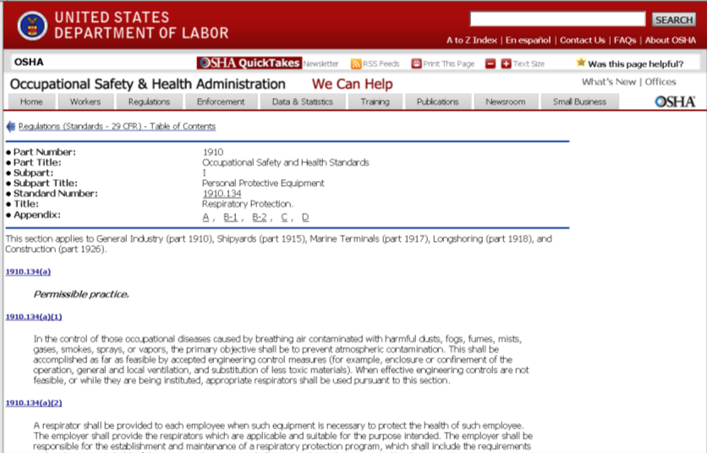
OSHA’s Respiratory Protection
Standard - 29 CFR 1910.134
SEARCH
Regulations
A- Z INDEX
Notes:
OSHA’s Respiratory Protection Standard is 29 CFR 1910.134
located on the OSHA website shown on this slide
Can get to this place 3 different ways
1- Search
2- Regulations
3- A-Z Index (respirators)
4- Google search

Slide 13
Scope
This standard applies to
  General Industry (Part 1910),
  Shipyards (Part 1915),
  Marine Terminals (Part 1917),
  Longshoring (Part 1918), and
  Construction (Part 1926).
Notes:
Respiratory Standard applies to General Industry as well as others
Do not see Agriculture

Slide 14
Ag standards
Occupational Safety & Health Act of 1970 – Federal Laws & Regulations Affecting Agricultural Employers (29 CFR 1928)
  8 sections
  . 1 Purpose and Scope
  . 21 Applicability and standards
  Followed by 6 specific Agriculture standards
Notes:
Ag Standards in 1928
Deal mostly with machinery equipment safety
Not to PPE including Respiratory Protection
This can be confusing

Slide 15

General Industry applicable standards
  29 CFR 1910.142: Temporary Labor Camps
  29 CFR 1910.111(a) and (b): Storage & Handling of Anhydrous Ammonia
  29 CFR 1910.266: Logging Operations
  29CFR 1910.145: Slow Moving Vehicles
  29 CFR 1910.1201: DOT Markings
  29 CFR 1910.1200: Hazard Communication
  29 CFR1910.1027 Cadmium (welding, grinding, painting)
These standards can be cited directly
Notes:
These are the General Industry standards that can be applicable to Agriculture

Slide 16

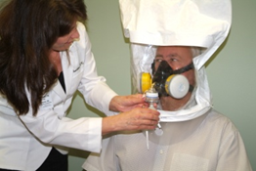
General Duty Clause
General Duty Clause [5(a)(1) of the OSH Act )
Use this when the standard is not specific to the industry (Agriculture)
  29 CFR 1910.134: Respiratory Protection
Notes:
OSHA can cite under General Industry Standards & the General Duty Clause. This can be confusing for agriculture settings.
We Have another webinar – Ag Exempt; this discusses Enforcement Guidance for Small Farming Operations.
The Appropriations Act exempts small farming operations from enforcement of all rules, regulations, standards or orders under the Occupational Safety and Health Act. A farming operation is exempt from all OSHA activities if it:
Employs 10 or fewer employees currently and at all times during the last 12 months; and
Has not had an active temporary labor camp during the proceeding 12 months.
Photo property of AgriSafe Network

Slide 17
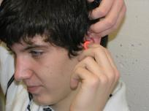
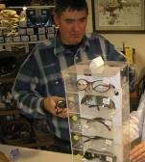
Additional OSHA Standards related to Agriculture
29 CFR 1910.95: Hearing Conservation & Noise Exposure
29 CFR 1910.133: Eye & Face Protection
29 CFR 1910.132: General Requirements for Personal Protective Equipment
Notes:
Photos property of AgriSafe Network
Additional OSHA standards related to Agriculture, but would be cited by OSHA under the General Duty Clause

Slide 18

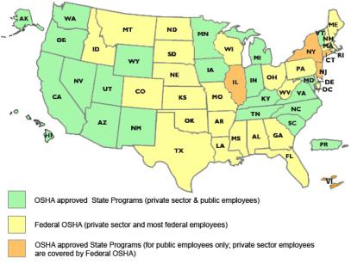
State to State
Important to check with your state OSHA since there are 25 states that match or exceed this OSHA Instruction
Notes:
Many states have different OSHA Instruction
Could require more under each state plan – be sure to check with your state
State OSHA can be a resource

Slide 19
Organization of Respiratory Standard
(k) Training and information
(l) Program evaluation
(m) Recordkeeping
(n) Dates
(o) Appendices (mandatory)
A: Fit Testing Procedures
B-1: User Seal Checks
B-2: Cleaning Procedures
C: Medical Questionnaire
D: Information for Employees Wearing Respirators When Not Required Under the Standard
(a) Permissible practice
(b) Definitions
(c) Respirator program
(d) Selection of respirators
(e) Medical evaluation
(f) Fit testing
(g) Use of respirators
(h) Maintenance and care
(i) Breathing air quality and use
(j) Identification of filters, cartridges, and canisters
Notes:
Standard is organized to assist employers in following all aspects of the Respiratory Standard [29 CFR 1910.134]

Slide 20
Respiratory Program Elements
1. Selection
2. Medical evaluation
3. Fit testing
4. Use
5. Maintenance and care
6. Breathing air quality and use
7. Training
8. Program evaluation
Notes:
Section C of the Standard is the Respiratory Program
includes the following 8 elements
1. Selection
2. Medical evaluation
3. Fit testing
4. Use
5. Maintenance and care
6. Breathing air quality and use
7. Training
8. Program evaluation

Slide 21
Respiratory Program
Must develop a written program with worksite-specific procedures when respirators are necessary or required by the employer
Must update program as necessary to reflect changes in workplace conditions that affect respirator use
Must designate a program administrator who is qualified by appropriate training or experience to administer or oversee the program and conduct the required program evaluations
Must provide respirators, training, and medical evaluations at no cost to the employee
Note: OSHA has prepared a Small Entity Compliance Guide that contains criteria for selection of a program administrator and a sample program – Publication OSHA 3384 - 09 2011
Notes:
A Respiratory Program that meets the OSHA standard must :
develop a written program with worksite-specific procedures when respirators are necessary or required by the employer
update program as necessary to reflect changes in workplace conditions that affect respirator use
designate a program administrator who is qualified by appropriate training or experience to administer or oversee the program and conduct the required program evaluations
provide respirators, training, and medical evaluations at no cost to the employee
Other resources:
CPL 02-00-120 OSHA Instruction for Inspection Procedures for the Respiratory Protection Standard 09/25/1998 - tells how OSHA enforces this standard (what OSHA expects)
Letters of Interpretation can be helpful –located on OSHA website

Slide 22
Respirator Program (cont’d)
Where Respirator Use is Not Required
Employer may provide respirators at employee’s request or permit employees to use their own respirators, if employer determines that such use in itself will not create a hazard
If voluntary use is permissible, employer must provide users with the information contained in Appendix D
Must establish and implement those elements of a written program necessary to ensure that employee is medically able to use the respirator and that it is cleaned, stored, and maintained so it does not present a health hazard to the user
Exception: Employers are not required to include in a written program employees whose only use of respirators involves voluntary use of filtering face pieces (dust masks).
Notes:
When a Respirator is not required:
Employer may provide respirators at employee’s request or permit employees to use their own respirators, if employer determines that such use in itself will not create a hazard
If voluntary use is permissible, employer must provide users with the information contained in Appendix D. Employer should document that they provided this information. This is not a training. Can copy this and give it to them so be sure to document what you did. Document for each individual even if do a group session.
Must establish and implement those elements of a written program necessary to ensure that employee is medically able to use the respirator and that it is cleaned, stored, and maintained so it does not present a health hazard to the user.
Exception: Employers are not required to include in a written program employees whose only use of respirators involves voluntary use of filtering face pieces (dust masks).
Employer needs to be sure that the mask does not become the hazard. (For example the mask causing or contributing to a medical condition).

Slide 23
Permissible Practice
The primary means to control occupational diseases caused by breathing contaminated air is through the use of feasible engineering controls, such as enclosures, confinement of operations, ventilation, or substitution of less toxic materials
When effective engineering controls are not feasible, or while they are being instituted, appropriate respirators shall be used pursuant to this standard
Employer shall provide respirators, when necessary, which are applicable and suitable for the purpose intended
Employer shall be responsible for establishment and maintenance of a respirator program which includes the requirements of paragraph (c), Respiratory protection program
Notes:
Hierarchy of Industrial Hygiene - this can be difficult in Agriculture – many times PPE is the only option
The primary means to control occupational diseases caused by breathing contaminated air is through the use of feasible engineering controls, such as enclosures, confinement of operations, ventilation, or substitution of less toxic materials
When effective engineering controls are not feasible, or while they are being instituted, appropriate respirators shall be used pursuant to this standard
Employer shall provide respirators, when necessary, which are applicable and suitable for the purpose intended
Employer shall be responsible for establishment and maintenance of a respirator program which includes the requirements of paragraph (c), Respiratory protection program

Slide 24
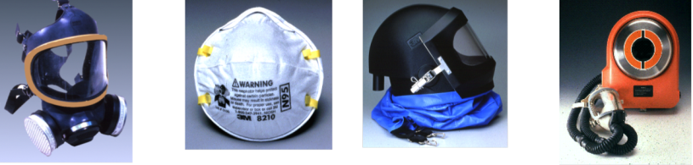
Selection of Respirators
Employer must select and provide an appropriate respirator based on the respiratory hazards to which the worker is exposed and workplace and user factors that affect respirator performance and reliability
Notes:
Photos from OSHA.gov power point
Employer must select and provide an appropriate respirator based on the respiratory hazards to which the worker is exposed and workplace and user factors that affect respirator performance and reliability

Slide 25
Selection of Respirators (cont’d)
Select a NIOSH-certified respirator that shall be used in compliance with the conditions of its certification
Identify and evaluate the respiratory hazards in the workplace, including a reasonable estimate of employee exposures and identification of the contaminant’s chemical state and physical form
Where exposure cannot be identified or reasonably estimated, the atmosphere shall be considered Immediately Dangerous to Life or Health (IDLH)
Select respirators from a sufficient number of models and sizes so that the respirator is acceptable to, and correctly fits, the user
Notes:
Select a NIOSH-certified respirator that shall be used in compliance with the conditions of its certification
Identify and evaluate the respiratory hazards in the workplace, including a reasonable estimate of employee exposures and identification of the contaminant’s chemical state and physical form
Where exposure cannot be identified or reasonably estimated, the atmosphere shall be considered Immediately Dangerous to Life or Health (IDLH)
Select respirators from a sufficient number of models and sizes so that the respirator is acceptable to, and correctly fits, the user

Slide 26
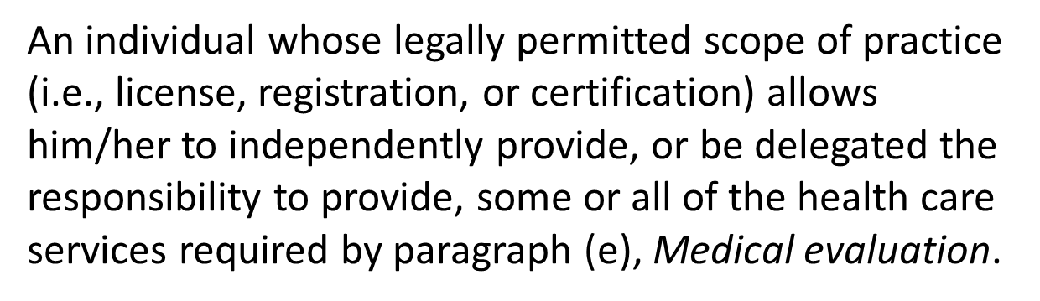
Physician or Other Licensed Health Care Professional (PLHCP)
Notes:
This can be physician, nurse, nurse practitioner, physician assistant
Does not have to be a physican.

Slide 27
Medical Evaluation
Procedures
Must provide a medical evaluation to determine employee’s ability to use a respirator, before fit testing and use
Must identify a PLHCP to perform medical evaluations using a medical questionnaire or an initial medical examination that obtains the same information
Medical evaluation must obtain the information requested by the questionnaire in Sections 1 and 2, Part A of App. C
Follow-up medical examination is required for an employee who gives a positive response to any question among questions 1 through 8 in Section 2, Part A of App. C or whose initial medical examination demonstrates the need for a follow-up medical examination
Notes:
Must provide a medical evaluation to determine employee’s ability to use a respirator, before fit testing and use
Must identify a PLHCP to perform medical evaluations using a medical questionnaire or an initial medical examination that obtains the same information
Medical evaluation must obtain the information requested by the questionnaire in Sections 1 and 2, Part A of App. C
Follow-up medical examination is required for an employee who gives a positive response to any question among questions 1 through 8 in Section 2, Part A of App. C or whose initial medical examination demonstrates the need for a follow-up medical examination

Slide 28
Medical Evaluation
Additional Medical Evaluations
Annual review of medical status is not required
At a minimum, employer must provide additional medical evaluations if:
  Employee reports medical signs or symptoms related to the ability to use a respirator
  PLHCP, supervisor, or program administrator informs the employer that an employee needs to be reevaluated
  Information from the respirator program, including observations made during fit testing and program evaluation, indicates a need
  Change occurs in workplace conditions that may substantially increase the physiological burden on an employee
Notes:
Annual review of medical status is not required- depends on each person
At a minimum, employer must provide additional medical evaluations if:
Employee reports medical signs or symptoms related to the ability to use a respirator
PLHCP, supervisor, or program administrator informs the employer that an employee needs to be reevaluated
Information from the respirator program, including observations made during fit testing and program evaluation, indicates a need
Change occurs in workplace conditions that may substantially increase the physiological burden on an employee

Slide 29
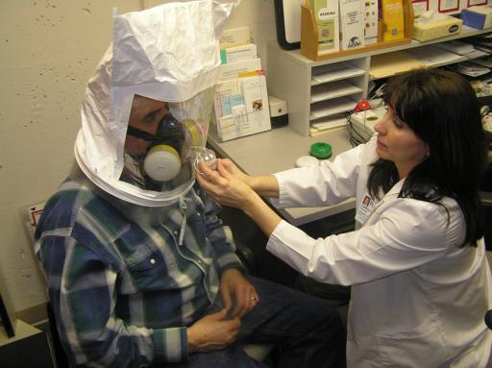
Fit Testing
Before an employee uses any respirator with a negative or positive pressure tight-fitting face piece, the employee must be fit tested with the same make, model, style, and size of respirator that will be used.
Notes:
Photo property of AgriSafe Network
Fit testing must be done for each employee prior to use of a respirator

Slide 30
Fit Testing (cont’d)
Employees using tight-fitting face piece respirators must pass an appropriate qualitative fit test (QLFT) or quantitative fit test (QNFT):
  prior to initial use,
  whenever a different respirator face piece (size, style, model or make) is used, and
  at least annually thereafter
Must conduct an additional fit test whenever the employee reports, or the employer or PLHCP makes visual observations of, changes in the employee’s physical condition (e.g., facial scarring, dental changes, cosmetic surgery, or obvious change in body weight) that could affect respirator fit
Notes:
Employees using tight-fitting face piece respirators must pass an appropriate qualitative fit test (QLFT) or quantitative fit test (QNFT):
prior to initial use,
whenever a different respirator face piece (size, style, model or make) is used, and
at least annually thereafter
Must conduct an additional fit test whenever the employee reports, or the employer or PLHCP makes visual observations of, changes in the employee’s physical condition (e.g., facial scarring, dental changes, cosmetic surgery, or obvious change in body weight) that could affect respirator fit

Slide 31
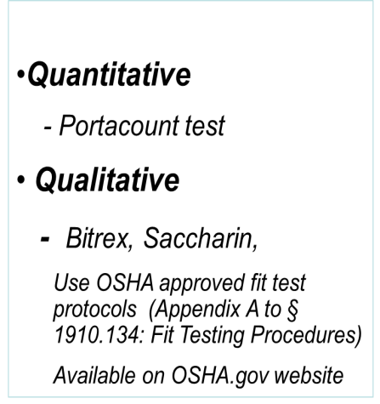
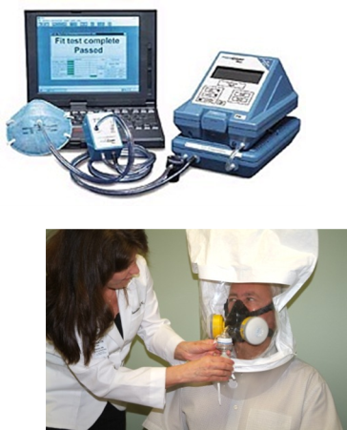
Type of Fit Testing
Notes:
Photo property of AgriSafe Network
Two types of Fit Testing
Need to use OSHA approved fit testing protocols
The fit test must be administered using an OSHA-accepted QLFT or QNFT protocol contained in Appendix A

Slide 32
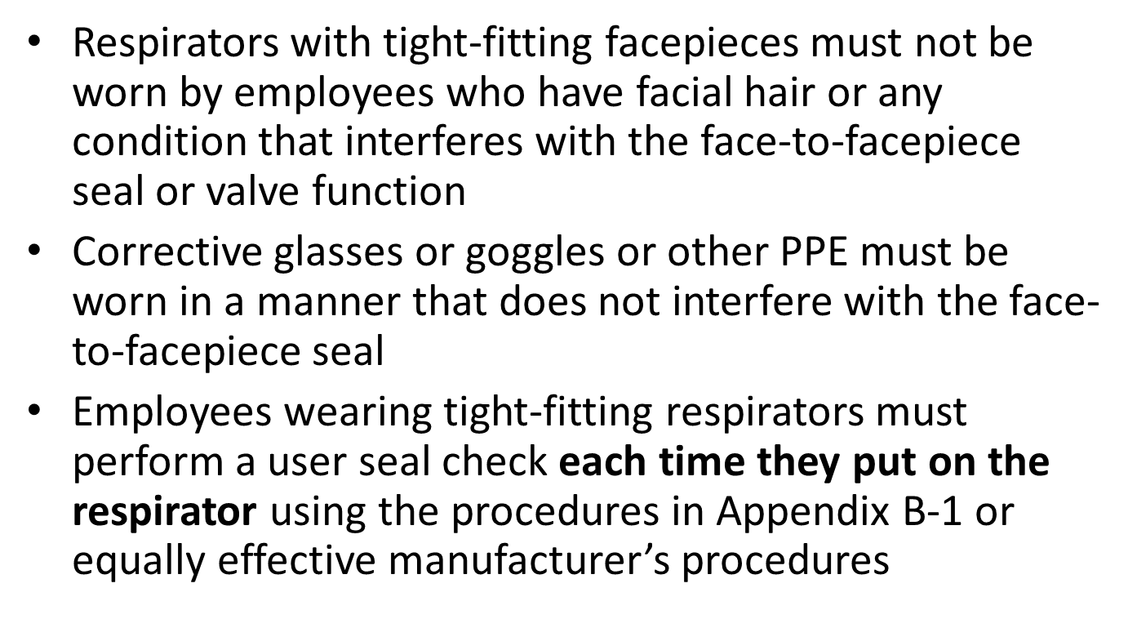
Use of Respirators
Facepiece Seal Protection
Notes:
Paragraph G of the Standard

Slide 33
User Seal Check
An action conducted by the respirator user to determine if the respirator is properly seated to the face.
Positive Pressure Check
Negative Pressure Check
Notes:
Photos from OSHA Website
User Seal check is part of teaching user to determine proper fit test when using respiratory protection

Slide 34
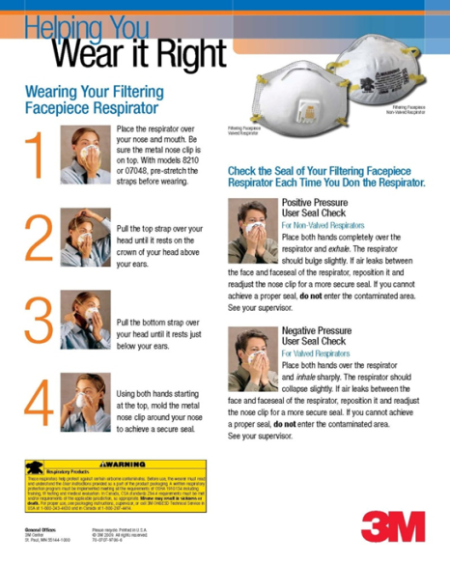
Filtering Face Piece Fit Test
Notes:
Filter face piece fit test method

Slide 35
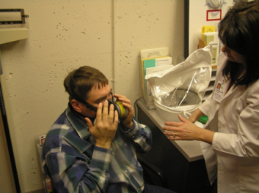
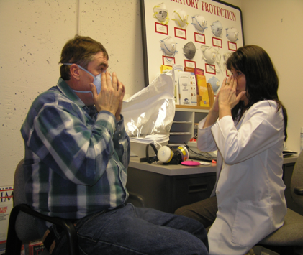
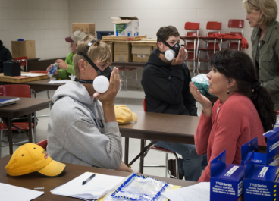
Demonstration - education
Notes:
Education needs to include demonstration to be effective
Photos property of AgriSafe Network

Slide 36
Use of Respirators
Continuing Respirator Effectiveness
Maintain appropriate surveillance of work area conditions and degree of exposure or stress; reevaluate the respirator’s effectiveness when it may be affected by changes.
Employees must leave the respirator use area:
  to wash their faces and respirator facepieces as necessary
  if they detect vapor or gas breakthrough, changes in breathing resistance, or leakage of the facepiece
  to replace the respirator or filter, cartridge, or canister
If employee detects vapor or gas breakthrough, changes in breathing resistance, or leakage of the facepiece, employer must replace or repair the respirator before allowing employee to return to the work area.
Notes:
Part of respiratory program includes continuing to evaluate respirator effectiveness by maintaining surveillance of work are conditions and degree of exposure or stress.
Respiratory effectiveness may be affected by changes.
Instruction needs to include when to leave respirator use area and they also must know when to replace or repair their respirator

Slide 37
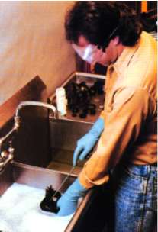
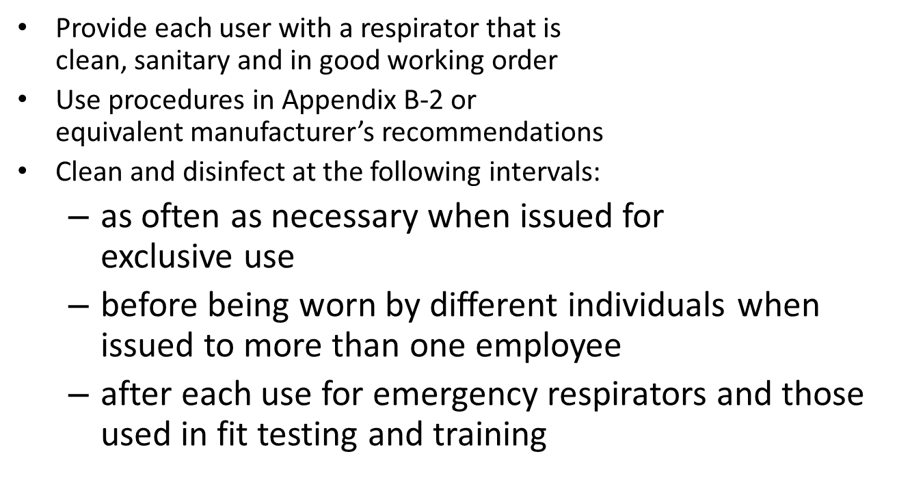
Maintenance and Care
Notes:
Photo from OSHA website
Maintenance and Care is a critical part of the respiratory program
Follow procedures in Appendix B-2 or by manufactures recommendations
Establish a cleaning procedure and guidelines

Slide 38

Proper Storage
Important to store the respirator properly
Sometimes may throw away the 2 strap dust mask (filtering facepiece)
Notes:
May need to delete this slide due to limited time

Slide 39
Identification of Filters,
Cartridges, and Canisters
All filters, cartridges and canisters used in the workplace must be labeled and color coded with the NIOSH approval label
The label must not be removed and must remain legible
“TC number” is no longer on cartridges or filters (Part 84)
Marked with “NIOSH”, manufacturer’s name and part number, and an abbreviation to indicate cartridge or filter type (e.g., N95, P100, etc.)
Matrix approval label supplied, usually as insert in box
Important to use same manufacture for cartridges as respirator facepiece
Notes:
All filters, cartridges and canisters
used in the workplace must be labeled
and color coded with the NIOSH
approval label
The label must not be removed and must remain legible
“TC number” is no longer on cartridges or filters (Part 84)
Marked with “NIOSH”, manufacturer’s name and part number, and an abbreviation to indicate cartridge or filter type (e.g., N95, P100, etc.)
Matrix approval label supplied, usually as insert in box

Slide 40
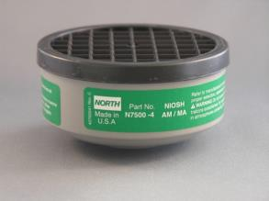
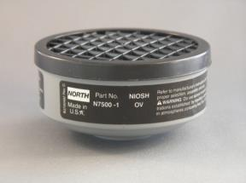
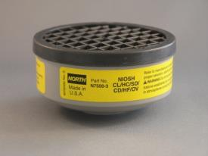
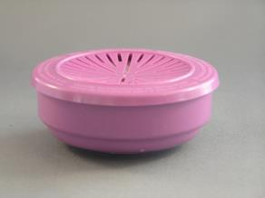
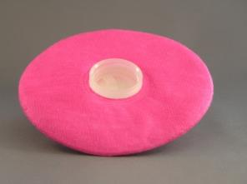
Half Mask Cartridges
Ammonia
Organic Vapor
Acid Gas
North Products
P100
P100
Mention of any company name in our presentations does not constitute an endorsement by AgriSafe
40
Notes:
Types of cartridges for canister respirator – photos property of AgriSafe Network

Slide 41
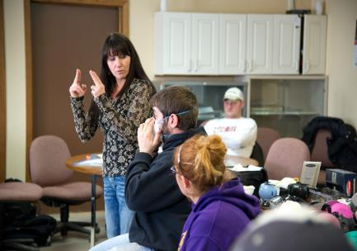
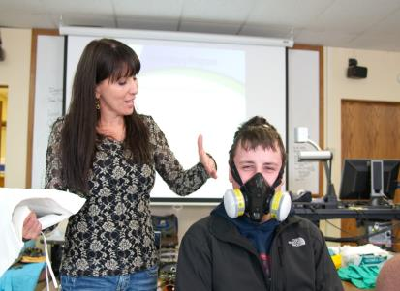
Training and Information
Employers must provide effective training to employees who are required to use respirators.
Notes:
Photos property of AgriSafe Netork
Effective training is part of training and information for employees who are required to wear respirators

Slide 42
Training and Information
Employees who are required to use respirators must be trained such that they can demonstrate knowledge of at least:
  why the respirator is necessary and how improper fit, use, or maintenance can compromise its protective effect
  limitations and capabilities of the respirator
  effective use in emergency situations
  how to inspect, put on and remove, use and check the seals
  maintenance and storage
  recognition of medical signs and symptoms that may limit or prevent effective use
  general requirements of this standard
Notes:
Employees who are required to use respirators must be trained such that they can demonstrate knowledge of at least:
why the respirator is necessary and how improper fit, use, or maintenance can compromise its protective effect
limitations and capabilities of the respirator
effective use in emergency situations
how to inspect, put on and remove, use and check the seals
maintenance and storage
recognition of medical signs and symptoms that may limit or prevent effective use
general requirements of this standard

Slide 43
Training and Information (cont’d)
Training must be provided prior to use, unless acceptable training has been provided by another employer within the past 12 months
Retraining is required annually, and when:
  changes in the workplace or type of respirator render previous training obsolete
  there are inadequacies in the employee’s knowledge or use
  any other situation arises in which retraining appears necessary
The basic advisory information in Appendix D must be provided to employees who wear respirators when use is not required by this standard or by the employer
Notes:
Training must be provided prior to use, unless acceptable training has been provided by another employer within the past 12 months
Retraining is required annually, and when:
changes in the workplace or type of respirator render previous training obsolete
there are inadequacies in the employee’s knowledge or use
any other situation arises in which retraining appears necessary
The basic advisory information in Appendix D must be provided to employees who wear respirators when use is not required by this standard or by the employer

Slide 44
Program Evaluation
Must conduct evaluations of the workplace as necessary to ensure effective implementation of the program
Must regularly consult employees required to use respirators to assess their views on program effectiveness and to identify and correct any problems
  factors to be assessed include, but are not limited to:
  respirator fit (including effect on workplace performance)
  appropriate selection
  proper use
  proper maintenance
Notes:
Must conduct evaluations of the workplace as necessary to ensure effective implementation of the program
Must regularly consult employees required to use respirators to assess their views on program effectiveness and to identify and correct any problems
factors to be assessed include, but are not limited to:
respirator fit (including effect on workplace performance)
appropriate selection
proper use
proper maintenance

Slide 45
Record Keeping
Records of medical evaluations must be retained and made available per 29 CFR 1910.1020
A record of fit tests must be established and retained until the next fit test is administered
A written copy of the current program must be retained
Written materials required to be retained must be made available upon request to affected employees and OSHA
Notes:
Records of medical evaluations must be retained and made available per 29 CFR 1910.1020
A record of fit tests must be established and retained until the next fit test is administered
A written copy of the current program must be retained
Written materials required to be retained must be made available upon request to affected employees and OSHA

Slide 46
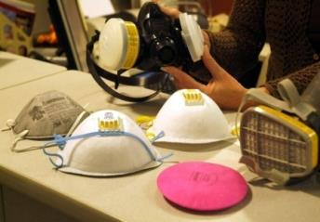
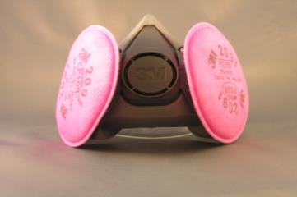
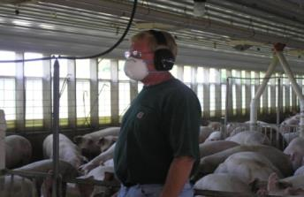
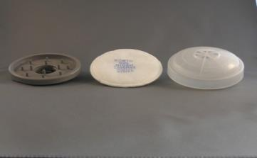
Choices and Comfort
Notes:
Photos property of AgriSafe Network
Important to have Choices and Comfort even when the Respirator is part of a Respiratory Program

Slide 47


OSHA Resources
Available on www.OSHA.gov Website
In search bar type Respiratory Program
Notes:
OSHA Resources available on OSHA. Gov
How to get to this location
Search Bar
A-Z Index

Slide 48
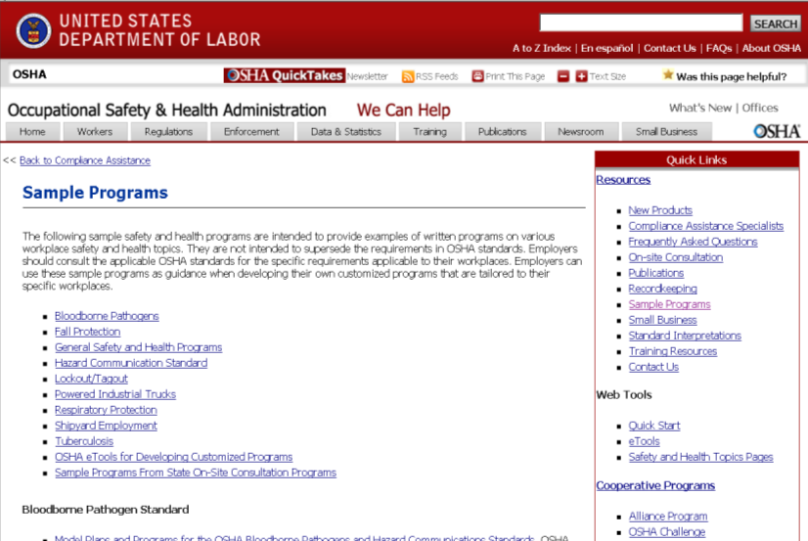
Information Resources - Sample programs
Respiratory Protection Respiratory Program
Notes:
Step by Step on how to get to right area

Slide 49
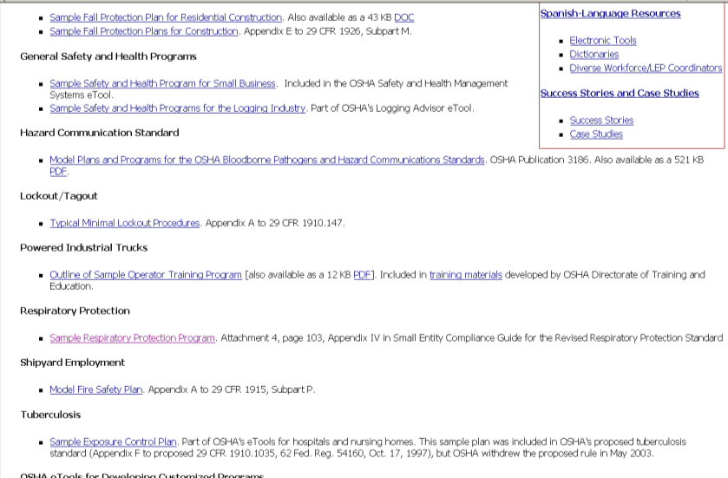
OSHA Sample Respiratory program
Respiratory Protection Respiratory Program
Sample Respiratory Program
Notes:
Sample Respiratory Protection Program

Slide 50
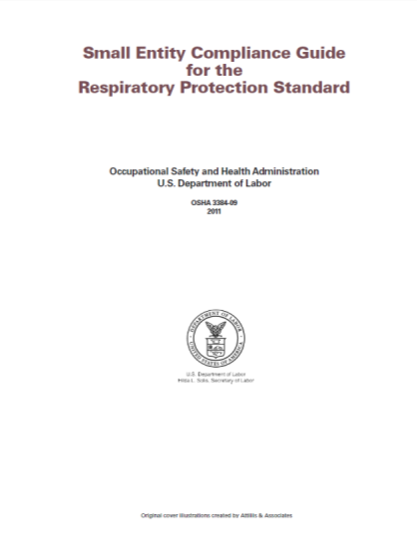
OSHA Resource
Notes:
On line printable OSHA Resource – OSHA Publication 3384-09 2011
‘ Small Entity Compliance Guide for the Respiratory Protection Standard’
The Guide includes all aspects of the Standard, including a sample program

Slide 51
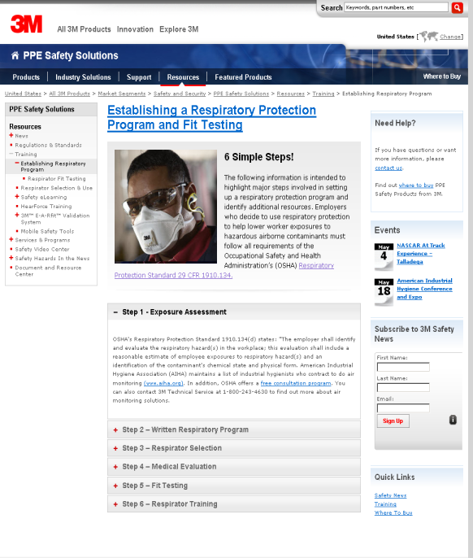
3M Sample Respiratory Program
Notes:
3M has a good online resource
Specific Step by Step Guide

Slide 52
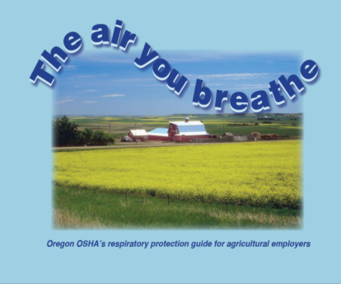
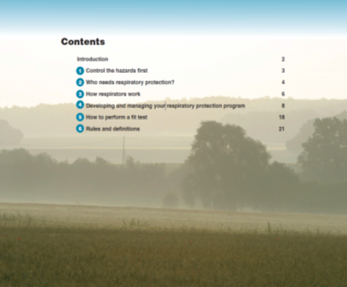
Oregon OSHA Resource
Oregon OSHA Resource Center and AV Library:
Phone: (503) 947-7453 or (800) 922-2689
tech.web@state.or.us
www.osha.oregon.gov
Notes:
Oregon OSHA resources include an agricultural specific respiratory protection guide for agricultural employers
How to find this resource:
Oregon OSHA

Slide 53
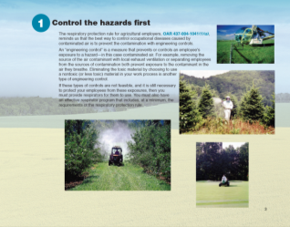
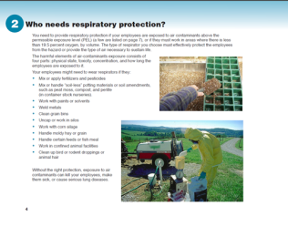
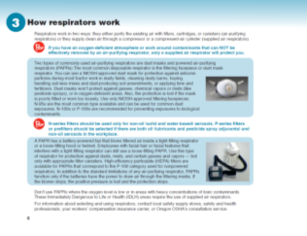
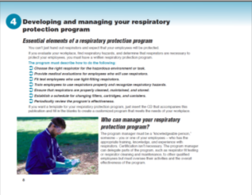
Step by Step Resource
www.osha.oregon.gov
Notes:
Oregon OSHA resources include an agricultural specific respiratory protection guide for agricultural employers
How to find this resource:
Oregon OSHA

Slide 54
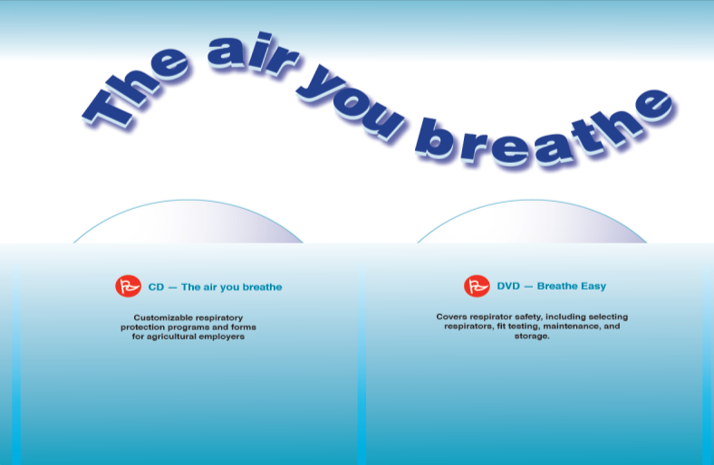
Oregon OSHA Resource
Customizable respiratory
protection programs and forms
for agricultural employers
Covers respirator safety, including selecting
respirators, fit testing, maintenance, and
storage.
www.osha.oregon.gov
Notes:
Oregon OSHA resources include an agricultural specific respiratory protection guide for agricultural employers
How to find this resource:
Oregon OSHA

Slide 55
Agriculture OSHA Resources
Available on www.OSHA.gov Website
In search bar type
Agriculture Operations Safety and Health Topics
Notes:
Go to our website to find more information

Slide 56

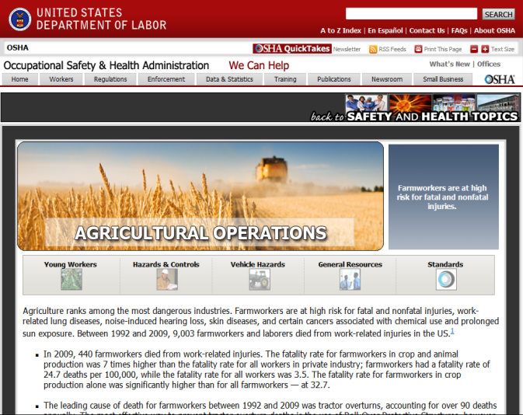
Agriculture Operations
Safety and Health Topics Page
General Resources

Slide 57

Agriculture Operations
Safety and Health Topics Page
Standards
Notes:
Agricultural Operations Safety and Health Topics Page on OSHA website

Slide 58
Employee Rights and Responsibilities
You have the right to:
  A safe and healthful workplace
  Know about hazardous chemicals
  Information about injuries and illnesses in your workplace
  Complain or request hazard correction from employer
Notes:
Review Employee Rights

Slide 59
Employee Rights and Responsibilities
You have the right to:
  Training
  Access to hazard exposure and medical records
  File a complaint with OSHA
  Participate in an OSHA inspection
  Be free from retaliation for exercising safety and health rights
Notes:
Review Employee Rights

Slide 60
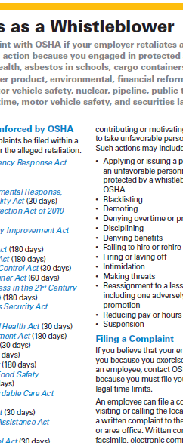
Whistleblower Fact Sheet
(FS 3638)
Notes:
Review Employee Rights – OSHA Publication Fact Sheet (FS) 3638

Slide 61

Whistleblower Protection Program

Slide 62
Test Questions
1. The Medical Evaluation must be completed by a physician or licensed health care provider (PLHCP). T___ F___
Answer: True. The Medical Evaluation report must be completed by a PLHCP. The PLHCP can be a physician, physician assistant, or nurse/nurse practitioner trained in the process and whose scope of practice allows him or her to do so. The pulmonary function or fit test process can be administered by a provider specifically trained to do so (i.e. respiratory technician, nurse, etc.).
2. The only type of respirator that does not need a written respirator program protocol is the filtering face piece used in a voluntary use setting. T___ F___
Answer: True
3. Training must be provided initially prior to respirator use and when there are changes in the work setting. T___ F___
Answer: True the only exception would be a situation in which acceptable training has been provided and documented within the past 12 months by a previous employer
4. Elements of a Respiratory Program do not include:
a. respirator selection
b. fit testing
c. medical evaluation
d. breathing air quality and use
e. elimination of voluntary respirator use
Answer: e – there is a voluntary use component related to filtering face pieces

