Slide 1
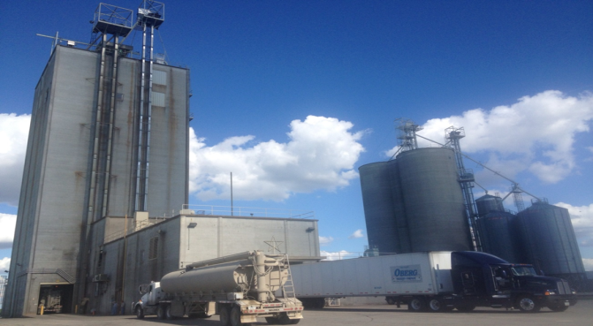
Advanced Methods of Grain Dust Control!
Photo: KSU
Notes:
Welcome to the Training on Advanced Methods of Grain Dust Control. This training program is being delivered to create awareness on combustible grain dust and learn about some advanced grain dust control mechanisms available for the grain processing industry. This presentation the seriousness of grain dust accumulations and how to avoid grain dust explosions.
Materials will be available on OSHA and K-State website
Thank you for being here, let’s go around and introduce ourselves!

Slide 2
Grain Dust Control
Grantee: Kansas State University, Department of Grain Science and Industry; Manhattan, Kansas
Grantor: U.S. Department of Labor, Occupational Safety & Health Administration, Susan Harwood Training Grant Program Award Number: SH-24936SH3
Project Title: Training on Advanced Methods of Grain Dust Control within the Grain Handling and Processing Industry
Project Period: 2013-2014

Slide 3
Disclaimer
This material was produced under grant number SH-24936-SH3 from the Occupational Safety and Health Administration (OSHA) of the U.S. Department of Labor. It does not necessarily reflect the view or policies of the U.S. Department of Labor, nor does mention of trade names, commercial products, or organizations imply endorsement by the U.S. Government.
This training manual was produced by Kansas State University, Department of Grain Science and Industry; Manhattan, Kansas.
The information in this power point presentation has been compiled from a variety of sources believed to be reliable and to represent the best current opinion on the subject. However, neither Kansas State University nor its authors guarantee accuracy or completeness of any information contained in this publication, and neither Kansas State University or its authors shall be responsible for any errors, omissions, or damages arising out of the use of this information. Additional safety measures may be required under particular circumstances.

Slide 4
Module –I
Introduction to Combustible Dust
Notes:
In this first module we will show the perils of grain dust explosion and the devastating damage an explosion can cause to an industry and a facility.

Slide 5
Learning Objectives – Module I
Become aware of the past grain dust explosion incidents in the U.S.
Understand dust explosion pentagon
Learn about primary and secondary explosions
Learn about good housekeeping practices

Slide 6
Grain dust explosion incidents from 2006-2012
Grain dust explosion incidents from 2006 - 2012
Source: KSU & NGFA, 2013
Notes:
As we can see, the number of explosions are not constant. While these numbers are lot less than what happened in 1980’s and 90’s, the long-term consequences of any explosion affect individuals, families, facilities and communities. 2006 to 2012 data was recently compiled by Drs. Bob Schoeff and Kingsly Ambrose of KSU, in collaboration with National Grain and Feed Association.
Permission for data granted from Drs. Bob Scheoff, Kingsly Ambrose, and NGFA

Slide 7
Grain dust explosion incidents from 2006-2012 by month
Grain dust explosion incidents from 2006 – 2012 (by month)
Notes:
Grain dust explosions occur irrespective of time or season. But most of the explosions has happened in the month of August. It might be that we start receiving grains in August and due to the volume of grains that is handled, the amount of dust generated is high.
Permission for data granted from Drs. Bob Scheoff, Kingsly Ambrose, and NGFA

Slide 8
And They Happen Today…
Since 1979 there have been over:
  184 deaths
  677 recorded injuries in the US due to grain dust explosions
  An average of 12 grain dust explosions per year in the US
  In the last decade, injuries and deaths have been greatly reduced even though grain handling volume has significantly increased
Notes:
Since 1979 there have been over 184 deaths and over 677 recorded injuries in the US due to grain dust explosions according to data collected by the Occupational Safety and Health Administration. These are the injuries that are reported. In the US, all fatalities and 3 or more hospitalizations have to be reported to OSHA.
Explosions do occur in other countries, but data is harder to mine for international incidents.
Do you remember some recent grain dust explosions?
Over the next several slides we will explore some of the explosions.

Slide 9
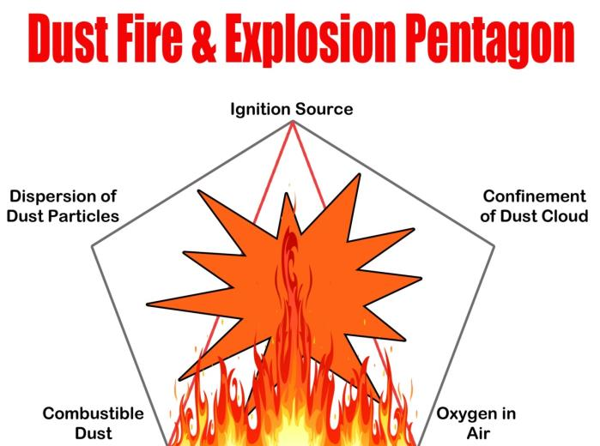
Dust fire & explosion pentagon
Photo: KSU
Notes:
Only three elements are needed for a fire, an ignition source, fuel or for the purposes of our discussions, combustible dust, and oxygen. A fire will burn hot, or flash, but add confinement and dispersion to the mix and you have the deadly ingredients for an explosion.
Due to the smaller particle size, grain dust is even more explosive than coal dust. Coal dust, an actual fuel!
Lets talk about each one individually.

Slide 10
Dust fire & explosion pentagon
Photo: KSU
Notes:
Only three elements are needed for a fire, an ignition source, fuel or for the purposes of our discussions, combustible dust, and oxygen. A fire will burn hot, or flash, but add confinement and dispersion to the mix and you have the deadly ingredients for an explosion.
Due to the smaller particle size, grain dust is even more explosive than coal dust. Coal dust, an actual fuel!
Lets talk about each one individually.

Slide 11

Oxygen
Always present
  Air is approximately 20% oxygen
Can’t be eliminated in grain handling and processing facilities
Notes:
So what is oxygen? It is the third most abundant chemical element in the universe.
It is all around you and not something that can be controlled easily.

Slide 12
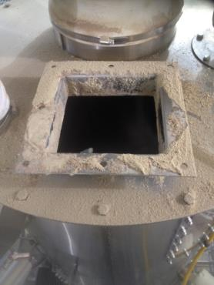
Fuel – Combustible Dust
Always present in grain facilities
One metric tonne of grain contains about 1-5 kg of dust
Housekeeping is key
Photo: KSU
Notes:
There is never a shortage of dust in a grain processing or storage facility. It is everywhere. It is sitting on ledges up high, where it can’t always be seen. It is the single most challenging component to manage within the pentagon, but it is also the most important. Not only is dust an issue with a primary explosion, but once the dust becomes airborne it creates continuous fuel to explode over and over until the fuel source is maxed out.
The best way to reduce the dust is through housekeeping, which will be discussed in depth in future lectures.

Slide 13

Ignition Source
Potential sources
  Welding
  Overheated bearings
  Friction from choked legs
  Tramp metal introduced in receiving
  Static Electricity
  Sparks from other sources
Photo: KSU
Notes:
What do you think are some potential ignition sources in your facility?
There are several different potential contributing factors listed here that could provide the spark or heat needed for an explosion. I talked about the fire triangle, all you really need is oxygen, fuel and an ignition source to create a fire, but if you add the two additional elements, confinement and dispersion, you have an explosion, so it is important to reduce the possibility of an ignition source through behavioral and engineering controls. These include preventive maintenance grating on dump pits to prevent tramp metal from being introduced to a system as well as hot work permits when performing welding activities. This is the second area that can be controlled of the five elements needed for an explosion.
Start with definition of the word.
Give an example (if appropriate)
Give a preventative method.
Parallel delivery makes the discussion easier to follow.

Slide 14
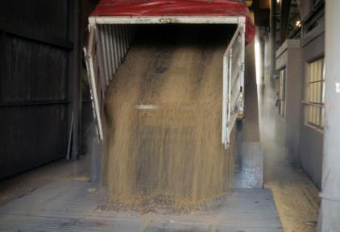
Dispersion
The particle size of dust is very small
Dust particles dispersed in air as dust clouds
Dispersion of dust settled due to primary explosion
Photo: KSU
Notes:
Dispersion is the effect of moving the cloud of dust from one place to another, may it be by mechanical processes such as transporting grain or occur during unloading. In addition, dispersion often happens as the result of a primary explosion, which will be discussed later in this lesson. The best way to control dispersion is through good housekeeping, by preventing dust accumulation in areas that can’t always been seen, such as high ledges. In addition, mineral oil can be applied to reduce the amount of dust generated and there are other engineering controls that will be discussed later in this course.

Slide 15
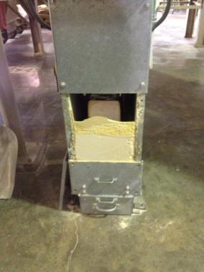
Confinement
List several areas within a grain processing facility that are confined
Not necessarily enclosed space, think restricted movement
Photo: KSU
Notes:
So far we have discussed almost all of the elements needed for an explosion, the last is confinement. Confinement doesn’t always mean an enclosed space, it really means restricted movement.
There are several places in a grain handling facility that are confined, can you think of a few…Several of these areas also have some of the other elements required for an explosion.
Some examples of confined space are: The building itself (dust dispersed in air), conveying/handling equipment, dust collectors.

Slide 16
Primary and Secondary Explosions
Dust
1. Dust settles on flat surfaces
2. A primary explosion disturbs the settled dust into a cloud
3. Dust cloud is ignited and a secondary explosion happens
Adapted from U.S. Chemical Safety Board
Notes:
Look at this phenomenon another way.

Slide 17
Safety – Everyone’s Responsibility
How do I keep myself safe?
How do I keep my co-workers safe? My facility?
  Look for accumulations of dust and remove them
  Where in the facility are there confinement areas?
  Identify and investigate possible sources of ignition
Notes:
Safety is truly everyone’s responsibility and in the US can actually lead to legal repercussions if not taken seriously. Safety really needs to be a mindset that is considered all the time because in that moment where it isn’t being considered, could be extremely dangerous. Safety is truly a culture.

Slide 18
Grain Dust Concentration
Minimum explosion concentration (MEC) for grain dust: 40 g/m³ (varies with particle size)
Notes:
Whenever we ignite any material, there will be release of energy (similar to burning coal for electricity generation). Unfortunately, in grain handling and processing industry, we are dealing with fine and dry dust particles that burn instantaneously. And here we are not talking about burning a single particle, but millions and billions of dust particles that are suspended in air as dust cloud or settled in the floor or walls or on top of equipment in our facility. If this millions and billions of dust particles ignite and burn at a single instance, we could imagine the amount of heat that it could produce and we all know the resulting effects from this burning – a devastating explosion that completely damages the facility.
Minimum explosion concentration (MEC) is the concentration of dust required to initiate an explosion. Minimum explosion concentration varies based on their particle size, moisture content, environmental humidity, distance from ignition source, etc. If the particle size of dust is higher or if the moisture content, environmental relative humidity is high, then the MEC will be high. i.e. the threshold level to start an explosion will be high. Optimum explosive concentration (OEC) is the concentration of dust that could explode even at a lower temperature spark from an ignition source.
Though the MEC is lower than the OEC, presence of dust at minimum EC could trigger a primary dust explosion. So it is our duty to clean up dust and be careful that the level does not reach to OEC level. Dust at OEC level could aid a secondary dust explosion.

Slide 19
Extent of Damage by Dust Explosion
Maximum pressure from corn dust explosion is greater than 100 psi.
Concrete structures (like elevators) withstand about 25 psi.
Most grain handling equipment will fail at pressures less than 6 psi.
Notes:
Data from U.S. Bureau of Mines
“Maximum explosive pressures can exceed 100 psi with the maximum rate of rise of pressure approaching up to 8500 [psi per second] which is an indication of the intensity and speed of a grain dust explosion. When the rate of rise of pressure is higher, explosions are more severe.” – James E. Maness, “Grain Industry’s approach to Dust Explosions”
James. E. Maness has giving his permission to use the quote.

Slide 20
Identifying Dust Hazards
Processes that use or produce combustible dust
Try to eliminate what is generating dust during grain transfers
  Misalignment in the bucket elevator belt
  Leaking conveyors and spouts

Slide 21
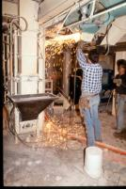
Preventing Ignition Sources
Enforce hot work permit
Have hazard monitoring/sensors on moving equipment (like conveyors and bucket elevators)
  If the alarm goes off, check the equipment immediately!
Watch for anything creating a spark or fire
Check the electrical wiring and
conduits for breaks/wear
Photo: KSU
Notes:
Calibration and preventative maintenance emphasis as required by manufacturer.
Photo: KSU

Slide 22
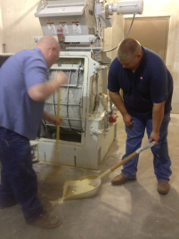
Practicing Good Housekeeping
Prevent dust accumulation
  Vacuum with proper equipment (NFPA 61)
  Compressed air (1910.272)
  Dry sweep with brooms
  Pay attention to “hidden areas”
    On top of beams
    Light fixtures
    Ledges
Establish a consistent housekeeping procedure and schedule
Photo: KSU
Notes:
When sweeping, use a soft-bristle and dissipated (anti-static) broom. Take care when sweeping to not stir the dust up into the air.
Train all employees on good housekeeping practices

Slide 23
Practicing Good Housekeeping
Maintain dust aspiration or ventilation systems at grain transfer points
Maintain dust aspiration systems on enclosed bucket elevators and conveyors
Clean out dust collectors and change filter bags at scheduled intervals
Clean out dust cyclone collector holding bins at scheduled intervals
Notes:
Grain turbulence and air entrainment will be very high at transfer points. High turbulence leads to separation of smaller dust particles entrained in the grain stream which results in higher dust generation. To contain the dust, aspiration systems should be connected at grain transfer points (for collecting the dust). Or else, a ventilation system should be designed at the transfer points to avoid dust accumulation within the grain conveying systems.
Dust aspiration systems (such as dust collectors) should be standard in bucket elevators and other closed conveyor systems such as drag conveyors. This will keep the dust collected within the conveying system at a low level.
Dust collectors in the facility should be cleaned at scheduled intervals by changing the filter bags to avoid clogging of the filter bags. Clogging of the bags reduces the efficiency of dust collection within the entire facility.
Dust cyclone collector bins should be cleaned and the dust collected removed frequently to keep the efficiency of the dust collection systems at the optimum performance level.

Slide 24
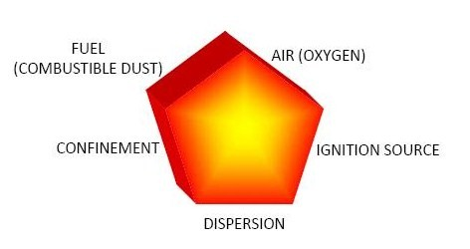
Pentagon
Remember the pentagon – What do we need for an explosion?
Notes:
Review the pentagon: what 5 elements do we need for an explosion? How about in a bucket elevator, conveyor, storage bin, etc.

Slide 25
Learning Objectives – Module I
Become aware of the past grain dust explosion incidents in the U.S.
Understand dust explosion pentagon
Learn about primary and secondary explosions
Housekeeping practices to prevent grain dust explosions

Slide 26
Module-II
Proper Grain unloading and grain handling

Slide 27
Learning Objectives – Module II
Understand how dust and small particles separate from grain stream
Learn about devices that aid unloading of grains at receiving
Understand the use of appropriate material handling techniques

Slide 28
How Dust And Small Particles Separate
Physics and gravity!
When moving grain down through spouts, loading a bin or down leg in an bucket elevator separation occurs:
  Smaller particles tend to stay in the air longer producing a grain dust cloud!
Notes:
The entrapped air in the grain bed increases the air turbulence during grain handling. The air adds to effect of flow and impact in separating the dust adhered on the grain surface. Since the dust particles are low in density, they suspend in air for longer duration forming dust clouds.

Slide 29
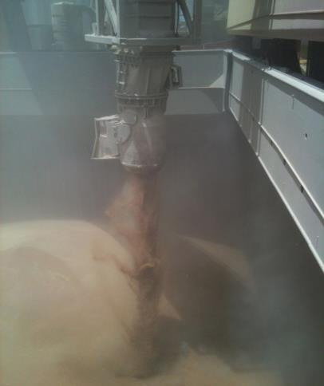
Example:
Photo: KSU
Notes:
Picture taken of loading vessel with wheat at CHS Myrtle Beach grain export elevator located in Belle Chasse, LA in July 2012
Explanation of both examples:
1- Bucket elevator: as grain or its co-products (i.e. Dried Distillers Grains, Soybean Meal) falls through the down leg in the elevator, separation will occur due to the different particle sizes and weight.
2- Unloading spout: as grain is unloaded, bigger particles will fall down faster due to gravity (bigger size and weight), smaller particles tend to stay in the air causing a grain dust cloud.

Slide 30
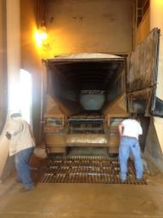
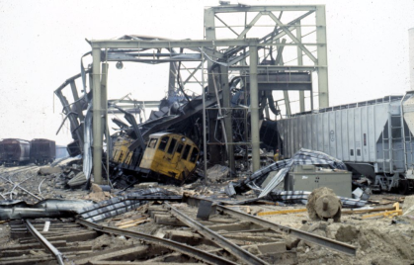
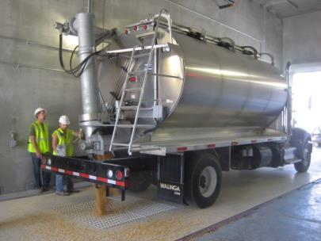
Grain Receiving
High dust generation
Turbulence and impact
Photo: KSU
Source: k-rex.k-state.edu
Photo: KSU
Notes:
As we saw in the previous module presentation, grain receiving is the high dust generation area. The higher turbulence due to flow of grains and the impact of grains leads to higher dust generation. The bottom (left) picture shows an explosion that has occurred/originated in a grain receiving area.
How we can reduce high dust generation in grain receiving area?

Slide 31
Discussion
How can we reduce high dust generation in grain receiving area?

Slide 32
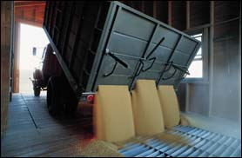
Grain Receiving
Controls used at unloading and loading areas:
  cyclones
  fabric filters
  baffles in unloading pits
  choke unloading
  use of deadboxes
  specially designed spouts for grain loading
Source: OSHA
Notes:
Grain receiving is an area with potential for high amount of dust generation. To avoid this high amount of dust that potentially could settle in the industry premises, controls like cyclones, fabric filters, etc., could be used. These controls the flow of grains during unloading and resist the separation of dust from grain surface.

Slide 33
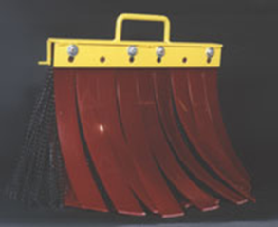
Grain Receiving
Install dump pit baffles on truck dump pits to provide a major reduction in airborne dust during dumping operation.
Chute baffles for unloading/conveyor – Reduces about 30% dust emissions
Notes:
Dump pit baffles and chute baffles are other common flow restrictors that could be used in grain receiving areas. If we can control the air borne dust, the secondary explosion risks can be greatly reduced.

Slide 34
Materials Handling Techniques
Avoid grain turbulence at grain transfer points
  Unload grain uniformly to avoid changes in flow that can create turbulence
  Any time a stream “opens up” (fans out), dust and other smaller particles escape the stream/are released
  Unload grain in well ventilated areas outside of buildings

Slide 35
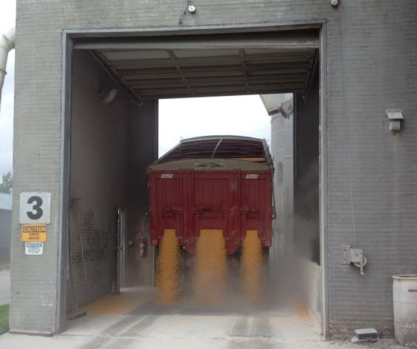
Example of Grain Turbulence:
Photo: KSU
Notes:
Show example of grain turbulence as it opens-up from the conveying of the screw. What is good? Answer: Unloading in a well ventilated area and even flow.
Explanation: As grain comes from the auger into the open space, the open space allows all the particles and whole grain to spread out causing turbulence and allowing the dust particles to stay in the air longer, therefore creating dust cloud.

Slide 36
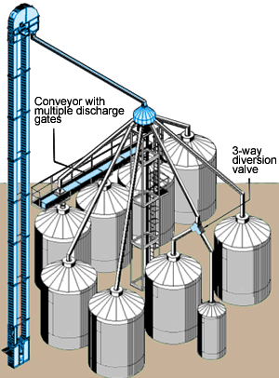
Spouting
Spouting must be steep enough for the material being conveyed to slide down the spout.
Spout must be of adequate size to convey materials at the rate required.
Notes:
Spouting are used to convey the materials by gravity. Due to the speed and volume of grain movement, there will be potential high amount of dust that generates inside the spouting. So, if there is a choke or leakage, the dust becomes airborne within the grain handling facility.

Slide 37
Spouting Types and Sizes
Recommended Minimum Spout Slopes (Industry Practice):
Whole Grains
  A. Dry Grain 40 deg.
  B. Wet Grain 45 deg.
Ingredients
  C. Free Flowing 50 deg.
  D. Difficult Flowing 60 deg.
Feed
  E. Mash Types 50 deg.
  F. Pellets 45 deg.
Spout
Slope
Angle
Horizontal Plane
Notes:
These are some of the recommended minimum spout slopes to avoid grain being choked within the spout. If there is a choke in the spouting, this could lead to overload in the bucket elevator system that precedes the spouts. We do not want to overload the bucket elevators for the primary explosion risks that could arise.

Slide 38
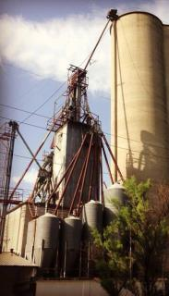
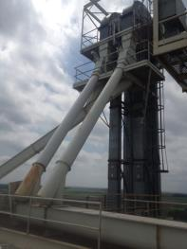
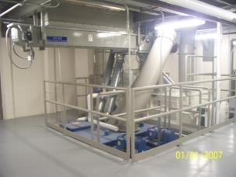
Spouts
  Designed to relieve or stop if the discharge end is plugged
  Dust tight spouts
  Spouts – lining at impact points and
  on wear surfaces
Photos: KSU
Notes:
These are some common precautions that we can follow to avoid overloading of spouts and or for avoiding leaks in spouts.

Slide 39
Spout Liners
Liners are used on the interior of spouts, usually square spouting to provide a longer wearing surface.
Lining material may be:
  Abrasion Resistant (AR) steel
  Ultra High Molecular Weight (UHMW)
  Ceramic tile
  Most liner materials are bolted in to allow replacement when worn out.
Notes:
Spout liners help in longevity of the pipes by protecting its inner surface and prevents crack formation in the spouts due to grain impacts and friction.

Slide 40
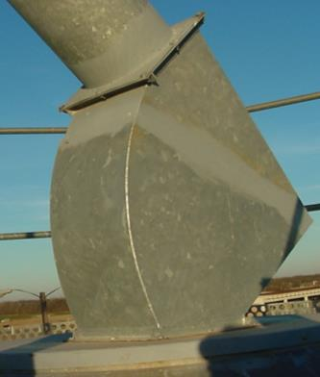
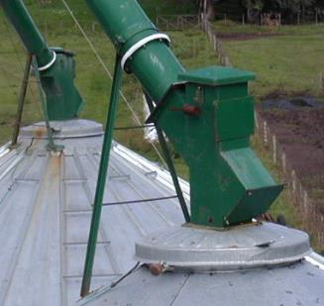
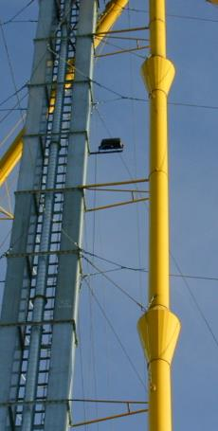
Usage of Appropriate Spouting Design
Cushions boxes
velocity reducers
Photos: KSU
Notes:
Usage of grain cushions to reduce speed of grain when coming through a spout. Picture taken from a grain elevator from Argentina.
Explanation: Cushions boxes allows grain to accumulate in one side creating a sort of cushion that allows the incoming grain from the spout to slow down by hitting the accumulated grain instead of hitting directly the metal of the connecting metal piece (between spout and grain bin) that can cause it to break into smaller pieces (grain dust).
Yellow spout: Has velocity reducers for grain that is falling through the vertical spout by gravity. In the velocity reducers, when the area or diameter of the spout is increased, the velocity is reduced, since flow of grain (Q) = cross sectional area (A) times grain velocity (v). Grain flow stays constant, so increase area will reduce velocity, Q/A = v.

Slide 41
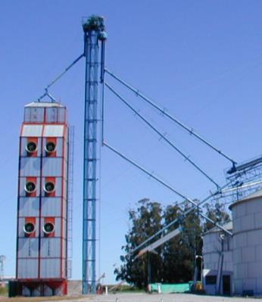
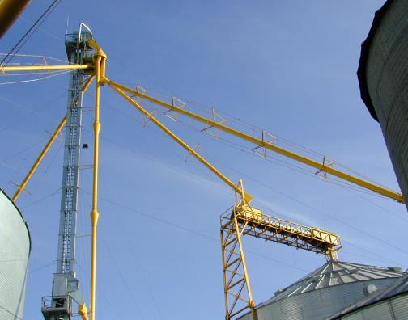
Avoid These Design in Spouts
Photo: KSU
Notes:
Example of problems in grain handling equipment that can create grain breakage (grain dust). Pictures from grain elevators in Argentina.
What is the problem? See red circles.
Answer: Vertical spouts (gravity) will increase the grain velocity, then it will hit the angle spouts to unload grain into the bins.
Avoid vertical spouts from grain distributors to grain bins. A vertical part will cause grain to increase its velocity so when it hits the other section of the angled spout, it can break into smaller pieces (grain dust).

Slide 42
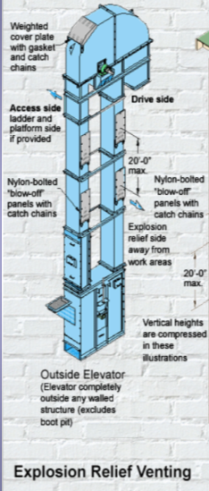
Bucket Elevators
Bucket elevators located within 3 m (10 ft) of an exterior wall
Proper vents (NFPA 68) and explosion suppression (NFPA 69)
Outside legs provided with explosion relief panels
Outside legs – Explosion vent in head section
Source: essmueller.com
Notes:
Bucket elevators have four elements required for a grain dust primary explosion to occur. So, our duty is to prevent the occurrence of ignition or ignition source in the bucket elevators.

Slide 43
Bucket Elevators
Replace steel cups with plastic cups in elevator legs to prevent possibility of a spark
Use anti-static belting material in legs and horizontal belt conveyors
Install quick-opening cleanout doors on leg boot side panels for grain and dust cleanout
Appropriate vents in bucket elevators
Notes:
These are some of the precautions that could be followed to avoid primary dust explosions from happening in a bucket elevator.

Slide 44
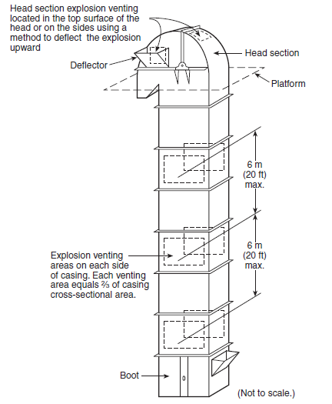
Typical elevator explosion venting for a single casing leg
Fig: Typical elevator explosion venting for a single casing leg (Source NFPA 61)
Notes:
This design is based on NFPA 61 standard to have proper venting in a single casing leg.

Slide 45
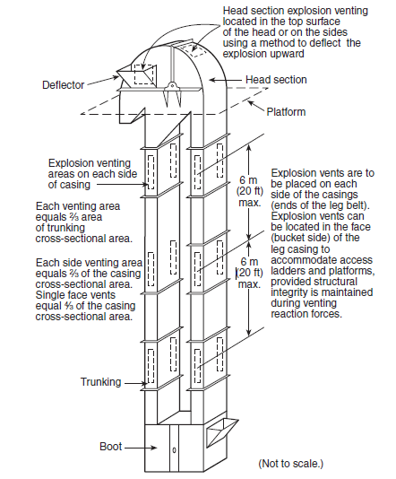
Typical elevator explosion venting for a double casing leg
Fig: Typical elevator explosion venting for a double casing leg (Source: NFPA-61)
Notes:
This design is based on NFPA 61 standard to have proper venting in a double casing leg.

Slide 46
Materials Handling Techniques
Use of appropriate equipment for grain conveying and handling
  Size or adjust speed of handling equipment to reduce dust
  Use grain cushions at the end of a down spouts into a bin to reduce grain breakage.
  Put covers on drag and belt conveyors and keep them closed when not in use.

Slide 47
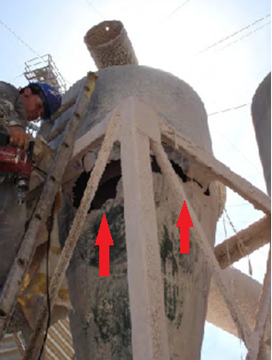
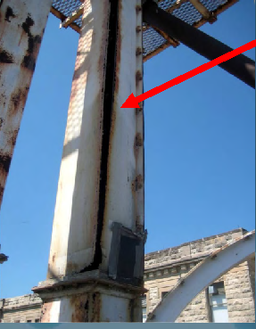
Perform Maintenance in Equipment
Photo: KSU
Notes:
Show examples of equipment that has not received any maintenance! Pictures from KSU.
Explanation of examples:
1- Hole in the cyclone will make it not to work properly for dust separation – NOT WORK EFFICIENTLY
2- Opening in bucket elevator leg will allow grain and dust to leak out and produce contamination and possible hazards
The possible hazards are:
Dust dispersion within the premises and ineffective dust collection

Slide 48
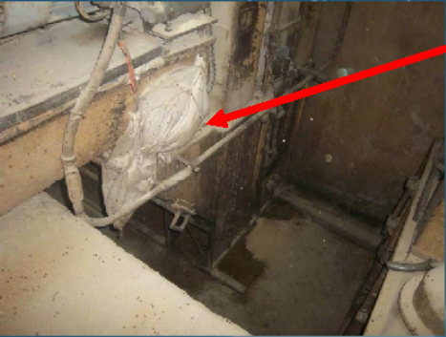
Avoid Possible Hazards
Photo: KSU
Notes:
Show example of what to avoid using red arrow (hole in the screw conveyor covered by duct tape). See dust all over the surrounding area.
Picture from KSU.
Screw conveyor has a hole and was partially repaired by putting a plastic bag and duct tape. This repair will not work properly and will allow grain and dust to leak out of the screw conveyor causing dust accumulation and possible grain dust hazards.

Slide 49
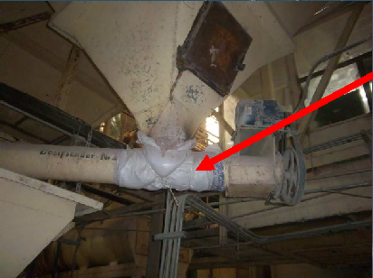
Avoid Possible Hazards
Photo: KSU
Notes:
Show example of plastic bag covering hole in screw conveyor below a hopper. Picture from KSU.
Screw conveyor has a hole and was partially repaired by putting a plastic bag and duct tape. This repair will not work properly and will allow grain and dust to leak out of the screw conveyor causing dust accumulation and possible grain dust hazards.

Slide 50
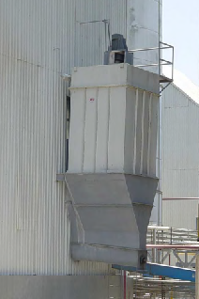
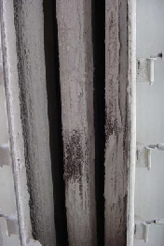
Performed Maintenance in Equipment
Photo: KSU
Notes:
Show example of equipment that has not received any maintenance!
Pictures from KSU.
Filter of dust collection system were not cleaned causing a decrease in dust collection efficiency.

Slide 51
Safeguards in Materials Handling Equipment
Perform maintenance on all handling and processing equipment in the facility to avoid dust leaks in:
  Spouts
  Bucket elevators
  Grain distributors
  Grain bins/silos
Notes:
Maintenance of equipment should be an important part of employee education & training. Through proper maintenance a grain handling or processing industry can avoid a primary explosion from happening.
Ask: What are those other safeguards?
preventive/predictive/proactive maintenance of belts, bearings…

Slide 52
Safeguards in Materials Handling Equipment
Perform maintenance on handling equipment
    Change worn bearings
    Do not over-grease bearings
    Change damaged drags or screw conveyors
    Replace worn head pulleys in bucket elevators
    Repair lose metal parts in any handling equipment
      Especially important when you have grinding or milling equipment in your facility

Slide 53
Materials Handling Techniques
Use of appropriate equipment for grain conveying and handling
  Install magnets to catch metals ahead of processing equipment (Hammer mill).
  Have easy access removal doors for inspection at the head and bottom of the bucket elevators.
  Make sure all motors and pulleys are properly aligned.

Slide 54
Materials Handling Techniques
Avoiding overload during handling
  Do not use handling equipment at the limits of their rated capacity.
  Do not overfill bucket elevator, screw and drag conveyors to avoid spills or to overload the motor.
  At transfer points, do not reduce handling capacity to avoid overflow or chokes.
  Bucket elevators shall not be jogged to clear a choked leg (Jogging is when an employee tries to force a loaded/choked belt to run).

Slide 55
Learning Objectives – Module II
Understand how dust and small particles separate from grain stream
Learn about devices that aid unloading of grains at receiving
Understand the use of appropriate material handling techniques

Slide 56
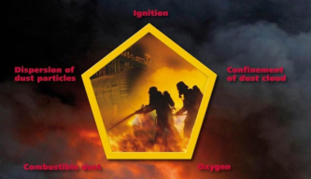
Module III
Advanced Engineering Controls
Source: www.powderbulksolids.com
Notes:
Photo: public site

Slide 57
Learning Objectives – Module III
Become aware of the safety precautions available for bucket elevators.
Learn about dust explosion suppression devices
Notes:
In this module, we will look into some of the safety precautions for grain handling equipment and learn about dust explosion suppression devices.

Slide 58
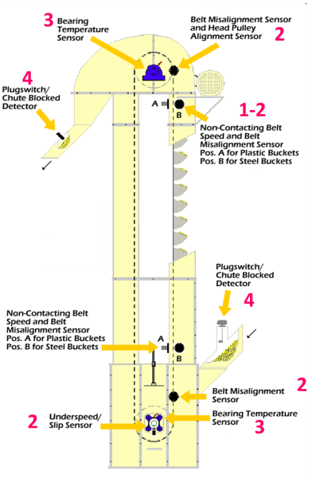
Safety Precautions
1. Belt speed sensors
2. Belt alignment sensors
3. Bearing temperature sensors
4. Plug switches
Safety Devices
Notes:
Safety devices in a bucket elevator to avoid dust related incidents. It is very important to have belt speed sensors, belt alignment sensors, bearing temperature sensors and plug switches to reduce the potential for sparking and avoid an explosion incident.
Anytime there are sensors, it is important to stress calibration and preventative maintenance. Ask the supplier/manufacturer to understand what the frequency of calibration and/or preventive maintenance should be.

Slide 59
Sensors for Bucket Elevators
Belt speed sensor
  10% change in speed – alarm
  20% change in speed – shut down
Notes:
Belt speed sensors – If the belt speed is too fast or slow, that should give an indication that there are issues within the bucket elevator system. A slow speed indicates overload on the system causing increase in bearing temperature. A high speed could indicate that the conveyor is not carrying enough material or some buckets are damaged resulting in less load and increased speed.

Slide 60
Sensors for Bucket Elevators
Belt alignment sensor
  Non-contact magnetic sensor
  Not affected by dust or material build up
  Adjustable Sensing Range of 1 to 3 Inches
Notes:
Belt alignment sensors – Tripping due to overload is a commonly faced issue in bucket elevator systems. An alignment sensor will warn the operator about the tripping issues so that it can be rectified before any mis-happenings.

Slide 61
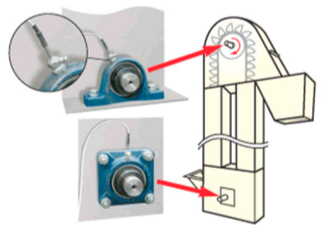
Sensors for Bucket Elevators
Bearing temperature sensor
Source: www.directindustry.com
Notes:
Bearing temperature sensors – Continuous use of bucket elevator system (without proper maintenance) could increase the temperature of bearings. This could result in generation of a spark leading to primary explosion of dust collected in head section.
Plug switches – Plug switches should be used to avoid overload of materials.
Photo: public website

Slide 62
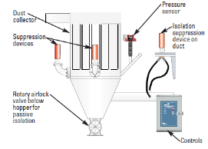
Explosion Suppression Systems
Depending on the industry and end use of grains:
Oil suppression systems
Dry chemical suppression systems
Pressure containment
Source: Johnson, Powder and Bulk Engineering, 2012
Notes:
In general, these are the three suppression or containment systems used by the industry to either suppress dust or to contain an explosion. Use of these systems depend on the end use of grains, the facility design and the type of equipment. In the following slides, we will have a detailed view on the suppression systems.
Photo: public, magazine article

Slide 63


Dust Explosion Protection Options
N₂
Containment
Deflagration Venting
Suppression
Oxidant Reduction
Deflagration Isolation
Source: BS&B Systems
Notes:
Due to advancement in science, we have different options to contain or suppress dust explosion and its effects. These are some of the examples of protection options that we have for containing dust explosion. As we talked about earlier, the protection options depends on the type of facility, type of equipment and the potential dust accumulation or collection. With the focus on employee safety and minimizing damage to the facility, if an explosion occurs, industry is free to adopt any of these methods.
Graphic: permission granted from BS&B Systems

Slide 64
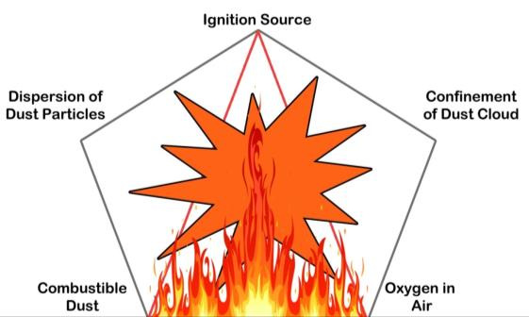
Group Activity!
List the places, in your facility, where you will need an explosion prevention equipment!
Notes:
The participants will be asked to form into small groups of 3-4 and then discuss and come-up with the list of places where we need a explosion prevention equipment. Emphasis the why is this important and what elements of the pentegon do you see in each example?
Some examples of places are:
Dust collector
Cyclone
Milling equipment
Bin
Bucket elevator

Slide 65
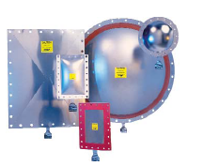
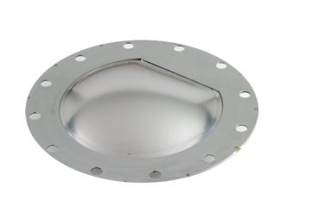
Venting
Explosion Venting:
  Explosion flame, pressure and unburned mixture are vented to a safe area.
Source: BS&B Systems
Source: FIKE Corp.
Notes:
Explosion venting is the most common and most used method for protection from dust explosion. Venting the flame, pressure, and unburned mixture saves the facility from damage and prevents further explosion from happening within the facility.
Photo: permission granted from BS&B Systems and FIKE Corp.

Slide 66
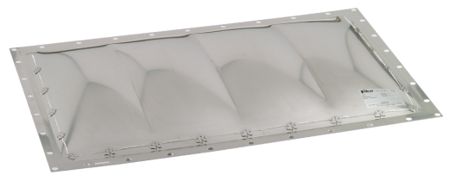
Vent Closures
Composite Vent:
Round, Square, Rectangular shapes
50-75% operating ratio of set burst pressure
Applicable both in extremely hot and cold conditions
Source: FIKE Corp.
Notes:
In this part of presentation we will learn about some of the available vent closure types. Composite vent covers most applications and provides an excellent service life for static to light pressure cycling conditions and partial vacuum conditions.
Photo: permission granted from FIKE Corp.

Slide 67
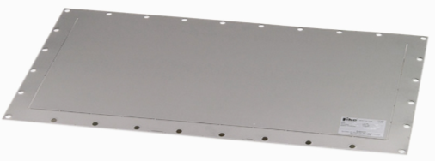
Vent Closures
Composite Vent (CV) with Support:
Provides all the features of the CV, with vacuum capabilities up to a full atmosphere, and when pressure cycles and /or equipment vibration are present.
Source: FIKE Corp.
Notes:
Photo: permission granted from FIKE Corp.

Slide 68
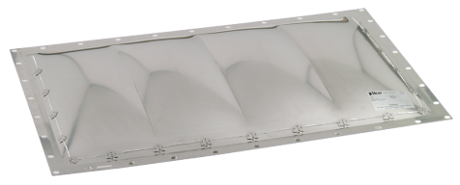
Vent Closures
Vmax Single Element Vent
Is provided for high vacuum service, or for applications involving heavy cyclic, or pulsing, duty.
Source: Fike Corporation
Notes:
Photo: permission granted FIKE Corp.

Slide 69
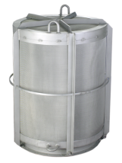
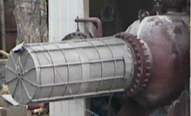
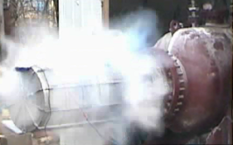
Flameless Venting
Deflagration venting through a listed dust retention and flame-arresting device
For indoor installations – eliminates need for equipment relocation or duct work
Must ensure that the room or building can withstand the pressure released during venting.
Source: FIKE Corp.
Source: BS&B Systems
Notes:
Graphic: permission granted from BS&B Systems and FIKE Corp.

Slide 70
Explosion Suppression
Suppressor
N₂
Suppressant
Fireball
Fireball 30 ft/s
Pressure Wave 1,100 ft/s
Pressure
Detector
Source: BS&B Systems
Notes:
The fireball that develops from a dust explosion could have a velocity of up to 30 ft/s with a pressure wave moving at a speed of up to 1100 ft/s. So, the pressure wave moves faster than the fireball. So, the explosion suppression devices are based on detecting the pressure and then quenching the pressure and the fire.
Graphic: permission granted from BS&B Systems

Slide 71
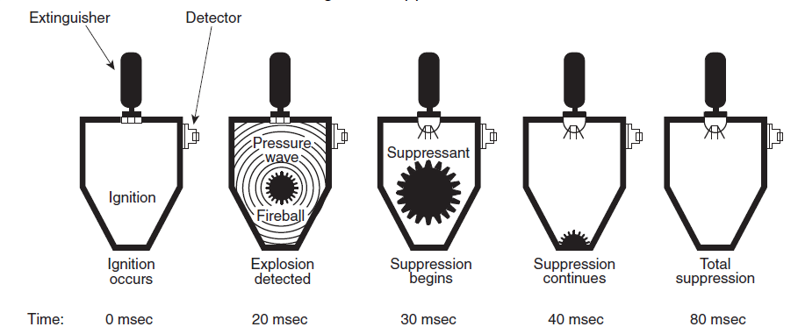
Deflagration Suppression
Source: NFPA 664
Notes:
From this slide we could see that a suppression system contains the pressure and fire from an explosion within 80 milli seconds. The suppression will be continued till the fire stops burning and there is no more dangers of secondary explosion in that vicinity.

Slide 72
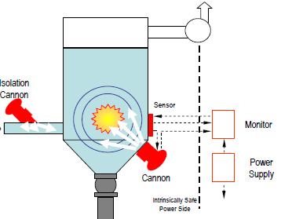
Suppression System Advantages
No major damage to dust collector
Limited downtime
Low Pressure System
Mounting flexibility
Customer Refit and Quarterly Inspections
Source: BS&B Systems
Notes:
Graphic: permission granted from BS&B Systems

Slide 73
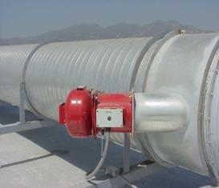
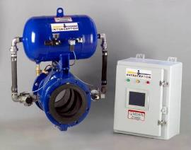
Isolation of equipment
Isolation of Equipment
To interrupt or mitigate flame, deflagration pressure, pressure increase, and ignition between enclosures that are interconnected by pipes or ducts.
Means of Isolation:
Chemical barrier
Fast-acting mechanical valve
Externally actuated float valve
Actuated pinch valve
Source: BS&B Systems
Notes:
Photos: permission granted from BS&B Systems

Slide 74

Explosion Isolation Methods
Chemical Isolation
Protect any size duct
Can trigger with pressure sensor or vent burst sensor
Lowest cost option
Mounting options
Source: BS&B Systems
Notes:
Photo: permission granted from BS&B Systems

Slide 75



Explosion Isolation Methods
Mechanical Isolation
Prevent propagation of flame through piping
Fast acting knife gate valve.
Pinch valve
Rotary valve of suitable construction
Source: BS&B Systems
Notes:
Photos: permission granted from BS&B Systems

Slide 76
Chemical vs. Mechanical Isolation
Chemical Isolation
Most Economical
Fast response~2 msec
Requires 4’ to 12’ of duct length
Easy retrofit or new installation
Flexible; functions with round or rectangular ducts
Can be triggered by pressure sensor or vent with burst sensor
Mechanical Isolation
More expensive
Slower response requiring between 20’ and 50’ of duct length
Available in round configuration only
Heavier construction
Can be triggered by pressure sensor or vent with burst sensor

Slide 77
Bucket Elevator Protection:
Suppression & Isolation
Potential Sources of Ignition:
Head / Boot Friction
Head / Boot Bearing Heat
All Zones Electrostatic Discharge*
All Zones Tramp Metal Sparks
* High risk ignition source for materials having low MIE (minimum ignition energy).
Source: BS&B Systems
Notes:
Since we learned from the previous modules that bucket elevators are the major ignition source that we see in a grain handling and processing industry. In this part of presentation, we will take a look at the potential areas where ignition could occur and the places in a bucket elevator where we could place a suppression or isolation device.
Graphic: permission granted from BS&B Systems

Slide 78
Bucket Elevator Protection:
Suppression & Isolation
Single Leg Construction:
Protect the ‘head’ with suppression (red) and isolation (orange) cannons
Protect the ‘boot’ with suppression (red) and isolation (orange) cannons
Protect the legs with suppression (red) cannons triggered by sensors distributed to detect ignition at any location
Source: BS&B Systems
Notes:
Graphic: permission granted from BS&B Systems

Slide 79

Bucket Elevator Protection:
Suppression & Isolation
Double Leg Construction:
Protect the ‘head’ with suppression (red) and isolation (orange) cannons
Protect the ‘boot’ with suppression (red) and isolation (orange) cannons
Protect the legs with isolation (orange) cannons as flame propagation barriers*
Notes:
Graphic: permission granted from BS&B Systems

Slide 80
OSHA Regulations
Worker Responsibilities
  Section 5(b) of the OSH Act states that each employee shall comply with occupational safety and health standards and all applicable rules, regulations and orders.
  Workers are encouraged to follow all appropriate safety and health rules, and wear protective equipment while working.
Notes:
As an employee or worker, you have a responsibility to comply with OSHA standards. Not only is it required by OSHA, by abiding by safety and health rules, you can assure that you are being responsible for your safety.

Slide 81
OSHA Regulations
Worker rights and responsibilities
  Right to a safe and healthful workplace
  Right to know about hazardous chemicals
  Right to information about injuries and illnesses in your workplace
  Right to complain or request hazard correction from employer
  Right to training
  Right to access hazard exposure and medical records
  Right to file a complaint with OSHA
  Right to participate in an OSHA inspection
  Right to be free from retaliation for exercising safety and health rights
Notes:
As an employee, you have the right to know. You have the right to work in a safe work environment, and this includes knowing about any hazardous chemicals you might be exposed to. You have the right to information regarding injuries and illnesses that occur at your workplace. You have the right to inform employers of unsafe work environments and the right to resolution of those issues. If hazards aren’t addressed, you have the right to share that information with OSHA without retaliation. It is required that you have training, and your right as an employee to be trained specifically on hazards in your facility.

Slide 82
OSHA Regulations
Employer Responsibilities
  Provide a workplace free from recognized hazards & comply with OSHA standards
  Provide training required by OSHA standards
  Keep records of injuries and illnesses
  Provide medical exams and access to exposure and medical records
  Not discriminate against workers who exercise their rights
  Post OSHA citations and abatement verification notices
  Provide and pay for PPE
Notes:
Just as workers have responsibilities, employers do as well. Employers responsibilities are centered around providing the required information necessary to workers to keep them safe. Included in those responsibilities are the right to provide a hazard free workplace and comply with OSHA standards. In addition, provide training as required by OSHA, keep records of all injuries and illnesses. In addition, employees can not be discriminated against when exercising their rights, so as an employer it is important to understand workers rights as well.
In addition, as an employer, there is responsibility of providing and paying for PPE as required to perform a job safely.

Slide 83
OSHA Regulations
If you, your co-workers and/or your union representative determine that an OSHA inspection is needed to get workplace hazards corrected, you have several options.
  You can download the complaint form from OSHA's website, complete it and mail or fax it to OSHA. A written, signed complaint submitted to the OSHA area or State Plan office is most likely to result in an onsite inspection.
  You can file a complaint online. However, most online complaints are handled by OSHA's phone/fax system, which means they are resolved informally over the phone.
  You can telephone or visit your local, regional or area office to discuss your concerns. After the discussion, OSHA staff can give or send you a complaint form if you wish to file.
  Note that if a hazard is life-threatening, call the Regional or local office or 1-800-321-OSHA immediately.
Notes:
As an employee, you are free to file a complaint in the event that your safety and health issues aren’t addressed locally.

Slide 84
OSHA Regulations
Whistleblower Protection
  You may file a complaint with OSHA if your employer retaliates against you by taking unfavorable personnel action because you engaged in protected activity relating to workplace safety and health
  Complaints must be filed in writing, following OSHA guidelines
Notes:
Section 11(c) of the Act prohibits your employer from discharging or in any manner retaliating against you or any worker for exercising your rights under the Act. We've covered many of your rights under OSHA earlier. Can you recall some of them? Depending upon the circumstances of the case, "discrimination" can include: firing or laying off; demoting; denying overtime or promotion; disciplining; reducing pay or hours, and other actions. If you believe your employer has discriminated against you because you exercised your safety and health rights, contact your local OSHA Office right away. The OSH Act gives you only 30 days from the condition to report discrimination. If you would like any additional information regarding Whistleblower protection, please reference the appendix which further discusses the protection.

Slide 85
Learning Objectives – Module III
Become aware of the safety precautions available for bucket elevators.
Learn about dust explosion suppression devices

